Slide 1
Overview of the CDS-LTS2 Support Fixation
Janusz Skrzypacz
Jarosław Poliński
Przemyslaw Jaszak
Maciej Chorowski
Critical Design Review Meeting, 11-12 January 2017, Wroclaw, Poland

Slide 2
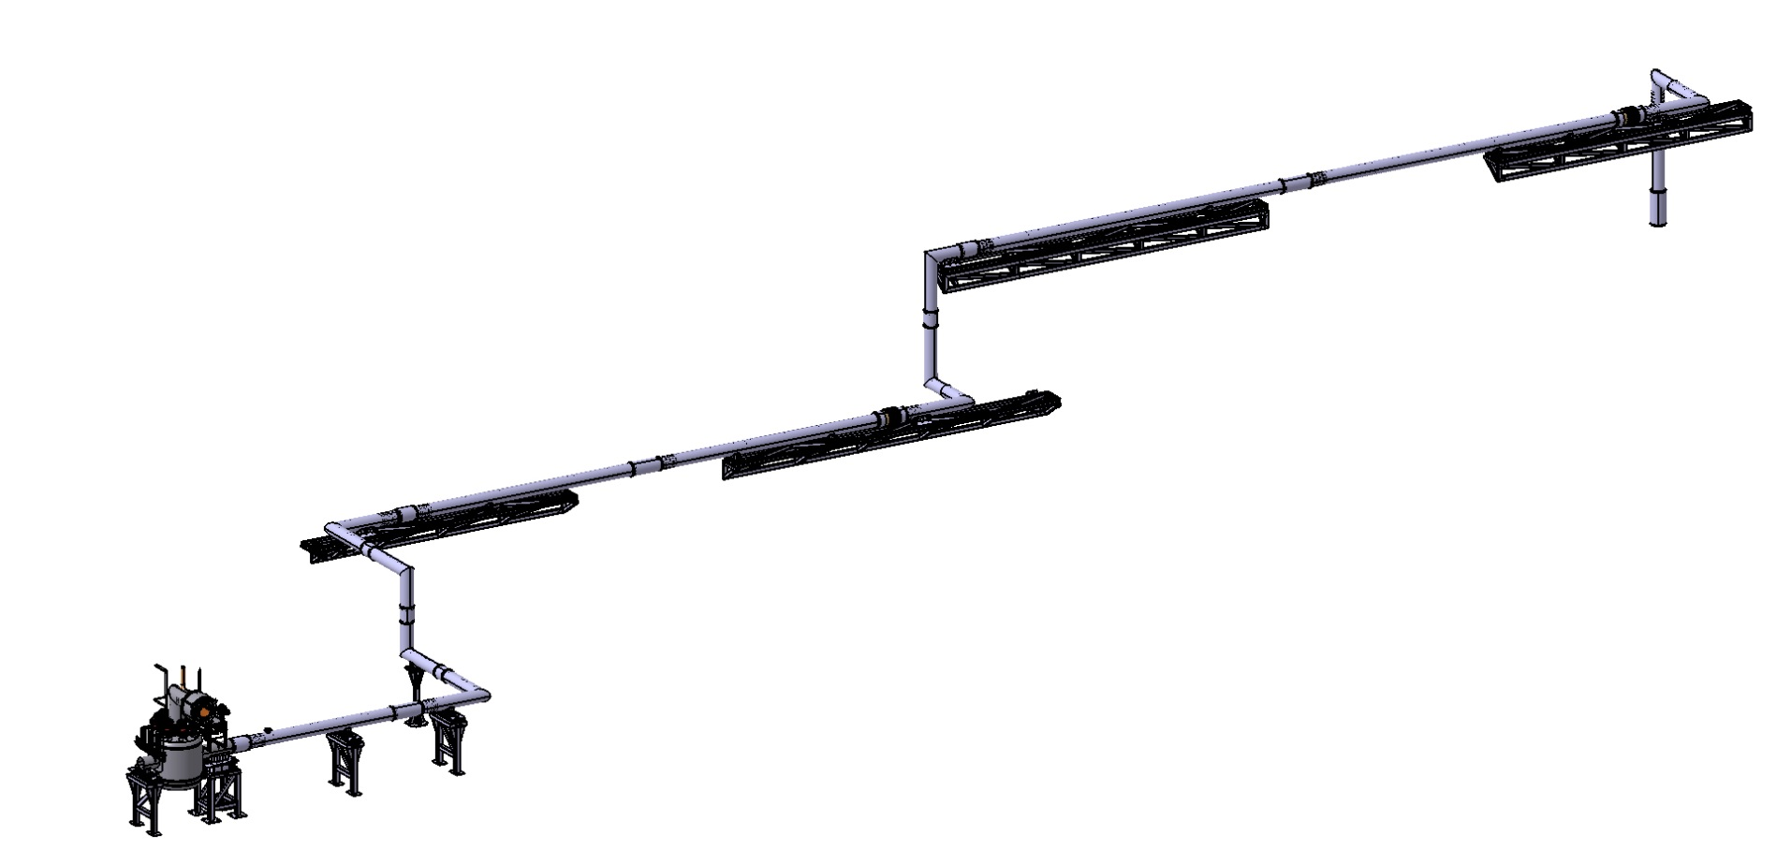
Type of CDS-LTS2 external supports
4 Frames
5 Supports on the floor
(1 Fixed Support)
(4 Sliding Supports)

Slide 3
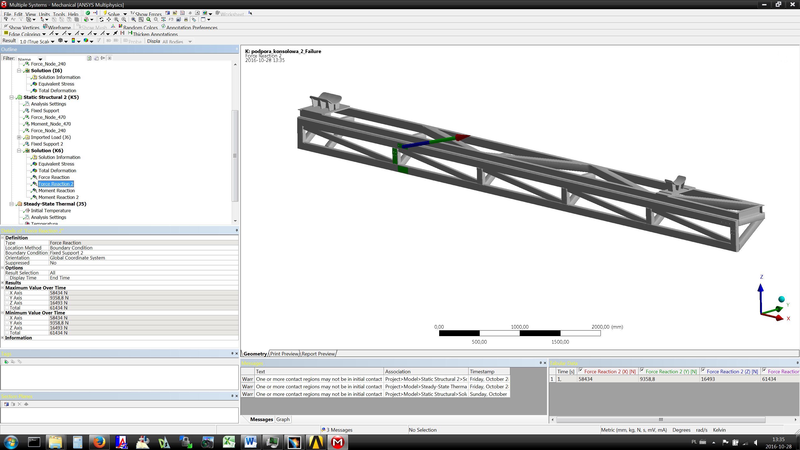
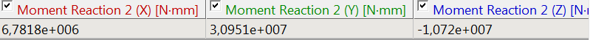
Calculations of the Frame Fixation

Slide 4
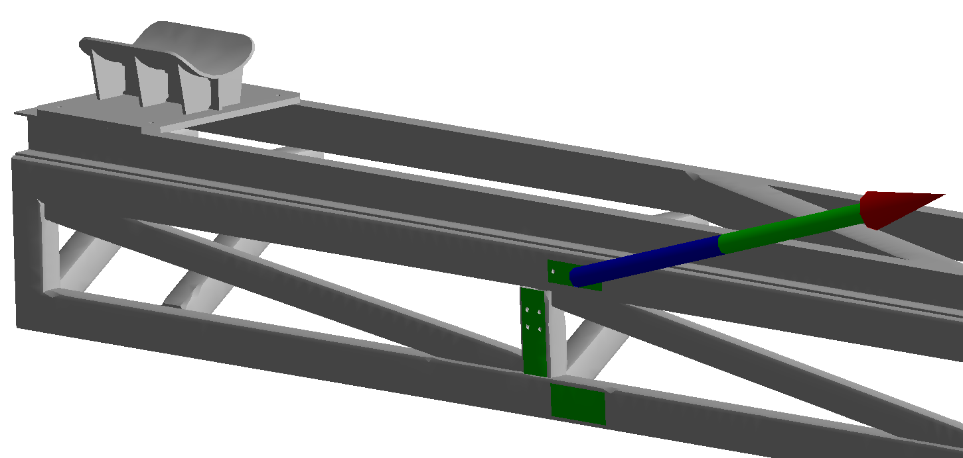
Calculations of the Frame Fixation
upper
middle
bottom
 | F_{x} (N) | F_{y} (N) | F_{z} (N) | M_{x} (Nm) | M_{y} (Nm) | M_{z} (Nm)
Total | 58434 | 9358.8 | 16493 | 6782 | 31000 | -10720
Upper | 95692 | -33436 | -17965 | 200 | 3378 | -2112
Middle | -6612 | 39803 | 42172 | -302 | 1258 | 1883
Bottom | -30647 | 3000 | 1410 | 1577 | 1318 | -1668

Slide 5
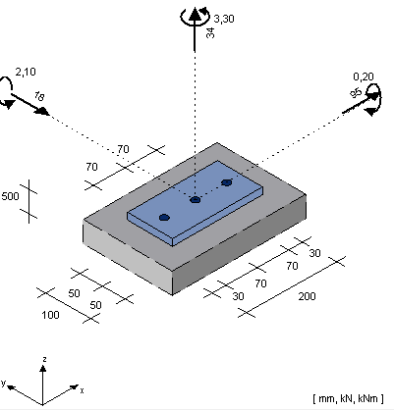
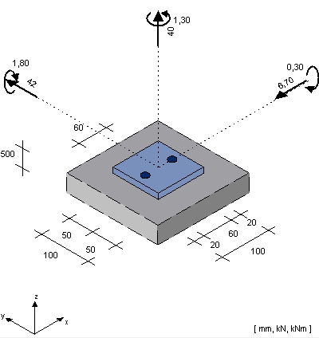
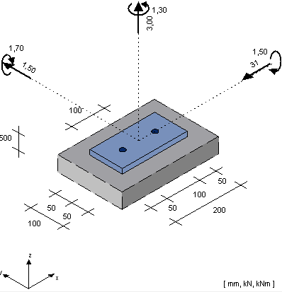
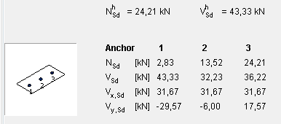
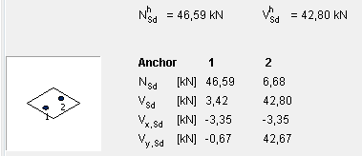
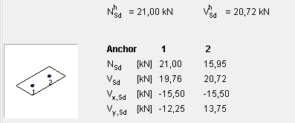
Calculations of the Frame Fixation
Upper Middle Bottom

Slide 6
Calculations of the Frame Fixation
EN 1993-1-8 Eurocode 3: Design of steel structures - Part 1-8: Design of joints
M16 class 10.9
F_{v,Rd} = 69175 > F_{v,Ed}
F_{t,Ed} = 103763 N> F_{t,Ed}
0.93 < 1

Slide 7
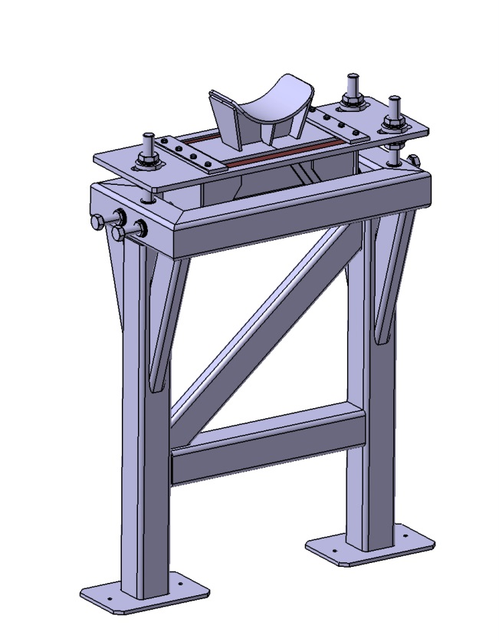
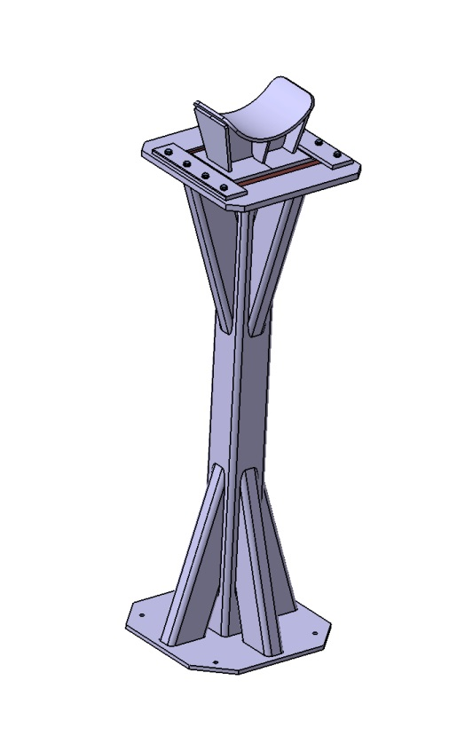
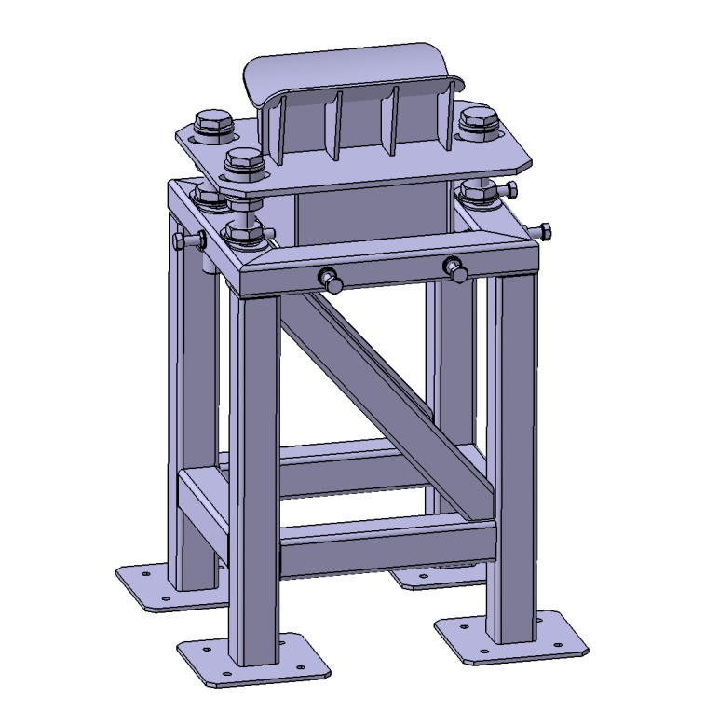
Calculations of the Exetrnal Supports Located on the Floor Fixation
ValveBox Fixed Support
Sliding Support with Adjusting System
Sliding Support without Adjusting System

Slide 8
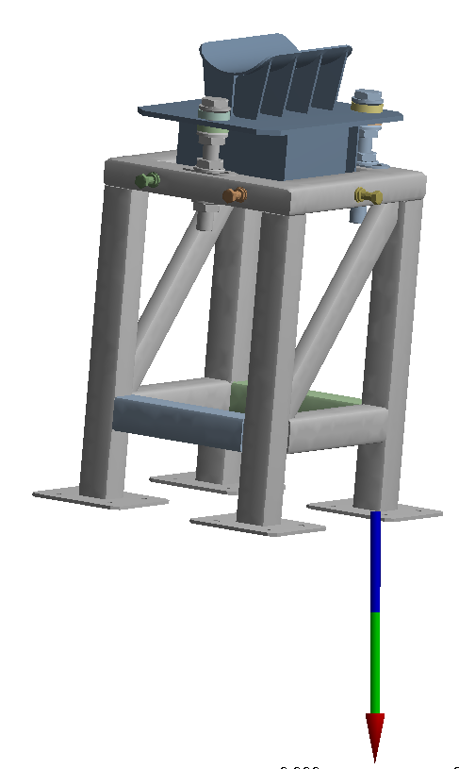
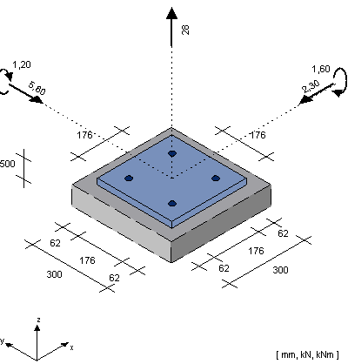
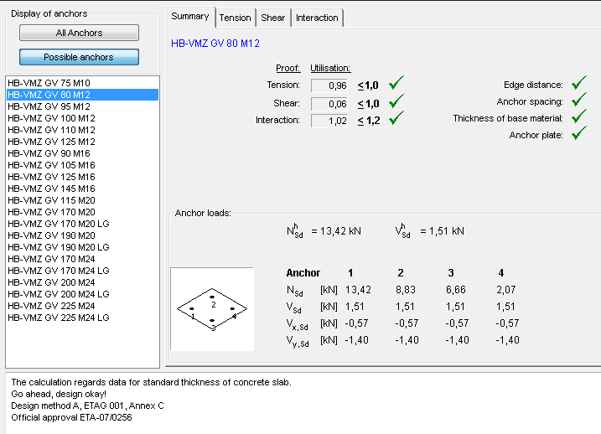
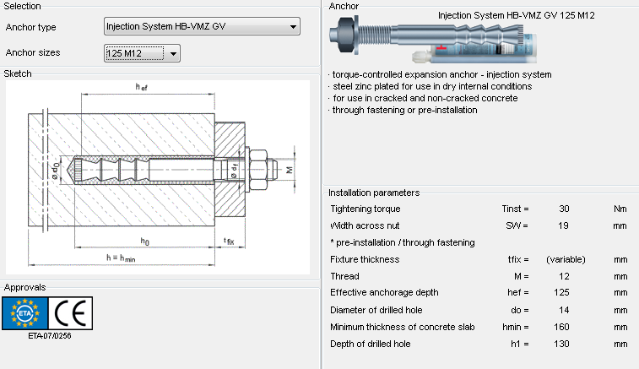
Calculations of the Exetrnal Supports Located on the Floor Fixation
Fx [N] | Fy [N] | Fz [N]
-3600 | 2400 | -21200
Mx [Nm] | My [Nm] | Mz [Nm]
-390 | -960 | -66

Slide 9
Calculations of the Exetrnal Supports Located on the Floor Fixation
ValveBox Fixed Support
Sliding Support without Adjusting System
Sliding Support with Adjusting System

