Slide 1
Auxiliary Process Lines for Lund Test Stand thermo-mechanical analysis
Janusz Skrzypacz
Jarosław Poliński
Przemyslaw Jaszak
Maciej Chorowski
Critical Design Review Meeting, 11-12 January 2017, Wroclaw, Poland

Slide 2
Operating parameters of the Pipes
Pipe description | Size | PS [bar abs] | T_{n} [K] | D_{o} [mm] | e_{min} [mm] | e [mm] | e/D_{o}
SV relief line | DN100 | 6 | 4 – 310 | 114.3 | 0.239 | 2.6 | 0.023
HP line | DN25 | 16 | 310 | 33.7 | 0.187 | 2 | 0.059
Purge return line | DN50 | 16 | 310 | 60.3 | 0.335 | 2 | 0.033
He recovery line | DN50 | 6 | 4 - 310 | 60.3 | 0.126 | 2 | 0.033
He recovery line / OJ | DN100 | 1,5 | 300.5 | 114.3 | 0.020 | 4 | 0.035

Slide 3
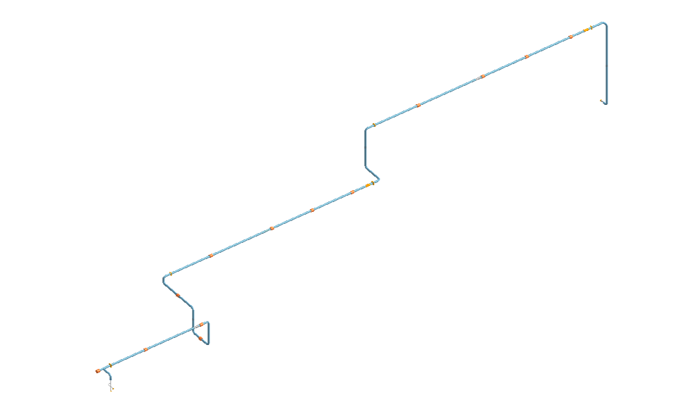
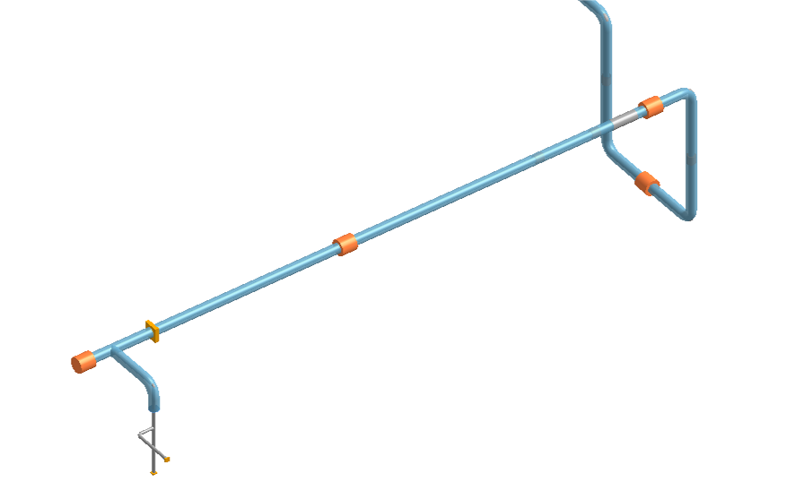
Pipes flexibility calculations
He recovery line model

Slide 4
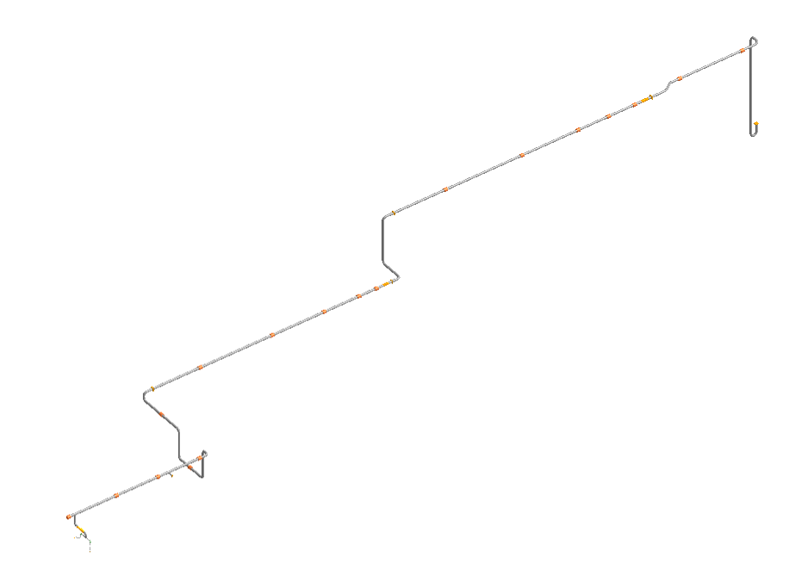
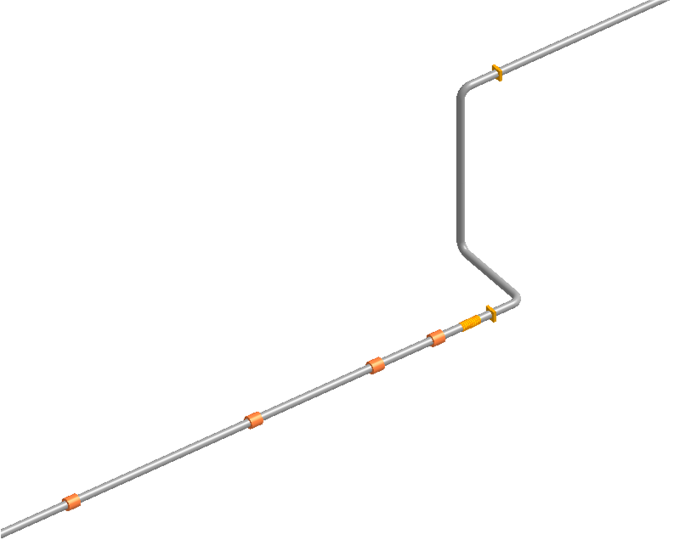
Pipes flexibility calculations
SV relief line model

Slide 5
Pipes flexibility calculations
LC1 - normal operating conditions
No | Parameter | SV relife | He recovery | Purge return | HP line
1 | DN [mm] | 100 | 50/100 | 50 | 25
2 | PS [bar g] | 6 | 6/-1 | 16 | 16
3 | Temperature [K] | 4 | 4/300 | 310 | 310
4 | Fluid density ρ [kg/m³] | 130 | 130 | 27 | 27
6 | Max. sustained stress σ₁ [MPa] | 16.6 | 46.1/15.8 | 33.19 | 27.35
7 | Max. expansion stress σ₃ [MPa] | 145.3 | 162.4/0 | 0 | 0
8 | Max. σ₄ = (σ₁+σ₃) [MPa] | 152.9 | 165.1/15.8 | 33.19 | 27.35
9 | Max. movement of a flex. element [mm] | 44 | 22/0.1 | --- | ---

Slide 6
Pipes flexibility calculations
LC2 – pressure test conditions
No | Parameter | SV | He recovery | Purge return | HP
1 | DN [mm] | 100 | 50 | 50 | 25
2 | PS [bar g] | 8.6 | 9.6 | 22.9 | 22.9
3 | Temperature [K] | 300.5 | 300.5 | 300.5 | 300.5
4 | Fluid density ρ [kg/m³] | 1.4 | 1.4 | 1.4 | 1.4
6 | Max. sustained stress σ₁ [MPa] | 19.2 | 48.2 | 38 | 30.26
7 | Max. expansion stress σ₃ [MPa] | 0 | 0 | 0 | 0
8 | Max. σ₄ = (σ₁+σ₃) [MPa] | 19.2 | 48.2 | 38 | 30.26
9 | Max. movement of a flex. element [mm] | 1 | 0.5 | --- | ---

Slide 7
Pipes flexibility calculations
LC3a – failure of the He recovery – the whole OJ is cooled down to 4.5 K

Slide 8
Pipes flexibility calculations
LC3b – failure of the He recovery – critical section of the OJ is
cooled down to 4.5 K, other sections to 223 K
Cooled down model sections

Slide 9
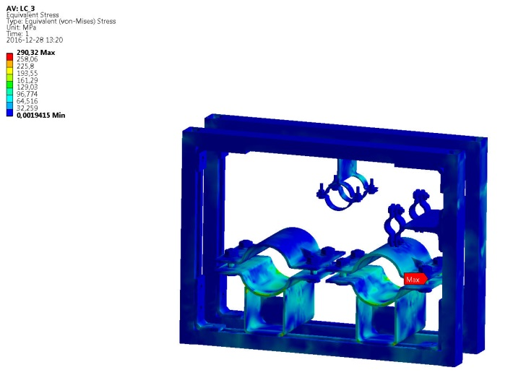
Pipes flexibility calculations
LC3a
LC3b

