Slide 1
Project Quality Plan
Cryogenic Distribution System
for the Lund Test Stand 2
Agnieszka Piotrowska
Wrocław, 2017-01-12

Slide 2
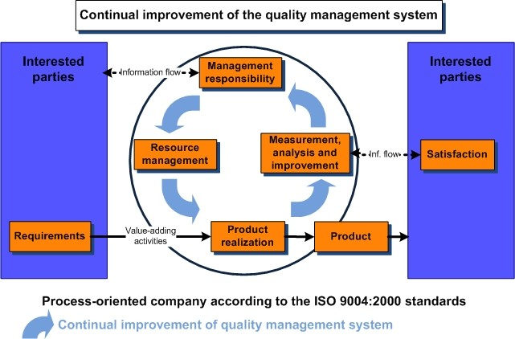
Introduction
Wroclaw University of Science and Technology
public academic school
quality managment system can’t be confirmed
by standards e.g ISO 9000

Slide 3
Introduction
Wroclaw University of Science and Technology
public academic school
quality managment system can’t be confirmed
by standards e.g ISO 9000
PROJECT QUALITY PLAN

Slide 4
Collaboration Structure
In-Kind
Contribution
Agreement
Commercial
Contracts
ESS
WUST
CONTRACTORS
Technical
Annexes
Technical Documents
Status Reports
Technical Packages
Reports
- Manufactures
- Producers

Slide 5
Cycle of the LTS2 Project Execution
Requirements for the CDS-LTS2 (specification, conceptual design)
WUST
Detailed technical model of the system
System components
ESS
CONTRACTORS
Commissioning of the system
Procurement
Manufacturing
Installation incl. tests
Integration
Transport
Testing

Slide 6
Cycle of Project Execution
Wroclaw University of Science and Technology
Project Manager: Jaroslaw Polinski
overall responsibility for the successful execution of the project according to the ESS requirements including coordination of all technical issues, supervising engineering team, delivery of technical documentation, contact and supervision of the suppliers and manufacturers
Engineering team:
Janusz Skrzypacz design, mechanical calculations
Krzysztof Tomczuk instrumentation and control systems
Przemysław Jaszak design, mechanical calculations
Agnieszka Piotrowska risk analysis, quality supervision
Maciej Grabowski design
Requirements for the CDS-LTS2 (requirments, specification, conseptual design)
WUST
Design (technical details of the system)
Procurement
ESS
CONTRACTORS
Commissioning of the system
Procurement
Manufacturing
Installation incl. tests
Integration
Transport
Testing

Slide 7
Cycle of Project Execution
Sub-contractors
Manufacturing: External company with at least 10 years of confirmed experience in manufacturing of complex cryogenic systems, certified in conformity with ISO 9001 and ISO 3834
Delivery: External company certified in conformity with ISO 9001
Installation, External company with at least 10 years of
Testing: confirmed experience in installation and testing of complex cryogenic systems, certified in conformity with ISO 9001 and ISO 3834
Requirements for the CDS-LTS2 (requirments, specification, conseptual design)
WUST
Design (technical details of the system)
Procurement
ESS
CONTRACTORS
Commissioning of the system
Procurement
Manufacturing
Installation incl. tests
Integration
Transport
Testing

Slide 8
LTS2 project quality goals

Slide 9
Responsibility structure for the LTS2 project execution
Requirements for the CDS-LTS2 (specification, conceptual design, requirements)
Detailed design of the system
Procurement
Manufacturing
Supervision of the system manufacturing, transportation and installation
Testing
Schedules
Procurement
Transport
Installation incl. tests
ESS
WUST
CONTRACTORS
System Commissioning

Slide 10
Responsibility structure for the LTS2 project execution
ESS - WUST
List of documents needed to complete the PQP
Identification of key document, retention period of the records
Resources, infrastructure
Communication between the ESS and WUST (reports, meetings)
Control and aproval of changes
Control of nonconforming products
Implementation, revisions of the PQP
Audits
WUST – SUB-CONTRACTORS
Supervision of the sub-contractors (visits, reports)
Comunication between the WUST and sub-contractors
Infrastructure required
Purchasing
Codes, identification and traceability of the components
Requirements for the CDS-LTS2 (specification, conceptual design, requirements)
Detailed design of the system
Procurement
Manufacturing
Supervision of the system manufacturing, transportation and installation
Testing
Schedules
Procurement
Transport
Installation incl. tests
ESS
WUST
CONTRACTORS
System Commissioning

Slide 11
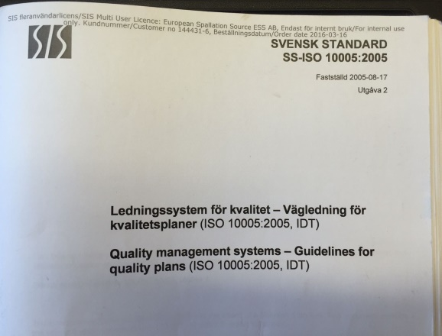
PQP document
ESS Template for Project Quality Plan
Project Quality Plan:
Technical data packages for
CDR, TRR1, IRR, TRR2, SAR
Quality managment system – Guidelines for quality plans
(ISO 10005:2005, IDT)

Slide 12
Thank you for your attention!

