Slide 1
XFEL cryomodule quality management (Application of EDMS)
Quality Assurance and Quality Control – Learning and Planning Workshop - 30 June 2016
Christelle Cloué

Slide 2
Cryomodule configuration
  In the process of assembling cryomodule, it is mandatory for traceability to gather, record, process and archive the complete configuration and fabrication information for each cryomodule.
  The data is kept in the DESY Engineering Data Management System (EDMS). The DESY EDMS is the central information platform for the European XFEL.
  The Acceptance Data Package (ADP) produced by ALSYOM/CEA for each cryomodule is uploaded on DESY EDMS.
  The Manufacturing Bill Of Material (MBOM) as the fabrication part structure contains all the parts handled during assembly. The cryomodule MBOM contains roughly 500 lines.

Slide 3
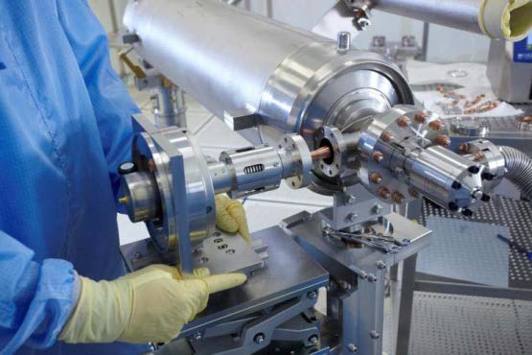
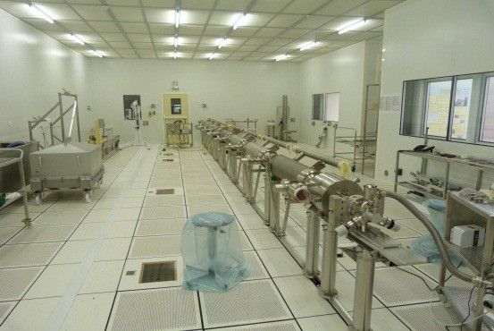
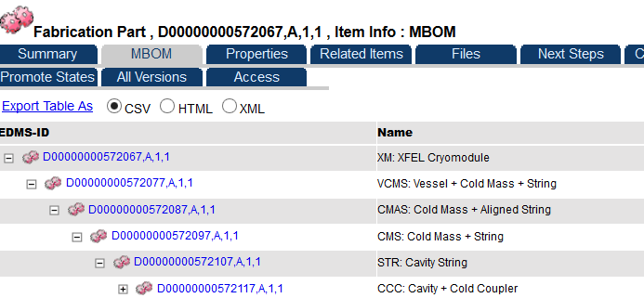
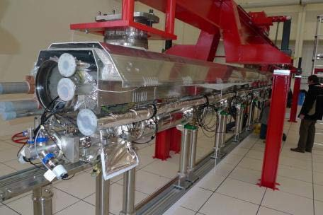
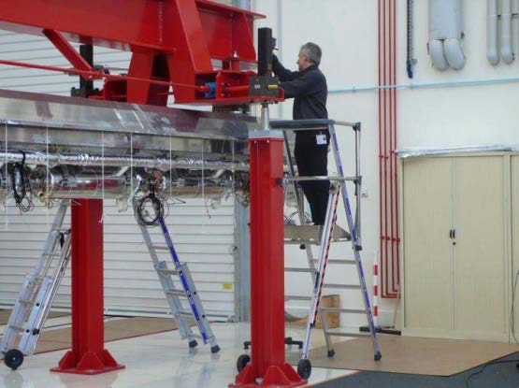
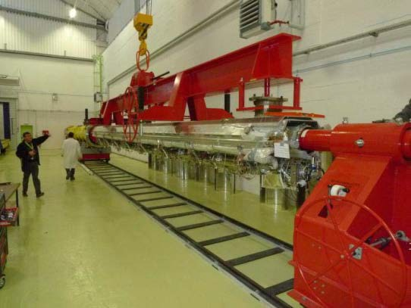
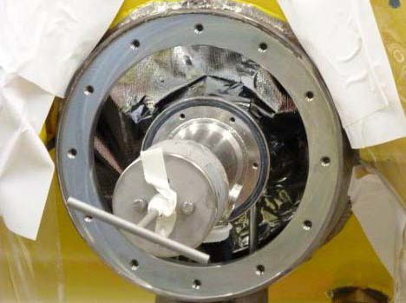
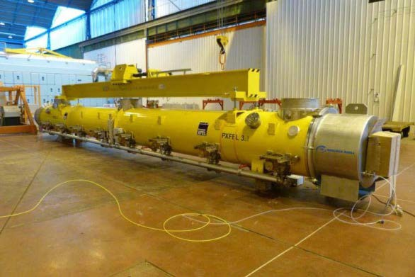
Documentation Structure
Document structure based on the workstation area organization
MBOM structure
  XM (WS-6, WS-7)
  VCMS (WS-5)
  CMAS (WS-4)
  CMS (WS-3)
  STR (WS-2)
  CCC (WS-1)
WS-1 Cold coupler
WS-2 Cavity String
WS-3 Roll out
WS-4 Alignment
WS-5 Cantilever
WS-6 Warm coupler
WS-7 Shipment

Slide 4
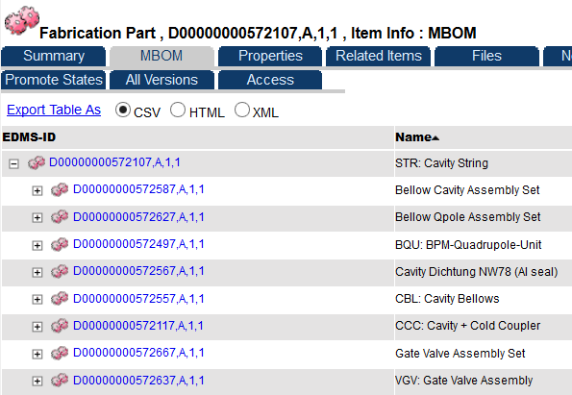
MBOM - Fabrication part
The MBOM defines how a specific part type (fabrication part) is produced. It includes information about how the parts relate to each other.
  For each element of the MBOM, a set of describing documents is stored in the EDMS (inspection to be performed, the tests to be recorded, the assembly procedures etc…).
There is a link to the individual physical parts created according to the fabrication part description.
The whole configuration of one cryomodule is recorded in the Bill of Material (BOM).

Slide 5
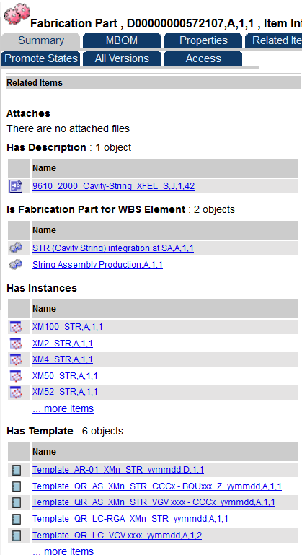
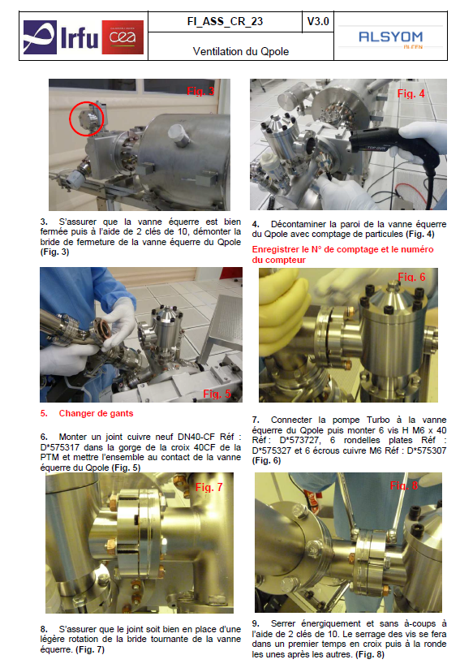
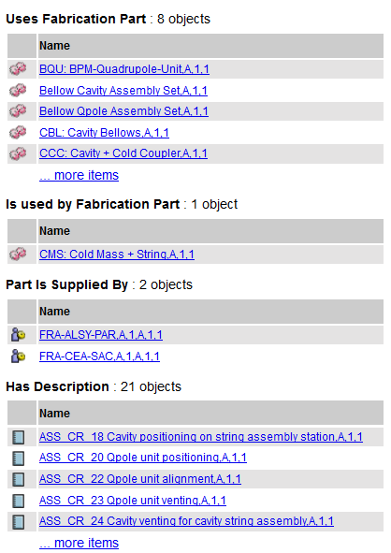
Fabrication Part description
Drawing
Physical parts
Assembly and test instructions
Templates for reports

Slide 6
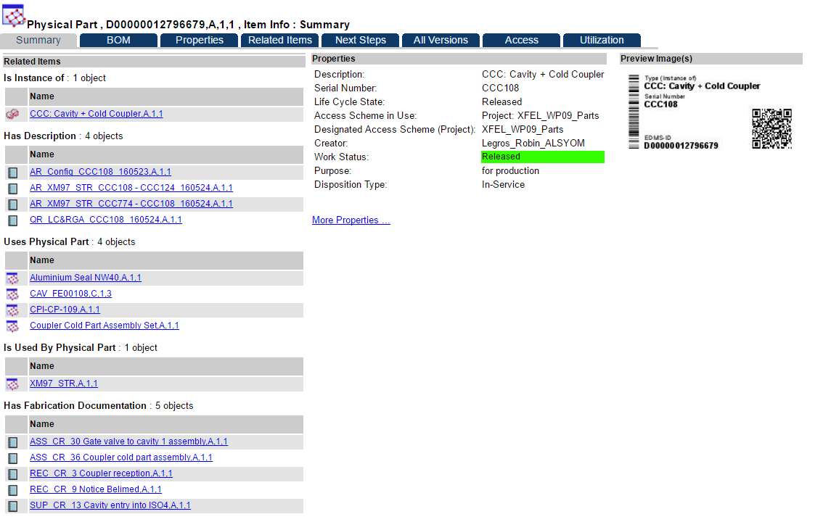
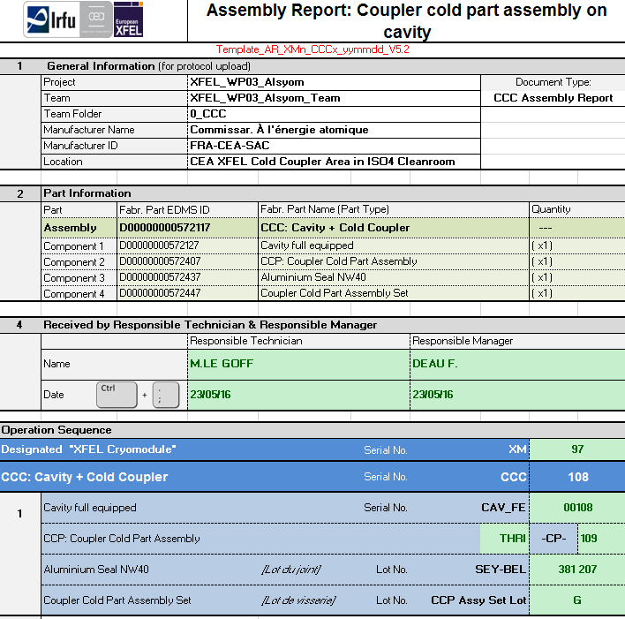
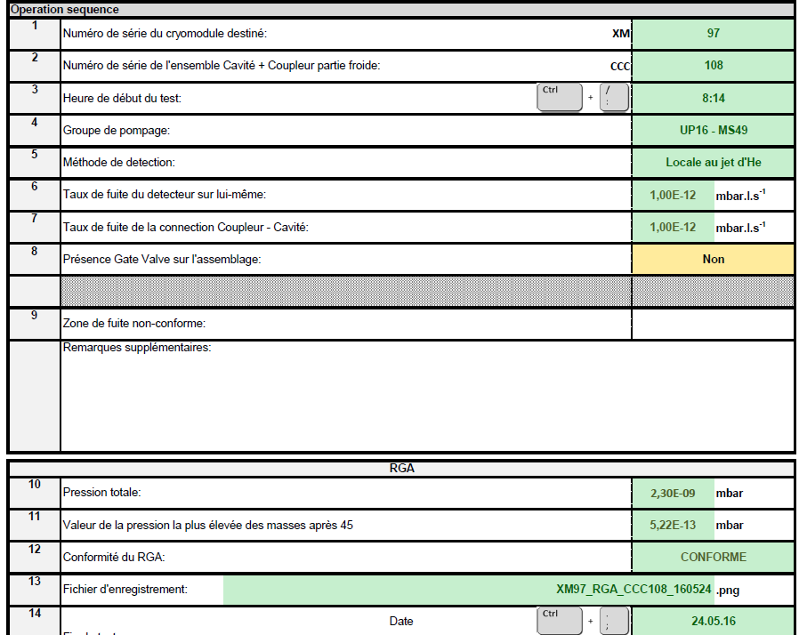
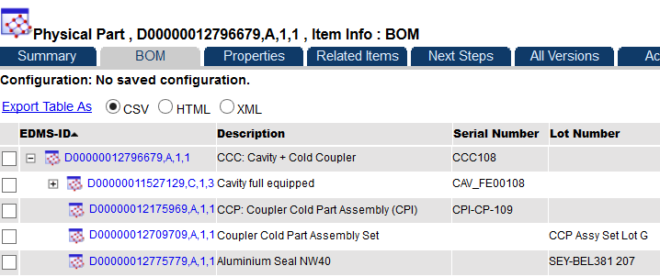
BOM - Physical Part
Serial number
Assembly & test reports
Assembly configuration

Slide 7
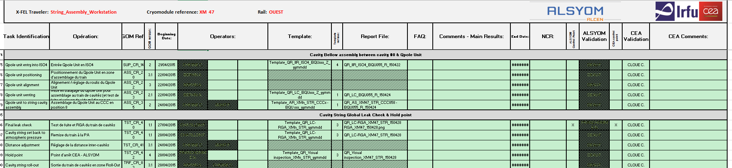
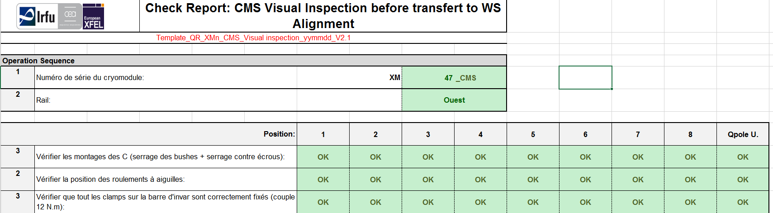
tRAVELER and Hold point
Travelers : monitoring of the assembly and test operations with the operator names, the report references and all the non-conformities detected.
Hold point : inspection checks performed by CEA and ALSYOM at key points (tuner assembly…) and at the end of each work station authorizing transfer to the next workstation.

Slide 8
Document workflow
ALSYOM
Quality control
CEA
Documents approval by experts / quality control team
Welding Quality Control Plan (PED)
Assembly and test reports,
travelers, inspection sheets
(Acceptance data package)
TÜV NORD
Approval
For all exchanges, CEA-Alsyom share folders
DESY EDMS
BOM
Acceptance Data Package
DESY
Cavity RF database
Cryomodule released on EDMS (completeness of the documentation), ready for the acceptance tests @ DESY
Welding Quality Control Plan
Acceptance data package: 350 documents for each cryomodule
All the documents have to be uploaded on EDMS when the cryomodule is delivered to DESY (+/- 2 days)

Slide 9
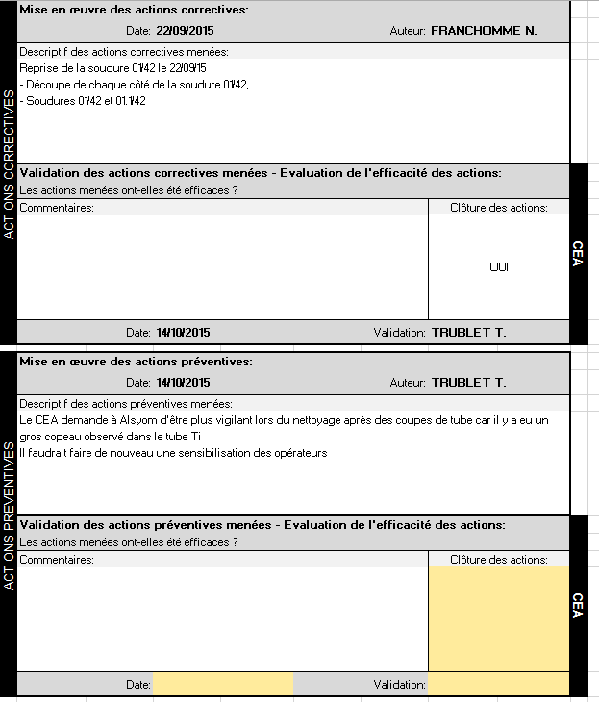
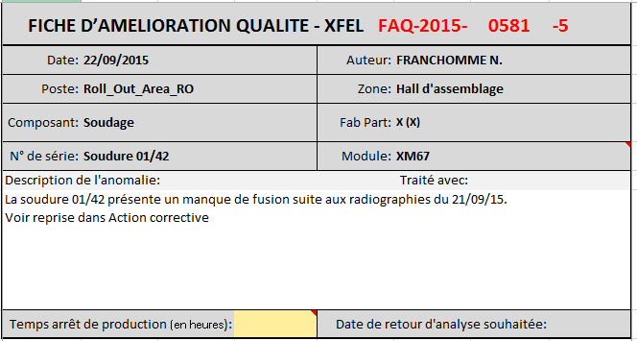
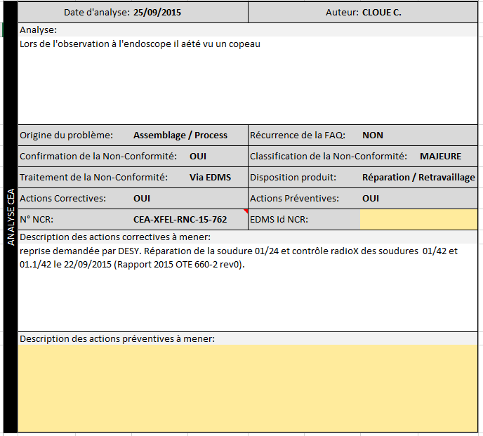
FAQ (fiche d’amélioration qualité) /
NCR (Non Conformity report)
    All non-conformities are generating a FAQ which is processed internally (Alsyom/CEA).
    The CEA expert decides if it needs to escalate to NCR through EDMS.

Slide 10
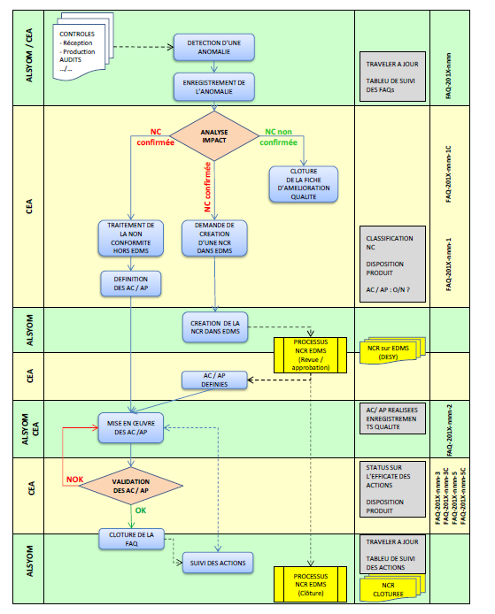
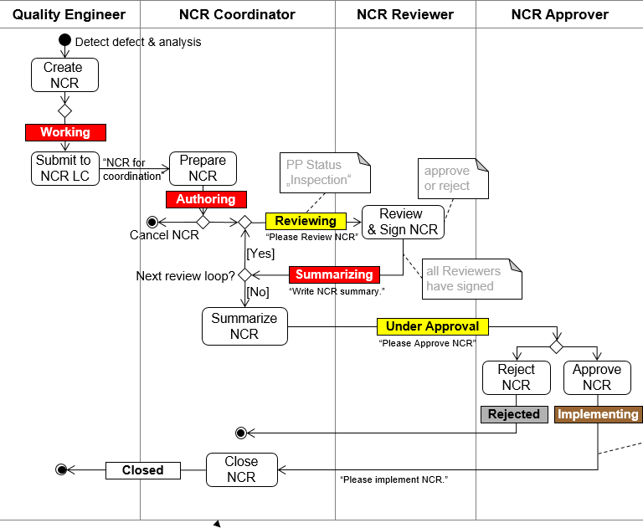
Non conformity process
CEA/ALSYOM Nonconformity (FAQ) process
CEA/DESY Nonconformity process on EDMS
Non conformity to be processed on EDMS

Slide 11
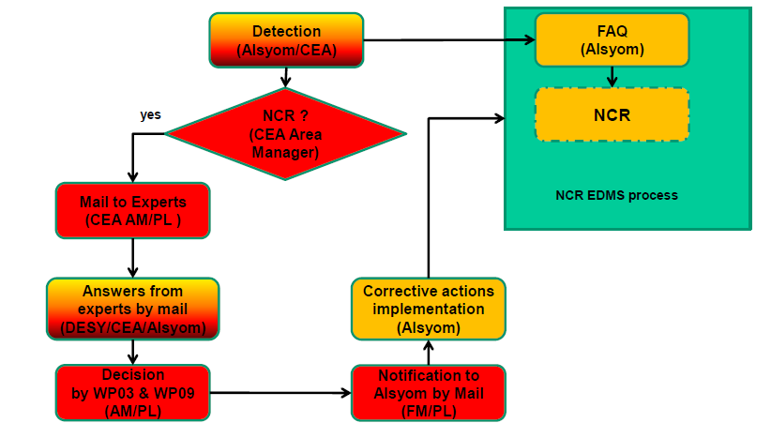
FAST decision process for NCR

Slide 12
CONCLUSION
  The establishment of the document structure and the definition of the templates have represented an important effort by CEA and Alsyom. The establishment of the documents was made in parallel with some EDMS developments.
  The physical parts delivered at Saclay were not released on EDMS at the beginning of the assembly of the cryomodule serie. The loadings of the assembly reports were difficult and required many interactions with EDMS engineers.
  The large number of nonconformities (on supplies and during assembly and testing) requires a lot of work for treatment and reporting. The fast process is used to avoid any delay, the EDMS process is used for the traceability.
  Finally the traceability of operations is very satisfactory but it requires a constant effort to validate documents in time and to upload them on EDMS.

