Slide 1
ESS Configuration Management
Matthew Conlon
ESS ACCSYS QA/QC
www.europeanspallationsource.se
Quality Learning & Planning Workshops
CEA Saclay, 30 June – 01 July 2016

Slide 2
Definitions
Term | Definition
Baseline | Defined set of work products that has been formally reviewed and agreed upon, that thereafter serves as the basis for further development, and that can be a scope, cost, or schedule baseline. It can be changed only through formal change control procedures.
Change Control | a process for establishing creating a Baseline and for moving from a Baseline towards and to a new Baseline
Configuration | Set of interrelated characteristics of a technical product (component or system) which together communicate or describe that system i.e. defining description(s) of a technical product
Configuration Control | Change Control of Configuration
Controlled Item (CI) | A document or data set under Change Control. Thus, a Baseline consists of a set of CIs
Scope | Work to be done (e.g. SoW, project plan activities), and / or Configuration (described by CI such as requirements, 3D models, procurement specs. Etc)

Slide 3
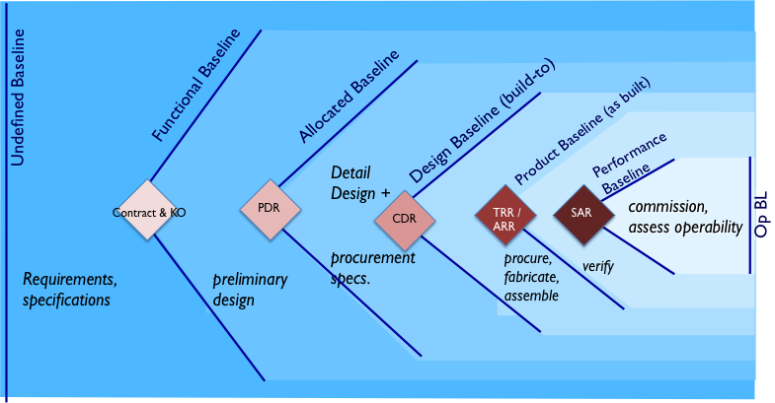
Configuration Baselines

Slide 4
ESS-0003688 Config. Management Plan
Guidance Document only
Chapter 5 Configuration Identification
5.1.5 Formal config. Baseline Identification
A guide to ESS and Partners for:
defining in a contract (TA/SoW) the ‘Stages’ of work e.g. Stage 1 Design, Stage 2 Realisation
Identifying technical reviews needed (for Baselining, for risk reduction, for Change / Configuration Control)
Identifying deliverables to be reviewed and thereafter controlled i.e. Controlled / Configuration Items (CI)

Slide 5
Yes, but …
what Configuration is managed, and how is Configuration managed?
ESS and a partner negotiate and agree their first Configuration Baseline by documenting agreement in a contract e.g. IKC Agreement TA:
Requirements, specifications, and/or reference design
SoW: stages, technical reviews (CDR, SAR etc), deliverables, delivery dates
between Baselines, ESS or Partner make Change Requests, and ESS and Partner review / discuss / agree through a CCB.
a new Baseline is made after successful technical review

Slide 6
Yes, but …
if more detail about how to manage Configuration is needed? This can be described and agreed in:
The contract e.g. TA Chapter 5 or in a referenced document to the TA
Project Management Plan
Project Quality Plan
Verification Plan
test and inspection plan
etc.

Slide 7
Questions?
or
let’s hear from Vincent
☺

Slide 8
BACK-UP Slides Contracting for Quality - IKC Agreements
Chapter 4. PROJECT DEFINITION i.e. defining the work to be done and the deliverables
4.1 Deliverable Item Definition: an executive summary of deliverables, time schedule and value of work
4.2 defining the work Stages in executing the scope:
Design: activities, review and other milestones, tech. data packages
Realization and Verification i.e. procurement, manufacture, pre-and post-delivery verification including test.
support for Installation, Commissioning and Initial Operations
4.3 defining the Project time Schedule and Key Milestones
4.4 defining the (document) Deliverables

Slide 9
BACK-UP Slides Contracting for Quality - IKC Agreements
Chapter 5. TASKS APPLICABLE TO ALL PROJECT STAGES
5.1 Project Management and Control
5.2 Risk Management
5.3 Configuration Management
5.4 Project & Quality Assurance and Safety
Chapter 6. DOCUMENTATION FORMAT
Chapter 7. TRANSPORTATION AND DELIVERY
Chapter 8. WARRANTY
Chapter 9. EXCLUDED BACKGROUND

Slide 10
BACK-UP Slides Types of Technical Reviews - explanations
Design Reviews, for example
PDR: a review of Preliminary (i.e. conceptual, pre-prototype) Design
CDR: a review in detail of the complete or near finalized detailed design data and documentation of the components or systems.
includes reviewing results, decisions from any analysis, prototyping testing.
‘Critical’ because it is a risk-reducing ‘toll-gate’ review, for proceeding to component and system procurement and manufacture
May also be held for agreement high-value, long-lead time procurement
Readiness Reviews, for example
TRR: Test Readiness Review
confirms a component’s or assembled system’s ‘as-built’ status, and
confirms planning and that all is ready for verification
ORR: Operational Readiness Review. post-commissioning.
(Component, ) System Acceptance Reviews:
confirm results of FAT, SAT and other verification activities. Includes check of QC inspections and tests
the mechanism for ESS to accept products – enacts the transfer of ownership

