Slide 1
Quality Plan
Documentation Management & Non Conformities

Slide 2
Quality Control for a large scale production at the Industries “built to print strategy”
What we learnt in last years....
European XFEL: 800 1.3 GHz & 10 (+10) 3.9 GHz cavities succesfully produced in industries: “build to print strategy”
No performances guarantees
Strict rules to be applied in all steps of the cavity production
Inner quality control (industry) supervised/checked by an “external quality control” managed by the orderer (DESY/INFN)

Slide 3
Quality Control for a large scale production at the Industries: how it works
How it worked (E-XFEL)
Detailed specs relative to all cavity production phases, from the row material up to the “ready to be cold RF tested” status
Technology transfer, qualification of infrastuctures and of all surface treatments
“hot line” between the industries and the DESY/INFN experts
“External Quality Control”

Slide 4
The “external quality control”
How the external quality control was organized
Acceptance levels to overcome (3 levels)
Detailed documentation of “most critical” steps required to the industries
Check (and approval) of documents by experts -> only if approved, the cavity goes on with next steps
Managing of Non Conformities (NCR)
-> proposal of solution (by industry)
-> only if accepted (by orderer), the cavity can re-start the cycle applying steps reported in the NCR
Final release of the cavities

Slide 5
The “external quality control”
Some more issue...
A fast response is needed to avoid any delays of the cavity production at the industry
Many documents to be managed/reviewed/approved
As an example...E-XFEL
1.3 GHz case -> about 180 doc per each cavity (in total about 150000 docs for the 800 cavities!!)
3.9 GHz cavities -> about 140 doc per each cavity (in total about 3000 docs for the 20 cavities!)
-> Document management system is required

Slide 6
The “external quality control”
and...
Quick analysis of production data essential for promt feedback to industries (corrective actions) -> creation of a DB for data process analysis
Clear definition of incoming/outcoming checks mandatory for limiting waste of time and NCRs proliferation!!
XFEL used: EDMS (document management and approval cycle) Cavity Database (analysis of the process)

Slide 7
ESS quality control: the Acceptance Levels
ESS medium beta cavities Quality Control:
Five Acceptance Levels
Al1-Al3 related to the industry (INFN responsibility)
QC documents for control of critical production steps to be checked by INFN experts
INFN experts for the approval (or not) of steps done
Al4: related to the RF performances: VT at DESY (INFN responsibility)
Al5: final acceptance level for the ESS release (after last step -> ESS/CEA incoming check)

Slide 8
ESS quality control: NCR definition
ESS medium beta cavities managing of NCRs:
Each deviation from the specs requires the emission of a Non Conformity Report (NCR)
-> description of NCR
-> proposal of NCR resolution
-> if OK, NCR approval and release for the resolution
Approval responsibility will depend on the Severity of the NCR

Slide 9
ESS quality control: NCR Severity (approval)
ESS medium beta cavities NCRs Approval:
Severity 1: all NCR that will not affect the final performances of the cavity or the interfaces for string assembly
-> Approval: responsibility of INFN
Severity 2: NCR related to interfaces for string assembly or to possible consequence of the cavity performances
-> Approval: responsibility of ESS and INFN

Slide 10
ESS quality control: SCHEME
Industry
NCR
INFN Experts Check
INFN
Managing System
Quality Control
Cavity production data
Database
(parameter analysis)
INFN Managing system
Documents for full equipped cavity acceptance (for string assembly)
NCR
CAVITY with TANK
Documents for cold RF test acceptance
NCR
ESS
(approval)
NCR
NCR
DESY (Cold RF test)
CEA
CAVITY with TANK
STRING ASSEMBLY
MODULE
Q₀ vs. Eacc
ESS

Slide 11
The Acceptance Levels for the ESS Series Production
Level | Cavity status | Needed documents | If Level reached
One | “Naked” cavity after mechanical fabrication | Mechanical, RF, vacuum, visual documents | Proceed to Level Two
Two | Cavity before He-tank integration | Mechanical, RF, vacuum, Treatment documents & tank documents | Proceed to Level Three
Three | Accessory assembly, last surface treatments, outer inspection document | Treatment, vacuum, RF, transfer measurements documents | Integrated cavity ready to be cold RF tested
Four | Cavity cold tested | Documents relative to cold test results and in/out checks | Cavity can be sent to CEA for string assembly
Five | Cavity accepted for string assembly | Documents with incoming inspection at CEA | Cavity final approval

Slide 12
ESS quality control: the Acceptance Levels: Al1
Al1 structure:
Subcomponents (HCs, DBs, EGs) -> IC, PC, etc.
RF (before/after trimming operation), mechanical (2D+3D), vacuum, visual inspection (EBW)
Cavity after equatorial EBW
RF (ff & spectrum), mechanical (runout, etc.), vacuum, outer/inner visual inspection (EBW & surface quality)

Slide 13
ESS quality control: the Acceptance Levels: Al2-Al3
Al2 structure:
Cavity treatments (before He-Tank integration)
bulk BCP, annealing, RF after tuning (ff & spectrum), HPR and other rinsing/cleaning steps, vacuum
He tank (mechanical)
Al3 structure:
Cavity treatments (after He-Tank integration)
final BCP, HPR & rinsing/cleaning steps, accessories assembly, RF (spectrum), vacuum, transfer measurements, mechanical check
-> Release of cavity shipment for the qualification test (VT)

Slide 14
ESS quality control: the Acceptance Levels: Al4
Al4 structure:
Documents with outcoming check at the industry (mechanical check, vacuum, RF, etc.)
Incoming inspection at DESY
and documents produced at the qualification LAB (DESY)
Result of cold RF test
Outcoming inspection after test operaton (vacuum, RF, etc.)
-> Release of cavity shipment to CEA for string assembly operation

Slide 15
ESS quality control: the Acceptance Levels: Al5
Al5 structure:
Result of cold RF test
Outcoming inspection after test operaton (vacuum, RF, etc.)
All other documents needed for the check of interfaces compatibility
and documents produced at CEA
Incoming inspection at CEA (RF, check of mechanical interferences, etc.)
-> Final release of cavity

Slide 16
ESS quality control: the managing system at LASA
We are going to use Alfresco (INFN CNAF) as document repository
Market survey started for:
Alfresco Client front end (data management system, workflow definition, web interface, …)
Database and tools for statistical analysis
-> Evaluation of proposed solutions and offers is now underway

Slide 17
ESS quality control: documents structure
INFN Document Managing (example: CAVxxx)
Family of folders associated to the cavity
ESS Cavities
CAVxxx Al1
For each cavity:
5 folders contaning documents for the relative Acceptance Level
1 folder contaning NCR occurred for the cavity
1 folder with retreatments done after the VT test (if done)
2 folders containing approval documents (release from INFN or from ESS/INFN)
CAVxxx Al2
Cavity 001
CAVxxx Al3
CAVxxx INFN Cavity Acceptance
Cavity xxx
CAVxxx Al4
Cavity 036
CAVxxx retreatment
CAVxxx NCR
CAVxxx Al5 CAVxxx ESS Acceptance

Slide 18
ESS quality control: Al1-Al3 acceptance flow (example: OK)
INDUSTRY
Cavity Alyy folder creation
INFN
Basic check of docs:
Cavity name
Document name
Check with respect to cavity composition HCP doc (Al1 only)
Folder CAVxxx Alyy
Production Steps up to Alyy level
Documents arrenged in subfolder (criteria: filename)
Family A
Family B
Family C
Family D
Request to have completed Alyy & request to go on with next level (Alyy+1)
Documents to be shipped (from Industry to INFN):
All documents relative to steps done in Alyy level (xlsx, doc, pdf)
Expert advices with e-mail
NCR avalilable to all INFN experts (to be used during check of documents)
experts A
experts B
experts C
experts D
Only one expert for each different families take the review (signing, other experts of the same families are inhibited for the same review)
Production release up to Alyy+1 Level
OK
OK
OK
OK
NCR
(List of NCR relative to CAVxxx)
AND
Only if ALL families are OK, the expert E do final checks (congruence of steps done with respect to time stamp operation and NCRs request -> release to proceed with following Levels
expert E
Start process of following steps at Industries
OK

Slide 19
ESS quality control: Al1-Al3 acceptance flow (example: NOK)
INDUSTRY
INFN
Basic check of docs:
Cavity name
Document name
Check with respect to cavity composition HCP doc (Al1 only)
Folder CAVxxx Alyy
Production Steps up to Alyy level
Documents arrenged in subfolder (criteria: filename)
Family A
Family B
Family C
Family D
Request to have completed Alyy & request to go on with next level (Alyy+1)
If ONE expert gine NOK (es. Expert B), the cavity is not released but rejected.
The Industry is informed on action to do (wrong document, etc.)
NCR avalilable to all INFN experts (to be used during check of documents)
experts A
experts B
experts C
experts D
Production release up to Alyy+1 Level
NOK
OK
OK
OK
NCR
(List of NCR relative to CAVxxx)
AND
NOK
expert E
Cavity is Rejected (explanation of reasons & requests from expert A)
OK

Slide 20
ESS quality control: Al1-Al3 acceptance flow (example: NOK -> OK)
INDUSTRY
Shipment of missing or reviewed document
INFN
Basic check of docs:
Cavity name
Document name
Check with respect to cavity composition HCP doc (Al1 only)
Folder CAVxxx Alyy
Production Steps up to Alyy level
Documents arrenged in subfolder (criteria: filename)
Family A
Family B
Family C
Family D
Request to have completed Alyy & request to go on with next level (Alyy+1)
Industry ship the reviewed/missing document
Th check of documents restart only for Family A (in this example).
If OK si chiude, the release of the cavity is completed and following process steps can start
NCR avalilable to all INFN experts (to be used during check of documents)
experts A
experts B
experts C
experts D
Production release up to Alyy+1 Level
OK
OK
OK
OK
NCR
(List of NCR relative to CAVxxx)
AND
OK (after the review or shipment of the document)
expert E
Start process of following steps at Industries
OK

Slide 21
ESS quality control: Al4 acceptance flow
INFN
TEST LAB (DESY)
Incoming Acceptance
Outcoming from company
Docs needed for Test
OK
RF Test
NOK
NOK
Back to the Industry with disposal for the recovery
New folder «Retreatment» created in the managing system
INFN
OK
CAVxxx Al4
Documents in the folder:
Outcoming inspection from the Industry and info needed for the RF test
Incoming inspection del test lab
Test Result
Outcoming inspection after test
Family A
expert A
Cavity on Hold
NOK
Release of cavity shipment to CEA
OK

Slide 22
ESS quality control: Al5 acceptance flow
INFN
CEA
Outcoming (DESY)
Test result (DESY)
Docs needed for Acceptance (interfaces compatibilities)
Vacuum
RF Test
Dimensional drawings
Transfer measurements
.....
Incoming Acceptance
INFN
OK
NOK
INFN
CAVxxx Al5
Family A
ESS FINAL RELEASE
expert A
Cavity on Hold
NOK
OK

Slide 23
ESS quality control: prototypes will teach
Prototypes will be used for:
Optimization of production and treatment cycles
Test and debugging of the Quality Control System
Moreover, the experience gained with prototypes:
will highlight the critical checks to be done in the industry process
will finalize the strict prescription needed for the series production (built to print strategy)
For prototypes only Two Acceptance levels foreseen (No Tank integration) + One for VT test (similar Al4)

Slide 24
ESS quality control: actual status
Actual Status
Definition of the production process (prototypes):
Already defined in collaboration with industry (steps from row material to the naked cavity ready to be RF tested at LASA)
....but not freezed...opened to improvement!
Prototypes will be used for the process optimization and for the infrastructure debugging -> quality control will be done in more steps than the ones foreseen for the standard procedure (series)
Definition of the production process (series):
Already defined but opened to improvement gained with prototypes experience (first RF test in September ‘16);

Slide 25
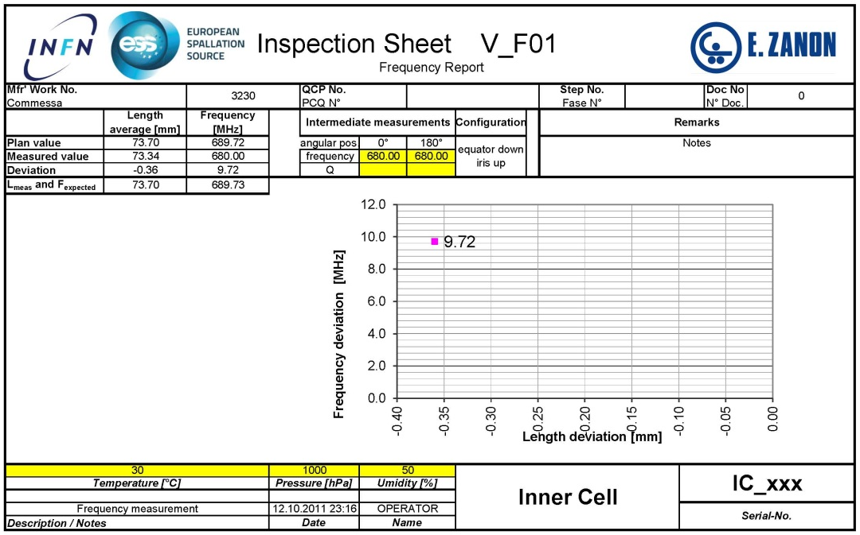
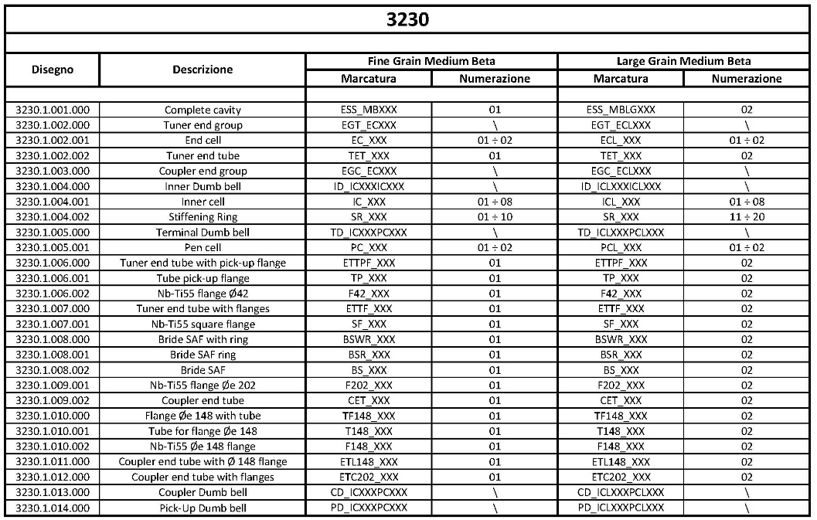
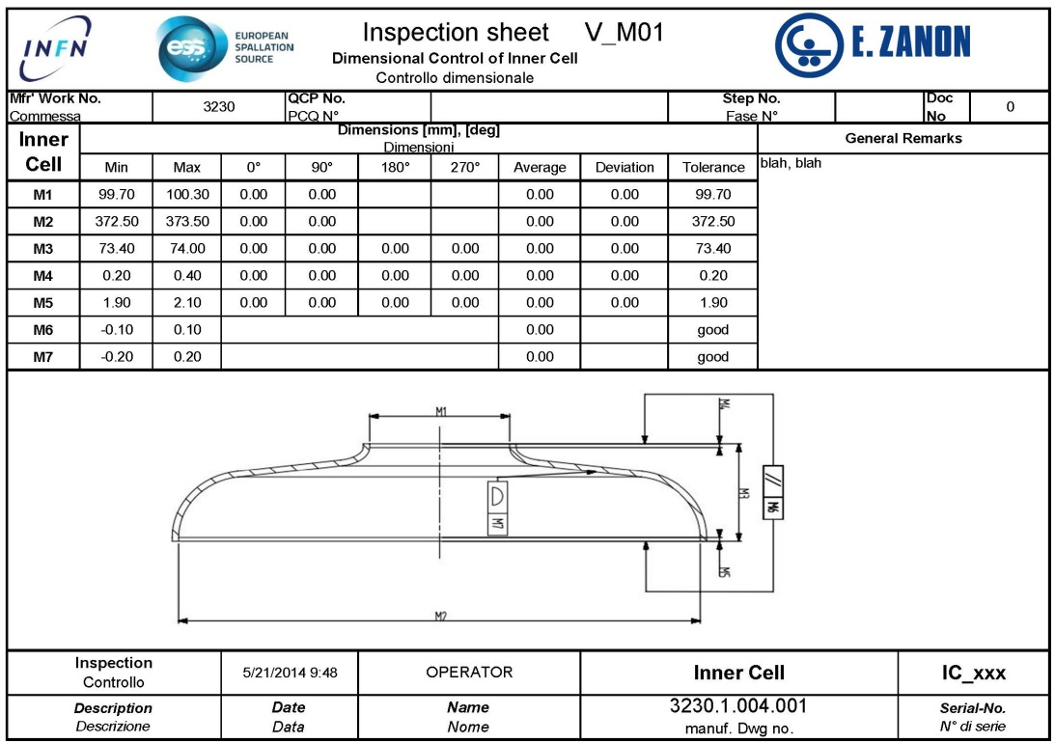
ESS quality control: debugging is on-going now!
Subcomponent Labeling
Frequency Check
Mechanical Check
Prototype Treatment cycle

