Slide 1
NBEX Optics and ‘fast track’
IKON 11
Neutron beam extraction
I.Sutton

Slide 2
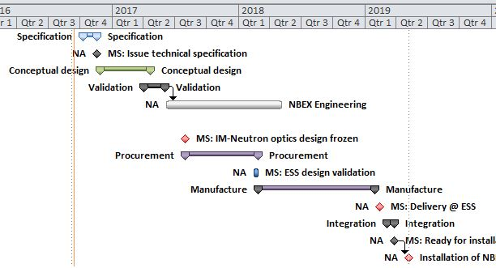
‘Fast track’
End Q2
In-monolith optic
Design Freeze
Q1 2019
Delivery
Notes:
Protons on target summer 2019 (Q3)
Closure on Monolith vessel End Q2
Installation inserts Q2
Delivery of inserts Q1
Procurements – Supply ~12month
Which implies order placement for in-monolith optics Q2-Q3 2017

Slide 3
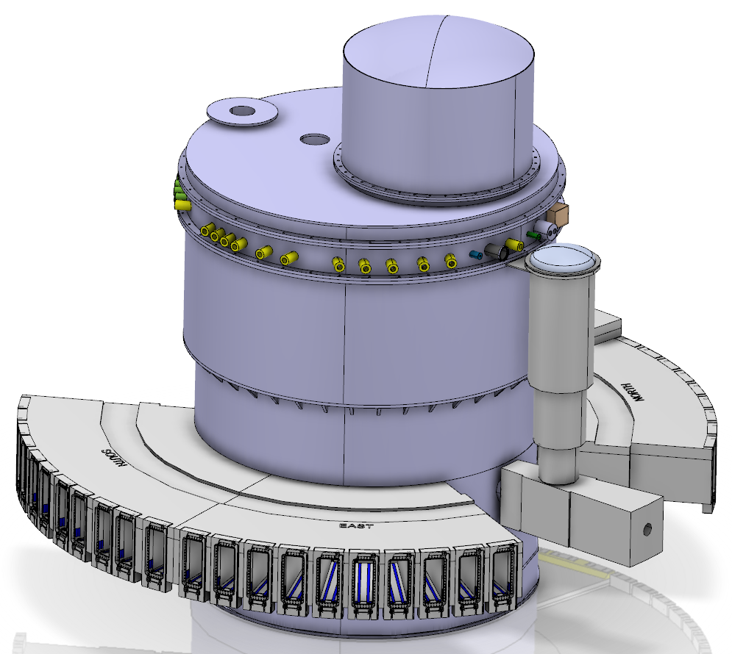
NBEX – Optical assembly (in-monolith optics)
NBEX Optical assembly
Neutron optical element (3.5m)
Support & Alignment
Streaming Shielding
Cooling (if required)
‘Optical assembly’
This bit !
Neutron bean extraction insert
Optics R 2 – R5.5

Slide 4
NBEX – optical assembly
A critical component
a performance critical component
Installed of the life of the instrument
A very hostile environment
Nuclear authority compliance
Active waste
On the critical build path

Slide 5
NBEX – optical assembly
Discussions with potential suppliers to identify, develop and validate technical solutions for in-monolith optics
Objective
Validated solutions with suppliers and authorities which can be tailored to your needs
Performance of technical solutions
Cooling
alignment stability
Aging
Compliance with Swedish nuclear authority
Accelerated Delivery

Slide 6
Headlines
Protons on target summer 2019 (Q3)
Closure on Monolith vessel End Q2
Installation inserts Q2
Delivery of inserts Q1
Procurements – Supply ~12month
Teams to be ready for advanced order placement Q2-Q3 2017
Please make definition of the optics of these components a priority in the early phase of your design following TG2

Slide 7
Thank you for your attention
I will be pleased to answer any questions ..

Slide 8
What does this change for you ?
Benefits to you
Less paperwork
Less technical risk
Optimised delivery schedule
Constraints
Recommendation to use approved designs
A date for ‘design freeze’ on your requirements for first 3.5m

