Slide 1
Neutron Beam Extraction System Design update for IKON-11
Jarich Koning, Bengt Jönsson
www.europeanspallationsource.se
14/15-09-2016

Slide 2
Alignment strategy
Port blocks measured at installation (expected <±2mm) ->TNBA
Machine internal mounting pads to correct to within <±0.05mm
Replicate port block situation on test-bench
Align NBPI + BBG (=shutter) internal guides there (±50µm / <200µrad guide-to-guide)
BBG provides fiducials to help bunker-mounted equipment
NBPI-to-BBG kinematic mount delivers good repeatability
Blind mount of NBPI and BBG should deliver some ±150µm / <<200µrad absolute
Notes:
Building is not directly connected to vessel. Several sources of deformation present.
Target-building Target floor foundation is different compared to bunker floor.
Notes:
TNBA, Theoretical Neutron Beam Axis

Slide 3
Implemented changes
Relaxation of radiation protection
BBG not parked in gamma-shielding structure during shutdown
Simplification: only BBG with GBS on top (no other blocks like NBS), and:
Solve fast-closing (<60s) requirement
One configuration simplifies locking/engaging system
Allows other actuator which allows faster-closing
Relaxation of position accuracy
Semi-kinematic mount between NBPI and BBG lead to more available space for NB guides
Increase space for beam guides, and
Solution for Al-to-SS316L connection, and
Solution for seal retainment, and
Integration of NBW in flange
Integrate all these in one Al60601T6 flange (single-use): saves cost, too
Yields much more space for NB guides at back flange

Slide 4
Light Shutter System
GBS
GBS on top of BBG. Not configurable.
Each shutter has a braked, ballscrew-style actuator
Shutter actuator pushes BBG up to its mount against Flange/NBW.
BBG then tilts slightly to engage fully to Flange/NBW
Loss of power causes a quick descent of the GBS+BBG
During maintenance, GBS will stay in front of beam port on dedicated hooks
BBG
NBPI
Bunker roof support
Flange/NBW
GBS hooks
Floor fill shielding
Floor filler block
Handling tooling
Shutter actuator
Rigid chain actuator

Slide 5
New integrated all Al Flange/NBW
NBW area
Vacuum sealing edge
Vacuum seals milled
Sealing length halved
Much more space for NBW: h562 x w270mm
Still have to solve safety case, possibly resulting in several smaller NBW variants
Z, Y and rX Degrees-of-Freedom to position NBW w.r.t NBPI
Dowel-in-pin and dowel-in-oblong hole constrain Y, Z and rX
Vessel-side water flange

Slide 6
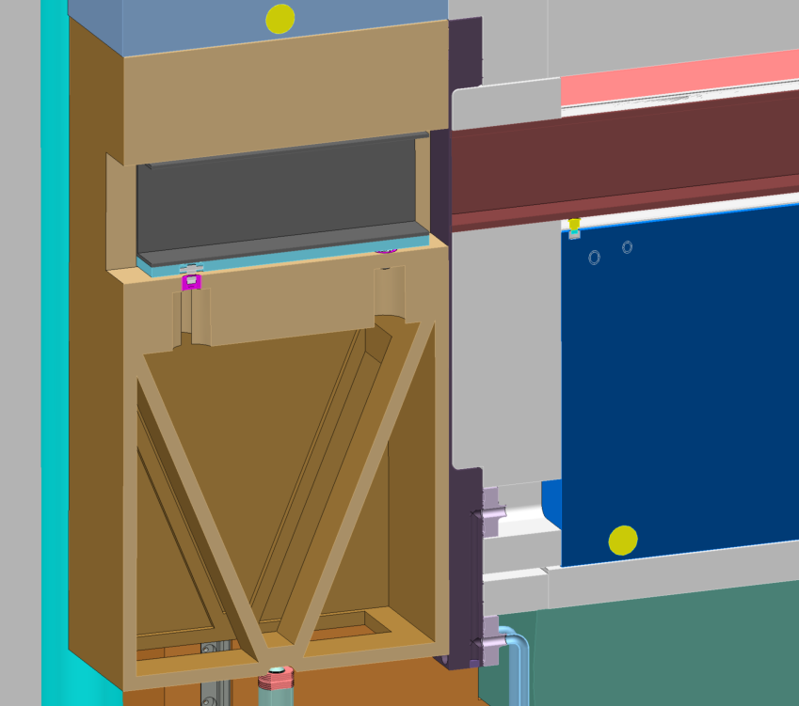
Flange/NBW & BBG
NBW provides kinematic mount to BBG
NBW connects Cooling water flow to NBPI
NBW pushes NBPI (on its integrated disc spring stacks) forward on its kinematic mount to port blocks
Mount:
Sphere (3DoFs)
Cylinder (2DoFs)
Top pad touches (1DoF)
NBW area
Cooling
Tilting axis
Notes:
Extra slides follow

Slide 7
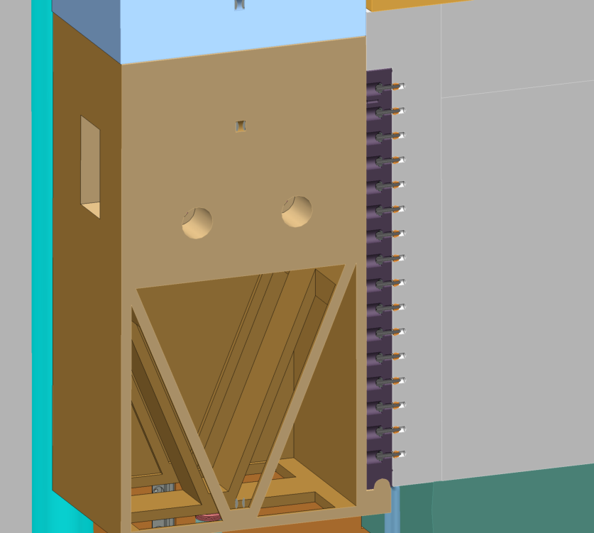
BBG tilting engagement
Tilting axis
Actuator force
Notes:
Extra slides follow

Slide 8
Beamlines in new shape
Note: flange/NBPI/BBG reflect new focal points at TCS ±89, ±54mm!
Current 3D beamline models:
Freia (pink, large red)
Heimdal (red/blue)
Loki (purple)
NMX (green/grey)
Pictures:
Left: Insert back flange
Mid: With flange, Xsec @5.5m & @R6m
Right: With BBG, Xsec@R6m

Slide 9
NBEX ← → Instrument
Highlighted: Common NBEX fixed features
Vertical relocation of wheels only after discussion with NBEX
Sizing of wheels yet to be confirmed
Rest of volume is up to Instrument
BBG Side view
TCS
TCS

Slide 10
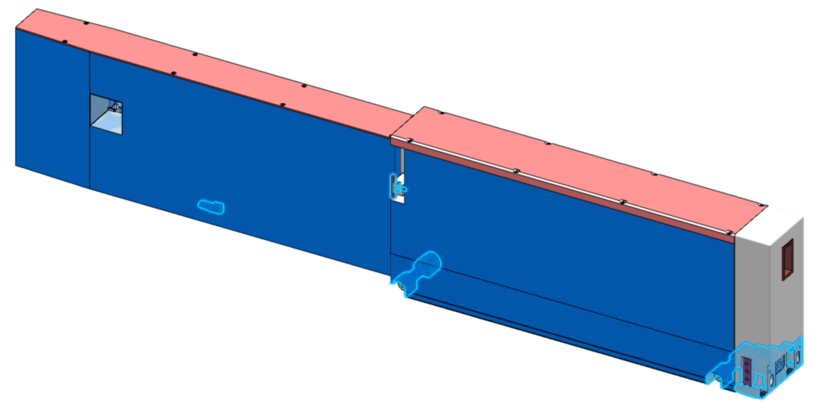
NBEX ← → Instrument
Highlighted: Common NBEX fixed features
Rest of volume is up to Instrument
NBPI back
view

Slide 11
Notes for instruments
Currently there is only water cooling (doubles as thermal conditioning) to the insert (ESS-0060741: 35±5°C, ΔT_{max}=3°C):
If low-pressure He is required in insert, enclose it permanently
If flow of anything else is required in insert, make your case today.
Active cells will not process all materials (ESS-0029936):
If you need anything else then Steel, Stainless Steel, Tungsten, BoronCarbide, Copper, Aluminium, Lead, make your case today. Be aware that Si, ceramics in general are not currently allowed.
There is no cooling/conditioning planned for the BBG
If you need He in the guides, it has to be permanently enclosed.
No trespassing from bunker into shutter space nor contact are allowed
Instrument that pushes forward like ESTIA proposed is likely to interfere with safety concept.

Slide 12
Notes for instruments
Please design beam lines with physical beam guides AND their support to the Insert & BBG.
Connect cooling fluid in the Insert as well.
Design BBG to contain shielding for slits around Insert
Current BBG example does not yet have this…

Slide 13
Questions?
Notes:
Extra slides follow

