Slide 1
Utilities and Infrastructure D01/D03 IKON 11
Clara Lopez – Loki & FREIA Integration Engineer
www.europeanspallationsource.se
Lund, September 2016

Slide 2
Topics
EPL Buildings/areas
Gallery location and section
Infrastructure details [1]
Cave
Path ways
LoKI and Freia overview in D02/D03
Civil construction [2]
[1] Instrument projects – CF Information- https://ess-ics.atlassian.net/wiki/display/SPD/CF+Info
[2] ESS-0066249 – Status Civil construction – Division meeting

Slide 3
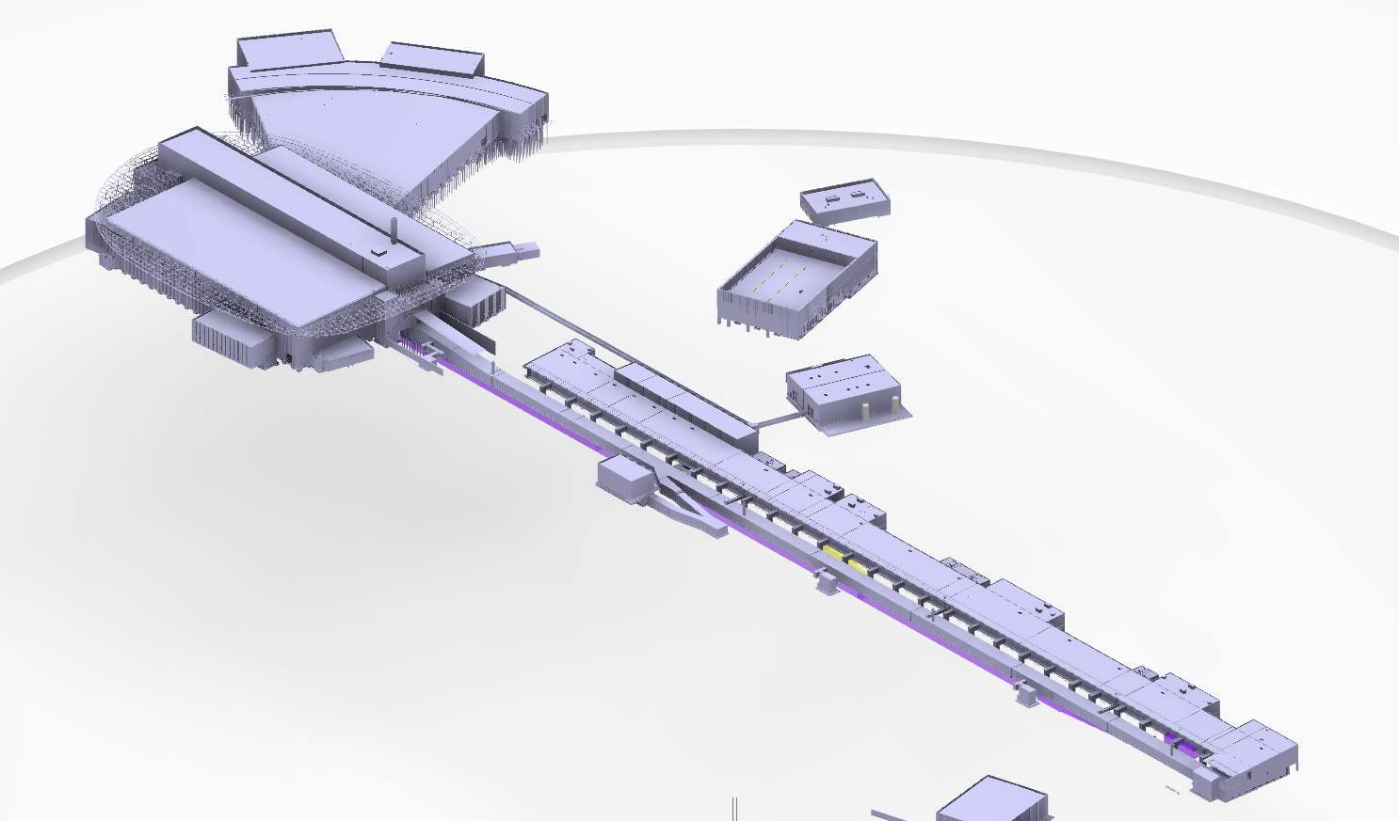
EPL – ESS Plan Layout
Main entrance
E01
E02
D03
D01
D02
G02
Accelerator

Slide 4
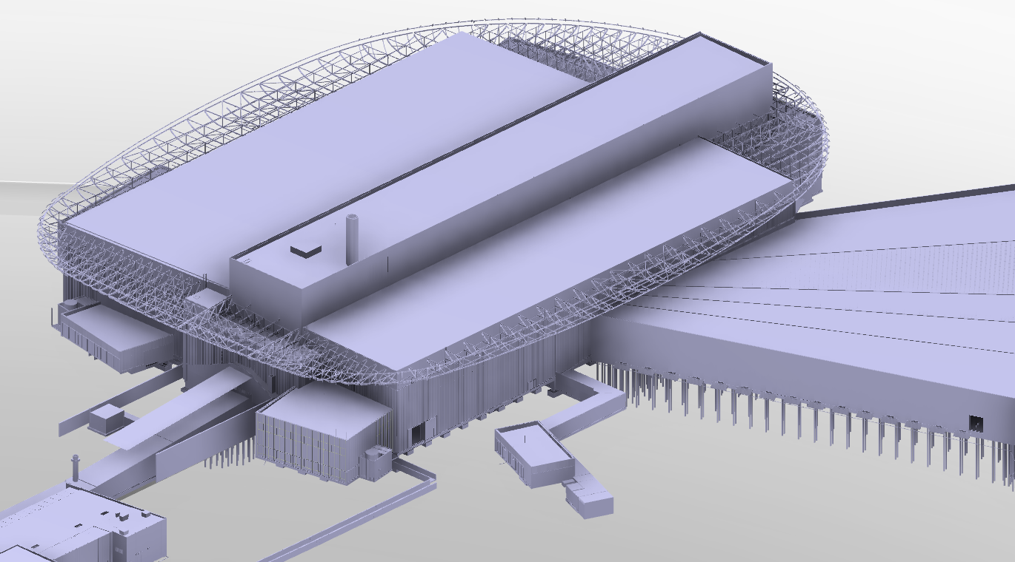
Instrument Halls D01/D03
D01
D02
D03
Personnel access
Lab D04
Nitrogen filling station
Bay door
Forklift access

Slide 5
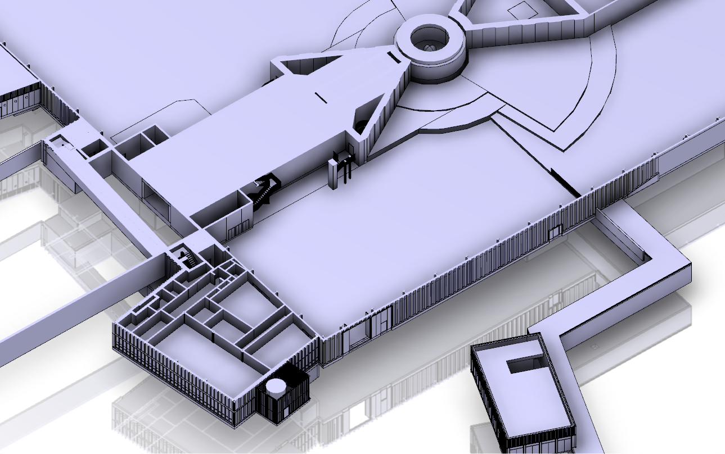
Buildings in D03
Building Joint
Target building
33m
Instrument hall Building
51 m
Substation

Slide 6
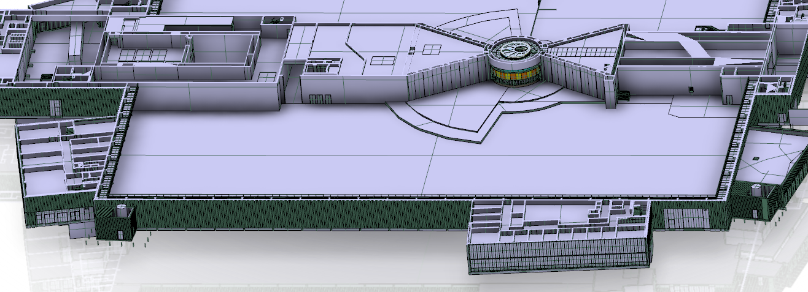
Buildings in D01
Target building
Building Joint
56 m
Instrument hall Building
130 m
Labs
Labs
Substation

Slide 7
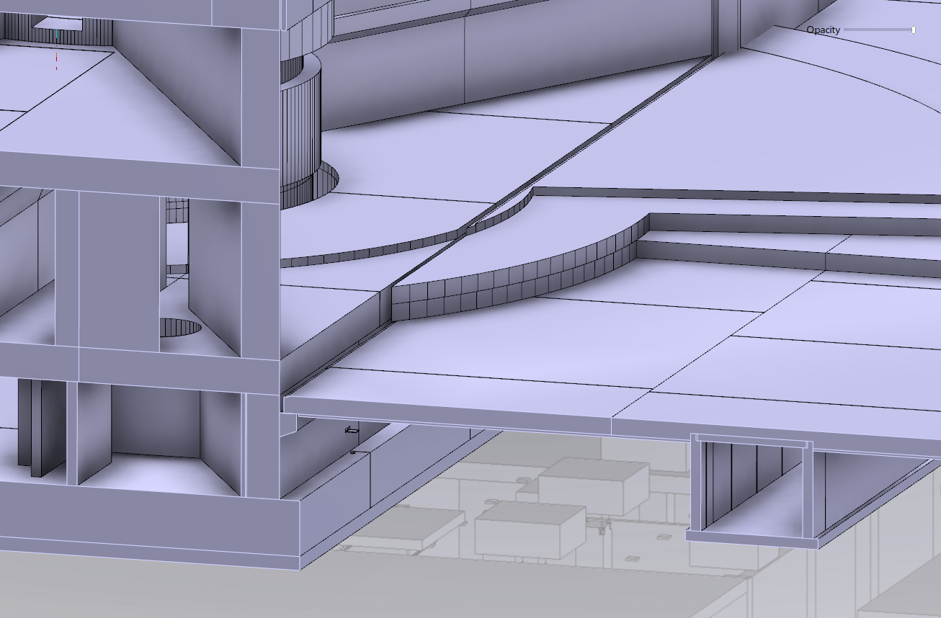
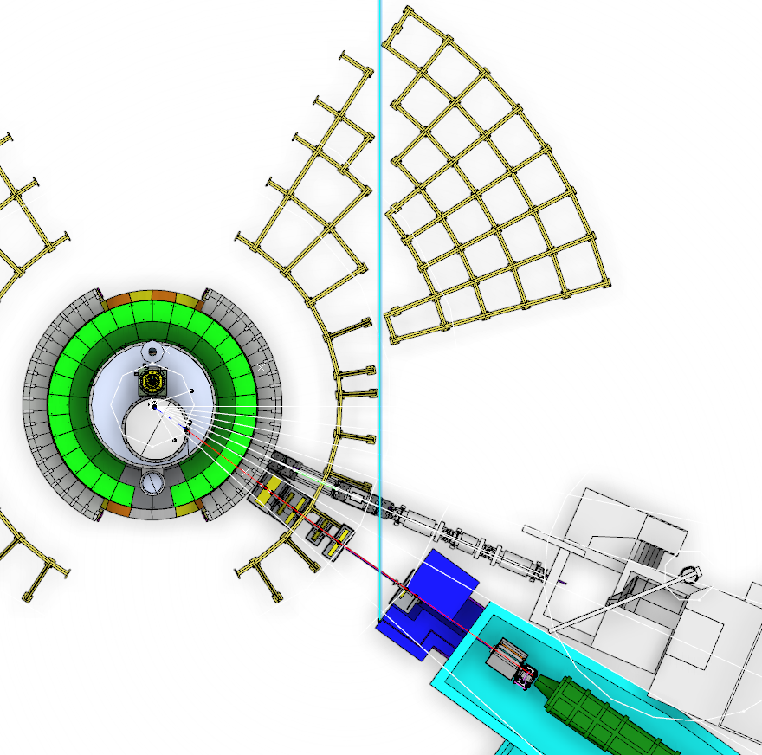
Building joint/ Heights

Slide 8
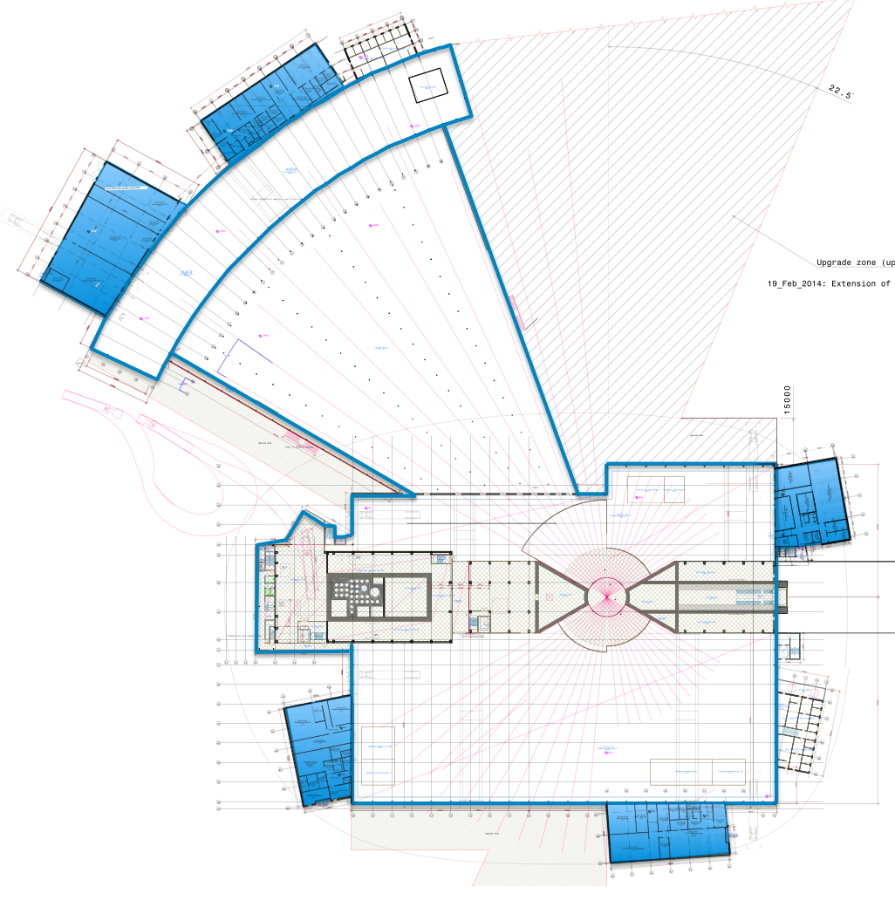
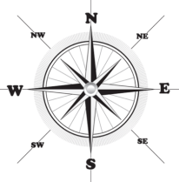
Instrument Halls and labs
Hall 1
E1 Estia
E7 Vespa
E8 Skadi
S2 Odin
S4 Dream
S11 Vor
D07
1 × LS/SCM
1 × cold room
D08
1 × Basic chemistry
N
E04
E03
Hall 2
N1 HR-NSE
N5 Freia
N7 Loki
D04
1 × LS/SCM
1 × cold room
2 × instrument room
D03
E01
D04
E02
Hall3
W1 NMX
W2 Beer
W3 C-Spec
W4 Bifrost
W5 Miracles
W6 Magic
W7 T-Rex
W8 Heimdal
E03
1 × Engineering
E04
1 × LS/SCM
1 × cold room
1 × instrument room
1 × Basic chemistry
1 × characterisation
D01
D08
Total = 14 + RML
D02
Courtesy: P.Henry
8
D07

Slide 9
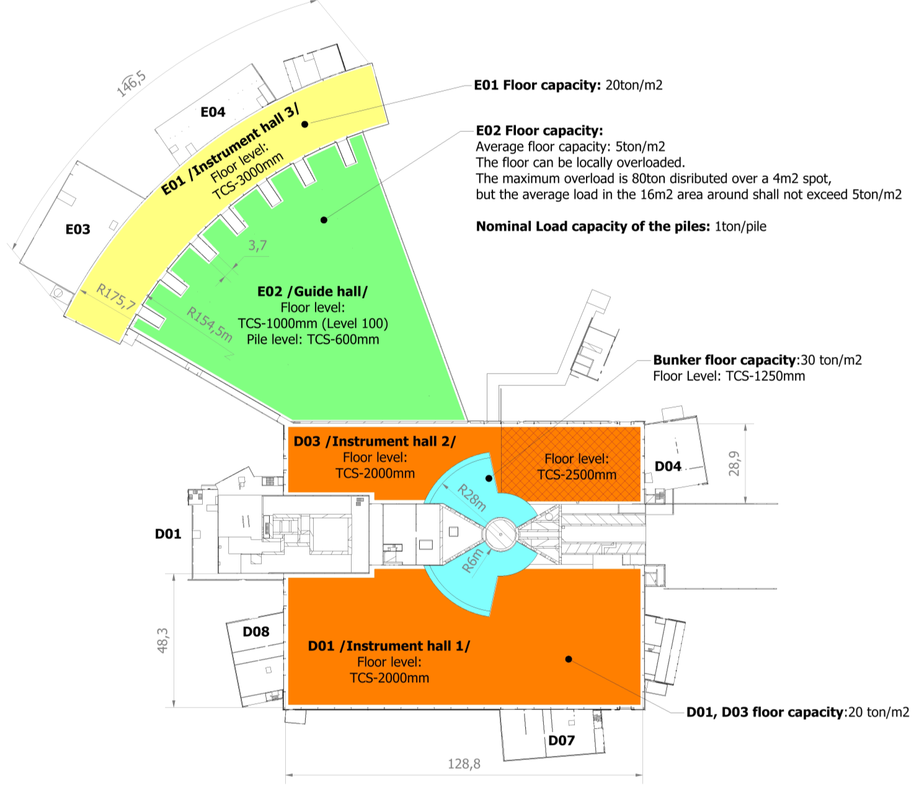
Floor capacity and floor level in D01, D03, E01, E02.
Floor settlement requirement under the instruments
The floor in the experimental halls and bunker area will due to dynamics loading have a stability for elastic movement.: 3mm
Stability for creep/deformation over the lifespan of the facility: 3mm

Slide 10
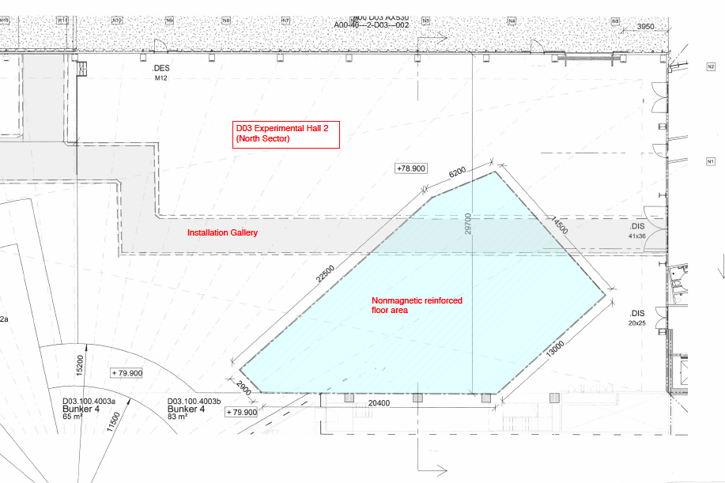
Non-magnetic details in D03
ESS procedure for material choice in vicinity of NSE instruments, ESS-0036612.

Slide 11
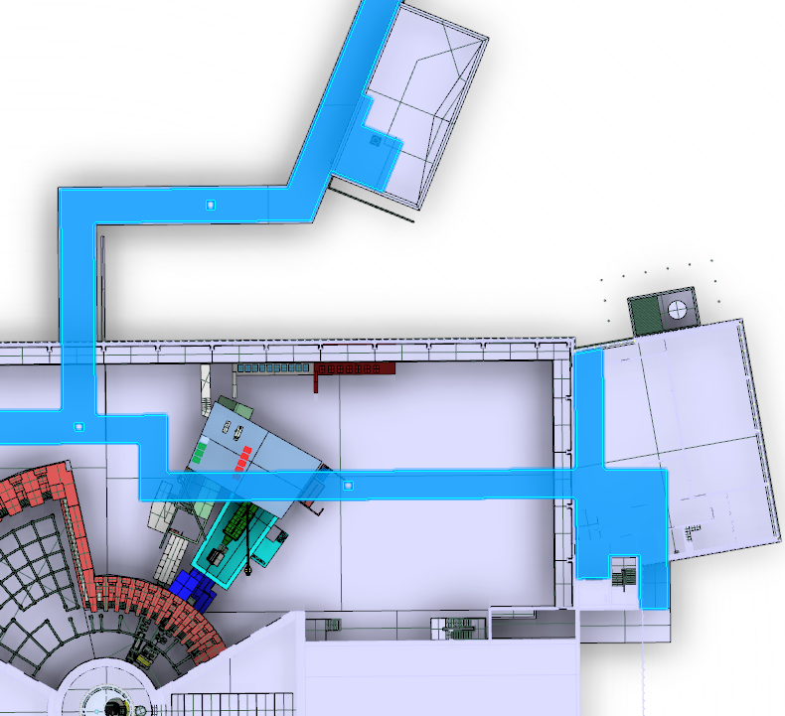
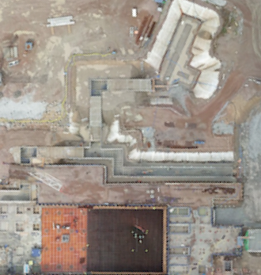
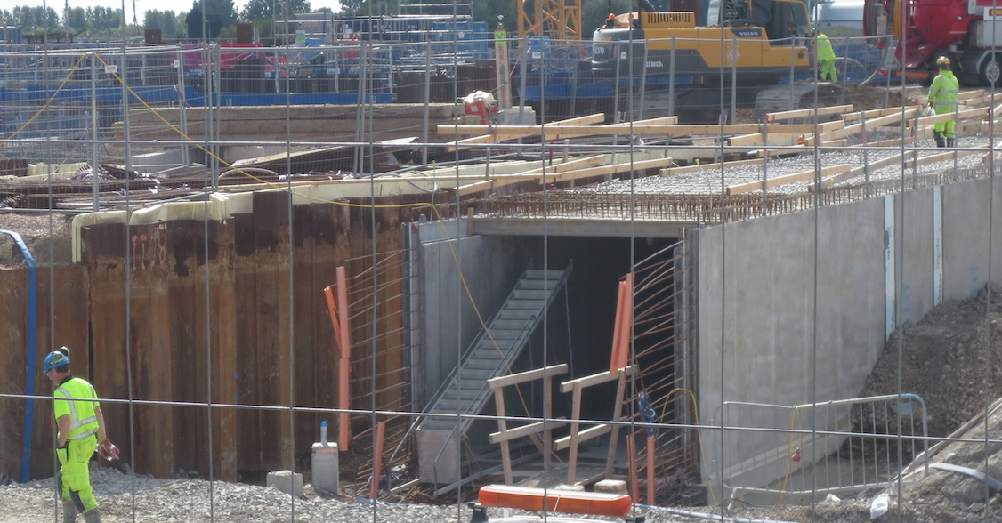
Routing of infrastructure D03 Access gallery – Level 090
From the gallery
From conduits
https://ess-ics.atlassian.net/wiki/display/SPD/CF+Info

Slide 12
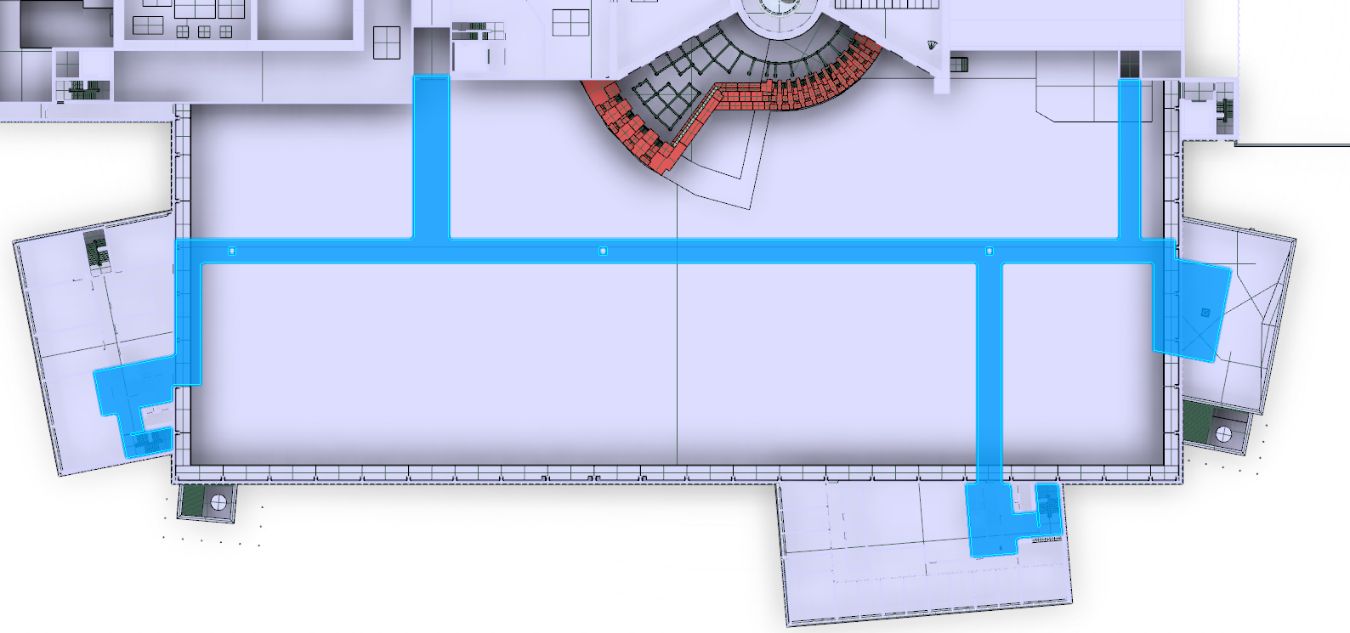
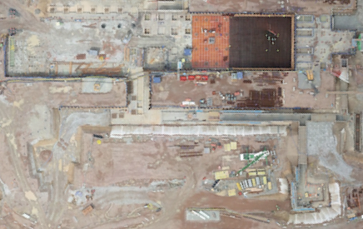
Routing of infrastructure D01 Access gallery – Level 090
From the gallery
From conduits
https://ess-ics.atlassian.net/wiki/display/SPD/CF+Info

Slide 13
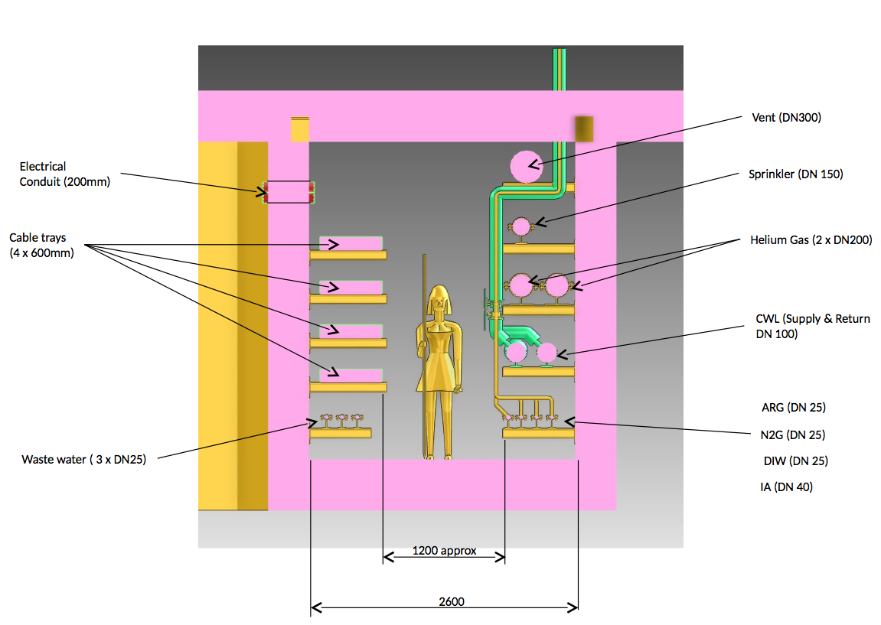
Gallery section
Preliminary

Slide 14
Gallery distribution
3000
500
AREA FOR PENETRATION
FHV
HR
HRR
SPR-D03
N2G
IAR
DIW
ORW
NSS-CT
Maintenance access way
2100x1200
DHL
2600
AREA FOR LOCAL GROUPS OF NSS CONNECTION
ICS/DMSC-CT
CWL
-
SPARE
CF-CT
SPARE
900
800
14
Notes:
Cooling Water Low temperature CWL
Instrument Air (Compressed Air) Deionized Water Nitrogen Gas FHV Fume Hood Ventilation Helium Recovery Helium Recovery Return Cable Tray Integrated Control System Data Management System Center Ordinary Risk Waste Water Sprinkler D03 Experimental Hall 2

Slide 15
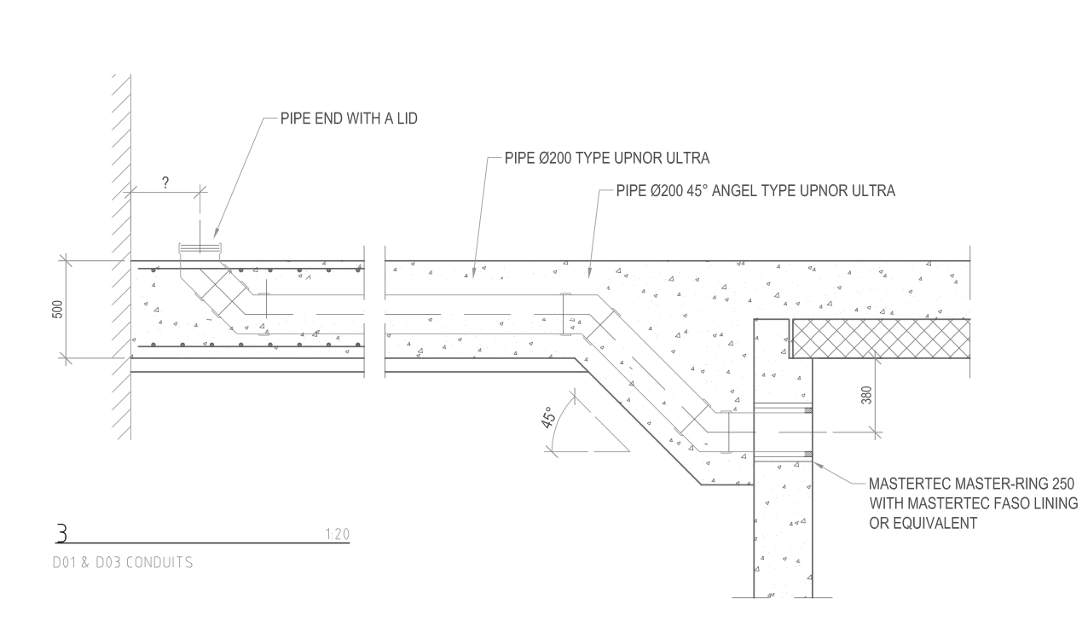
Conduits detail location

Slide 16
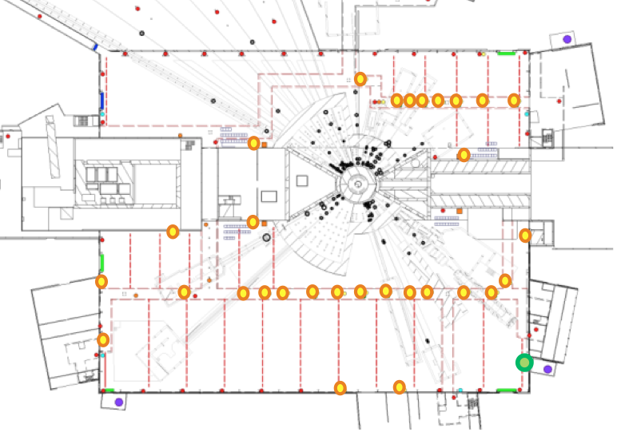
Nitrogen/Deionized water/Compressed Air/LAN
Nitrogen gas (10bar)
Deionized water (8 Bar)
Compressed air (6Bar)
LAN: 2 outlets/connections
Liquid nitrogen
1 filling point / sector
North Sector
9 connections from the gallery and 2 on the wall.
East and south sector
14 connections from the gallery and 7 on the wall
East and South Sector
14 connections from the galery and 7 on the wall.
Process flow chart: ESS-0046901, Layout: ESS-0046984

Slide 17
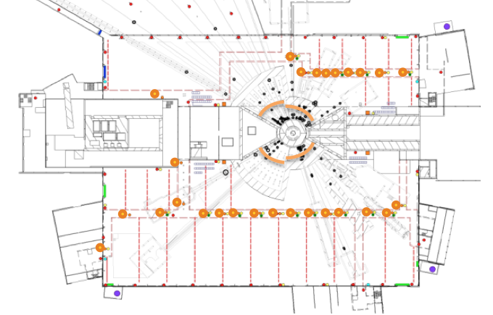
Cooling water
North Sector
9 connections from the D03 gallery.
Properties
7Bar, 8°C
Cooling capacity / average instrument: 27kW
Bunker
Separate cooling loops for each sector provided by ESS. Connections are by the beamlines.
(1 skid/sector, dedicated pipes for each instrument)
East and South Sector (D01)
17 connections from the gallery.

Slide 18
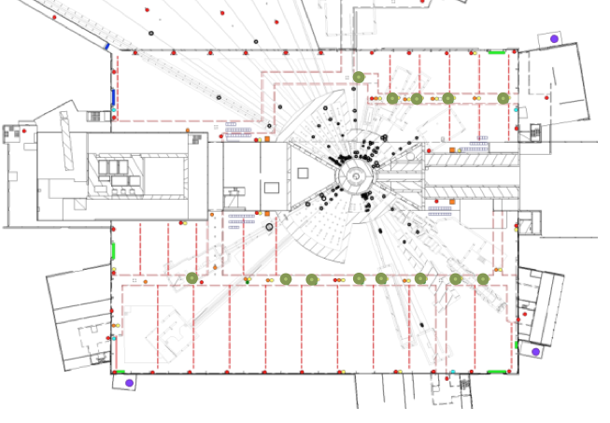
Fume hoods and exhaust pipes for sample environments
North Sector
5 connections from the D03 gallery.
East and South Sector (D01)
8 connections from the gallery.
ESS-0056058, ESS-0048000, Layout: ESS-0046984

Slide 19
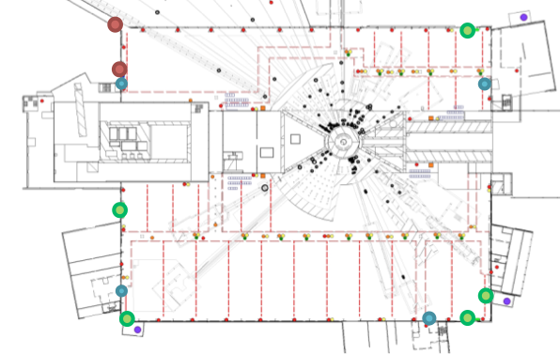
Tap and waste water
1 drain to radiological waste water system in D03
North Sector
1 water connection in D03 on the wall
1 drain to risk water system in D03
East and South Sector (D01)
2 water connections in D01 on the wall
4 drains to risk water system in E01
Process flow chart: ESS-0046901, Layout: ESS-0055781, ESS-0055780, ESS-0046984

Slide 20
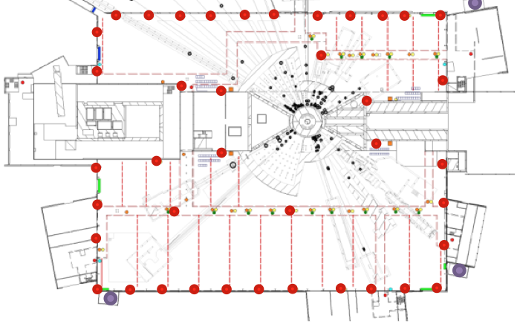
CF Power outlets
North Sector
1 connection from the galery level 090 and 7 on the wall level 100.
Utilities power for installation and maintenance:
3pcs. 16A 1-phase outlets
1pcs. 16A 3-phase outlet
1pcs. 32A 3-phase outlet
East and South Sector (D01)
2 connections from the gallery level 090 and 20 on the wall level 100.
LAYOUT: ESS-0046984

Slide 21
Instrument Power distribution Concept
Preliminary
CF responsibity CF budget
Substation
NSS responsibity, Instrument budget
Gallery/Halls
Bunker distribution panel
/Bunker zone/
Instrument distribution panel
/Main grounding zone./
Instrument distribution panel
/Grounding zone X/
NSS responsibity, NSS budget
Light
Motion
SAD
Detector
...
Lights
Chopper
Vacuum
Instrument 1
Instrument 2
Instrument 3
Instrument 4
Motion
...
Instrument X

Slide 22
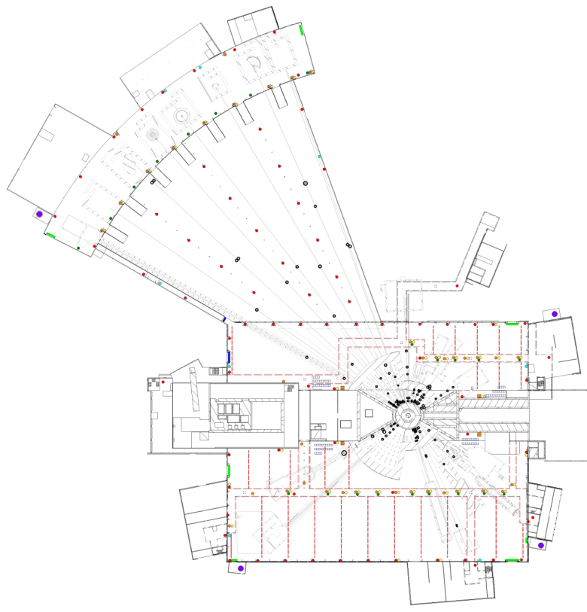
Instrument Power distribution Concept
The design will be provided by ESS, the installation and material cost will be paid by the instruments. The design will be finalized according to the instrument designs.
There will be no central UPS system
The power distribution network will be planned according to ESS grounding rules.
All the missing insulation rules and solutions will be defined ASAP
36
Preliminary
15
Cave /Main zone/
There will be connection points similarly placed as the Sample environment connections
Bunker:
The bunker is a unified zone. There will be four distribution panels by D02 walls for the four sectors.
38
ESS Power and Grounding: ESS-0051373 (Not released)

Slide 23
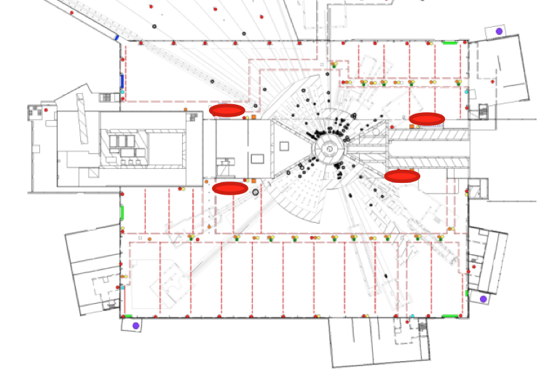
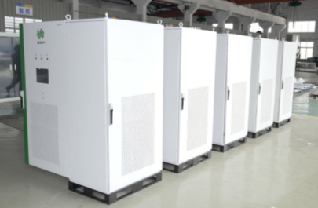
Cabinet placement
Constrains on cabinet placement:
Cable length limitations
Floorspace
Distance from sensitive components
Blocking of trafic routes including cranes
The cabinets should be outside of the shielding
Preliminary
Bunker:
NSS is planning to have cabinet arrays for each sector in order to minimize the cable lengths. The cabinets will be connected to the power distribution panel of the bunker sector. Also they will be connected to a common ICS router.

Slide 24
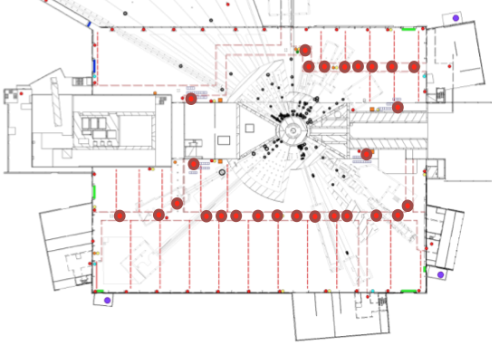
ICS/DMSC
ICS/DMSC network will be provided by ESS. The network design will be finalized according to the instrument designs.

Slide 25
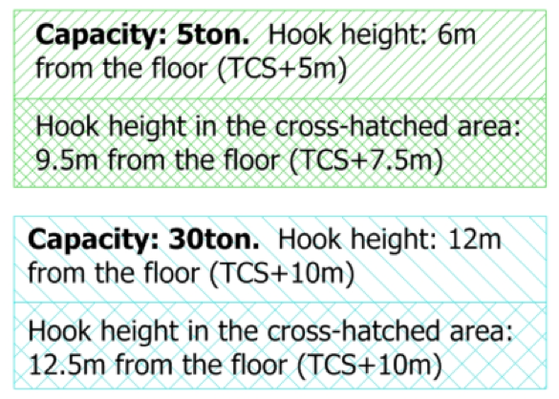
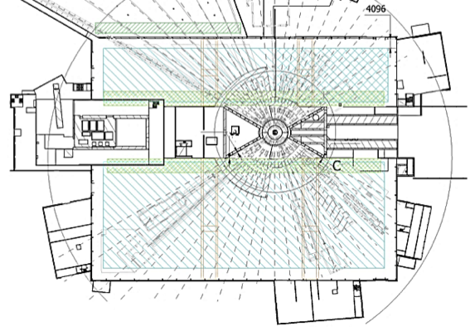
Cranes
D01 : ESS-0055303 (5ton), ESS-0055308 (7.5ton), ESS-0055305 (30ton)
D03 : ESS-0055307 (5ton), ESS-0055304 (7.5ton), ESS-0055306 (30ton)
E01 : ESS-0052338 (10ton)
E02 : ESS-0052339 (5ton)
E03, E04: ESS-0048477 (5/15 ton)
Mobile crane (preliminary): https://ess-ics.atlassian.net/wiki/display/SPD/Mobile+Cranes+in+E02

Slide 26
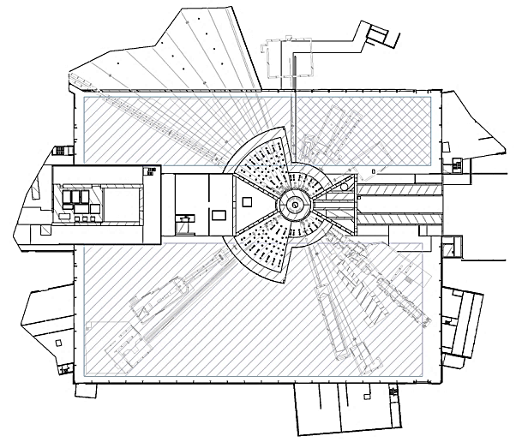
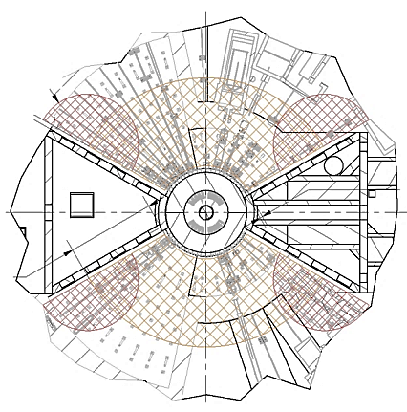
Cranes

Slide 27
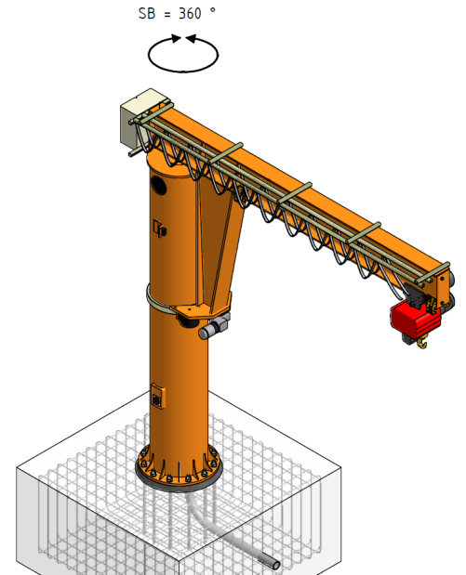
Jib cranes for sample area
CF has approved the mounting of the LoKi Crane to D03 floor.
Arm length: 7m
Capacity: 1500kg.
Mounting recommendations and will be release soon.
LoKi Crane

Slide 28
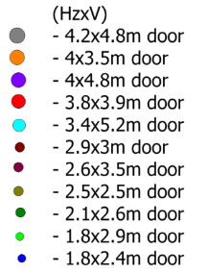
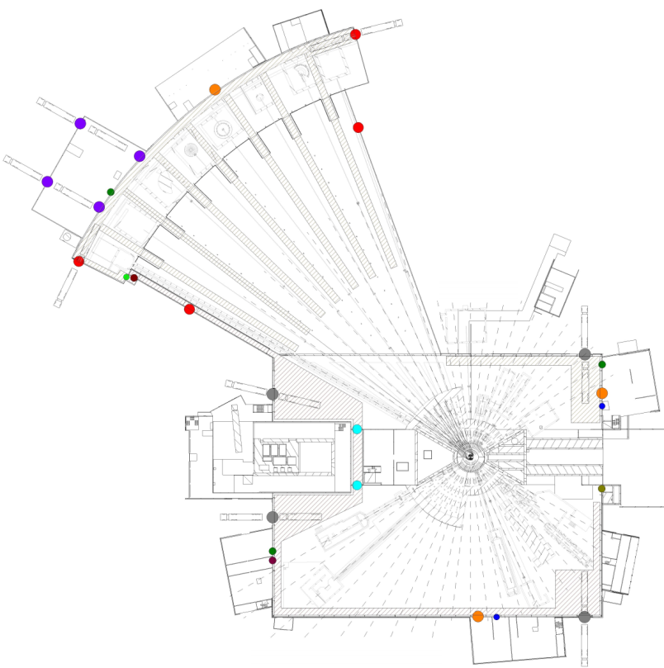
Considerations for logistics inside the halls
General logistics: planning of logistics has started, comments are welcome:
https://ess-ics.atlassian.net/wiki/display/SPD/Logistics+in+D01%2C+D03%2C+E01%2C+E02
Crane logistics: Not analyzed in detail
Shielding logistics: Not analyzed in detail
Logistics for vehicle and personal traffic: Not analyzed in detail (,but)

Slide 29
Additional information
Sprinkles: Technical Specification D01-D08_E01-E05 ESS-0013209
Air conditioning: ESS-0056058, ESS-0048000
Considerations for Free – paths in instrument halls:
NSS Logistics https://ess-ics.atlassian.net/wiki/display/BO/Free+path+by+the+building+wall

Slide 30
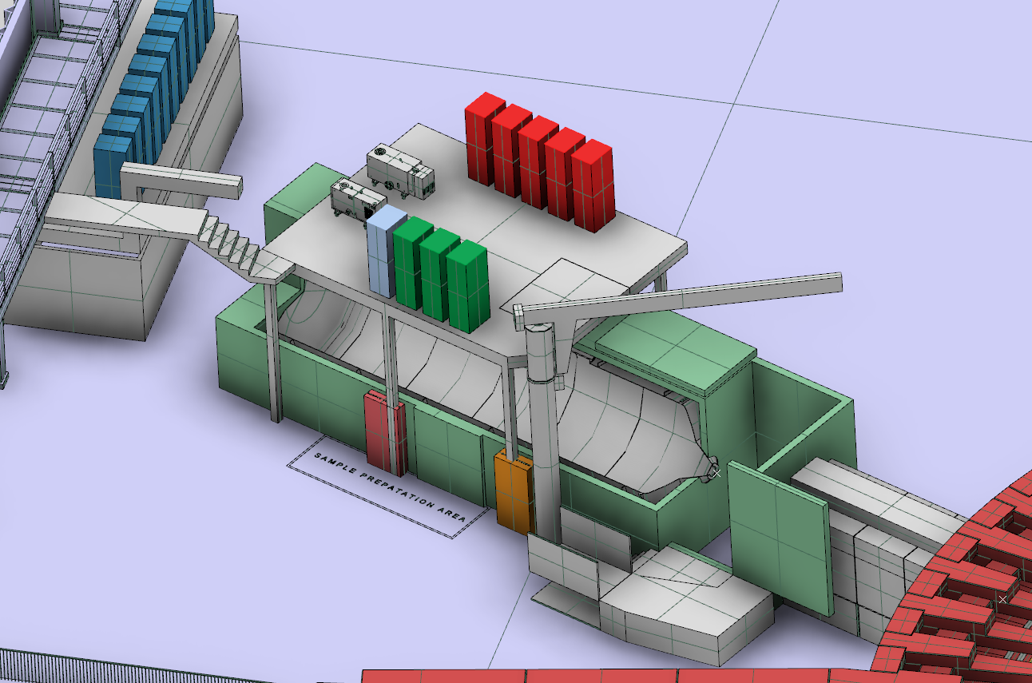
Cave - Loki
ESS-0038163 Sample environment utility supplies
Cooling water
Tap water
Power outlets
Gasses supply
Communication
Compressed air
Supply infrastructure:
Power
Network
Lighting
Ventilation
Fire protection BFS 2011:26
Local crane

Slide 31
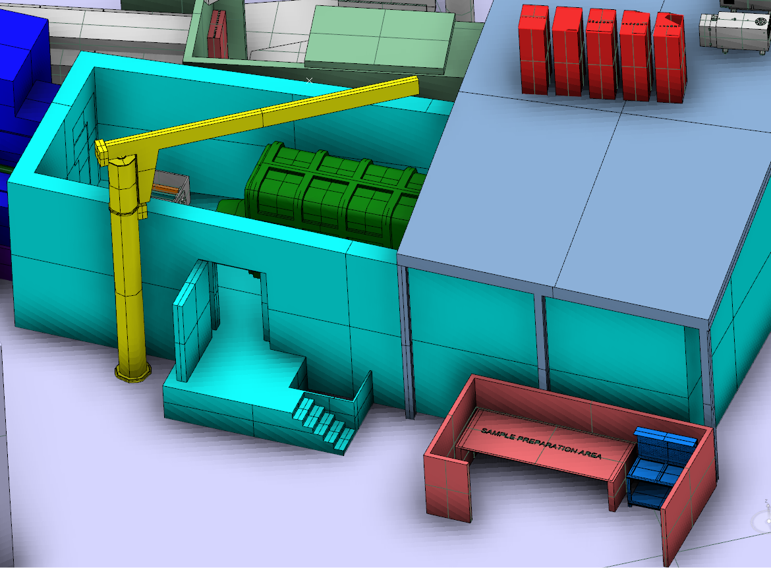
Cave - Freia

Slide 32
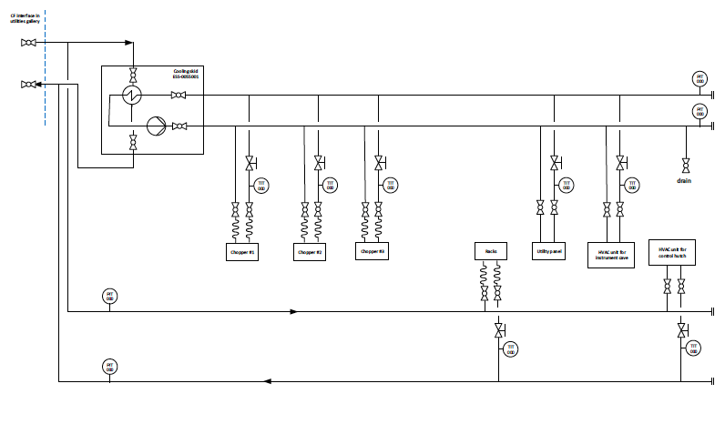
LoKI - Cooling diagram

Slide 33
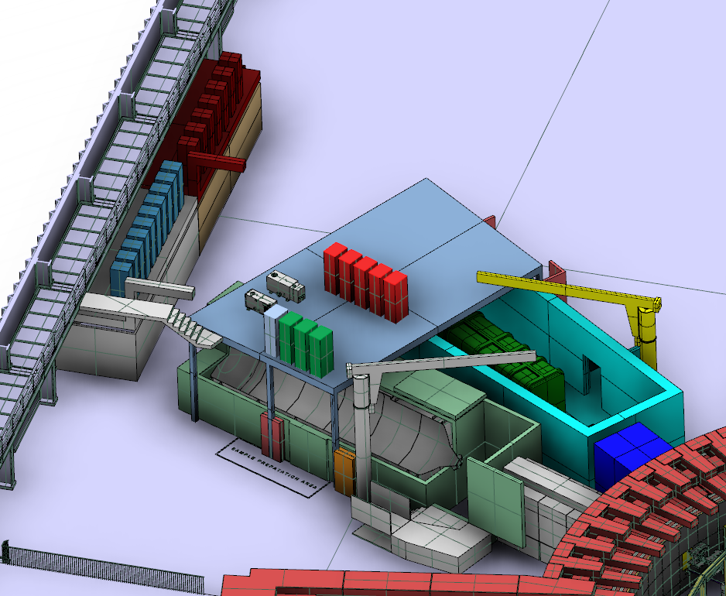
Access to sample area
Local crane
Lifting cage (equipment)
Sample area preparation
Pathways
Personnel access
Required information about recommendations for:
Mounting and Location for local cranes
Grounding practical details
Instrument height limitations
Anchoring system
4
3
1
2
5

Slide 34
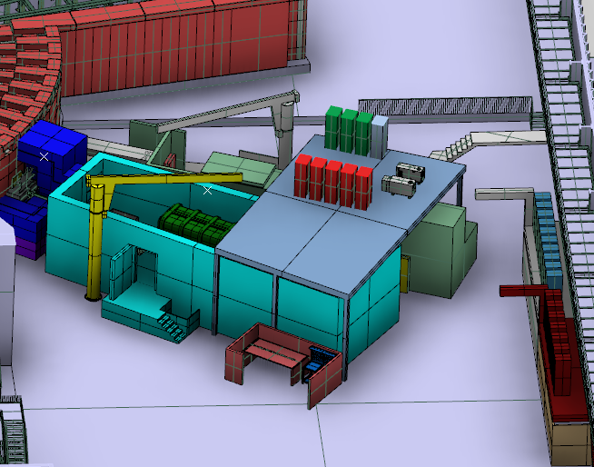
Path ways
2550 mm [3]
[3] NSS Logistics https://ess-ics.atlassian.net/wiki/display/BO/Free+path+by+the+building+wall

Slide 35
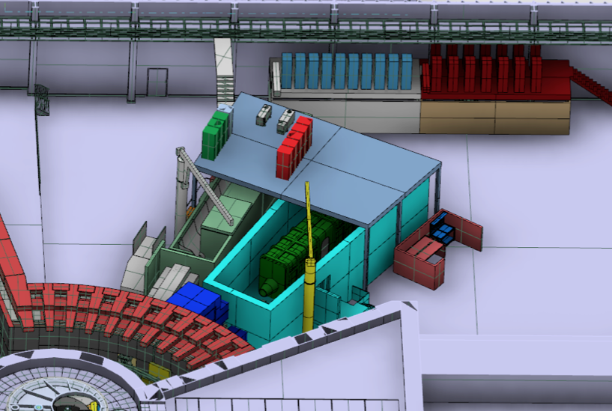
FREIA- LoKI overview

Slide 36
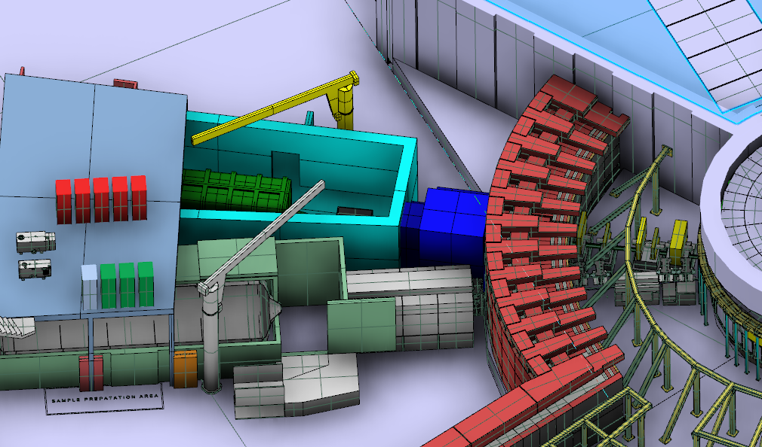
Freia – Loki Bunker wall - Integration

Slide 37
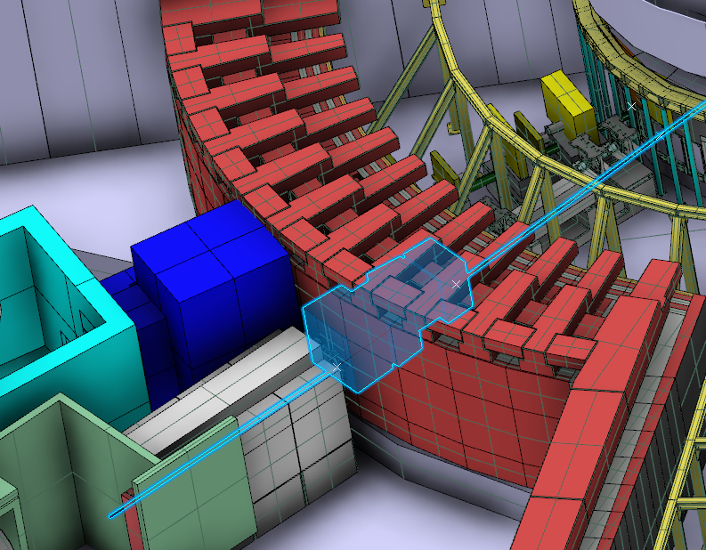
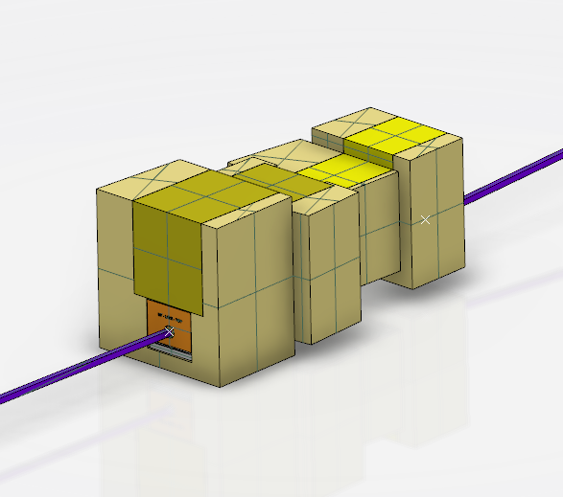
Integration in bunker wall
According to ESS-0062127
Short instrument wall
Feedthru outline

Slide 38
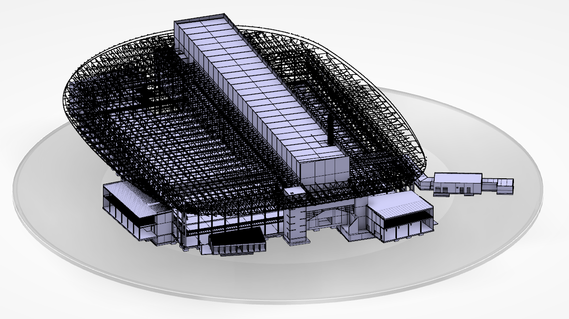
ESS Buildings
Personnel access

Slide 39
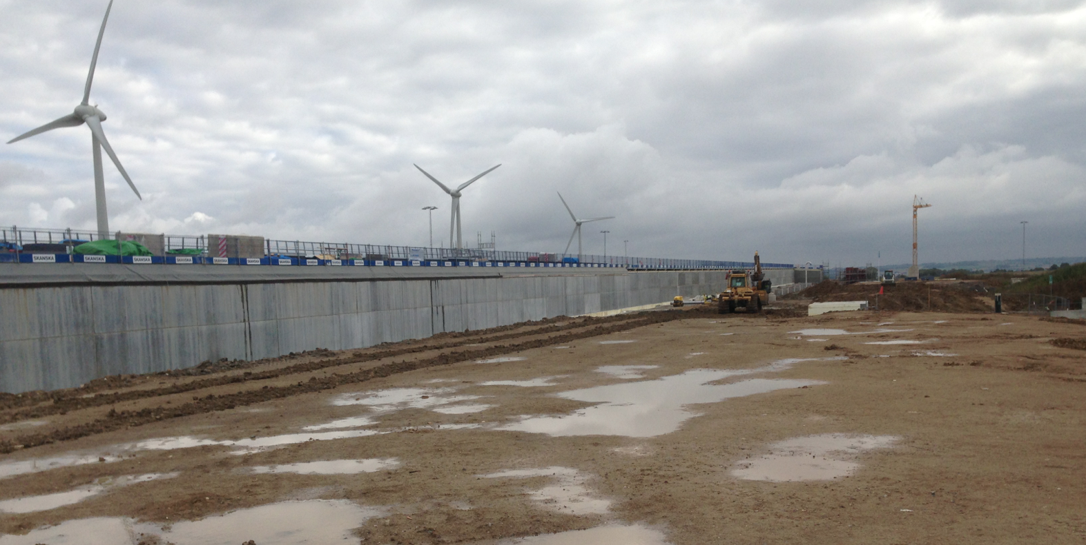
Civil construction
Tunnel G01 Outside

Slide 40
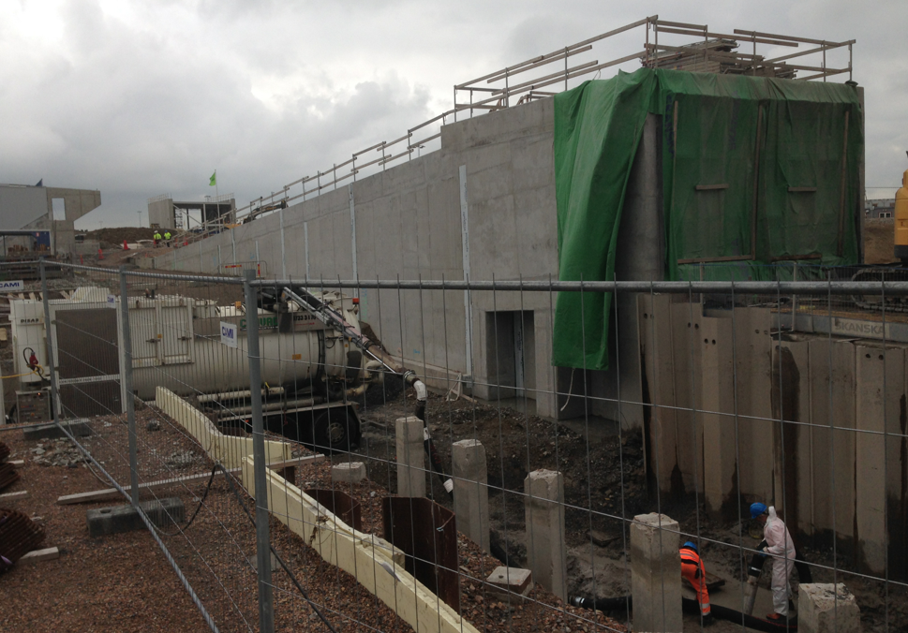
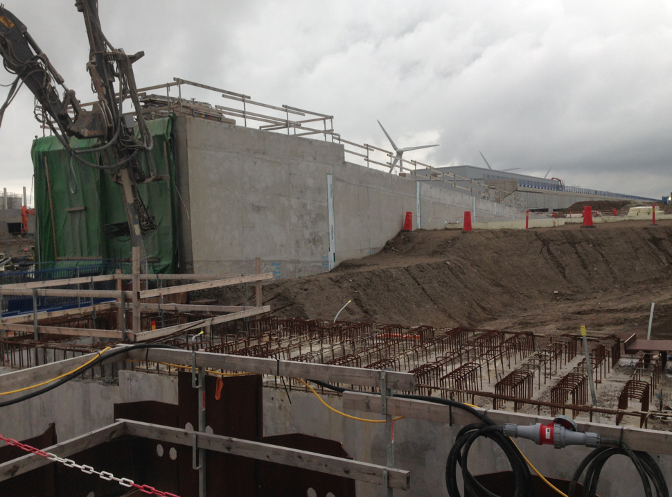
Civil construction
A2T

Slide 41
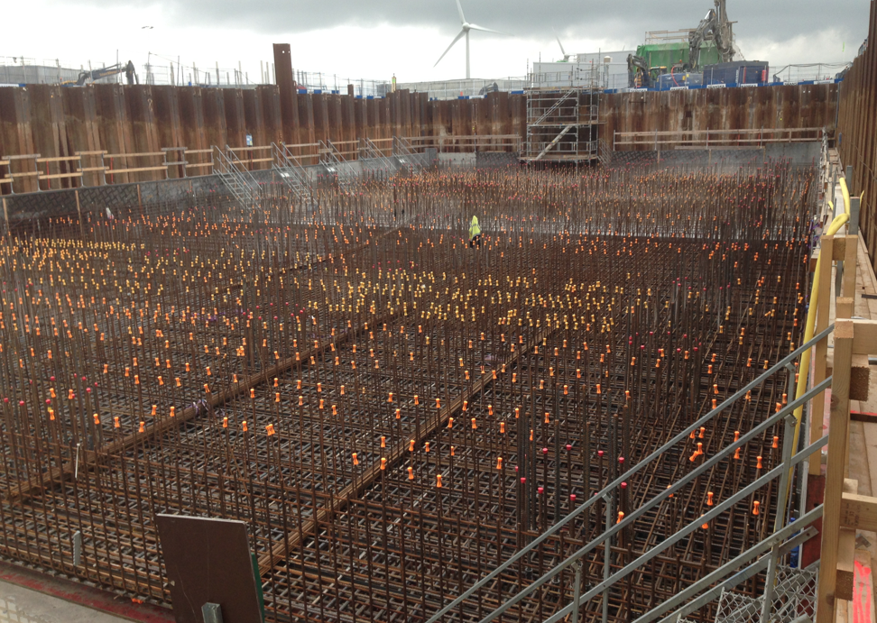
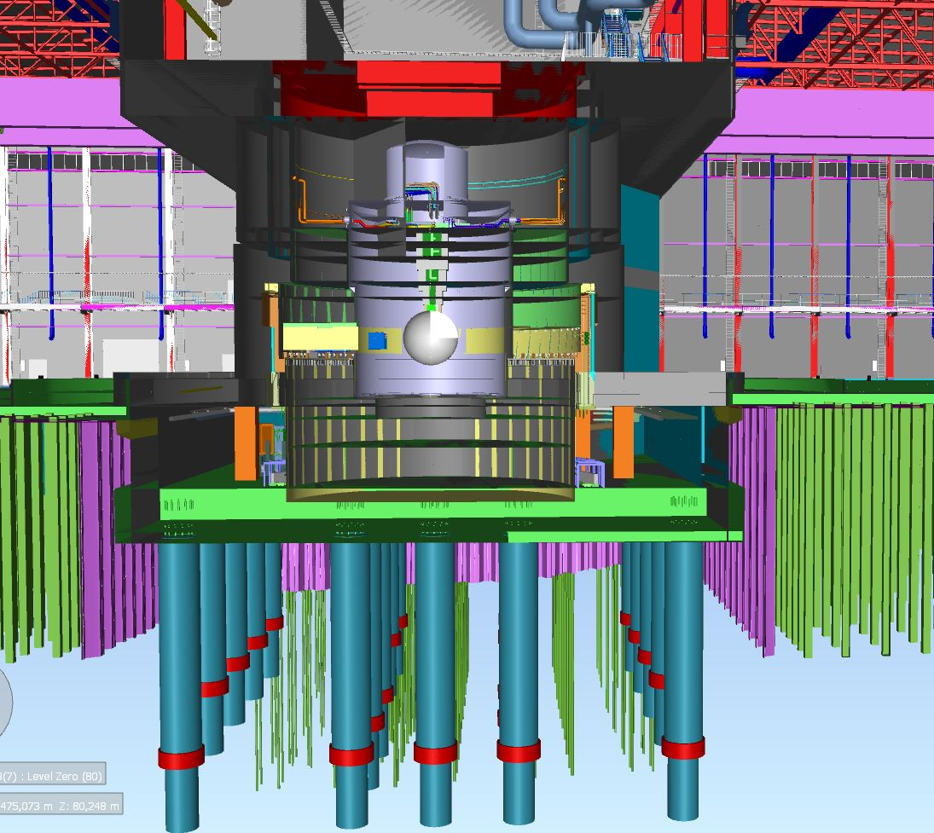
Civil construction
TARGET

Slide 42
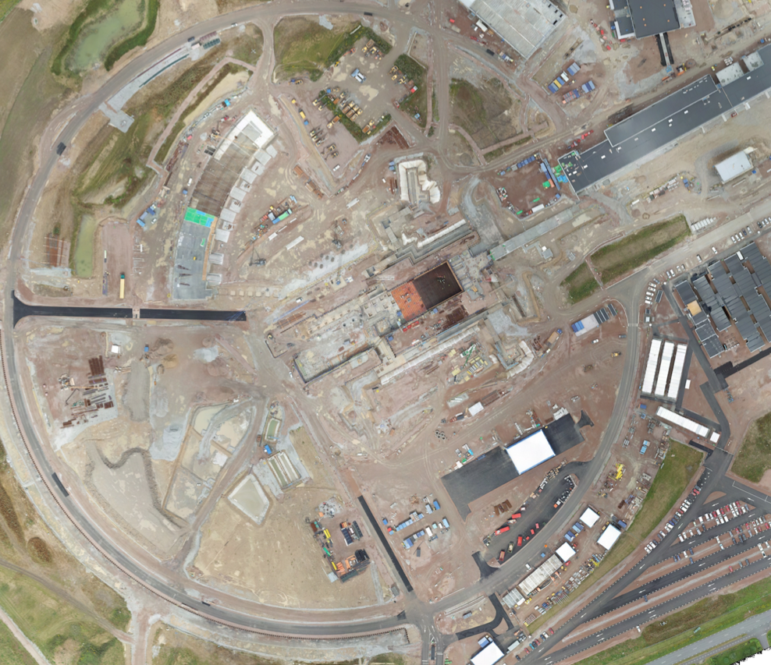
ESS Orthophoto August 2016

Slide 43
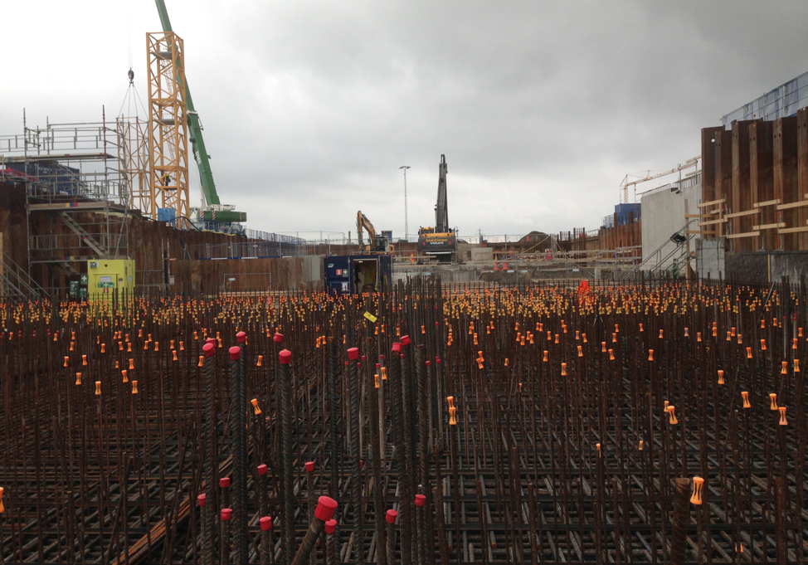
Civil construction
TARGET

Slide 44
Civil construction
Instrument Halls

Slide 45
Civil construction
Instrument Halls

Slide 46
Civil construction- reinforcement 20 ton/m2

Slide 47
Questions?

