Slide 1
“Life After Tollgate 2”
LoKI Project Update
Andrew Jackson
LoKI Lead Scientist

Slide 2
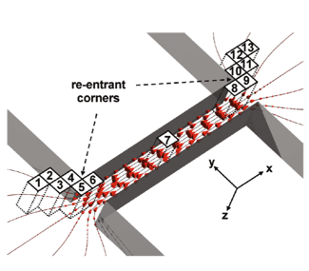
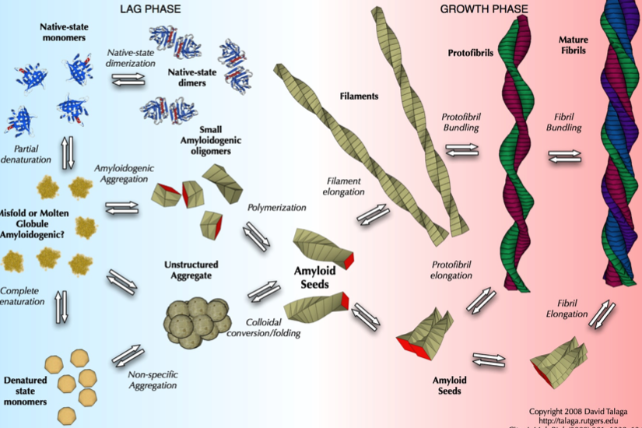
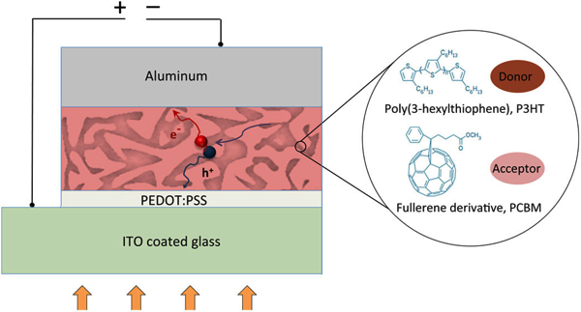
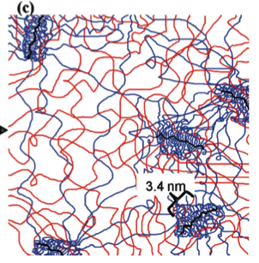
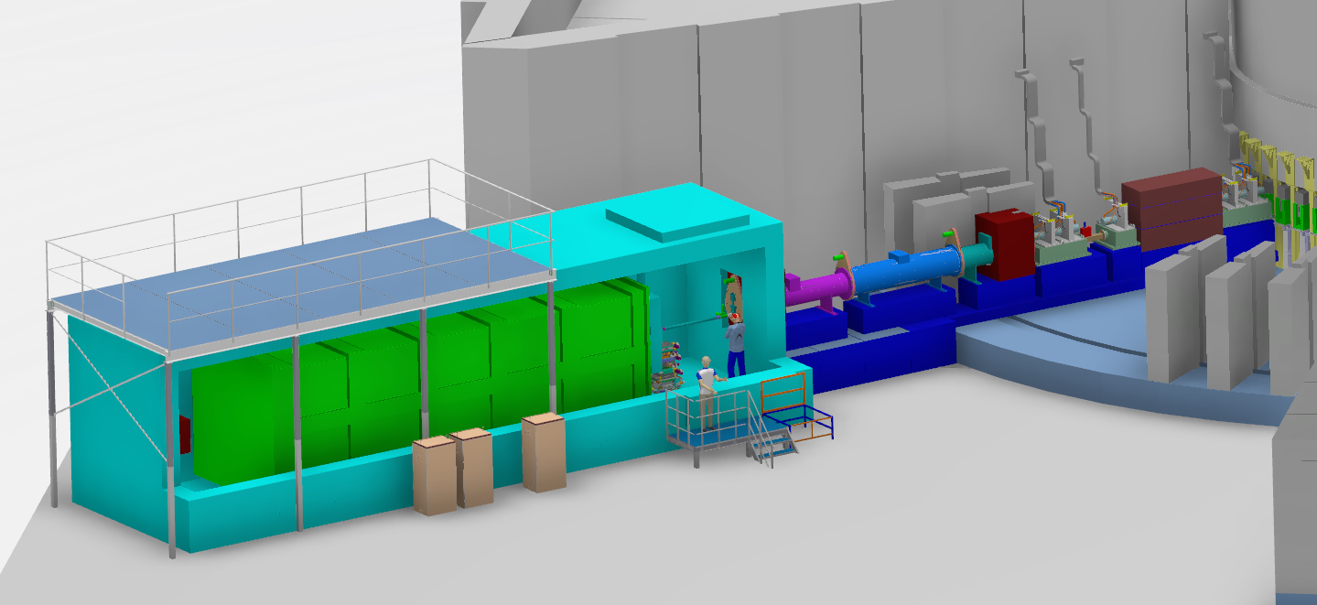

LoKI
SANS for Soft Matter, Materials and Bio-Science
The combination of a large solid angle of detectors and a broad wavelength band will provide a world leading SANS instrument for the ESS.
LoKI will have high flux, wide simultaneous size range, and a flexible sample area.
Small beams, making scanning experiments routine.
The ability to perform “single-shot” kinetic measurements on sub-second time scales
MULTISCALE
DEVICES
FLOW
KINETICS
BIOLOGY
8 + 10 m collimation
14 Hz or 7 Hz operation
Up to 20 Å bandwidth
Option for resolution enhancing choppers

Slide 3
Requirements
A broad Q range, high flux SANS instrument for soft matter, materials & bio-science
High-level Scientific Requirements for the Instrument
The instrument shall allow data to be collected to a Q_{min} of < 0.001 Å⁻¹.
The instrument shall allow data to be collected to a Q_{max} of > 2 Å⁻¹.
The instrument shall allow data to be collected simultaneously over a continuous Q range with Q_{max}/Q_{min} > 1000.
The instrument shall match the size of the neutron beam to the size of the sample.
The instrument should allow the Q resolution (dQ/Q) to be optimised for the experiment.
The instrument should be capable of providing a Q resolution < 10% dQ/Q over the whole Q range.
The instrument should allow data collection from samples < 8 mm³ volume

Slide 4
Project History
October 2012 – Initial proposal submitted
February 2013 – Proposal re-submitted after STAP feedback
April 2013 – Recommendation from SAC
October 2013 – Approval from Steering Committee
2014 – Phase 1
December 2014 – Scope Setting & Tollgate 2 Review
2015 – Project updates and Consortium building
2016 – ISIS becomes lead partner. Information transfer, design update and development, preparing TA.

Slide 5
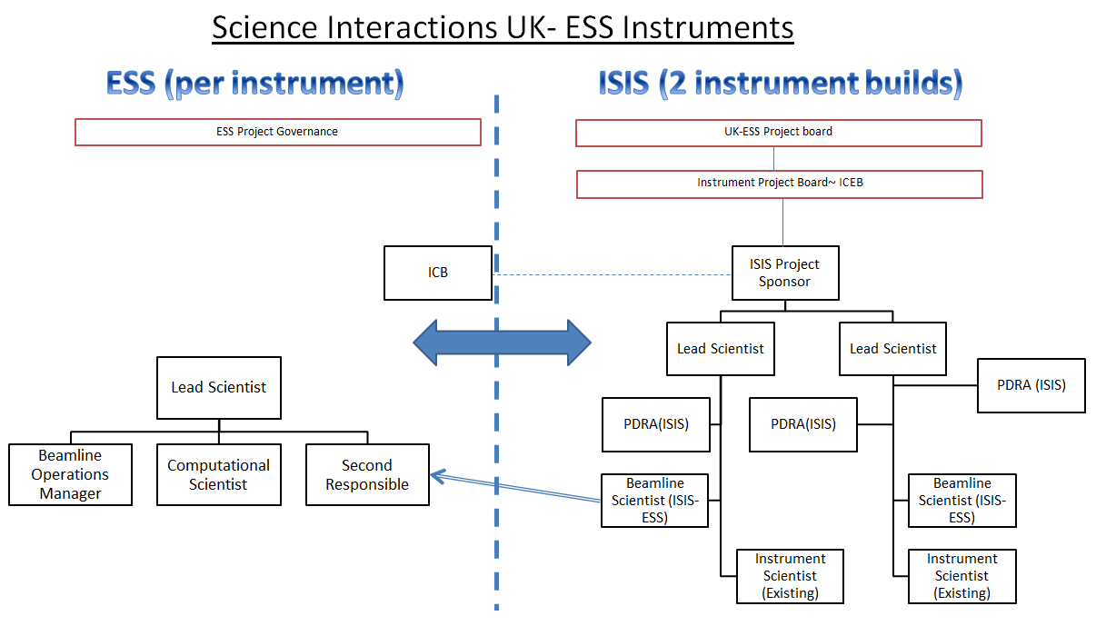
Collaboration Model

Slide 6
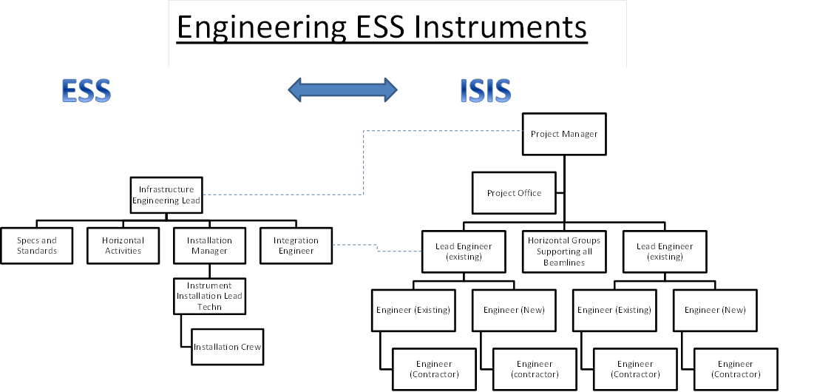
Collaboration Model

Slide 7
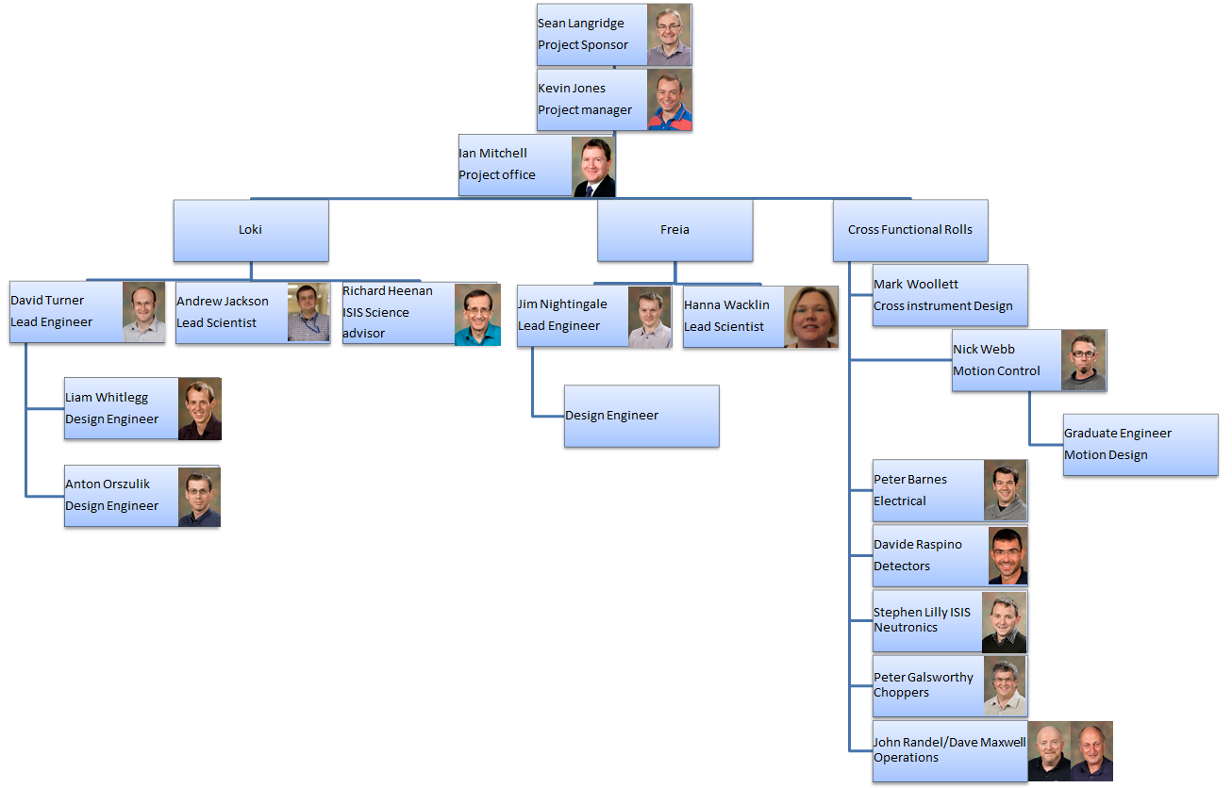
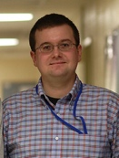
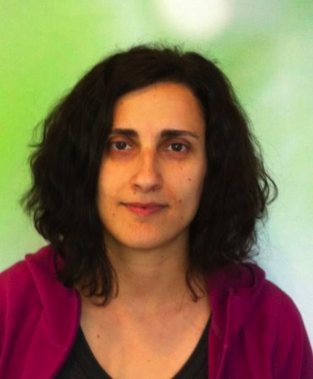
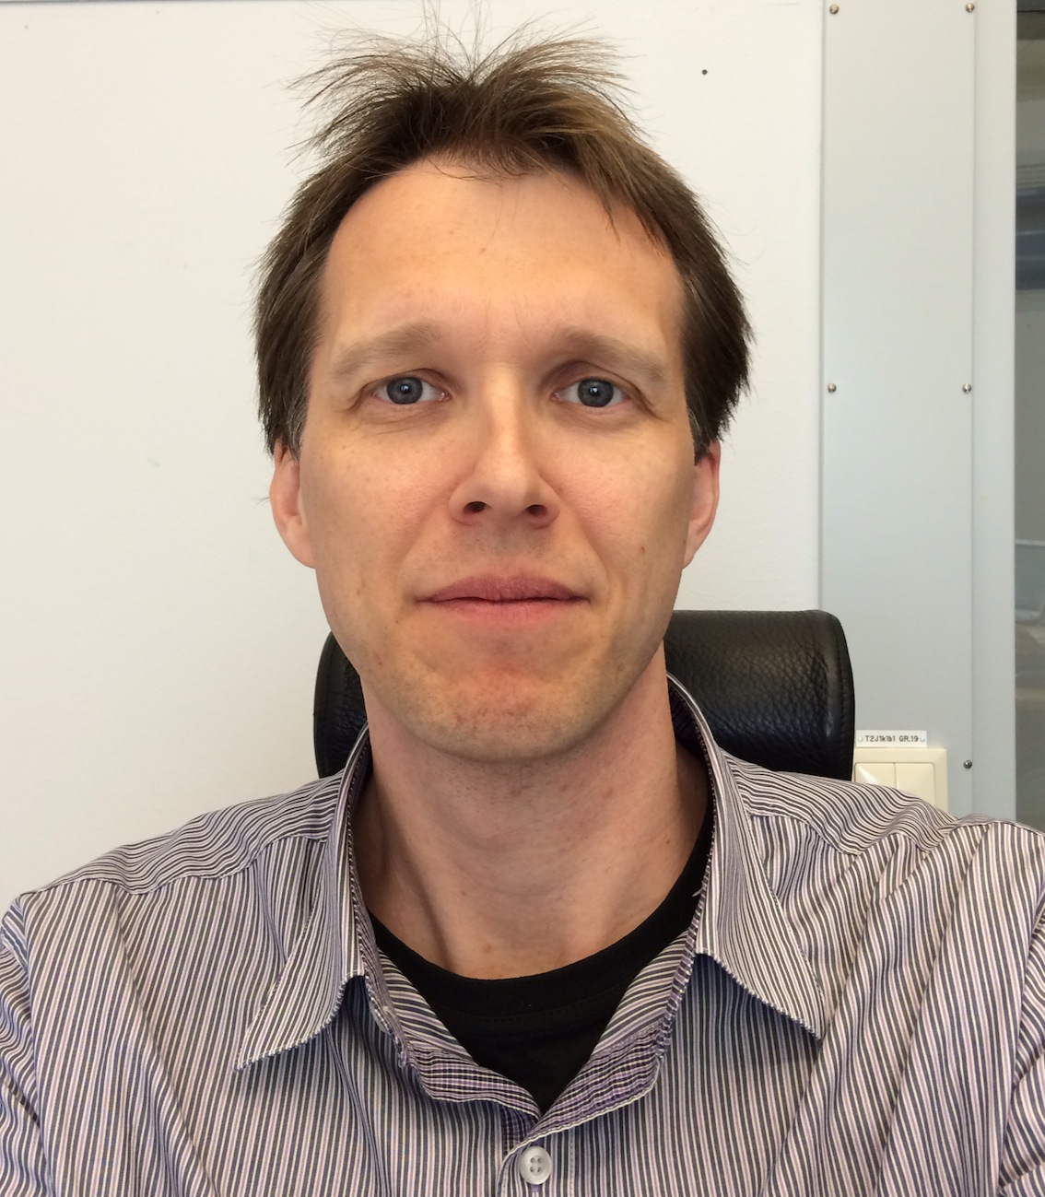
Delivery Team
Ken Andersen
Lead Instrument
Scientist
Gábor László
Lead Instrument
Engineer
Andrew Jackson
SANS Coordinator
Clara Lopez
Integration Engineer
Kalliopi Kanaki
Detectors
Nataliia Cherkashyna
Neutronics
Erik Nilsson
Choppers
Anders Pettersson
Sample Environment
ESS
ISIS

Slide 8
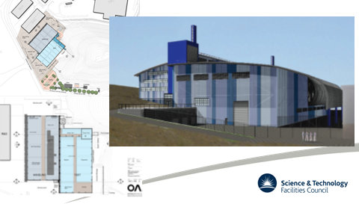
Build Model
ISIS will prebuild all beamline
ESS technicians involved in the pre builds
ESS technicians & craftworkers will assemble the beamlines at ESS
ISIS have machining and flame cutting capability on site
ESS need machining and flame cutting capability on site
STFC custom building to enable prebuilds
Notes:
Highlight that things don’t fit first time for a number of reasons from floors not being level to steels not being perfectly flat and that it is much easier to make it fit when the capability is on site that when it has to be sent away.
We will eliminate a lot of these problems by doing the prebuilds but we will not fix all of them
Highlight the importance of having the ESS technicians at ISIS during the prebuilds for knowledge and skills transfer and to understand how the beamlines go together

Slide 9
Scope
ESS – Hall 2 – North Sector – Port 7 – Cold Moderator
14 Hz or 7 Hz operation at up to 20 Å bandwidth
Wavelength selection chopper (double disk) in bunker at 6.5 m
Double bend (vertical) to get out of line of sight
  Bender 1 in Bunker
  Bender 2 in Shield Wall
Frame overlap chopper (double disk) just outside shield wall at ~15 m
Option for resolution enhancing choppers (Upgrade)
Collimating slits at 15.5m
Collimation changers between 15.5m and 20.5m (3m + 2m)
Aperture selector between collimation changers
Sample position at 23.5m
3 detector banks;
  1st ~ 1.9m from SP
  2nd ~ 4.5m from SP
  3rd ~ Variable from 5-10m from SP
Sample Environment – Temperature controlled sample changer, flow cell …
Design, Procurement/Fabrication, Testing and Installation of all components and whole instrument.

Slide 10
Scope
ESS – Hall 2 – North Sector – Port 7 – Cold Moderator
14 Hz or 7 Hz operation at up to 20 Å bandwidth
Wavelength selection chopper (double disk) in bunker at 6.5 m
Double bend (vertical) to get out of line of sight
  Bender 1 in Bunker
  Bender 2 in Shield Wall
Frame overlap chopper (double disk) just outside shield wall at ~15 m
Option for resolution enhancing choppers (Upgrade)
Collimating slits at 15.5m
Collimation changers between 15.5m and 20.5m (3m + 2m)
Aperture selector between collimation changers
Sample position at 23.5m
3 detector banks;
  1st ~ 1.9m from SP
  2nd ~ 4.5m from SP
  3rd ~ Variable from 5-10m from SP
Sample Environment – Temperature controlled sample changer, flow cell …
Design, Procurement/Fabrication, Testing and Installation of all components and whole instrument.

Slide 11
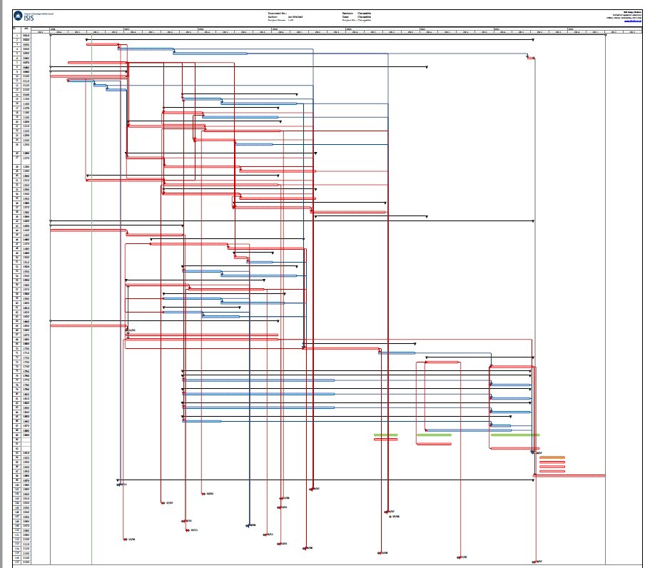
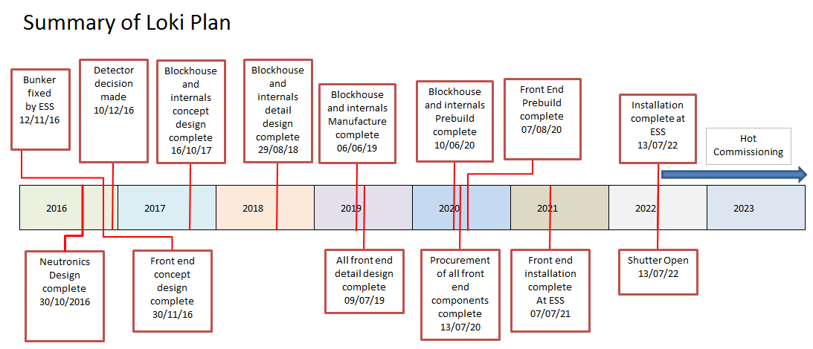
Loki Schedule
Notes:
Current schedule of Loki is driven by a full detailed plan
Ensuring that the front end concept design is completed on time relies heavily on interaction with ESS to ensure we are always aware of the current changes so that the design is constantly updated in line with this.

Slide 12
Costing
Cost book value : 12.19 M€
 | k€
Shielding | 1723.3
Neutron Optics | 478.6
Choppers | 676.0
Sample Environment | 394.0
Detector and Beam Monitors | 3733.3
Motion Control and Automation | 71.0
Instrument Specific Technical Equipment | 1210.0
Instrument Infrastructure | 830.0
Vacuum | 185.4
PSS | 122.1
Travel & Logistics | 949.0
Labour | 3555.3
1 GBP = 1.11 €
Notes:
We have not included the cost for the Italian development or delivery of the detector modules
We are estimating £4M for delivery of HE tubes but are currently working to assess coverage to clarify costs
The Project has already spent in the region of 0.5M which we have not included or agreed to pay for yet

Slide 13
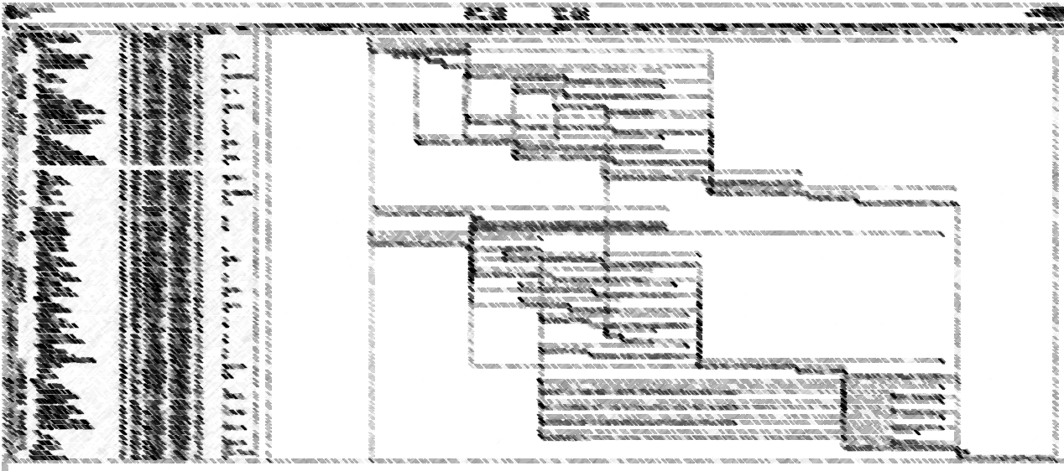
Critical Path
2016
Neutronics
Bunker Decision
2017
Shielding Design
Blockhouse Concept Design
2018-beyond
Sample Stack
Installation
Detector Decision
Notes:
Critical Path in mainly driven by ESS Decisions
There is more detail in the Installation Phase put at this stage is probably irrelevant as its so driven by other areas

Slide 14
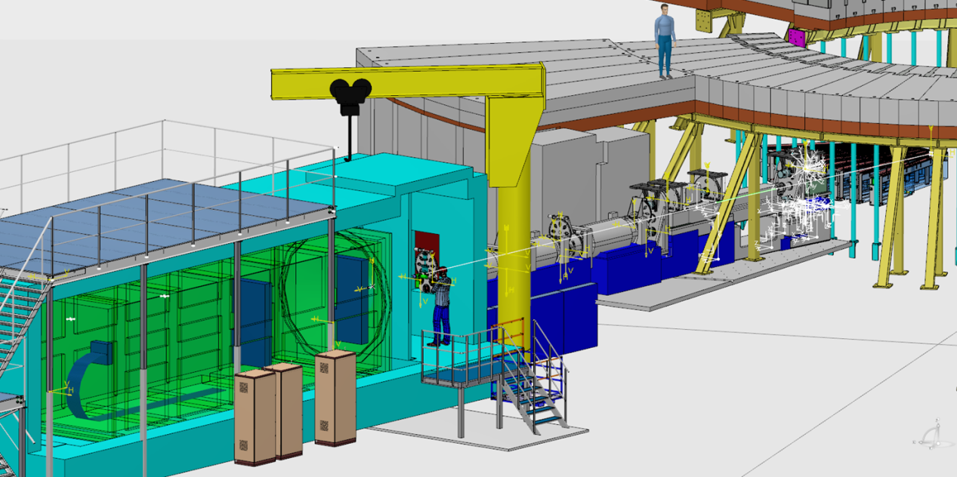
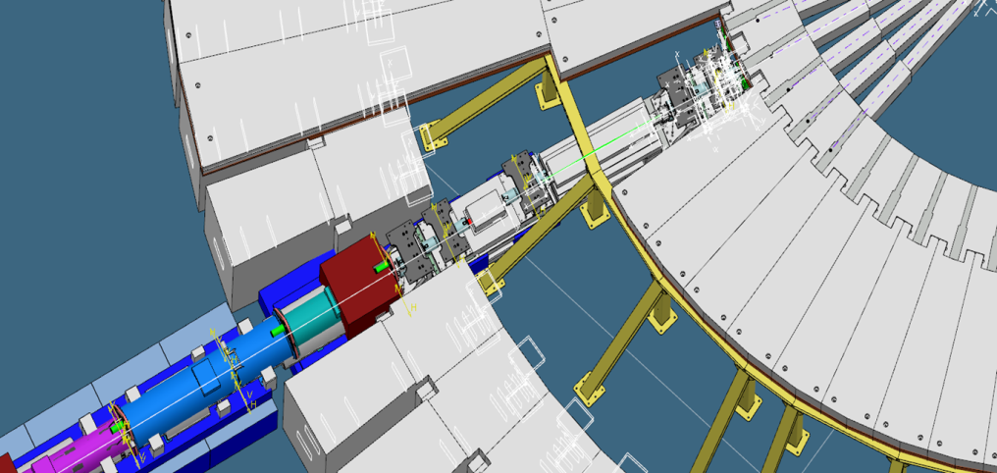
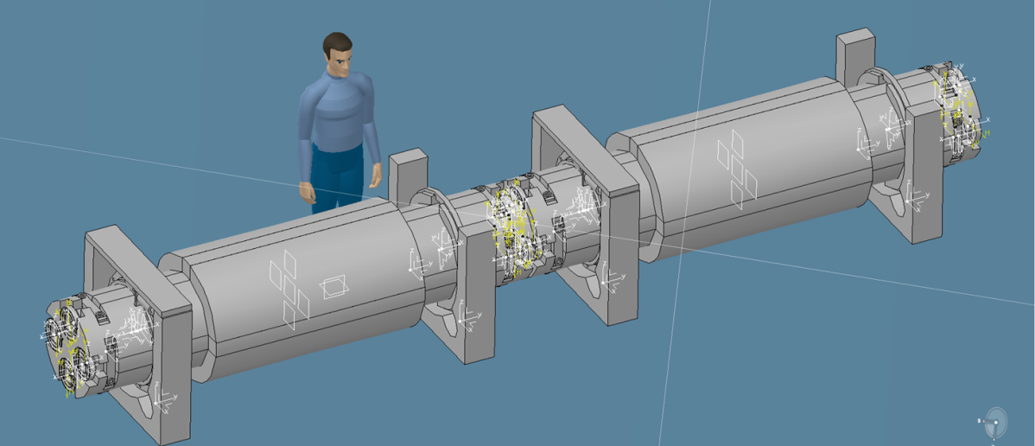
Progress & Challenges

Slide 15
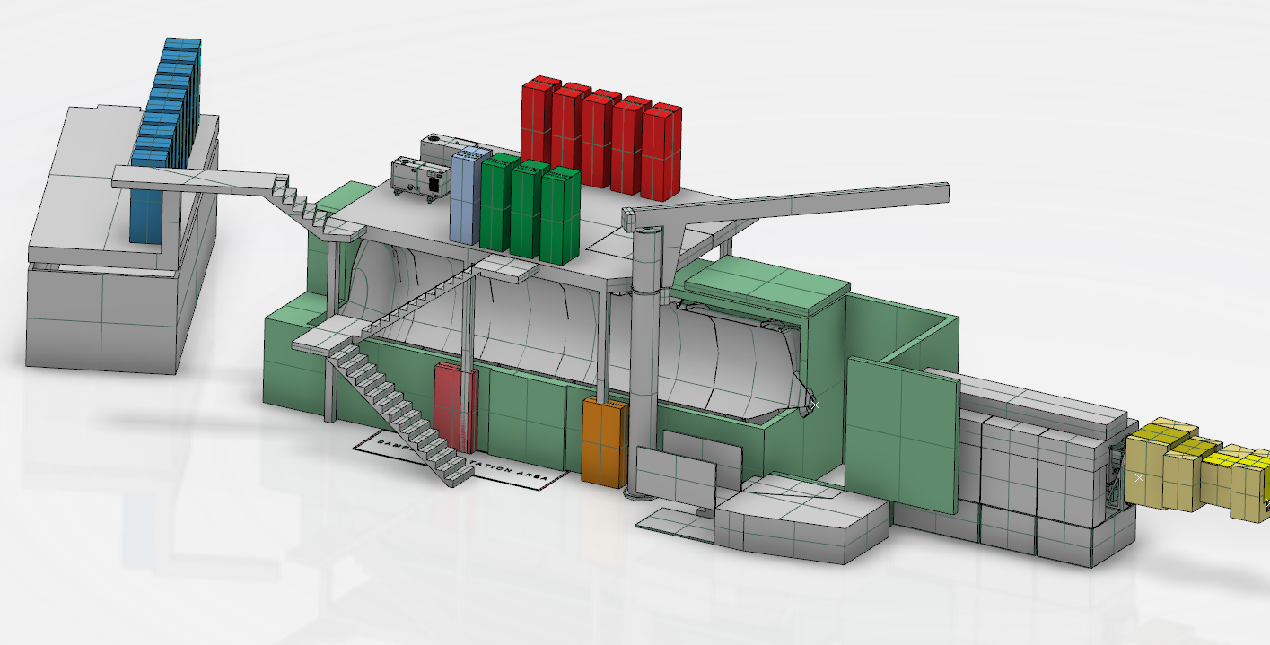
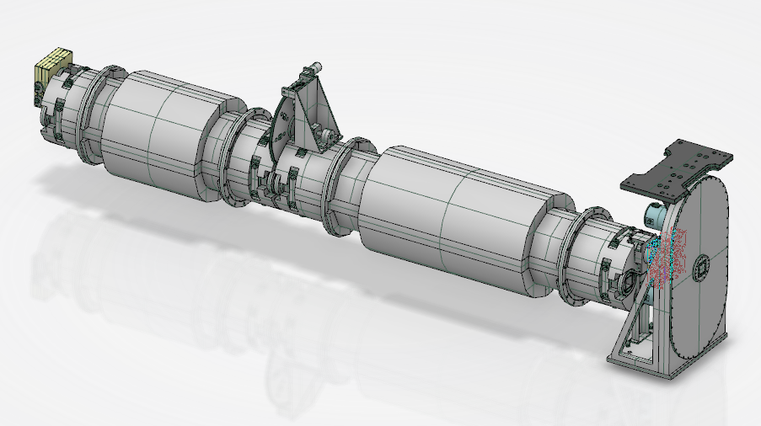
Bunker
Change instrument length
Redesign collimation
Relocate choppers
Redesign optics

Slide 16
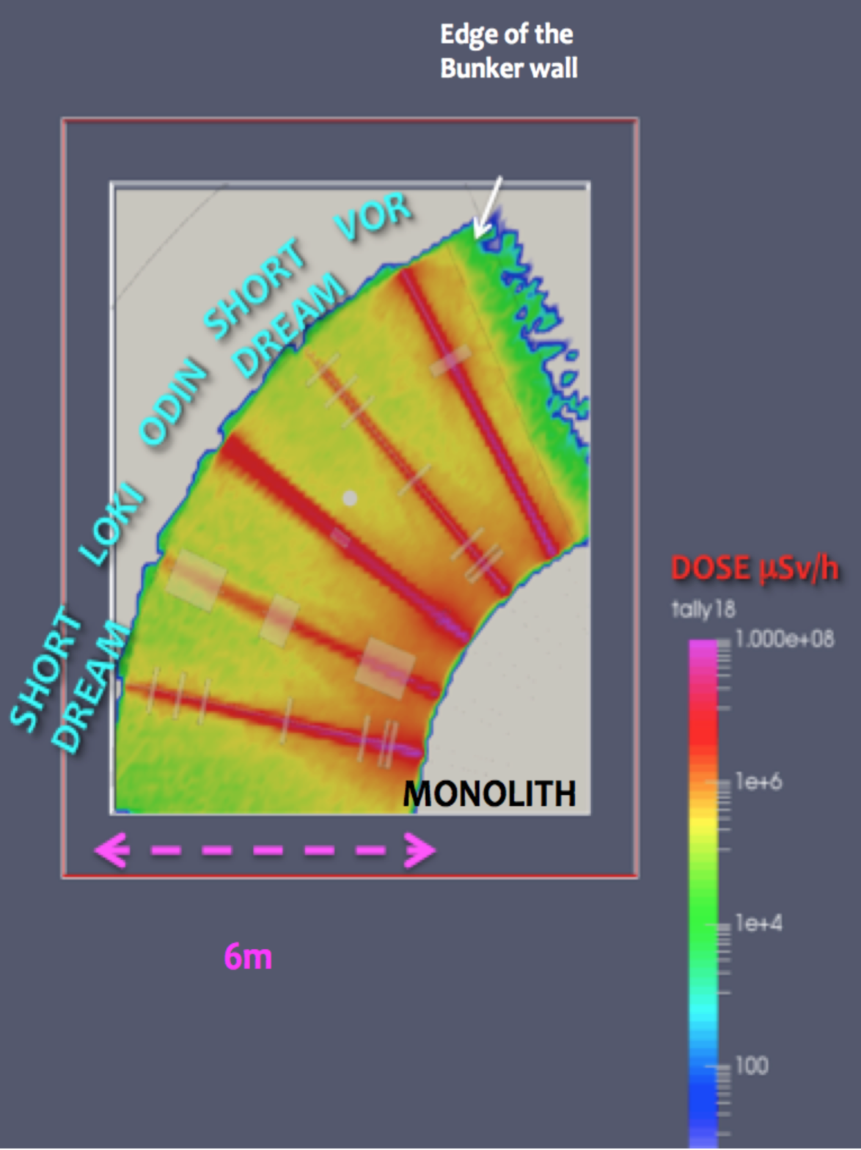
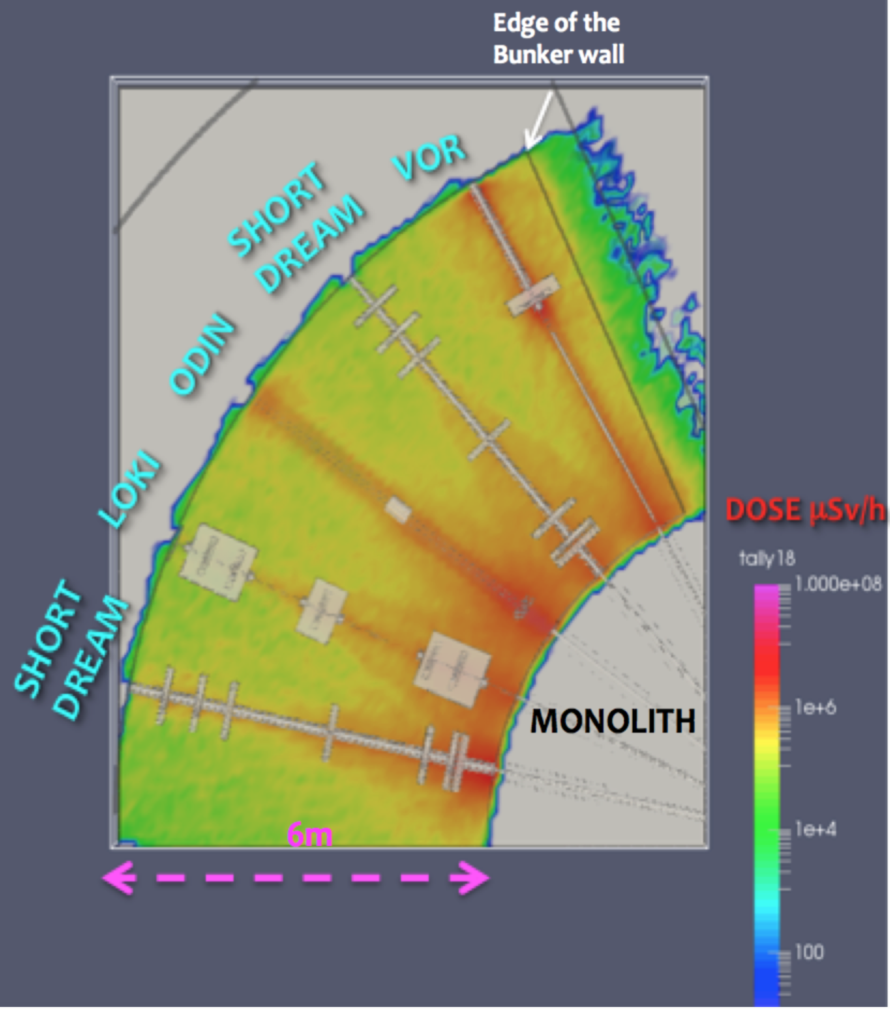
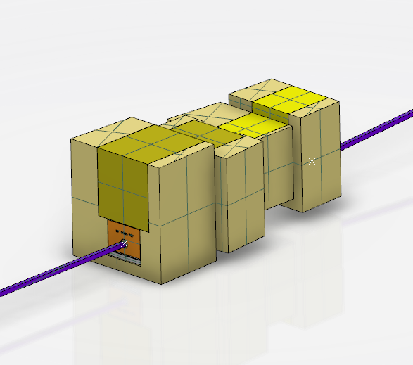
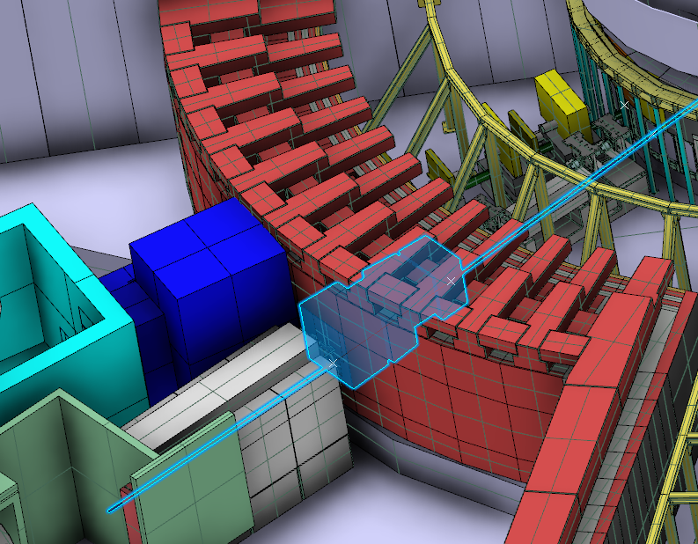
Optics
Vertical bend down in monolith
  61.5 m radius
  3.5 m long
Vertical bend up in bunker wall
  61.5 m radius
  3.5 m long
Can we use multi-channel in monolith?
At Beam Height
25cm above target centre
Notes:
New optics fits within current concept for instrument insert in bunker wall

Slide 17
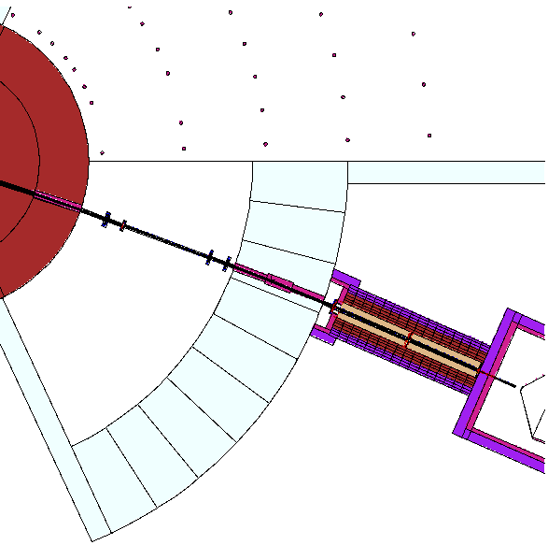
Shielding
MCNP model of LoKI ready. Initial runs underway.
First goal is to determine required shutter dimensions.
Cluster capacity and access is a limiting factor.

Slide 18
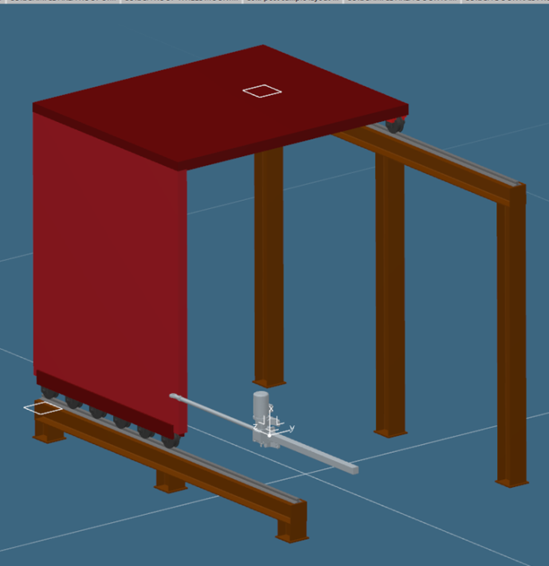
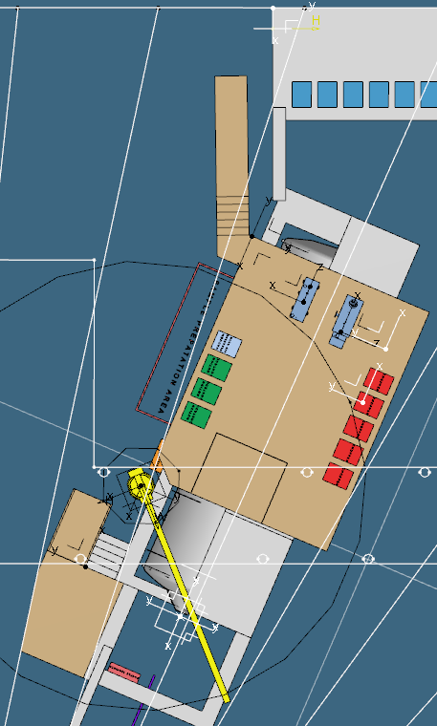
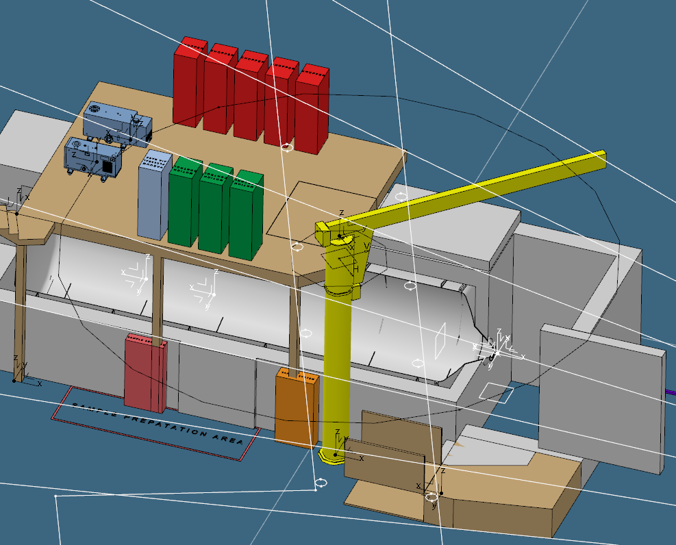
Sample Area
Access from Hall 2 Elevated Walkway
In order to shield against H1 event of whole beam being converted to gamma …
Estimate 140 mm steel around sample area ...
But also need sliding door and roof for equipment access – 27T door
Mechanical solution available – need to assess safety case.
Required Sample Environment Staging Area
Equipment lift + personnel stairs
Space to turn pallet truck
Sample equipment lift extends footprint to N9 port centre-line.

Slide 19
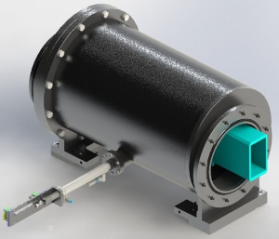
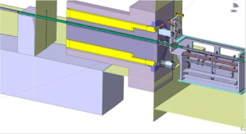
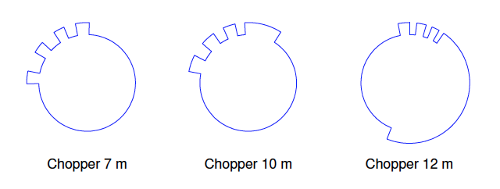


Shutter & Resolution Choppers
It seems that a “heavy” shutter will be required.
The only feasible location for LoKI is within the bunker.
Depending on how big it is, it may preclude resolution choppers.
Waiting for ESS standard designs to mature – currently horizontal translation inside bunker and rotary-in-wall designs being considered.
Prefer vertical shutter ending at ~11.5 m (inside bunker) – would fail safe.
42 Hz 28 Hz 14 Hz
ODIN
SKADI

Slide 20

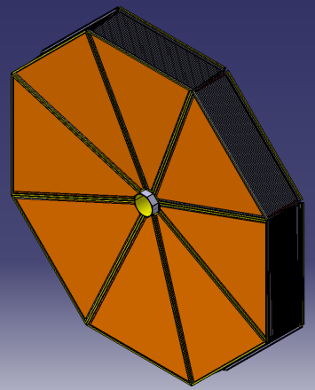
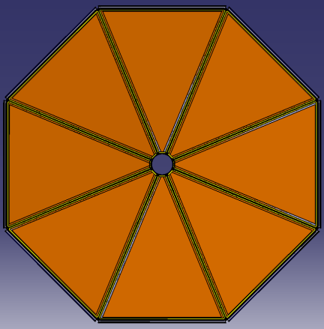
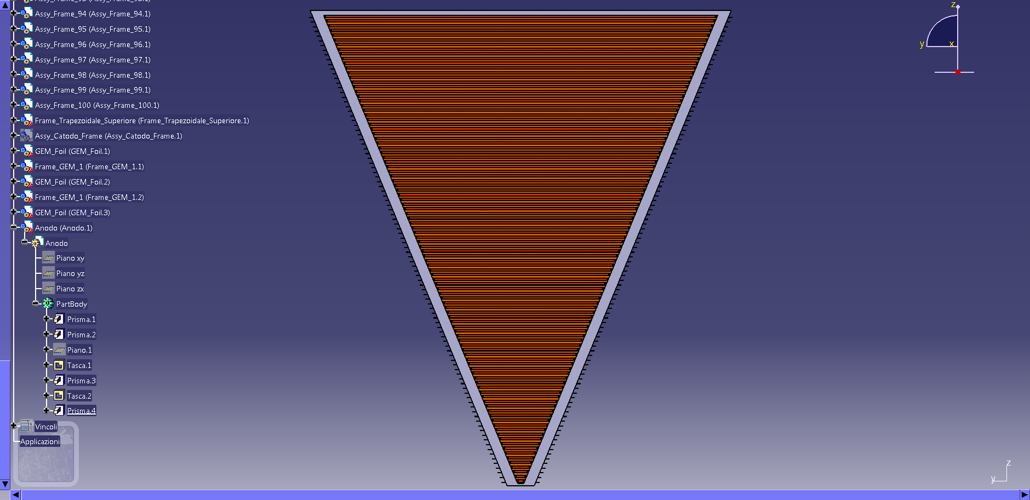
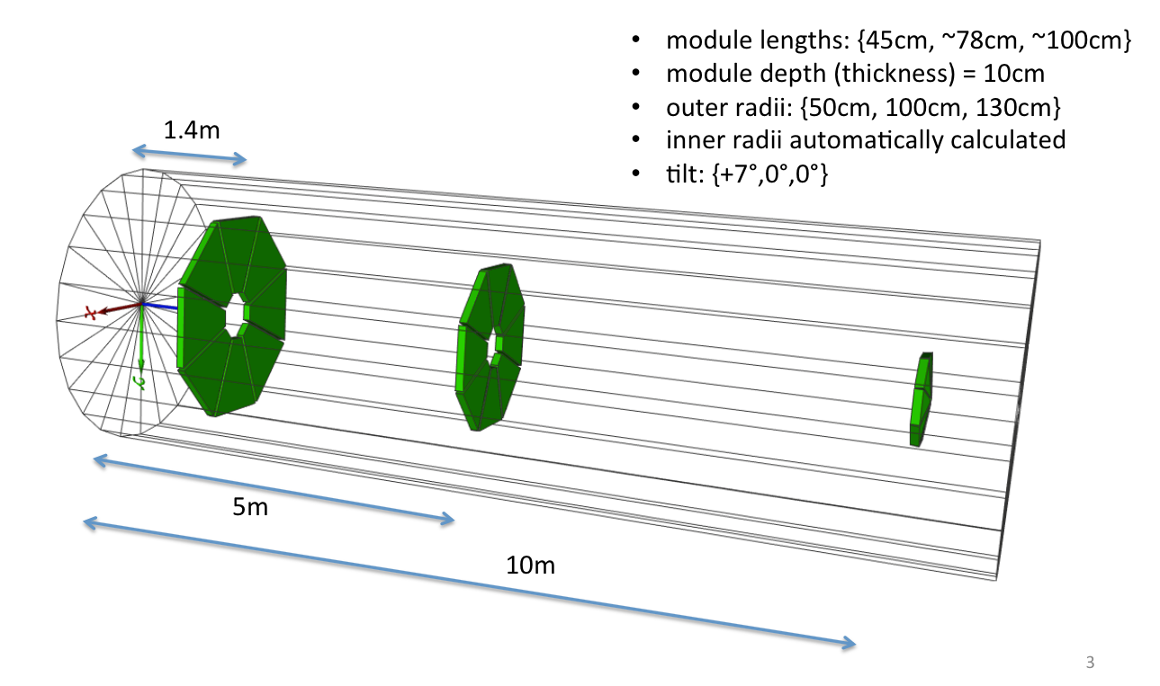
Detector Concept
337 mm
Layout subject to optimisation based on test results
Baseline layout :
400 mm
Readout anode
GEM 3
2
GEM 2
2
GEM 1
2
6
Lamellae system
96
Cathode
8

Slide 21
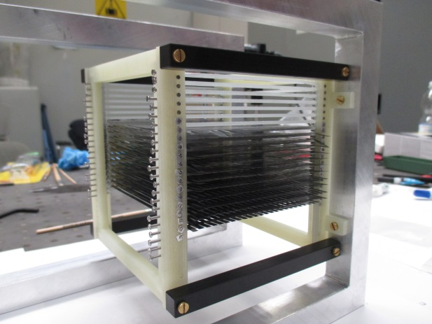
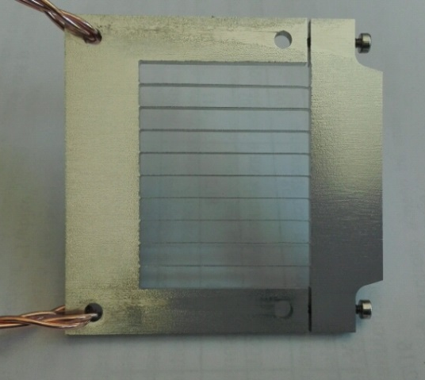
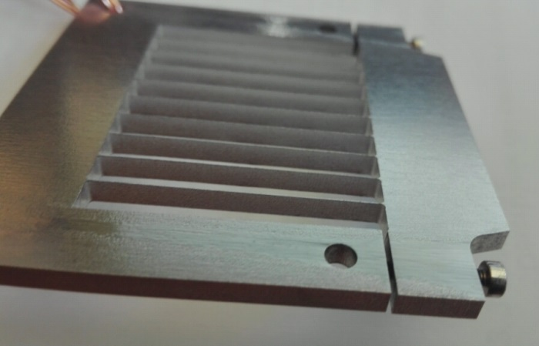
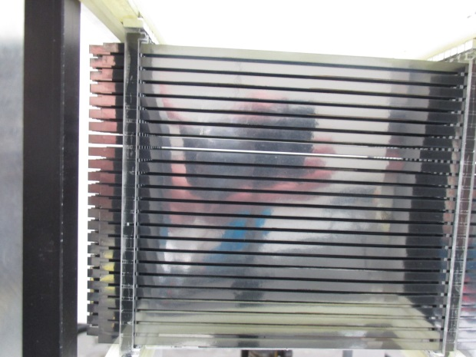
Detector Concept
1st Demonstrator module tested at ISIS.
Aim was to test electron transport and validate simulations
New water-jet cutting approach to lamellae production being tested in Milan and Linköping. Should improve assembly speed and robustness.
Will be built into demonstrator for test in October

Slide 22
Risks
Bunker
Access to key staff both ISIS and ESS
Supplier control
Communication
ISIS Prebuild Facility
Interfaces – service routing, grounding
Detector development
Clarity on ESS supplied items
Notes:
Point 1 – Discussed in cost but should point out that it is one of the top risks
Point 2 – More around science staff and continued access to integration engineer
Point 3 – Multiple beamline builds are going to place demands on our more specialised suppliers which will need to be managed and beamlines prioritised
Point 4 – This is currently very bad, slow
Point 5 – Internal risk but needs managing

Slide 23
Risks
Bunker
Access to key staff both ISIS and ESS
Supplier control
Communication
ISIS Prebuild Facility
Interfaces – service routing, grounding
Detector development
Clarity on ESS supplied items
Notes:
Point 1 – Discussed in cost but should point out that it is one of the top risks
Point 2 – More around science staff and continued access to integration engineer
Point 3 – Multiple beamline builds are going to place demands on our more specialised suppliers which will need to be managed and beamlines prioritised
Point 4 – This is currently very bad, slow
Point 5 – Internal risk but needs managing

Slide 24
Summary
We have a strong, well integrated, and enthusiastic team
We are approaching a robust design that will deliver on the science scope and work at ESS
Interaction and integration with ESS has improved significantly over the last 6 months
There are some key areas – shutter, bunker, service routing & grounding, detectors – where finalized designs or decisions are required very soon to avoid delays.

Slide 25
The Critical Path
2016
Neutronics
Bunker Decision
2017
Shielding Design
Blockhouse Concept Design
2018-beyond
Sample Stack
Installation
Detector Decision

Slide 26
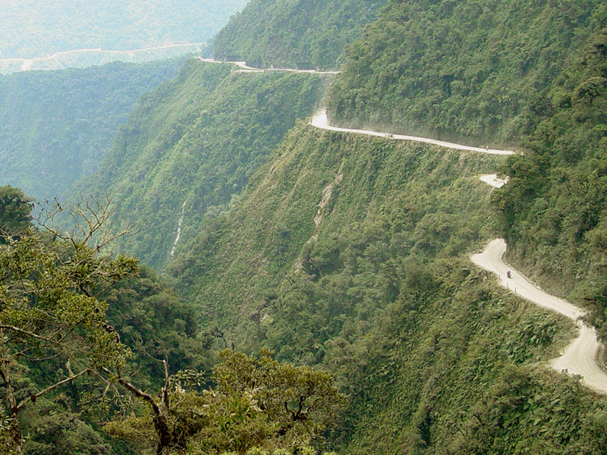
The Critical Path

Slide 27
Questions?

Slide 29
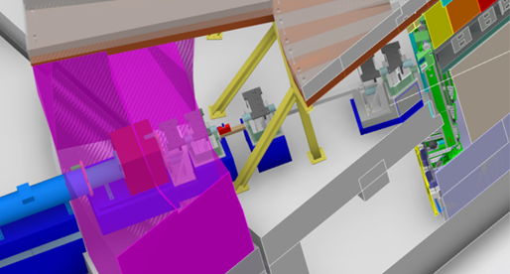
Bunker Risks
Maintenance of instruments
Installation of new instruments
Upgrades to existing instruments
Backgrounds on instruments
Radiation dose to personnel
Positioning of key components
PPS system and requirements for shutters
Down time when accessing components
Where shielding is store while instruments are opened
Alinement of components in the bunker
Realignment of components after settlement
Installation of insert
Remote handling
Validation of neutronics
Time taken to get to a solution
Multiple instrument builds phasing and running beam to target
Incurred cost of the final solution compromising any of the above or anything we have not thought of.
Notes:
Worst slide ever but I think it makes a point…….
The area that ISIS see as the main risk to delivery of both Friea and Loki in terms of time cost and quality is the bunker
Should make a point that when trying to run beam to target and install multiple instruments and having into install and uninstall the bunker shielding this is going to have a major impact on the rate of instrument construction

Slide 30
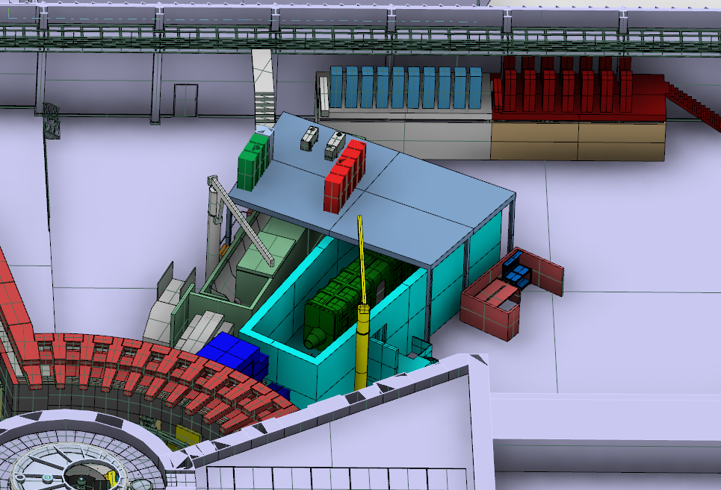
Interaction with FREIA

Slide 31
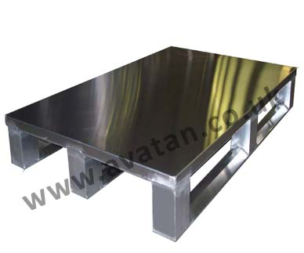
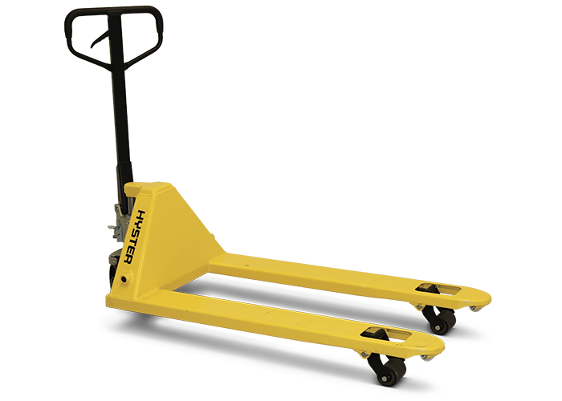
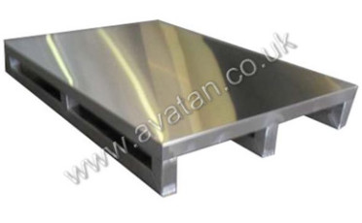
Sample Environment Pallets
Aluminium
Stainless Steel

Slide 32
ISIS Strategy
A successful ESS is strongly connected to the continued development of the ISIS facility
SANS is over subscribed, there is a business need for the instrument
ISIS wants to ensure a robust provision of neutron facilities ISIS-ILL-ESS
Opportunities for professional development of ISIS Staff

