Slide 1
D03-E01-E02 Infrastructure
Giuseppe Aprigliano
Lead Instrument Engineer NMX
www.europeanspallationsource.se
IKON 11 September 15th, 2014

Slide 2
3D Graphical Rendering

Slide 3
Summary
Halls and labs
Cranes and accessibility
Routing the infrastructure supply
Power and zones
Bunker and interface with CF
Logistics and NMX specific Infrastructure
Water distribution
Control hutches
Minutes will be taken
Question: What are the 3 main infrastructure issues currently hindering your design work (except bunker and extraction system!)

Slide 4
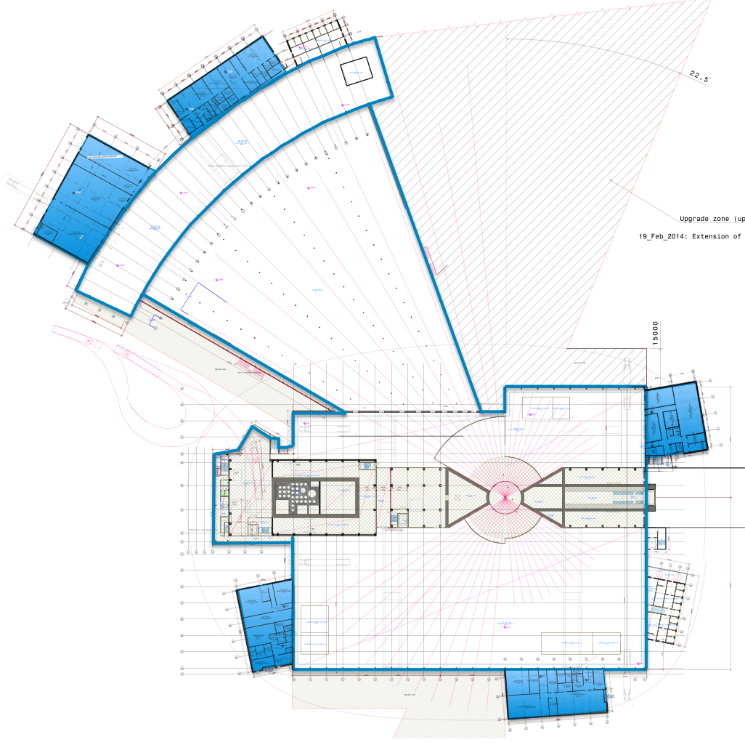
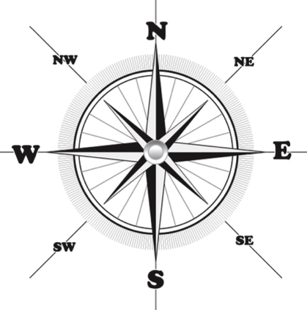
Instrument Halls and labs
Hall 1
E1 Estia
E7 Vespa
E8 Skadi
S2 Odin
S4 Dream
S11 Vor
D07
1 × LS/SCM
1 × cold room
D08
1 × Basic chemistry
N
E04
E03
Hall 2
N1 HR-NSE
N5 Freia
N7 Loki
D04
1 × LS/SCM
1 × cold room
2 × instrument room
D03
E01
D04
E02
Hall3
W1 NMX
W2 Beer
W3 C-Spec
W4 Bifrost
W5 Miracles
W6 Magic
W7 T-Rex
W8 Heimdal
E03
1 × Engineering
E04
1 × LS/SCM
1 × cold room
1 × instrument room
1 × Basic chemistry
1 × characterisation
D02
D08
Total = 14 + RML
D01
Courtesy: P.Henry
D07

Slide 5
E03
Level 100
Level 110
Slime
Optics assembly
Sample environment
Loading Bay

Slide 6
E04
Level 100
Level 110
Detectors
MCA

Slide 7
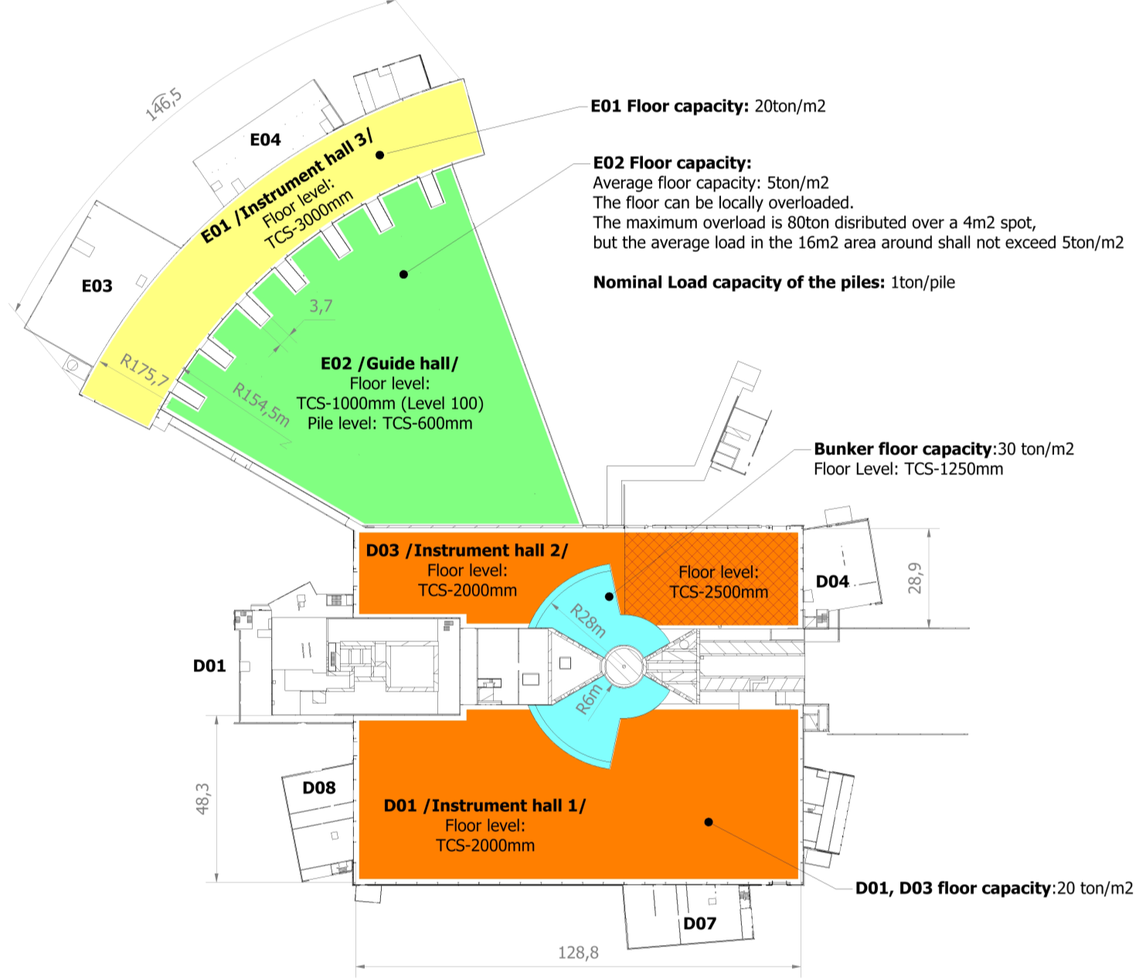
Floor capacity and floor level in D01, D03, E01, E02.
Floor settlement requirement under the instruments
The floor in the experimental halls and bunker area will due to dynamics loading have a stability for elastic movement.: 3mm
Stability for creep/deformation over the lifespan of the facility: 3mm
Notes:
Energy
Climate
Health
Agriculture
Digital society

Slide 8
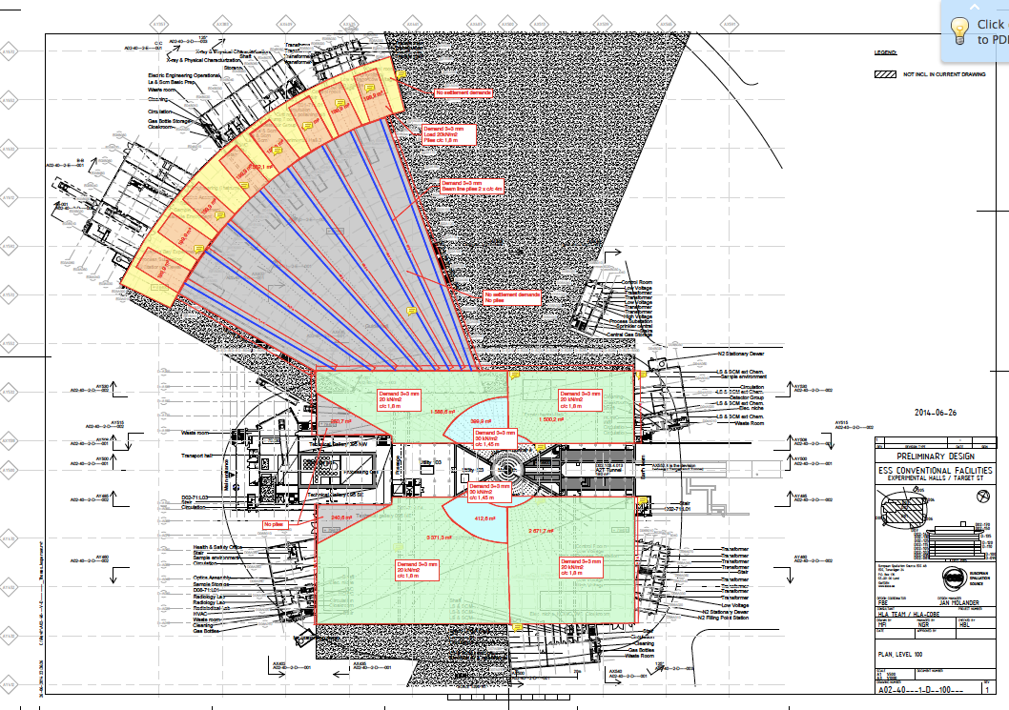
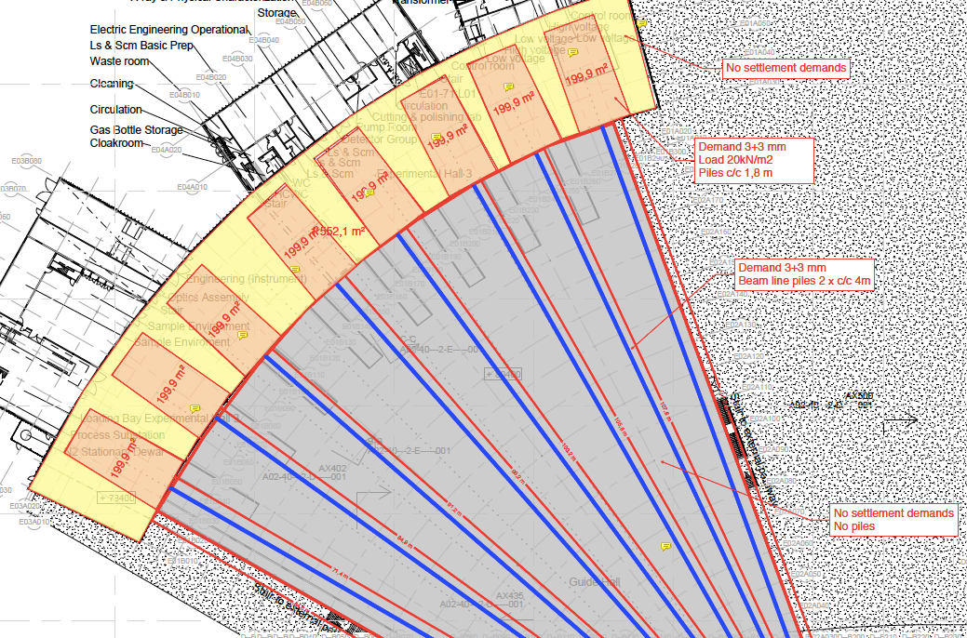
Floor capacity and floor level in D01, D03, E01, E02.

Slide 9
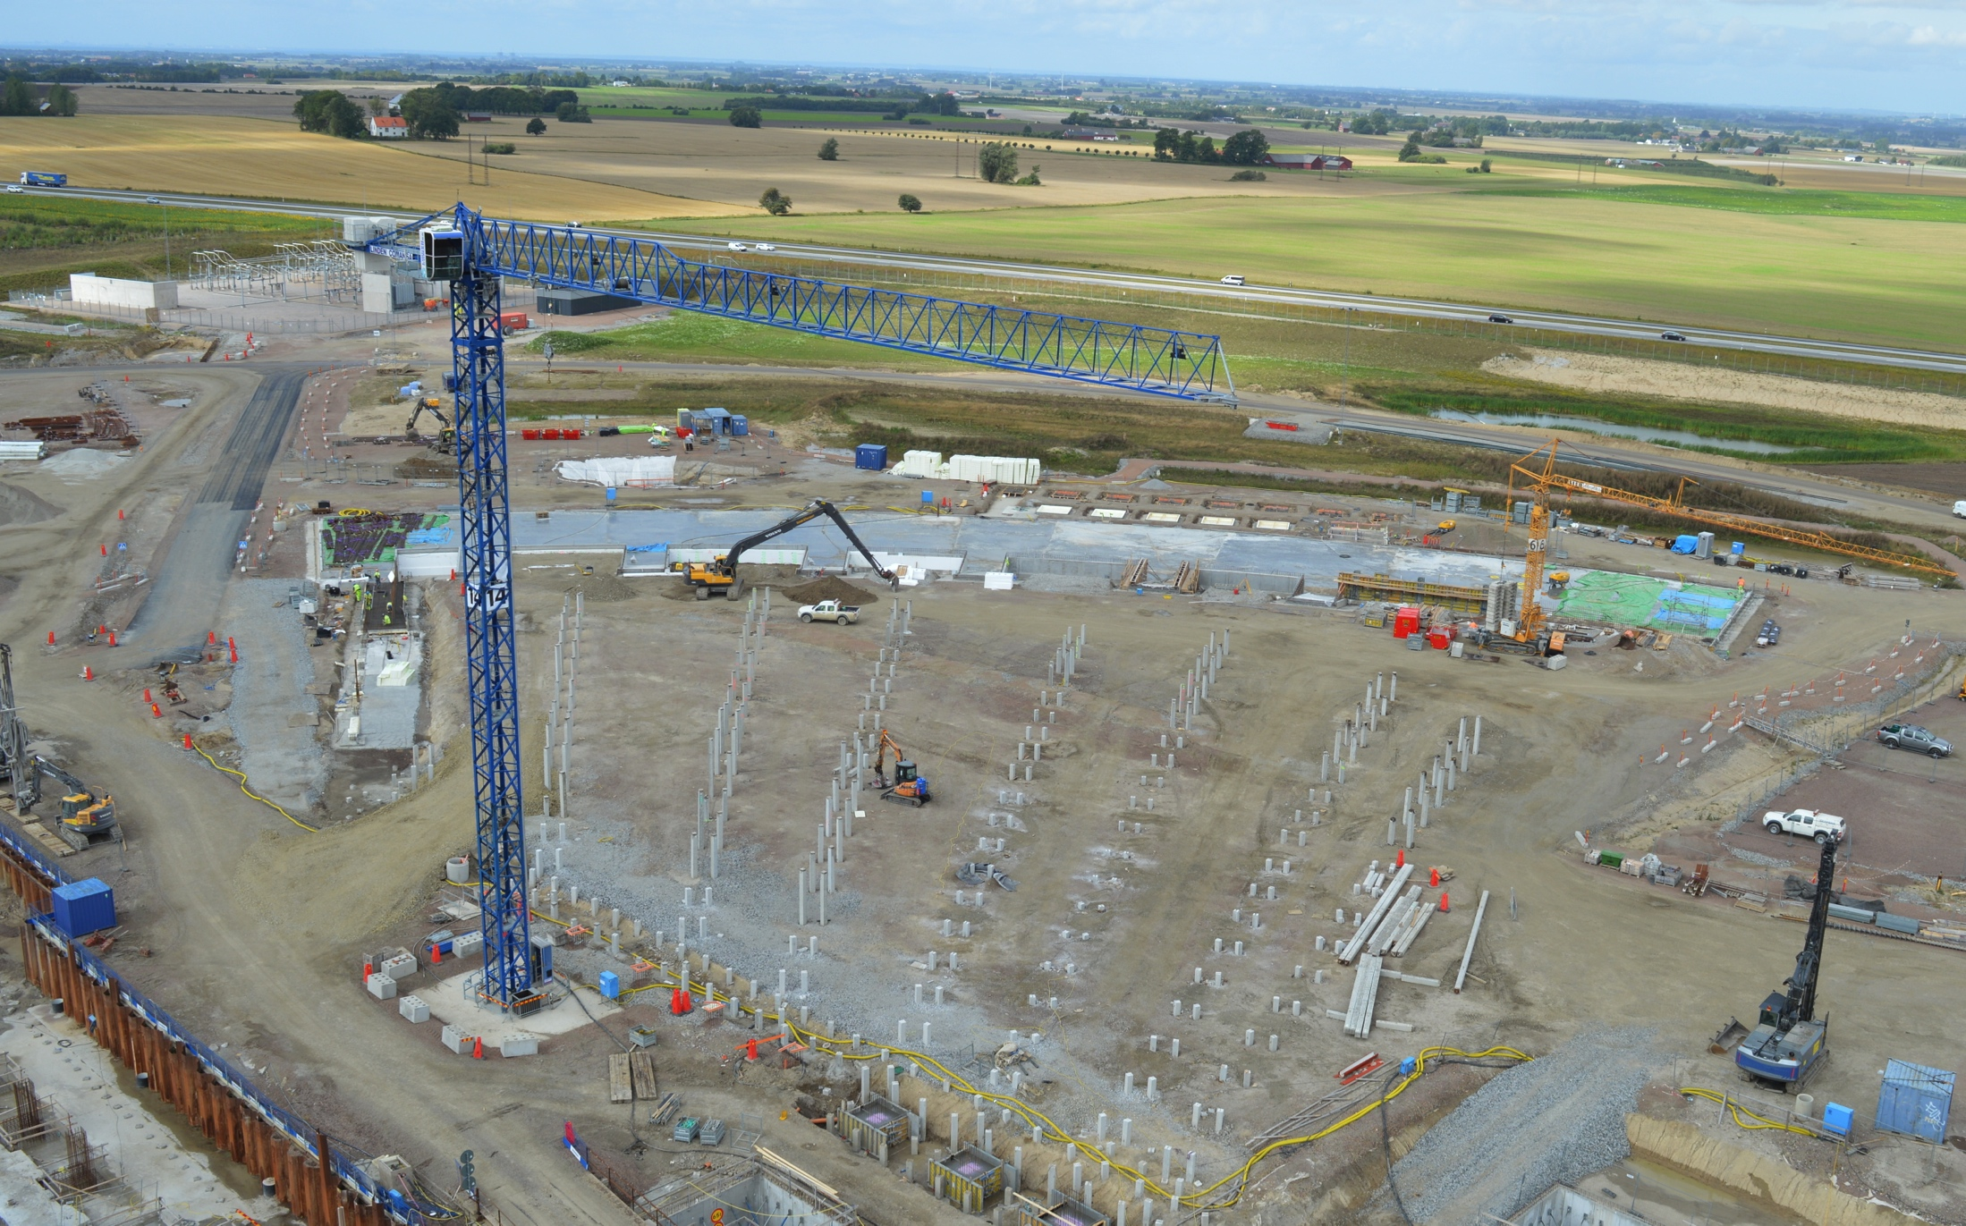
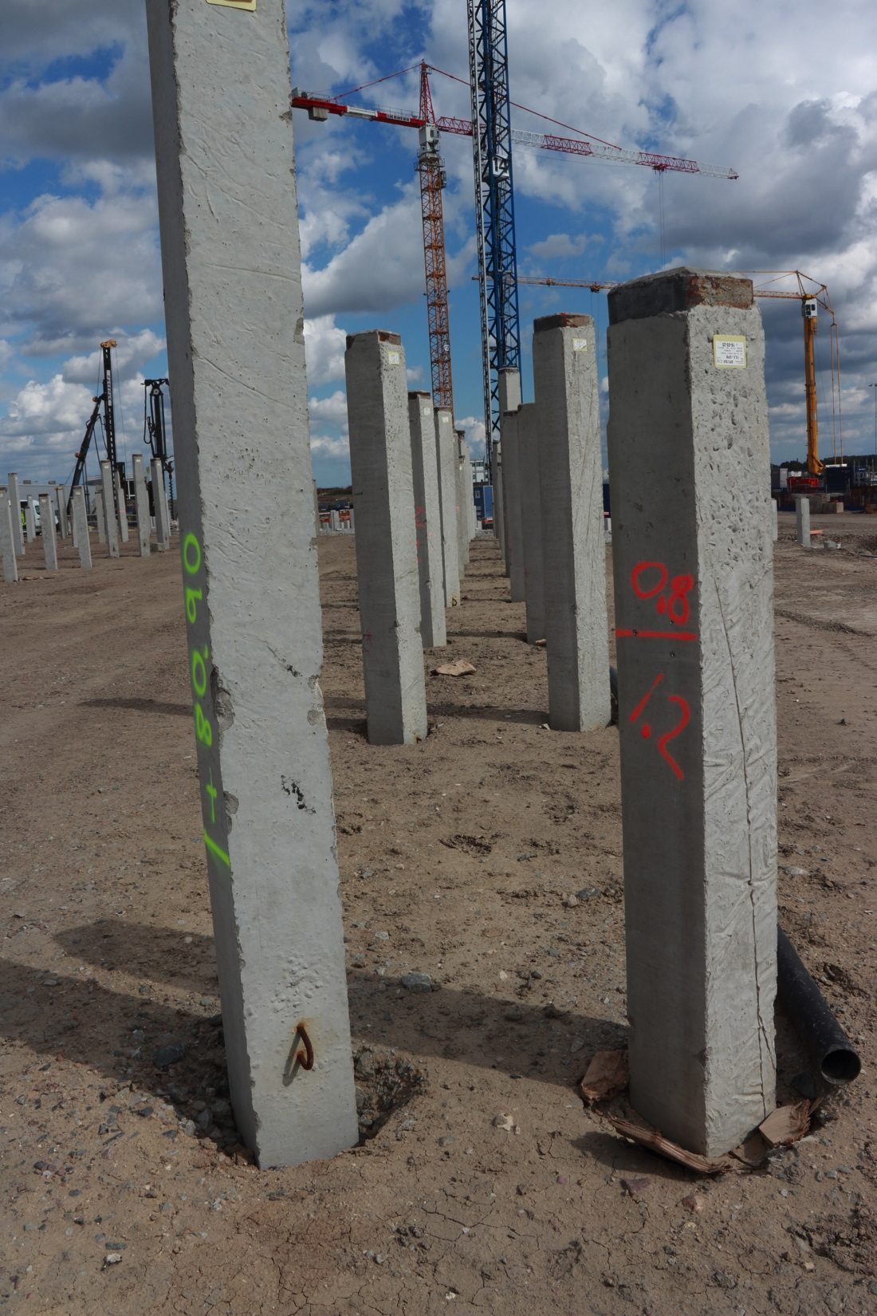
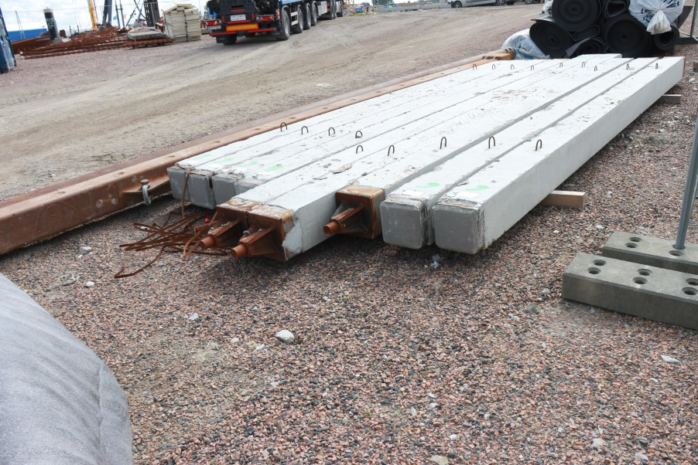
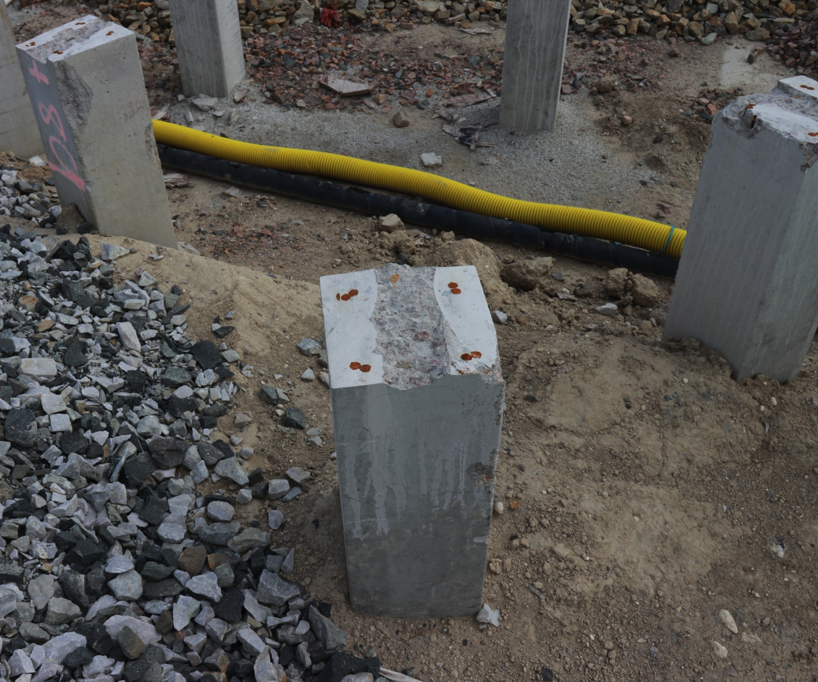
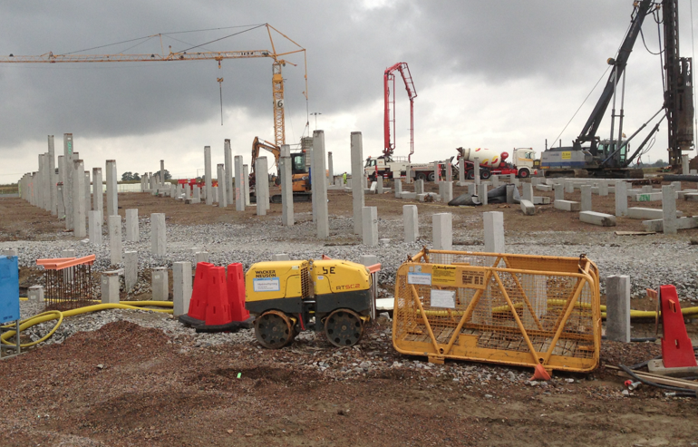
Floor capacity and floor level in D01, D03, E01, E02.

Slide 10
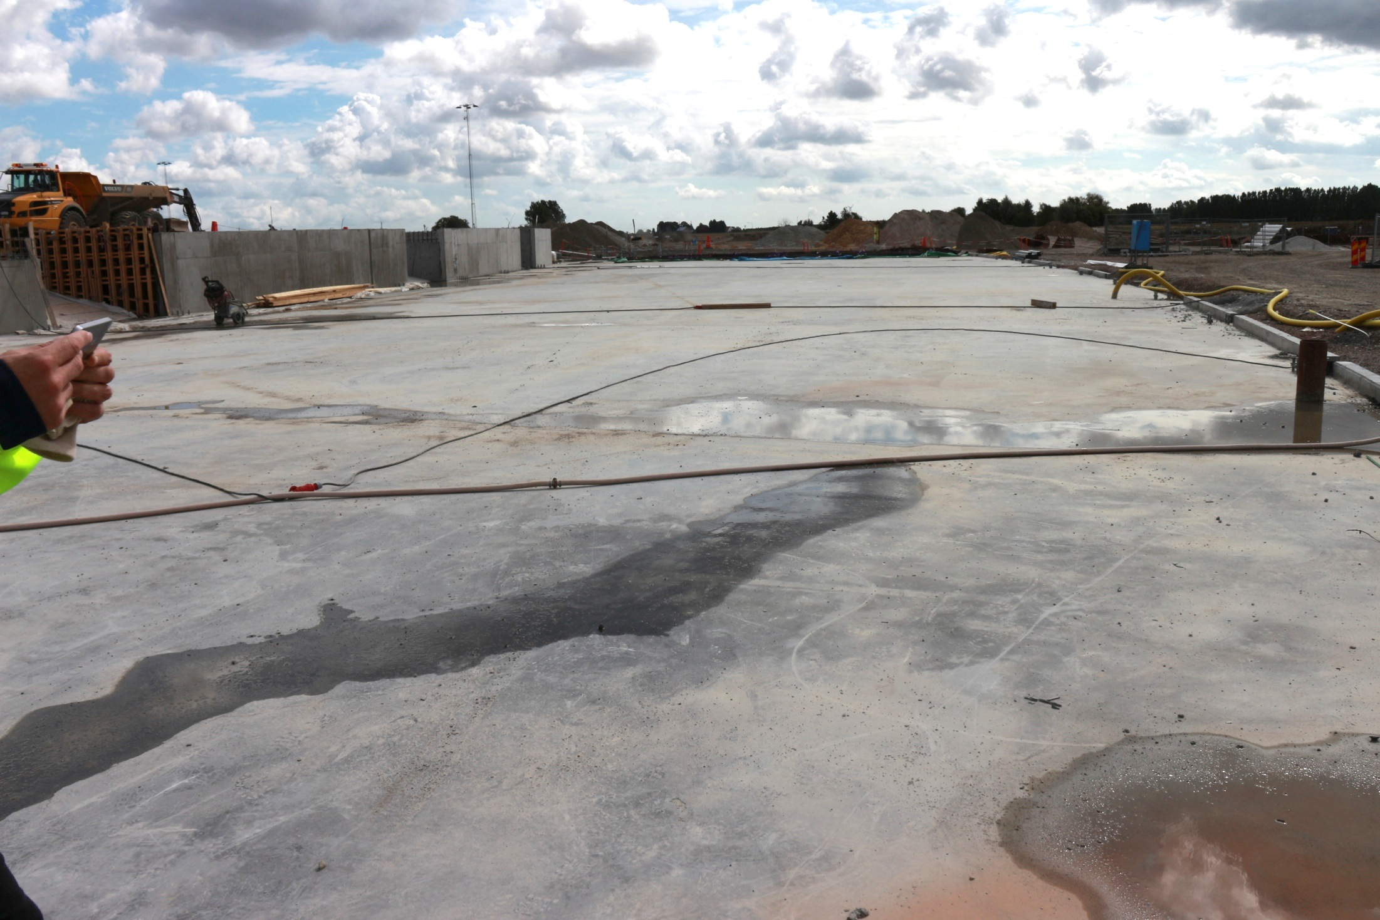
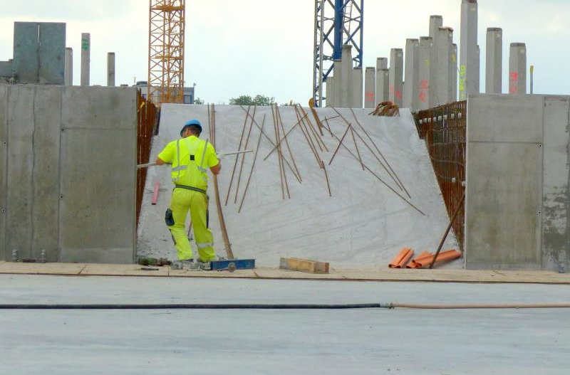
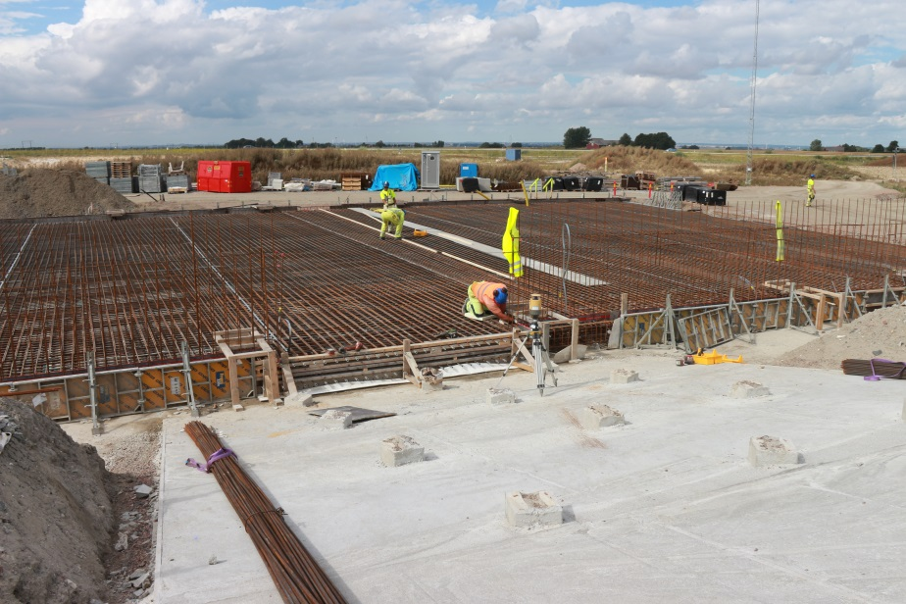
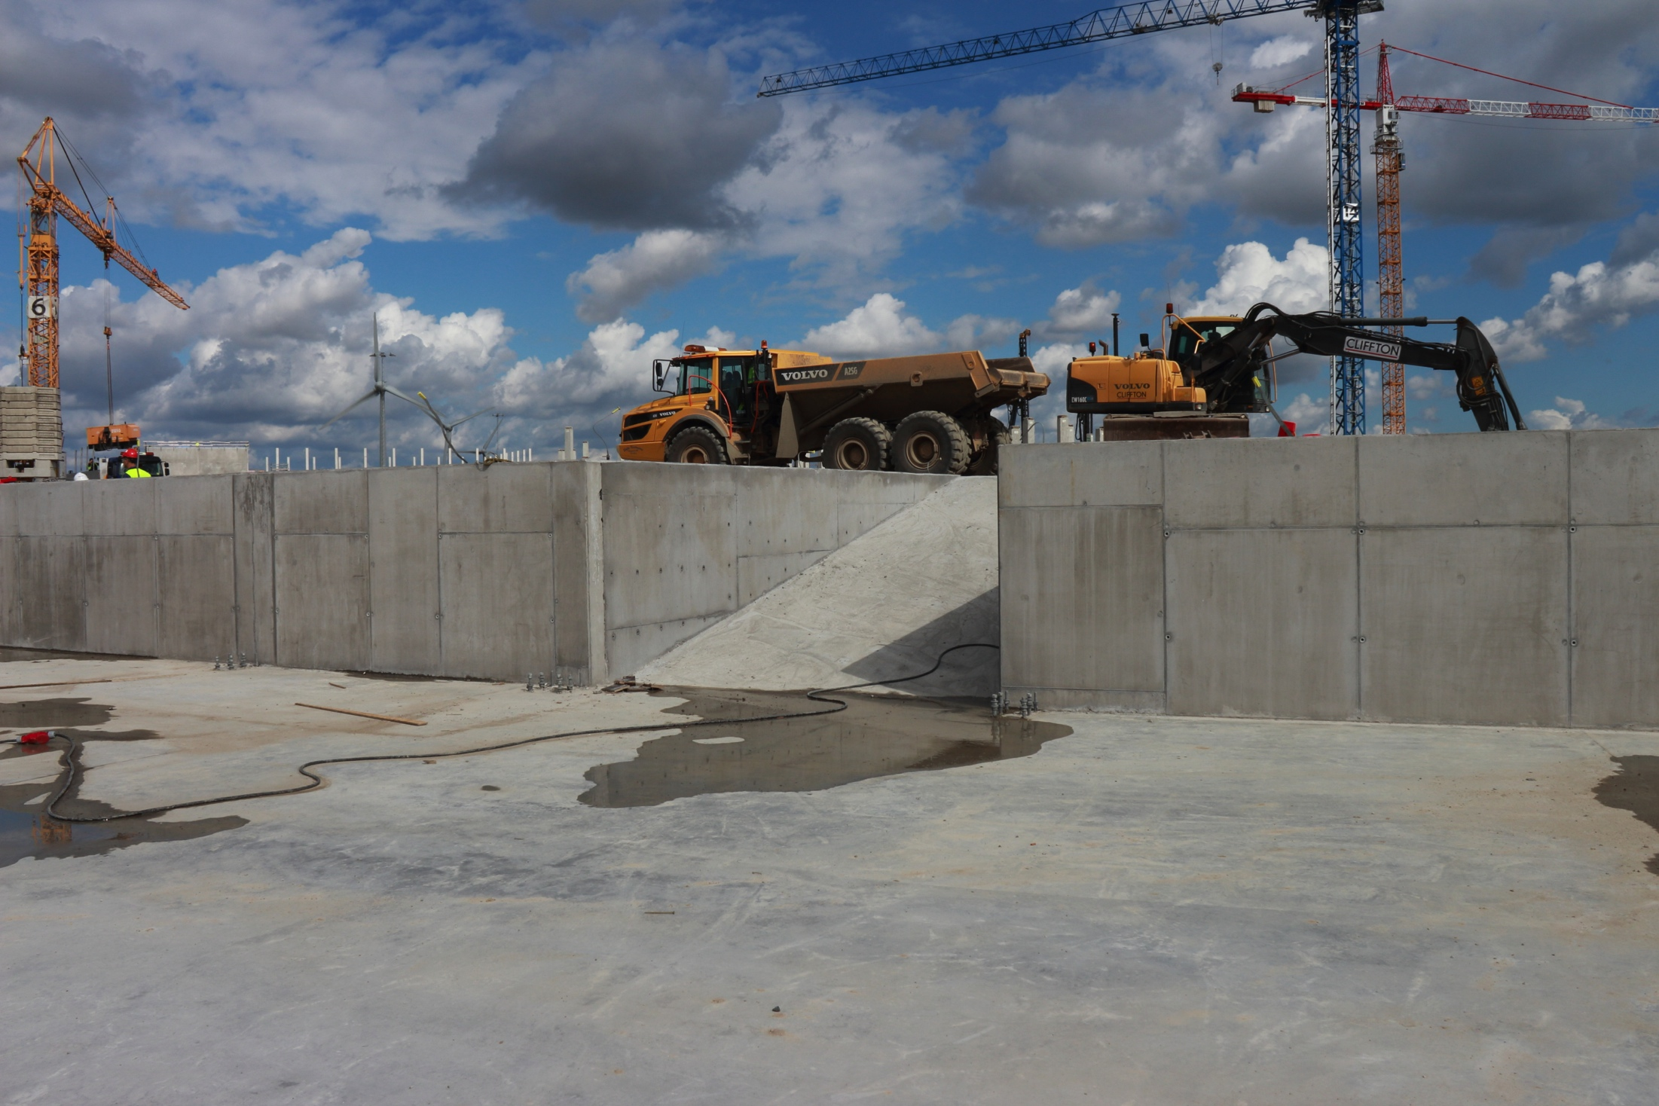
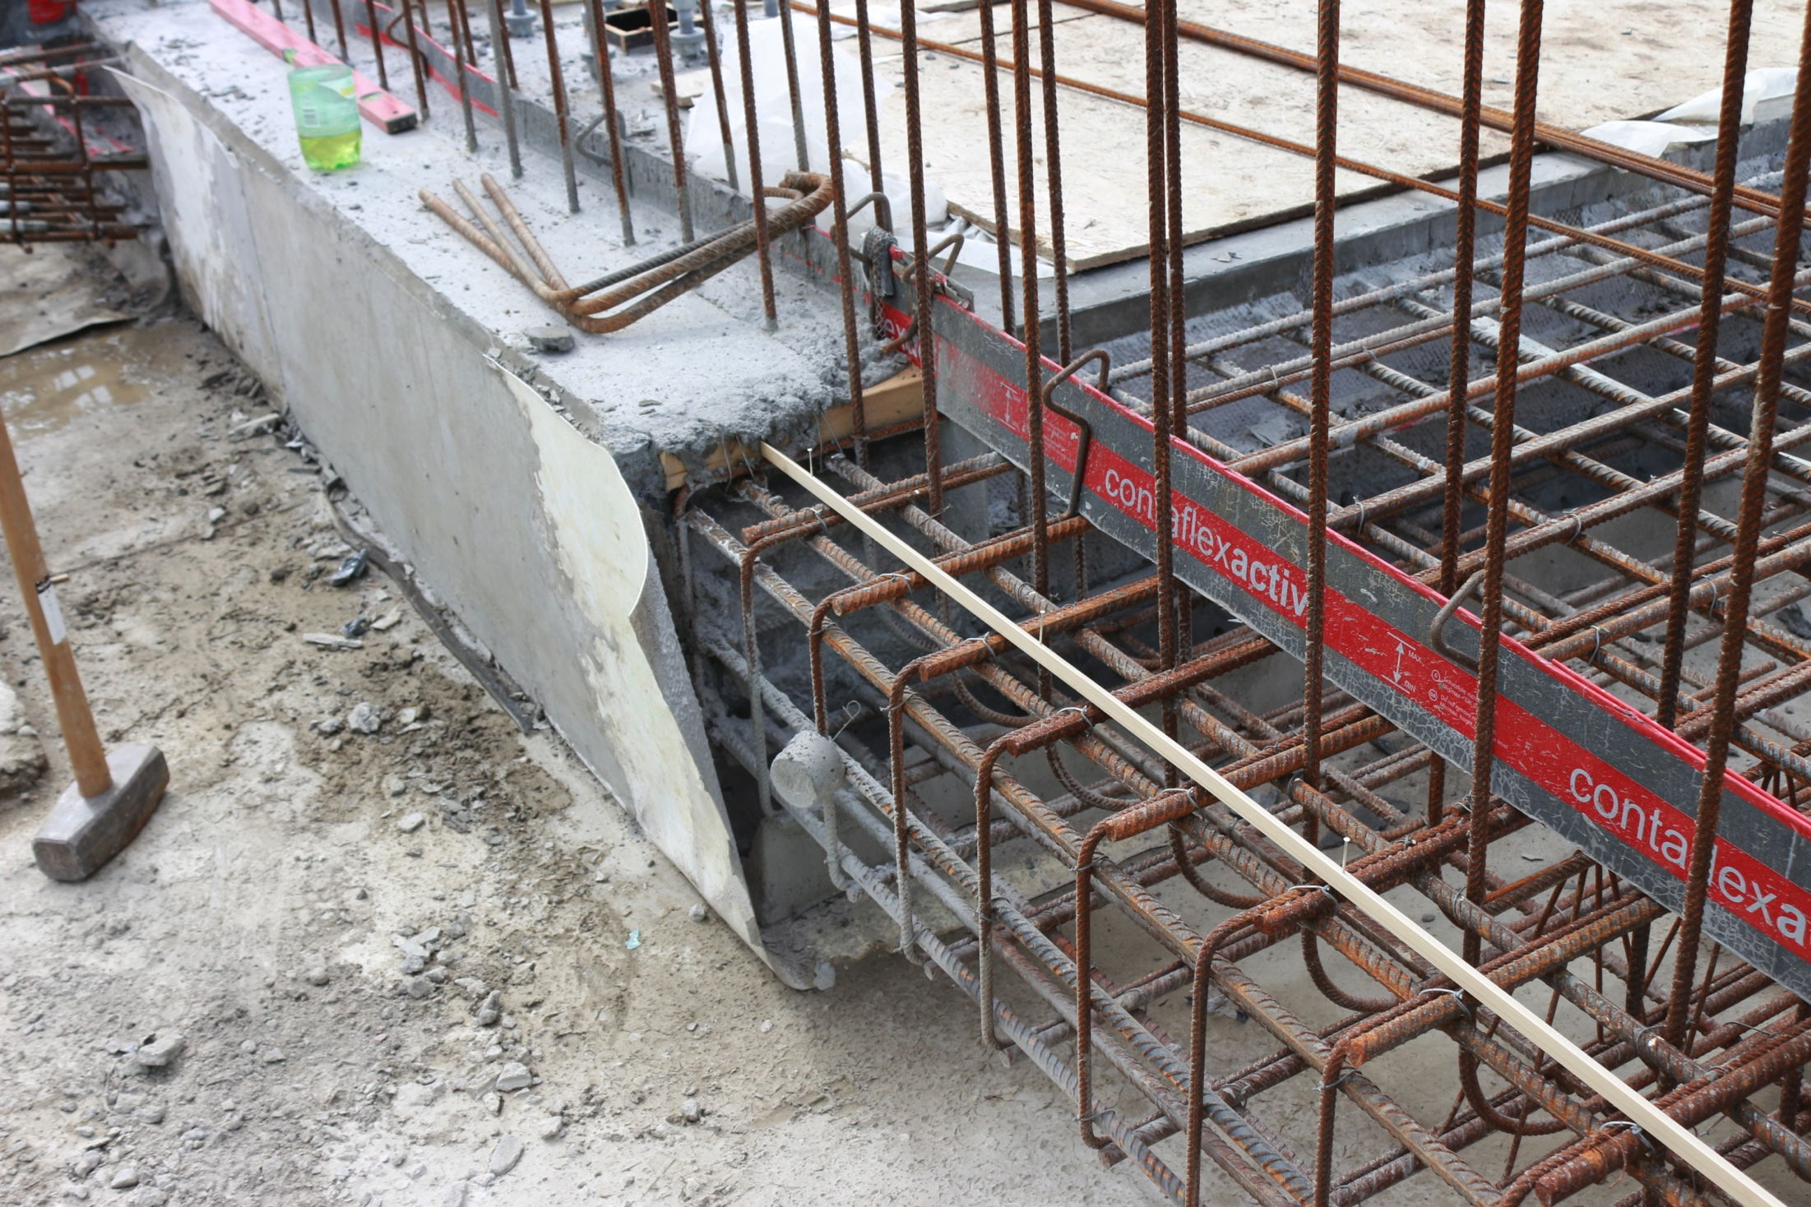
Floor capacity and floor level in D01, D03, E01, E02.

Slide 11
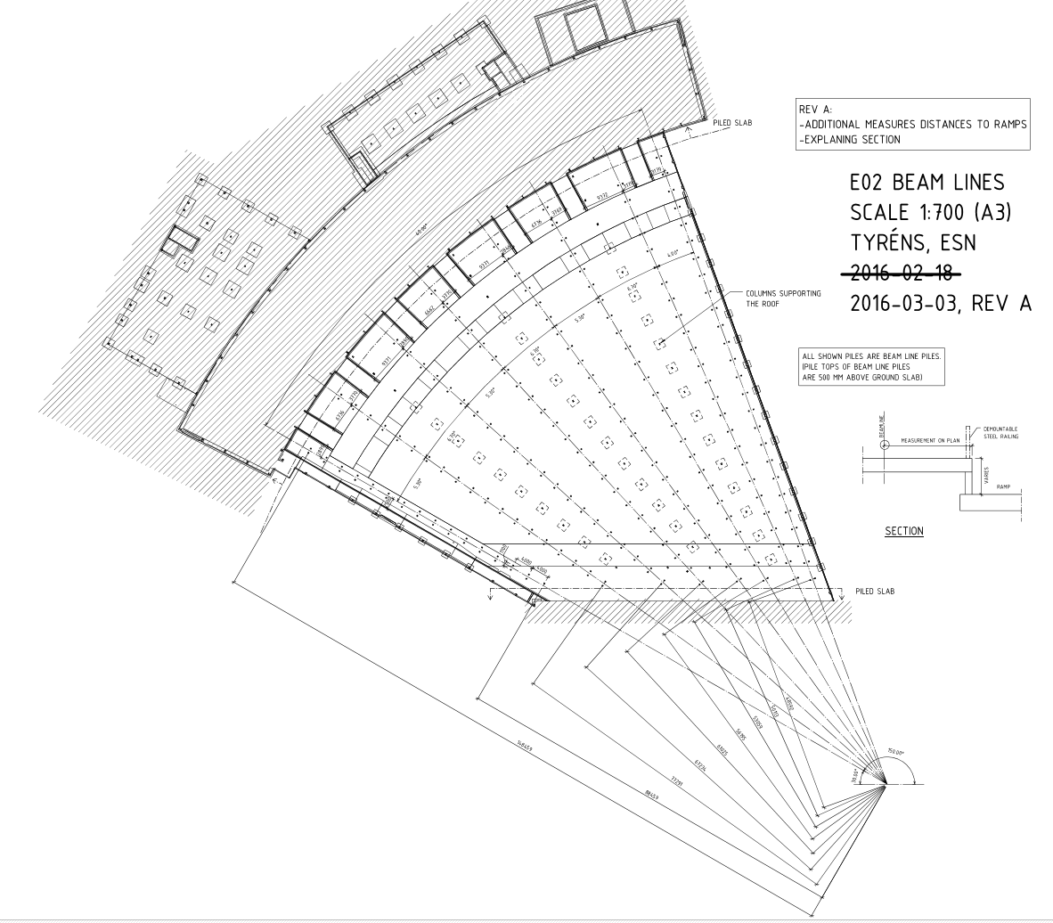
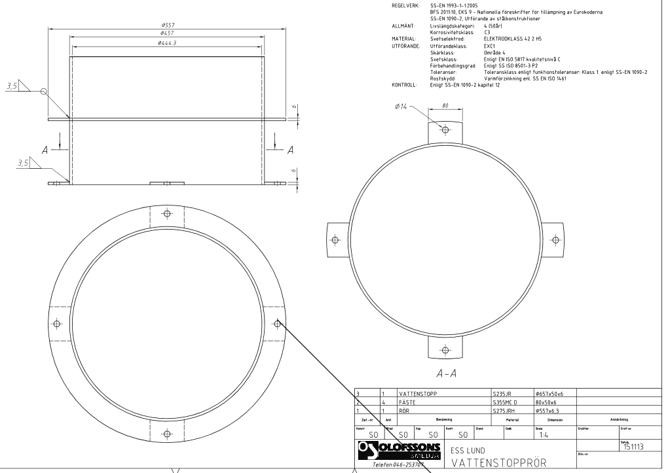
Floor capacity and floor level in D01, D03, E01, E02.

Slide 12
CWL
DWL
CWH
CMM
SPARE
SPR-D08
SPR-D03
SPR-D02
SPR-D01
NSS-CT
Maintainance access way
N2G IAR DIW
ICS/DMSC-CT
RWWS-TC
RWWS-D02
RWWS-D08
ORW
ARW
SPARE
CF CT

Slide 13
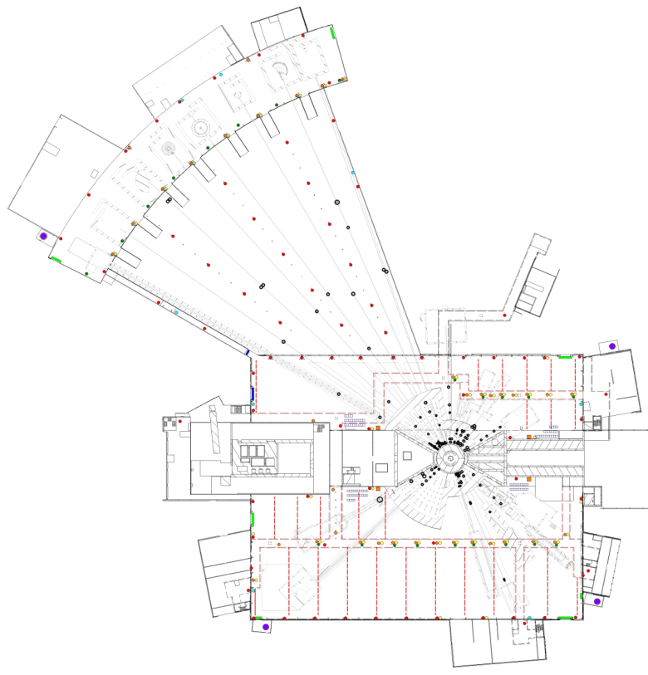
1. Nitrogen/Deionized water/Compressed Air/LAN
West sector
8 connections in E01 on the pillars+
1 at the bunker wall in D03.
No separate connection for W9-10.
Nitrogen gas (10bar)
Deionized water (8 Bar)
Compressed air (6Bar)
LAN: 2 outlets/connections
Liquid nitrogen
1 filling point / sector
North Sector
9 connections from the galery and 2 on the wall.
East and South Sector
14 connections from the galery and 7 on the wall.
Process flow chart: ESS-0046901, Layout: ESS-0046984
Courtesy: G.László
Notes:
Energy
Climate
Health
Agriculture
Digital society

Slide 14
2. Cooling water
West sector
8 connections in E01 +
3 in E02 +
1 in D03 from the galery
Properties
7Bar, 8°C
Cooling capacity / average instrument: 27kW
Bunker
Separate cooling loops for each sector provided by ESS. Connections are by the beamlines.
(1 skid/sector, dedicated pipes for each instrument)
North Sector
9 connections from the D03 galery.
East and South Sector (D01)
17 connections from the galery.
Process flow chart: ESS-0046901, Layout: ESS-0046984
Courtesy: G.László

Slide 15
3. Fume hoods and exhaust pipes for sample environments
West sector
8 connections in E01
North Sector
5 connections from the D03 galery.
East and South Sector (D01)
8 connections from the galery.
ESS-0056058, ESS-0048000, Layout: ESS-0046984
Courtesy: G.László

Slide 16
4. Tap and waste water
West sector
2 water connections in E01 on the wall +
2 in E02 on the wall + 1 in D03 on the wall
2 drains to risk water system in E01
1 drain to radiological waste water system in E02
North Sector
1 water connection in D03 on the wall
1 drain to risk water system in D03
East and South Sector (D01)
2 water connections in D01 on the wall
4 drains to risk water system in E01
Process flow chart: ESS-0046901, Layout: ESS-0055781, ESS-0055780, ESS-0046984
Courtesy: G.László

Slide 17
5. CF Power outlets
West sector
10 connections in E01 +
19 in E02 +
10 in D03
(Maximum distance : 18m)
Utilities power for installation and maintenance:
3pcs. 16A 1-phase outlets
1pcs. 16A 3-phase outlet
1pcs. 32A 3-phase outlet
North Sector
1 connection from the galery and 7 on the wall.
East and South Sector (D01)
2 connections from the galery and 20 on the wall.
Layout: ESS-0046984
Courtesy: G.László

Slide 18
6. Instrument Power distribution Concept
The design will be provided by ESS, the installation and material cost will be paid by the instruments. The design will be finalized according to the instrument designs.
There will be no central UPS system
The power distribution network will be planned according to our grounding rules.
All the missing insulation rules and solutions will be defined ASAP
36
15
Cave /Main zone/
There will be connection points similarly placed as the Sample environment connections
Bunker:
The bunker is a unified zone. There will be four distribution panels by D02 walls for the four sectors.
38
ESS Power and Grounding: ESS-0051373 (Not released)
Courtesy: G.László

Slide 19
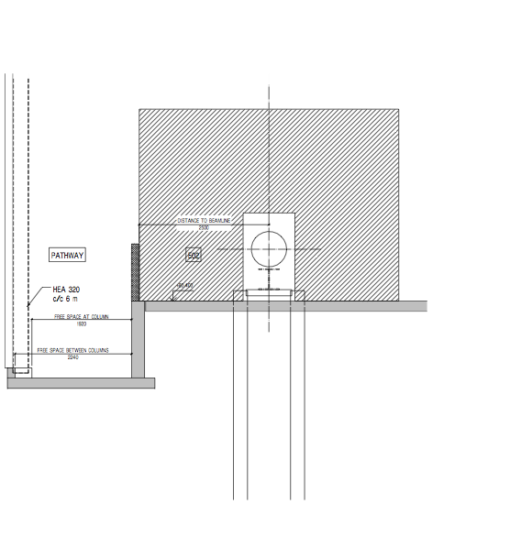
Passage between E01 to D03

Slide 20
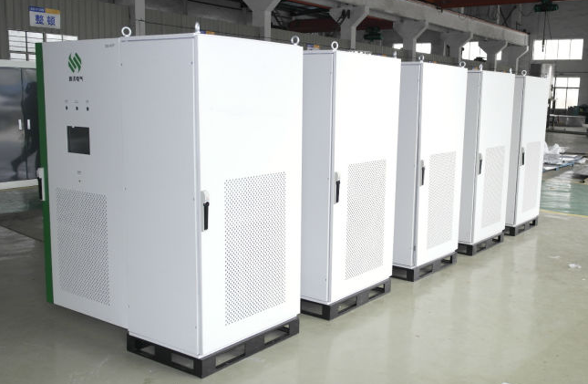
6. Cabinet placement Concept
Constrains on cabinet placement:
Cable length limitations
Floorspace
Distance from sensitive components
Blocking of trafic routes including cranes
The cabinets should be outide of the shielding
Bunker:
We are planning to have cabinet arrays for each sector in order to minimize the cable lengths. The cabinets will be connected to the power distribution panel of the bunker sector. Also they will be connected to a common ICS router.
Courtesy: G.László

Slide 21
6. Instrument Power distribution Concept
CF responsibity CF budget
Substation
NSS responsibity, Instrument budget
Galery/Halls
Bunker distribution panel
/Bunker zone/
Instrument distribution panel
/Main grounding zone./
Instrument distribution panel
/Grounding zone X/
NSS responsibity, NSS budget
Light
Motion
SAD
Detector
...
Lights
Chopper
Vacuum
Instrument 1
Instrument 2
Instrument 3
Instrument 4
Motion
...
Instrument X
Courtesy: G.László

Slide 22
7. ICS/DMSC Concept
ICS/DMSC network will be provided by ESS. The network design will be finalized according to the instrument designs.
Courtesy: G.László

Slide 23
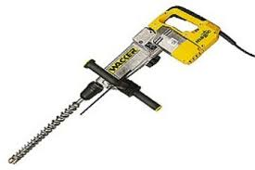
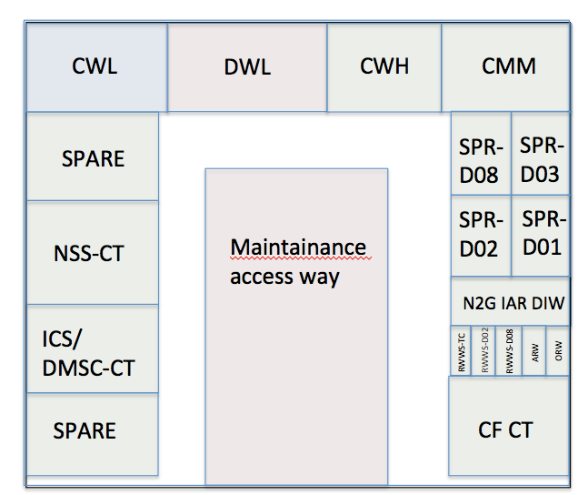
Routing of the infrastructure
A-A

Slide 24
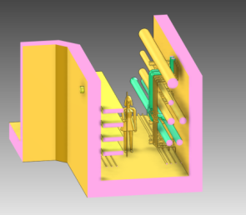
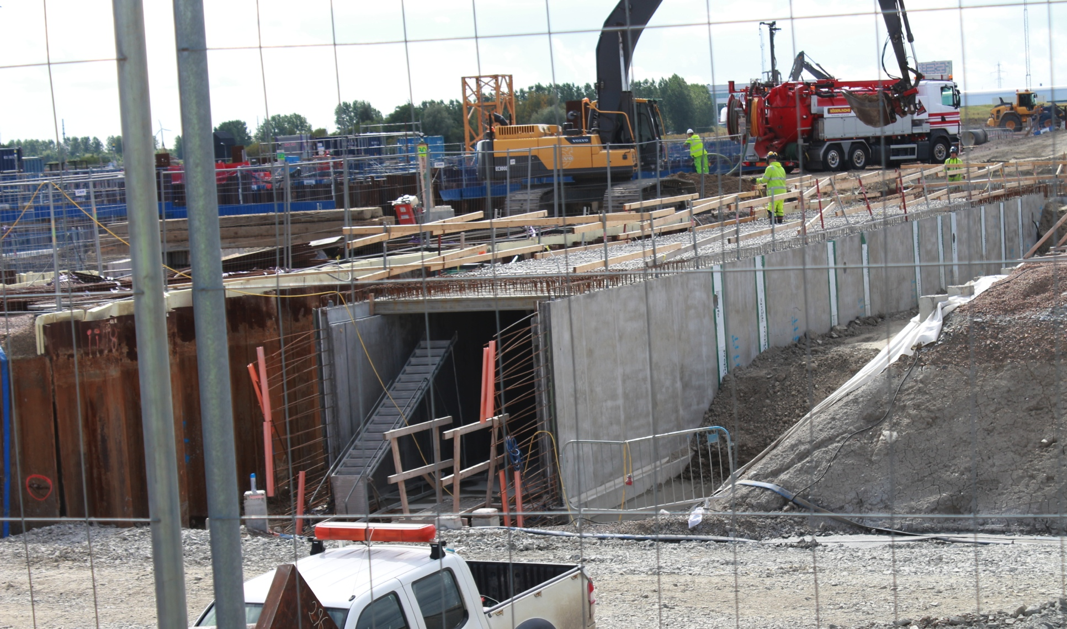
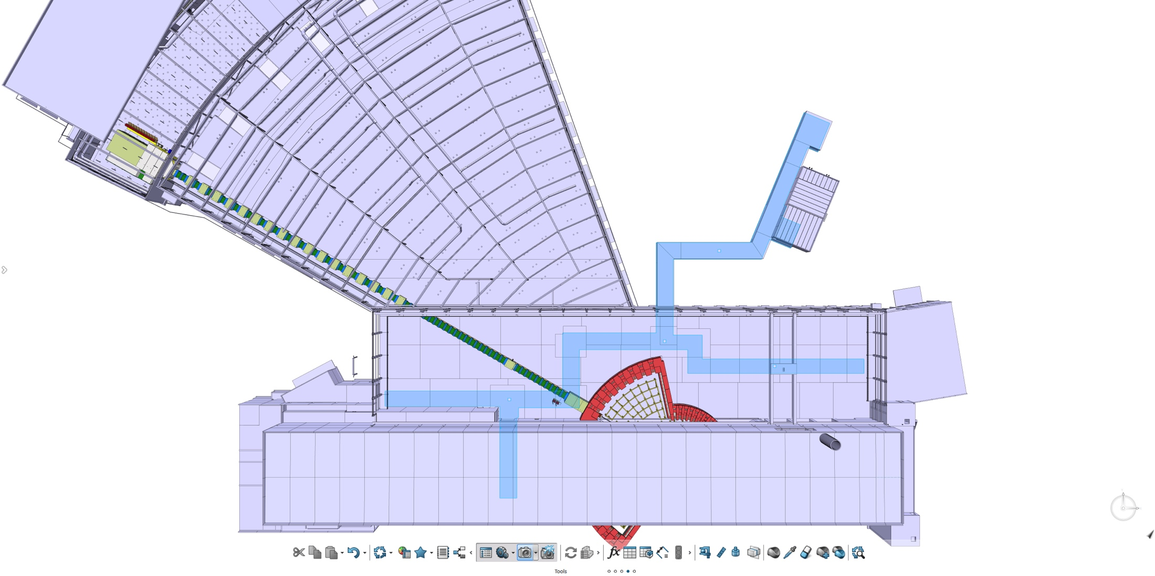
Routing of the infrastructure

Slide 25
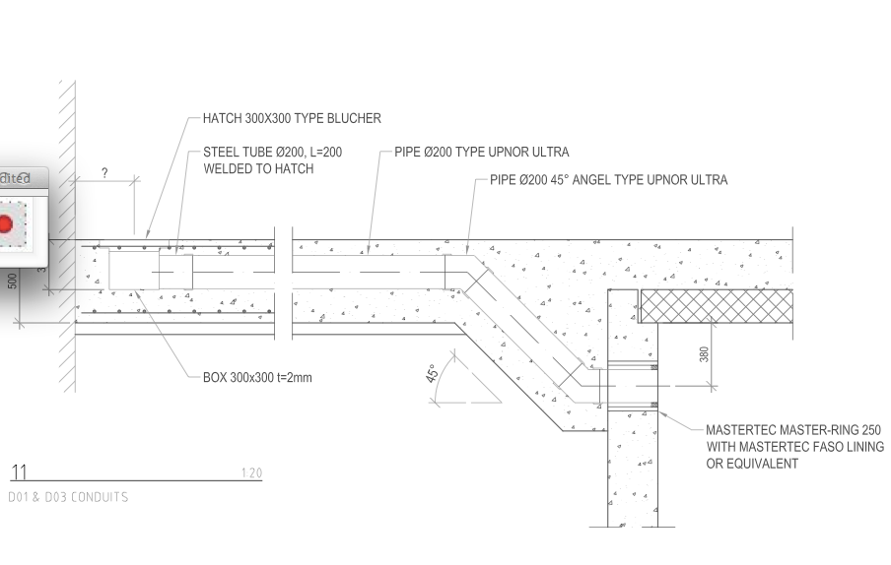
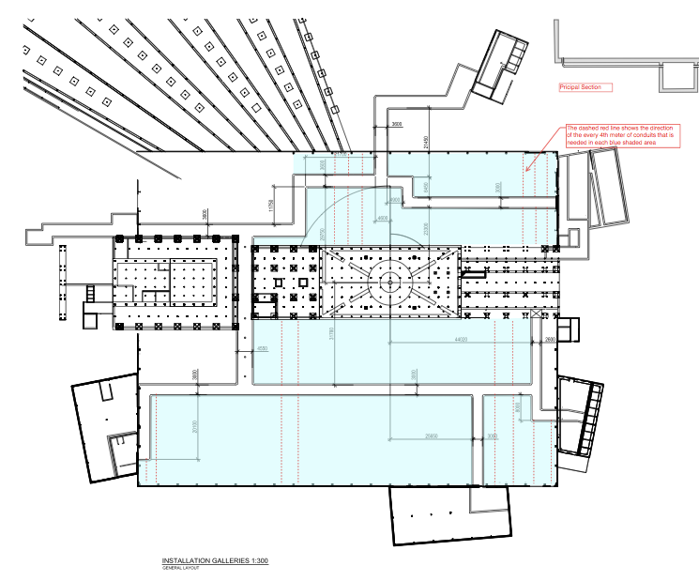
Routing of the infrastructure

Slide 26
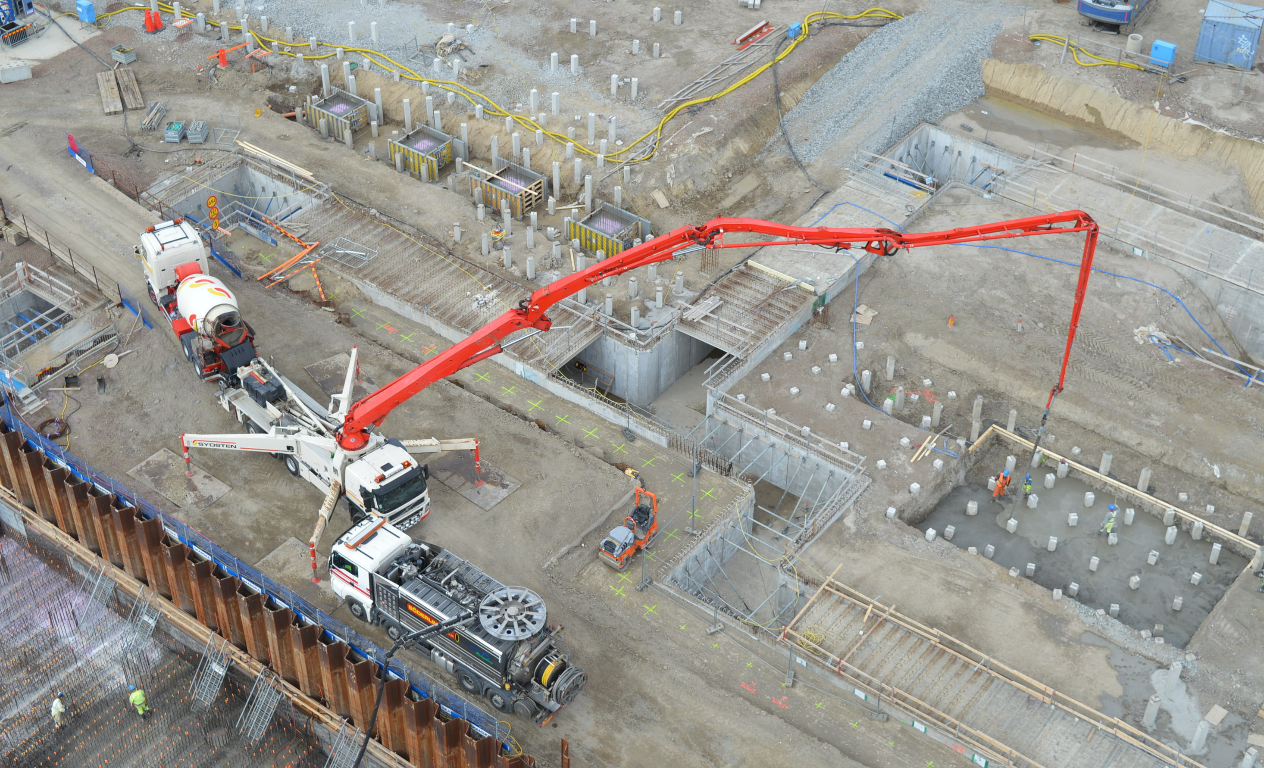
Routing of the infrastructure

Slide 27
8. Additional infrastructure
Air conditioning
Average temperature 22.0 ±2.0°C , No humidity requirement. No cooling only a ventilation system and heating.
Argon gas (Cylinder)
Helium gas(Cylinder)
3 spare gas lines in the galleries
Liquid Helium (Dewar)
Liquefier and recovery (up to the collection point in the gallery)
Air conditioning: ESS-0056058, ESS-0048000
Courtesy: G.László

Slide 28
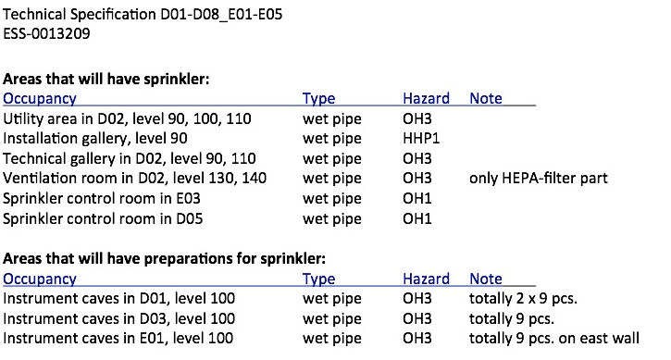
8. Additional infrastructure
Sprinklers
Courtesy: G.László

Slide 29
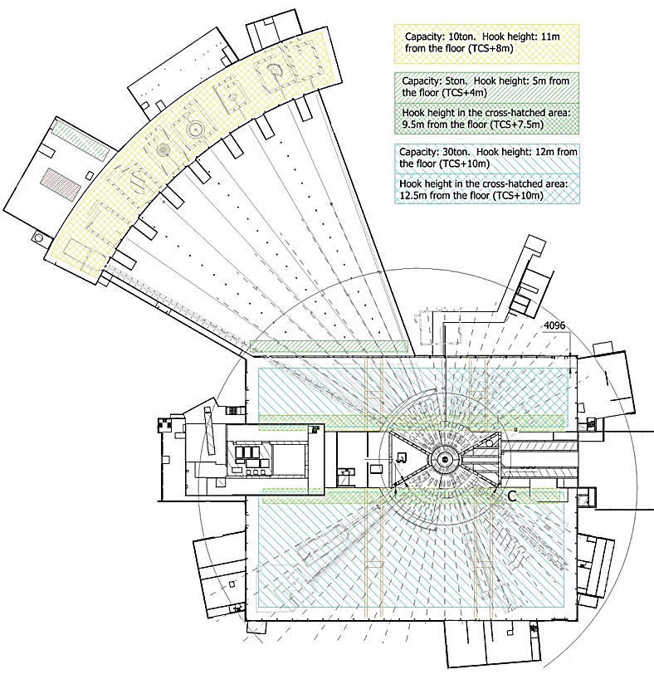
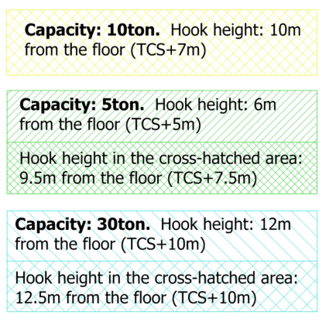
8. Cranes
There will be mobile gantry cranes in E02 with 10ton capacity
Gap 3315mm
D01 : ESS-0055303 (5ton), ESS-0055308 (7.5ton), ESS-0055305 (30ton)
D03 : ESS-0055307 (5ton), ESS-0055304 (7.5ton), ESS-0055306 (30ton)
E01 : ESS-0052338 (10ton)
E02 : ESS-0052339 (5ton)
E03, E04: ESS-0048477 (5/15 ton)
Mobile crane (preliminary): https://ess-ics.atlassian.net/wiki/display/SPD/Mobile+Cranes+in+E02
Courtesy: G.László

Slide 30
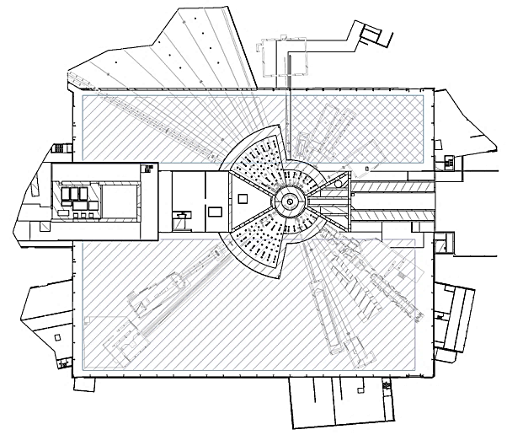
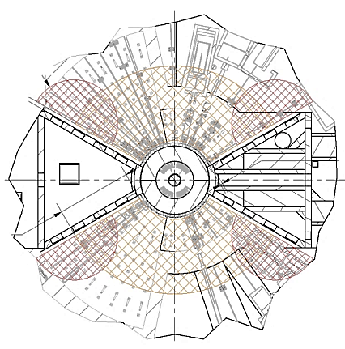
9. Cranes
Courtesy: G.László

Slide 31
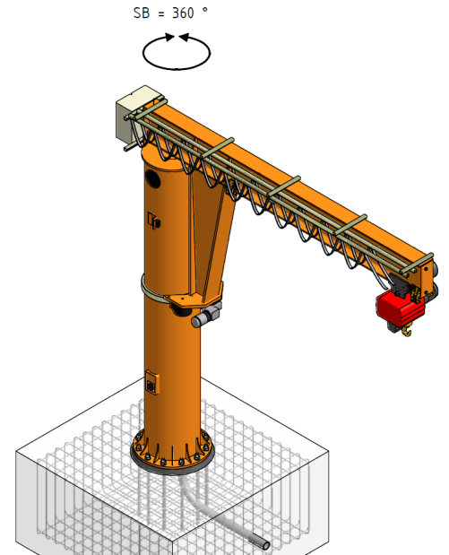
9. Cranes
CF has approved the mounting of the Lo-Ki Crane to D03 floor.
Arm length: 7m
Capacity: 1500kg.
LoKi Crane
Courtesy: G.László

Slide 32
Bunker and Interfaces with CF

Slide 33
Bunker and Interfaces with CF
Dilatation joint

Slide 34
Transition D03 – E02
Bunker and Interfaces with CF

Slide 35
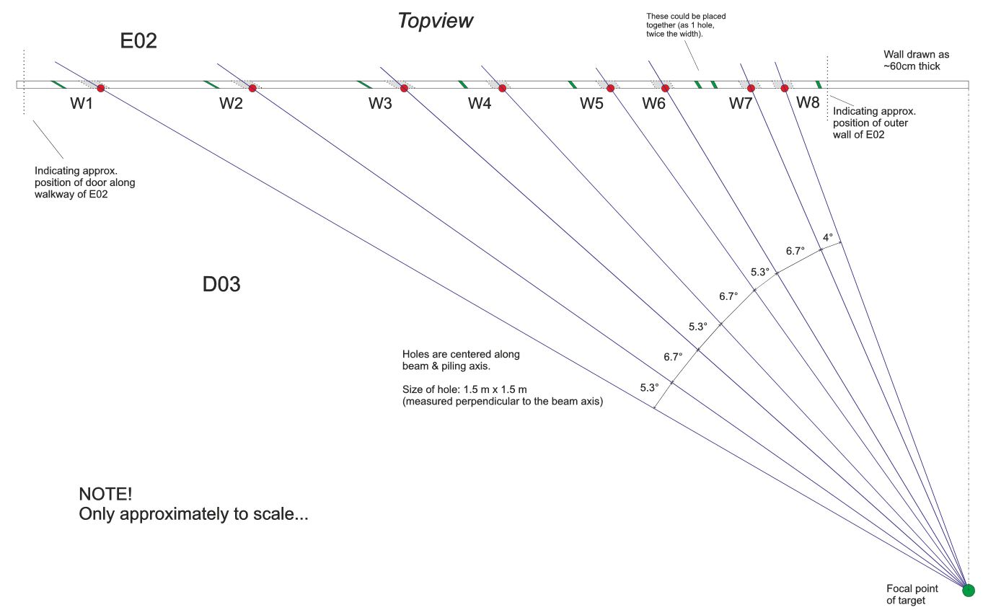
Bunker and Interfaces with CF
1.5x1.5 m² hole for instrument shielding
D=200mm penetration for cables and media

Slide 36
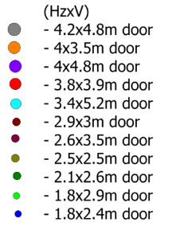
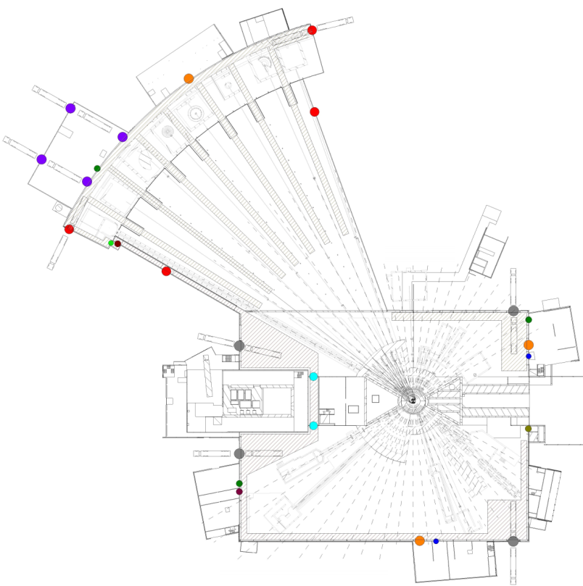
9. Considerations for logistics inside the halls
General logistics: planning of logistics has started, comments are welcome:
https://ess-ics.atlassian.net/wiki/display/SPD/Logistics+in+D01%2C+D03%2C+E01%2C+E02
Crane logistics: Not analyzed in detail
Shielding logistics: Not analyzed in detail
Logistics for vehicle and personal traffic: Not analyzed in detail (,but)
Courtesy: G.László

Slide 37
Logistics and NMX Specific infrastructure
Considerations for free path between the instruments and the building wall
Fire Safety path width: 0.9m
Size of vehicles: Truck (not oversized): 2.55m, 10 Ton forklift: 2.25 m.
Trucks will have dedicated loading areas at the bay doors. From these spots the goods will be transferred by forklifts or cranes.
Number and size of lanes (Free path rules)
Strategy: Every instrument sample area has to be accessible by a 10Ton forklift with a maximum distance of 2m.
There should be a possibility at every 60m where forklifts are able to overtake each other with proper visibility conditions. (Minimum width: 2.3m+2.3m+0.9m=5.5m, minimum length: 3x5.5m=16.5m).
There should be a possibility at every 60m where forklifts can turn around /Right Angle Stacking Aisle/: width: 6.5m, length: 5m.
One lane passages are possible between this places with a width of the maximum object size (see 4.): 3.6m.
There is an option for narrow passage if both side of the place can be approached by a truck. The width of the passage should be the width of a forklift plus 0.4m (2.7m). If there is a necessity for changing direction after the narrow passage (e.g.: corner of the building) the forklift should be able to turn safely: Length (loaded) 6m, Turning radius(outside): 3.9m.
In case of the above-mentioned options the possible maneuvers has to be considered.
Maximum width of transported objects: door width-0.1m=3.6m
Landing and transfer spots has to be also considered

Slide 38
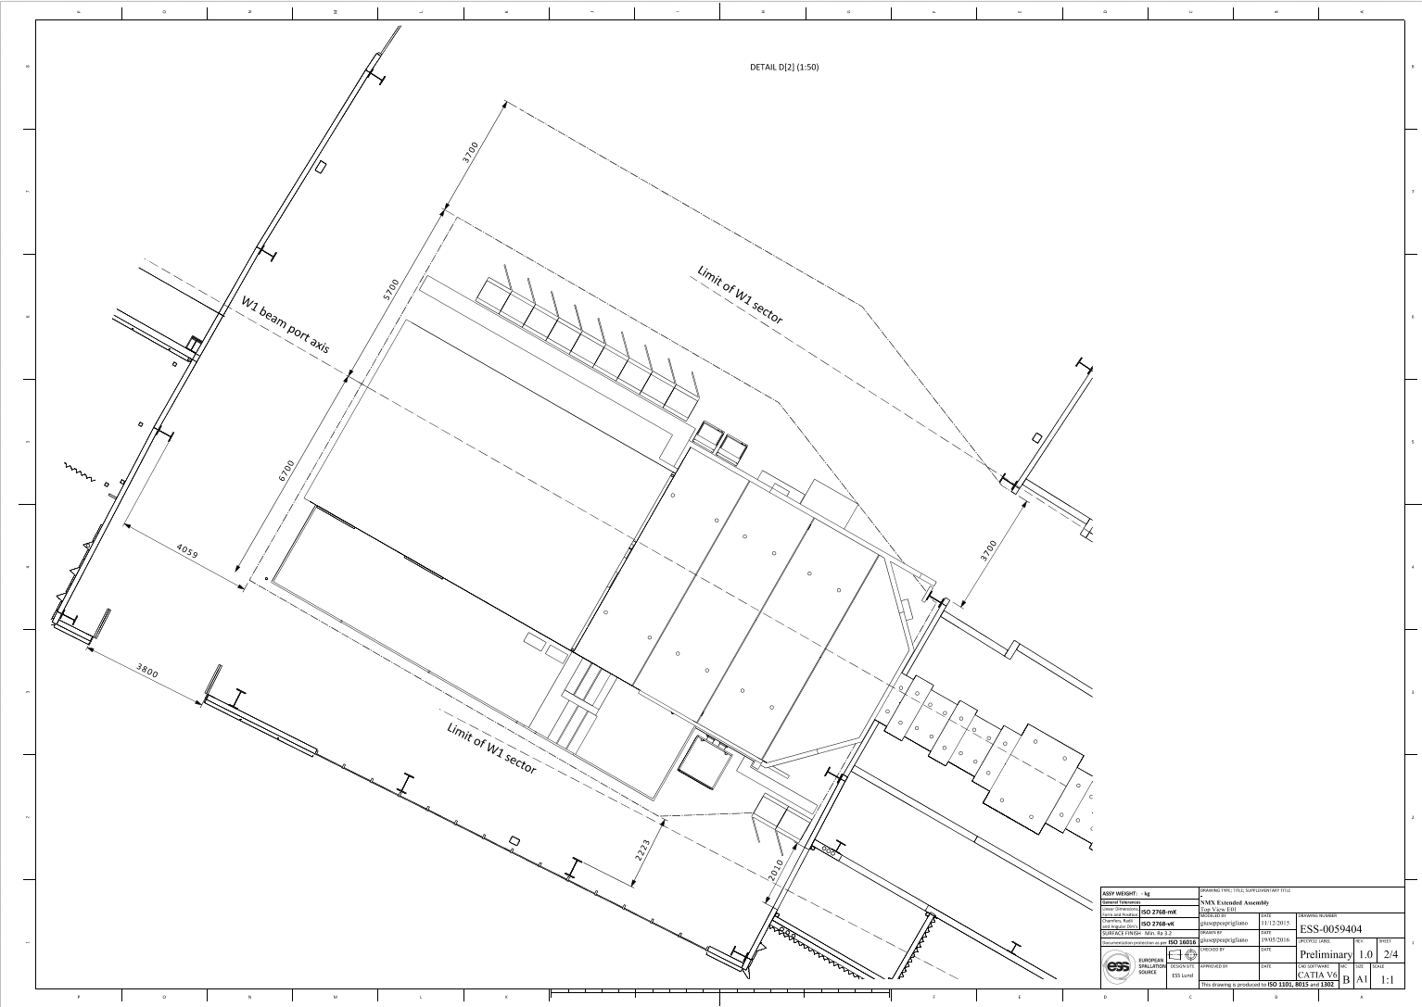
Logistics and NMX Specific infrastructure
NMX Preliminary real estate
3700
Still missing:
-Space for SE preparation
-Space for Installation logistics
5700
6700
DRAFT
4059
3700
3800
2223
2100

Slide 39
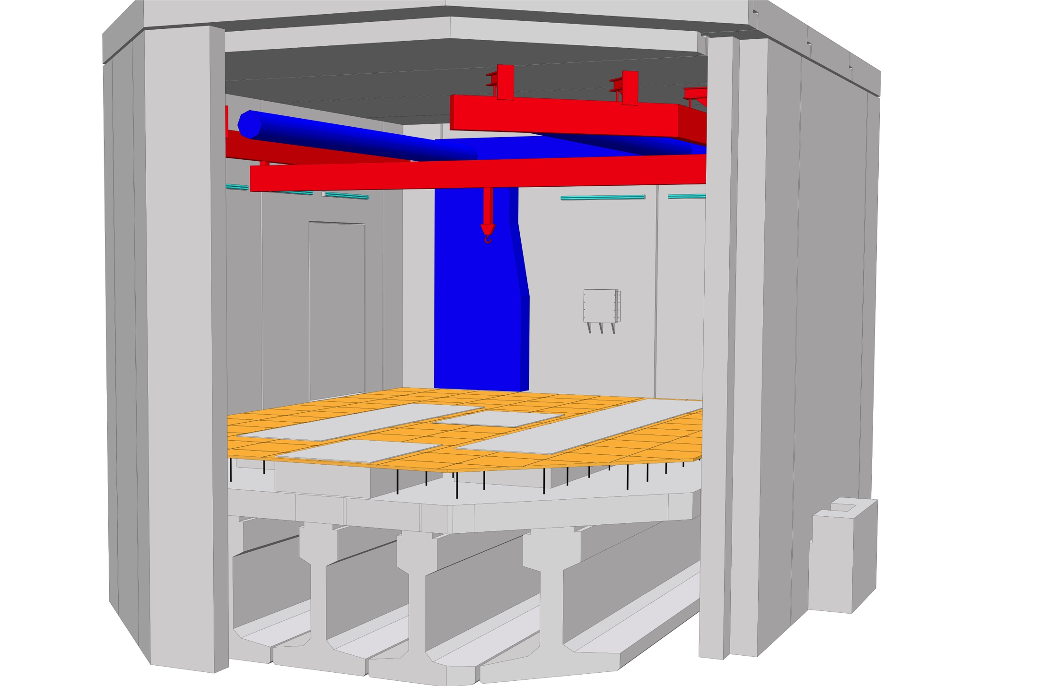
NMX Infrastructure inside the cave
Logistics and NMX Specific infrastructure
Climatization (22°±2)
False floor
Crane
Sprinklers
Lifting platform
DRAFT
Notes:
Temperature fluctuations during the day are too large for NMX that will need a closed circuit air cooling system.

Slide 40
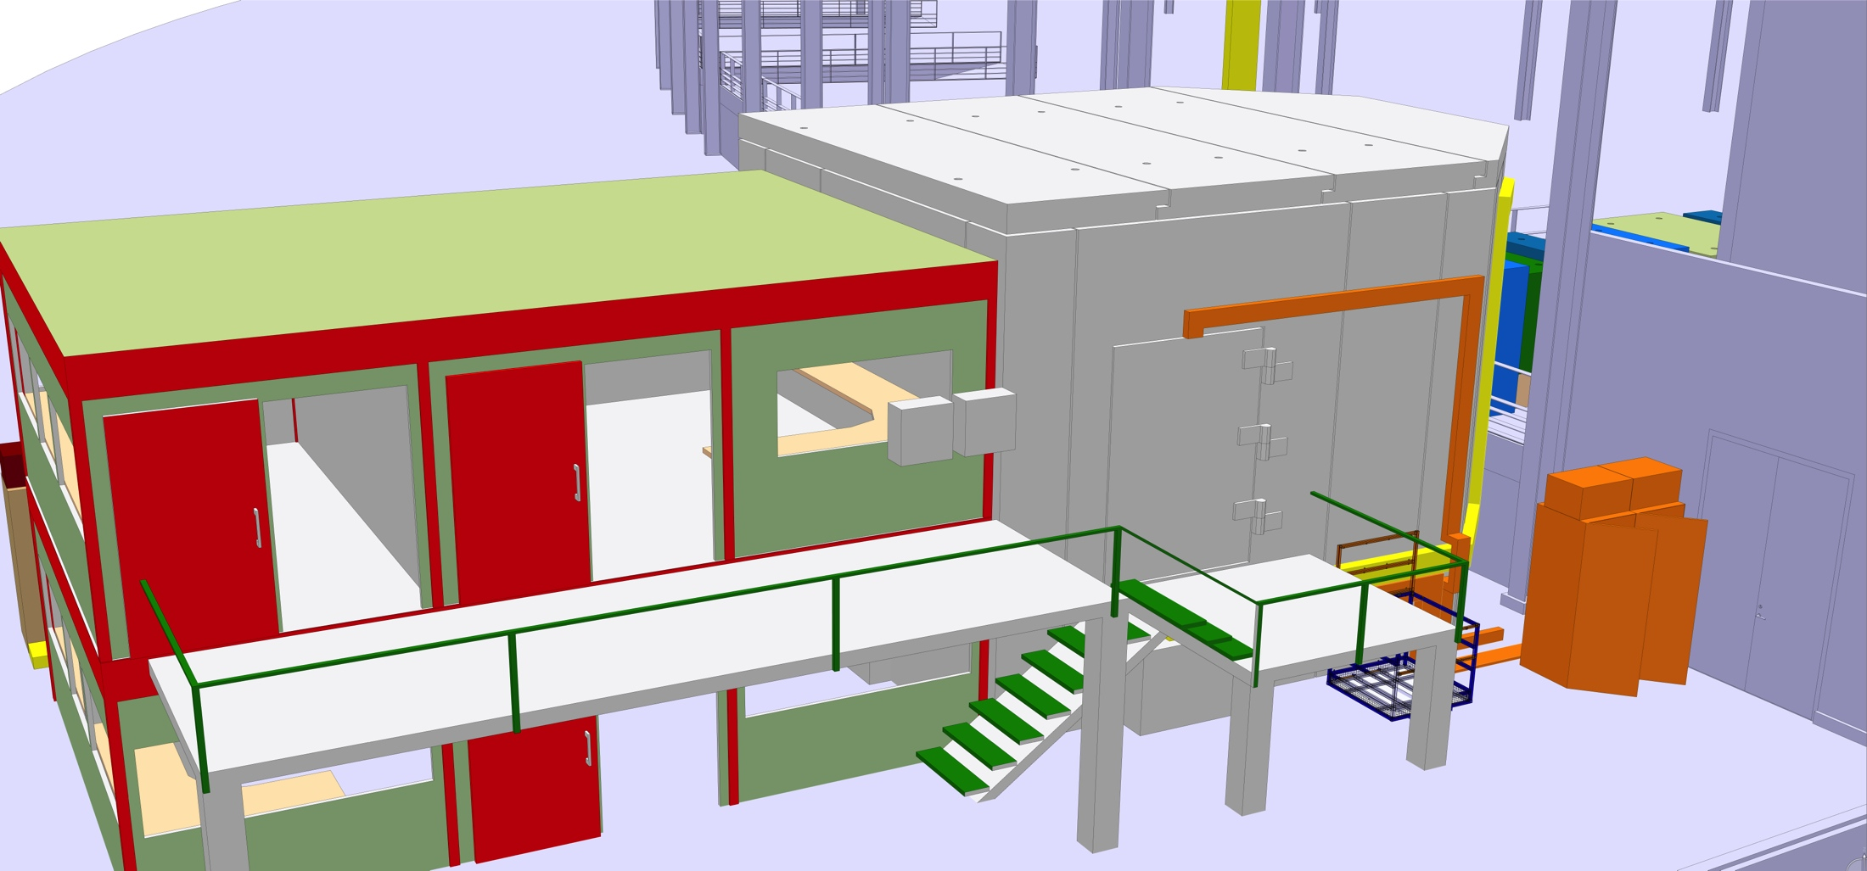
Infrastructure outside the cave
Logistics and NMX Specific infrastructure

Slide 41
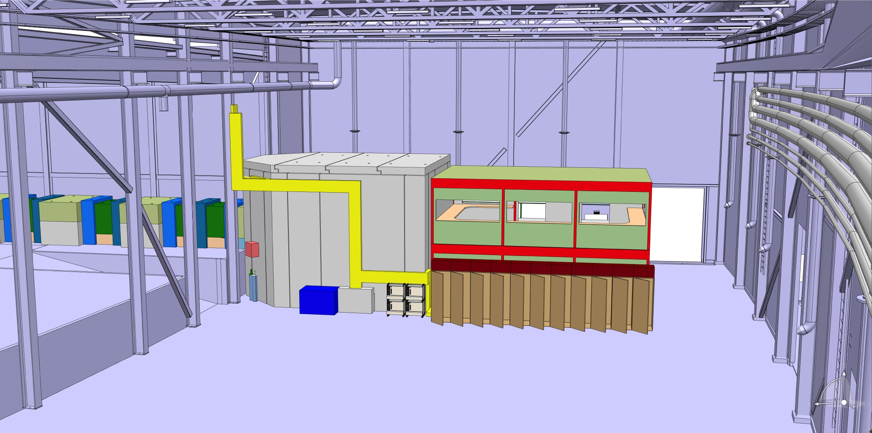
Infrastructure outside the cave

Slide 42
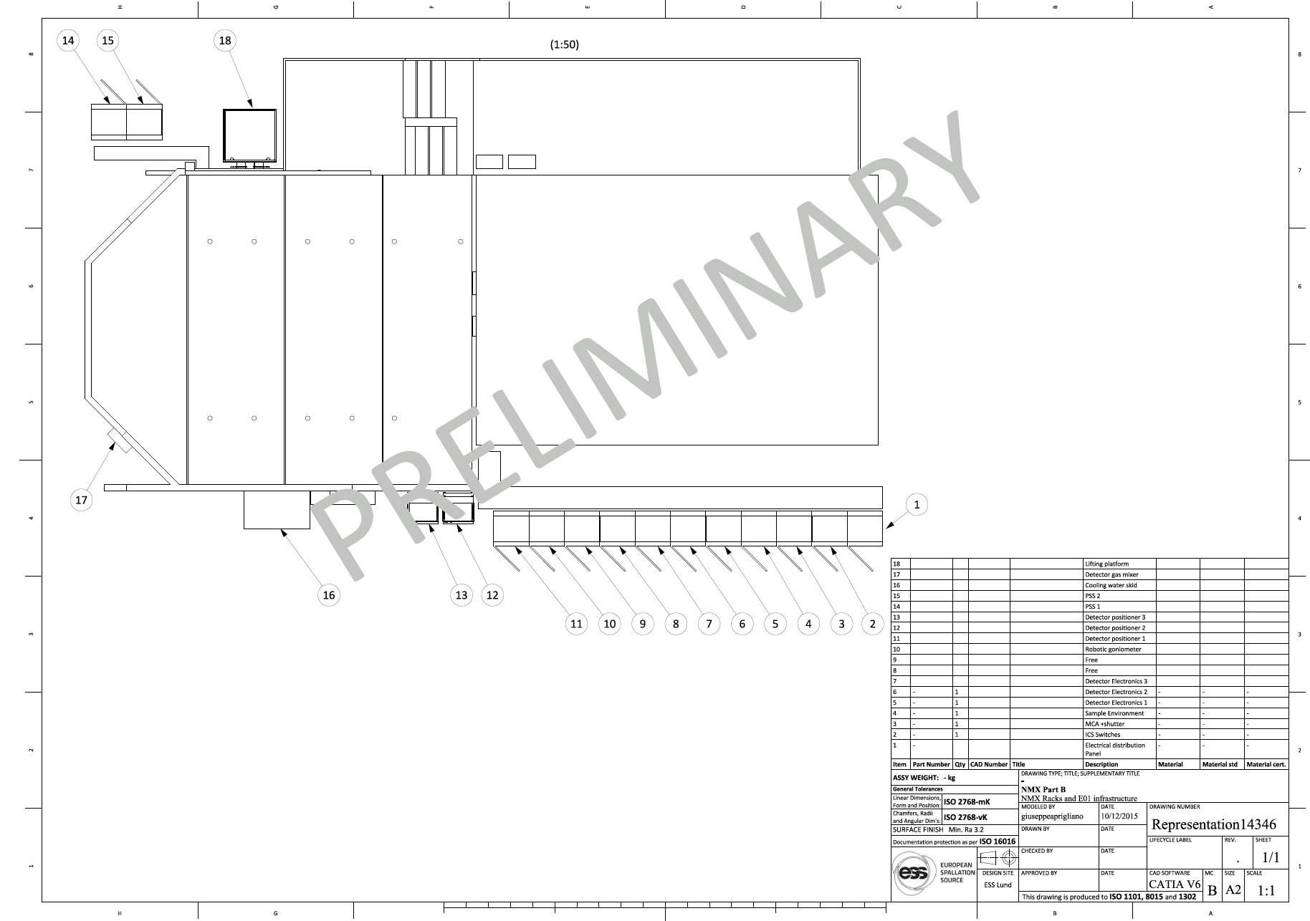
Logistics and NMX Specific infrastructure
Early stage considerations on
Control racks
Lifting platform
Trunking
Stairs

Slide 43
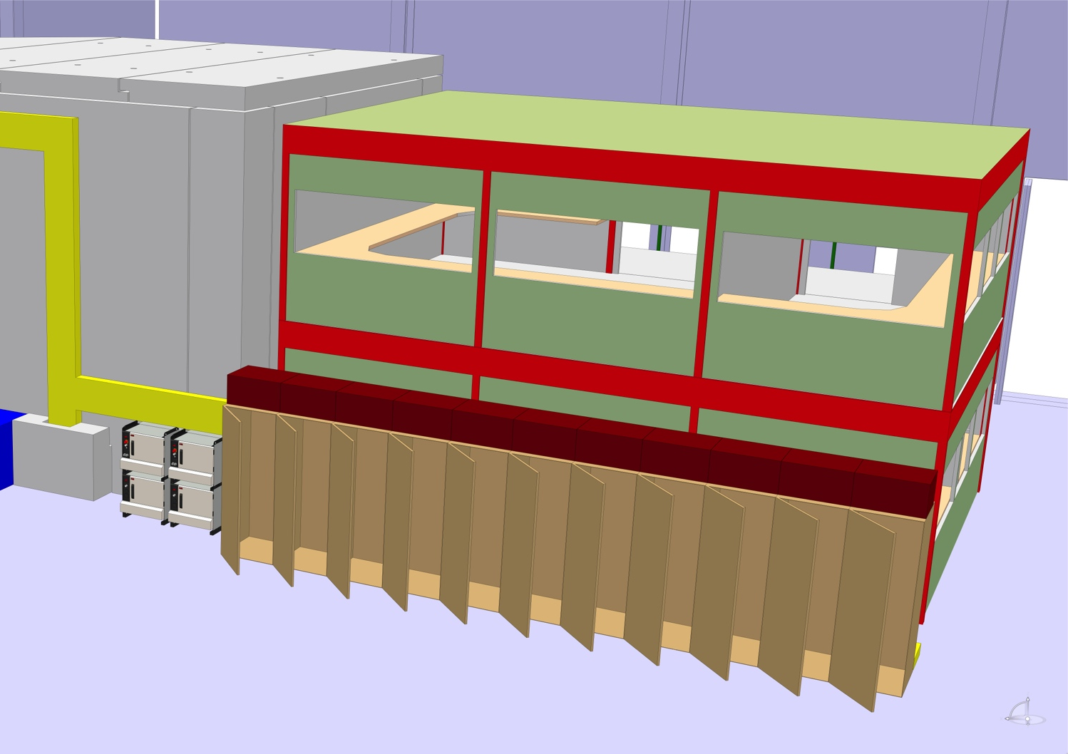
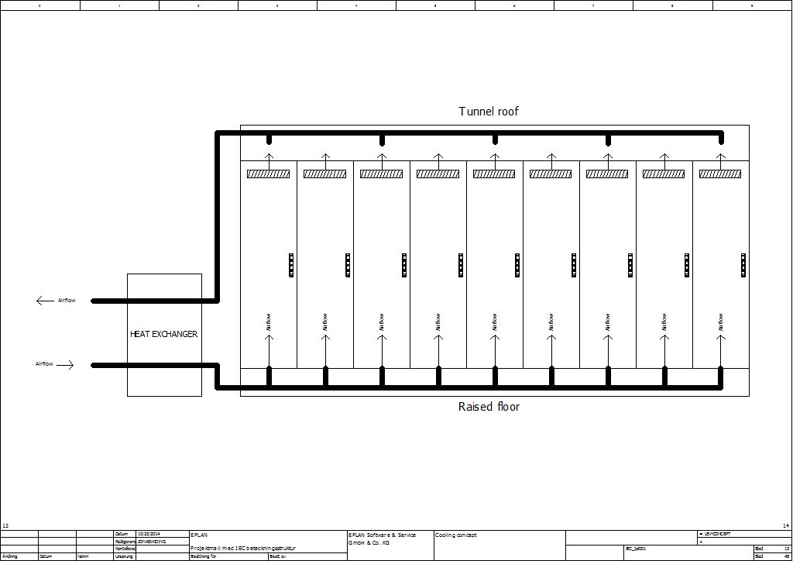
Logistics and NMX Specific infrastructure
Water cooled racks to recover 90% of dissipated power from the instrument
Where EMI shielding is not a problem, rack farms may allow some savings
Chopper control system ESS-0043775
Allowed noise level is not yet communicated
ESS-0017175 ACCSYS Standardization document

Slide 44
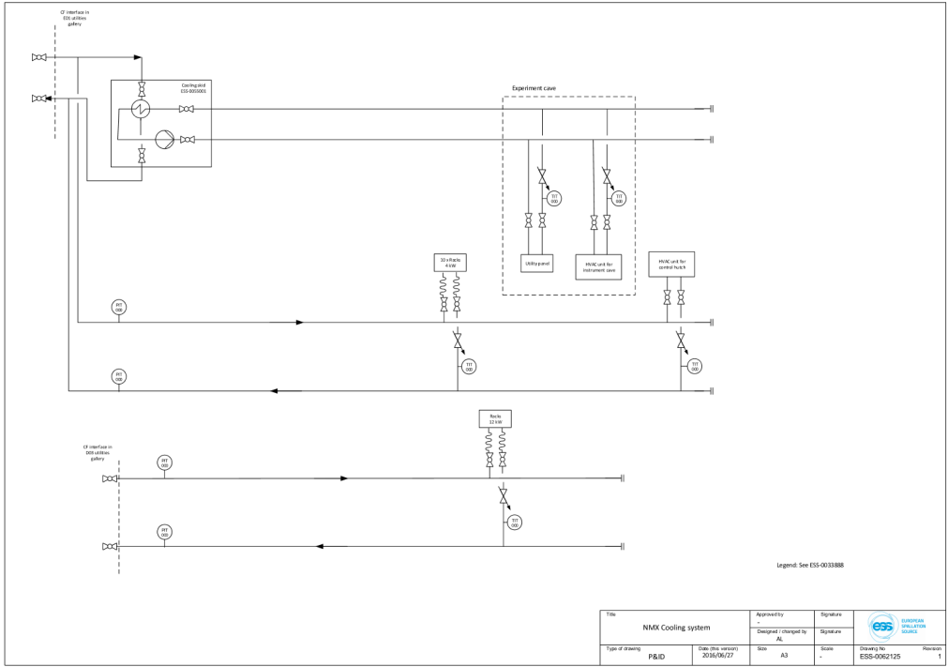
Water distribution (WP16)
DRAFT
DRAFT

Slide 45
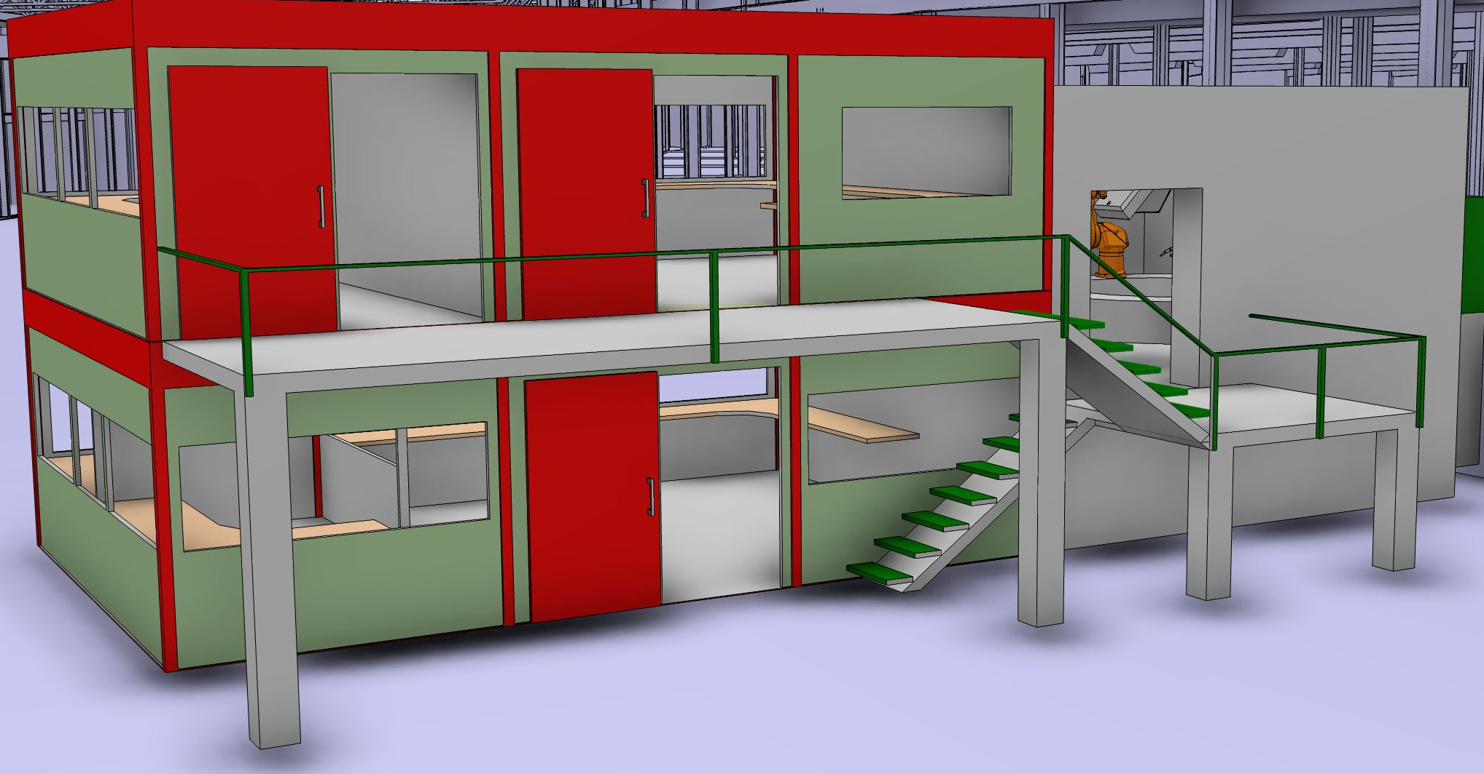
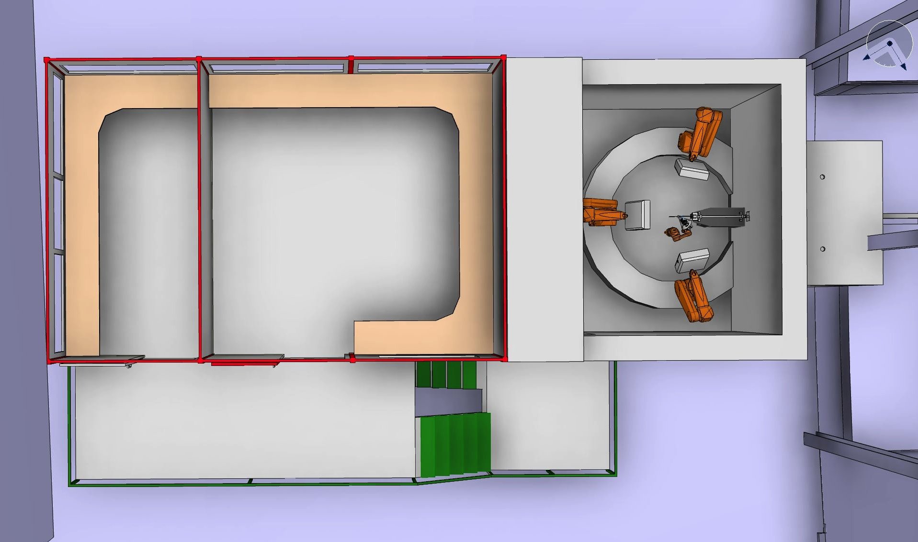
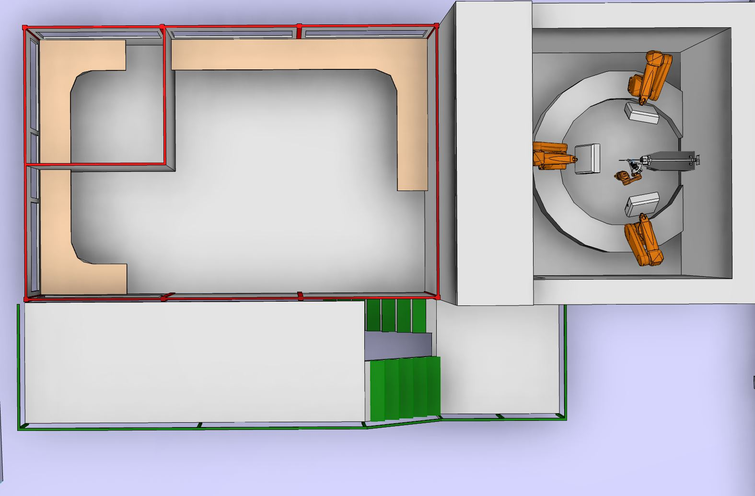
Control hutch
Adherence to national standards to be assessed
BFS http://www.boverket.se/en/start-in-english/
National board of housing, building …
AFS https://www.av.se/en/
Swedish work environment authority
(also in english!)
BFS 2011:26 section 5 ( Safety in case of fire)
Technical area
Sample preparation area
Control Hutch
45
45
Notes:
For instance:
3:3113 Work premises
The room height of workrooms shall be not less than 2.40 m. In restricted sections
of rooms, these room heights may be lower. In sections of the room where
standing height is needed, the room height must not be less than 2.10 m under
horizontal sections of roofs or 1.90 m under sloping roofs.
In educational premises and other premises intended for a large number of
people, the room height shall be not less than 2.70 m.
General recommendation
Arbetsmiljöverket also issues rules on room heights in work premises.

Slide 46
Most urgent interface definition
Question: What are the 3 main infrastructure issues currently hindering your design work (except bunker and extraction system!)

Slide 47
Thank you

