Slide 1
MCA/Chopper parallel sessions
Peter Harbott
on behalf of all teams
IKON11 14-16 September 2016
Motion Control & Automation Group

Slide 2
Parallel Session Motion Control + Chopper
Updates on the current progress in the groups
Presentation and discussion of the TG2 review (Check list)
Costing exercise: Presentation of the chopper/MCA costing for SKADI, DREAM, NMX, HEIMDAL and BIFROST
Concentrate on costing exercise
Overview of the different approaches
Defining Guidelines
Details in the talks on INDICO
Notes:
Here I am showing some of the main challenges the different instruments faced
At the bottom I explain some of the ways to overcome these challenges

Slide 3
Costing Motion Control
What Do you want to do?
How Do you want to do it?
How much does it cost?
Define moving parts (“Axes”) of an instrument >> Table of Motion
Define what's included, what’s excluded
Identify what’s Generic Motion Control, what’s Special Purpose Motion Control
Calculate Equipment cost
Calculate Manpower cost
Notes:
Here I am showing some of the main challenges the different instruments faced
At the bottom I explain some of the ways to overcome these challenges

Slide 4
Costing Motion Control – Included, Excluded
Examples of included
Axes with pneumatic actuators
Fixed installations of sample environment
Equipment: Motion Control Electronics, Racks etc.
Examples of excluded
Chopper axes >> Chopper Group
Vacuum valves (gate valves) >> Vacuum Group
Mobile sample environment equipment >> SE Group
To be decided
Equipment: Cables, connectors, motors, sensors etc.
Installation
Notes:
Here I am showing some of the main challenges the different instruments faced
At the bottom I explain some of the ways to overcome these challenges

Slide 5
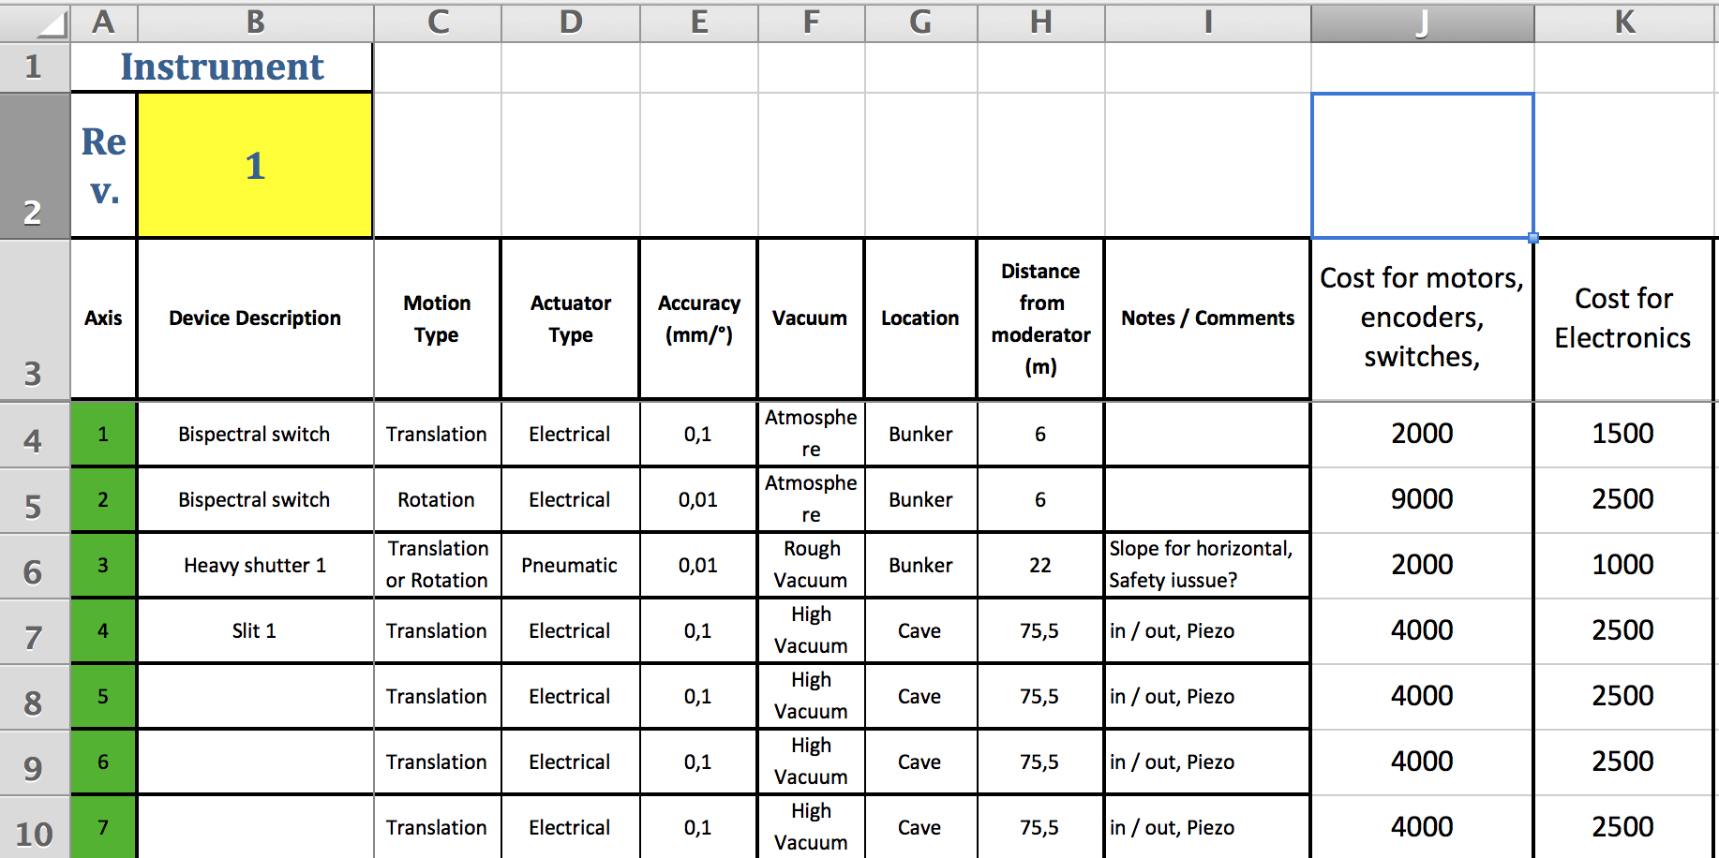
Costing Motion Control – How to calculate Equipment?
Table of Motion is the key document (example DREAM)
Use an average number for equipment for each axis
This number varies according to the requirements (Accuracy, radiation, technology)
Don’t forget cabinets, cables etc.
MCA Group supports you in finding these numbers
Notes:
Here I am showing some of the main challenges the different instruments faced
At the bottom I explain some of the ways to overcome these challenges

Slide 6
Costing Motion Control – How to calculate Manpower I ?
Example SKADI
Taking numbers from previous instruments projects and adapt them
Notes:
Here I am showing some of the main challenges the different instruments faced
At the bottom I explain some of the ways to overcome these challenges

Slide 7
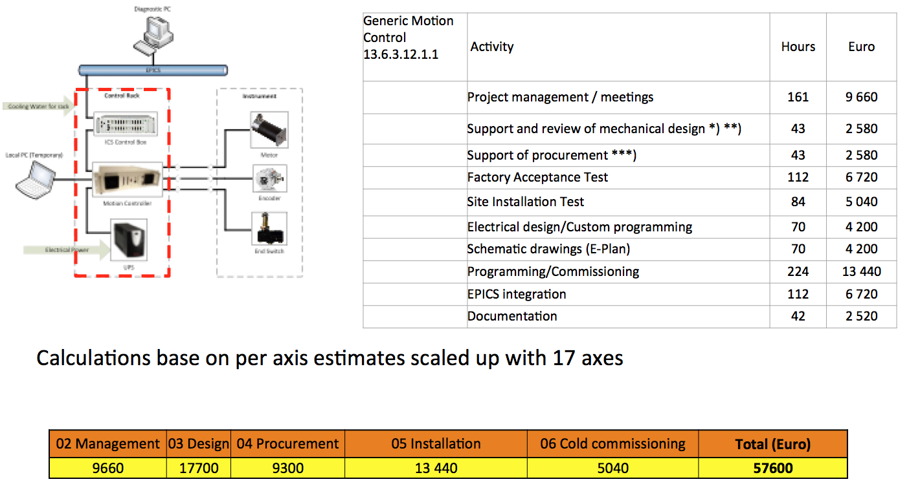
Costing Motion Control – How to calculate Manpower II ?
Example NMX
Design + Work breakdown and estimations on that level
MCA Group supports you in this tasks
Notes:
Here I am showing some of the main challenges the different instruments faced
At the bottom I explain some of the ways to overcome these challenges

Slide 8
Neutron Chopper Systems Common Costing Challenges
From P1 to operation
Trying to quantify cost contributors to building a chopper system at ESS
Notes:
I am trying to summarise what we tried to do in the the costing exercise

Slide 9
Neutron Chopper Systems Costing Challenges – Diversity of approaches
Quote “I depend on the ESS technology groups for an accurate costing that includes everything necessary for an ESS compatible instrument”
Quotes “ Reaching a budget within ±10% is difficult, instruments need clarity and help from ESS”
Instruments depend on:
Supplier costing or,
NCG costing or,
Supplier costing + NCG costing (recommended)
Notes:
I start by trying to show the diversity of opinions and the way instruments costed their instruments.
From the discussions it seems that getting a supplier and NCG cost verification was the most accurate and comprehensive way to get an accurate cost breakdown

Slide 10
Neutron Chopper Systems Common Costing Challenges
Supplier scope of work: Is integration, installation and commissioning included?
Double counting of components : e.g. Costing chopper drives should not be in the motion control cost, BUT Chopper translation stage should be in MCA costing
Double counting of manpower: Many instruments already include labour costs for commissioning, Chopper suppliers also include same costs
Important to:
…Understand the ESS instrument PBS structure i.e. what is needed
…Request detailed scope of work from suppliers
…Understand the assumptions made by suppliers
…Communicate with technology groups
Notes:
Here I am showing some of the main challenges the different instruments faced
At the bottom I explain some of the ways to overcome these challenges

Slide 11
Neutron Chopper Systems Costing Challenges - Commissioning and Upgrade paths
How do we deal with costing commissioning of inseparable items i.e. a chopper in a collimator ?
How do we deal with upgrade programs ?
Include basic preparatory infrastructure in baseline budget i.e. tubing baseplate , shielding
Make sure commissioning costs are accounted for in at least one of the work units
Make sure the supplier and tech. groups have been informed on the scope of work
Notes:
Here I show some more specific questions that had to do with instrument commission costs on complex items such as a SANS chopper in a collimator drum
And also the question that dealt of how do I cost my choppers when planning to have an upgrade eg. An extra chopper

Slide 12
Neutron Chopper Systems Costing Challenges – Accurate supplier costing
Concerns: ESS needs to provide ASAP clarity on Bunker design to suppliers and partners, It affects chopper design, installation, remote access and tooling costs
Suppliers need to be informed that if using ESS Integration Standards, tooling is at 0 cost and remote access in bunker components is guaranteed
Communication with Tech . Groups is strongly encouraged
Notes:
This concern is related the common problem that suppliers have when they try to cost given insufficient information from ESS about the bunker environment . Its very important that the ESS management remember its very difficult to get accurate costing to +- 10% given the rough design

Slide 13
Neutron Chopper Systems Costing Challenges – Reducing Cost
Common component needs between instruments:
Bulk ordering , special supplier agreements, collaboration between instruments ?
Prepare suppliers for ESS needs
ESS and partners need to act now
Reminder: When using standard components, design cost is absorbed by technology groups
Notes:
This was a common suggestion from instruments. Try to find commonalities so the costs can go down. It’s a very good suggestion that will help suppliers to plan their operations and staffing in preparation for the orders

Slide 14
Neutron Chopper Systems - TG2 review Reminder ESS needs you !
Request from your NCG contact a detailed costing estimate
Discuss ASAP with your NCG contact about completing together the NCS questionnaire
Your contact fills the TG2 review document and discusses with the team leader
The instrument team should attempt to rectify and address concerns 4 weeks before TG2
The NCG contact sends the final Review summary to the NSS management 2 weeks before the TG2 review
Notes:
This is a final reminder from the parallel session in preparation for the TG2 review . Communication between teams and ESS is crucial at this point so that instruments can pass the tollgate 2 review

Slide 15
TG2 Review
Key Documentation for TG2 review
MCA Ph1 Guidelines: ESS-0049514
NCS TG2 Questionnaire: ESS-0059934
NCS TG2 Review Summary: ESS-0060423
NCS Cost Estimate Document: ESS-0060400
Or simply ask your Instrument Representatives
https://ess-ics.atlassian.net/wiki/display/SD/CONTACTS
Notes:
Key documents that are required / please contact us communicate discuss/ constant dialogue is needed

Slide 16
Thank you -> Questions?

Slide 17
Chopper control systems -Steps-
Define moving parts of the instruments
Fill table of motion (raw version)
Mark what's included in and what's excluded of MCA work package
Move chopper axes (if any) to the chopper work package (WP)
Define technical solutions for axes inside the MCA WP
Identify axes that are covered by the Generic Motion Control. Finalise the Table of Motion restricted to these axes.
Identify axes that are covered by Motion Control with high volume of axes. Sketch the technical solution to be able to budget. Include potential development work.
Identify motions that are covered by Special Purpose Motion Control. Sketch technical solution and define what part is in the MCA WP.
Budget equipment
Budget manpower

Slide 18
IKON11: Questions in parallell sessi
Design update
Chopper control racks, need space around the bunker for the choppers in the bunker.
Cable lengths need to be 45-55 meters between the rack and the choppers in the the bunker for the north sector.
What will be the design of the T0 chopper? T0 calculation needed for Dream
CHIM needs to be tested
Is the Chopper group doing neutronics calculations, are you providing support for McStas?
Who is paying for the development of T0.
First Chopper position of the Dream instrument?
TG2 Review
Is the questionnaire a part of the TG2 documentation?

