Slide 1
Halls and Infrstructure
DREAM, ODIN, VESPA Instrument Group

Slide 2
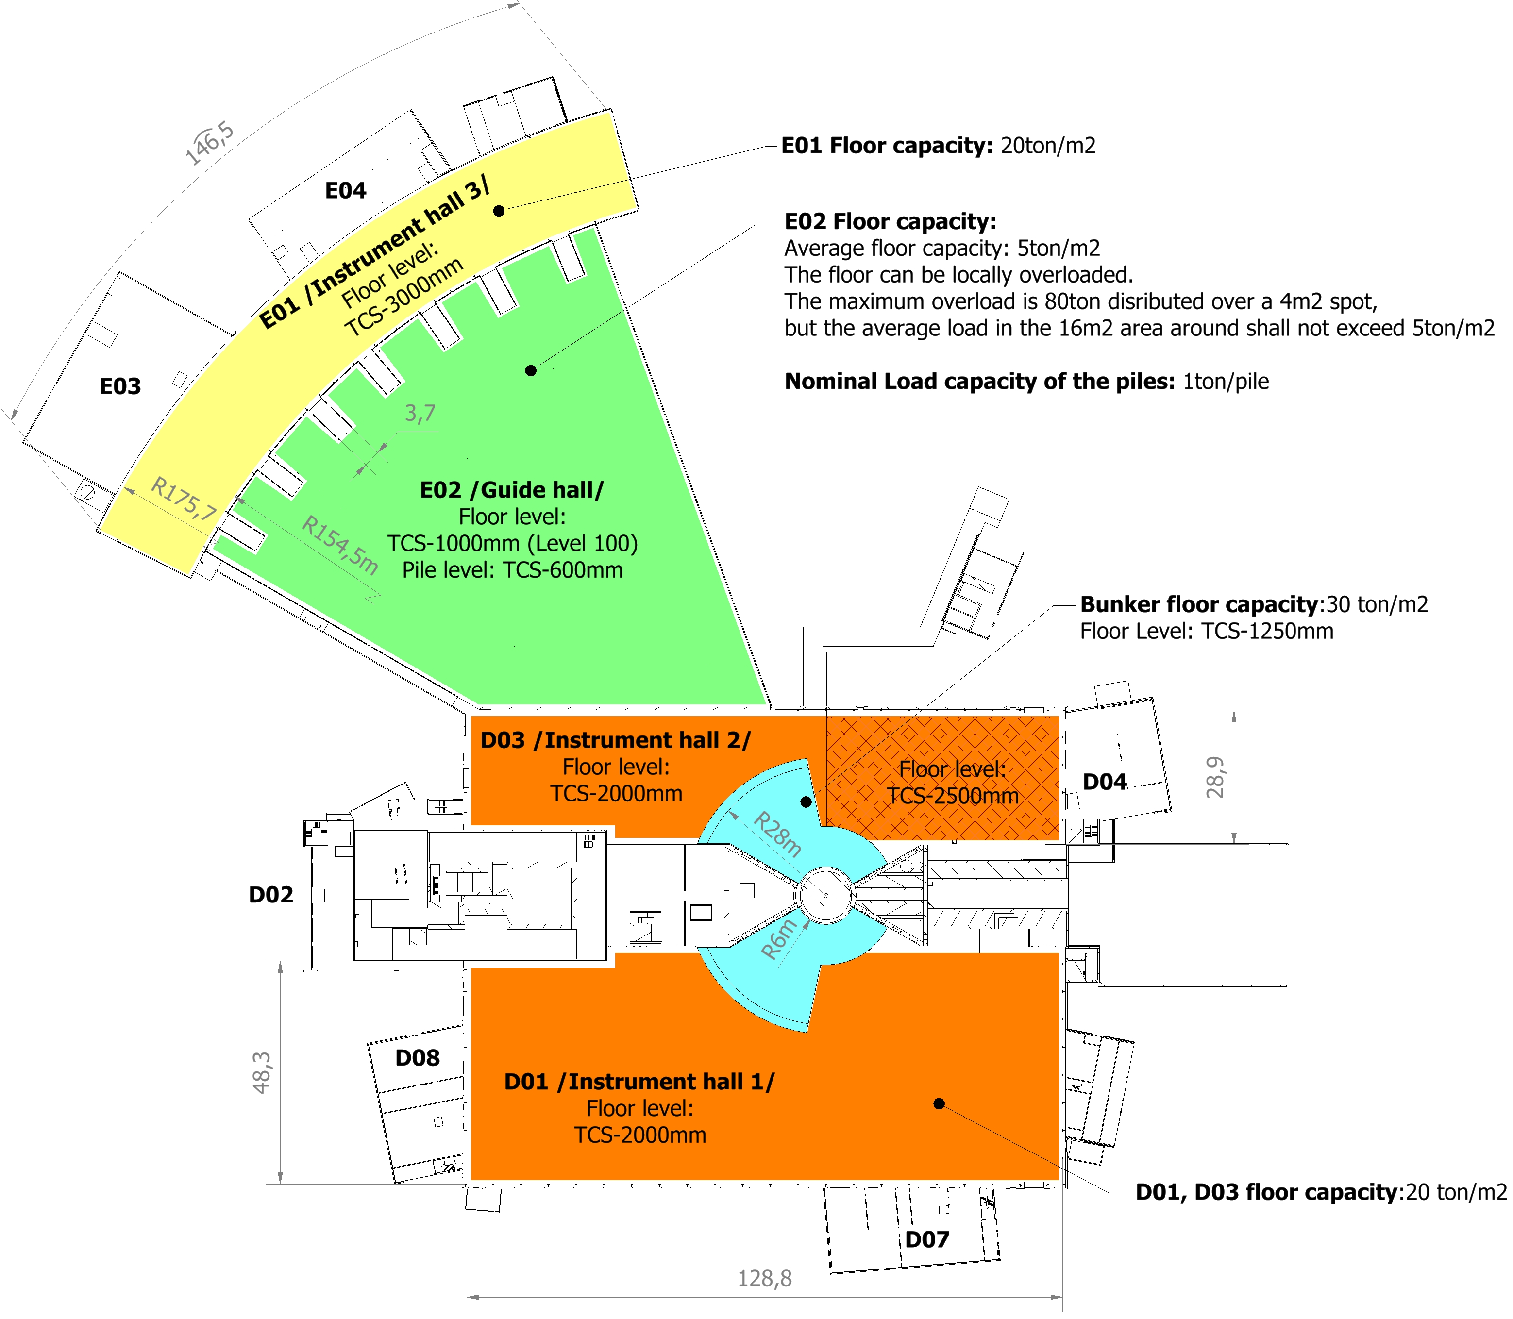
Floor Settlement
Floor settlement requirement under the instruments
The floor in the experimental halls and bunker area will due to dynamics loading have a stability for elastic movement.: 3mm
Stability for creep/deformation over the lifespan of the facility: 3mm

Slide 3
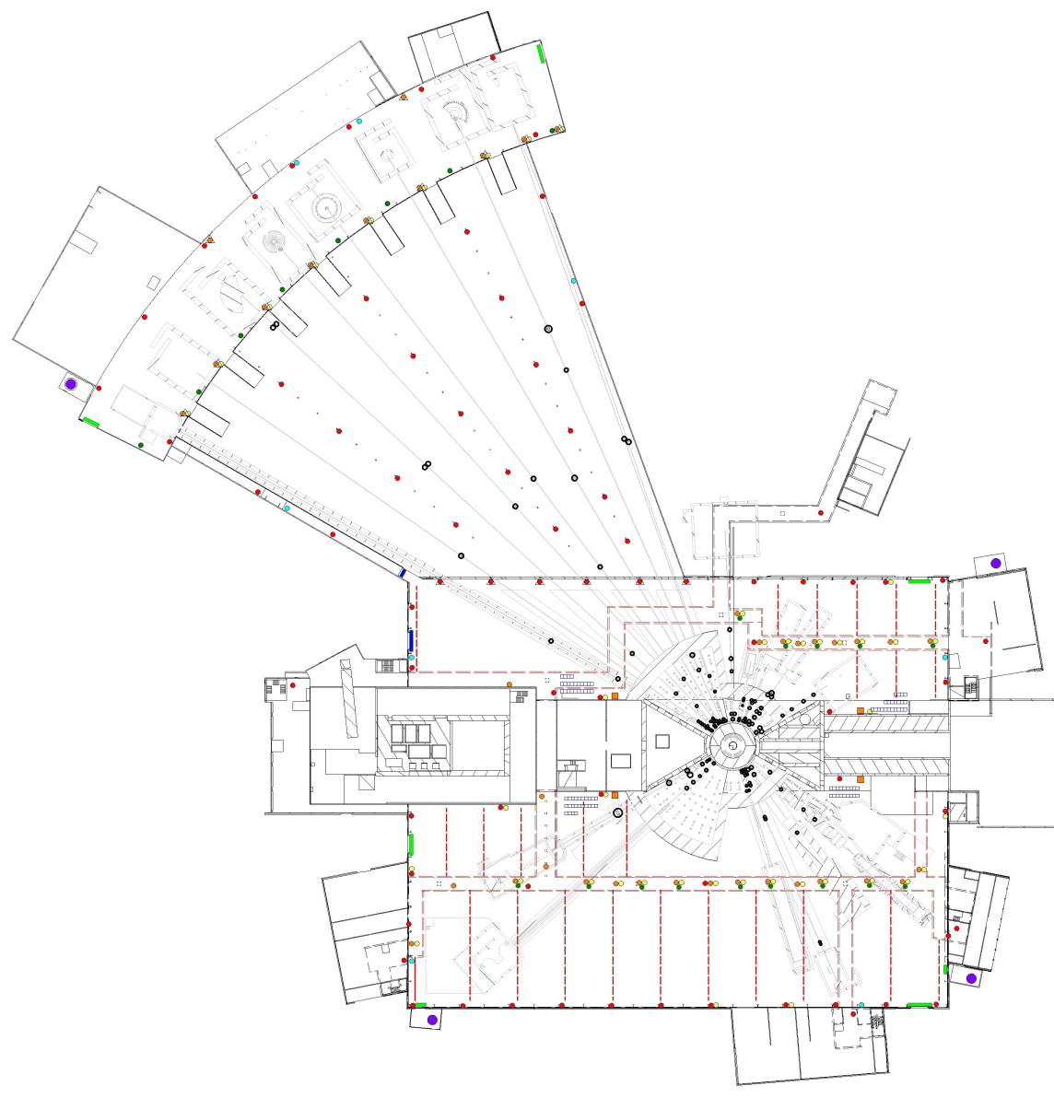
Infrastructure
Infrastructure routing
Nitrogen/Deionized water/Compressed Air/LAN

Slide 4
Infrastructure
Cooling Water
Fume hoods
Exhausts
Notes:
27kW/instrument

Slide 5
Infrastructure
Tap Water
Power outlets

Slide 6
Power distribution concept
CF responsibity CF budget
Substation
NSS responsibity, Instrument budget
Galery/Halls
NSS responsibity, NSS budget
Bunker distribution panel
/Bunker zone/
Instrument distribution panel
/Main grounding zone./
Instrument distribution panel
/Grounding zone X/
Instrument 1
Instrument 2
Instrument 3
Instrument 4
Detector
Chopper
Vacuum
Instrument X
Light
Motion
SAD
...
Lights
Motion
...
Notes:
Cost for Utility panels tbd

Slide 7
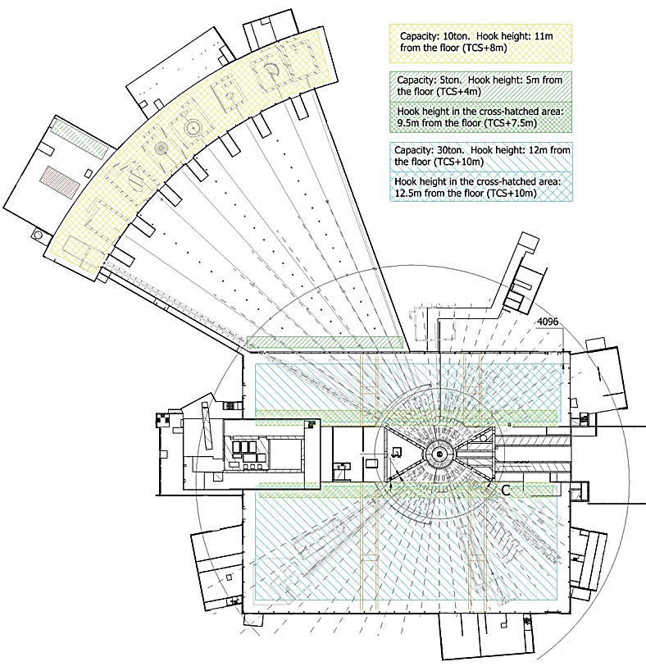
Cranes
There will be crane
Coverage throughout
D01

Slide 8
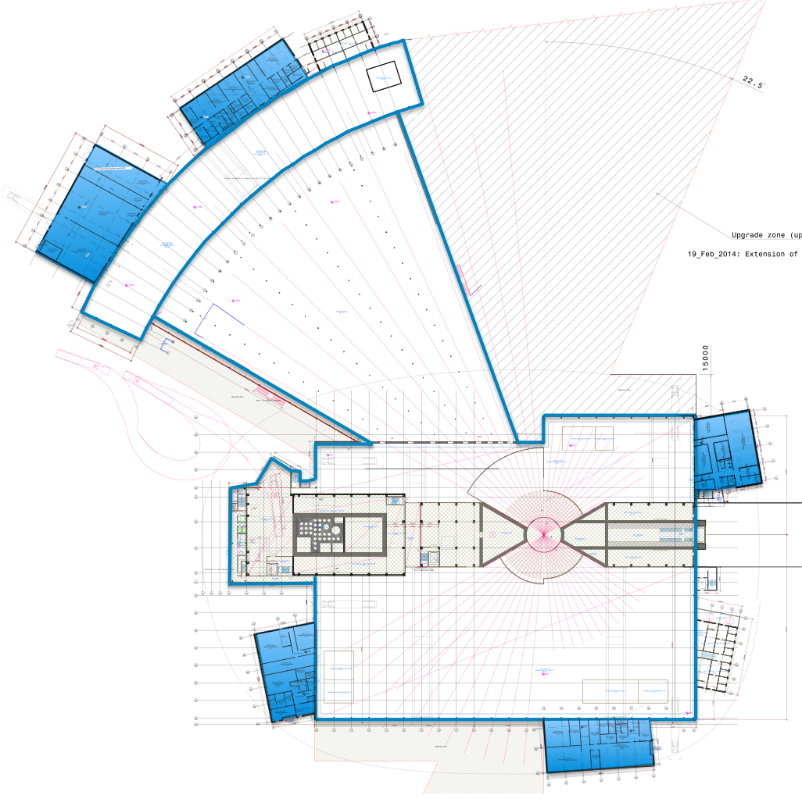
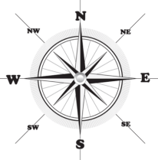
Lab Spaces
N
E04
E03
E01
D03
D04
E02
D01
D08
D02
D07

Slide 9
Issues/Questions
Grounding areas (e.g. technical equipment in different area from drive units)
Specialty gases can be supplied in bottles AFTER safety review
General safety issues (Swedish regulations vs local)
Bunker baseplate design
Elevation (beam height): additional slab to reduce beam height i.e. shielding
Clearance to building wall (distance and height)
Air Conditioning
Money ;-)

