Slide 1
Neutron Beam Extraction: Feedback
Damian Martin Rodriguez
on behalf of Bengt Jönsson, Jarich Koning and Iain Sutton
www.europeanspallationsource.se
16-09-16

Slide 2
Outline of the talk
The session
Feedback from the parallel sessions
Tasks

Slide 3
The session: Schedule
NSS Requirements (Damian Martin Rodriguez)
NBEX Optics and ‘fast track’ (Iain Sutton)
NBEX Design (Jarich Koning & Bengt Jönsson)
Free discussion

Slide 4
The session: Introduction
Beam extraction is a vital part of the Neutron Beam Transport System as it defines the amount of neutrons that can be transported to the sample.
It is placed in a very difficult environment.

Slide 5
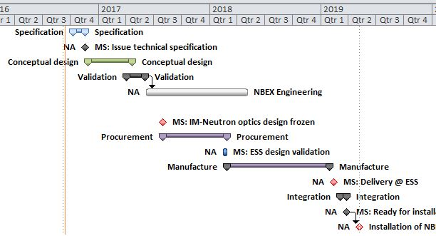
The session: Fast Track
End Q2
In-monolith optic
Design Freeze
The optics inside NBEX as a special work package for early delivery in Target before first neutrons
Collaboration with guide vendors for optics assembly (optics + cooling + alignment) solutions compatible with NBEX and validated by ESS and SSM
Goal: to facilitate the timely delivery of in-monolith optics for 16 instrument before monolith closure
Time constraint: Freezing of in-monolith optic design for Q2 2017

Slide 6
The session: NBEX design
GBS
Overview of the system
BBG
NBPI
Bunker roof support
Neutron Beam window
Flange/NBW
GBS hooks
Floor fill shielding
Floor filler block
Handling tooling
Shutter actuator
Rigid chain actuator
6
6

Slide 7
Feedback and comments from instrument teams (Fast track)
Fast track timeline is very tight as instrument teams are in different stages of development
Instrument teams pointed out that successive changes in the moderator baseline can compromise the schedule
Concerns about the actual workload of guide manufacturers affecting the timeline of the fast track
Some lack of clarity on the scope of delivery of the beam extraction systems

Slide 8
Feedback and comments from instrument teams (Technical solution)
Space requirements seem OK for most of the instruments.
Si wafers inside monolith can have some issues:
Active cell handling (in discussions with Target)
Cooling of Si wafers in vacuum (preliminary studies say it is not an issue, but needs to be analyzed thoroughly)
Neutron beam window thickness for safety case: different depending on instrument or standard for all?

Slide 9
Feedback and comments from instrument teams (Technical solution)
Is it possible integration of bi-spectral switch inside the light shutter system ? (T-REX expressed interest, DREAM not, MAGIC ?)
Estia team has requested a non standard configuration for light shutter (under discussion)
Need of communication of latest advances in Confluence wiki regarding beam extraction

Slide 10
Tasks (for instrument teams )
Current specification of the optics inside NBEX:
CAD models for Target Division (check space requirements)
Specification of geometry and coating as input for discussion with guide manufacturers (Template table will be provided)
Integration of bispectral switch with light shutter: If you have interest, please let us know (T-REX (yes), DREAM (no), MAGIC (?) )
Send it to your contact person (Damian, cc. Gabor and Ken)

Slide 11
Tasks (for NBEX)
Publish current status in Confluence wiki
Provide clarity on safety cases in Neutron Beam Window
Provide clarity on scope of supply from ESS
Initiate discussions with guide manufacturers regarding technical solutions in monolith optics

