Slide 1
Instruments beamline in the bunker
Valentina Santoro
on Behalf of Neutron and Optics Shielding Group @ ESS

Slide 2
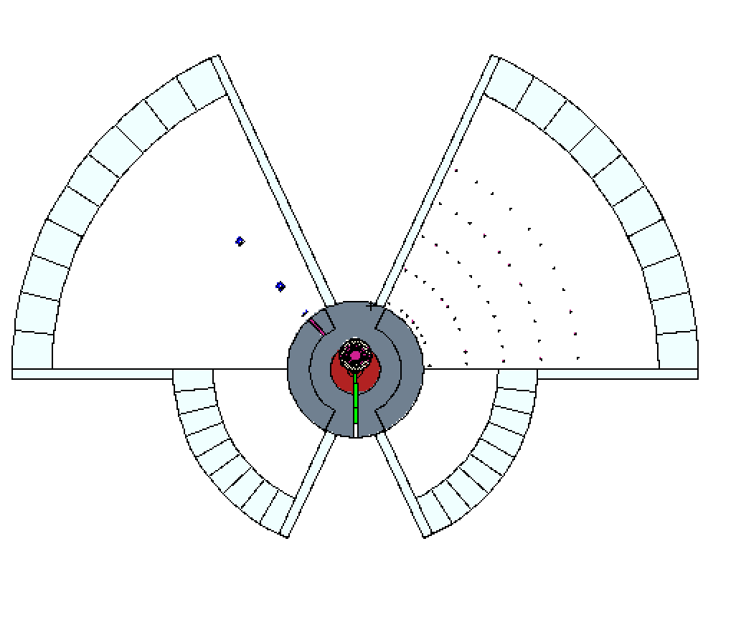
Our fantastic tool
Bunker
Engineering Model
Bunker
MCNP Model
SOUTH
WEST
EAST
NORTH
Comblayer Model for target +Bunker
-> produce very detailed input file for MCNP6

Slide 3
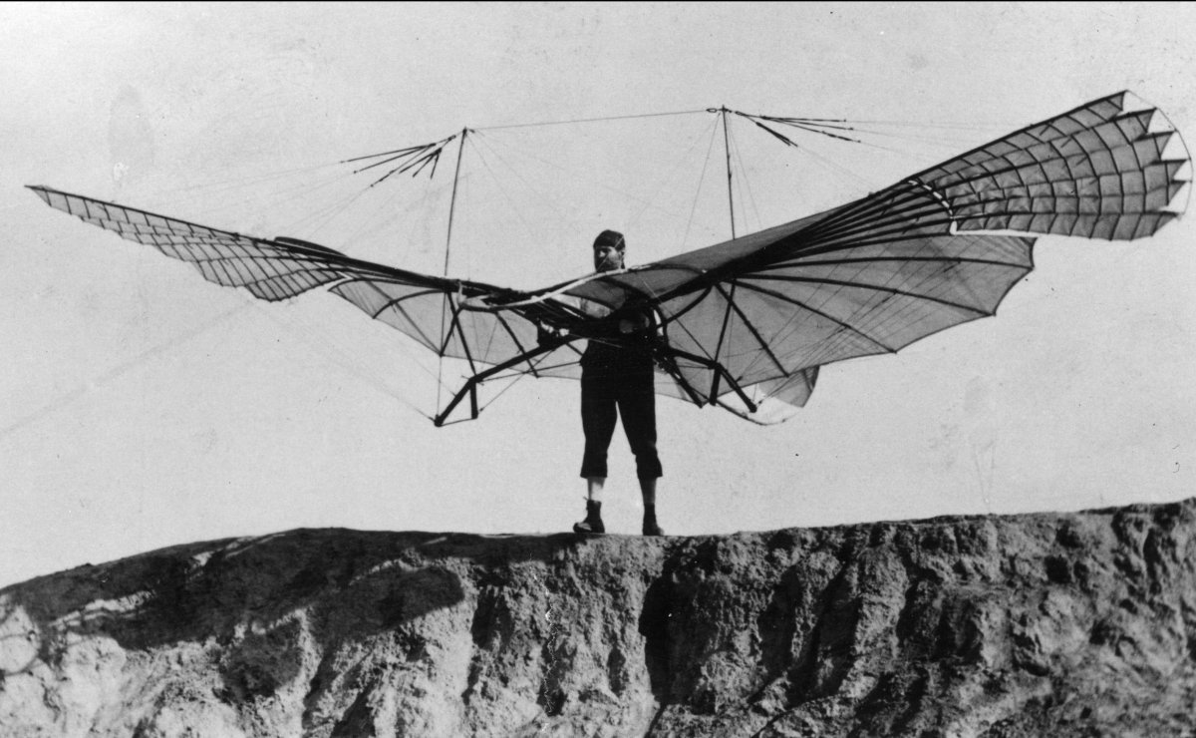
Stuart inventented the bunker and I’m testing it

Slide 4
Reminder
All the studies done in these slides are for finding the best solution for the NMX beamline
Some preliminary studies of the DREAM beam line
After 14m all the spectra suffer from low statistics (we are working on that)
All the studies presented here are showing the beam line inside the bunker or out of the bunker wall

Slide 5
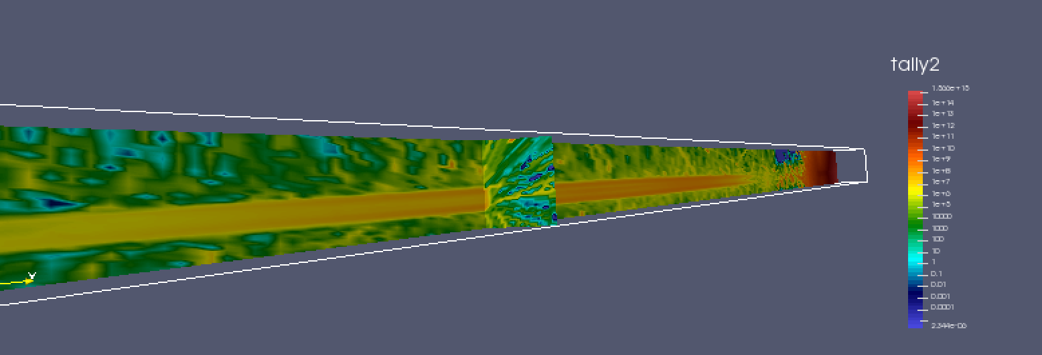
NMX beam line from the moderator to the bunker wall
Neutrons Energy > 0.1 keV
Neutron Flux
n/cm²s
Bunker Wall
Moderator
NMX

Slide 6
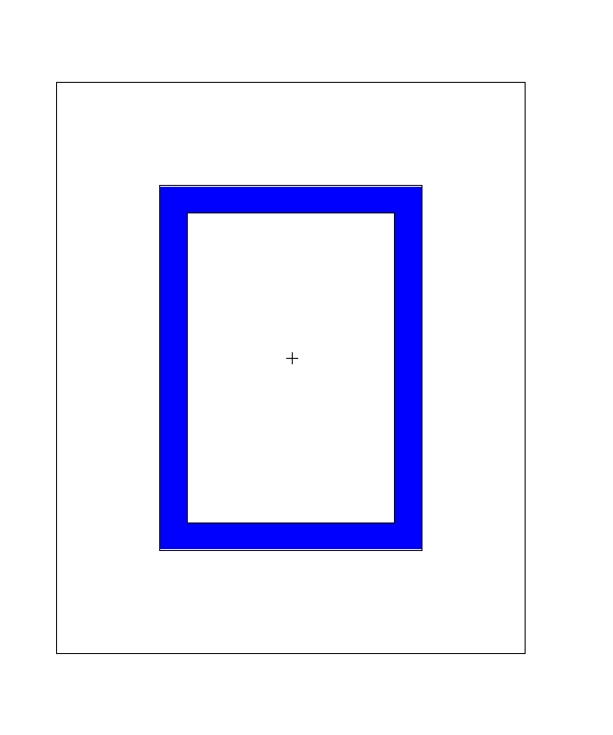
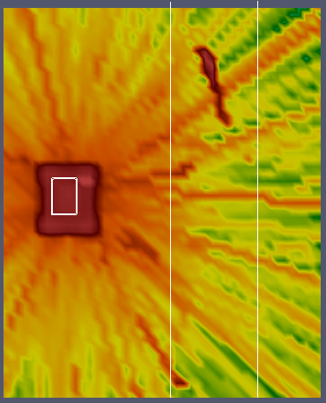
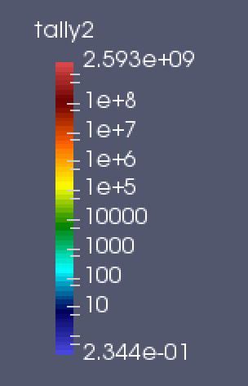
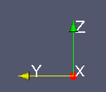
Slice of the beam line at 6m
Neutrons Energy > 0.1 keV
Guide
Neutron Flux
n/cm²s
NMX

Slide 7
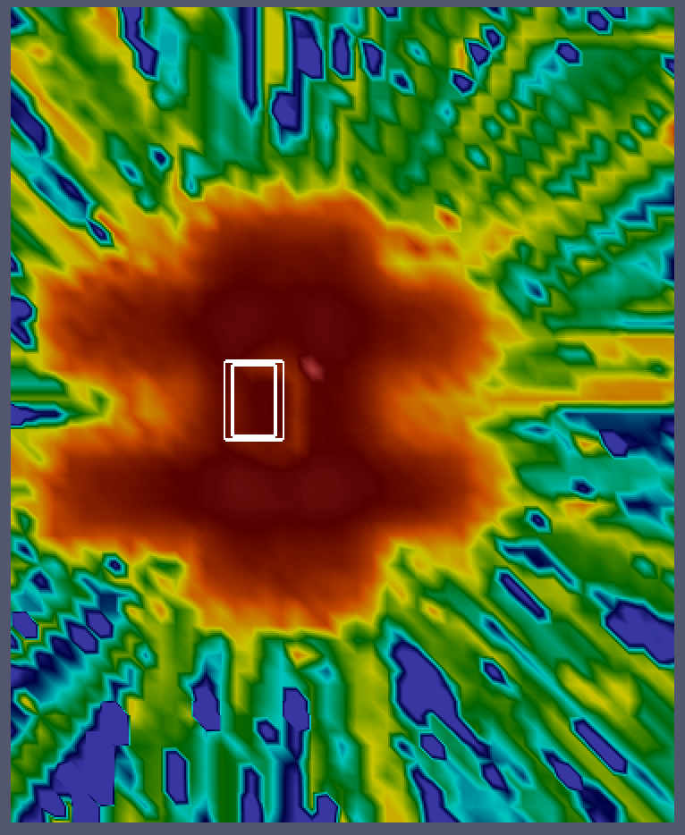
Slice of the beam line at 12m
Neutrons Energy > 0.1 keV
Guide
Neutron Flux
n/cm²s
NMX

Slide 8
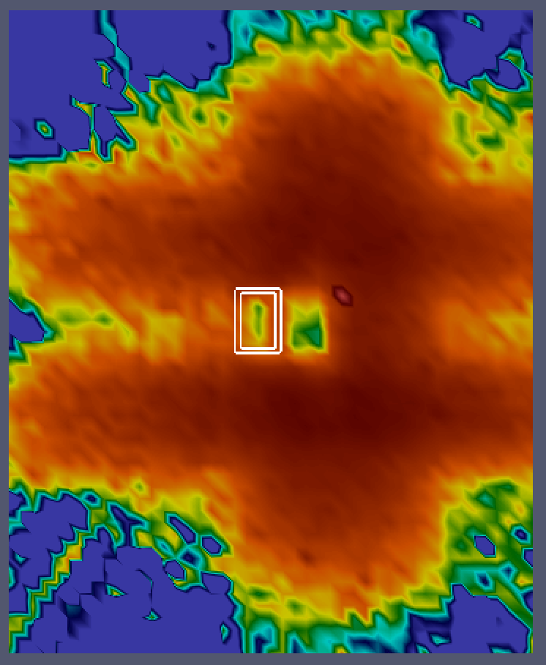
Slice of the beam line at 18m
Neutrons Energy > 0.1 keV
Guide
Neutron Flux
n/cm²s
NMX

Slide 9
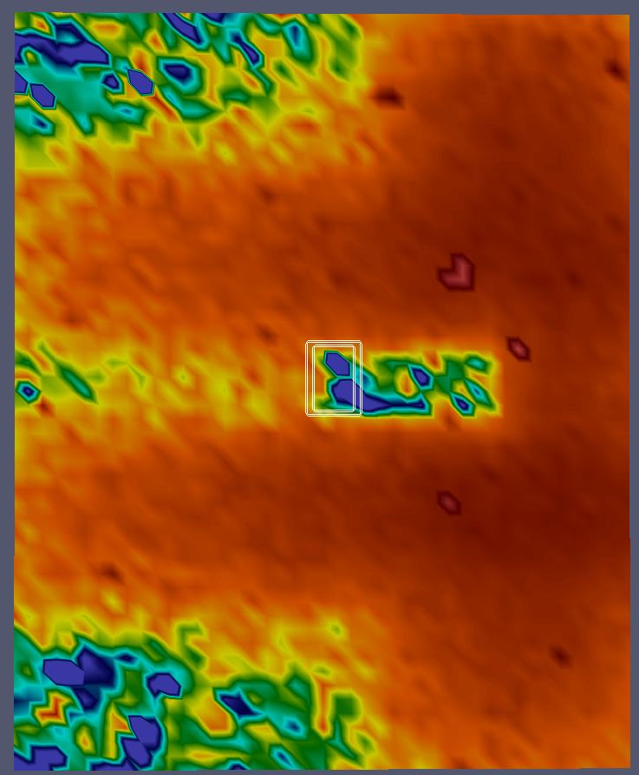
Slice of the beam line at 24 m
Neutrons Energy > 0.1 keV
Guide
Neutron Flux
n/cm²s
Main Beam
somewhere here
NMX

Slide 10
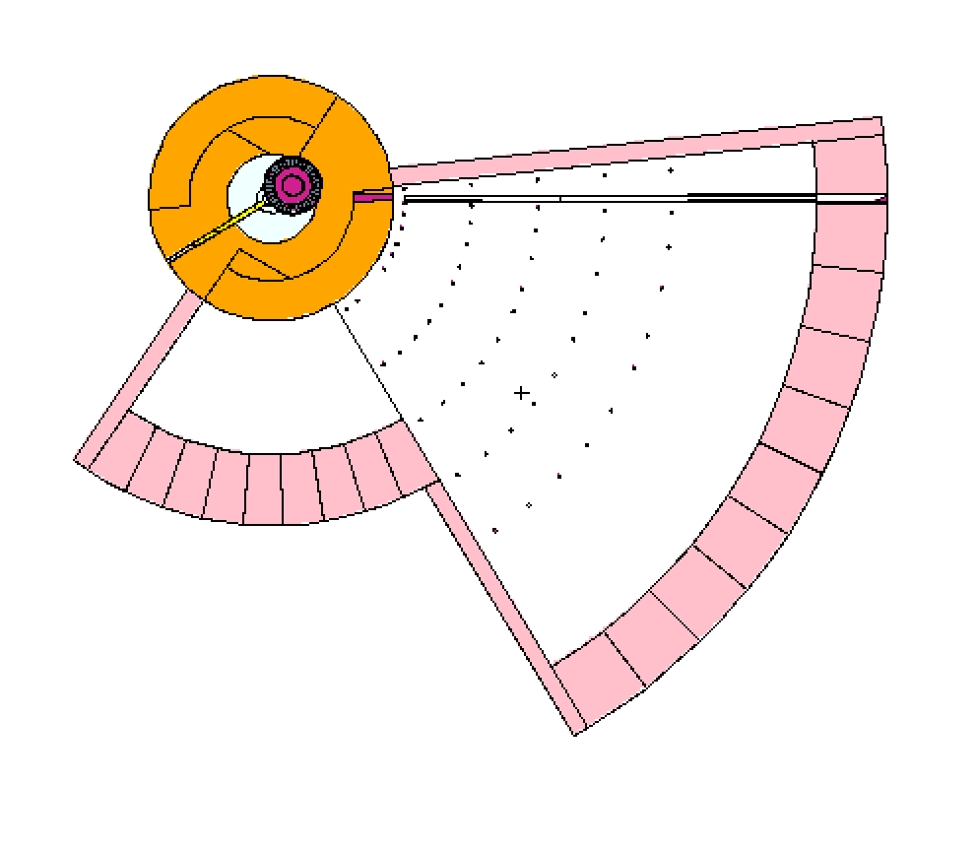
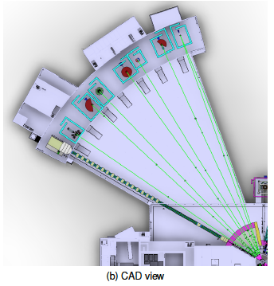
NMX in the Bunker
NMX
LONG INSTRUMENT SECTOR
Proton Beam
W1
NMX
11.5 m
24.5 m
SHORT INSTRUMENT SECTOR
NMX
CAD view
3.5 m
NMX Original Design

Slide 11
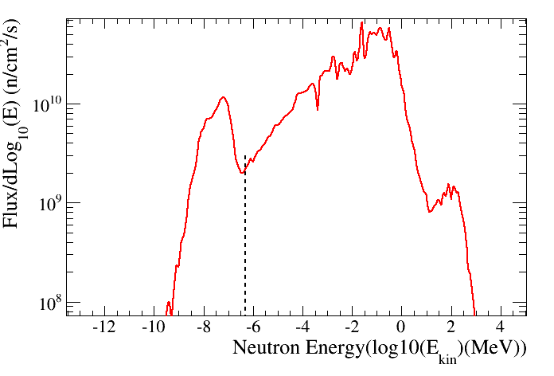
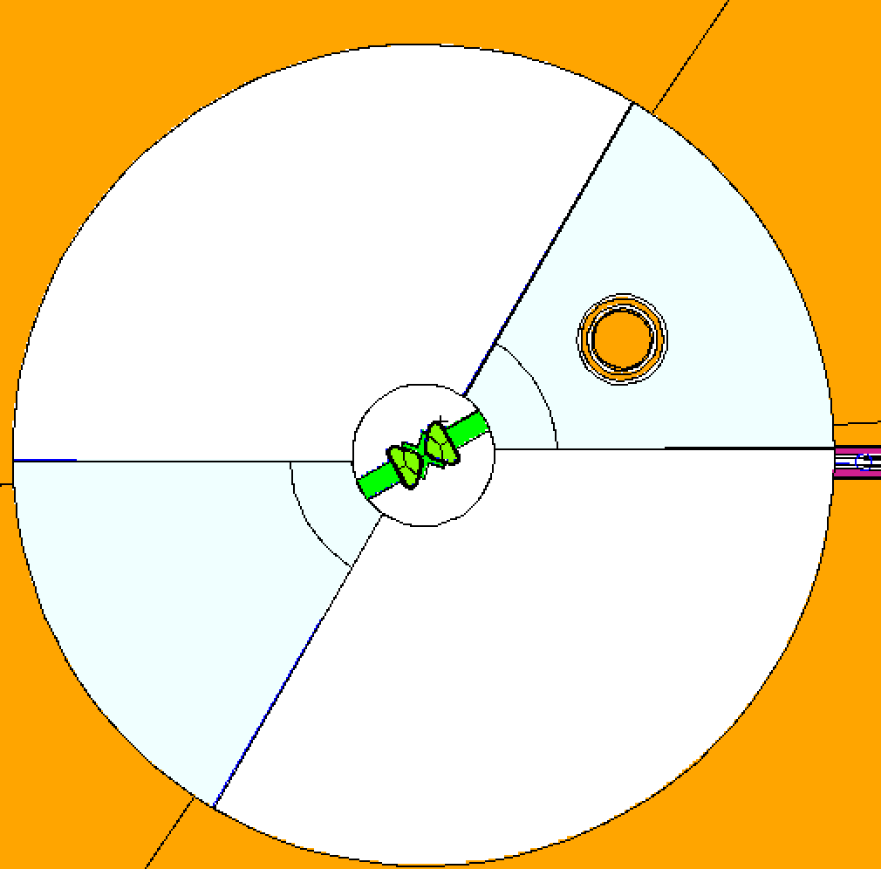
NMX in the Bunker: 2m from the Moderator
Neutron Energy Spectrum
2m from the moderator
1 eV
W1
NMX Original Design
NMX

Slide 12
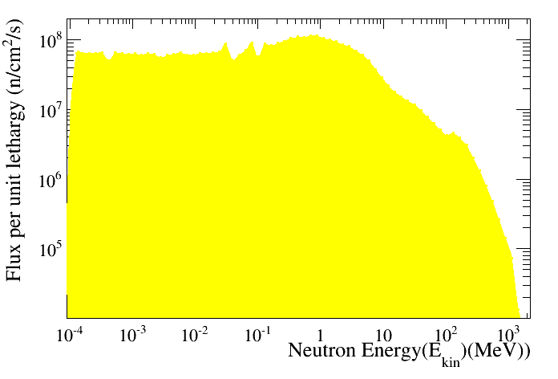
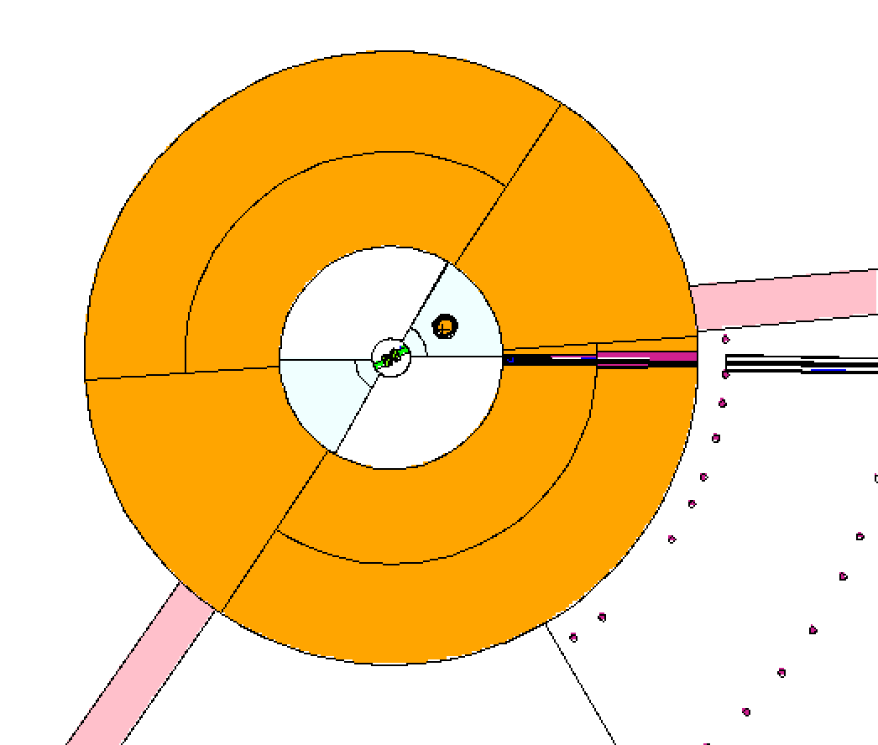
NMX in the Bunker: 6m from the moderator
Neutron Energy Spectrum
6m from the moderator
W1
NMX Original Design
NMX

Slide 13
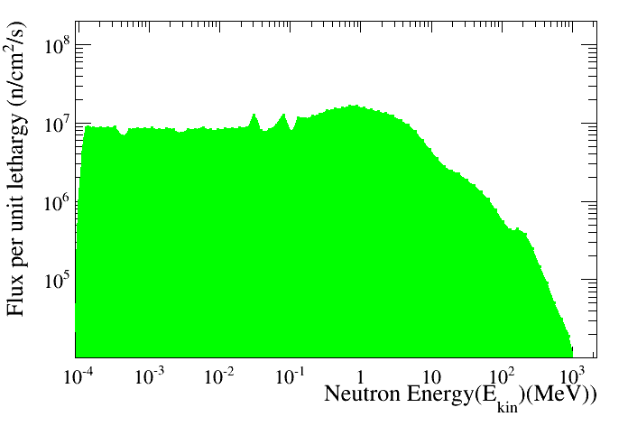
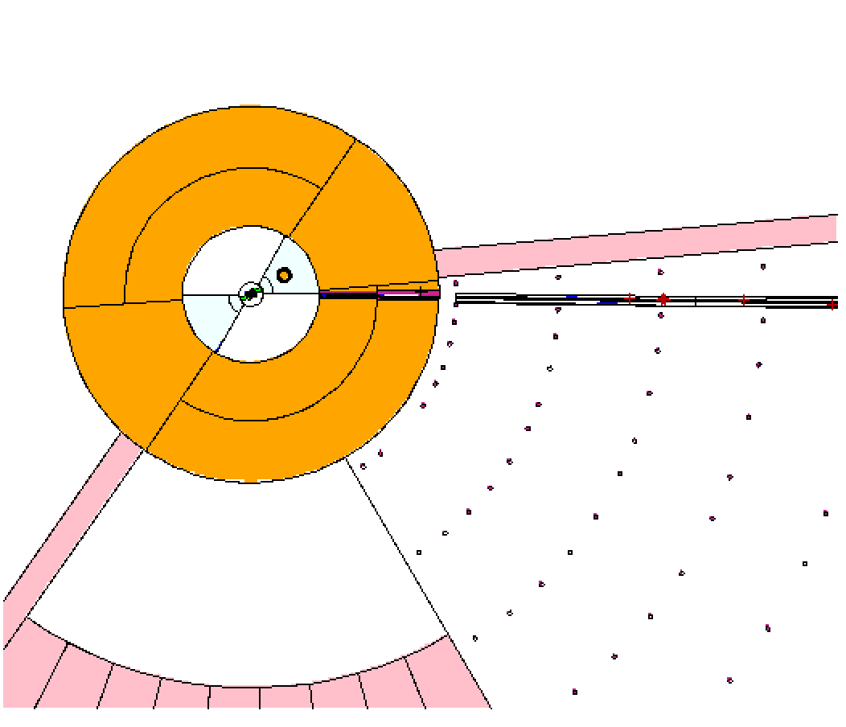
NMX in the Bunker: 12m from the moderator
Neutron Energy Spectrum
12m from the moderator
W1
NMX Original Design
NMX

Slide 14
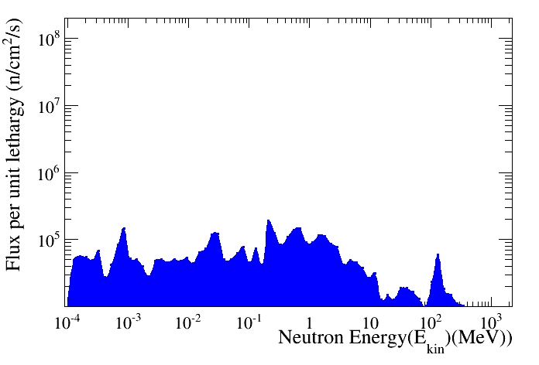
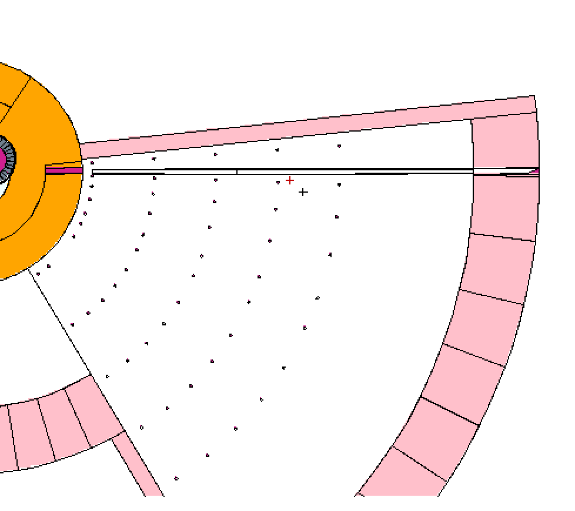
NMX in the Bunker: 18m from the moderator
Neutron Energy Spectrum
18m from the moderator
W1
NMX Original Design
NMX

Slide 15
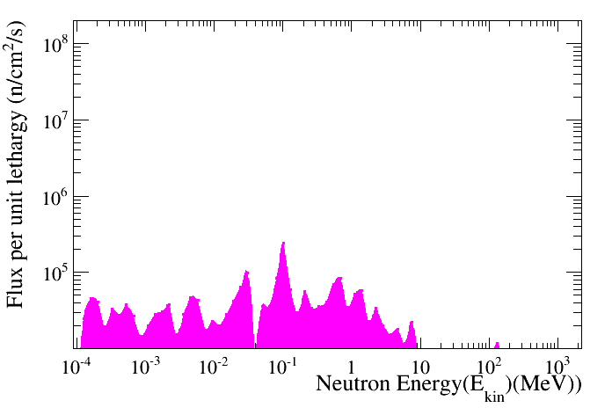
NMX in the Bunker: 24m from the moderator
Neutron Energy Spectrum
24m from the moderator
W1
NMX Original Design
NMX

Slide 16
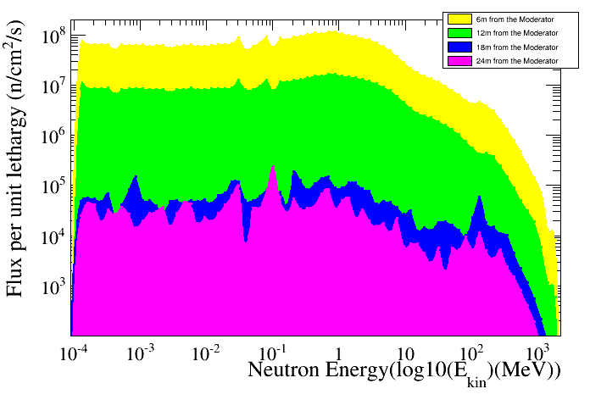
NMX Energy Spectra
NMX Original Design
MCNP entries/divided by Bin Width
NMX

Slide 17
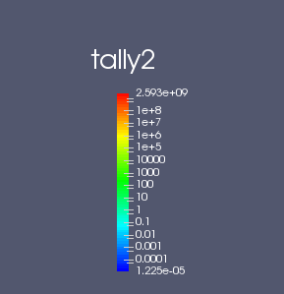
FootPrint of the beam at the bunker wall for W1
NMX

Slide 18
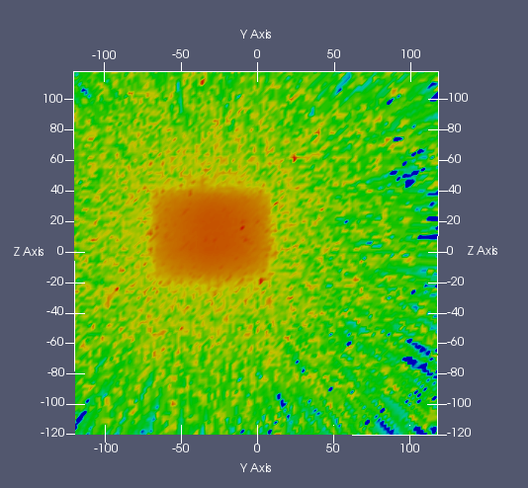
FootPrint of the beam @ the bunker wall for W8
NMX

Slide 19
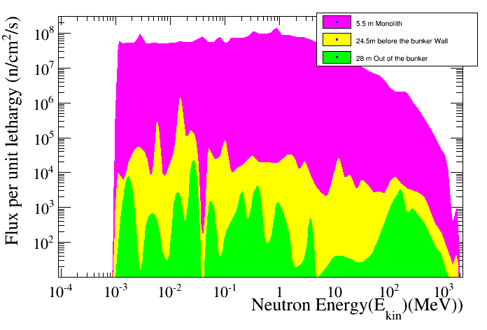
NMX

Slide 20
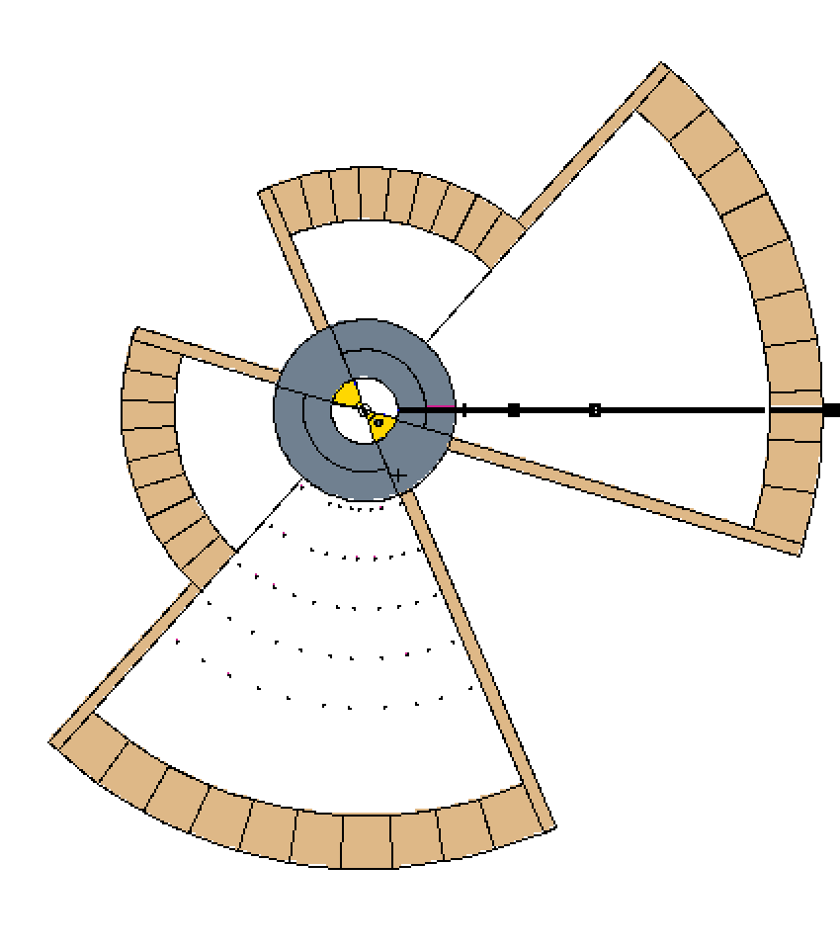
THE DREAM BEAM LINE @ S3
SOUTH SECTOR
S3
T0 Chopper
T0 Chopper
Band
Control
Chopper
Pulse Shape
Chopper
DREAM

Slide 21
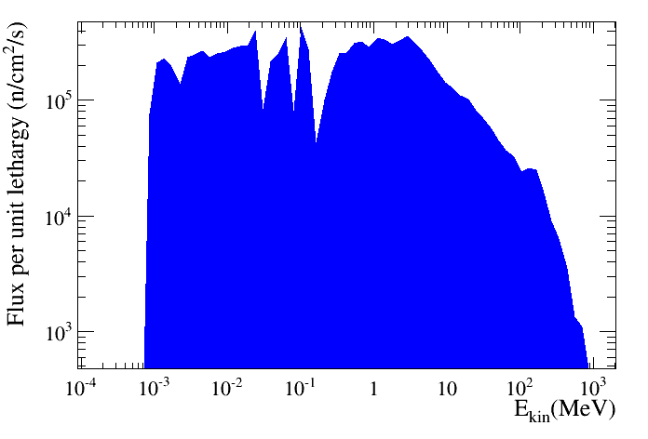
SPECTRUM OUT OF THE BUNKER
DREAM

Slide 22
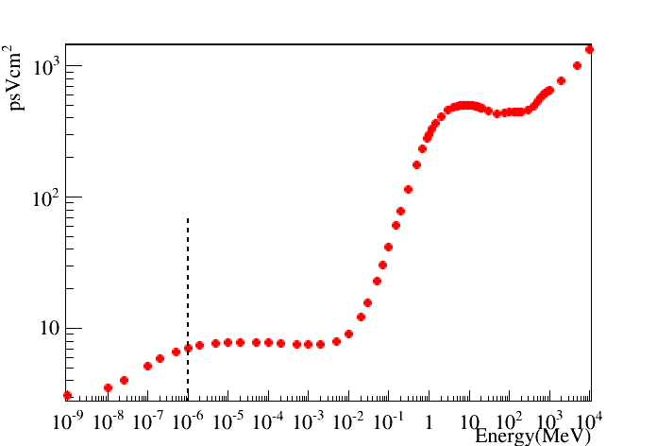
Dose pSv*cm² versus Neutron Energy
NMX

Slide 23
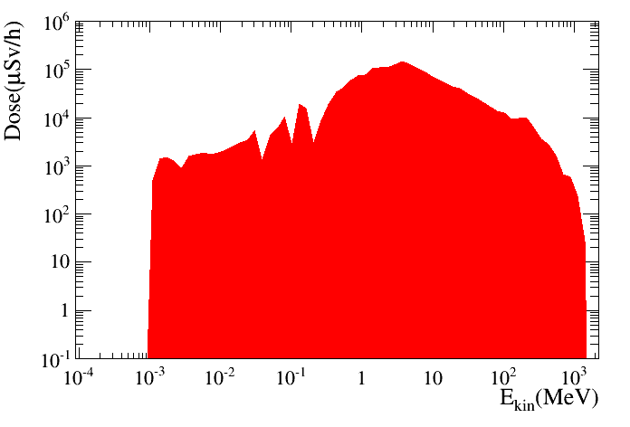
Neutron Dose out of the bunker
DREAM

Slide 24
Conclusions
The Bunker is ready (in our MCNP model)
We have showed some preliminary studies of DREAM (straight ) and NMX (curved) in the bunker
Next Step is to improve significantly the statistics (done very soon we produced a source term at 2m)
We have built a tool that allow you to test and optimize your instrument in the bunker

Slide 25
BACK –UP SLIDES

Slide 26
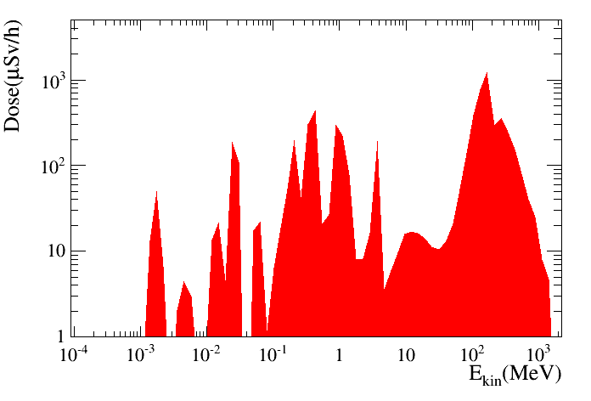
Dose μSv/h versus Neutron Energy
NMX

Slide 27
Conclusions
We have showed some preliminary studies of these beam line in the bunker
DREAM (straight ) and NMX (curved) are two interesting beamline
Next Step is to improve significantly the statistics (done very soon we produced a source term at 2m)
Bunker is ready and test are on-going

Slide 28
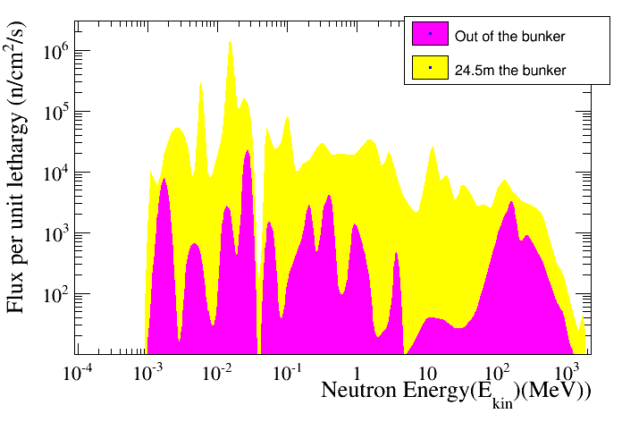
NMX

