Slide 1
How to manage your Schedule and Risks
NSS Planners
Jörgen Andersson
Sofie Ossowski
Clement Matheron
europeanspallationsource.se
Ikon, 2016-09-14

Slide 2
Agenda
Introduction
Scheduling guidelines
Earned value and progress reporting
Risk register and risk reporting
Summary

Slide 3
NSS Organization - Project management
Director for Science
Andreas Schreyer
ESS Technical Board
Chair: Roland Garoby
Project Leader: Shane Kennedy
Deputy Project Leader: Oliver Kirstein
Instrument Collaboration Board
Chair: Andreas Schreyer
Safety and Licensing:
Lead: Arno Hiess
Neutron Instruments:
Lead Scientist: Ken Andersen
Lead Engineer: Gabor Laszlo
In-Kind Office:
Lead: Sara Ghatnekar-Nilsson
Integration Activities:
Lead: Zvonko Lazic
Planning:
Lead: Sofie Ossowski
SSM application
Partner coordination
Neutron Bunker
Budgets & workflow
LOKI (ISIS)
ODIN (TUM/PSI)
Safety Systems analysis & design
Requirements & Standards
Schedule
SKADI (FRJ)
BEER (HZG/NPI)
Memoranda of Understanding
ESTIA (PSI)
Risk Management
Systems Engineering
Four Instrument Classes
Large scale structures
Engineering & imaging
Spectroscopy
Diffraction
C-SPEC (TUM)
Heads Of Agreements
(& IKCA’s)
FREIA (ISIS)
T-REX (FZJ)
Conventional Facilities
DREAM (FRJ)
BIFROST (DTU)
Technical Annexes
Target Project
HEIMDAL (ÅU)
MIRACLES (ESS Bilbao)
NMX (ESS)
VESPA(CNR)
MAGIC (LLB)
VOR or HR-NSE

Slide 4
Planning & Project support
Planning & Project Support
Budget & workflows, Schedule & EV, Risk management
Project management
Sofie Ossowski
Bunker & Integration
Sofie Ossowski
Neutron Instruments
Jörgen Andersson
NSS Support Projects
Clement Matheron & Sofie Ossowski
Operations Planning
Clement Matheron
Target Interfaces
LOKI (ISIS)
ODIN (TUM/PSI)
Science Support Systems
Sofie Ossowski
Conventional Facilities Interfaces
SKADI (FRJ)
BEER (HZG/NPI)
Instrument Technology
Choppers, NOSG, MCA & Detector Systems
Clement Matheron & Sofie Ossowski
ESTIA (PSI)
C-SPEC (TUM)
FREIA (ISIS)
T-REX (FZJ)
DREAM (FRJ)
BIFROST (DTU)
DMSC
Clement Matheron
HEIMDAL (ÅU)
MIRACLES (ESS Bilbao)
NMX (ESS)
VESPA(CNR)
MAGIC (LLB)
VOR or HR-NSE

Slide 5
Planning & Project support
Planning & Project Support
Budget & workflows, Schedule & EV, Risk management
Neutron Instruments
Jörgen Andersson
NSS In-Kind Office
Sara Ghatnekar Nilsson
Michela Dell Anno Boulton
LOKI (ISIS)
ODIN (TUM/PSI)
SKADI (FRJ)
BEER (HZG/NPI)
ESTIA (PSI)
C-SPEC (TUM)
Support to IK instruments Project teams:
Monthly progress reporting
Earned value management
Integration with ESS projects
Information exchange on Procurement
Advisory
FREIA (ISIS)
T-REX (FZJ)
DREAM (FRJ)
BIFROST (DTU)
HEIMDAL (ÅU)
MIRACLES (ESS Bilbao)
NMX (ESS)
VESPA(CNR)
MAGIC (LLB)
VOR or HR-NSE

Slide 6
High Level Schedule – NSS/ESS
2014
2015
2016
2017
2018
2019
2020
2021
2022
2023
2024
2025
Global & Project MS
Machine ready for 1st Beam on target
Full Scope strategy
Instruments
First neutron measurement (test beamline)
Start User Programme
Neutron Bunker
Preliminary design
Detailed design
Manufacture & procurement
Installation and integration
Preliminary design
Hot commissioning
Test beamline
Detailed design
Manufacture & procurement
Installation and integration
Hot commissioning
First User Instrument
Preliminary design
Detailed design
Manufacture & procurement
Installation and integration
Hot commissioning
Operation

Slide 7
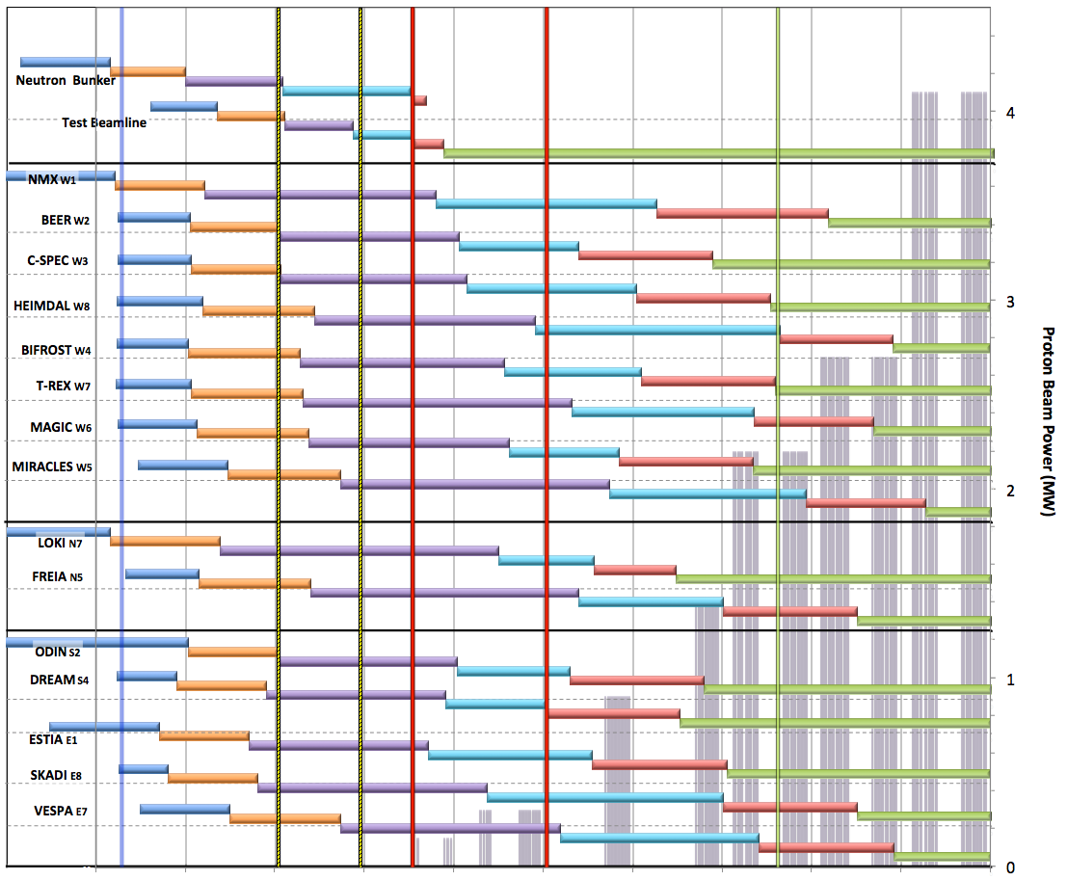

Neutron Beam Instrument Draft Schedule
V1.6, 7th April 2016
Currently under review
Current date
Early Access D01/D03
Full Access D01/D03
Beam on Target / 1st spectrum
Start Hot Commission
User instruments
Start User Program
Commissioning of test beam – to demonstrate performance and inform instrument projects
Notes;
The order of completion 1- 8 chosen for science and deliverability
Shift 9-16 to focus on 1-8 for early science success
Hot Commissioning start;
  E ≥ 200 MeV
  P ≥ 200 kW
  January 2021
DRAFT
West sector
North sector
Preliminary Design
Detailed Design
Manufacturing & Procurement
Installation & Integration
Hot Commissioning
Operation
East and South sectors
2016 2017 2018 2019 2020 2021 2022 2023 2024 2025

Slide 8
Schedule and scope change- approval flow
Class A – ESS ERIC council
  Technical specification in Programme Plan
  5-7 overall milestones
  Total budget 1843 M€
Class B – CEO
  ESS level configuration (including ICD PBS L2)
  About 30 milestones with dependencies between projects
  Project budget, use of contingency
Class C – Project Manager -> Change decisions are made at NSS Project coordination meetings
  Project configuration
  Project activities and milestones (not part of Class B)
  Sub-project budget distribution
Class D (E) – Sub-project Manager / Instrument Class Coordinator
  Sub-project configuration
  Sub-project activity rescheduling without impact on Project level
Change requests to be communicated with the Instrument
Class Coordinator and Lead Instrument Engineer

Slide 9
Examples – Change control
Instrument key MS delayed
  Partner institute discuss with NSS project (through Instrument Class Coordinator and Lead engineer) and ask for formal change request
  NSS coordinator revise/discuss implications on ESS level
  Decision (& updating plans if approved)
ESS key MS for Instrument delayed
  NSS Project to inform potentially affected partner institute
  Re-plan accordingly and following change process
  P6 updated with new dates after approval from Change Control Board
  Change control process needed for any suggested scope change
  Including scope and schedule impact analysis
  Before approval of change all scope and schedule issues shall be handled as forecast and/or risk
Notes:
Lead engineer main contact for ESS delays

Slide 10
Preparing for Installation on site
Installation planning identified as key success factor
  Accelerator and Target first in line. Starting now.
ESS Guidelines for integration and installation ongoing
ESS Installation coordinators to be in place for aligning detailed plans
IK partners are required to establish integration and installation process.
We encourage to start this at an early stage.
Notes:
Key MS indicated

Slide 11
Preliminary Over all site organization
Over all Site Manager
Deputy Site Manager
Framework Agreements
Workshop
Welders
Fitters
Electrical
I&C
Technicians
Etc.
Over all QC
Installation Inspection
Receival inspection
NDT (X-ray, PT, UT etc.)
Accredited Inspection Body AIB
Accredited Body AB
Final quality documentation
Site Admin
Time Schedule
Financial control
Procurement inst. hardware/manpower
Temporary Services
Scaffolding
Laydown Areas
Crane Drivers
Logistics/Transport
Warehouse
Heavy lifting
Temporary Power & Fluids
Concrete Boring/Drilling
Survey/Alignment
Waste
TD
Site Manager
ACC
Site Manager
NSS
Site Manager
ICS
Site Manager
CF
Site Manager
NSS
Lead Engineer Gabor Laszlo
Service from outside the project organization
Notes:
Overall site manager – support
NSS site manager – authority (within scope/area…)
Each instrument needs someone that can correspond to the NSS site manager.

Slide 12
NSS and partners
Anticipate integrated approach between the NSS Project office
and collaborating Project offices at institutes with large involvement in ESS instruments.
NSS Project Support (PS)
Jülich PS
ISIS PS
PSI PS
…
LLB PS
  Principles for collaborating/interacting:
  Best practice
  Good & regular communication
  Openness and collaborative approach
  Continuous improvements
Notes:
Looking to find the right level of interaction

Slide 13
Agenda
Introduction
Schedule guidelines
Earned value and progress reporting
Risk register and risk reporting
Summary

Slide 14
Project Planning guidelines
Use MS Project or similar to create a detailed plan aligned with baseline
(proposal to council including cost book values for instruments and all other activities as well as the preliminary schedule)
The detailed plan shall include the full project scope broken up into work packages and work units with linked activities showing a critical path with dependencies. Resource load activities – track where staff is deployed
Use schedule margin to minimize risk for slippage of deliverables
Track contingency as tool for early warning
  Part of the detailed plan (high level) will be mirrored in
  ESS planning tool (Primavera P6)

Slide 15
Milestones/key deliverables in TA
When drafting the milestones/key deliverables in the Technical Annex,
consider that:
  Key deliverables and milestones with earn value weight (i.e. with cost value) should be in NSS schedule as well as in the partner schedule.
  The number of milestones in the TA should be relevant to the size and schedule of the instrument project, but in general 5-10 high level milestones
  Outside the TA, 1-5 milestones per quarter are expected to be mirrored in the ESS plan and the partner’s plan.
  Any change to the committed dates while executing the plan needs approval from NSS Project leader (i.e. undergo ESS Change Control)

Slide 16
Project execution & follow up
The partner and NSS will have monthly progress updates including:
  Partner provide NSS with a copy of their full plan (MS project or similar)
  Progress on milestones mirrored in the NSS planning tool (milestones with earned value weight will be the basis for the planned value curve).
  Review and discuss total schedule and key deliverables
  Reporting project issues and risks
  Use of Instrument Project contingency
  Any changes to key deliverables/milestones are under NSS Change Control and must be approved by NSS Project leader.

Slide 17
Key Milestones & Deliverables

Slide 18
Milestones phase 1
Phase 1
  STAP meeting (50% of contract value)
  Scope setting meeting (20% of contract value)
  Submission of TG2 documents (20% of contract value)
  TG2 / PDR completed (10% of contract value)
  General set up implemented in all TA’s for Phase 1.
Draft MS suggestion for phase 2
  Component / sub-system CDR
  Contract signing with vendors and contractors
  Submission of TG3 documents
  TG3 / CDR completed

Slide 19
Agenda
Introduction
Schedule guidelines
Earned value and progress reporting
Risk register and risk reporting
Summary

Slide 20
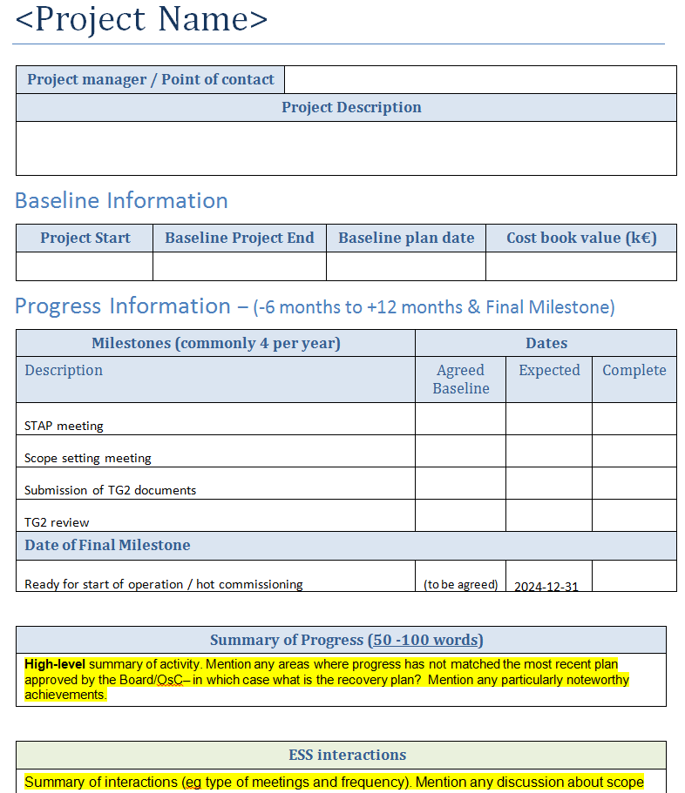
Project report template

Slide 21

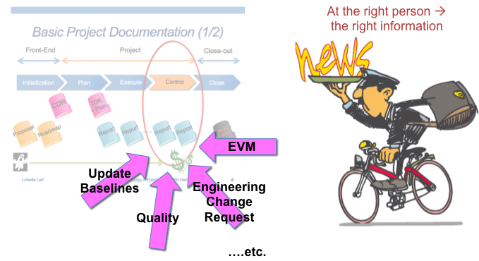
How to measure project performance?
Earned Value Management (EVM) is the tool used for defining success in meeting the project schedule.
EVM integrates project scope, cost and schedule measures.

Slide 22
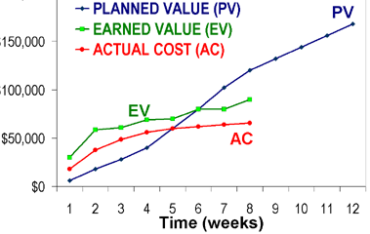
Earned value - key components
Planned Value (PV) – what you plan to do
Earned Value (EV) – what you accomplished
Actual cost (AC) – what you have spent
CPI = EV/AC = 1 by definition for in kind contracts
SPI > 1 means ahead of schedule

Slide 23
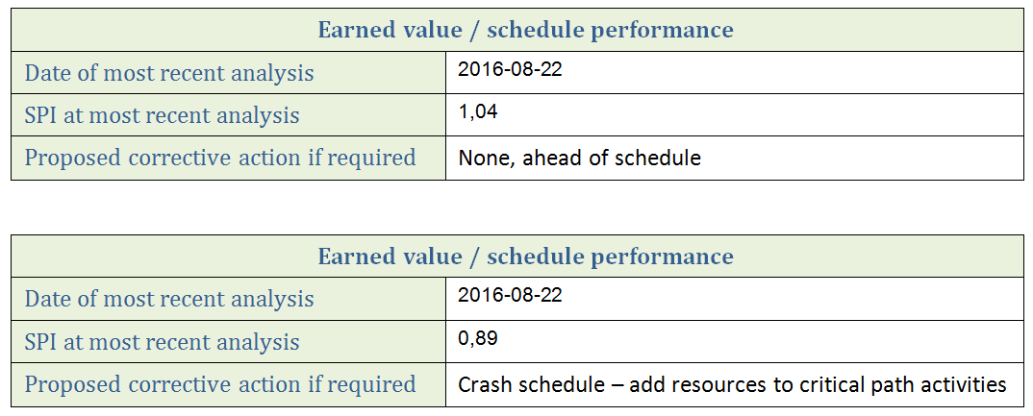
Variance reporting – two examples

Slide 24
SPI variances
Potential causes of schedule variances
Ambitious plan
Inaccurate planning
Work complexity not in line with estimations
Resource availability differs from plan
Revised execution plan
Vendor and subcontractor performance
Rework
Unclear requirements
Scope creep

Slide 25
Agenda
Introduction
Schedule guidelines
Earned value and progress reporting
Risk register and risk reporting
Summary

Slide 26
Risk communication and reporting
Risk communication is a central part of Risk Management
Frequent reporting of the risk exposure will help all parties understand what might influence the projects
Inputs to risk registers form part of what is being reported
  Carefully consider what is entered in the register
Several stakeholders on all levels have interest of ESS project risks, e.g.
  Project Management teams
  ESS senior management
  ESS ERIC council, SAC, AFC
  Other committees and partners

Slide 27
Risk register - example
Risk description
Metrics with assessed likelihood and impact
Action plans

Slide 28
Typical risk areas in instrument projects
  Inadequate or insufficient verification
  Available resources do not meet needs
  Ambiguous or insufficient set of requirements*
  Late delivery of key components
  Logistics arrangement not in line with needs
* Both functional and non-functional requirements

Slide 29
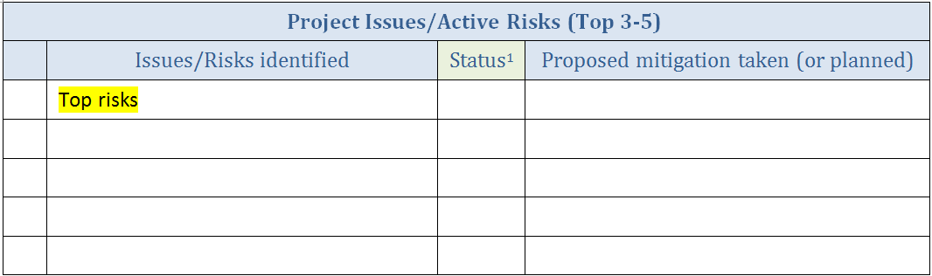
Risk communication and reporting
The monthly report contains:
  Summary of most severe risks
  How the risk exposure has changed over time
  Risk treatment status; actions closed and planned
^{[1]} Include change rising/falling/steady

Slide 30
Agenda
Introduction
Schedule guidelines
Earned value and progress reporting
Risk register and risk reporting
Summary

Slide 31
Summary – scheduling and EV
ESS expectations on a good project plan
The project plan shall cover the full project scope
Define robust and resource loaded activities
Identify all activitity dependencies
Key deliverables and milestones with earn value weight
Keep the plan consistent with all approved change requests
Use earned value variance analysis to
Monitor and Control your project/work packages
Communicate cost and schedule performance

Slide 32
Summary - How we work with risks at ESS
  Projects are driving their internal Risk Management work
  Risk registers are owned and maintained by the projects
  The risk register shall include metrics with assessment of likelihood and impact severity
Focus:
  Make sure that work with Risk Management progresses
  Risk communication within and between Projects
  Monthly reporting based on updated risk register
Risks and risk treatments are handled on the most suitable level – always assign responsibility

Slide 33
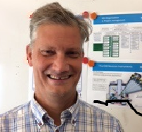

Contact us
Instrument Projects coordination
Jörgen Andersson
Jorgen.andersson@esss.se
+46721792156
NSS Support Projects & Operations Planning
Clement Matheron
Clement.matheron@esss.se
+46721792397
NSS Project Management & Interfaces,
Bunker Project
Sofie Ossowski
Sofie.ossowski@esss.se
+46721792095

