Slide 1
SKADI
Scope and Budget
14. September 2016 | Sebastian Jaksch

Slide 2
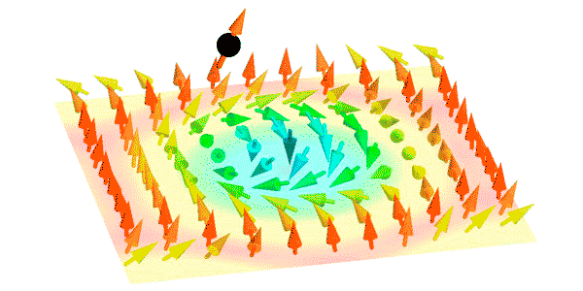
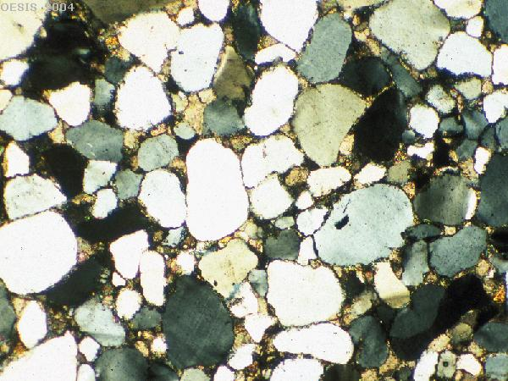
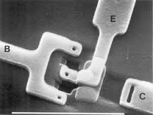
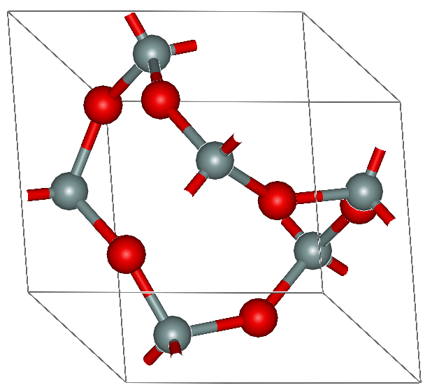
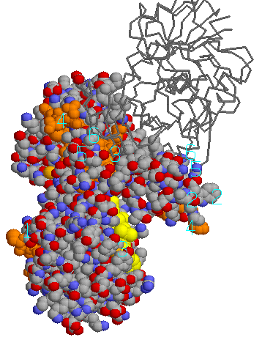
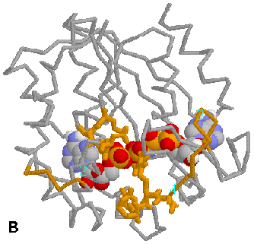
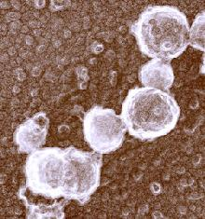
Magnetic Systems
Geological Studies
Electronics
Polymers
Proteins
Viruses and Cells
Food Science
1Å
10Å
100Å
1000Å
1µ m
10µ m
Q
1Å⁻¹
0.1Å⁻¹
0.01Å⁻¹
0.001Å⁻¹
10⁻⁴Å⁻¹
10⁻⁵Å⁻¹
SANS
VSANS
SESANS

Slide 3
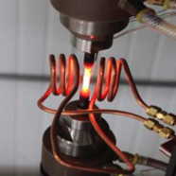
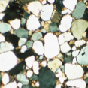
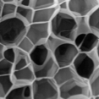
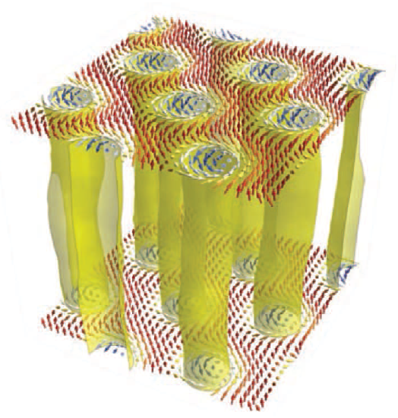
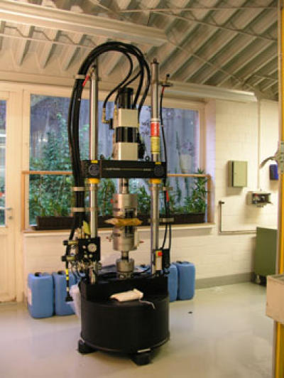
Science Case
Science Case → Design Goals
Flexibility (sample area is approx. 3x3 m², and versatile collimation) for custom sample environments
Very small Q by focusing optics, for accessing length scales in the µm range
High dynamic Q-range covering three orders of magnitude simultaneously
Polarization for magnetic samples
High time-resolution together with Q-range will allow for the in-situ investigation of fast, non-reversible processes in a single measurement

Slide 4
Scope Overview
1 m² detector
Relaxed footprint (more than 6°)
Polarizer, no polarization analysis
Detector movable
4 choppers with high-flux and high-resolution mode
Upgradeable to full scope
2 m² detector
Polarization analysis
Sample environment

Slide 5
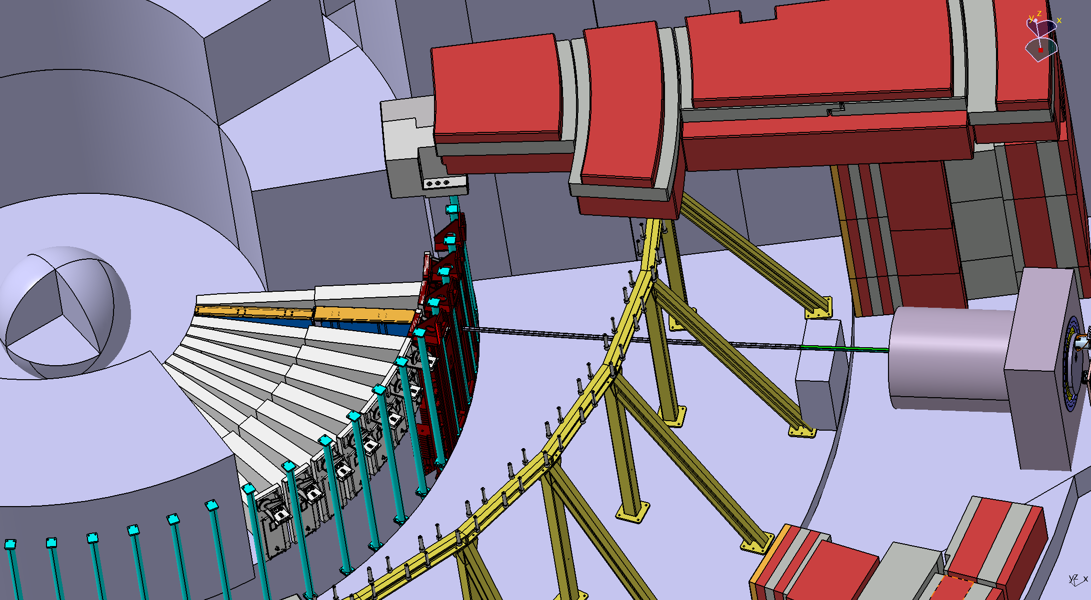
Have a look: Beam Extraction
Get out of line of sight fast
Low Background
No active component inside bunker

Slide 6
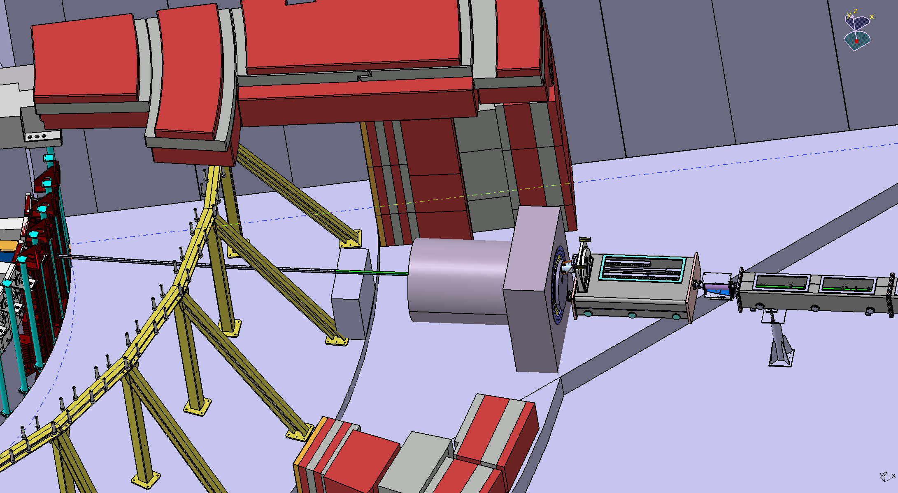
Have a look: Exit the Bunker
Heavy Shutter
Polarizer
First Chopper

Slide 7
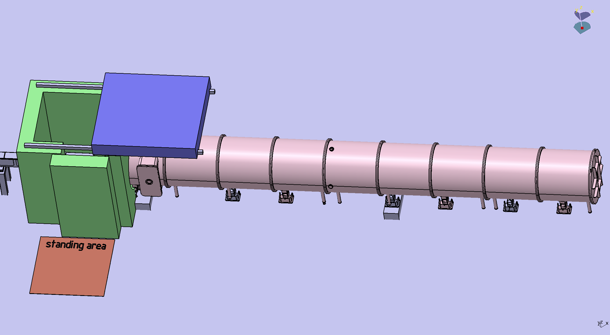
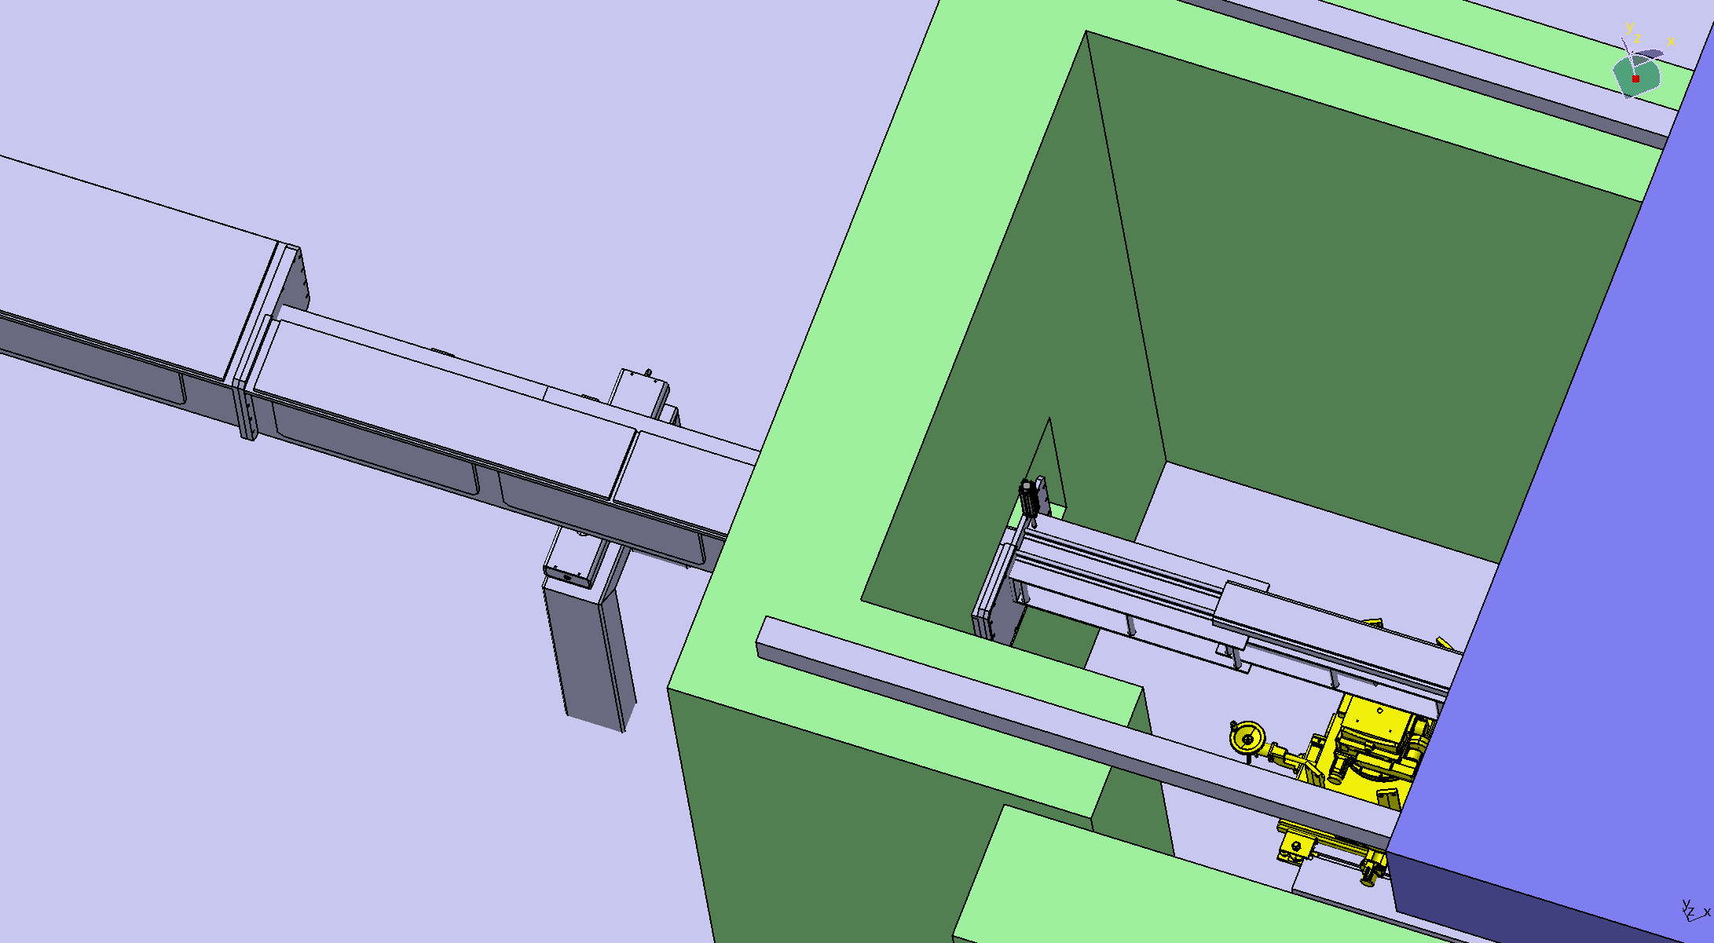
Have a look: Sample Area
Versatile (large) Volume
Accessible by door and roof hatch
Emergency shutter inside wall
Active shielding

Slide 8
Budget Overview
01 Shielding | € 2,000,000
02 Neutron Optics | € 3,073,200
03 Choppers | € 779,480
04 Sample Environment | € 403,500
05 Detector and Beam Monitors | € 3,730,000
06 Data Acquisition and Analysis | ESS
07 Motion Control and Automation | € 545,200
08 Instrument Specific Technical Equipment | € 861,000
09 Instrument Infrastructure | € 250,000
10 Vacuum | ESS
11 PSS | € 114,640
12 Contingency | € 1,175,702.00
Total | € 12,932,722
Main contribution: Optics, Detectors and Shielding
Approx. 25 years of work
Focus on critical components to avoid risks
Contributions from common systems from ESS needed
Interaction/Sharing with other instruments, especially
Sample environment
Shielding

Slide 9
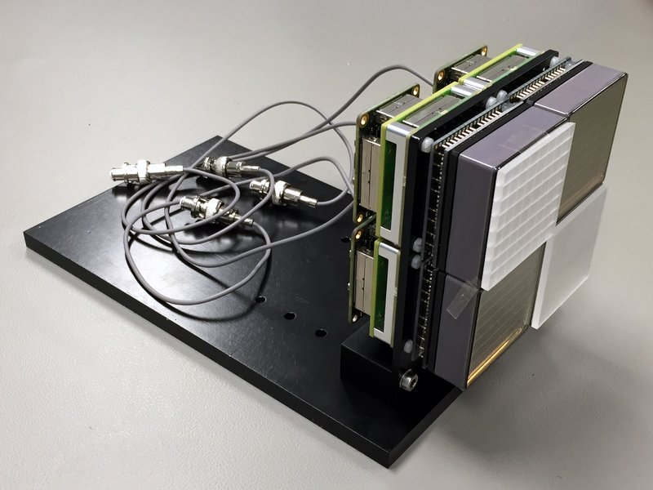
Selected Issues: SoNDe Detector
High time-resolution together with Q-range will allow for the in-situ investigation of fast, non-reversible processes in a single measurement
Develop a large area PSD neutron detector with:
high-flux capability (gain factor of 20 over current detectors)
high-resolution of at least 3 mm by single-pixel technique
efficiency of 80 % or more
no beam stop necessary
strategic independence of ³He
time-of-flight (TOF) capability, time resolution in the µs regime
modularity
High bugdet contribution → High risk
Distinguish in performance from existing SANS instruments
Workshop on Oct. 17th – 19th

Slide 10
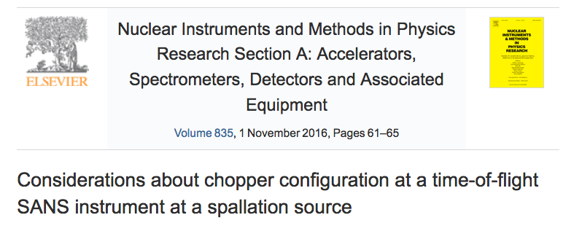
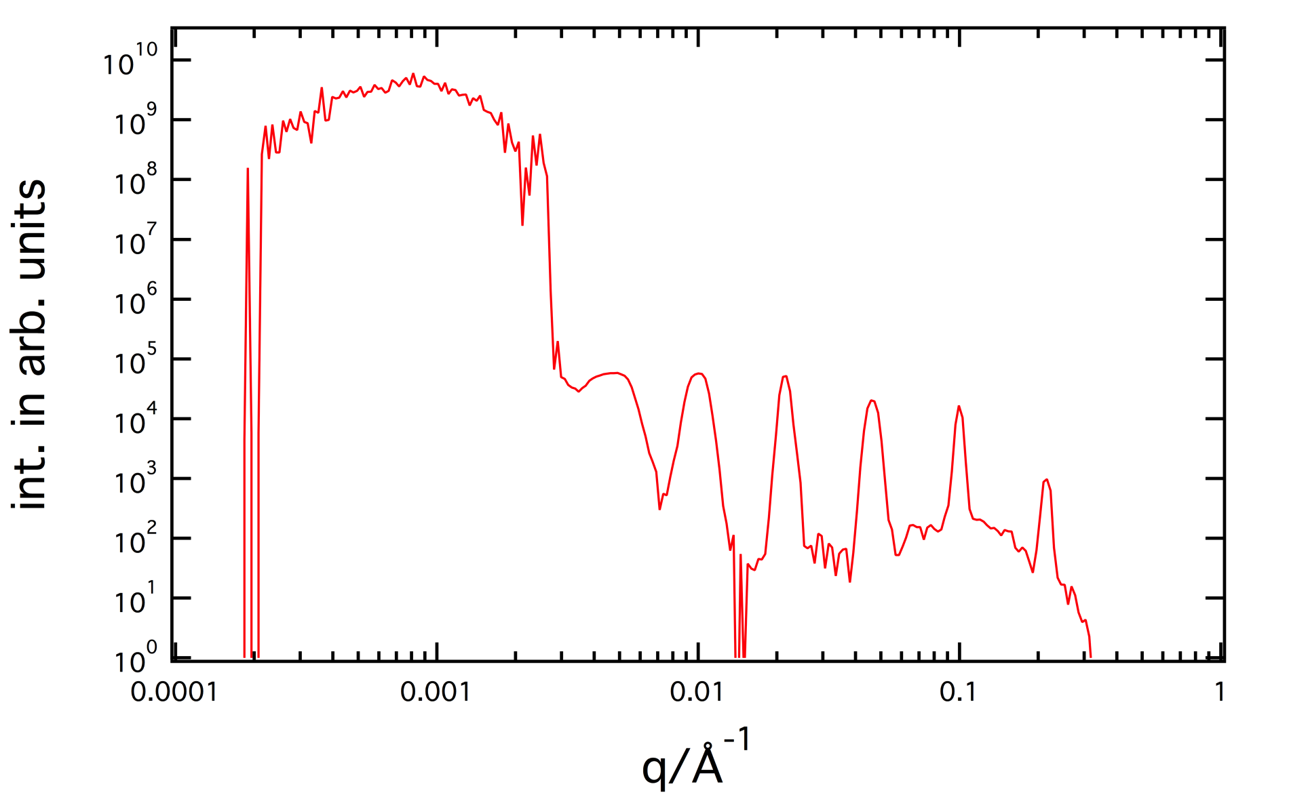
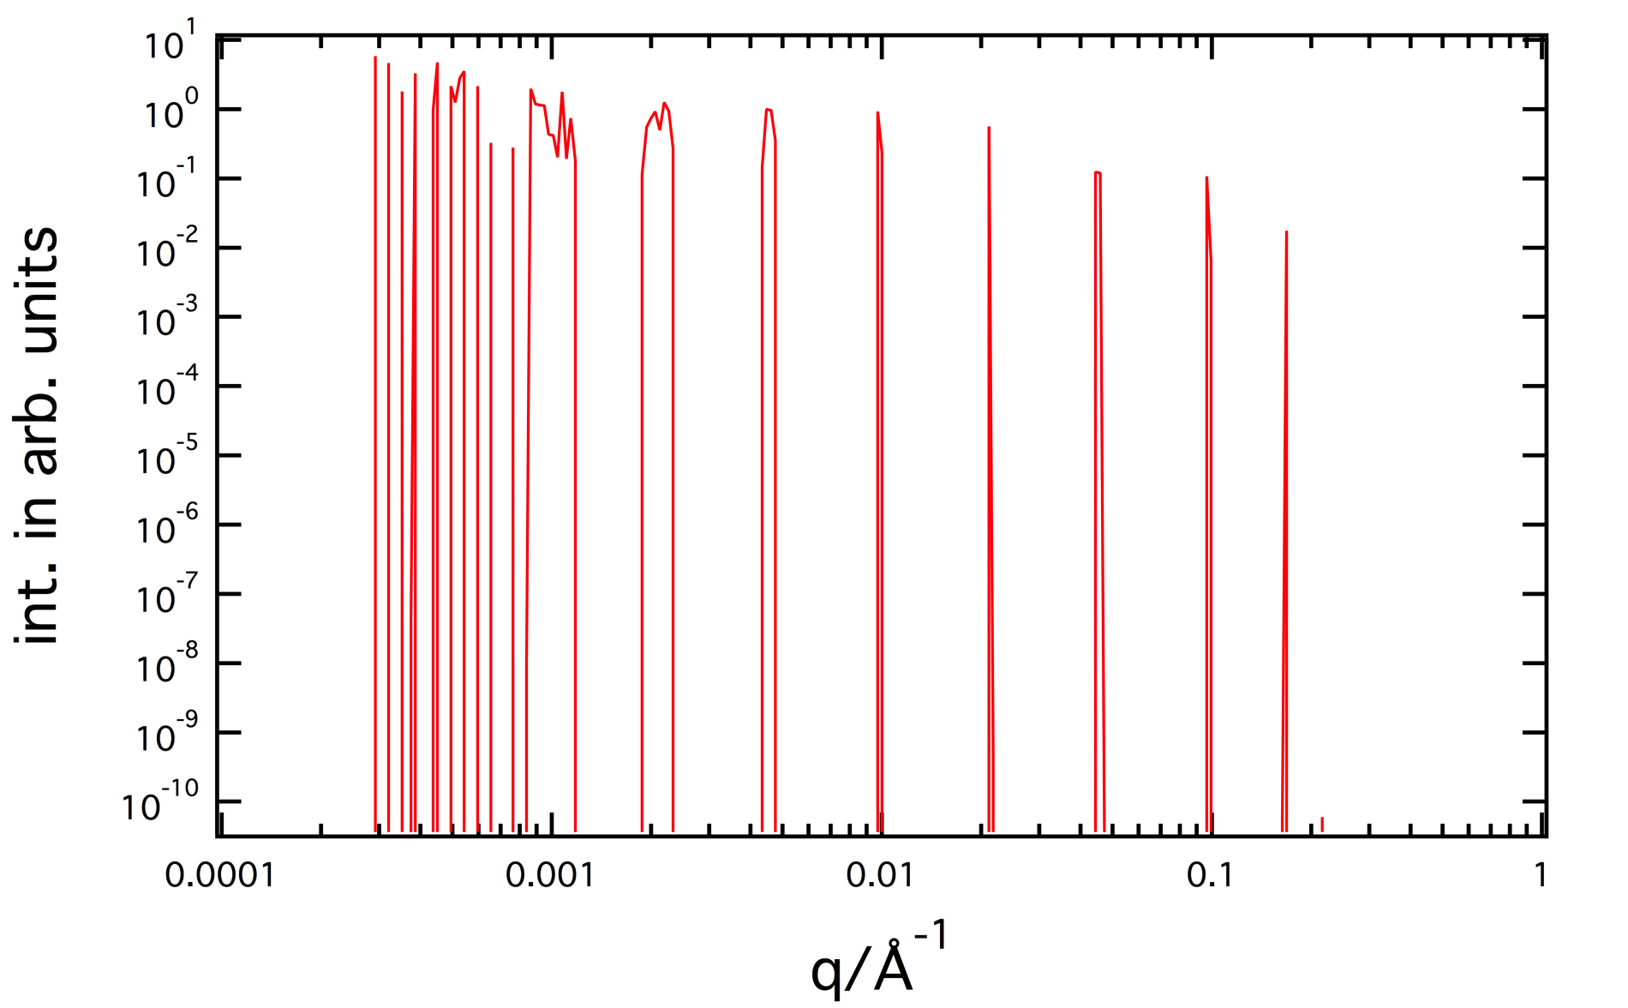
Selected Issues: Chopper Setup
Four single chopper disks
Two always at source frequency
Two either
At source frequency (max. flux)
At integer multiples (1% wavelength res.)
Avoid need for double disk choppers
Get a high-resolution mode „for free“
WAIT FOR PARALLEL SESSION

Slide 11
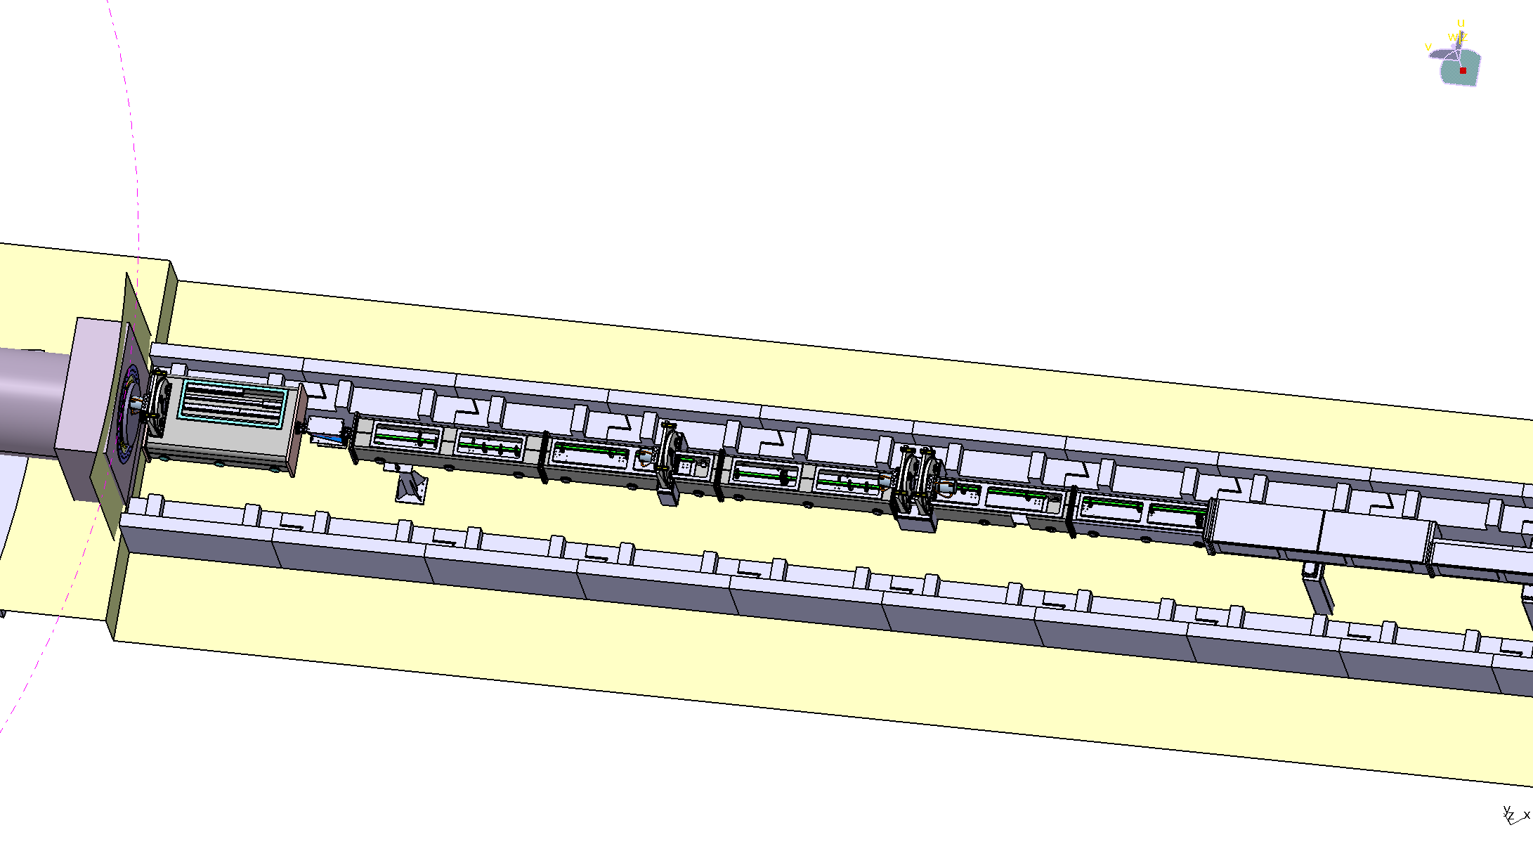
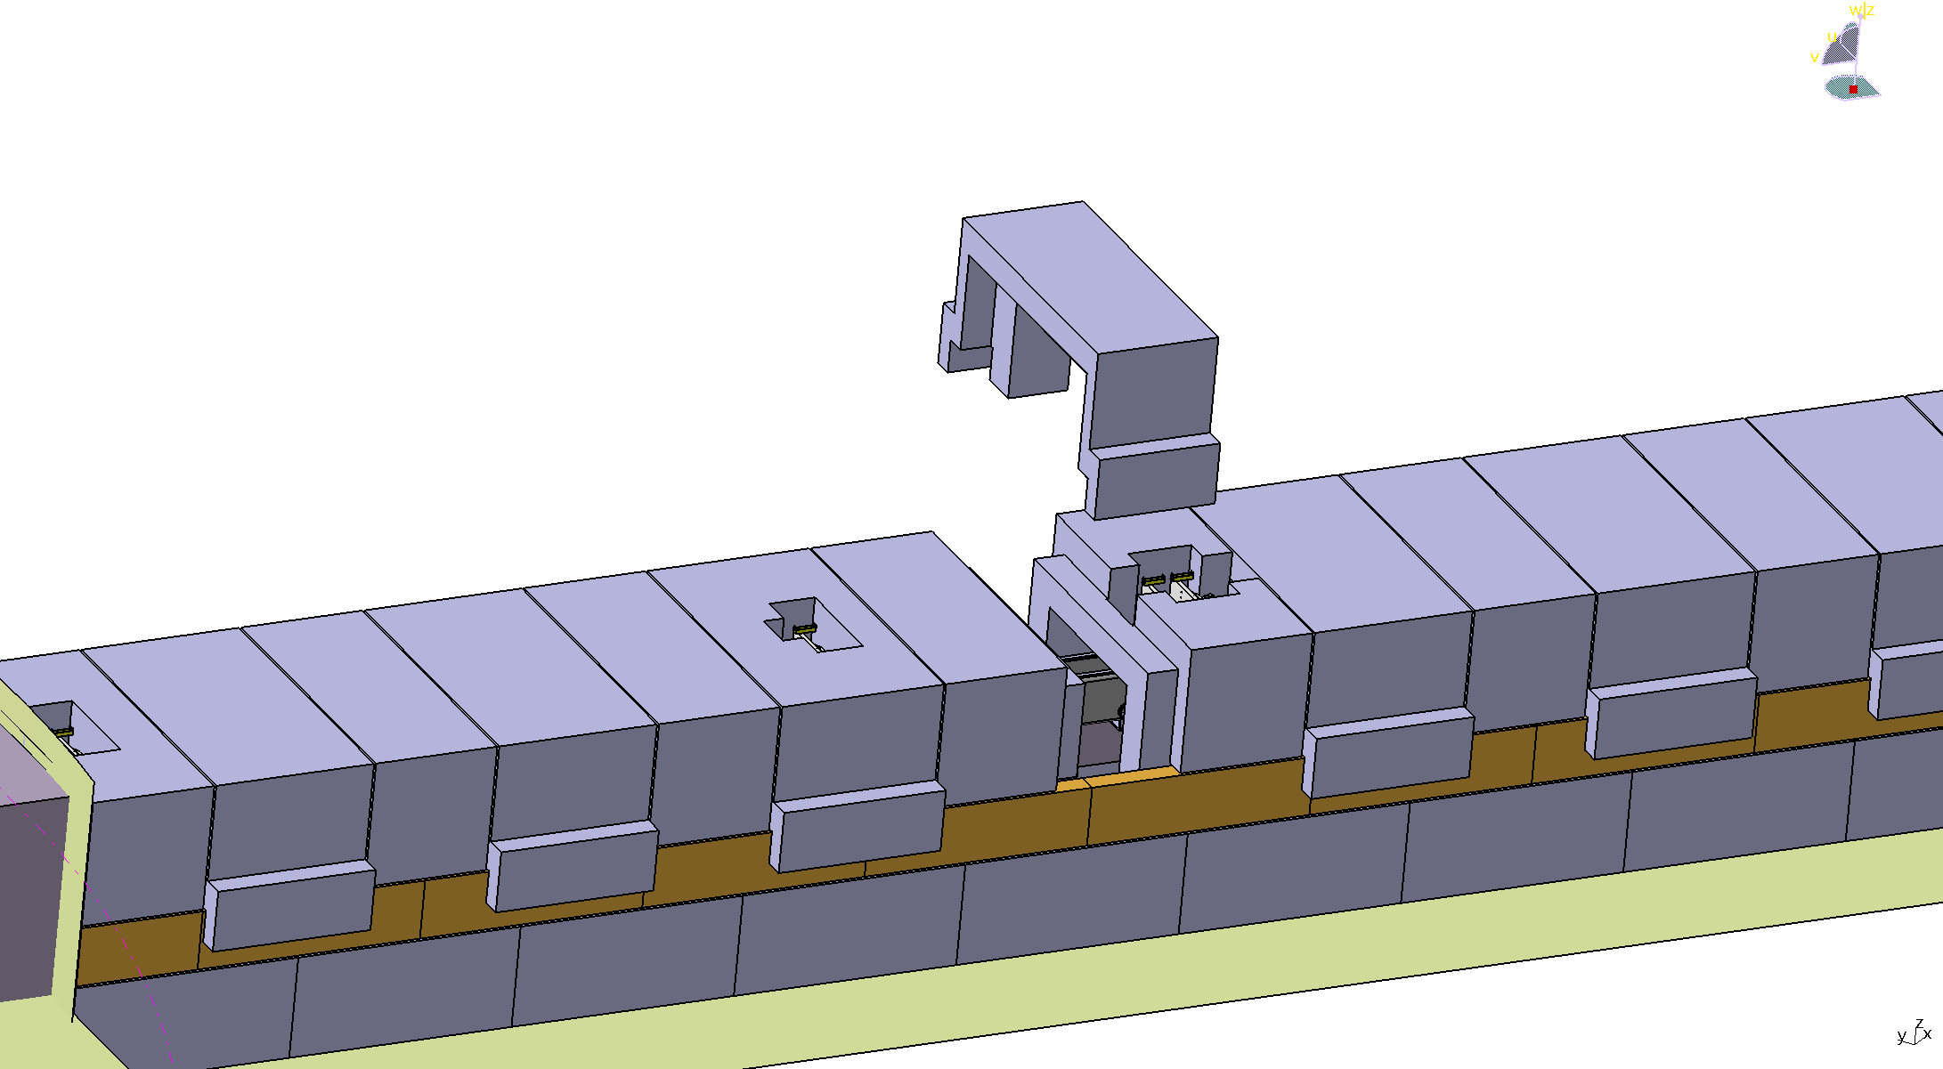
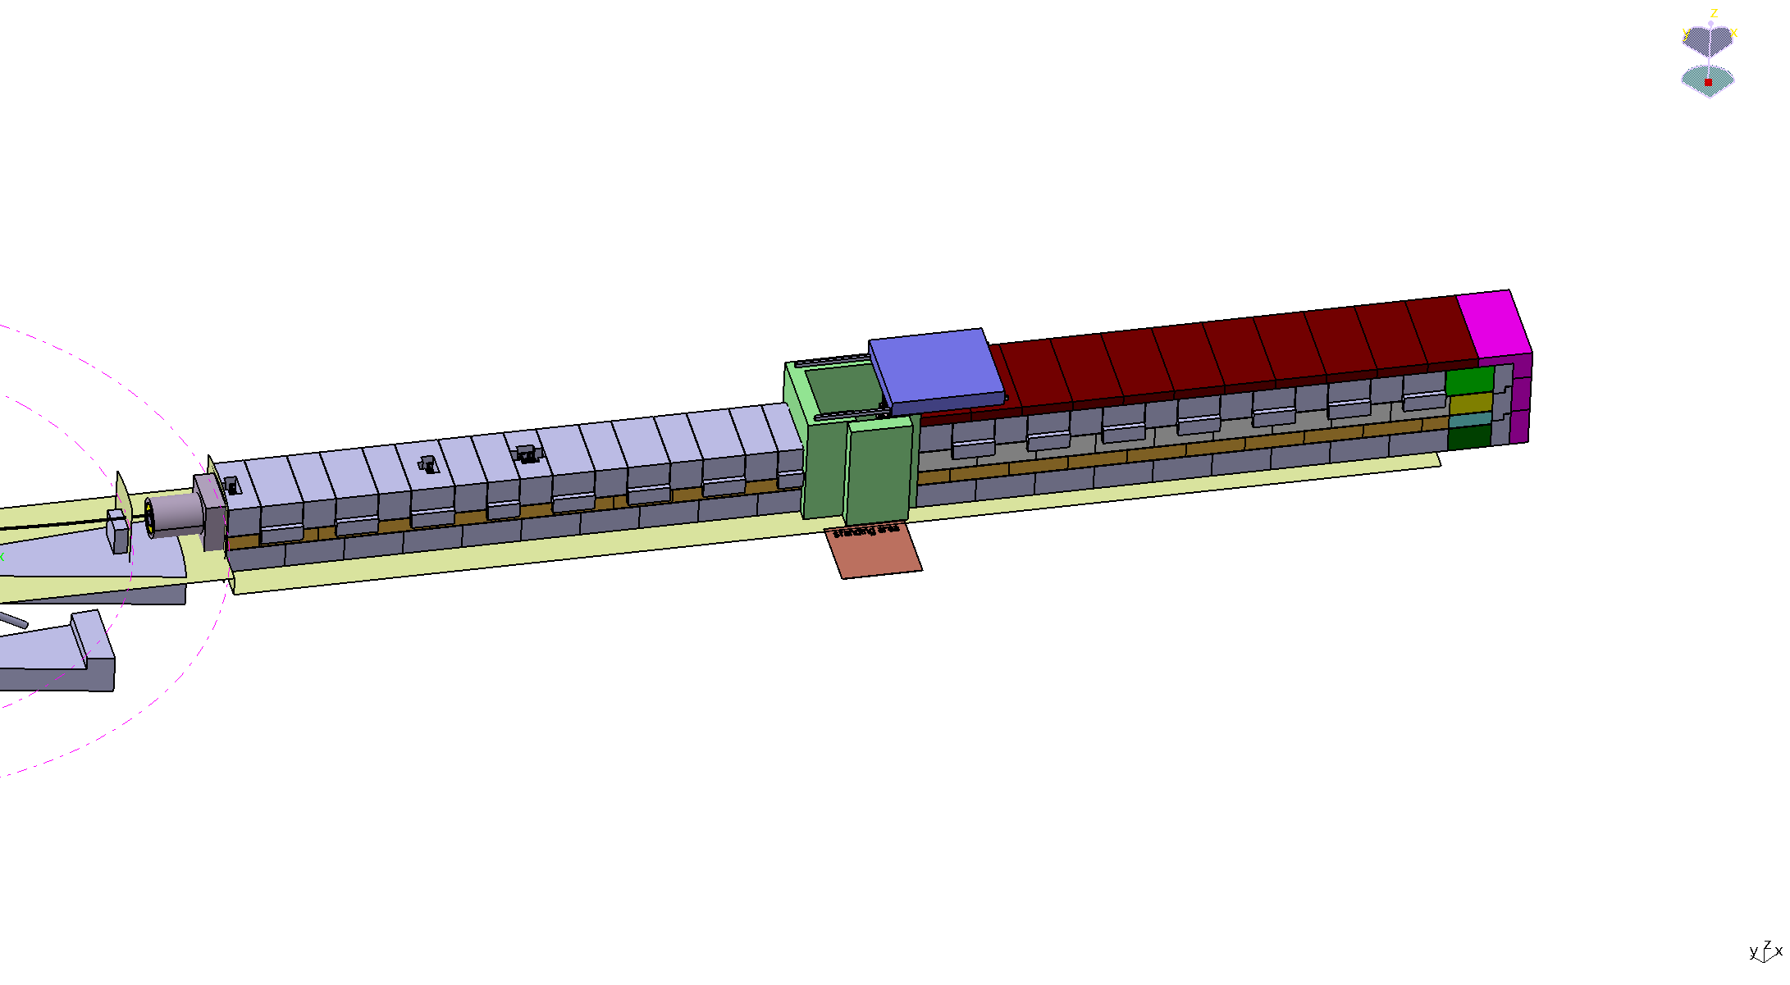
Selected Issues: Shielding
Two diametrically opposites
Perfect biological shielding
Operation of a scientific instrument
Heavy Shielding
Easy to disassemble/move
Not too bulky
Possibility to bulk order

Slide 12
Take home message
From our scope/budget discussion:
Some things are more expensive than others: Focus and explain.
Try and find commonalities with other instruments: Sharing is caring.
Shielding
Shielding
Shielding
→Open proposal (for details please contact either PSI or JCNS teams):
Create two (hot and cold) standard shieldings (at least for collimation)
Buy larger quantities and save
Easier to handle later (everybody knows how to do it)
We are willing to share our collimation shielding (for cold instruments)

Slide 13
Thanks to ...
Sylvain Désert
Jacques Jestin
Henrich Frielinghaus
Romuald Hanslik, FZJ
Achim Gussen, FZJ
... and you, for YOUR attention!

