Slide 1
Solid State Klystron Modulators
for
Long Pulse (>100µs) Linac’s
Topologies and Design Issues
Carlos A. Martins
European Spallation Source – ESS AB
Accelerator Division, RF Group
1

Slide 2
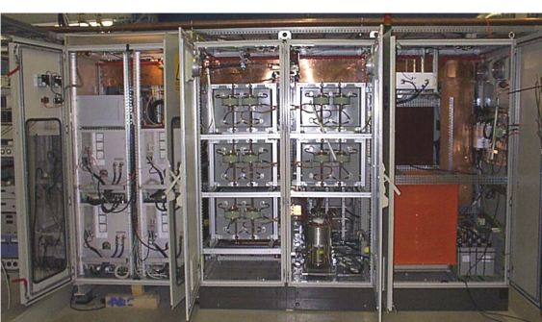
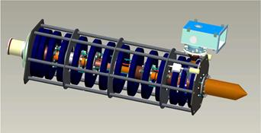
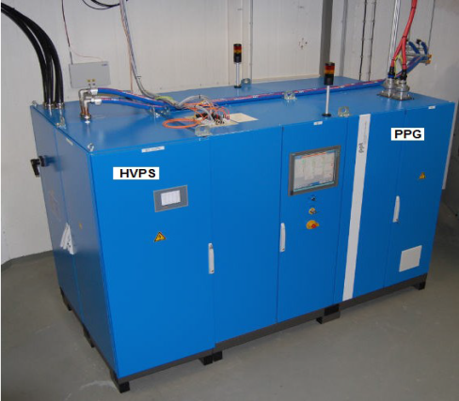
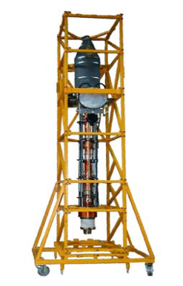
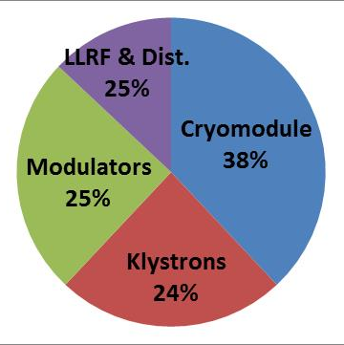
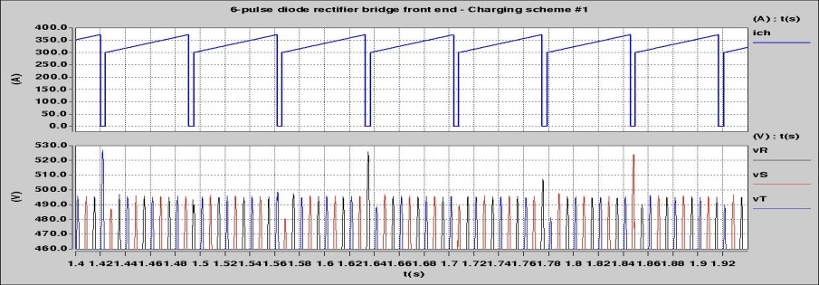
Introduction - Modulator? Isn’t it just a power supply?
Sophisticated power electronics systems
Very few companies exist worldwide
SS Long pulse (ms) modulator companies | Long list (have designed & built 1 prototype) | Short list (have successfully designed & built several units used in accelerators)
Europe | 5 | 2
USA | 1 | 1
klystron
modulator
Large footprints & Heavy equipment
modulator
Vert klystron
Considerably costly
Standard low/medium voltage power supply: < 1€ / W
Klystron modulators: > 3€ / W_{av}
Yes, but not an “usual one”
(impacts strongly on the Linac design, construction, cost, availability)
1.6m
3.8m
1m
Can disturb the electrical grid significantly
Impacts highly on the Linac availability (MTBF, MTTR)
MTBF (1 modulator) = ~ 70’000 hrs;
MTBF (1 klystron) = ~ 50’000 hrs;
2`

Slide 3
Typical requirements & parameters
(SS Pulsed klystron modulators)
V
Rise time
Fall time
time
Flat-top
Pulse width
 | SNS | ISIS | HP-SPL | ESS | CLIC
Pulse width (50% amplitude): | 1.6ms | 2ms | ~2.5ms | 3.5ms | 140µs
Flat-top duration | 1.5ms | 2ms | ~2.2ms | 3.31ms | 135µs
Precision/droop at flat-top (low freq,< 1kHz): | <1% | <5% | <1% | <1% | <1%
HF ripple at flat-top (> 1 kHz): | 0.1% | 0.1% | <0.1% | <0.01% | <0.01%
Pulse repetition rate | 60Hz | 50Hz | 50Hz | 14Hz | 50Hz
Nominal pulse voltage | 140kV | 110kV | 115kV | 100kV | 150kV
Nominal pulse current | 70A | 45A | 50A? | 50A | 160A
Nominal pulse power | 9.8MW | 5MW | 5.7MW? | 5MW | 24MW
Nominal average power | 940kW | 440kW | 710kW | 250kW | 170kW
Rise/fall times (99% / 1%) | 100µs | 10µs | ~250µs | ~190µs | 5µs
Maximum energy in case of arc | <10J
Maximum reverse cathode voltage | ~10%
3

Slide 4
Pulse transformer (PT) based
Ver. 1: Monolithic PT with LC bouncer
FERMILAB, DESY, CERN, RRCAT, …
Medium voltage electronic pulser installed in air insulated cabinet;
PT installed in a oil tank;
LC passive bouncer compensates for voltage droop;
HV solid state switch generates the pulse and protects the klystron in case of an arc;
Undershoot network demagnetizes the PT;
Voltage reversal on the klystron shall be limited by design of the undershoot network;
Pulse rise/fall times determined by the PT leakage inductances (typically 100..200µs);
No high frequency ripple is generated in the flat-top;
Monolithic system;
4

Slide 5
Pulse transformer (PT) based
Ver. 3: Interleaved stacked converters as primary side pulser
DESY
Medium voltage electronic pulser installed in a air insulated cabinet;
PT installed in a oil tank;
Active voltage droop compensation through feedback;
Low voltage solid state switches required;
Active demagnetization of PT with energy recovery (limited voltage reversal on the klystron);
Active current shut-down in case of arcing;
Pulse rise/fall times determined by the PT leakage inductances (typically 100..200µs);
High frequency ripple is generated in the flat-top (can be filtered);
Modular system (up-to primary side of PT);
5

Slide 6
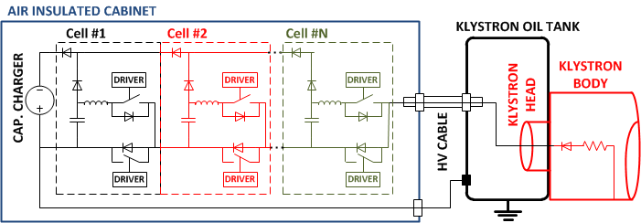
Marx Generator based
SLAC
High Voltage electronic pulser installed in a air insulated cabinet;
Oil free;
Several Marx cells are charged in parallel and discharged in series;
Active voltage droop compensation in each Marx cell;
Low voltage solid state switches required, but shall be isolated to ground at High Voltage;
No voltage reversal on the klystron;
Short rise/fall times (determined by the dI/dt limiting inductors, typically 10..20µs)
High frequency ripple is generated in the flat-top (can be filtered);
Modular system;
6

Slide 7
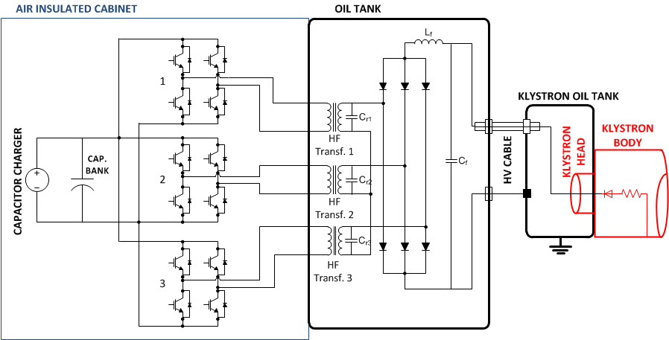
Resonant Polyphase
LANL, SNS
Medium voltage H-bridge converters installed in air insulated cabinets;
High Frequency transformers, diode rectifier bridge and output filter in an oil tank;
Active voltage droop compensation through feedback, by H-bridge frequency/phase control;
Low/Medium voltage solid state switches required;
No voltage reversal on the klystron;
Rise/fall times determined by the resonance circuit (typically 100..200µs);
High frequency ripple is generated in the flat-top (can be filtered);
Monolithic system;
7

Slide 8
Direct switch
Rutherford Appleton Lab
High Voltage direct switch buck-converter installed in a oil tank;
Active voltage droop compensation through feedback is possible (active bouncer);
High voltage solid state direct switch stack is required;
No voltage reversal on the klystron;
Rise/fall times determined by the dI/dt limiting inductor (typically 5..10µs);
High frequency ripple is generated in the flat-top if active bouncer used (can be filtered);
Monolithic system;
8

Slide 9
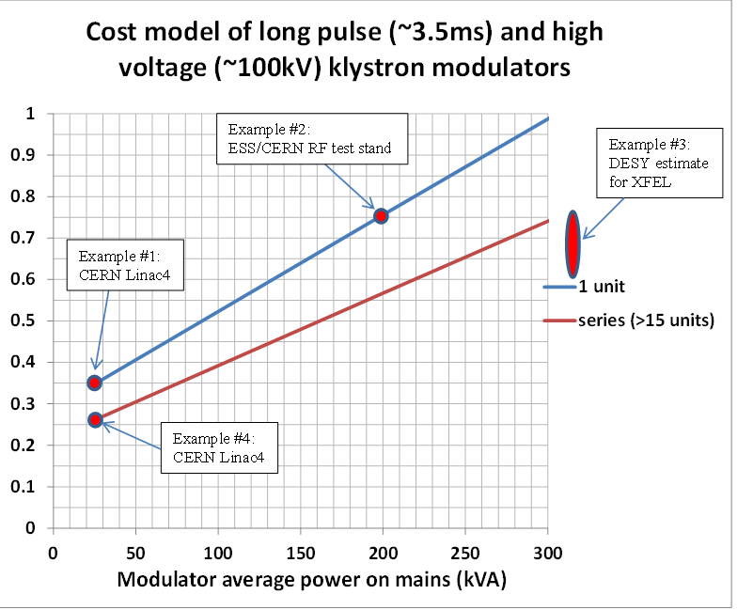
ESS cost model and cost optimization
ESS choice
120 cavities (1cav./klyst.) | 1 klys/ mod | 2 klys/ mod | 3 klys/ mod | 4 Klys/mod
# klystrons | 120 | 120 | 120 | 120
# modulators | 120 | 60 | 40 | 30
Average power per modulator | 150kVA | 300kVA | 450kVA | 600 kVA
Cost / modulator | 0.47pu | 0.75pu | 1pu ^{(*)} | 1.26pu ^{(*)}
Total cost of modulators | 56.4pu | 45pu | 40pu | 37.8pu
Relative cost savings (wrt 1 klys/mod) | 0% | 20% | 29% | 33%
Relative cost (p.u.)
^{(*)} - extrapolation
9

Slide 10
Development and procurement strategies
- Can’t we just buy them?
 | Strategy I - in house development; - call for tender for series production as “built-to-print” | Strategy II - call for tender for qualification of prototypes (ex: 3 units from 3 manufacturers); - call for tender for series production (ex: best 2 out of the 3 pre-qualified) | Strategy III - single call for tender for the whole quantity
CERN – Linac4 (17 modulators / ~500 kVA) | X
CERN – RF test stand (1 modulator / 180 kVA) |  |  | X
DESY – XFEL (~25 modulators / ~7.5 MVA) |  | X
RAL – ISIS (1 modulator/ ~400 kVA) |  |  | X
ONRL – SNS (~16 modulators/ ~16 MVA) | X
KEK – JPARC | X
10

Slide 11
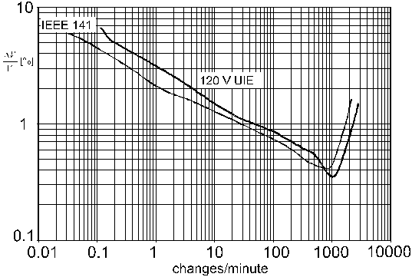
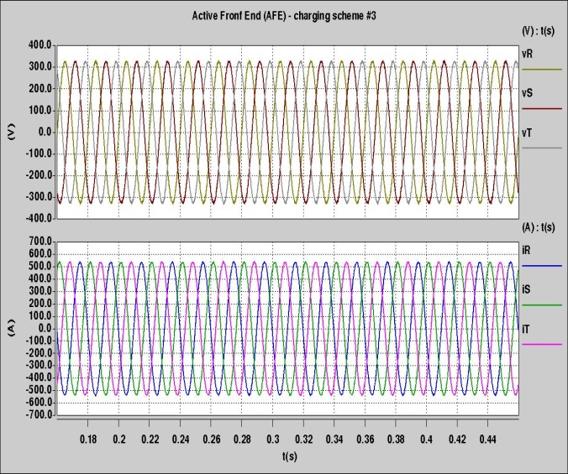
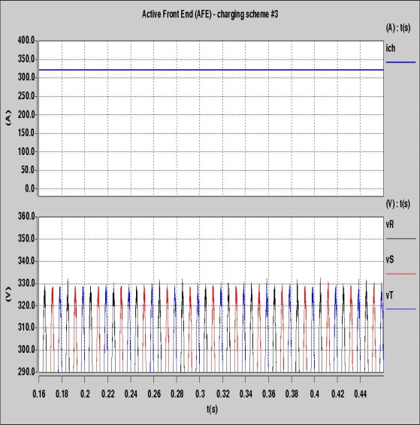
Electrical grid power quality
- Can’t we just connect them into the wall plug?
Flicker standards (low voltage public grids)
Grid power quality
(dictated by the capacitor charger)
EMC (conducted noise, immunity & susceptibility)
Current harmonic distortion (depends on the capacitor charger topology)
Flicker (depends on the capacitor charger topology & on the charging control scheme)
(ΔV/V)_{max}=0.35%
Possibility Capacitor Charger:
Active Front End with constant power regulation
14 Hz
11

Slide 12
Conclusions
1.- Klystron modulators for long pulse (100µs) Linac’s:
One of the main components of the High Power RF sources;
Large footprints required in the RF gallery;
High impact on costs, MTBF/MTTR and machine availability;
Depending on the power levels and pulse lengths required, may have a strong impact on the grid power quality (harmonic distortion, flicker)
2.- If possible invest on internal prototyping or at least on understanding the topologies and control techniques involved;
3.- Invest in R&D for grid power quality assessment (ex. flicker mitigation techniques)
4.- Adopt a convenient procurement strategy, involving multiple vendors and validation stages (prototyping, pre-series, series);
12

