Slide 1
A Raster-based Beam Expander System for the ESS?
Heine Dølrath Thomsen, Søren Pape Møller, Anne Holm, ISA, Aarhus University
Tom Shea, Dave McGinnis, Carlos Martins, Eric Pitcher, many others, ESS
Laurent Ducimetière et al, CERN

Slide 2
Beam Expander Systems: 1D Rastering
Magnification
Deflection
Notes:
Linear
Suitable for CW or long-pulse beams
Burn-in

Slide 3
Beam Optics: LANL MTS Concept (B. Blind et al)
ACH
A2T
Beamlet Size (waist + ~6 mm RMS)
Matching Q’s
RMs
CO Q’s
Deflection
n π
AP
CO
Target
Weak RMs & ⬇a
Luminescent coating (SNS)
Notes:
BPMs can sample deflection

Slide 4
Linear Optics: 10 RMS Beam Size
QP1-4
RMs
QP5,6
Waist
Ø40 x 2000
By By Bx Bx | Bx Bx By By
ACH
A2T
AP
CO
Target
Notes:
nRM = 4 + 4
Magnification: takes place@QP5,6

Slide 5
Linear Optics: 10 RMS Beam Size
QP1-4
RMs
QP5,6
Waist
Ø40 x 2000
By By Bx Bx | Bx Bx By By
ACH
A2T
AP
CO
Target

Slide 6
Linear Optics: 10 RMS Beam Size, Max ∆x, ∆y
QP1-4
RMs
QP5,6
Waist
Ø40 x 2000
By By Bx Bx | Bx Bx By By
ACH
A2T
AP
CO
Target

Slide 7
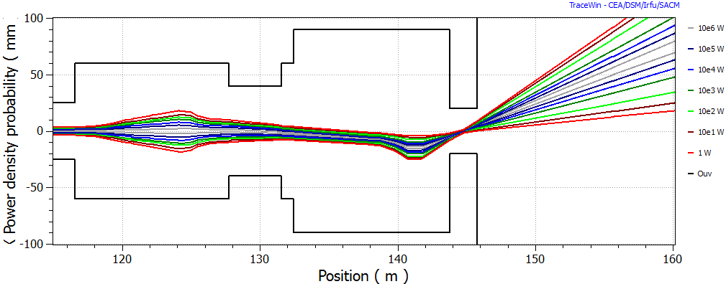
5M Particles from SCL incl. PICNIC
⬇ε+PS
4 RMS Gaussian input @ RFQ
⬇ε+PS
95%
Notes:
NSW: no function related to p’s
5.67 mm + 3.82 mm

Slide 8
Sweep Pattern?
Relative Frequencies (5:4)
Lissajous-like Pattern
f_{y} /f_{x} , φ_{x,y}, A_{x} , A_{y}
APT + MTS (LANL)
CEBAF
SPIRAL2 S3 + RIB lines
MYRRHA
ESS Challenges:
Frequencies: 20-40 kHz
fx ~ 20 kHz
fy ~ 40 kHz, T_{p-p} = 12.5 us
x,y [arb. units]
One pattern cycle

Slide 9
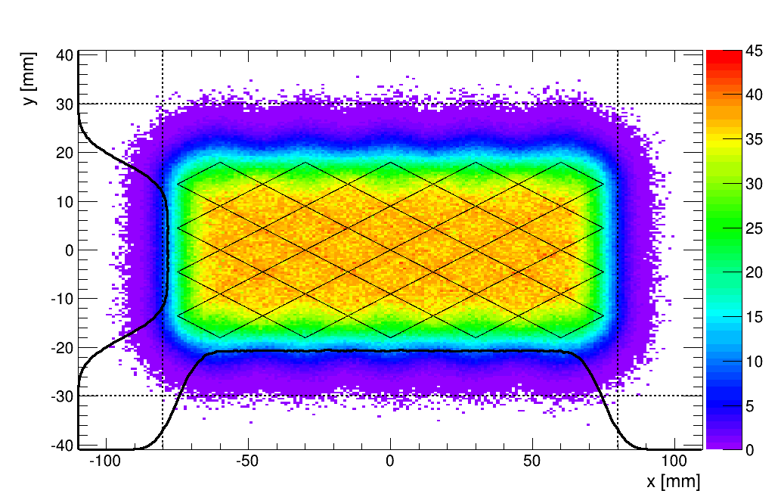
5:4 Pattern: BEW Simulation (10⁸ p)
J [uA/cm²] @ 2 mA
Max(∆x) = 75 mm, max(∆y) = 18 mm,
RMS(x-∆x) = 6 mm, RMS(y-∆y) = 4 mm
Notes:
J_max is lowered for free

Slide 10
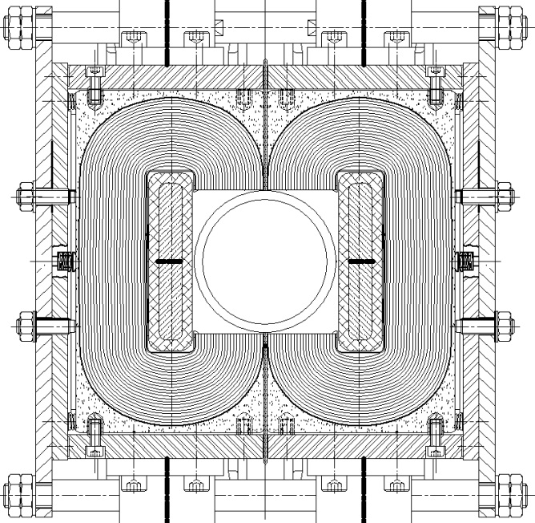
Raster Magnets (RMs)
nRM = 4 + 4, ferrite-based magnets?
1 magnet: max B.L_{mag} = ±5 mT.m (= ±17 mT x 30 cm),
Redundant and / or fail-safe design?
RMs: B-dot loops + PS: I-dot loop
5 MW: ESS MPS: <40 us (1.4%)
Ceramic vacuum chamber, Ø80 mm ID
Gap height ~100 mm, pole width ~ 100 mm (TBD)
Design pre-study by Laurent Ducimetière et al, Fast kicker systems, CERN
LHC MKD
Notes:
Individually powered
40% contingency

Slide 11
Conclusion
Raster-based system more independent on transverse beam kurtosis
Linear model seems well-applicable
Predictable beam behaviour
Induced neutron-modulations are intolerable?
Future Studies:
Off-nominal state: Statistical error studies, non-ideal waveforms
Finalize pattern -> raster magnet design
May: Risk analysis of system
June: Decision on beam delivery system

Slide 12
Thanks!

Slide 13
Beam Expander Systems II: 2D Rastering
LANL APT Design

Slide 14
nx = 40, fx = nx / 2.86 ms = 14.00 kHz
ny = 50, fy = ny / 2.86 ms = 17.50 kHz
3 RMS relative beam size

Slide 15
nx = 41, fx = nx / 2.86 ms = 14.35 kHz
ny = 50, fy = ny / 2.86 ms = 17.50 kHz
3 RMS relative beam size

Slide 16
Initial Experience with the Virtual RM-A2T
PRO | CON
PERFORMANCE
Independent of input beam distribution! | Neutronic yield modulations?
Lower need for collimation? Multipoles: Probing aperture! Lower uncontrolled beam losses? Shield: waist better defined? | Low-pass filter: intensity ridges?
HARDWARE
Linear optics – envelope calc. | Technical complexity?
Fewer element families, ‘operator intuition’ | Increased risk? dB/dt loop, QP5+6 critical
∆€ (magnet) + ∆€ (modulators) = 0?
To be confirmed / studied!
Notes:
Preliminary
Predictable beam behavior

Slide 17
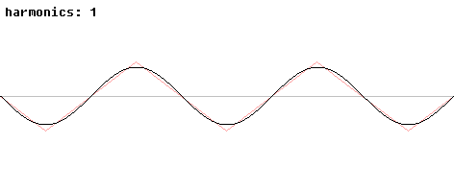
Current Waveform: Shape
http://en.wikipedia.org/wiki/File:Synthesis_triangle.gif

Slide 18
Current Waveform: Shape
Sinusoidal
Triangular
doi: 10.1016/j.nima.2004.09.034
Notes:
Tiny beam size

Slide 19
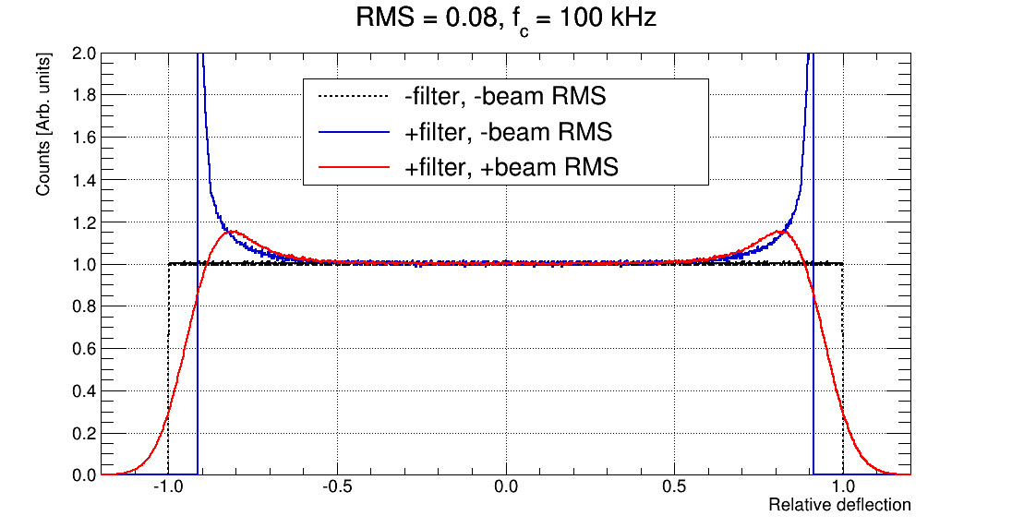
Current Waveform: Shape
Notes:
Tiny beam size

Slide 20
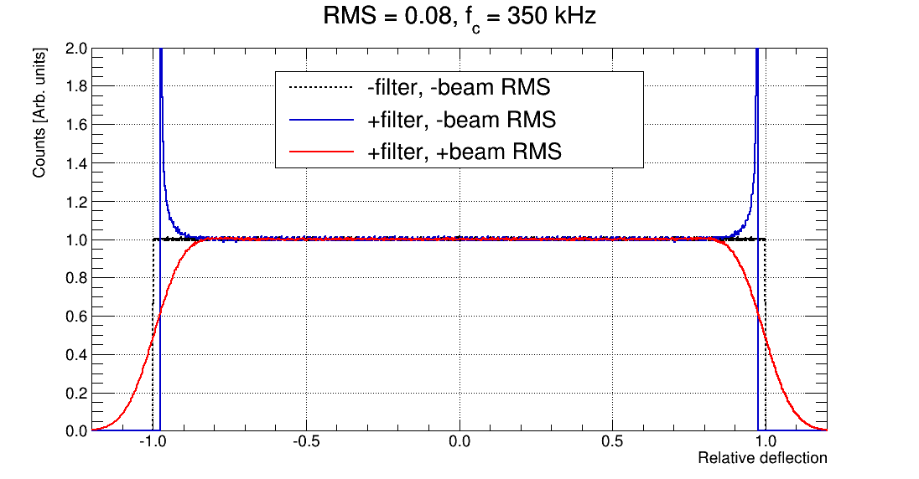
Current Waveform: Shape
Notes:
Tiny beam size

