Slide 1
Radiation shielding issues at the ESS linac
Lali Tchelidze
SLHiPP April 17-18
Louvain-la-Neuve, Belgium

Slide 2
Agenda
Linac tunnel earth berm shielding
Front end vs. high energy end of the linac.
Shielding issues for klystron building (around stubs)
Preliminary results and proposed solution.
Location of fences around the linac.
Tunnel air activation and release to environment.
Potential high energy neutron background to experiments.
Future plans.

Slide 3
Moral
Geometrical model - Beam loss assumptions - Radiation fields assessment
“Even if all the parameters affecting beam losses in the accelerator were known, the variability inherent in accelerator layout and operation together with the complicated physics of high energy particle interactions and the subsequent production of secondary radiation and radioactivity make it extremely difficult to quantify radiation and radioactivity levels in an absolute way.”
- A. H. Sullivan

Slide 4
“The methods used to assess radiation levels under idealized conditions only lead to adequate guideline values rather than a detailed scientific description of the situation being studied. Precision is of secondary importance.”
- A. H. Sullivan

Slide 5
Dose limits (GSO)
Mode | Dose limit to public | Dose limit to rad worker
Normal operations | 0.03 mSv/y | 10 mSv/y
Accidents | 0.05 mSv/accident | 20 mSv/accident
Exposure | Significance
3.5 Sv | 50 % chance of survival
> 1 Sv | Serious to lethal
> 50 mSv | Requiring medical checks
50 mSv/y | Occupational dose limit
15-50 mSv/y | Strict dose control necessary
5-15 mSv/y | Professional exposure
< 5 mSv/y | Minimum control necessary
1 mSv/y | Natural background
10 uSv/y | Insignificant
Guidelines to the significance of exposure to radiation, A.H. Sullivan

Slide 6
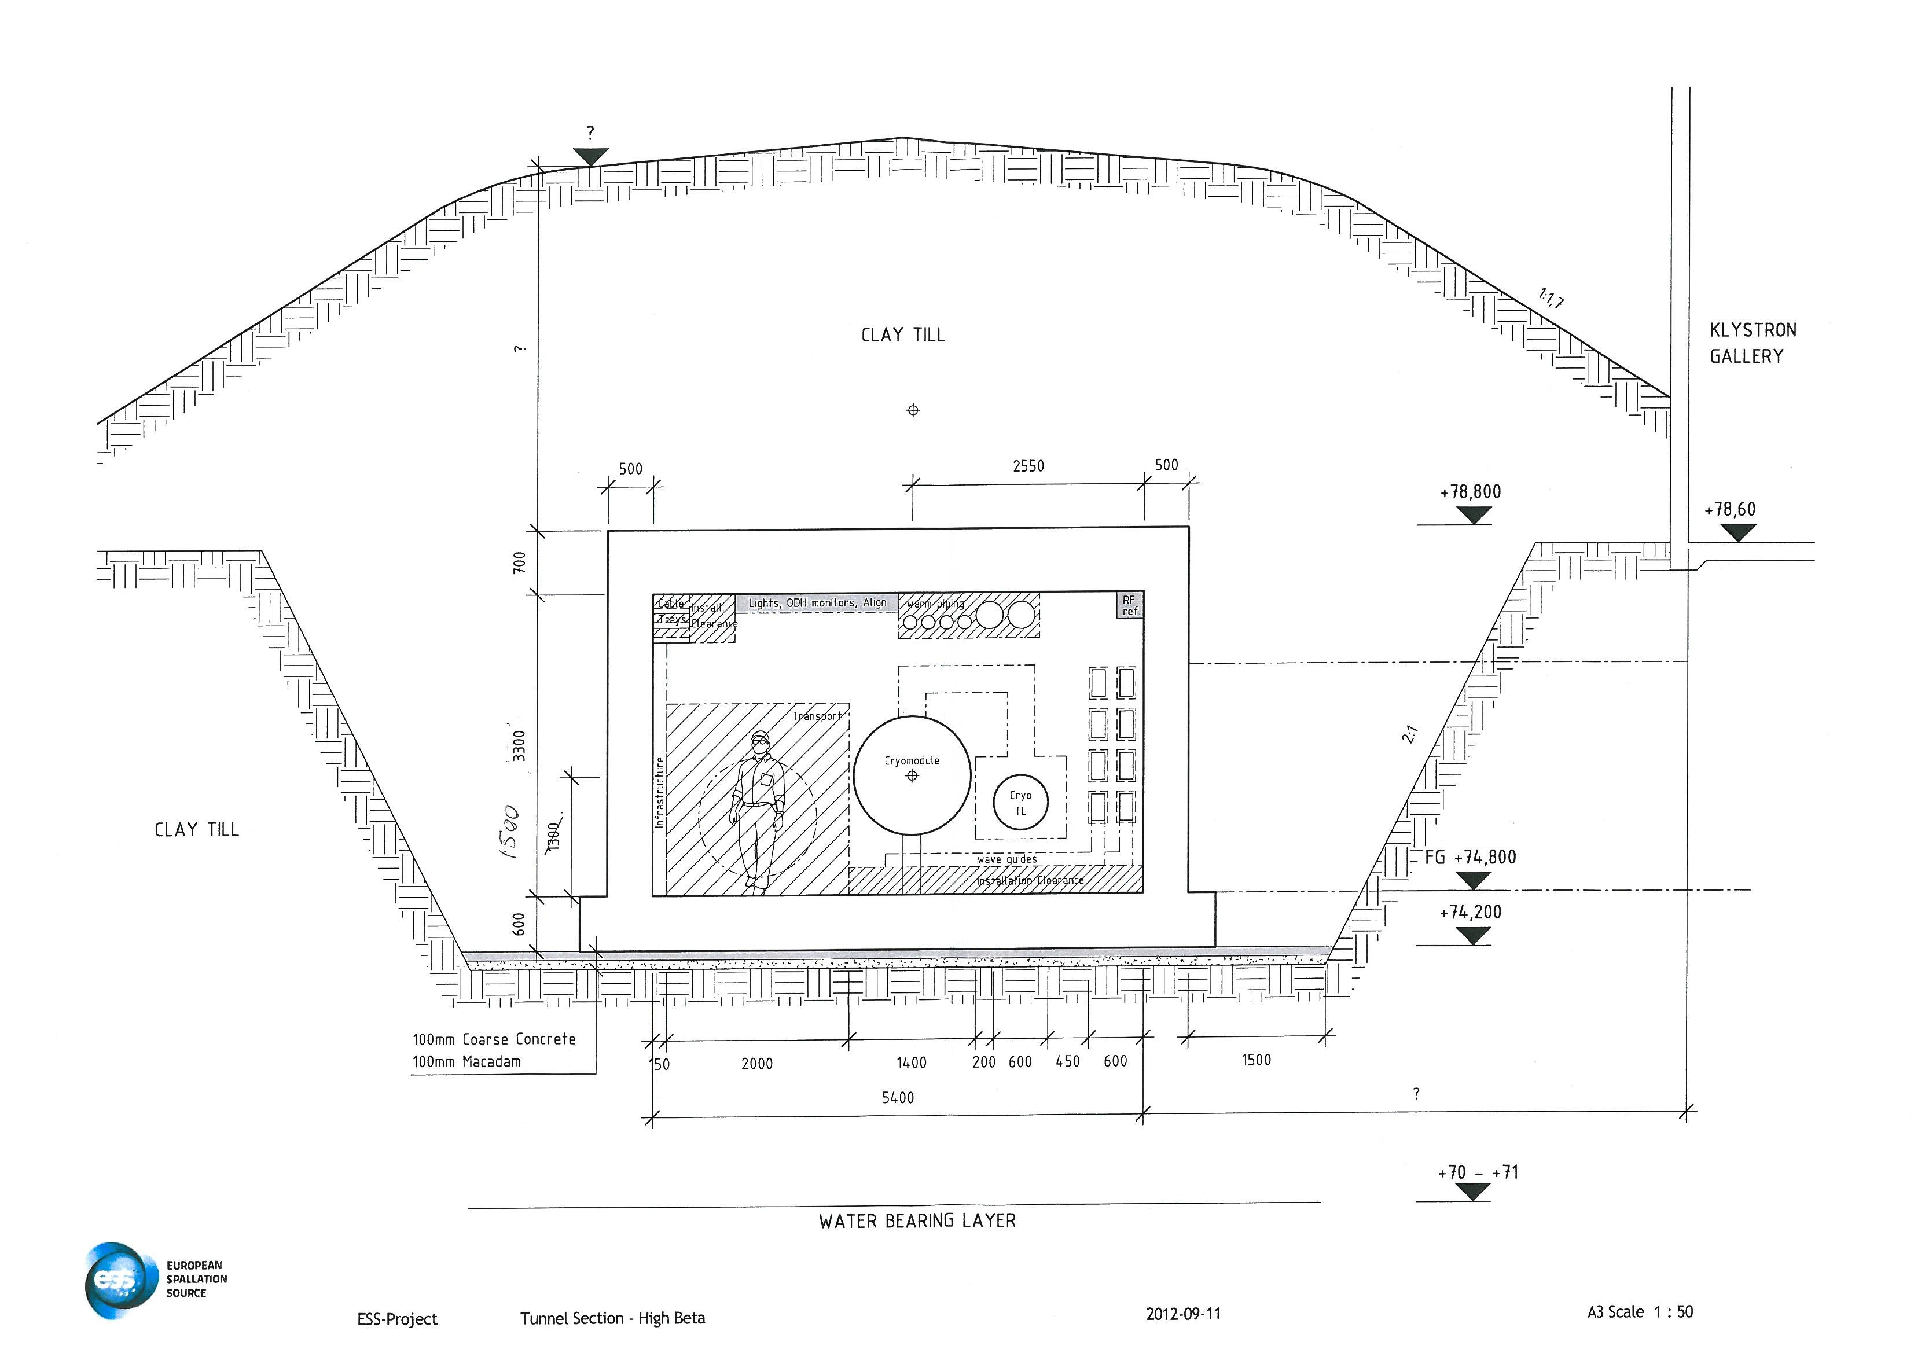
Earth berm shielding general assumptions
- Tunnel location is fixed so that the top of the concrete ceiling is at the ground level.
- Tunnel cross-section dimensions are 3.3 m x 5.4 m.
- Size of the tunnel ceiling (concrete) is fixed to 70 cm.
- Beam axis is in the middle of the tunnel.
ESS linac tunnel cross section
(October 2012)

Slide 7
Earth berm shielding general assumptions
- Beam loss is modeled longitudinally on a target in the middle of the tunnel.
- Target: 20 cm radius, 1 m long stainless steel/other (see later).
ESS linac tunnel cross section
(October 2012)

Slide 8
Tools used
Sullivan’s analytical approach (point and line spill models)
MARS simulation package
More assumptions:
Normal operations – 10 W beam loss on a target
Catastrophic accident – full beam loss on a target.
In case of uncontrolled full beam loss, the machine will be shut down within few pulses (< 1 sec).
Normal operations determine the berm thickness, therefore only the results for this are presented.

Slide 9
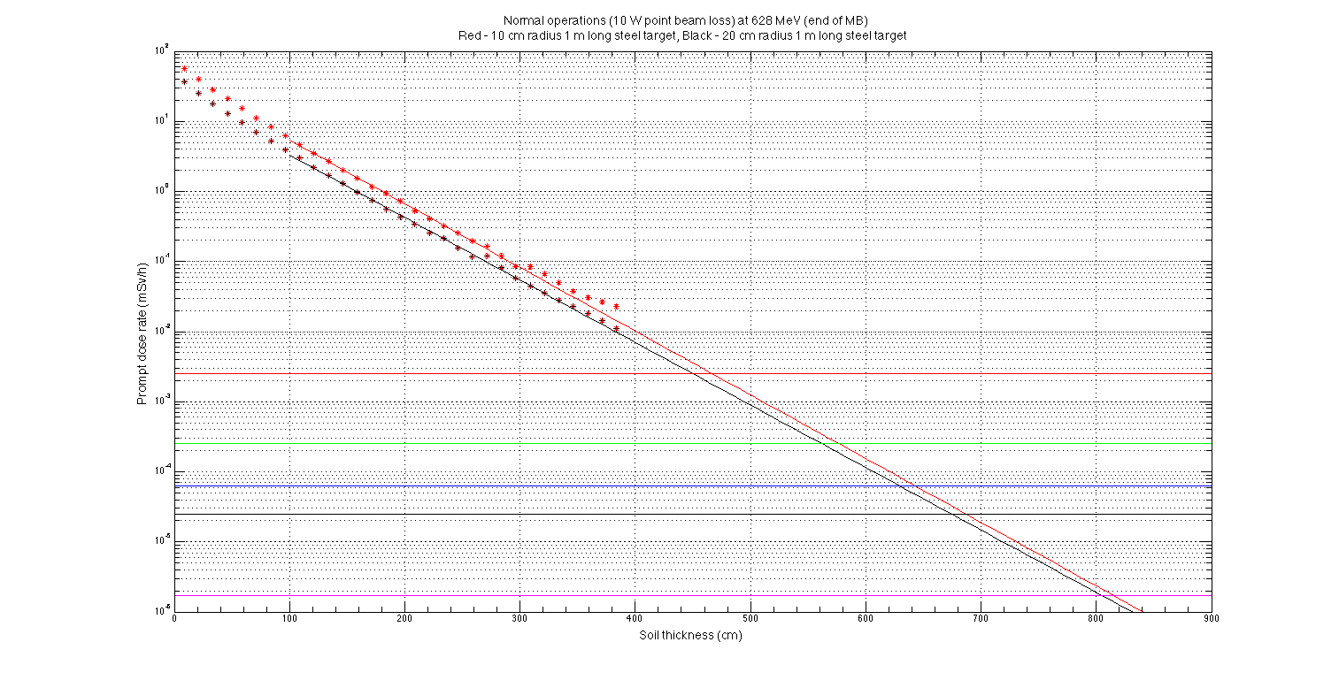
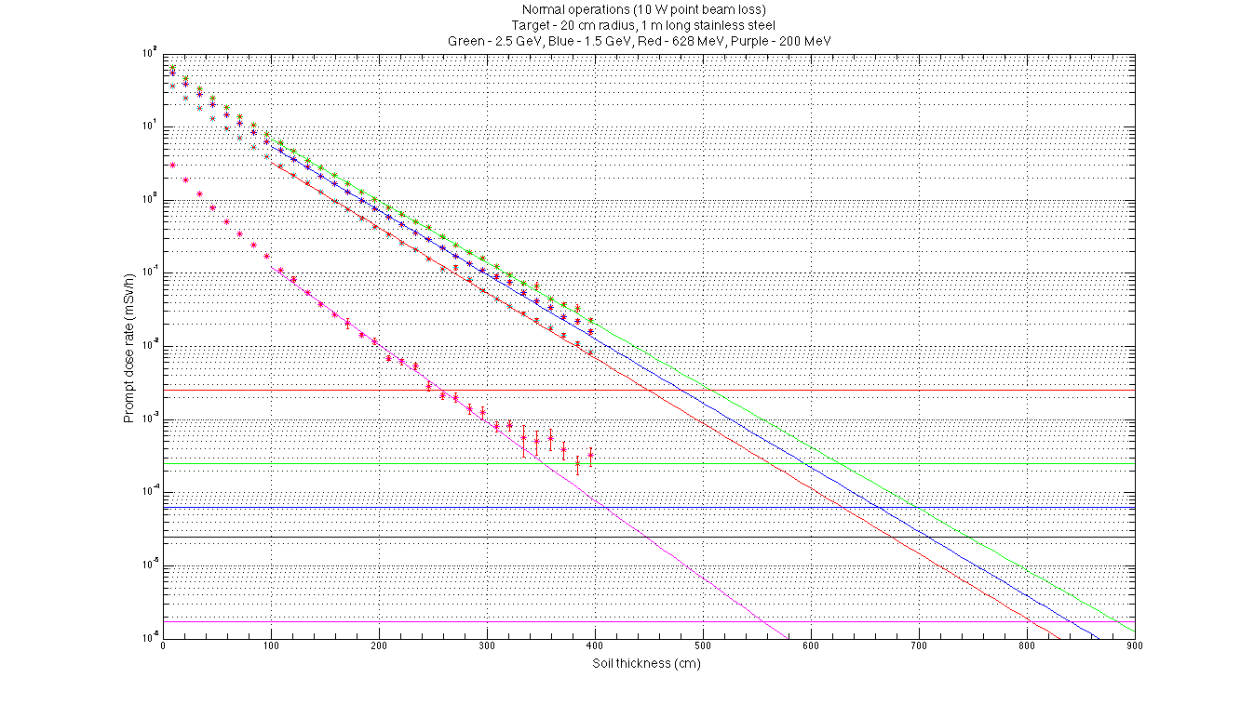
Point loss models. Green - MARS (target – 20 cm radius, 1 m long steel), Red - FLUKA (target – 20 cm radius, 1 m long copper), Blue – Sullivan’s analytical approach.
FLUKA results – by Michal Jarosz.
Point loss model (MARS results). Red - target 10 cm radius, 1 m long steel, Black – target 20 cm radius, 1 m long steel
All plots show Prompt dose rate as a function of soil thickness.
Horizontal lines – annual dose limit of 10 mSv, 1 mSv, 0.25 mSv and 0.1 mSv (200 hours occupancy limit) and dose rate limit for general public (3.4 nSv/h)
Data are shown for zero to 400 cm range. Exponential fit is performed in between 100 cm and 300 cm and extrapolation is drawn for > 300 cm.
Point loss model (MARS results). Green – 2.5 GeV, Blue – 1.5 GeV, Red – 628 MeV, Magenta – 200 MeV.

Slide 10
Results

Slide 11
Results
We would like to impose enough shielding for 0.25 mSv/y limit.
Official Limit is yet to be decided (universal for entire facility)

Slide 12
Distance to fences
Fences will limit access to general public.

Slide 13
Tunnel air activation
Radioisotope production rates – MARS
Activity calculator – you can vary loss rate, irradiation and cooling times to see the
effective doses to those working in tunnel or to public, through the release to
environment (current height of the stack is 40 m, shortest distance to public is 200 m,
delay time 30 mins).

Slide 14
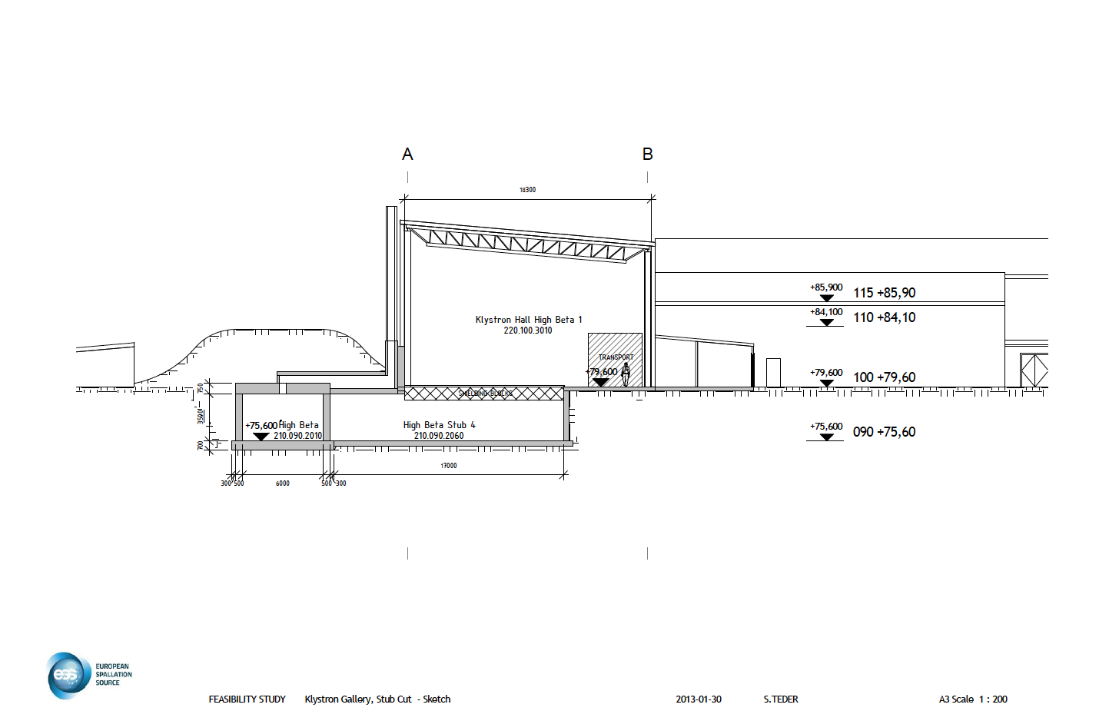
Stubs
Initial radiation assessment shows (at 2.5 GeV):
~ 10 mSv/h (maximum) dose rate in the klystron hall with no shielding
~ 1 mSv/h (maximum) dose rate (with bulk concrete shielding, but no shielding around waveguides).

Slide 15
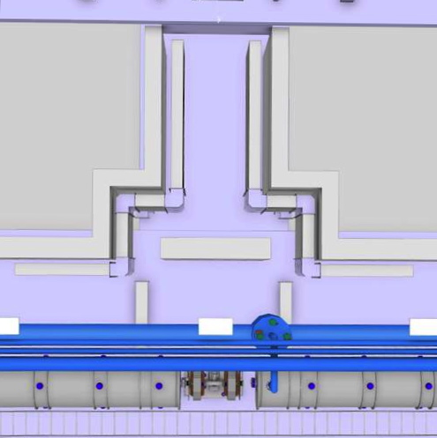
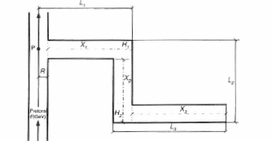
Stubs (T-concept)
Radiation assessment of the new concept
First step – analytical approach.
Second step – full monte-carlo simulations
n – number of bends
A – area of opening
H₀ and H_{n} – radiation dose rate the mouth of first leg and at the end of last leg.

Slide 16
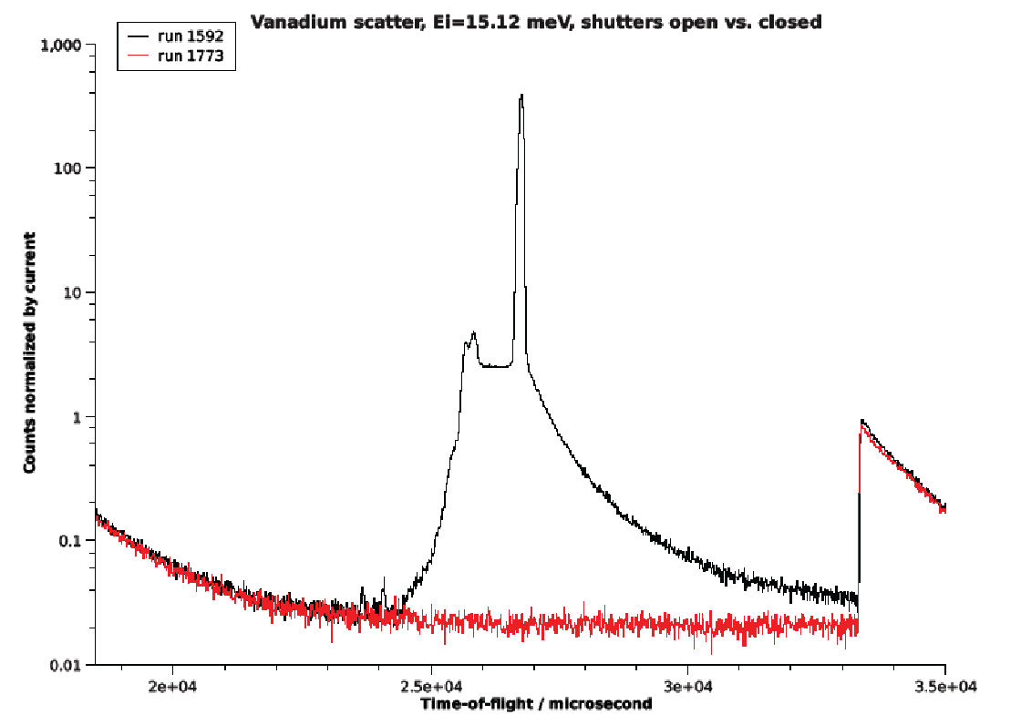
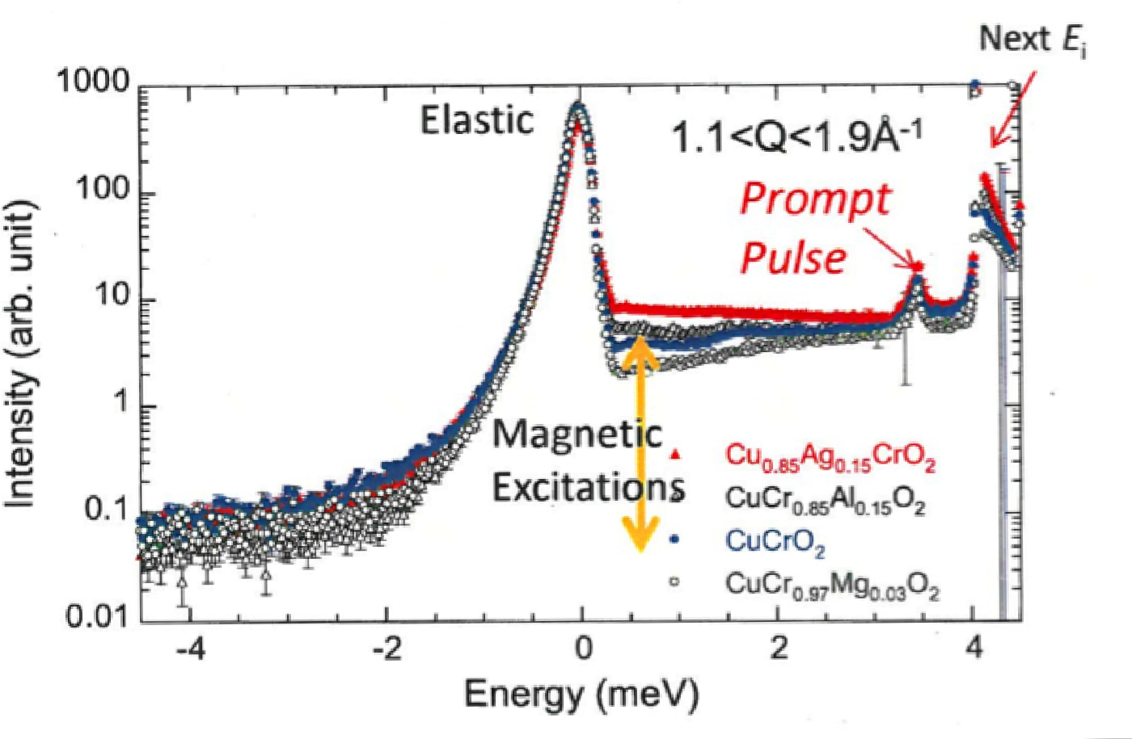
Neutron background to instruments (motivation)
Phil Bentley

Slide 17
Neutron background from accelerator
Maximum fluence of fast neutrons escaping the berm
3.5 10⁴ neutrons/sec m²
Through skyshine they end up in neutron instruments.
~ 320 n/sec m² at 100 m
~ 110 n/sec m² at 200 m
~ 18 n/sec m² at 500 m
These are highly overestimated values, but even they seem to be NOT a potential source of background for experimental instruments.

Slide 18
Summary/Future work
Optimize the dimensions of the chicane of stubs.
Run full 3D simulations to verify the analytical results.
Run full 3D simulations to verify the results for fast neutron background to neutron instruments.
Shielding of
HEBT loading bay area
Cryogenic transfer line
Emergency exits
Front end building
Thank you

