Slide 1
DESIGN OF A HIGH POWER TEST
STAND FOR ESS SPOKE CAVITIES
AT THE FREIA LABORATORY
Rutambhara Yogi
ESS RF Group Unit Leader for Spoke Power and RF Distribution
FREIA Group Unit Leader, Uppsala University

Slide 2
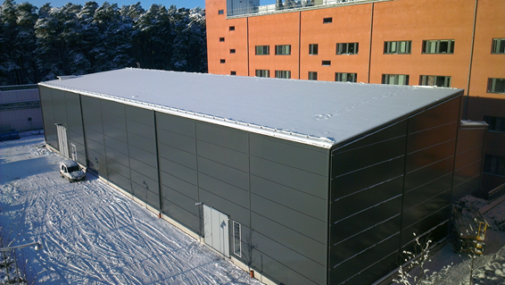
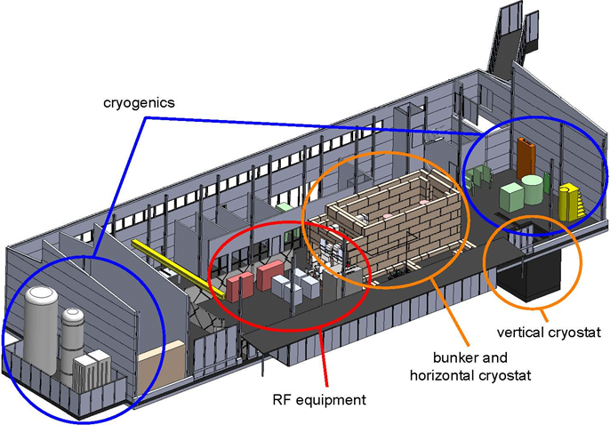
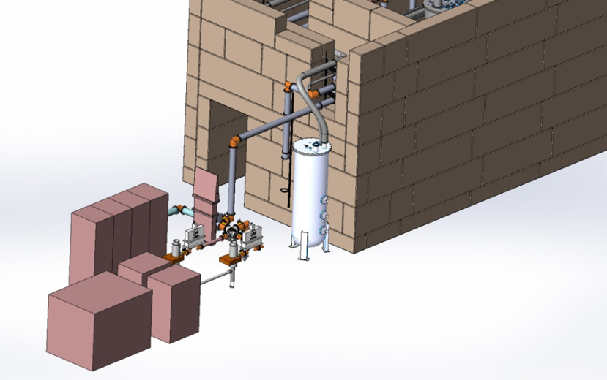
FREIA Laboratory
Facility for Research, Instrumentation and Accelerator Development
General Infrastructure
LHe production and distribution
concrete bunkers
RF Power Stations
352 MHz RF source for ESS spoke cavities
horizontal test cryostat (vertical in future)
RF Power Stations

Slide 3
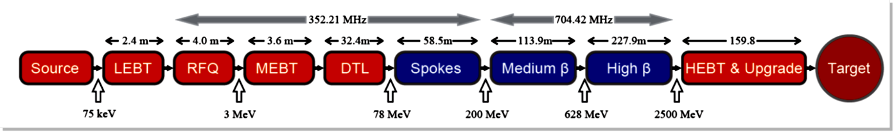

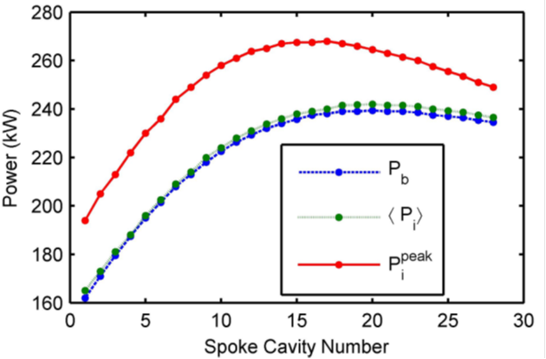
European Spallation Source (ESS)
Schematic of ESS Linac
Details about Superconducting Spoke Linac
Frequency = 352.21 MHz
Number of spoke resonators = 28
Maximum power to beam = 240 kW (320 kW)
Maximum Amplifier = 300 kW (390 kW)
Numbers in blue indicate updated specifications of ESS

Slide 4
Baseline Design for ESS RF system
Generation and distribution of the RF power from a single source to a single accelerating cavity

Slide 5
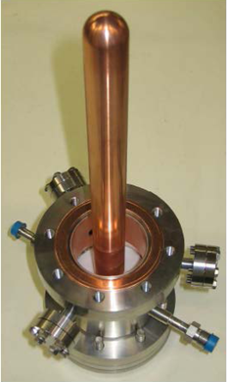
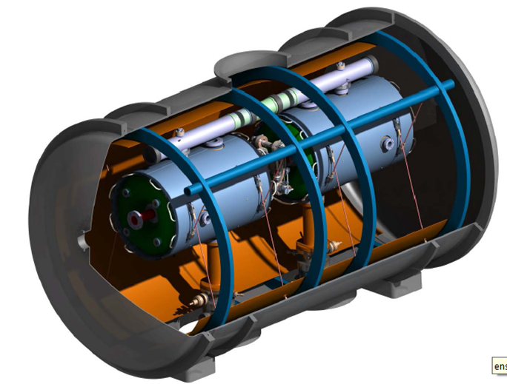
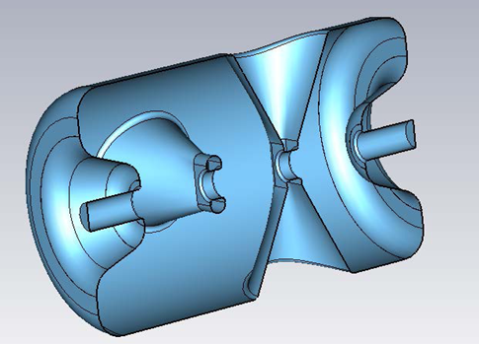
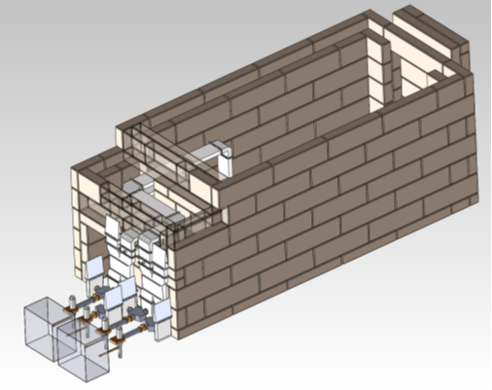
Superconducting spoke Cavities
New design being developed at IPN Orsay
Power Coupler
Horizontal cryostat and test bunker at FREIA Laboratory
Two RF power stations are needed to test two spoke cavities at Uppsala test stand !
RF transmitter with full pulse width and full power is needed for coupler conditioning and studying Lorentz detuning

Slide 6
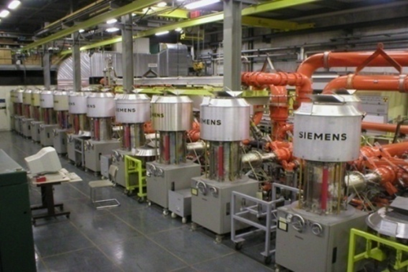
High Power RF Power Station
Specifications:
Frequency = 352.21 MHz
Power = 350 kW (400 kW)
3dB band-width ≥ 250 kHz
Pulse width = 3.1 ms
Pulse repetition rate = 14 Hz
No RF source exists at these specifications !
Hence development and prototyping is important !
Amplifier selection Accelerator cost
Capital cost:
Cost of the amplifiers, its power supplies
RF Distribution (circulator)
Decides gallery requirements (gain of the
power amplifier decides number of stages)
Running cost:
Efficiency: required electric power
and cooling
Life time: replacement, maintenance schedule
Photograph of SPS, CERN
650 kW cw @ 200 MHz

Slide 7

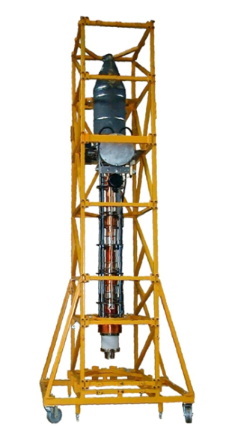
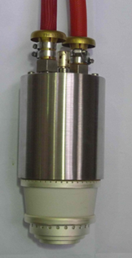
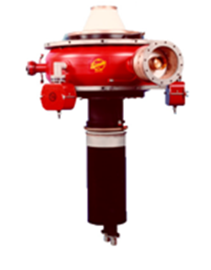
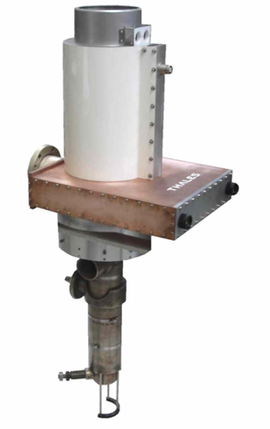
Compared all the possible RF Transmitters like Tetrode, Klystron, IOT, Solid state amplifier and selected Tetrode for the first RF power station (availability, price, footprint).
[Reported in SLHiPP2012, Katania]
High power RF Power Station using solid state technology under development by Siemens Research centre.
ESS Amplifier technology will be proposed
after testing tetrode and
solid state RF power stations.

Slide 8
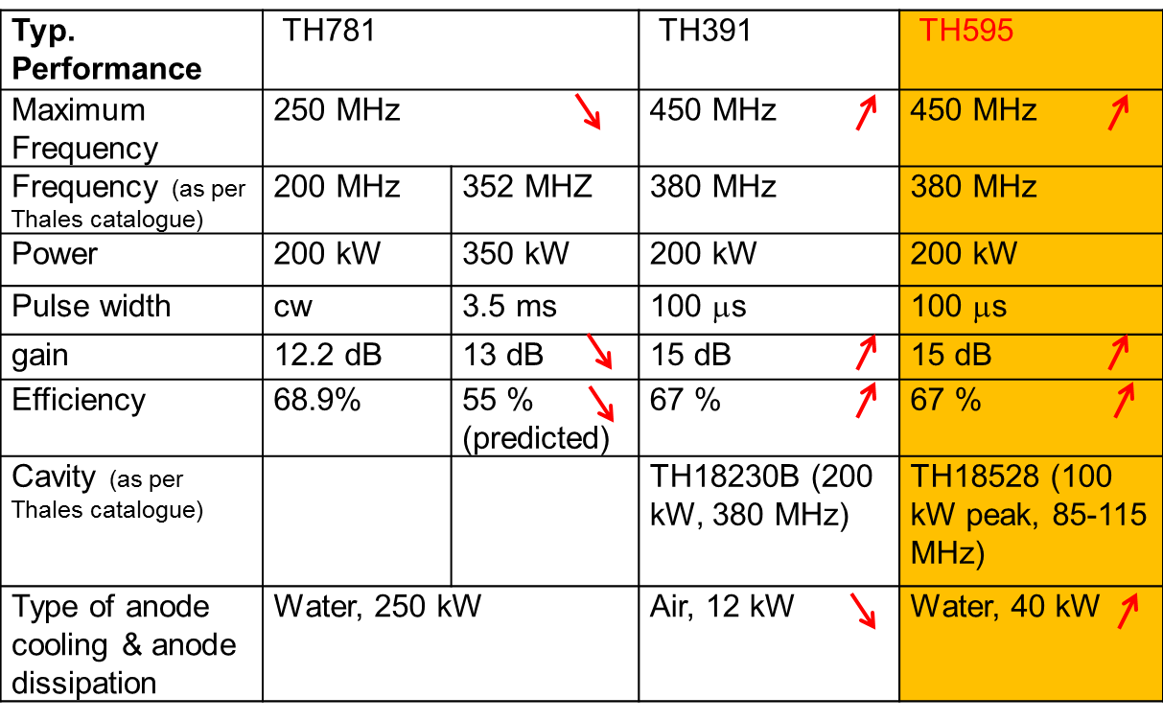
Comparison of Tetrodes
TH781, TH391 and TH595 tetrodes can be used at ESS specifications.
TH595 is sellected for first RF Power Station at FREIA.
Outputs of two TH595 shall be combined using Hybrid coupler.

Slide 9
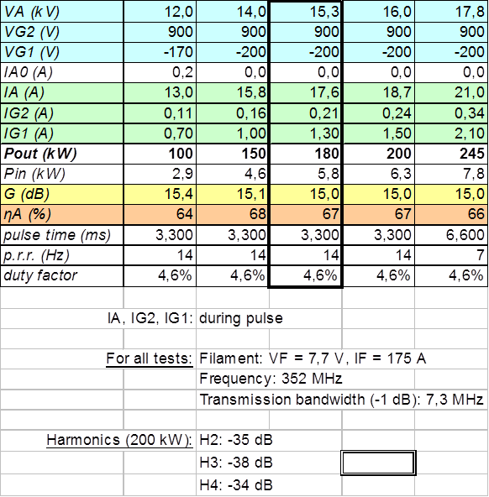
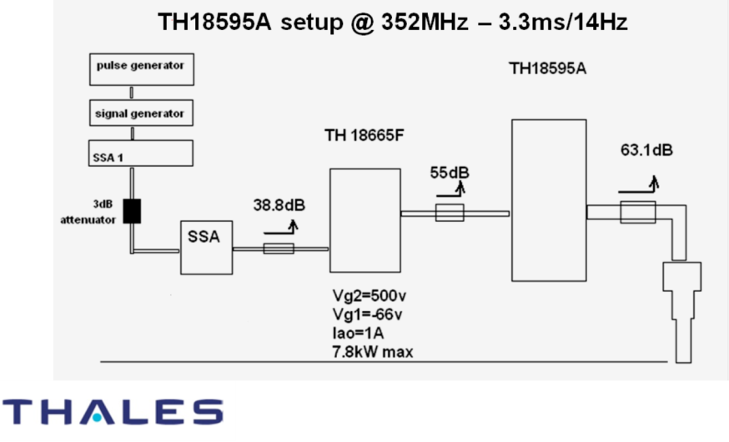
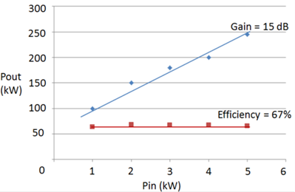
Summary of test results carried out at Thales
Thus TH595 is selected for first RF Power Station !

Slide 10
Preamplifer for Tetrode RF Power Station
Selected solid state amplifier as a preamplifier for tetrode.
- Gain 70 dB
- Efficiency > 50 - 55% (class AB)
- Good reliability: Built in redundancy
- Modular system, easy replacement
- Off-shelf available system
[Reported in SLHiPP2012, Katania]
To consider aging of Tetrode, conservative gain of 13 dB
Specifications:
Frequency: 352.21 MHz
Power = 10 kW
3dB band-width ≥ 1 MHz
Pulse width = 3.1 ms
Pulse repetition rate = 14 Hz
Solid State Amplifier installed in CERN

Slide 11
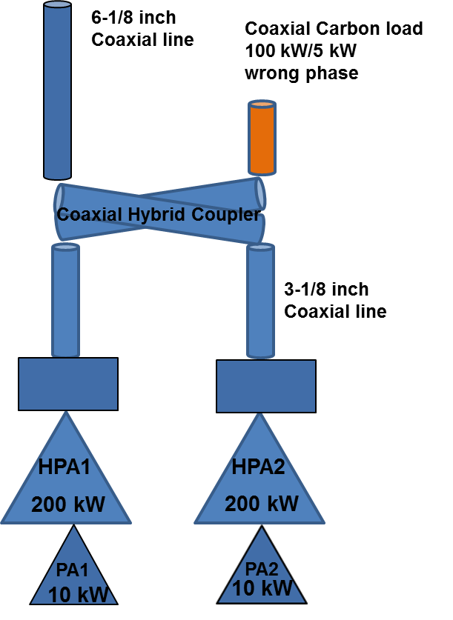
Tetrode RF Power Station
Spoke
Cavity
First RF Power Station at FREIA
Preamplifier: PA1 and PA2: Solid State Amplifiers
High power Amplifiers: HPA1 and HPA2 : Tetrodes
RF Distribution: 50 Ω Coaxial Line
7/8 inch line: 10 kW /500 W
3-1/8 inch line: 200 kW / 10 kW
6-1/8 inch line: 400 kW / 20 kW
Planning to avoid circulator:
Collaboration with Eric Montesinos (CERN)
Advantages:
system cost reduction by at least 70 kEUR
System is more efficient
Avoids pressurization
400 kW
Eric Montesinos
(CERN Collaboration

Slide 12
Solid State RF Power Station
Development by Siemens, to be tested
at FREIA
Features:
Footprint: 2 sq m (Four 19 inch cabinets)
Efficiency from wall plug to RF: 60%
Circulator not required
DC Power Supplies: 2 x 24 kW, 48 V
Power combiners:
- First stage power combiner:
8 kW input, 12 inputs
- Second stage power combioner:
96 kW input, 4 inputs.
RF Modules packed into 6 U high rack
Control system fits into 3 U high rack

Slide 13
Now:
Tender tetrode power station
FREIA hall ready (end June)
End 2013:
Delivery of Power stations,
liquefier
Begin 2014:
Installation of Power stations
Test on load
Test on variable short
Delivery test cryostat
Mid/End 2014:
Test on spoke

Slide 14
TIARA Workshop on
RF Power Generation for Accelerators
Monday 17 June – Wednesday 19 June
Uppsala University, Sweden
Electron tube devices,
Solid-state amplifiers,
Phase-stability and timing.
http://melba.its.uu.se/indico/event/RFworkshop2013
Thank you !

