Slide 1





ESS
Mats Lindroos
Head of the ESS Accelerator Division and Accelerator projects
Louvain-la-neuve, 17 April 2013

Slide 2
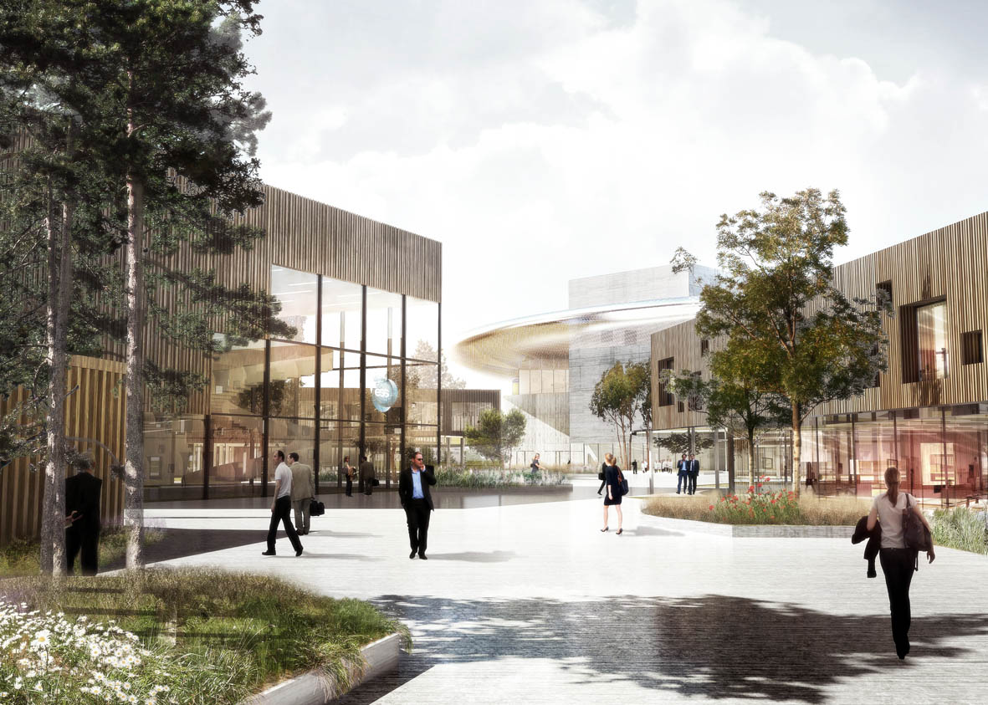

Welcome

Slide 3
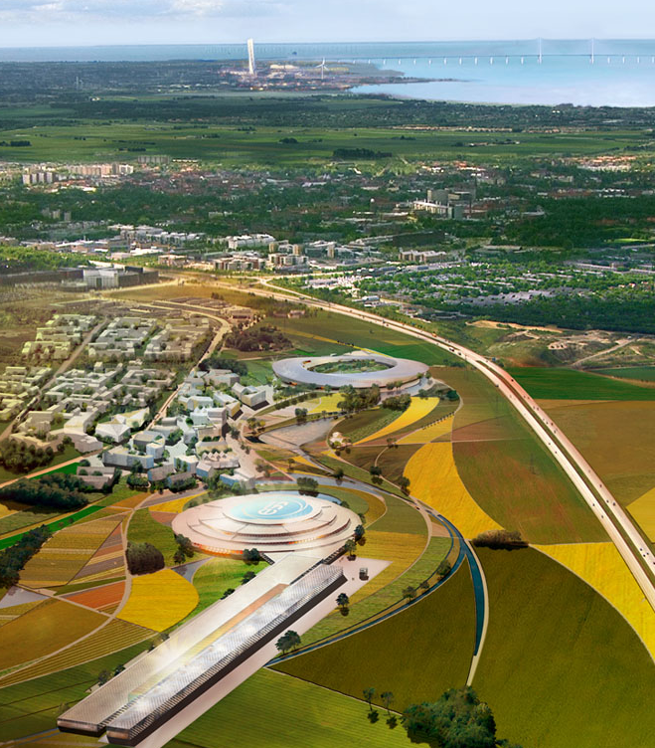
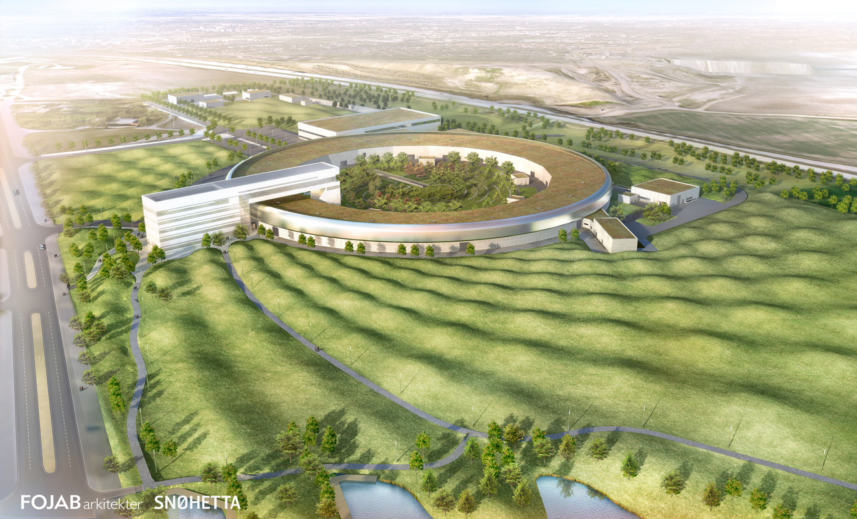


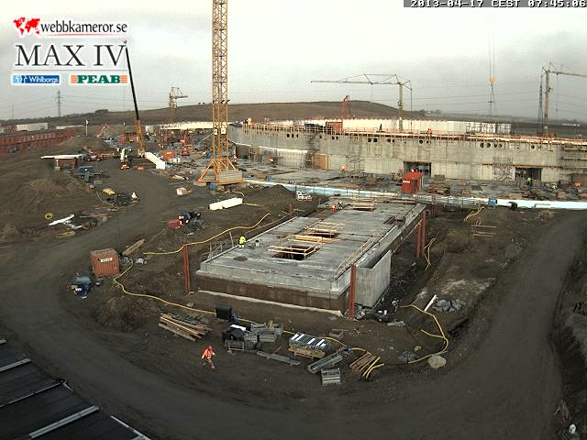

A material research center for Europe
Science village Scandinavia

Slide 4




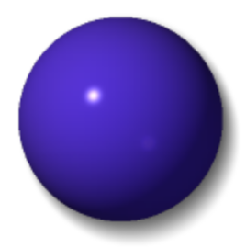






Light and neutrons
H
Li
C
O
S
Mn
Zr
Cs
X-rays
neutrons

Slide 5

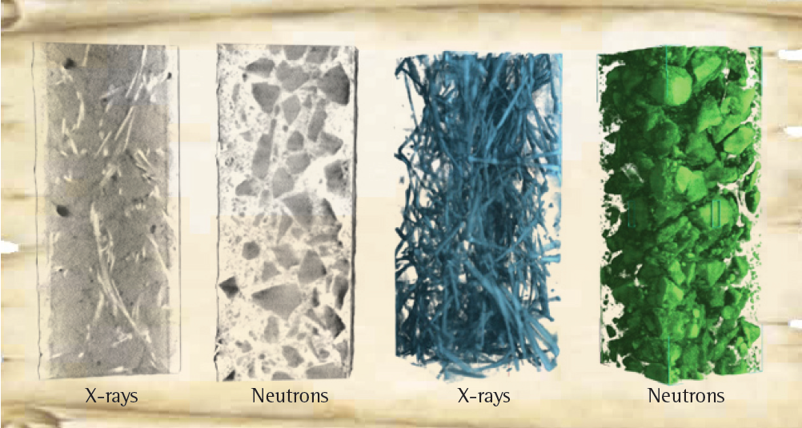
Engineering materials
Non-destructive analysis of a steel armed concrete block with neutron imaging and X-ray tomography.
Source: PSI, CEMNET workshop 2007

Slide 6
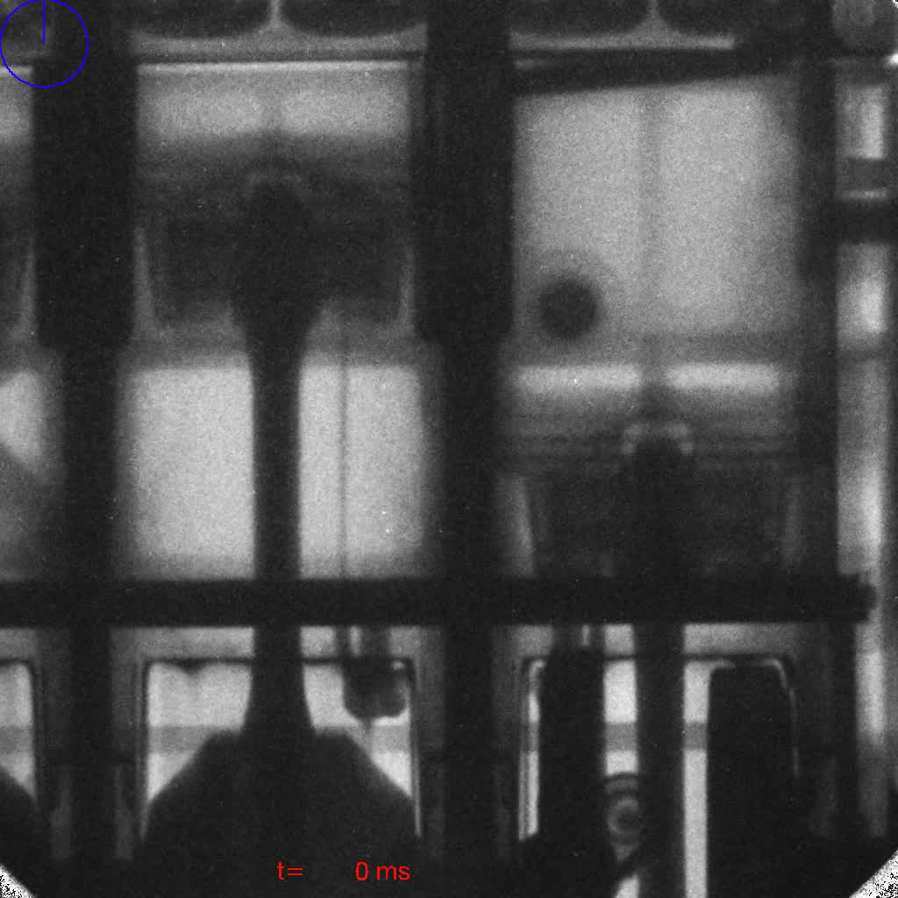
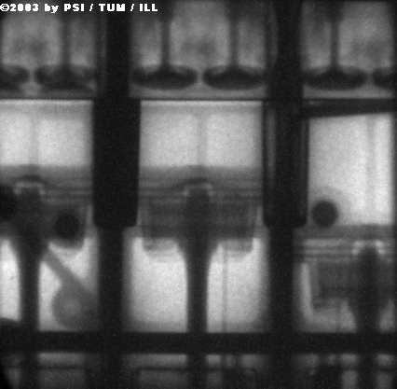
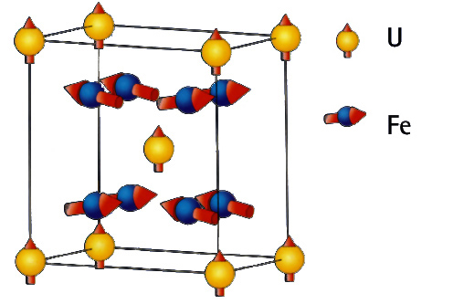
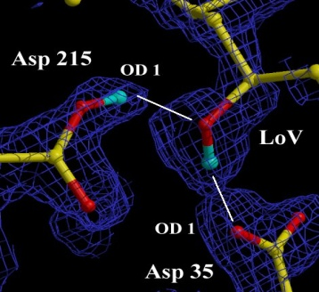
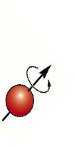

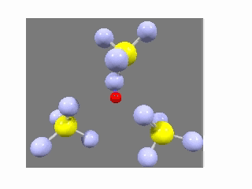
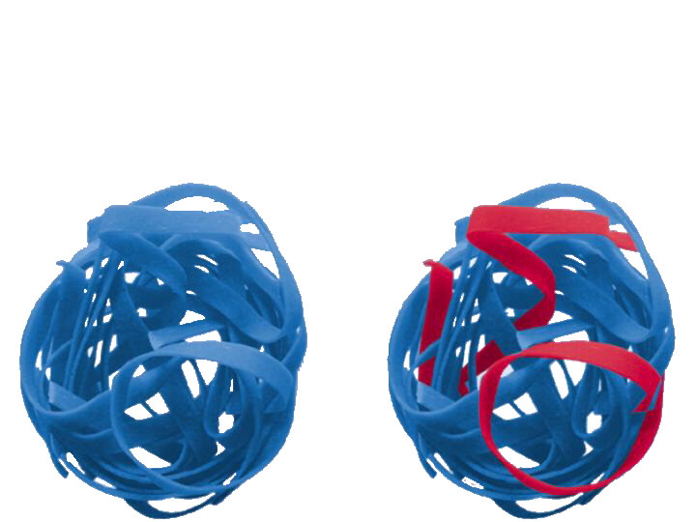
Neutrons and x-rays are complementary
- neutrons…
..see magnetic atoms
..see inside materials
..see light atoms
..see atoms move
..see isotopes
Coutsey of Ian S. Anderson
Notes:
Brief description:
Neutron scatter from the nucleus and not the electrons -> penetrating, see light atoms, and magnetic structures.
Top clockwise:
Neutron Radiograph (from Munich) of an operating BMW engine
X-rays reveal the protein crystal structure – neutrons reveal the positions of the H atoms which are key to the catalytic activity
Isotope contrast (H/D in this case) allows specific strands to be picked out in this complex polymer
Neutrons have mass similar to atoms – and can measure dynamics easily. This is a CH4 electrolyte – the H is transferred via a rotation and cross over mechanism – revealed by neutrons
Neutrons have a magnetic moment. Most magnetic structures have been determined with neutrons. Can also be applied to magnetic dynamics e.g. Spin waves – important in studies of high Tc materials.

Slide 7
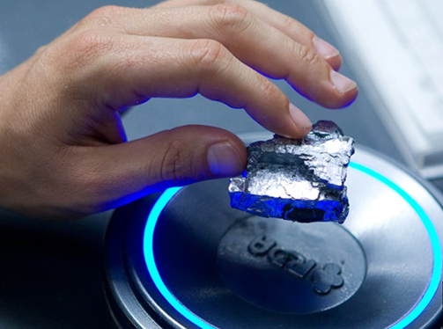
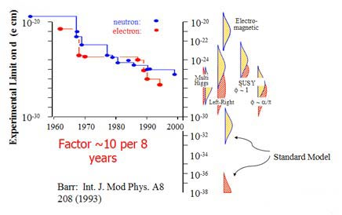
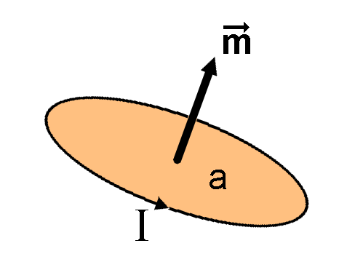
The visions for neutron science
Room Temperature Super Conductors
Sterile neutrinos
Hydrogen storage substrate
Neutron electric dipole moment
Efficient membrane for fuel cells
Flexible and highly efficient solar cells
Carbone nano-tubes for controlled drug release
Self healing materials – smart materials
Spin-state as a storage of data (10²³ gain in capacity)
CO₂ sequestration
Unobtainium
Avatar

Slide 8
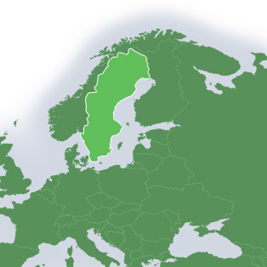

















International collaboration
Sweden, Denmark and Norway
covers 50% of cost
17 Partners today
The remaining ESS members states together with EIB covers the rest!

Slide 9
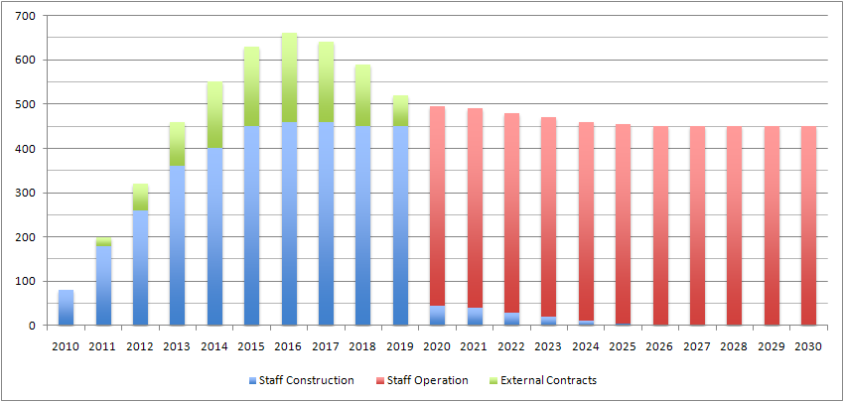
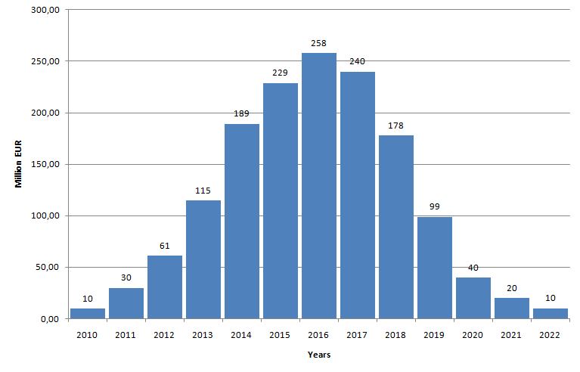
ESS construction cost estimates
Investment: 1478 M€ / ~10y
Operations: 106 M€ / y
Decomm. : 346 M€
(Prices per 2008-01-01)
Personel:
Investment:

Slide 10
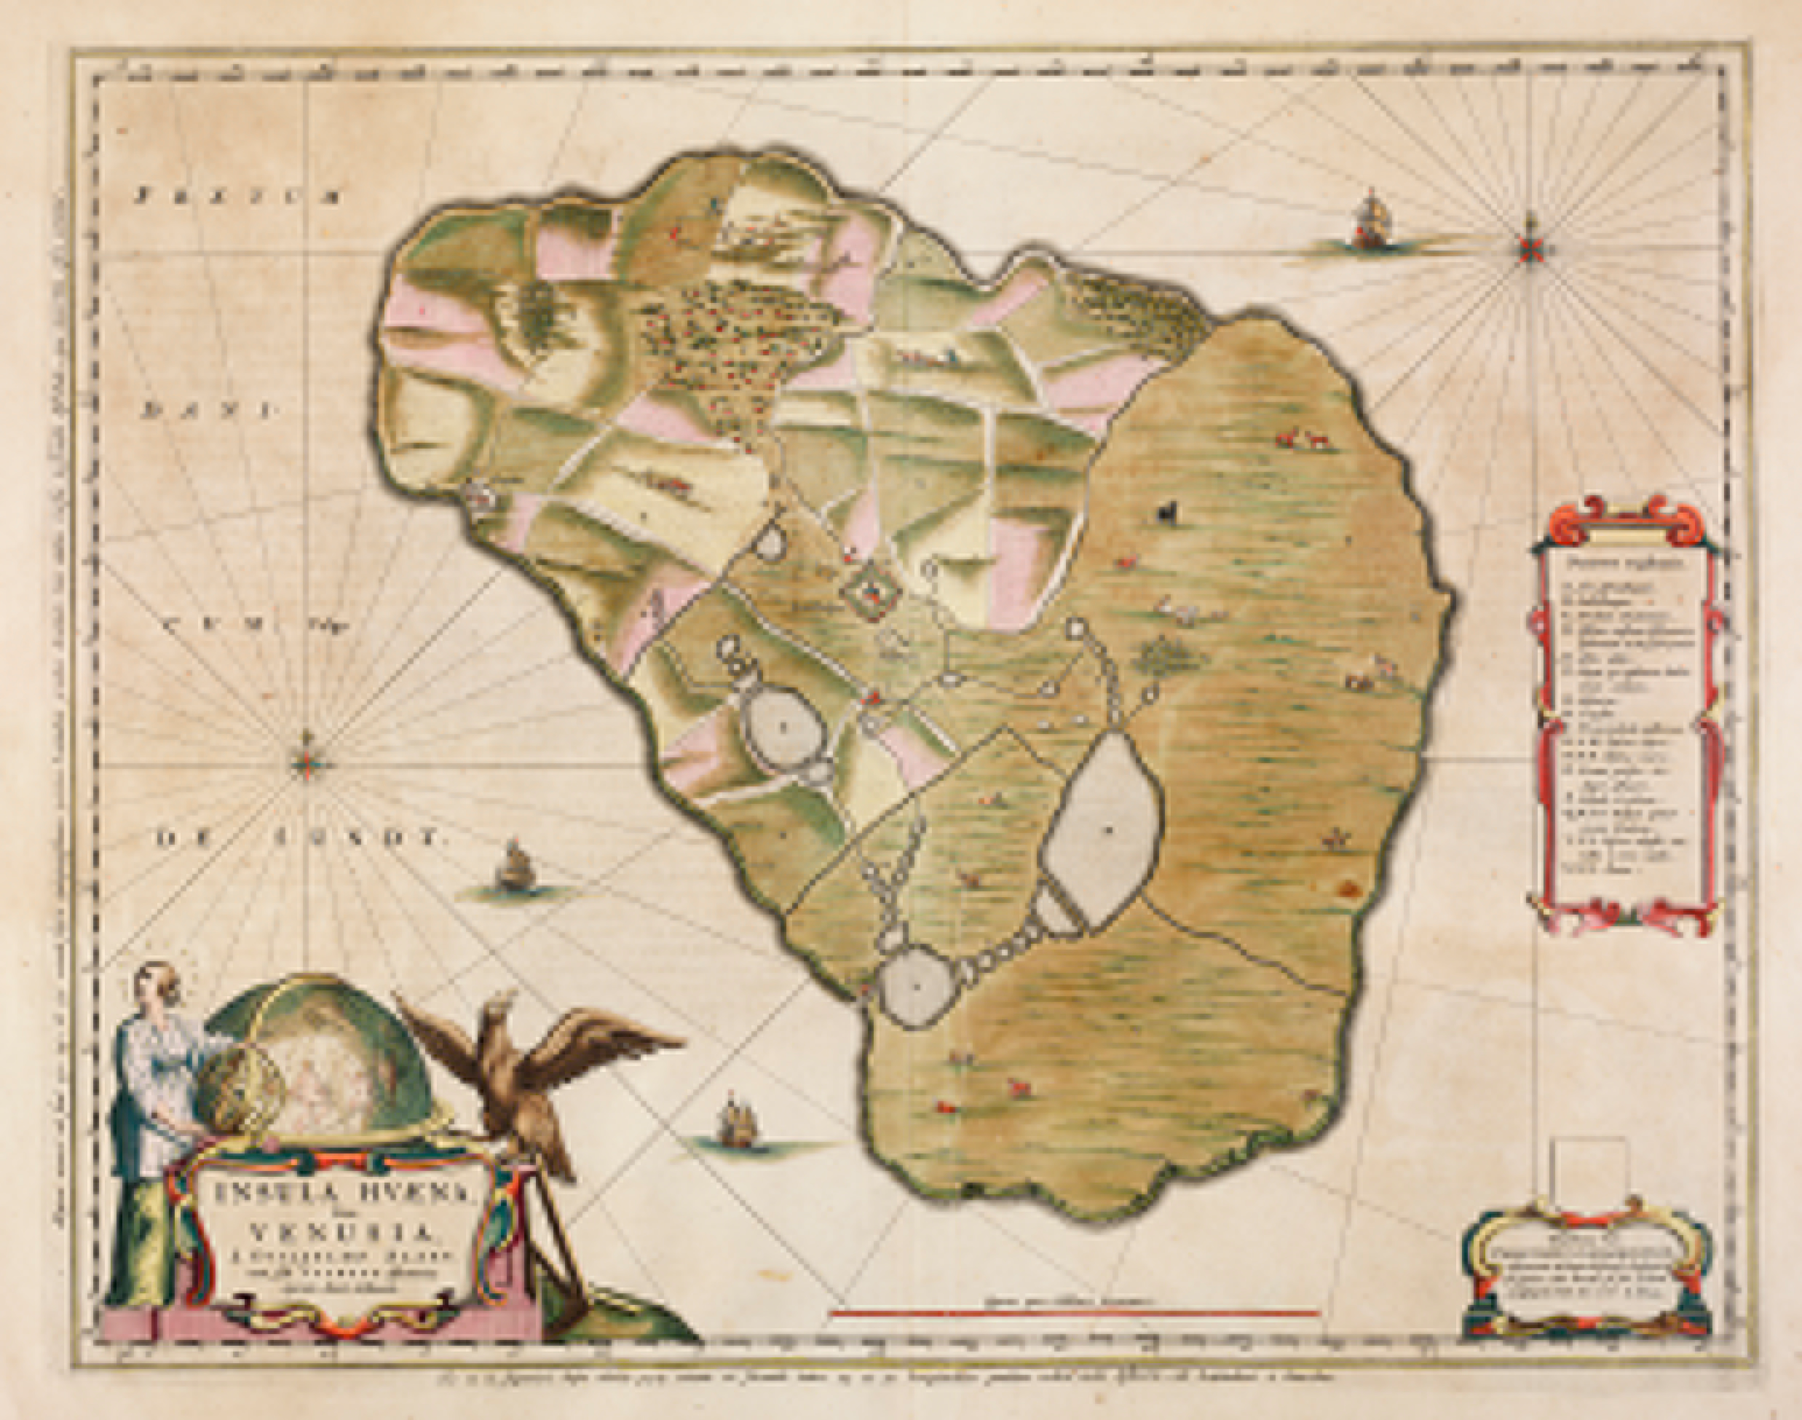
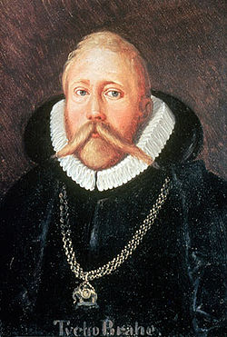
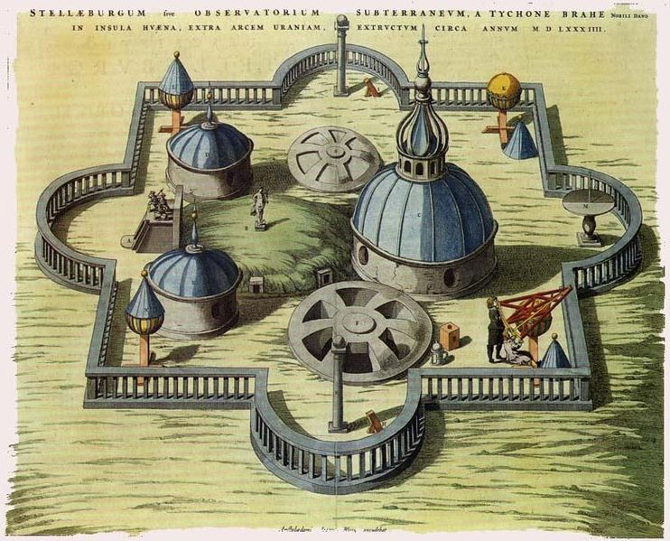
1.5 Billion Euros:
Biggest investment in Science ever in Scandinavia?
In modern time, definitely YES!
However, Tycho Brahe’s Stjärneborg costed the Danish king 1% of the state budget in 1580.
Or you could for 1.5 Billion Euros pay the US bankers bonuses for 24 days!
Notes:
1% would be 1.7 Billion Dollars in 2011

Slide 11
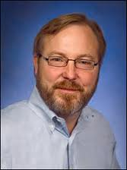
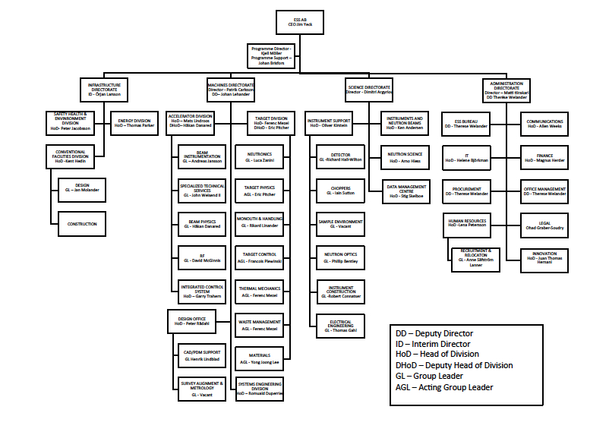
ESS Organisation
Jim Yeck, CEO from 1 March

Slide 12
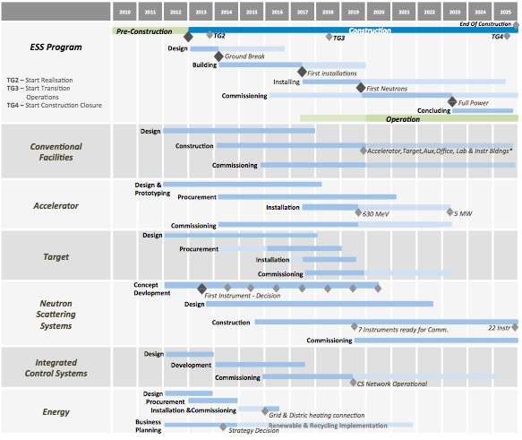
ESS Top-Level Schedule

Slide 13
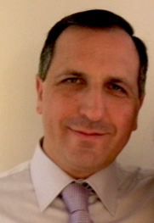
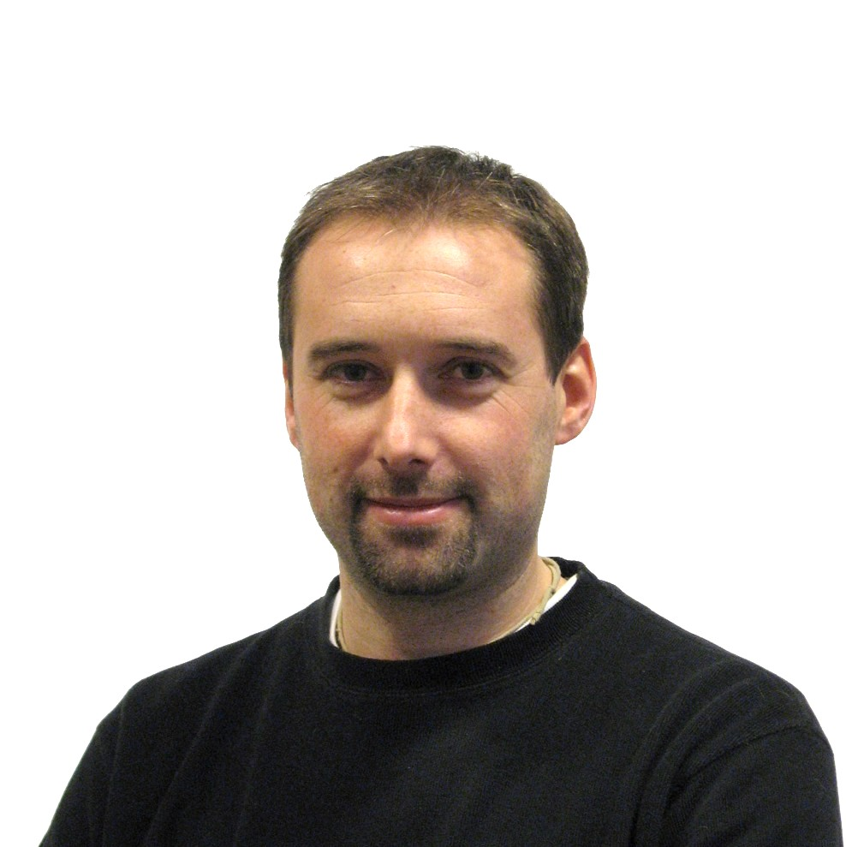
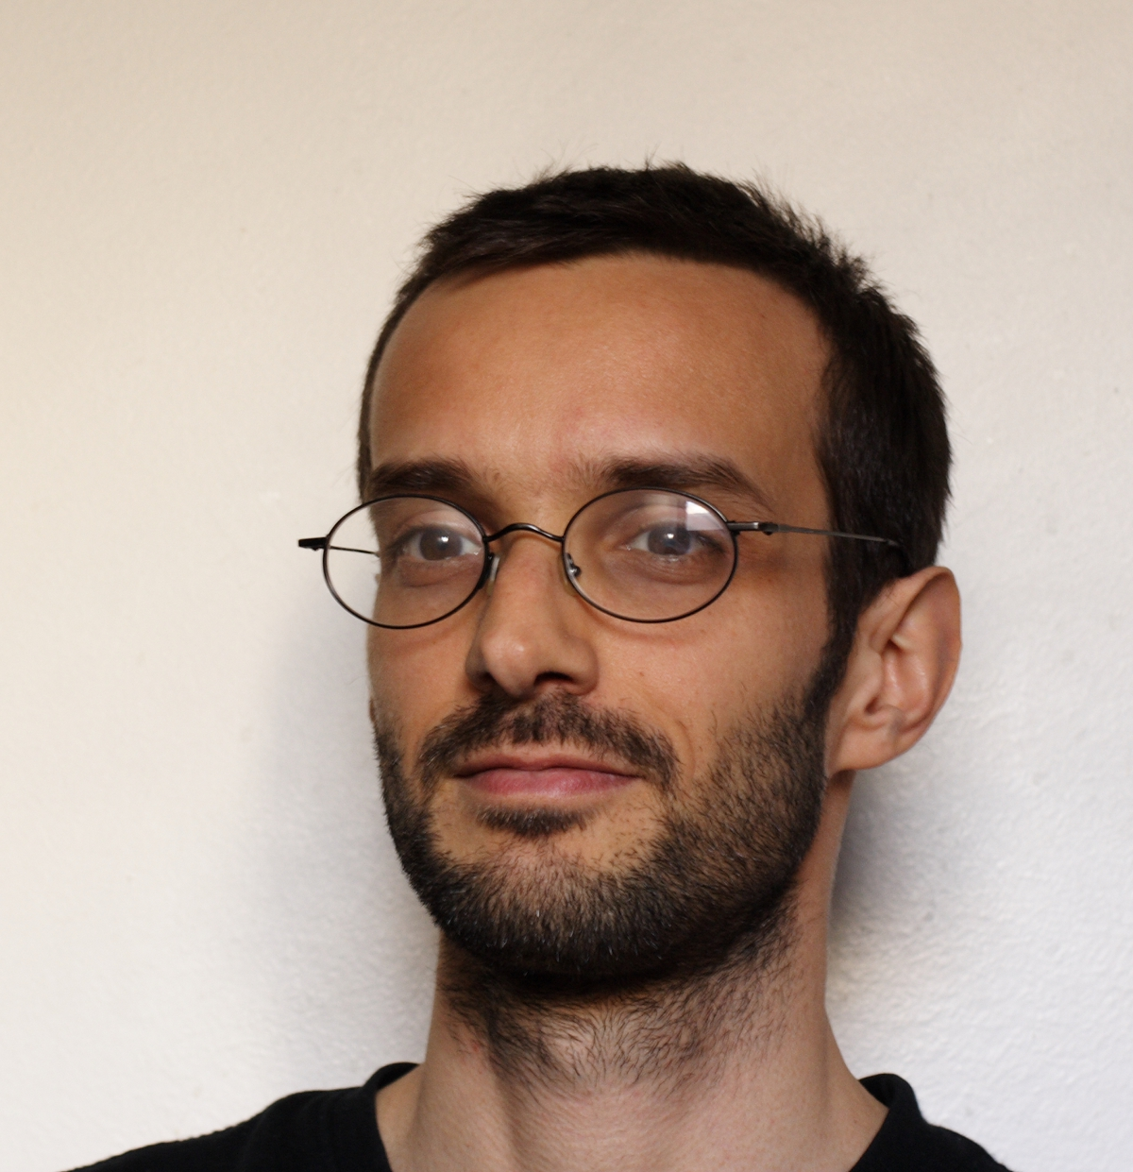
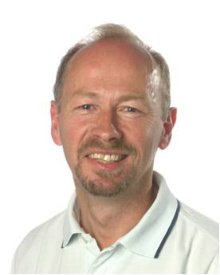



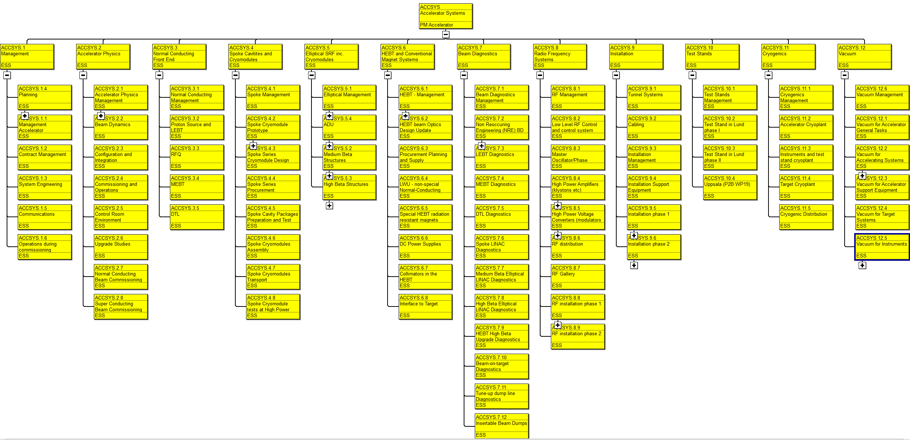

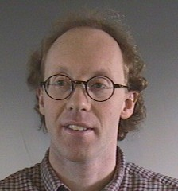



Collaborative project
Santo Gammino
Sebastien Bousson
Pierre Bosland
Søren Pape Møller
Roger Ruber
Ibon Bustinduy
Anders J. Johansson
Two new WPs to be added: WP13 Safety and Reliability and WP14 Design changes
Santo Gammino
Santo Gammino

Slide 14
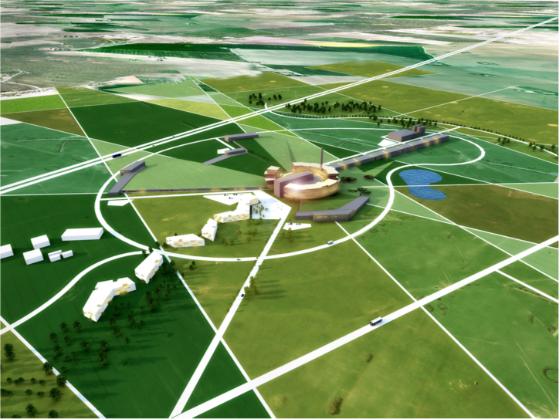
ESS accelerator
Design Drivers:
High Average Beam Power
5 MW
High Peak Beam Power
125 MW
High Availability
> 95%
Key parameters:
    -2.86 ms pulses
    -2 GeV
    -63 mA
    -14 Hz
    -Protons (H+)
    -Low losses
    -Low heat loss cryostats
    for minimum energy
    consumption
    -Flexible design for
    future upgrades

Slide 15
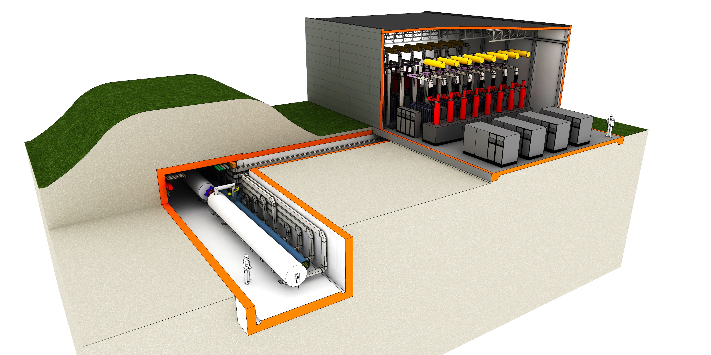

LINAC and klystron buildings, principal structure

Slide 16
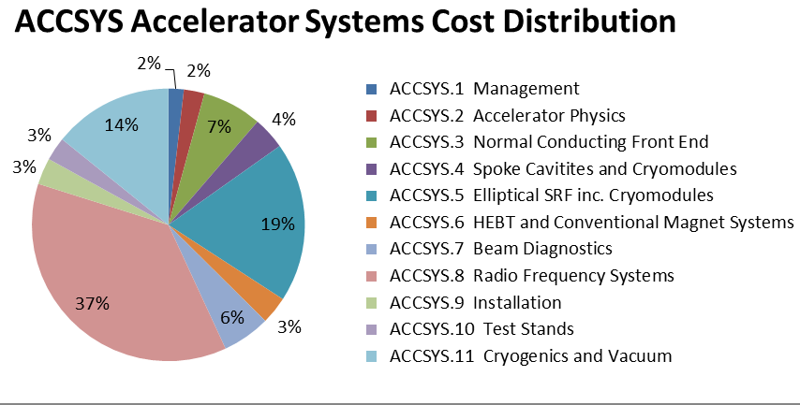
Cost Drivers
RF Systems – 37%
  Modulators – 15%
  Klystrons – 14%
Elliptical Cryomodules -19%
Cryogenics – 14%
Courtesy of A. Sunesson
Courtesy of S. Gysin

Slide 17
Design change!
Cost of TDR baseline beyond budget for accelerator project with 17%
First proposal for new baseline presented to all collaborators and TAC in November 2012 and March 2013
Design goal integrated at high level in cost book in March 2013
Decision by ESS to launch a new WP (14) lead by David McGinnis for the design change process as part of the ACCSYS project
New baseline to be adopted through ESS configuration control processes in two stages in June and September 2013

Slide 18
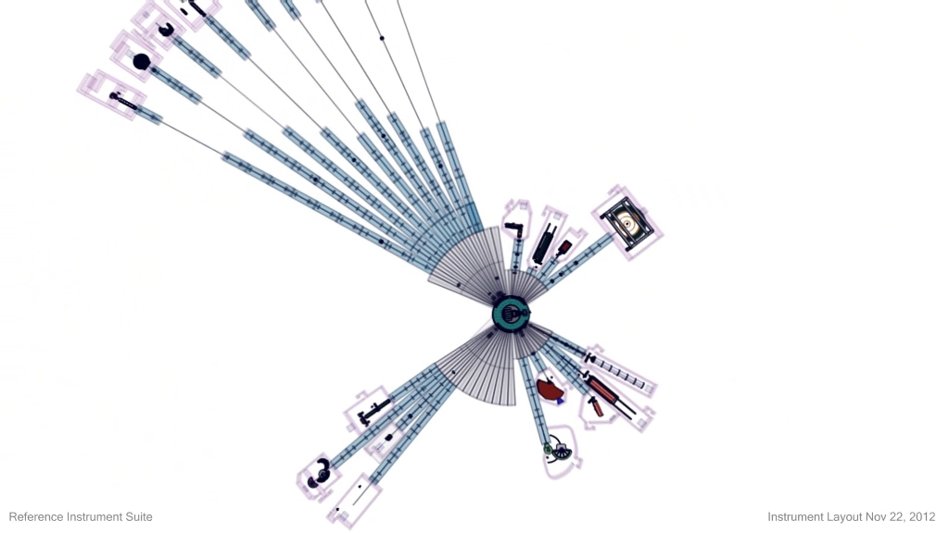
In-kind Process Begins With EoI
Call for Expressions of Interest
Based on TDR
Work Packages & Cost Book
May contribute “component” or “work”
Several calls; WPs will be released as they mature
Record of competence of the team, references important
Slightly different for Accelerator, Target & Instruments
After EoI response, a detailed discussions for IKC begin
We expect there will be partnering on Work Packages

Slide 19
Timing for Call for Expression of Interest
March
April
May
June
July
August
Sept
Oct
X
X
X
X
X
X
X
Go Out With Call
Discussions for In-kind Detailed Proposal
Expected Response
Present to StC
Pre-work with StC members and key stakeholders
Notes:
Expected timing for the EoI this year

Slide 20
In-kind Contribution (IKC) Process
Input
Scope of contribution
Value
Technical & Project Specs
Interfaces
Schedule
Standards
QA Requirements
Responsible Person(s)
Work Unit Confirmation
Acceptance
Integration
Commissioning
Expression of Interest (EoI)
by IKC Partners
ESS Project Evaluation
IKC Discussions (ESS & Partners)
Partner Project Responsibility
Management
Resources
Work
QA Control
Agreement + Technical
Annex
IKRC Recommendation
Confirmation by StC
Output
Hardware
Services
Manpower
Software
Documents
Agreement + Technical
Annex
IKRC
Confirm Contribution
Notes:
Part One – Explains how Partners can express interest and get from an EoI to a confirmed In-kind Contribution (IKC) package
Part Two – Once the Agreement is made, then the “Inputs” to the package are already defined in the Agreement + Tech Annex; The “Project Responsibility” is the actual implementation; “Output” is the expected result of the project + inputs
Part Three – Once the “Work Unit” is confirmed, then credit is given by the project to the partner country; the agreement at the end of the process is confirmed by the In-kind Review Committee (IKRC), closing the deal.

Slide 21
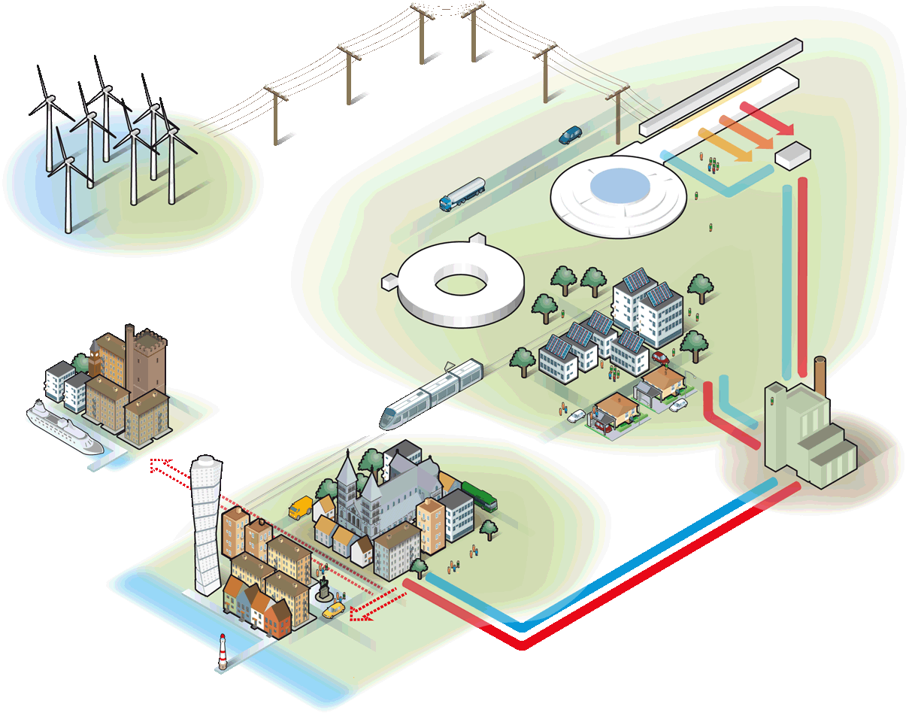
A sustainable research facility
Responsible
Carbondioxide:
- 30 000 ton/year
Renewable
Carbondioxide:
- 120 000 ton/year
Recyclable
Carbondioxide:
- 15 000 ton/year
Notes:
Högsta temp: 118 GWH
All värme: 215 GWh = 10 000 villor

Slide 22
Headlines
The European Spallation Source will be built in Lund
The Design will permit a long life with many upgrades
The accelerator design, prototyping and construction is done in a collaboration
The ESS partners (collaborations) are essential for the project
The EOI process is requested by the members states to assure that all possibilities for in-kind contributions are explored
Welcome to ESS!

