Slide 1
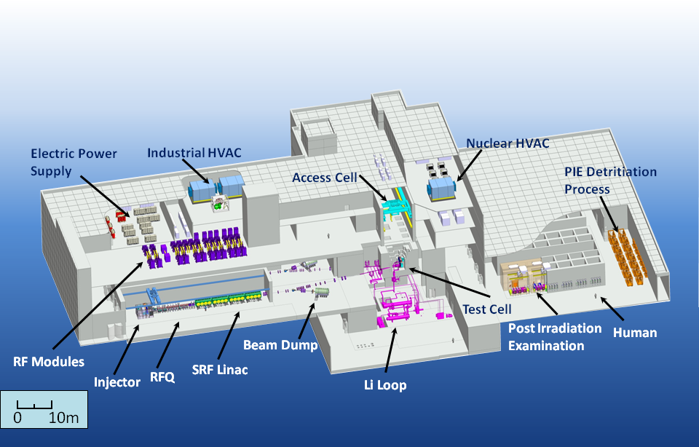
IFMIF status
Alban Mosnier
(on behalf of Juan Knaster)
SLHiPP 2013
Louvaine-la-Neuve

Slide 2
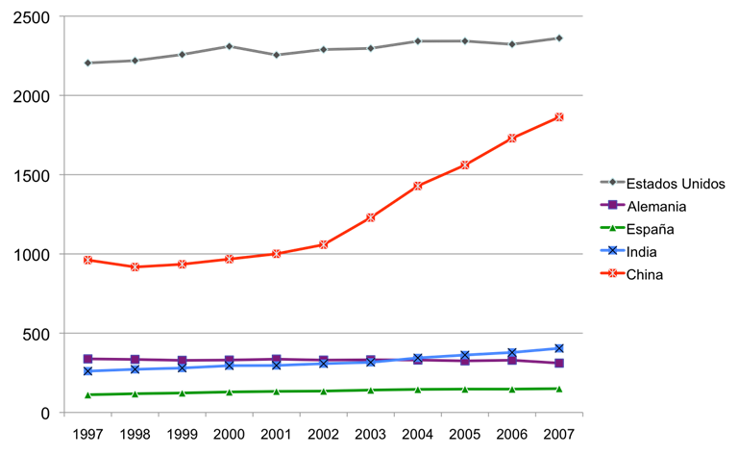
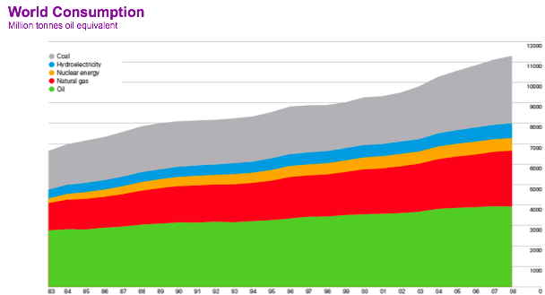
World energy scenario
In 2 years,
the growth of energy consumption in China was greater than total consumption in Germany
80% of world energy generated
from fossil fuels
Medium term Problems
Greenhouse effect
Resources are finite

Slide 3
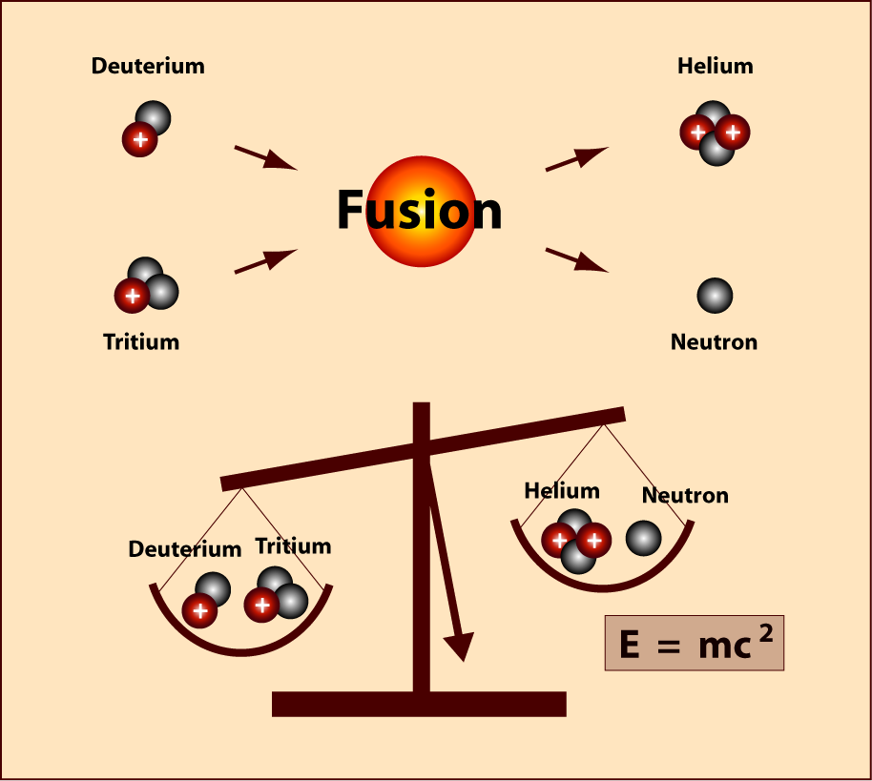
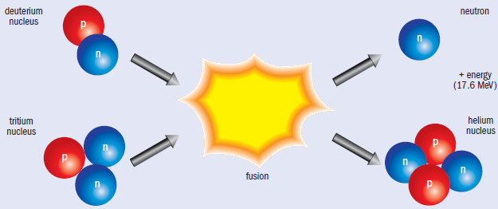
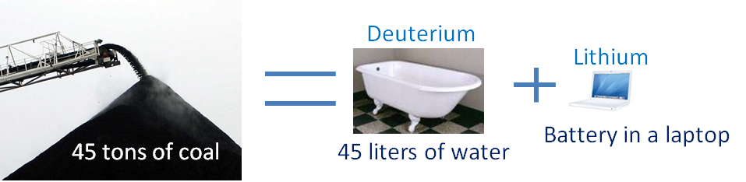
But why fusion?
14.1 MeV
3.5 MeV
Fuel needed
for energy consumption
by a Belgian citizen
for 50 years
Mass loss of 4 milligram in 1 gram!!

Slide 4
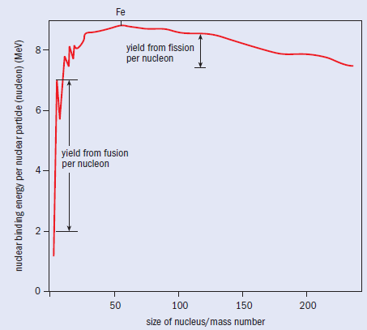
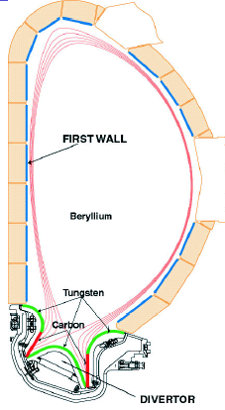
Advantages of fusion
Limitless resources
Lithium and Deuterium
(with an enormous efficiency)
Intrinsically safe
No chain reaction (difficult to maintain…)
Plant in operation contains a few grams of fuel
Reaction would extinguish within s
Tritium is produced and burned in a close circuit
Waste
No long-lived radioactive waste
Recycle of parts from decommissioned plant

Slide 5
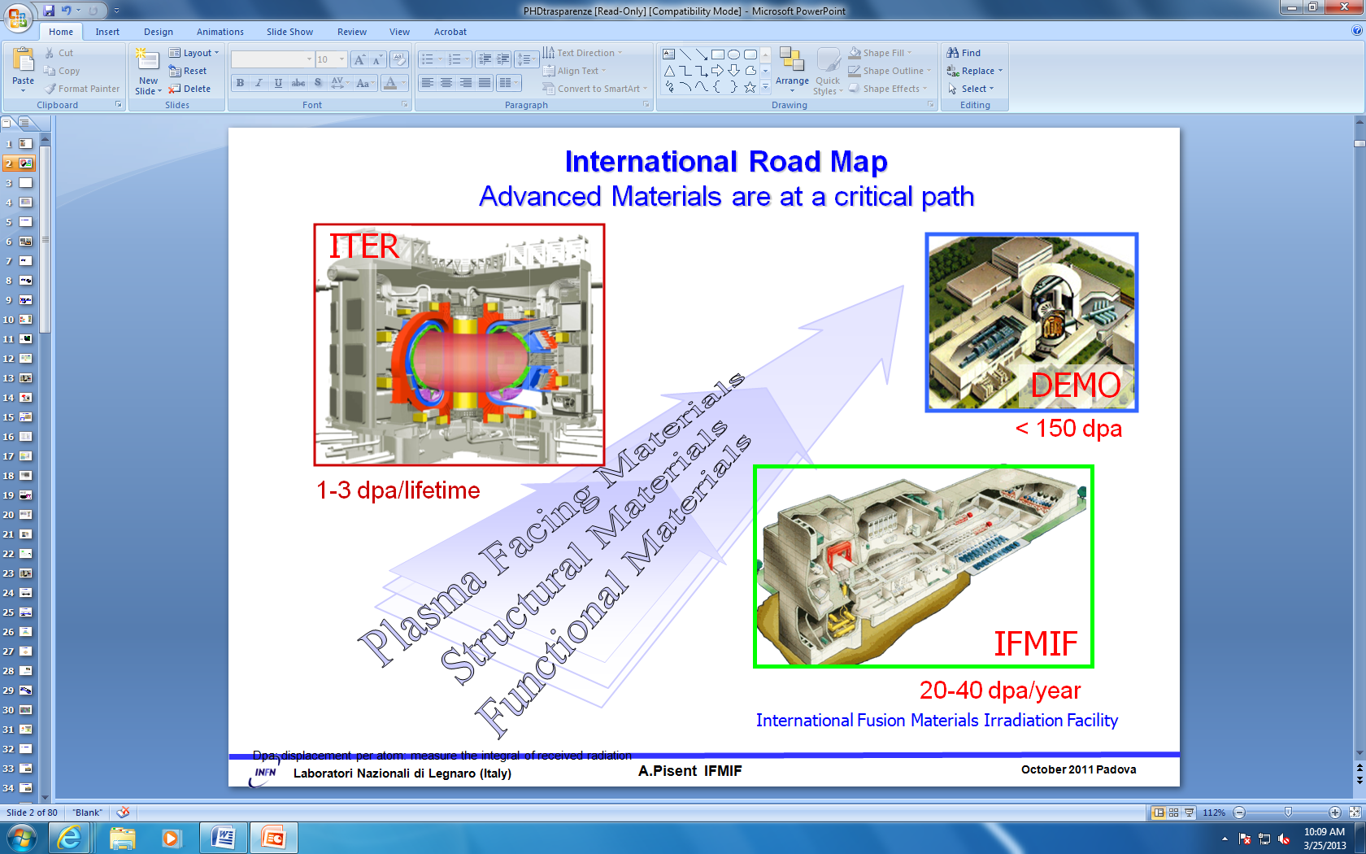
World Fusion Programme essential facilities

Slide 6
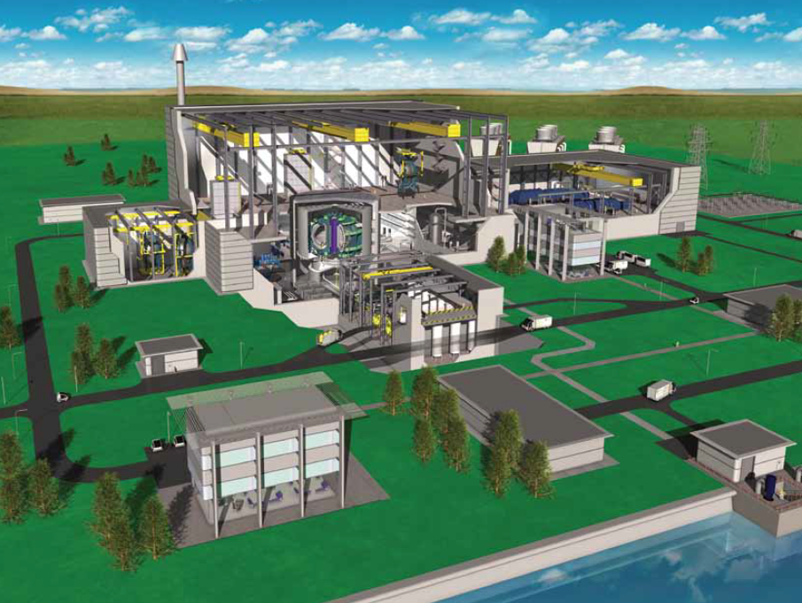
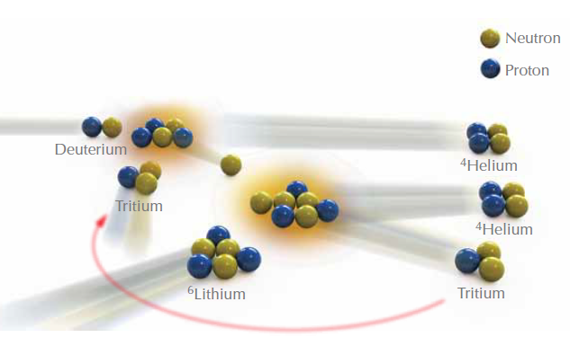
The first wall
of the reactor vessel shall
absorb neutrons energy
and
breed tritium
ITER first wall will present
<2 dpa at the end of its operational life
In a Fusion power plant
~150 dpa within 5 years are expected
Critical threshold observed beyond 30 dpa
but no relevant data is available

Slide 7
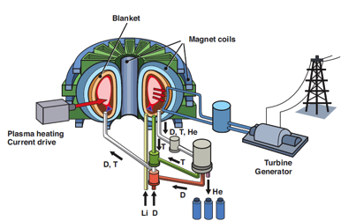
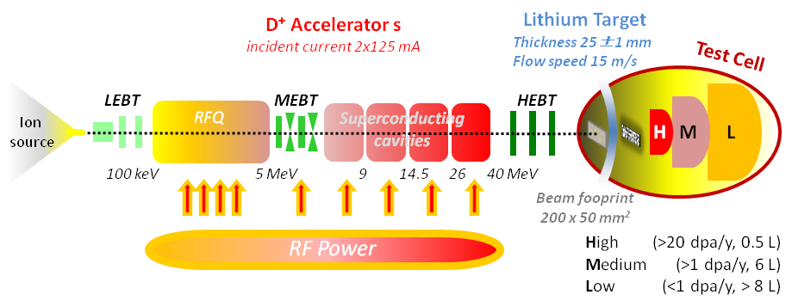
Understanding the degradation of the mechanical properties
of the materials critically exposed to 14.1 MeV n flux
is a key parameter to allow
accomplishment of the design
and
facility licensing
IFMIF a 14 MeV n source

Slide 8
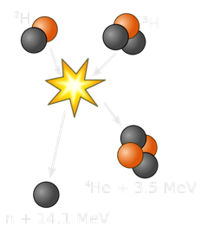
14 MeV beyond transmutation thresholds
The accumulation of gas in the materials lattice is intimately related with the neutron energy
⁵⁶Fe(n,α)⁵³Cr
(incident n threshold at 3.7 MeV)
and
⁵⁶Fe(n, p)⁵⁶Mn
(incident n threshold at 2.9 MeV)
H permeates
He do not and does not solve in metals
Swelling and embrittlement of materials takes place

Slide 9
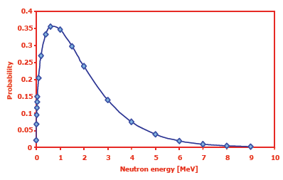
Fission and spallation sources no fusion n relevant
Existing neutron sources
do not provide the needed answers
Fission reactors n average energy ~2 MeV
Spallation sources present a wide spectrum with tails in the order of hundreds of MeV
Generation of light isotopes in the order of ppm
Spectrum fission n
No efficient
p⁺ or α-particle generation

Slide 10
Mission of IFMIF
Qualification of candidate materials
for fusion reactors
Generation of engineering data for
design, licensing and safe operation of DEMO
Completion, calibration and validation of databases
(mainly generated from fission reactors research)
Deepening on fundamental understanding of radiation response of materials hand in hand with computational material science

Slide 11
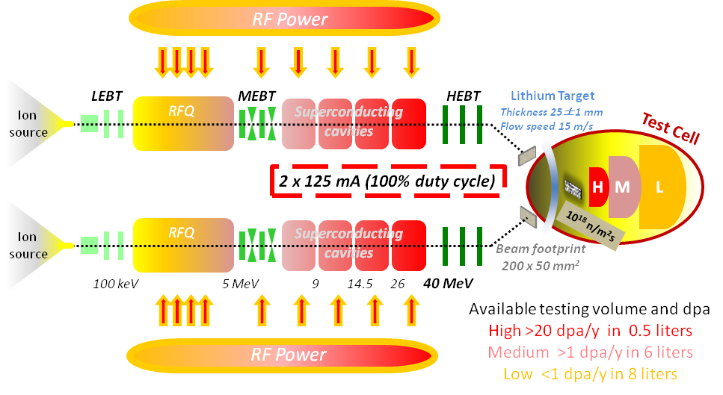
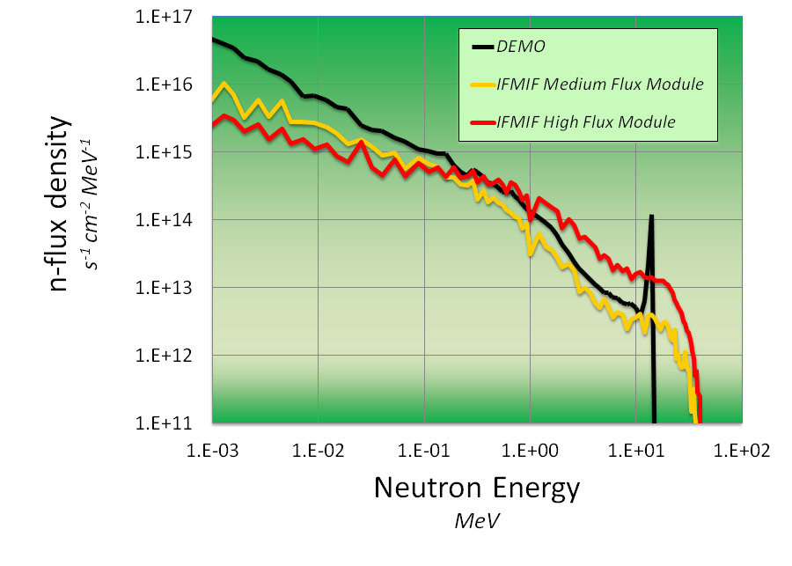
IFMIF concept
Deuterons at 40 MeV
collide on a liquid Li screen
flowing at 15 m/s
A flux of 10¹⁸ n·m⁻²s⁻¹
is stripped
with a broad peak
at 14 MeV
Availability of facility >80%

Slide 12
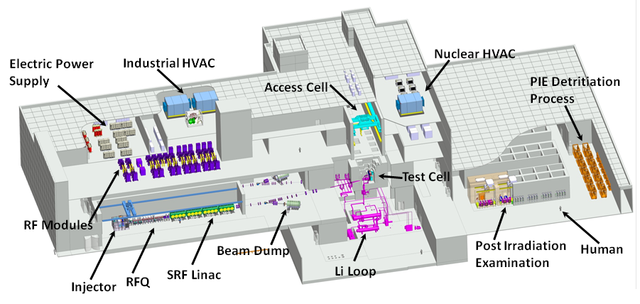
IFMIF/EVEDA phase
The validation activities comprises three main facilities
Accelerator facility
Target facility
Test facility
In addition, we are preparing an
Intermediate IFMIF Engineering Design Report
and the collaboration is very numerous with highest level labs and universities
in Europe and Japan

Slide 13
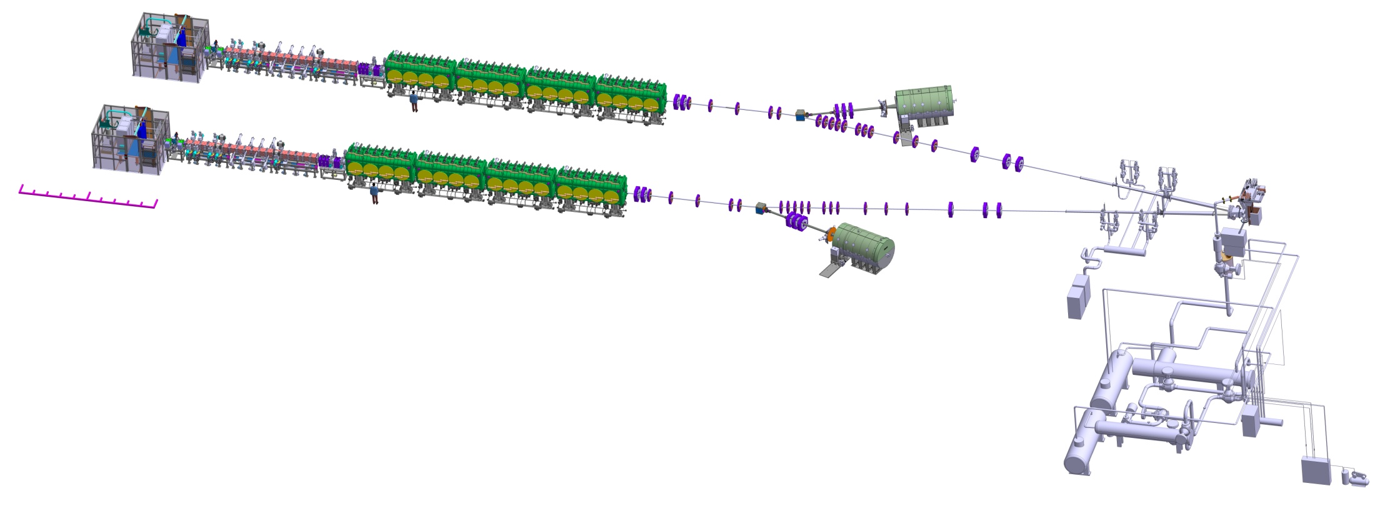
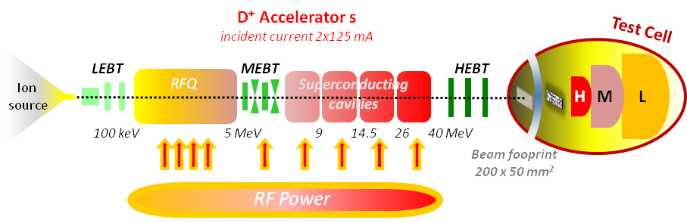
Accelerator facility
2 x 5 MW beams
10 m
Individual availability >90%
10
10 m

Slide 14
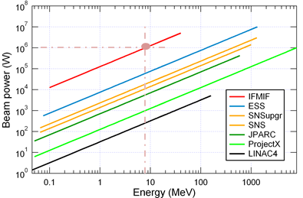
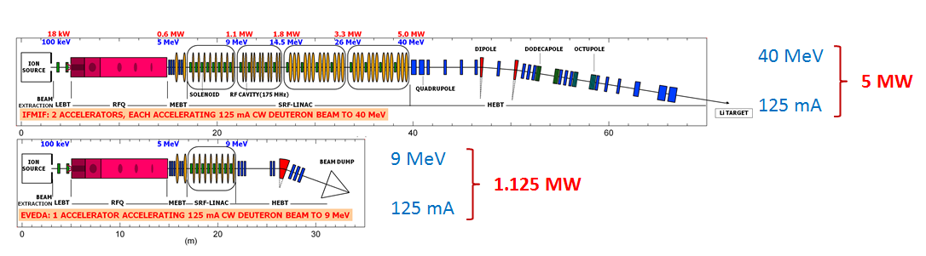
LIPAc vs IFMIF
LIPAc
LIPAc
  Features of IFMIF vs LIPAc
  d⁺ accelerator
  125 mA (100% duty cycle)
  5 MW vs 1.125 MW
  Space charge issues
  Low energy-high power

Slide 15
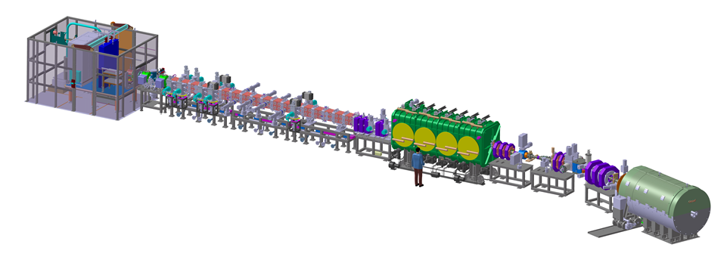
Accelerator facility validation
LIPAc contribution
Linear IFMIF Prototype Accelerator
Mainly
European contribution
Injector + LEBT
CEA Saclay
RFQ
INFN Legnaro
JAEA Tokai
SRF Linac
CEA Saclay
CIEMAT Madrid
MEBT
CIEMAT Madrid
HEBT
CIEMAT Madrid
BD
CIEMAT Madrid
36 m
Diagnostics
CEA Saclay
CIEMAT Madrid
RF Power
CIEMAT Madrid
CEA Saclay
SCK Mol

Slide 16
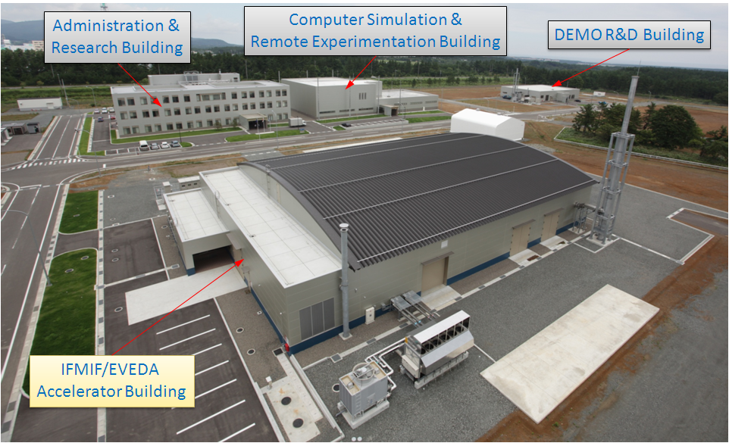
Site is ready
JAEA contribution

Slide 17
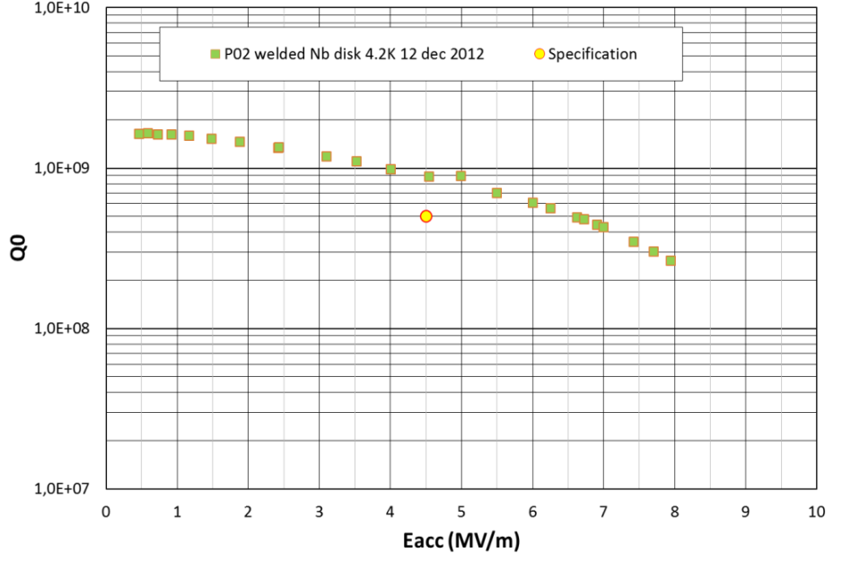
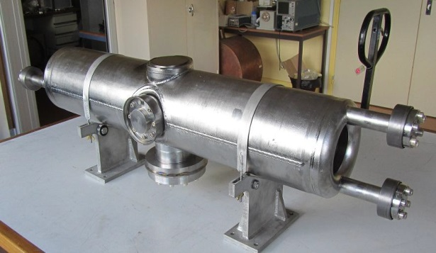
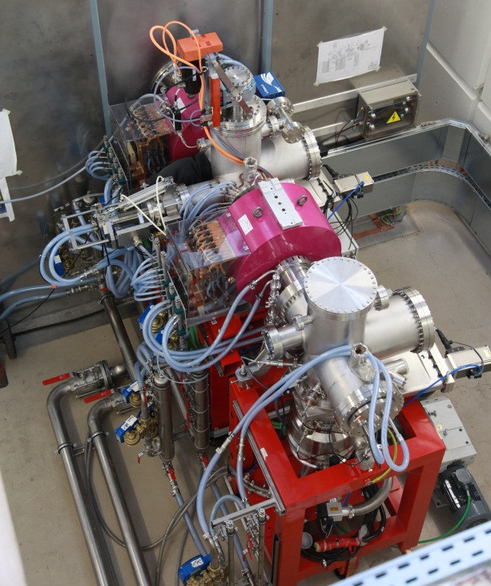
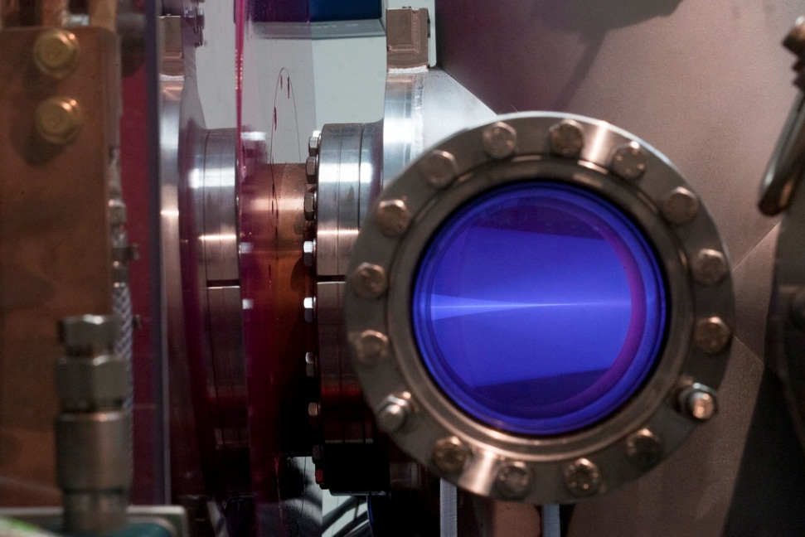
Ion source & SRF
Continuous Wave ECR (2.5 GHz)
E = 100 keV
I = 140 mA
emittance of 0.25 π mm·mrad
Availability > 95%
Acceptance tests in Saclay successful!!
Status of LIPAc
See Alban Mosnier’s talk
on Thursday (P-6-3)
R. Gobin et al., General design of the International Fusion Materials Irradiation Facility deuteron injector: Source and beam line, Rev. Sci. Inst. 81, 02B301 2010
picture coutesy of CEA/P. Stroppa

Slide 18
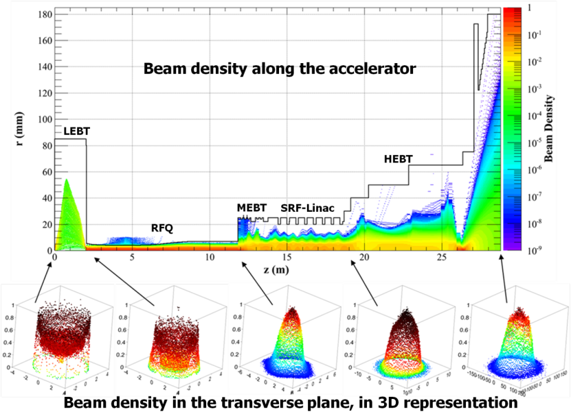
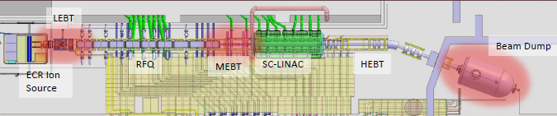
P.A.P. Nghiem, N. Chauvin, M. Comunian, O. Delferrière, R. Duperrier, A. Mosnier, C. Oliver, D. Uriot ,
The IFMIF-EVEDA challenges and their treatment, Nuclear Instruments and Methods in Physics Research A, 654 (2011) 63-71
Putting it all together…
LIPAc commissioning will be
a challenging (and fascinating) phase
Individual equipment is ‘commissioned’ in labs
and put together in Rokkasho
Starting with protons and 0.1% duty cycle
High power, (1.125 MW) high space charge
and nature of particle (deuterons) makes it fun (if I may)
Beam physics performed by CEA&CIEMAT&INFN
N. Chauvin

Slide 19
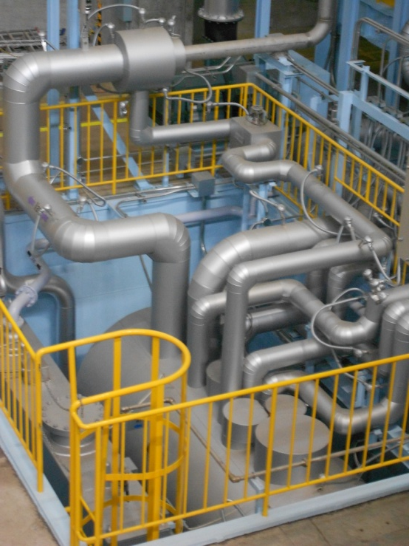
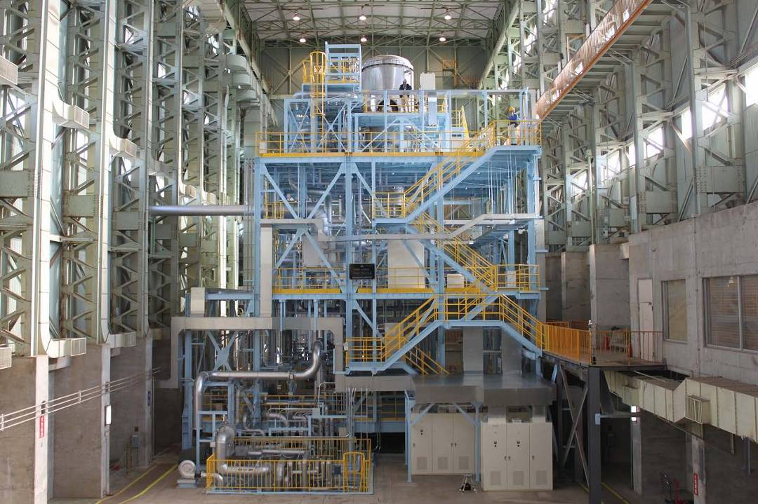
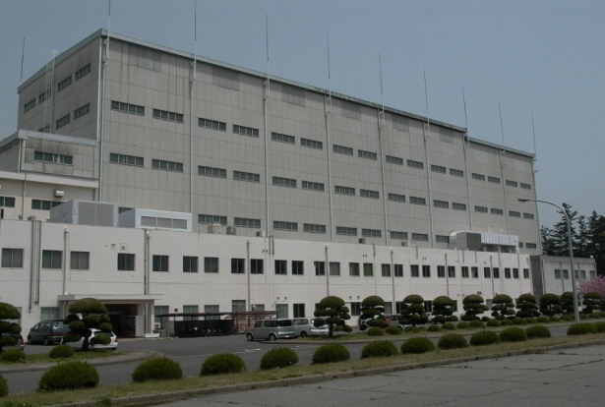
Target facility validation
World largest liquid Li loop
constructed by JAEA in Oarai
20 m
20 m
Kondo, H., et al., Completion of IFMIF/EVEDA lithium test loop construction,
Fus. Eng. Des. 87 (2012) 418

Slide 20
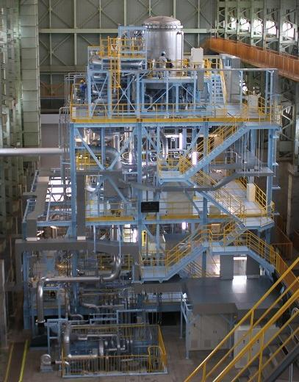
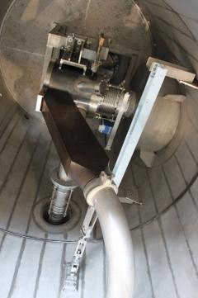
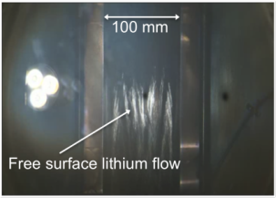
Target facility validation
Vesesl of Target Assembly
Inlet Pipe
View Port
Target Assembly
Air Cool Heat Exchanger
Nozzel
Electoro-magnetic Pump
20m
Vacuum issues!
Dump Tank
Constructed EVEDA Li Test Loop
(JAEA-Oarai)
Li Flow obsrved from View port

Slide 21





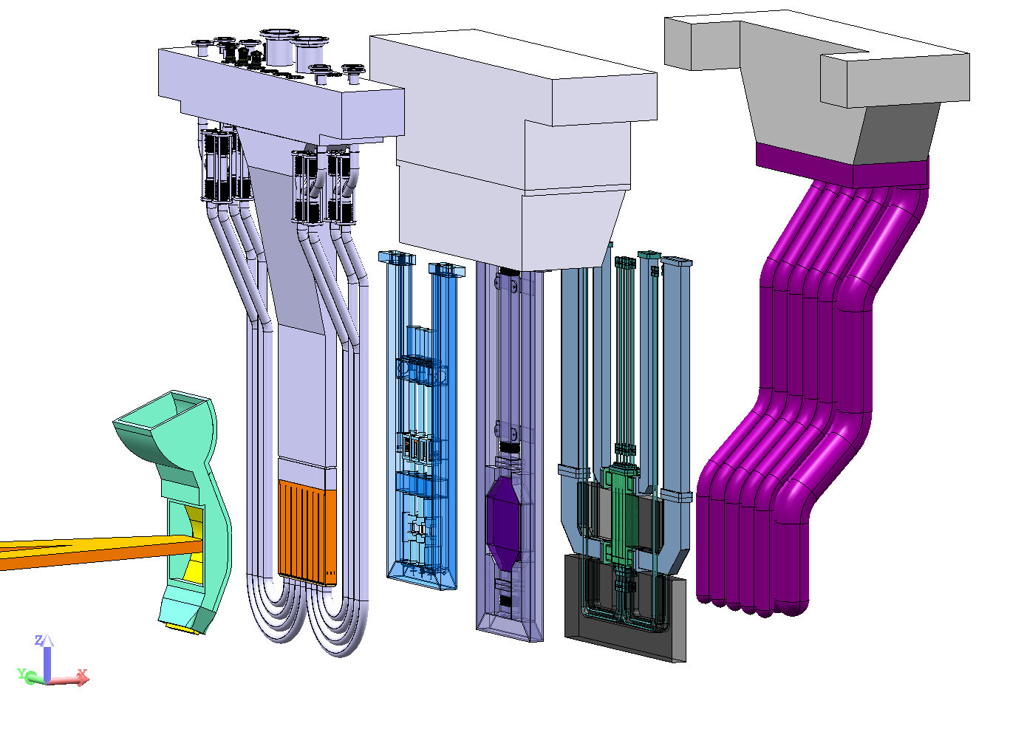
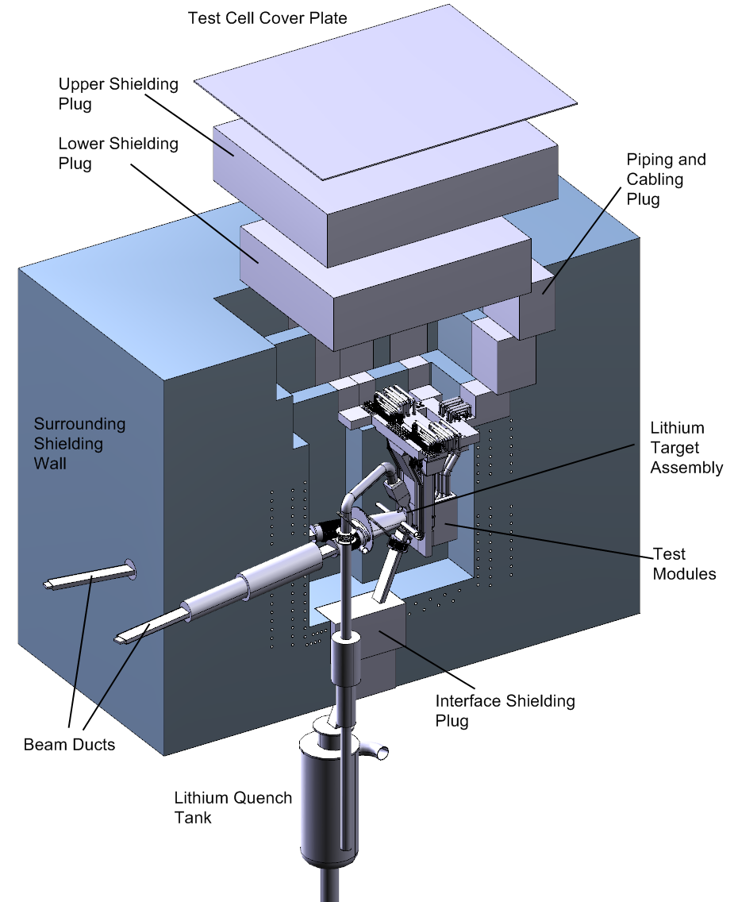
Test facility validation
High >20 dpa/y, 0.5 liters
Medium >1 dpa/y, 6 liters
Low <1 dpa/y, 8 liters
Test facility concept
Liquid
Lithium
40 MeV
D+ ions
Neutron
source
High Flux
Middle Flux Area
Low Flux Area
LT/BP
HFTM
UTM
MOD
TRM
LFTM
Decreasing neutron flux density
Softening neutron energy spectrum
structural materials
(FW, blanket)
breeder mat.
Be, Li-ceramics
auxillary
irradiation space

Slide 22
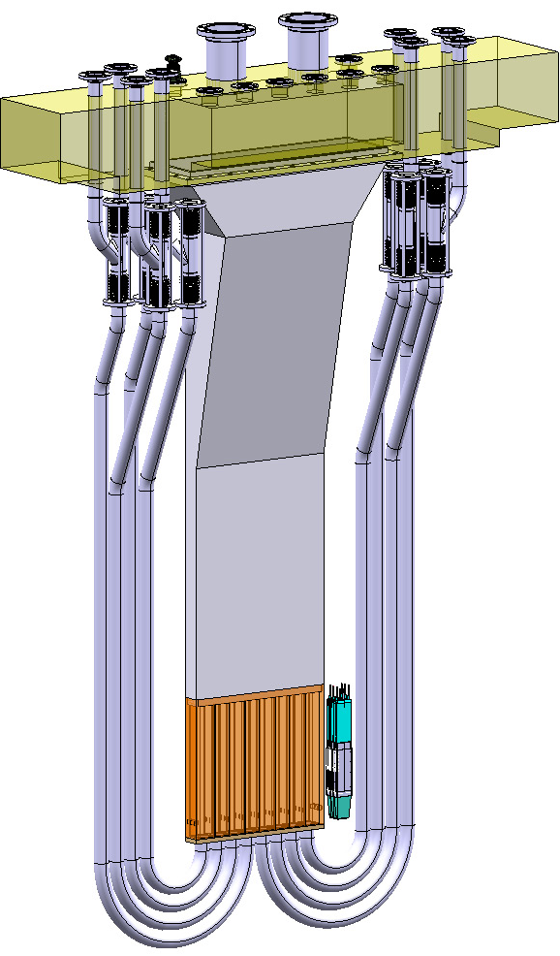
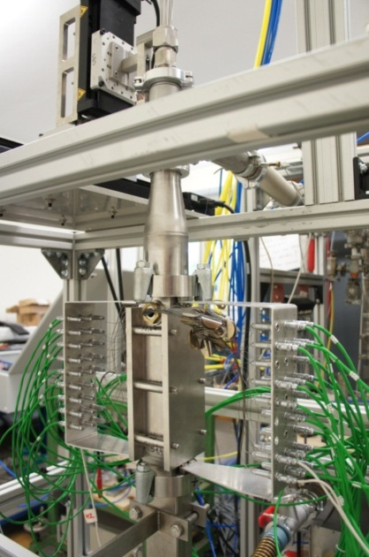
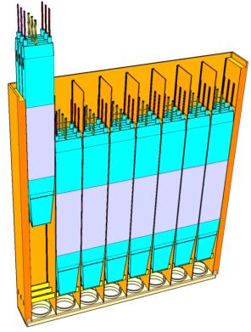
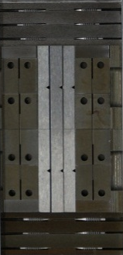
Test facility validation
Attachment
& Helium feed pipes
Beam footprint
200 mm x 50 mm
Irradiation
rigs
1
80 SSTT specimens
6
7
8
2
3
4
5
Container
8x3 Rigs
>20 dpa/y
High packing density of material specimens
in beam footprint 20 cm x 5 cm
Enable irradiation temperatures
250°C ≤ T_{irr} ≤ 550°C
Minimize temperature spread in specimen stack (within 3%) by NaK filling
Arbeiter, A., et al.,
Overview of results of the first phase
of validation activities for the IFMIF
High Flux Test Module,
Fus. Eng. Des. 87 (2012) 1506.

Slide 23
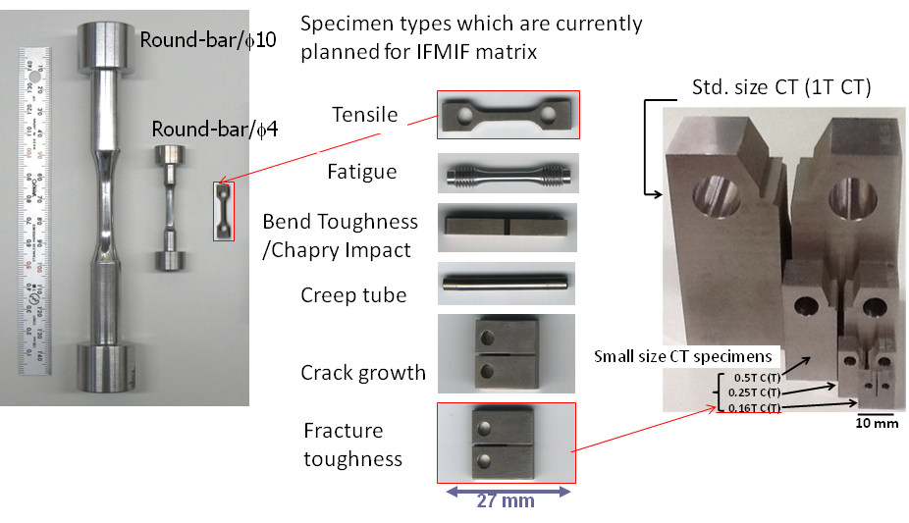
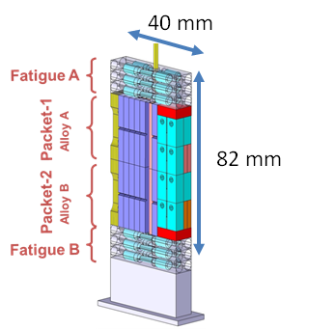
Small Specimens Test Technique
Small Specimens technique
is a mature technology developed
for fission reactors materials qualification
G.E. Lucas et al.,
The role of small specimen test technology in fusion materials development,
Journal of Nuclear Materials 367–370 (2007) 1549–1556
Available results on
Fatigue
Fracture toughness
Crack growth rate
Creep fatigue behaviour

Slide 24
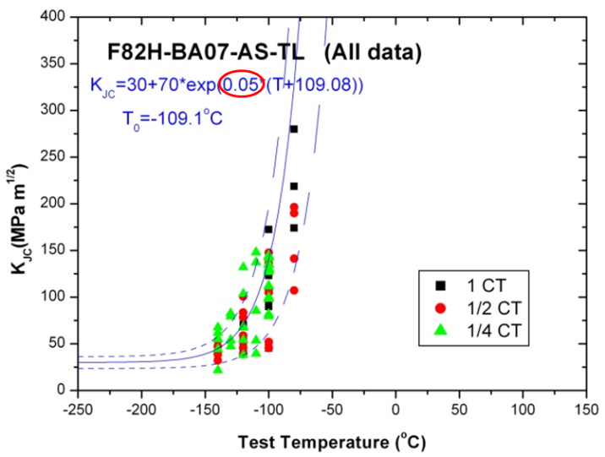
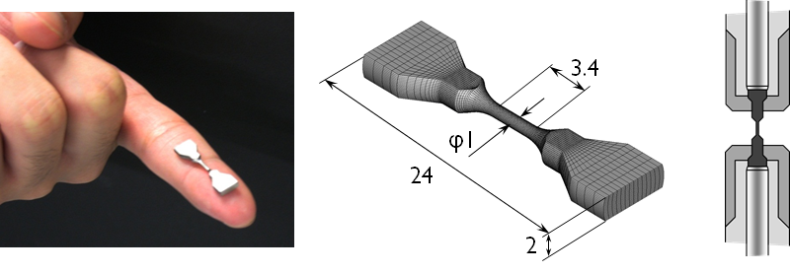
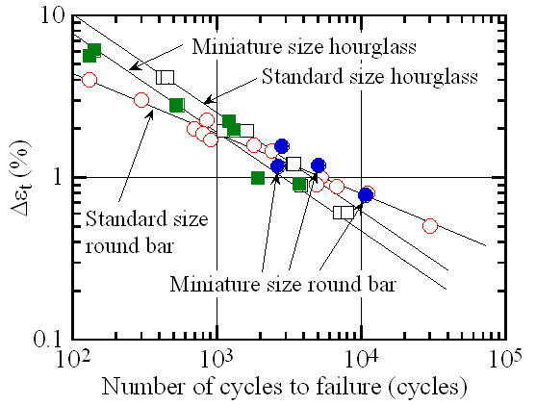
Small Specimens Test Technique
Fracture toughness
Fatigue
Master curve method (ASTM E1921) Developed to evaluate irradiation embrittlement for pressure vessel steels used to evaluate shift of DBTT
with limited number of small specimen
Wakai, E., et al., Development of small specimen test techniques for the IFMIF test cell, Proceedings of IAEA Fusion Energy Conference 2012, San Diego

Slide 25
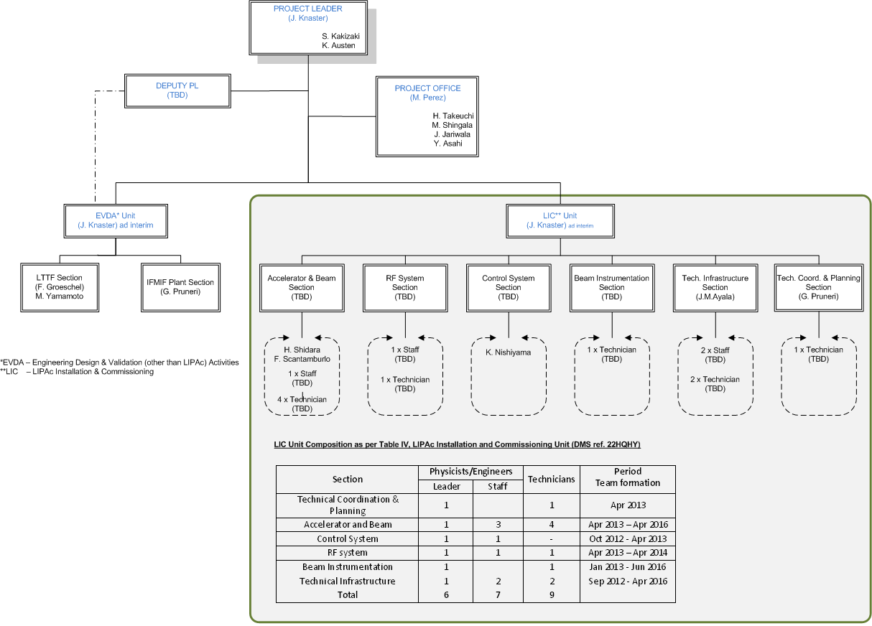
Team under formation
~25 staff

Slide 26
A joke in the fusion community
On 18 April 1967,
Lev Andreevich Artsimovich
said to UK minister of Technology
10 years ago we said it would take us 20 years
to make fusion work
and we still say that it will take 20 years,
so we haven’t altered our view in any way…

Slide 27
We are not doing so badly…
ITER
Accelerator
Energies doubles every 3 years
JT-60SA
KSTAR/EAST
Microprocessing speed doubles every 2 years
（Moore‘s Law)
Tokamaks
‘triple product’ doubles every 18 months
Lawson criterion
ntT > 10²¹ keVsm⁻³

Slide 28
Outlook
IFMIF is a unique facility merging
accelerators and fusion communities
Both communities have run in parallel
with common fields
but not joining forces in an optimal way
We have the great luck
to be partaking the efforts of humankind
to tame fire
for the second time in our short history

Slide 29
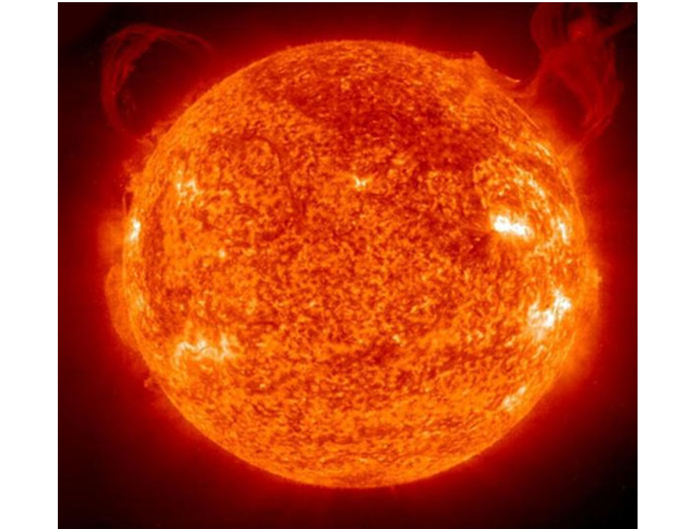
this time, the fire of the sun…

