Slide 1
High Gradient Goal in the SPL SC-RF Cavity
Introduction SRF@CERN and link to other presentations
Programme and Planning
Collaborations
Perspective
On behalf of EN-MME, TE-VSC and BE-RF/SRF at CERN

Slide 2
Introduction
CERN SRF has been “State of the Art” in 1990’s during LEP200 energy upgrade and LHC SRF cavity production.
Between 2000 and 2008, resources where dedicated to LHC construction and commissioning (including incident). In addition many RF specialist have retired recently ⇒ specific knowhow has disappeared and installations/tools were not further developed.
Other institutes have developed bulk Nb technology to the very limits ( X-FEL and ILC etc.) ⇒ ~60 MV/m have been reached.
CERN has recently engaged in EU networking programmes and collaborations in view of strengthening know-how in SRF at CERN. A dedicated section in the RF group was created and staffed by internal transfers.

Slide 3
CRISP ACCELERATORS WP4
Description of work
T1 Management of the Accelerator Topic (DESY)
T2 (QA) + T2 (RT): Quality assurance and Re-treatment for industrial cavity production
DESY has implemented a well-defined cavity process for industrial production of cavities suitable for the European XFEL. Detailed diagnostics and modest supple­men­tal treatment of the industry produced cavities will be performed and will be essential to guarantee the high performance important for the European XFEL and for any other European large scale SRF projects, such as the European Spallation Source ESS. At the same time International Linear Collider (ILC) R&D will benefit. CERN and DESY have accumulated know-how in the SRF quality assurance field, and will both profit from a common approach and development, in conjunction with the ESS and other projects. All future similar projects world-wide will directly benefit from new quality standards.
T3 (IS) Infrastructure upgrade at CERN (CERN)
The SM18 test facility at CERN was constructed 20 years ago and has since been used for superconducting magnet and RF tests. All SRF tests have involved 4 K technology. To be able to perform the characterisation of a first 4 cavities cryomodule designed for the ESS and the CERN-SPL, the test infrastructure will be upgraded to allow for 2K operation. Today’s standards in terms of ultra-clean work and modern diagnostics tools will be used. CERN will provide the basic test infrastructure for these projects.
T4 (KT) Knowledge Transfer (ESS, CERN)
ESS will join with CERN to build and test a 704 MHz elliptical cavity cryomodule prototype operating at 2 K. A test environment suited to the needs of both projects, and other future European projects will be provided. These activities will enhance the synergies between ESS, CERN and DESY projects, avoiding unnecessary duplication of effort and fostering the provision of common standards. A common test programme will provide essential training in RF and cryogenics technology to newly hired junior staff at ESS and elsewhere. ESS will strongly profit from the experience of an industrialised cavity and module fabrication gathered at European XFEL.

Slide 4
WP4 T3+T4 Status
1) Cryogenics upgrade and new He transfer line –completion during the winter shutdown with commissioning in April 2013
2) Vertical cryostats: modification of two cryostats for 2K operation - completed in March 2013
3) A CRISP supported engineer from ESS is working at CERN for 18 months on test and commissioning of the new cryogenics systems, and will assist in cavity and cryo-module testing.
4) Main clean room upgrade in SM18:
Finance Committee agreement for purchase in December 2012.
Now in negotiation with the company that supplied and maintained the existing clean-room. Initial upgrade of the air supply/filtering system planned before extending the clean-room.

Slide 5
4) SM18 rinsing cabinet: Order placed – delivery in July 2013.
5) UP water station: order placed – delivery in July 2013.
6) Ancillaries and diagnostics:
Kyoto optical device operational.
Temperature mapping systems for single and multi cell 704 MHz cavities being prepared for tests in 2013
Second sound measurements using OSTs – several measurements and tests done. Interpretation not straightforward – studies proceeding.

Slide 6
Related Talks
Cavity body production: Fabrication and metallurgical aspects of SPL cavities; Nuria Valverde, Ignacio Aviles; CERN EN-MME.
New cryogenic infrastructure for the Superconducting RF test facility at CERN; Torsten Köttig (ESS / CERN).
Infrastructure (“Diagnostics”) and Processing of SPL cavities; Janic Chambrillon; CERN BE-RF/SRF.
Status of the SPL short cryo-module development; Rossana Bonomi (CERN/ESS).

Slide 7
Programme and Planning
Produce one single cell and four five cell cavities 704 MHz in industry
Produce 2 copper 5-cell and 1 Nb 5-cell cavities 704 MHz at CERN
Set-up and debug all production-, test- and diagnostics facilities incl. related tooling
Process and test all Nb cavities until RF performance acceptable!
Provide a four cavity string with MC’s (no HOM’s)

Slide 8
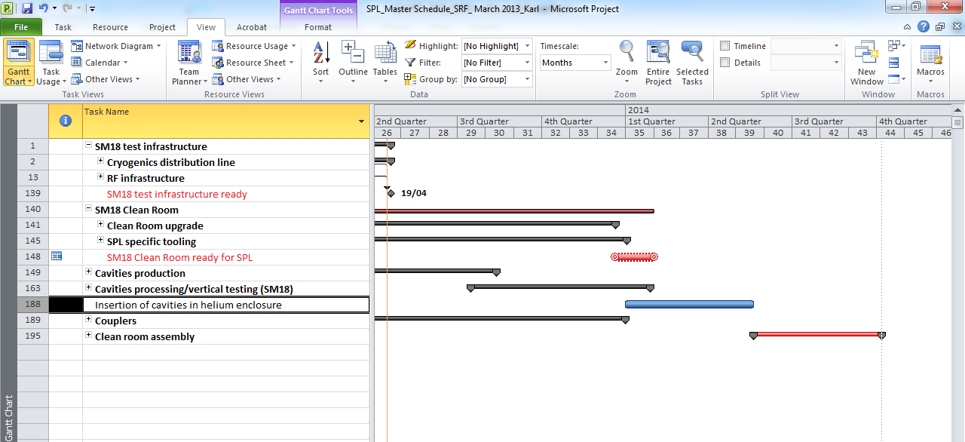

Slide 9
Cavity Processing

Slide 10
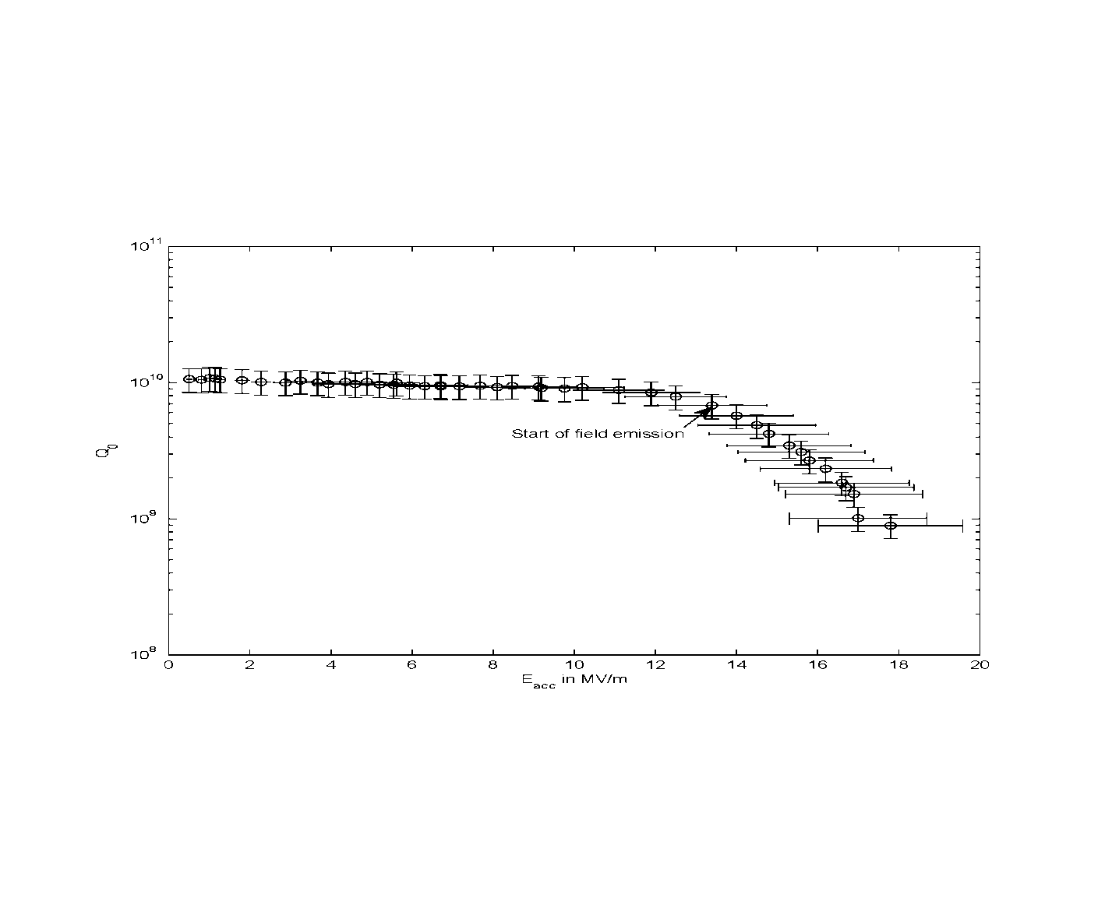
SPL Monocell β=1
preliminary: not fully processed, production issues, testing issues etc.; test aborted for cryo-shutdown

Slide 11
Collaborations
DESY – ESS in the frame of CRISP
JLAB – new frame agreement in preparation. Scope: Cavity processing and testing benchmark – 1 cavity.
CEA Saclay – common processing/testing/diagnostics??
Others: Open to any interesting offer!!!

Slide 12
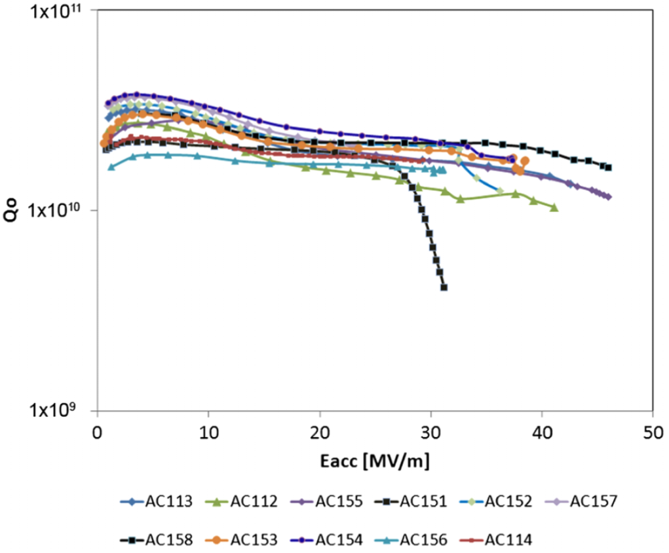
Goal of the R&D program @ DESY
Solid understanding/control of the industrial mass-production process (with 800 XFEL cavities)
Influence/feedback to the XFEL production
Clear identification of the gradient limiting factors
Elaboration of cavity treatment providing at least Eacc > 35 MV/m @ >90% yield 45 MV/m already shown! Yield?
W. Singer et al., PRST AB 16, 012003 (2013)

Slide 13
Perspective
Very limited time between reception of cavities and start of string assembly – planning is the key
Not aiming for record results – just confirm that we master the basics
One spare (if any?) should allow for some R&D
Very limited resources: collaborations is the key

Slide 15
High and Very High Gradient
from: R.L. Geng, Mini Workshop at Uni. of Chicago

