Slide 1

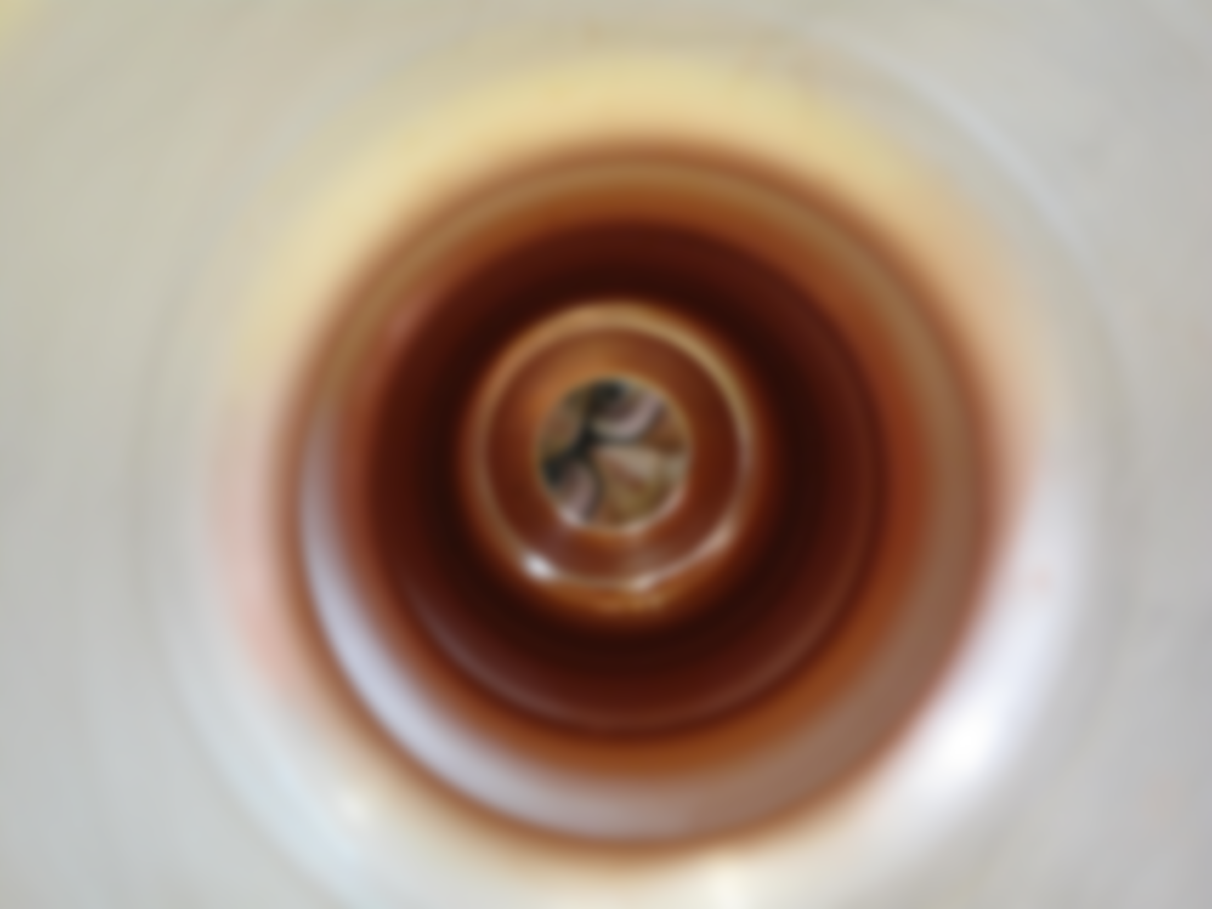

Fabrication and metallurgical aspects of SPL cavities
On behalf of SPL team

Slide 2
Overview
Copper cavity
Niobium cavity
R&D
Conclusions
-Fabrication steps
-Welding tests
-Assembly sequence
-Metrology control
-Applications
-Monocell niobium supplied by RI
-Status 5-cell Nb cavities ordered to RI
-Status 5-cell cavity Nb fabricated by CERN
- Brazing tests

Slide 3
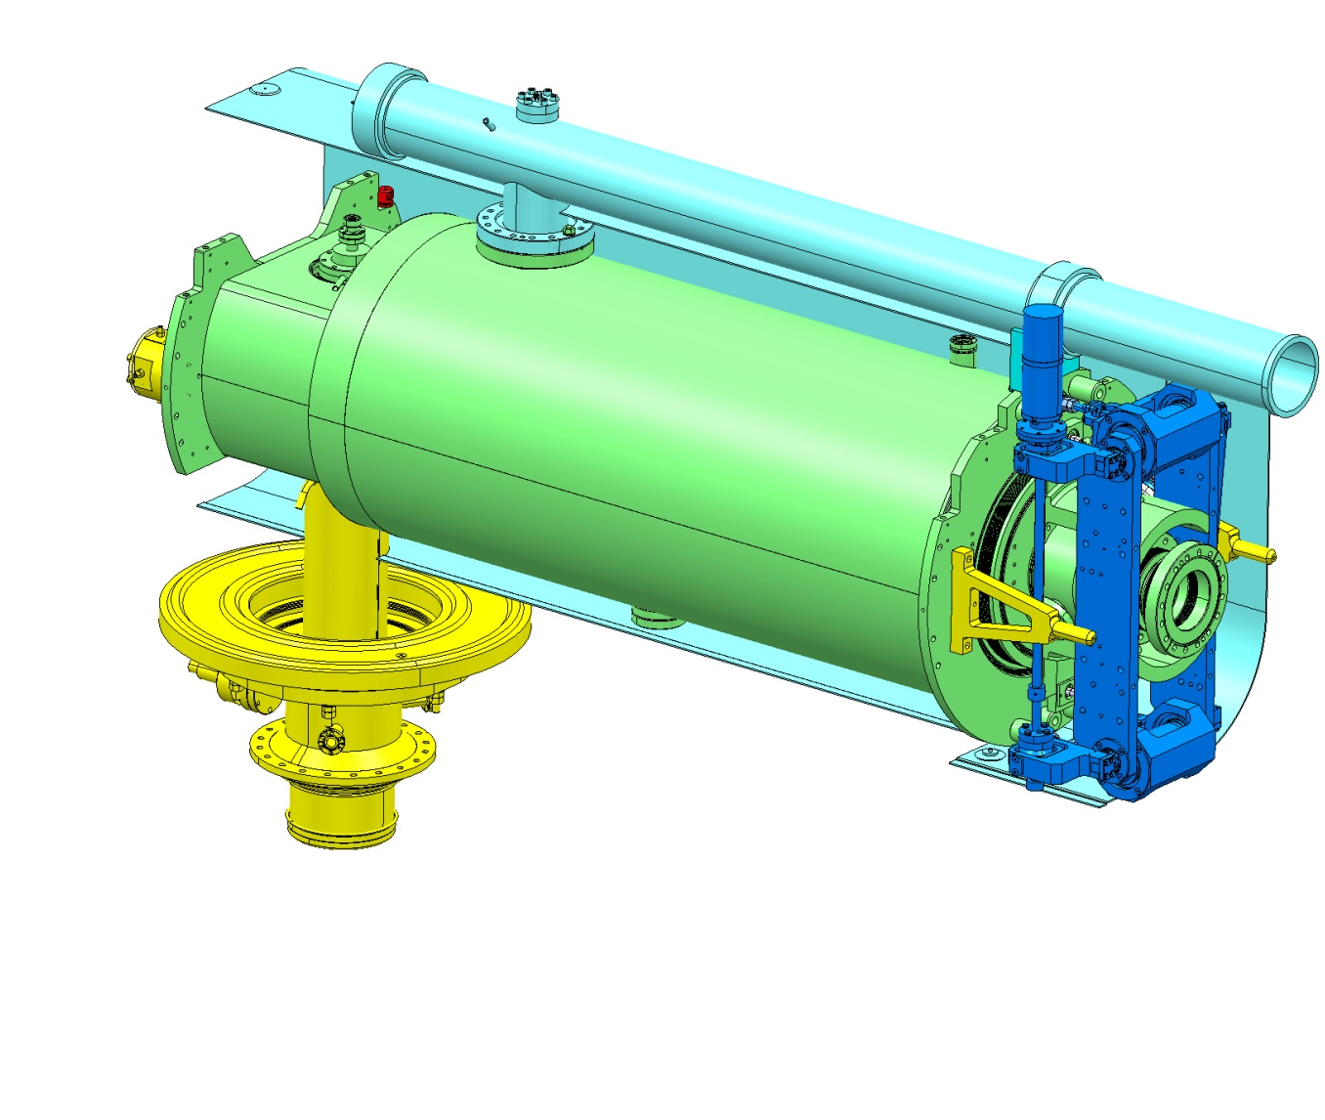
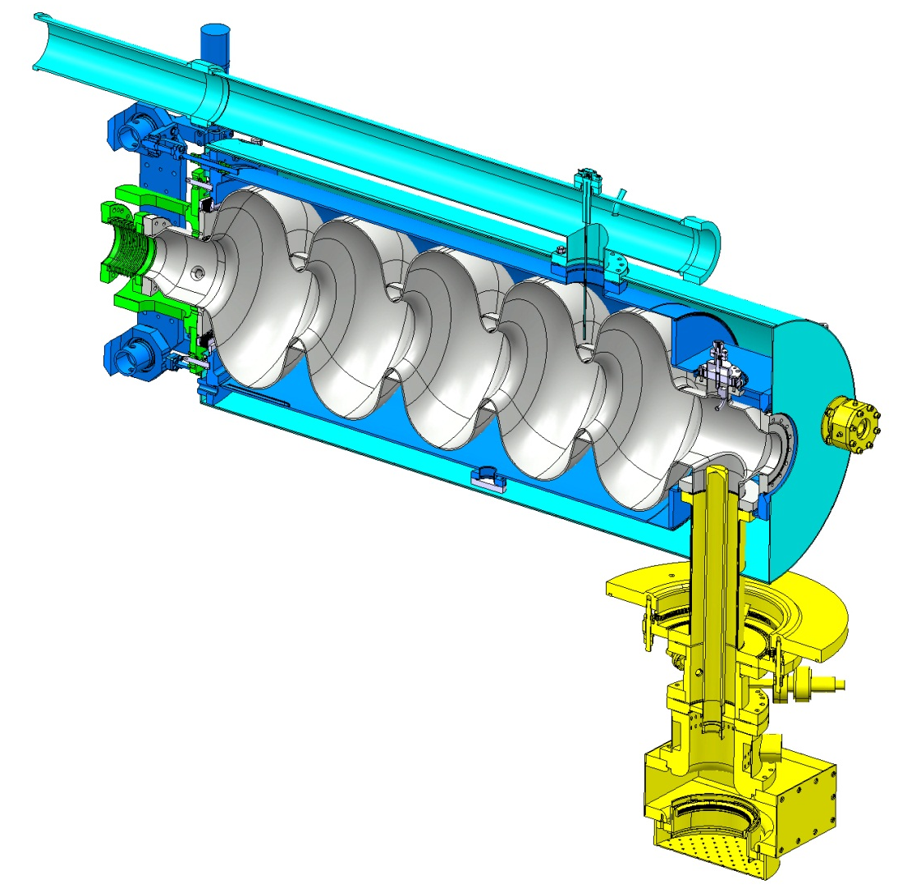
Overview
Pumping line & Magnetic shield to be provided IPN Orsay.
Bulk Niobium 5Cells cavity
Tuners provided by CEA. Under testing at CERN
4 niobium cavities under fabrication at RI
Stainless steel (316L /316LN) helium tank designed by CERN, supplied by CEA and welded to the cavity at CERN.
Design already validated by CERN.

Slide 4
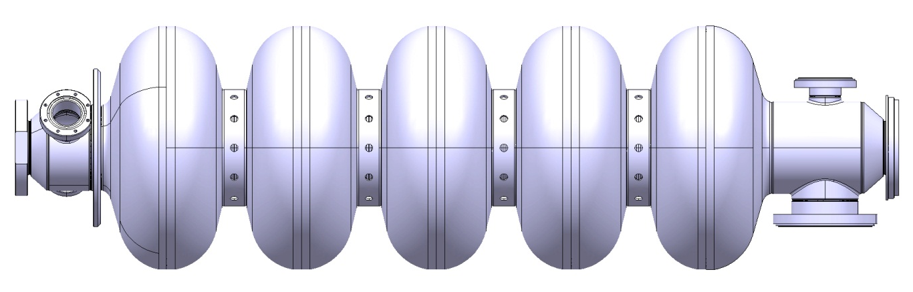
Overview: 5-cell Cavity
PROPERTIES
5-cell cavity β=1
Material: Bulk Niobium RRR300
Flanges: 316LN
Frequency: 704.4 MHz
Quality factor: 10¹⁰
Nominal gradient E_{acc}= 25 MV/m
Cavities under fabrication:
4 niobium 5-cell cavities β=1 at Research Instruments (RI)
1 niobium monocell already fabricated by RI
1 niobium 5-cell cavity β=1 at CERN
2 copper 5-cell cavities β=1 (prototypes) already fabricated at CERN

Slide 5
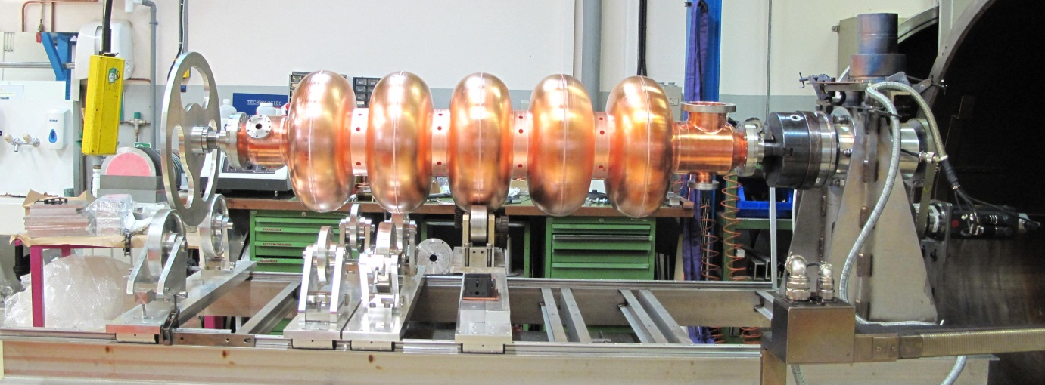
Copper cavity
Two copper cavities fabricated for the following purposes:
Learning during the fabrication process
RF measurements
Bead pull measurement
Validation of the tooling for the niobium cavity
Surface treatments

Slide 6
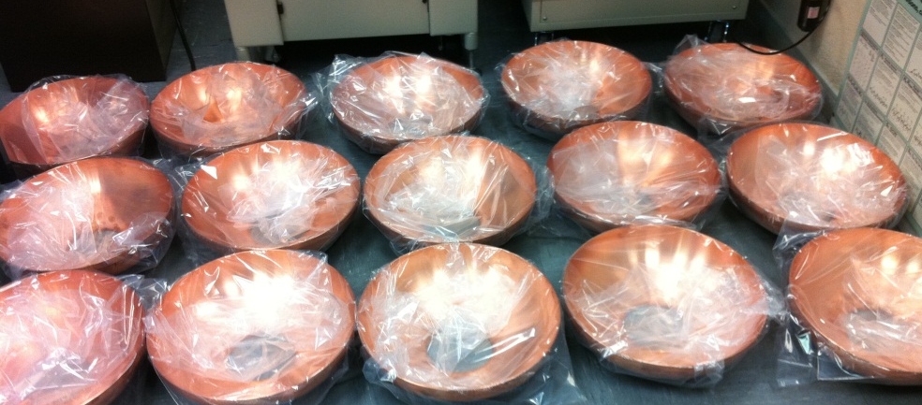
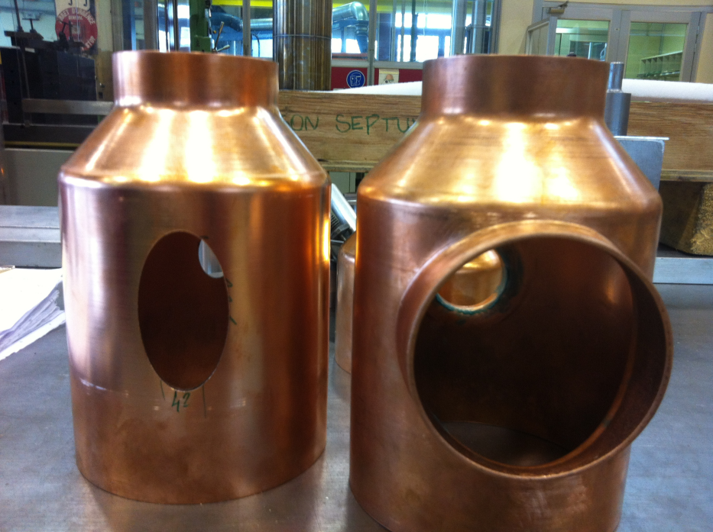
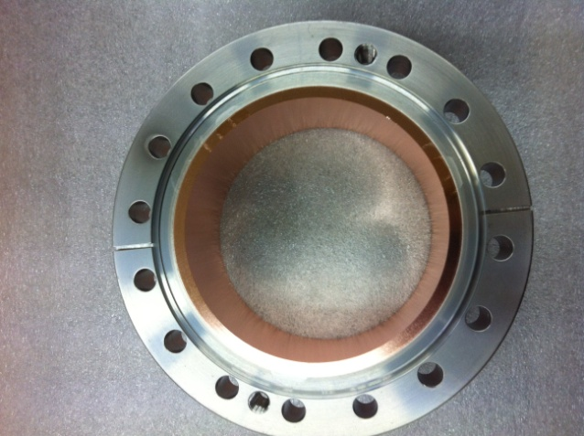
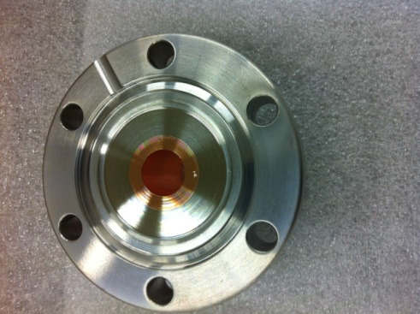
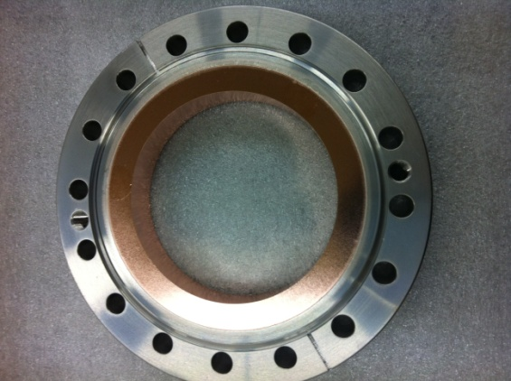
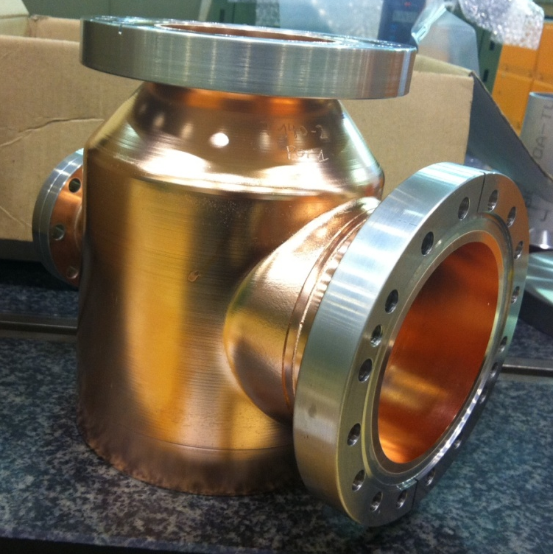
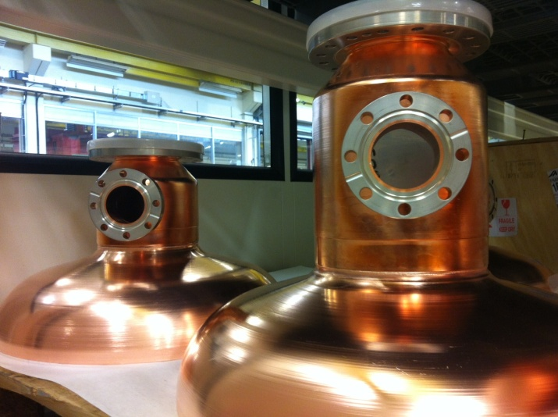
Copper cavity
Half-cells shaped by Spinning
Cut-off tube shaped by spinning + extrusion
Cut-off tube + Extremity half-cell
Brazing the SS flanges to the Cu tubes
Cut-off tube

Slide 7
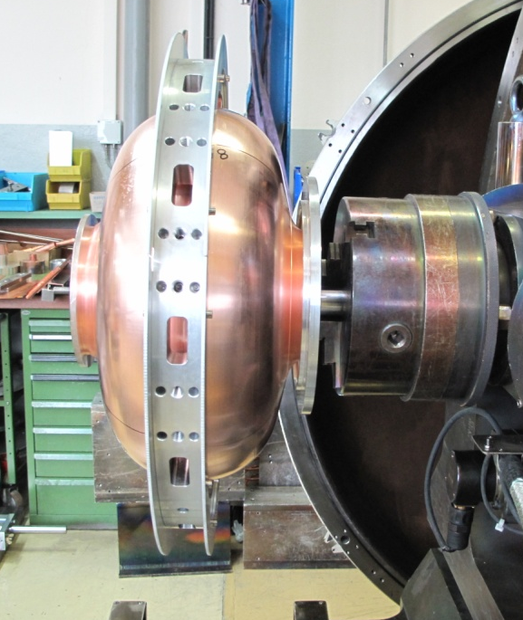
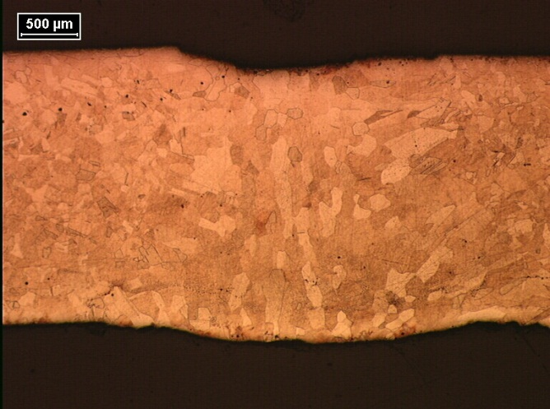
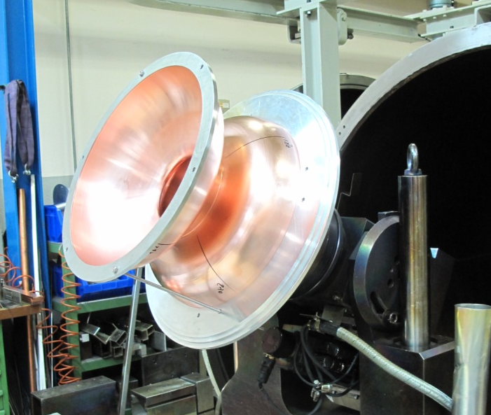
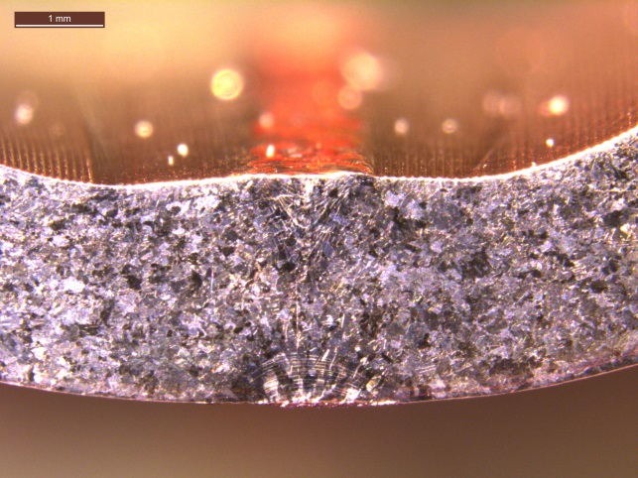
Copper cavity-EB welding tests
Equator:
Weld from the outside
Full penetration: 2.4 mm
Iris:
Weld from both outside and inside
Full penetration: 2.4 mm

Slide 8
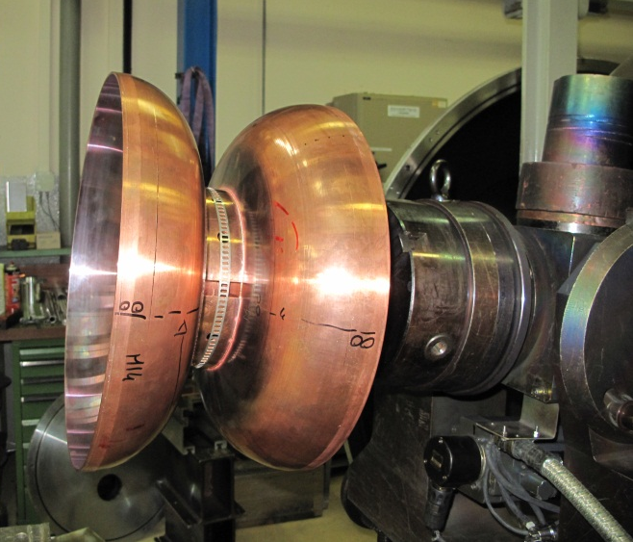
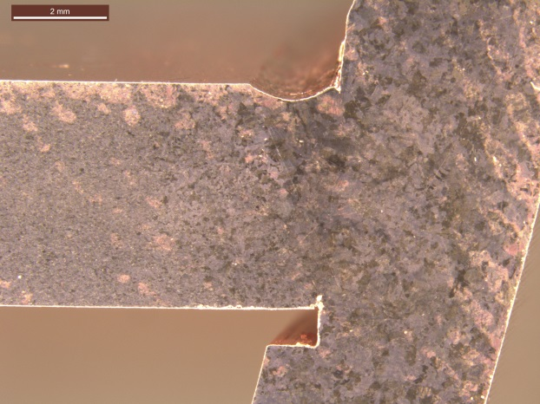
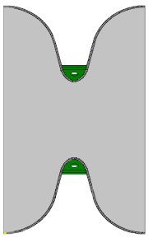
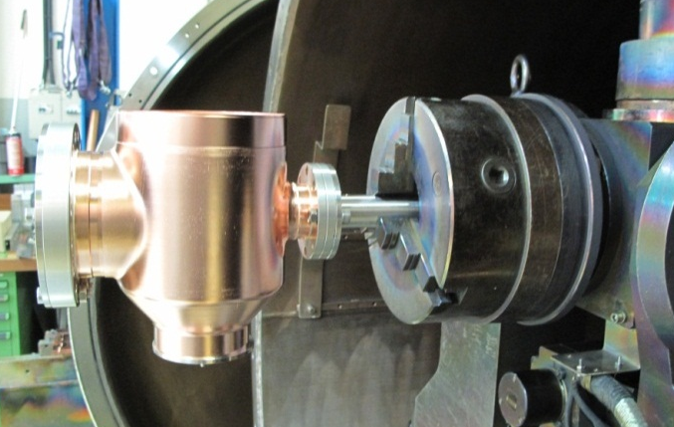
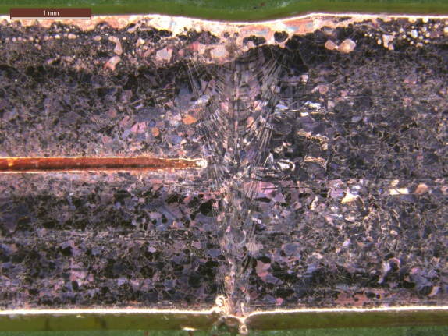
Copper cavity-EB welding tests II
Stiffening ring:
Weld from the outside
Full penetration: 2.4 mm
Pick-ups:
Weld from the outside
Full penetration: 2.2 mm

Slide 9
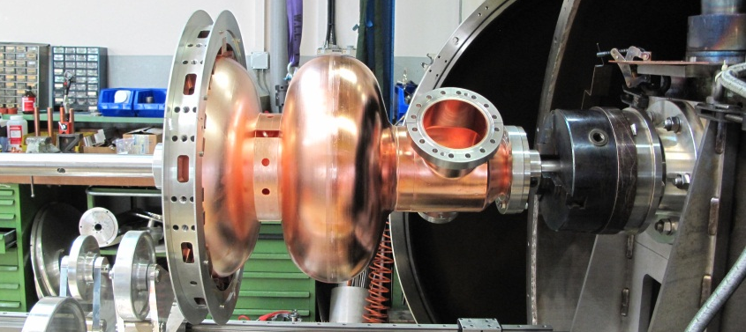
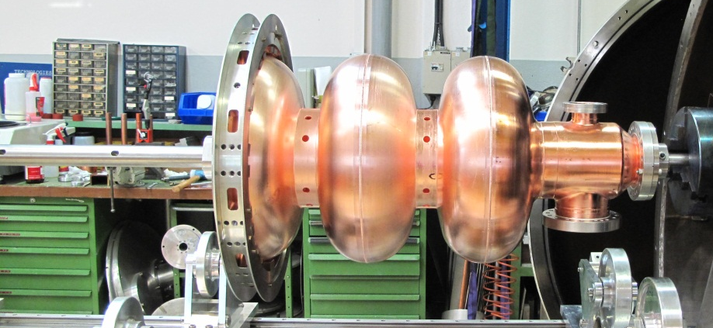
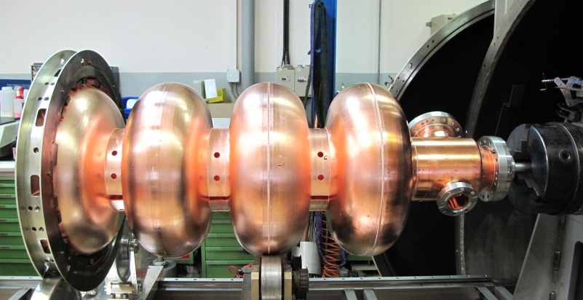
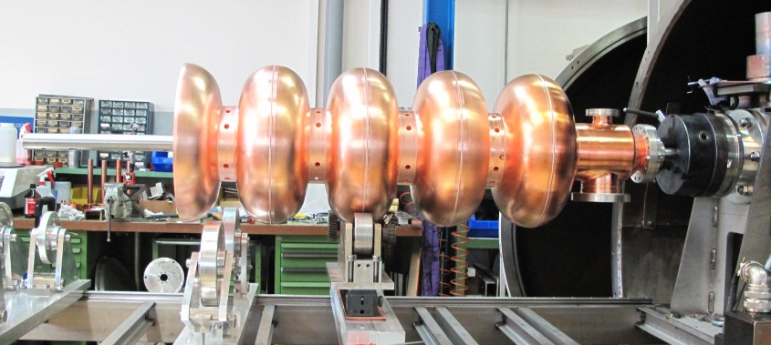

Copper cavity

Slide 10
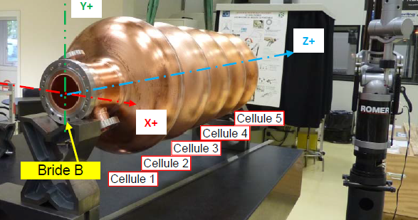
Copper cavity
Concentricity betwen A and B:
Cavity 1 =0.12 mm
Cavity 2 = 0.09 mm
Perpendicularity face flange to the axe A-B:
Cavity 1: Face A 0.10 mm / Face B 0.08mm
Cavity 2: Face A 0.24 mm / Face B 0.28mm

Slide 11
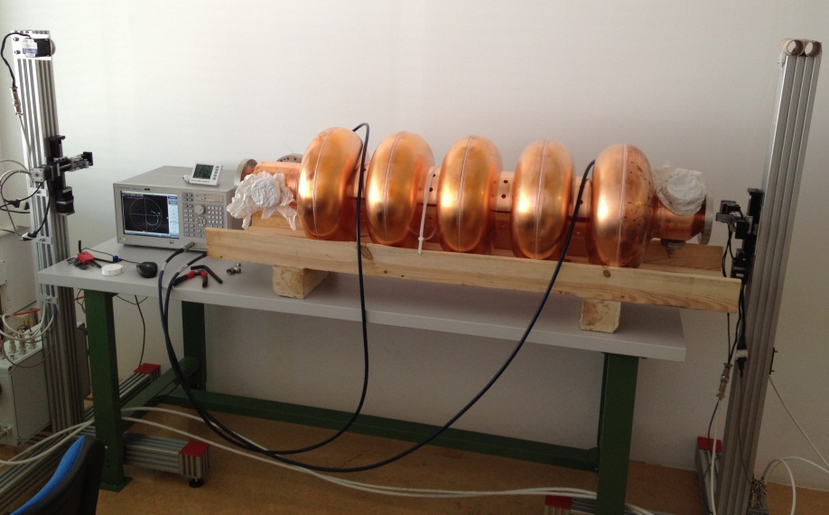
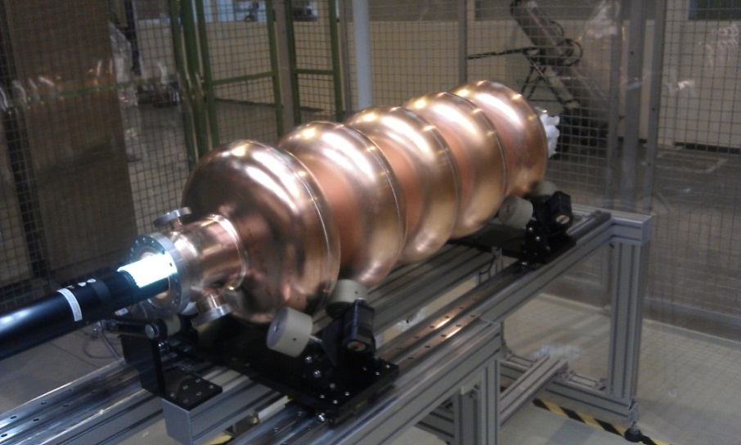
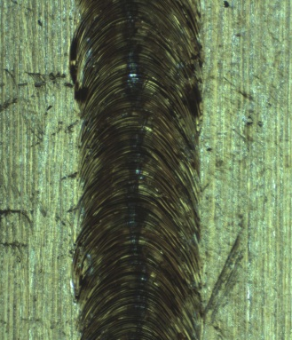
Copper cavity
Bead pull measurement
Optical inspection bench system
Inspection of the inner part of the welds with an optical inspection bench system by
J.K. Chambrillon
In house built equipment providing cavity field distribution through bead pull measurement under development by
S. Mikulas and N. Schwerg .

Slide 12
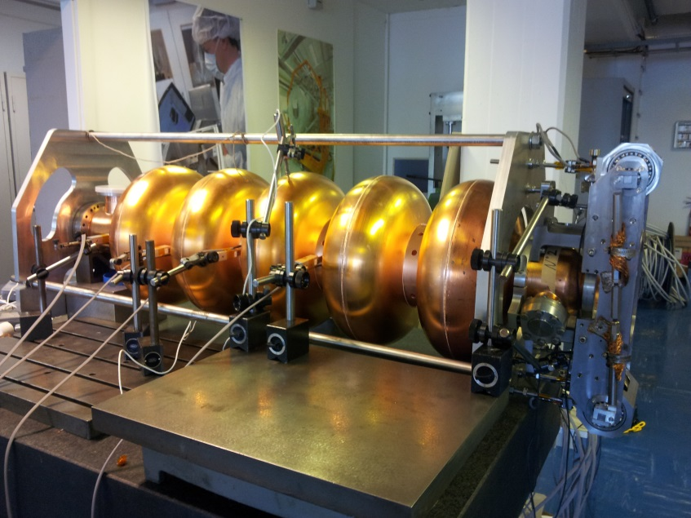
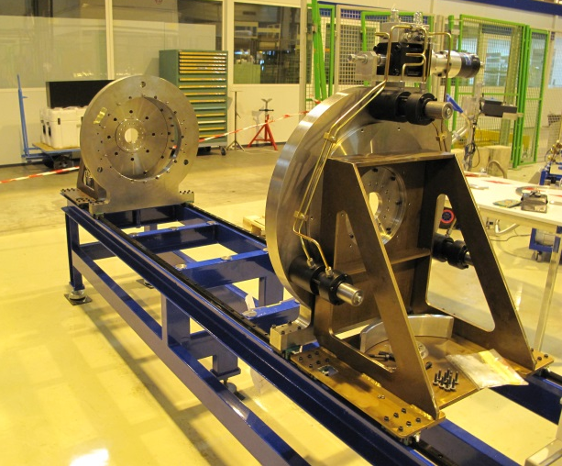
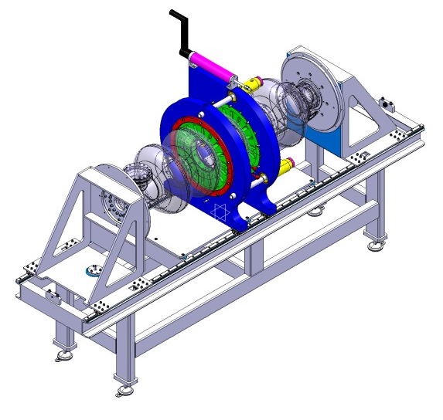
Copper cavity
Tuner testing (thanks to K.Artoos and M.Guinchard)
Tunning machine
Measurement of the stiffness of the cavity
Measurement of displacements while a force is applied by the tuner
Development at CERN of a tuning machine

Slide 13
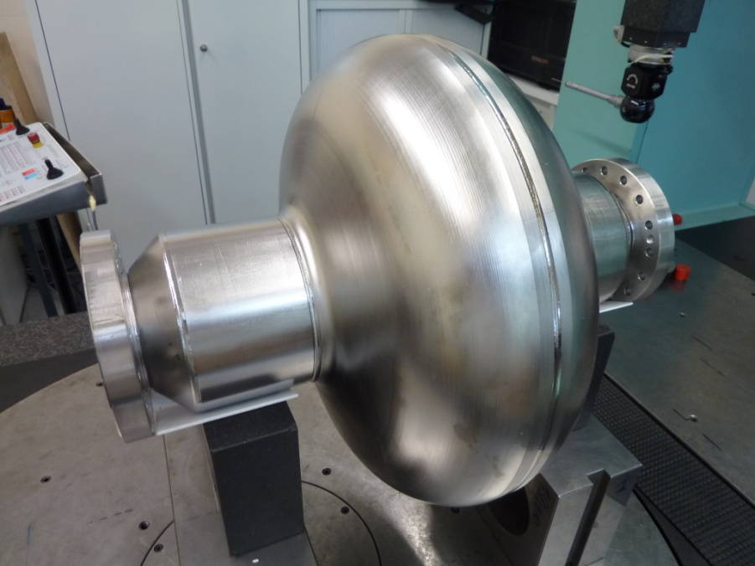
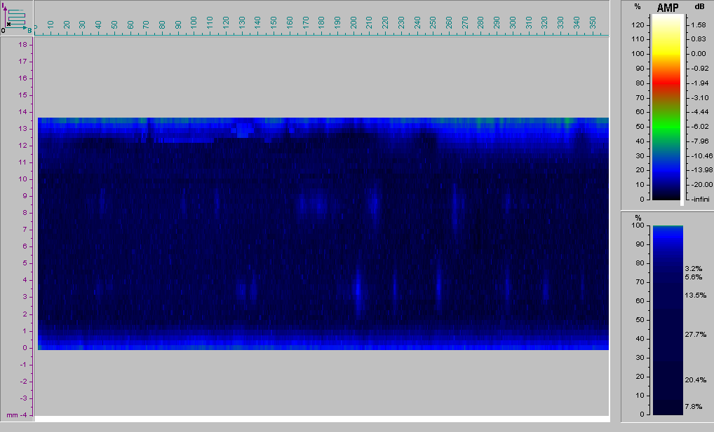
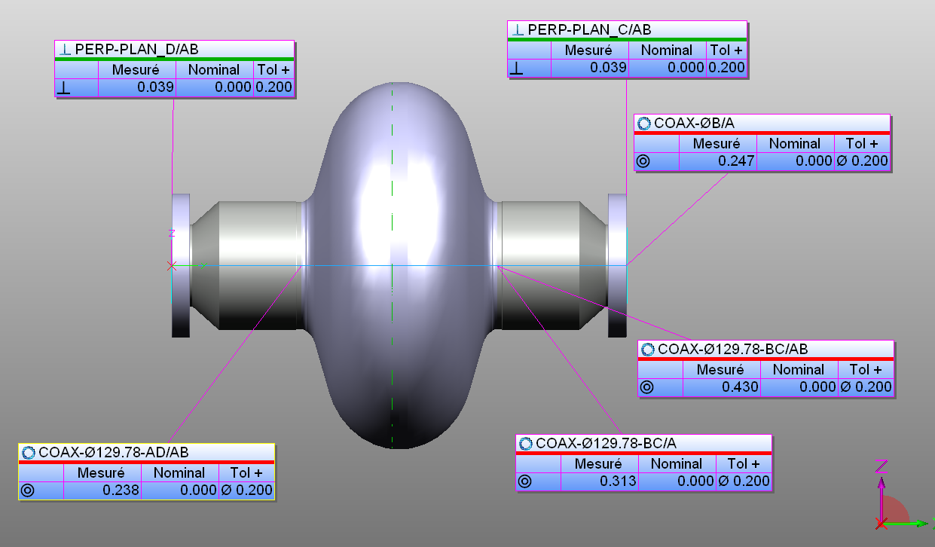
Niobium cavity-Monocell from RI
Dimensional control by CMM:
Ultrasonic examination :
Brazing between niobium tube and SS flanges. They fulfilled the requirements.

Slide 14
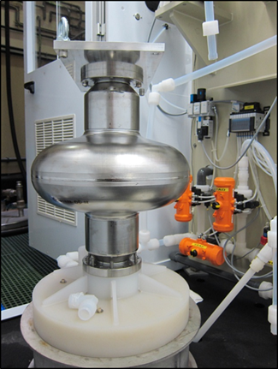
Niobium cavity-Monocell from RI
Electropolishing (EP) is an electrochemical process used to polish, passivate, and deburr metal parts. It results in a very smooth and shiny surface. During the first test 90 microns were removed.
HF (48%) & H2SO4 (> 96%)
mixed in a volume ratio of 1:9

Slide 15
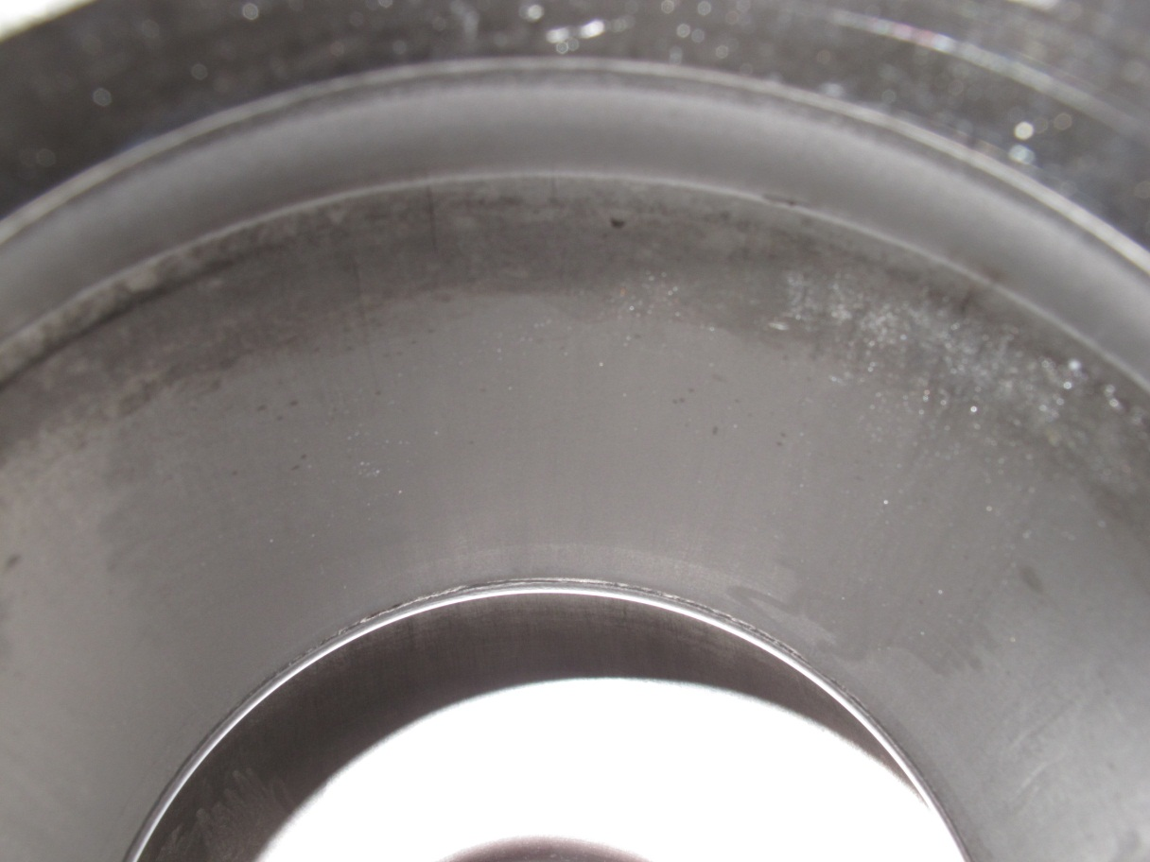
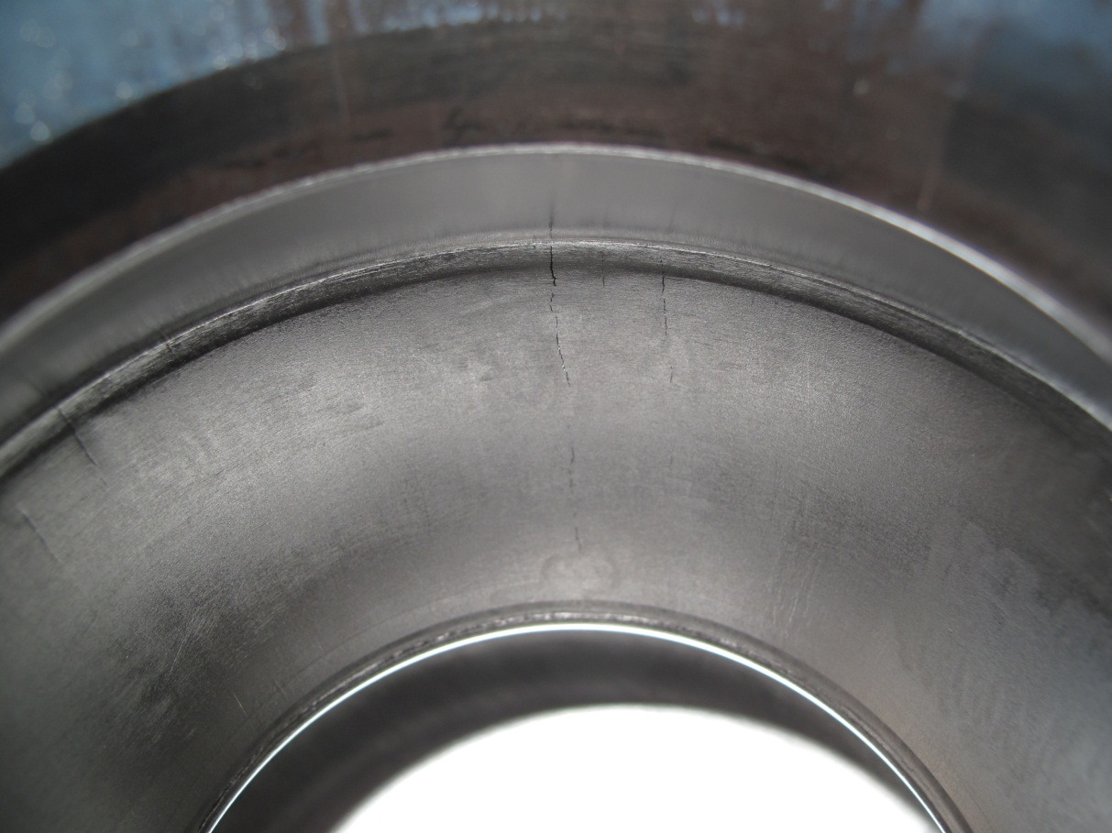
Niobium cavity-Monocell from RI
Material defects made evident after EP

Slide 16
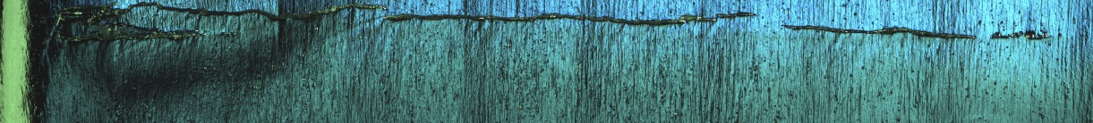
Niobium cavity-Monocell from RI
Full inspection of the monocell:
Non destructive examination:
  Radiographic examination
  Optical inspection
We found defects only in one beam tube
(Thanks to J.K. Chambrillon)

Slide 17
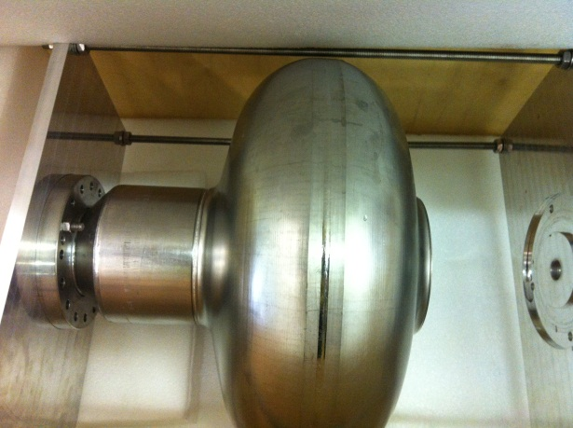
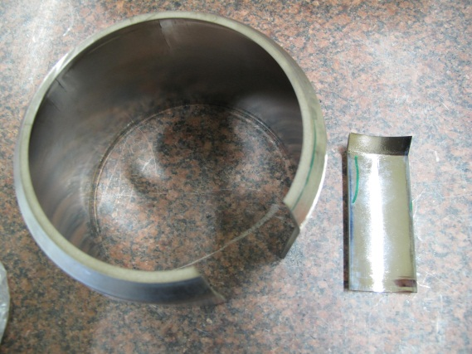
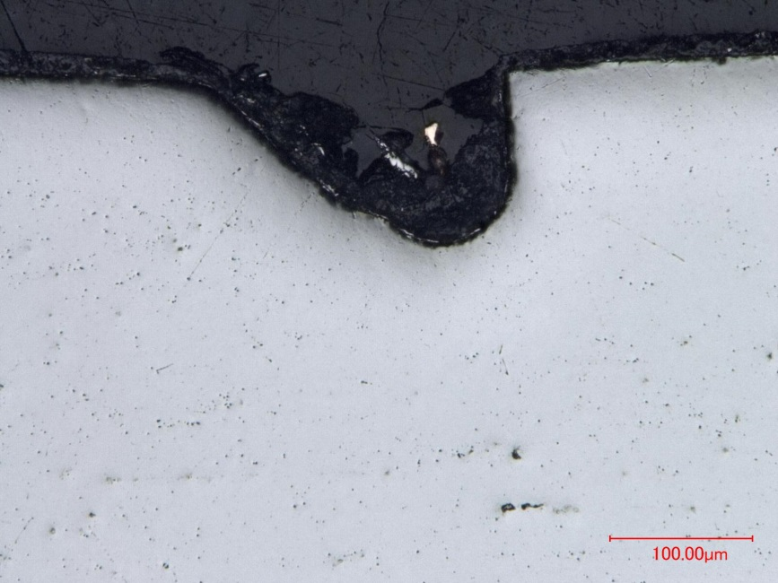
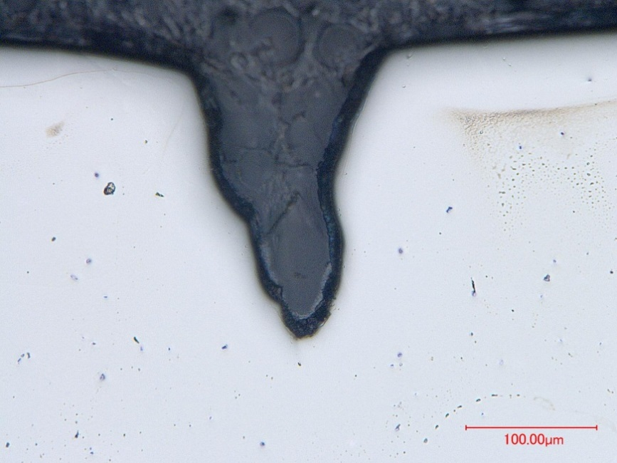
Niobium cavity-Monocell from RI
Destructive examination:
Cutting of the monocell in order to inspect the defects and assess their origin
3 different defects were inspected in several cross sections
Shallow
No progression
Round edges

Slide 18
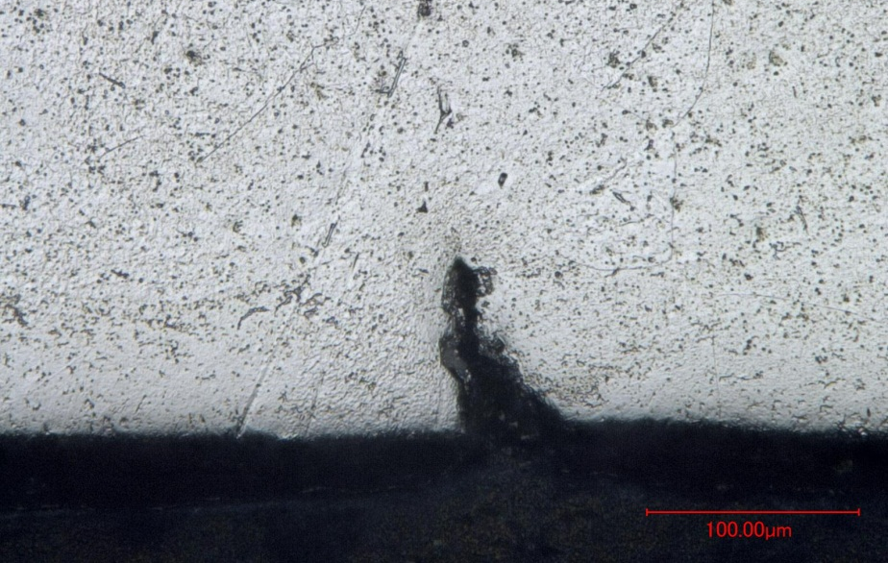
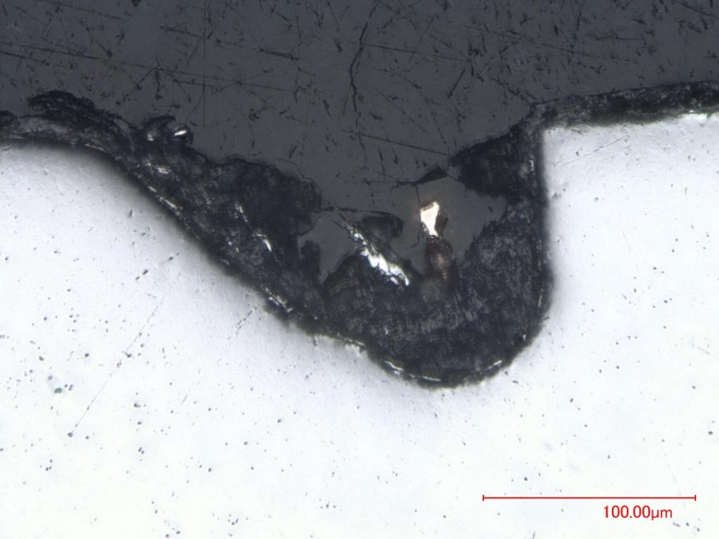
Niobium cavity-Monocell from RI
Outer defect
Inner defect
Aspect of chemical dissolution
Wider than the outer one
Surface discontinuities most likely are originated during fabrication and / or handling emphasised after EP

Slide 19
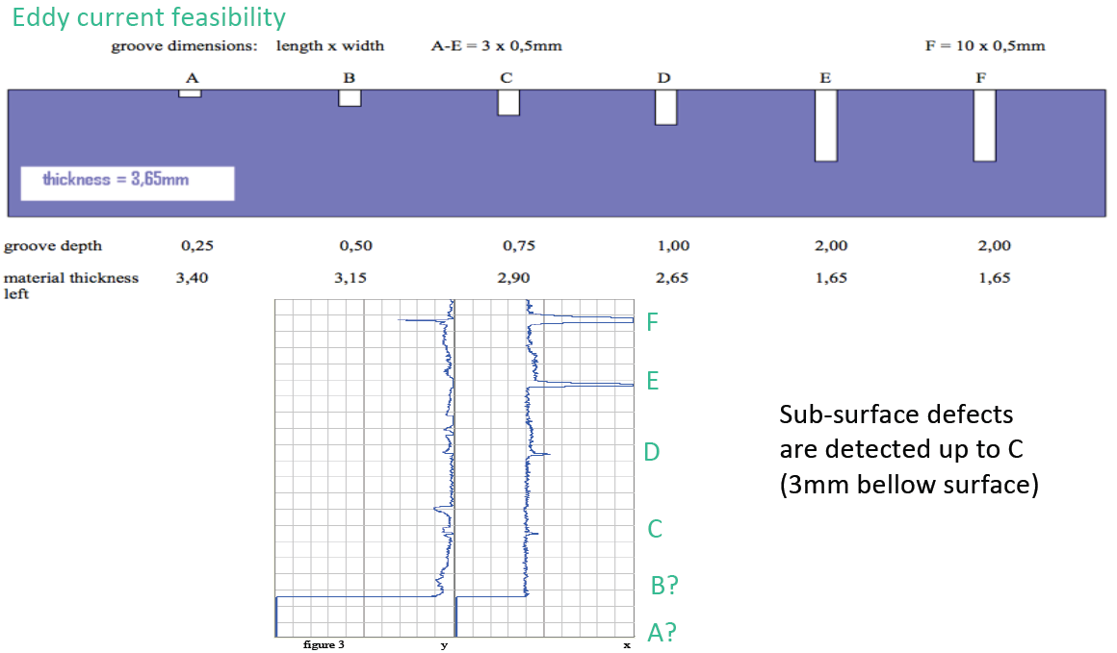
Niobium cavity – material studies

Slide 20
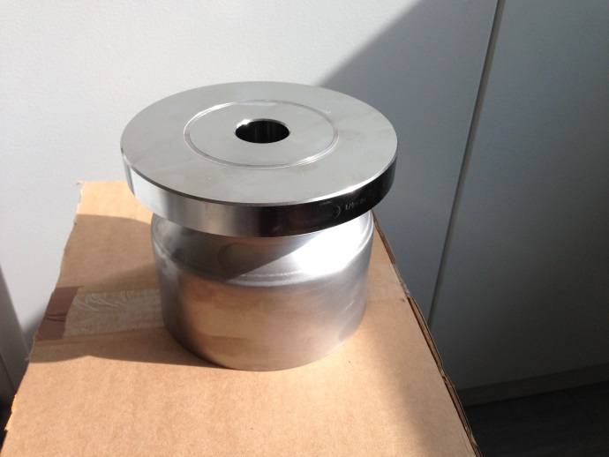
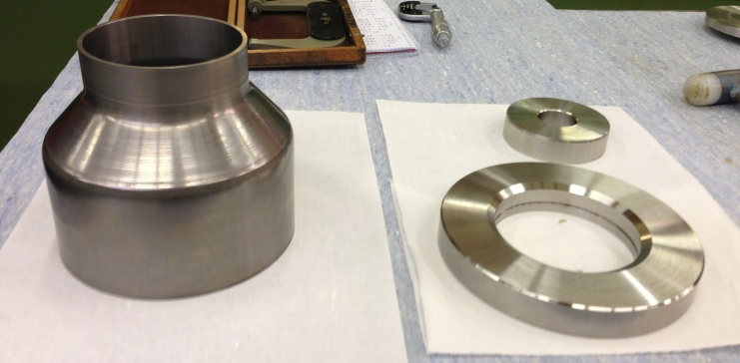
Reparation monocell from RI at CERN
The monocell is being repaired in order to continue with the electropolishing and cold tests
Brazing between niobium tube and Stainless steel (316LN) flange.
Machining (preparation before brazing)

Slide 21
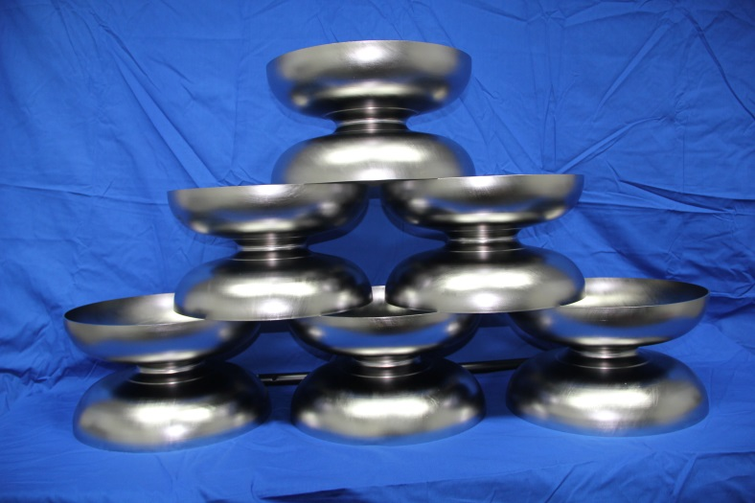
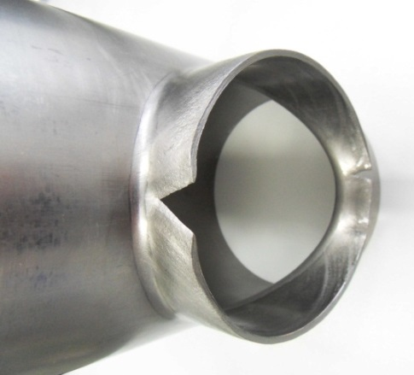

Niobium cavities-RI
4 niobium cavities under fabrication at RI
Delivery dates: 1st cavity end of June
last cavity end of July
Status: Dumb-bells welded
Cut-off tubes: difficulties during necking-out
Recrystallized equiaxial grains
Hardness: 57,1 HV10 (technical specification: < 60 HV10)

Slide 22


Niobium cavities-RI
Studies at CERN to optimize the necking out parameters in order to minimize the deformation:
  Ellipse diameters
  Necking height
  Tooling
Tests at CERN using improved parameters
with satisfactory results:
(10/4) RI still have problems with necking out with the improved parameters:
Material studies at CERN on this tube are under going

Slide 23




Niobium cavity at CERN
Spinning of 2 half-cells and 1 beam tube at HEGGLI for testing
Dimensional control by CMM
RF measurements.

Slide 24


Niobium cavity at CERN
Necking-out tests at CERN :
Satisfactory results even in a tube shaped by spinning starting from a niobium plate.

Slide 25

Niobium cavity at CERN
New EB welding machine at CERN (11 m³);
SS vacuum chamber;
Vacumm level 1x10⁻⁵ mbar up to 10⁻⁷ mbar (cryo. pump)→ Suitable for high RRR niobium welds.

Slide 26



Niobium cavity at CERN
Welding tests foreseen for optimization of parameters:
10 linear welding tests
4 circular welding tests – ( same diameter as HC)
3 circular welding tests at the equator
3 circular welding tests at the iris
3 welding tests – stiffening ring + HC

Slide 27

R&D- Brazing
Niobium cavity & SS tank
SS flanges
Brazing Nb / SS 316 LN with a Cu-OFE copper interface is a key technology developed at CERN in 1987
Difference in expansion of Nb/SS
Nb tube fitted to SS flange
Clearance ≤ 20 µm
SS plug to expand the Nb
Cu – OFE copper as brazing material
Brazing temperature 1100°C, ∆_{time} <<
P< 10⁻⁵ mbar

Slide 28


R&D- Brazing test I
Test I- Nb tube + SS flange DN100
The joint proved to be functional and to mechanically fulfil the requirements for the intended application
Full results in presentation
I. Aviles and N. Valverde SLHiPP2

Slide 29



R&D- Brazing test II
Test II- Effect of the chemical etching on the brazed joint
Chemical etching of niobium 8 hours before EBW to avoid oxidation and degradation of RRR
Composition of the bath: (1:1:2) HF 40%, HNO3 65% , H3PO4 85%
SS
Cu
Nb
The bath removed ~ 300 μm of Cu
The bath attacks more the Nb than the SS
Full results in presention
I. Aviles and N. Valverde SLHiPP2
It was decided to mask the brazed joint with a polymer

Slide 30




Brazing test III
Test III- Effect of EB weld close to the brazed joint
SS flange
EB welding
Nb tube
EB welding

Slide 31
Conclusions
2 copper cavities fabricated successfully at CERN being used to develop auxiliary equipment: tuner , tuning machine, bead pull measurement, optical inspection bench system …
Niobium monocell : intended to improve the electropolishing parameters and test the RF characteristics of the cavity at cold.
  Material defects were visible after electropolishing and several studies were carried out. They pointed out that exhaustive quality control of material is extremely important, specially when using seamless tubes.
Niobium 5-cell cavity: 4 cavities under fabrication at RI. Delays due to enhance quality control carried out in the niobium tubes and problems with necking out.
Niobium 5-cell cavity at CERN, several test undergoing to approve the manufacturing processes (spinning, EB welding, necking out, brazing …)
Brazing, It has been proved that it is a functional solution for the Nb/SS interfaces for superconducting cavities.

Slide 32
Thanks for your attention!!
We would like to thank the people who help us in our work:
G. Arnau, S. Atieh, K. Artoos, O. Capatina, JK Chambrillon, JM Dalin, L. Ferreira, S. Forel, A. Gerardin, M. Guichard,M. Malabaila, S. Marcuzzi, S. Mikulas, F. Pillon,A. Piguiet,D. Pugnat, M. Redondas, L. Remandet, T. Renaglia, JP. Rigaud, N. Schwerg, K. Schirm,T. Tardy, A. Vacca.

