Slide 1
Status of the SPL short cryomodule development PART2 - CNRS contribution
Patxi DUTHIL
Sébastien ROUSSELOT
Patricia DUCHESNE
Presented by:
Rossana BONOMI

Slide 2
Contents
1 – Introduction: the SLHiPP-2 meeting
Context: the SPL cryostat
SLHiPP-2 meeting status work
2 – Vacuum vessel design
Vacuum vessel design: updates overview
Vacuum vessel interfaces
New beam pipe interface
Safety devices
Thermal shield interface
Cryogenic distribution integration
Accessibility for maintenance
3 – Vacuum vessel fabrication
Preliminary Technical specifications file
Tendering phase
4 – Cryogenic distribution integration
5 – Conclusion: work plan

Slide 3
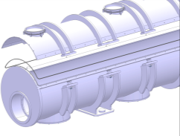
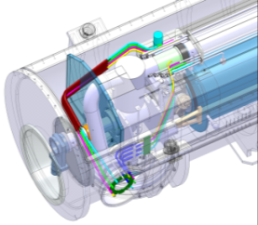
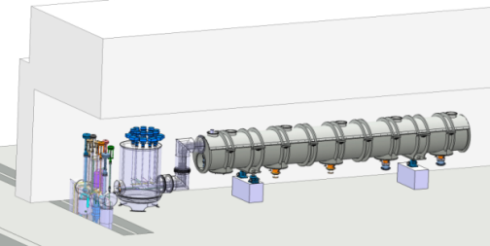
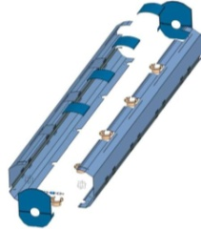
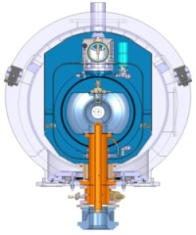
1- Introduction: the SLHIPP2 meeting
Context: the SPL cryostat
Due to integration, assembly (alignment) and maintenance issues, a cryostat consisting of two parts is being designed (string of cavities supported on vacuum vessel by means of coupler tubes)
Part1: top lid
Part2: bottom part
SLHIPP-2 meeting status work
At the time of SLHIPP-2, a lot of effort was done to:
propose technical solutions for a tight closure of the vacuum vessel
assess the mechanical behavior of the assembly for various conditions via static, linear and non-linear buckling analysis
assess the impact of technical choices on cavities alignment
Additional studies were done to integrate the other components of the cryostat and to interface the cryomodule with the SM18 bunker.

Slide 4
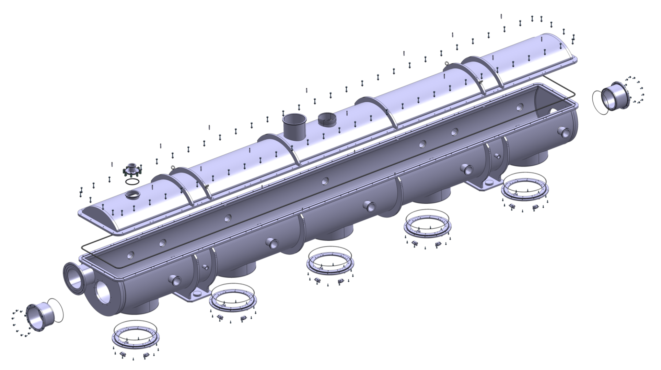
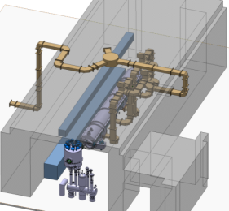
2- Vacuum Vessel design
Vacuum vessel design: updates overview
The vacuum vessel design was updated
A new interface was proposed for the top lid closure to obtain a more reliable tightness (SCM will experience cycling operations)
Safety aspects were considered leading to new interfacing of the cryogenic distribution (still under study)
Burst disk port
Pressure relief valve port
Bunker integration
Top cover (lid)
New cryogenic supply interface (to valve box)
New cold-warm transition (valve) interface
Bottom part
New interface: flat flanges + 0-ring
Flange for coupler interface

Slide 5
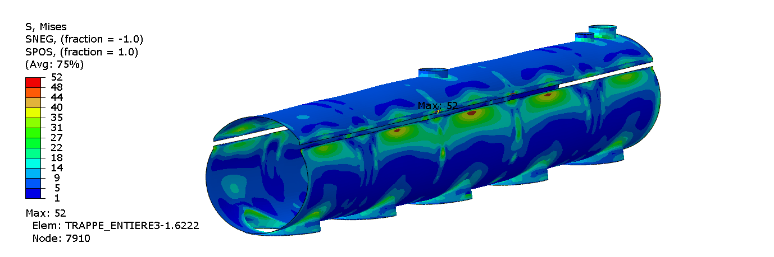
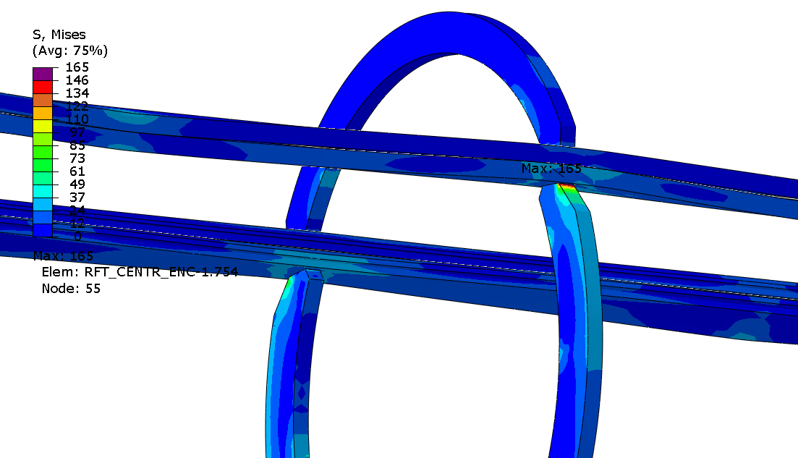
2- Vacuum Vessel design
Displacements and slidings
Vacuum vessel design: updates overview
Mechanical simulations were updated. They included:
new static analyses of the new shaped VV
general displacements
evaluation of the coupler bearings displacements (gravity, ext. pressure, handling)
Stresses
static analyses of the top lid/bottom part interface:
sliding and contacts forces (→ impacts on the O-ring)
closure function:
- contact-compression system (O-ring)
- VV stiffness
- fabrication influence on mechanical behaviour (weldings…)
linear and non-linear buckling analyses of the VV
(including the closure interface)
Sliding (flange/flange): 0.13mm max
Von Mises stresses
Linear buckling
P_{crit} (mode 1): 23 bar

Slide 6
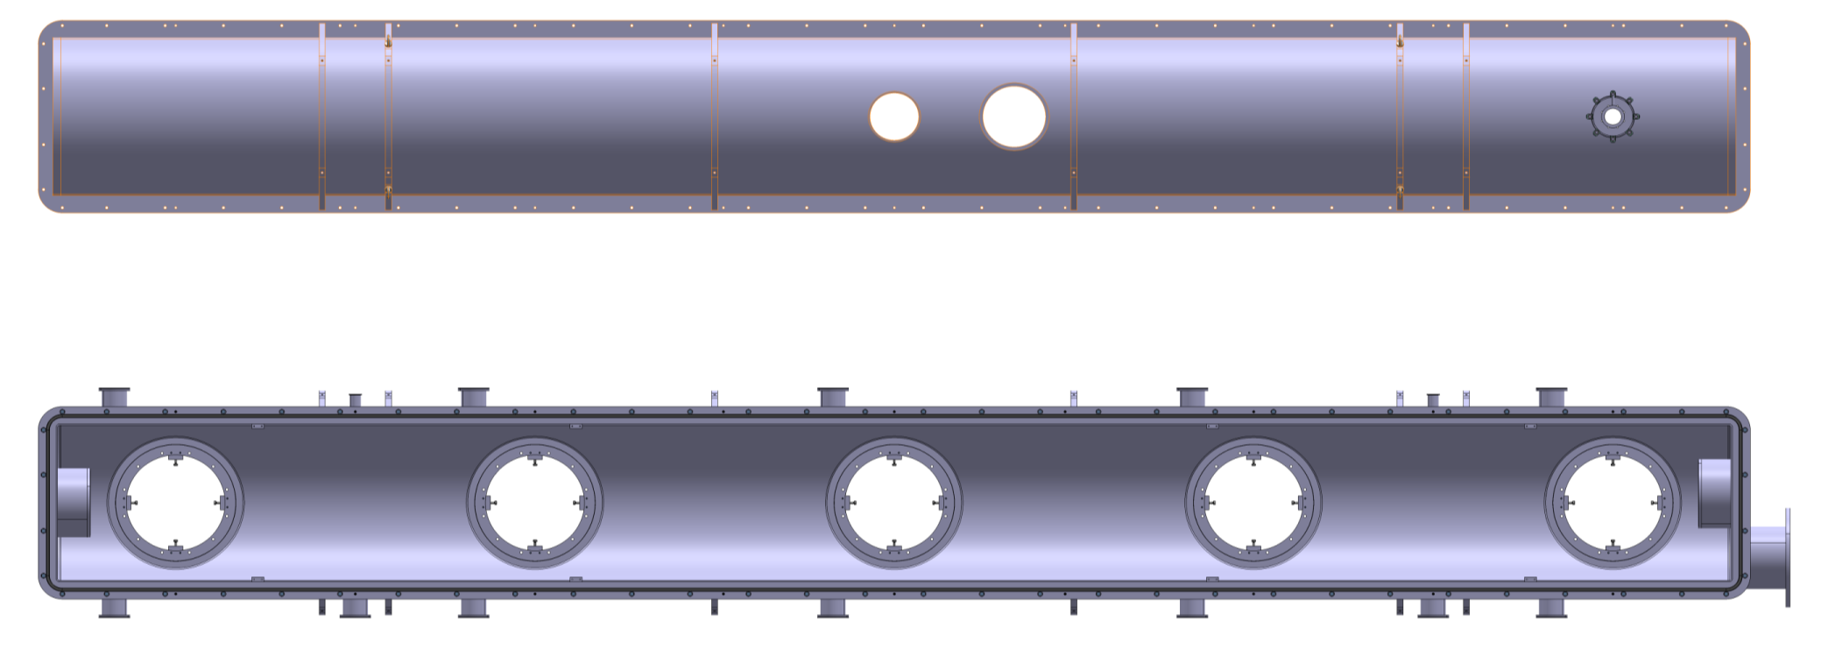
2- Vacuum Vessel design
Vacuum vessel interfaces
2K LHe level gauge port
ISO-F DN160
Burst disk interface
ISO-F DN250
Top-lid
Relief valve (LHC type) interface Ø=217
Instrumentation/vacuum ports DN 100 ISO-F
Instrumentation/vacuum ports ISO-F DN100
Bottom part
Bearing
(coupler support)

Slide 7
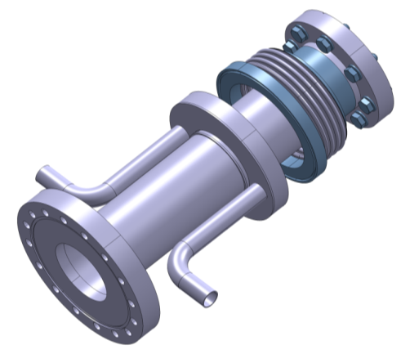
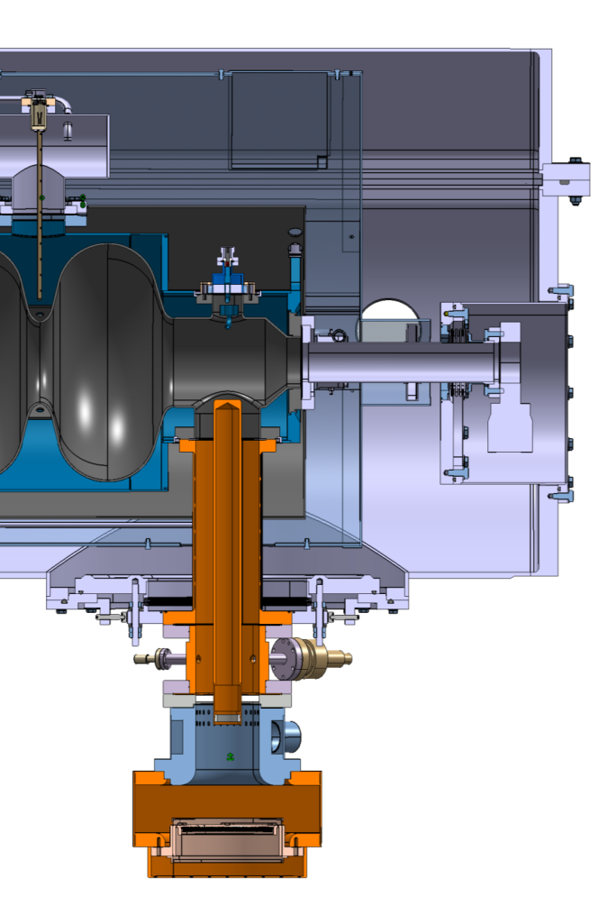
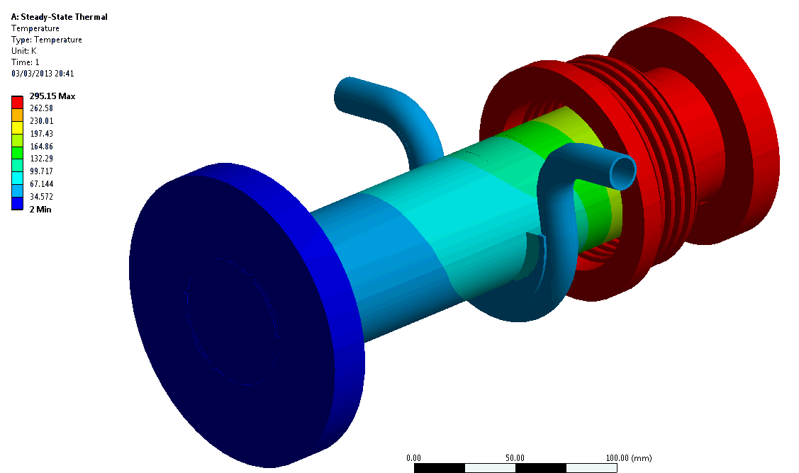
2- Vacuum Vessel design
New beam pipe interface
Cold-warm transition
Beam pipe warm valve is specified (VAT Vatterfly series 200)
A new interface was designed ⇒ it allows smaller end-caps
Bellow
300 K
2 K
Vacuum vessel flat ends
Active heat intercept:
50K He from thermal shield
Removable end cap
Ø=295
Heat loads @ 2K < 1.3 W:
- including all heat radiation transfers
- preventing icing on the bellow
Vatterfly valve
VAT 200
C-W transition with active heat intercept (50K)
⇒ Design not finalized

Slide 8
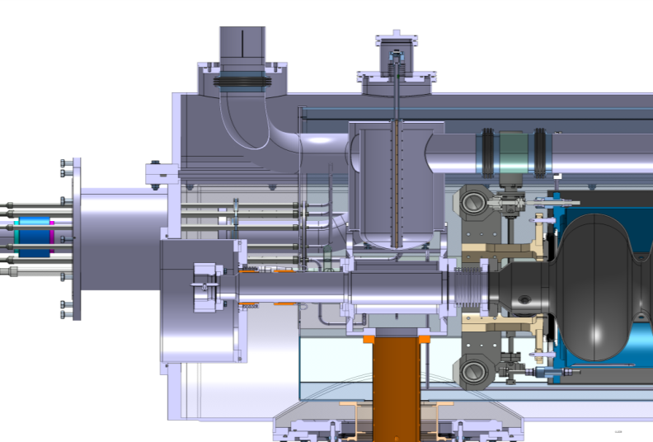
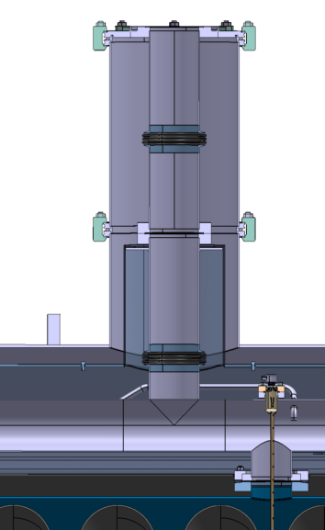
2- Vacuum Vessel design
Safety devices
LHe 2K Burst disk
Original layout
Integrated onto the 2K vapour pumping line
reduced heat loads onto the thermal bath
safety aspects: uncertainties concerning the pressure drop within the double wall 2K LHe vessel (pressure wave propagation)
Proposed new layout
Directly connected at the middle of the bi-phase pipe
⇒ reduces the pressure drop
⇒ limits the temperature of the exhaust vapors
⇒ heat loads were numerically estimated: Q_{2K}< 0.5W
but
⇒ increases the risk of thermoacoustic waves
this point has to be studied: possible integration of an acoustic impedance at ambient temperature
R
ν
L
C

Slide 9
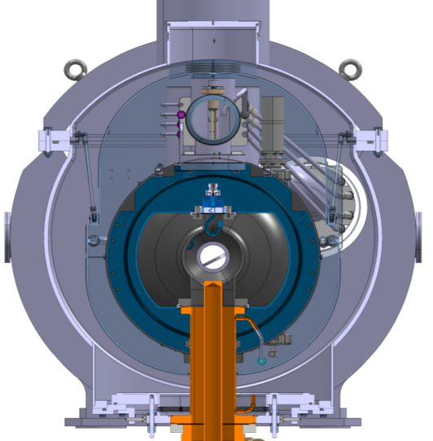
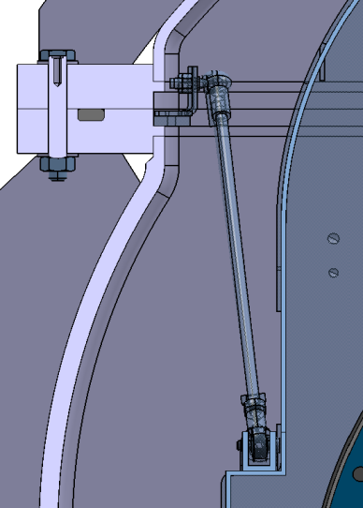
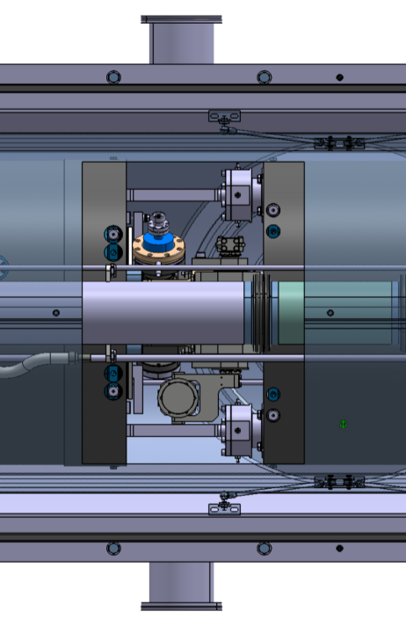
2- Vacuum Vessel design
Thermal shield interface
Before cryostating, thermal shield is positioned around the string of cavities and supported on the cryostating tooling
After cryostating, thermal shield is interfaced onto the VV by means for rods
The top lid being removed, maintenance access is provided via movable panels placed on the thermal shield
HOM
CTS motor

Slide 10
3- Vacuum vessel fabrication
Preliminary technical specifications file
Tendering phase
A preliminary technical specifications file, including detailed drawings was written
To be used as a basis for discussions with considered companies before the call for tender procedure
Several companies were contacted and the preliminary technical specification file was sent to 9 of them to check that:
- they have the capability of long length machining (~7 m)
- they have already made (steel) vacuum / pressure vessels
The list of companies has been transmitted to CERN
5 companies answered positively i.e. they are able to construct this vacuum vessel
As the 5 companies are possible new contractors for IPNO-CNRS, technical discussions / visits are planned (April-May)

Slide 11
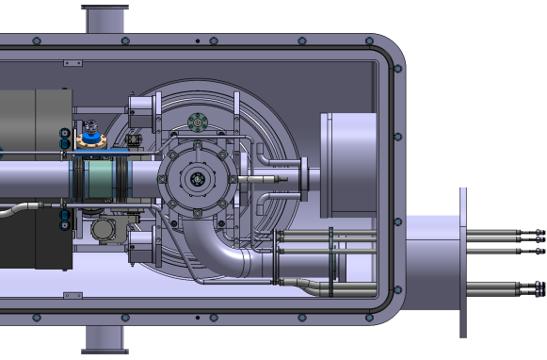
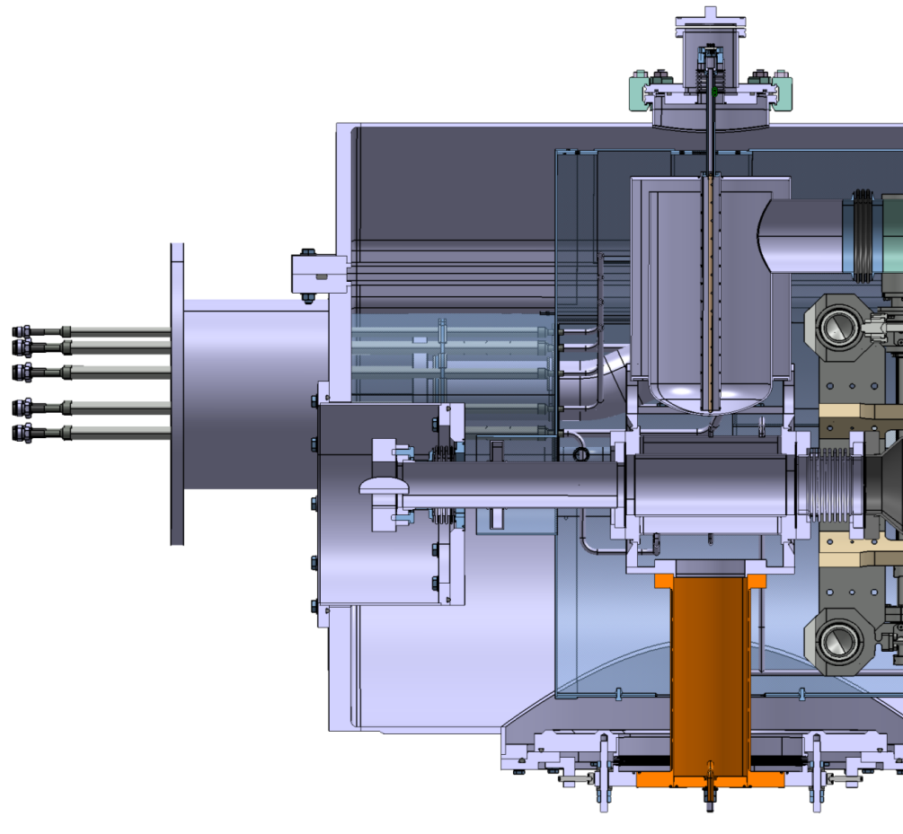
4- CRYOGENIC DISTRIBUTION
Cryogenic distribution integration
4K LHe level gauge (DWT vapour generator pot)
LHe tank
LHe level gauge
C-W transition
Connections to the valve box
2K pumping line supply

Slide 12
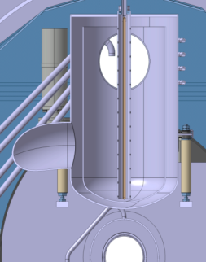
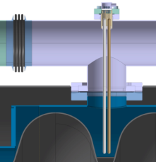
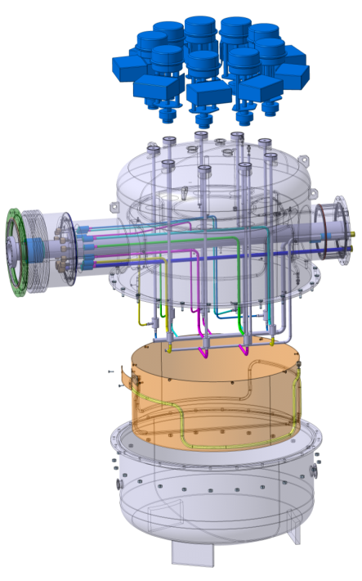
4- CRYOGENIC DISTRIBUTION
Cryogenic distribution integration
Bi-phase pipe
(line X)
LHe level gauge
Pumping line (XB)
To cold box and SM18
Gauge active length
Annular vapour collector
Liquid He tank
Valve box pre-design
A pre-design study is being achieved
It will be transmitted to CERN cryogenic group for a detailed study
Based on cryogenic calculations, the cold valves were specified with CERN (supplier: WEKA)

Slide 13
5- CONCLUSION: WORK PLAN
Vacuum vessel design
Cryostat components
Proposed vacuum vessel design and interfaces has to be validated by CERN
Material must be specified has a construction steel class:
first magnetic shielding (at room temp) is provided by the VV
Call for tender files are being written
Thermal and thermo-mechanical study of the thermal shield are being carried out
Cryogenic distribution has to be finalized (mechanical behaviour)
Tooling
Detailed study of the cryostating tooling is under progress

Slide 14
Thank you for your attention

