Slide 1
Single Spoke Cavity β = 0.37 for MYRRHA
(RF and) Mechanical Studies

Slide 2
Contents
Description of the cavity and its helium vessel
1.1 Cavity
1.2 Helium vessel
1.3 Assembly
RF design
2.1 Starting points
2.2 RF parameters
Static calculations
3.1 Description of the different loaded cases
3.2 Leak test of the cavity without helium vessel
3.3 Leak test of the cavity with its helium vessel
3.4 Pressure sensitivity in the cryomodule
3.5 Mechanical-vibration modes
RF-Mechanical coupled simulations
4.1 RF parameters
4.2 Sensitivity for cavity tuning
4.3 Helium bath pressure fluctuation
4.4 Lorentz forces detuning factor

Slide 3
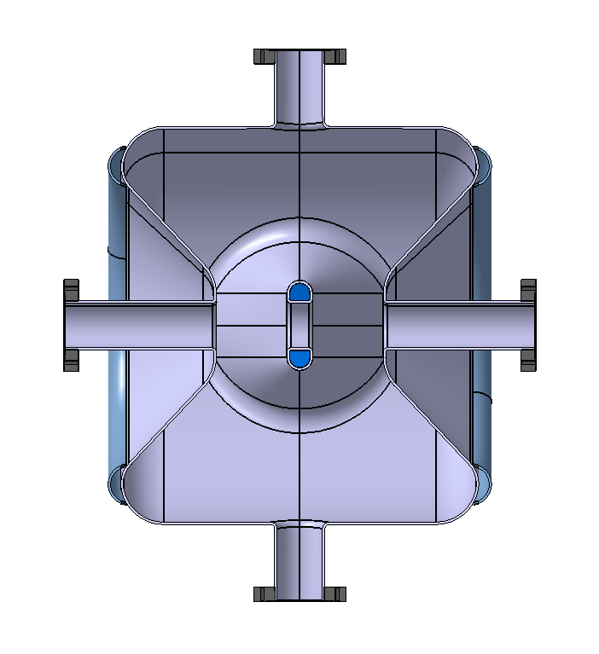
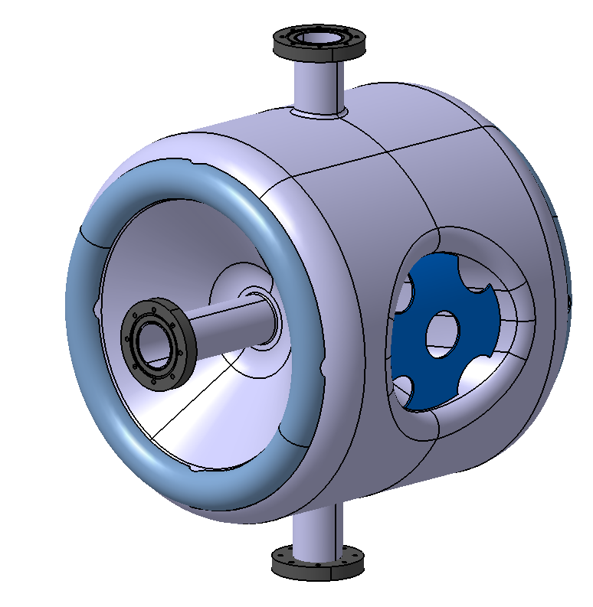
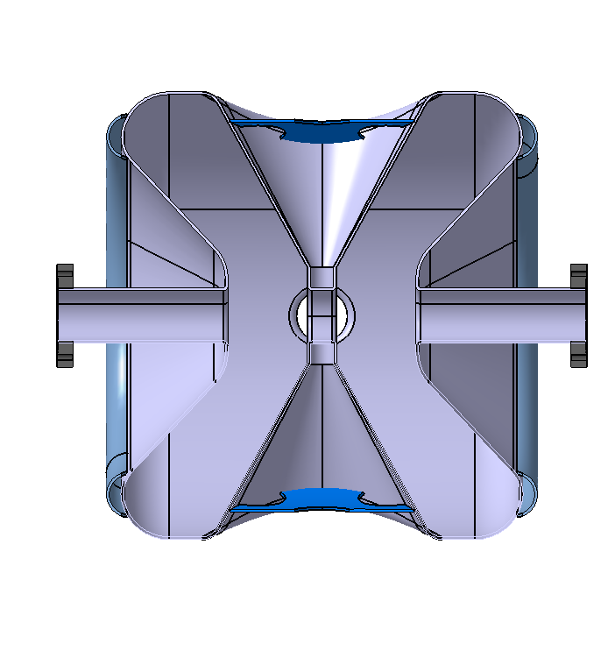
1. Description of the cavity and its helium vessel
1.1 Cavity
RF Design: 2-gap Spoke cavity defined by RF analysis (with CST Microwave Studio)
Material: 3-mm thick bulk Niobium
Pick-up probe port
∅_{int}= 56mm
∅_{int}= 56mm
Donut stiffener (x2)
580 mm
Spokebase stiffener (x2)
∅int 485 mm
Fundamental Coupler port ∅_{int}= 56mm
Total weight : 42 Kg

Slide 4
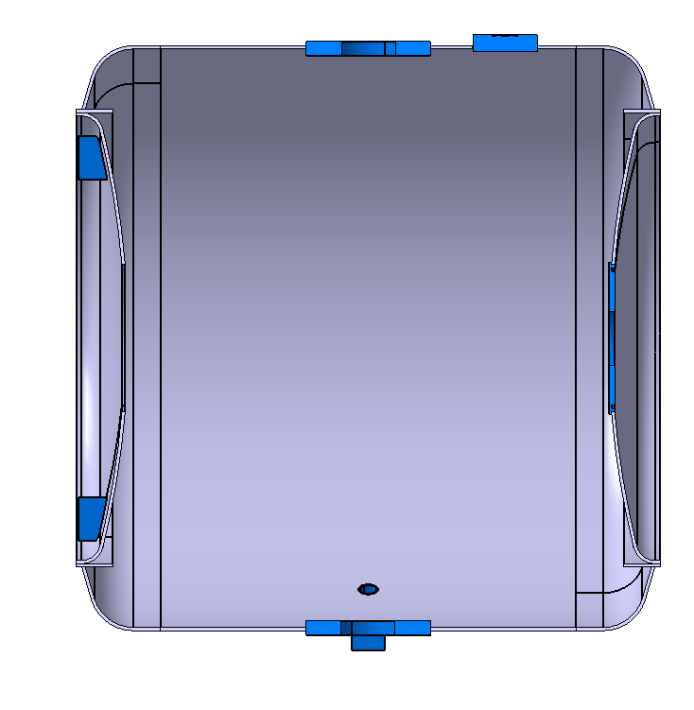
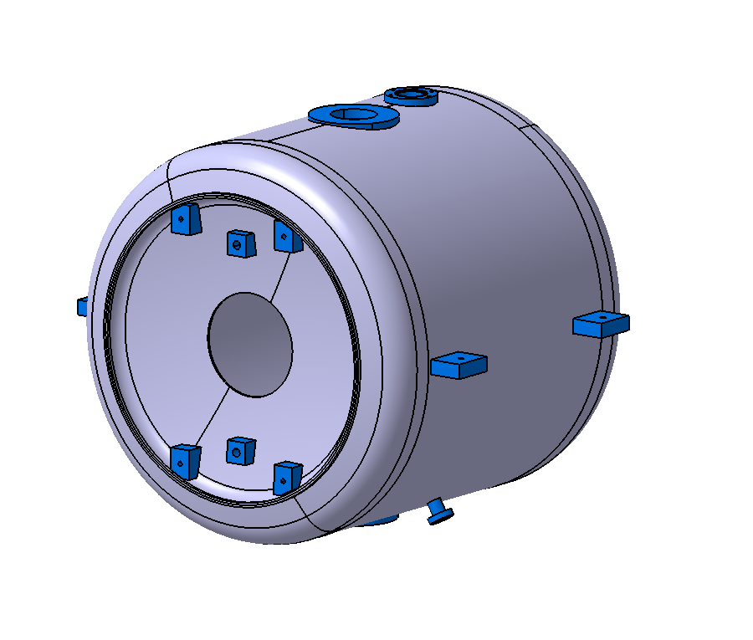
1. Description of the cavity and its helium vessel
1.2 Helium vessel
Material: 3-mm thick Titanium grade 2
Pick-up Flange
Helium Flange
Ring stiffener
∅int 530 mm
Bracket for supporting in the cryomodule (x4)
Supports for Cold Tuning System (CTS) (x4)
534 mm
Coupler Flange
Total weight : 22 Kg
Buckling analytical calculation
Roark formula:
CODAP:
E = Young modulus
e = thickness
L = free length
v = Poisson coef.
r = cylinder radius
Pallowable =
Pcrit =
Pcrit = 0,74 MPa
Pallowable = 0,30 MPa

Slide 5
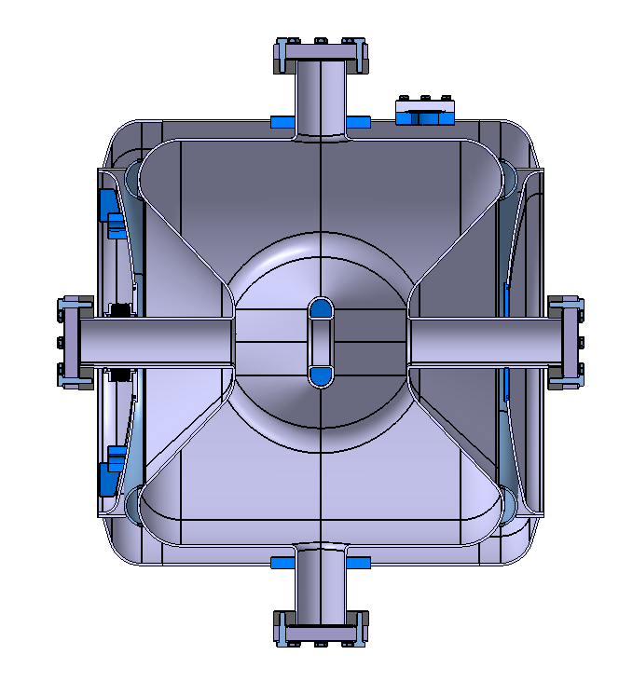
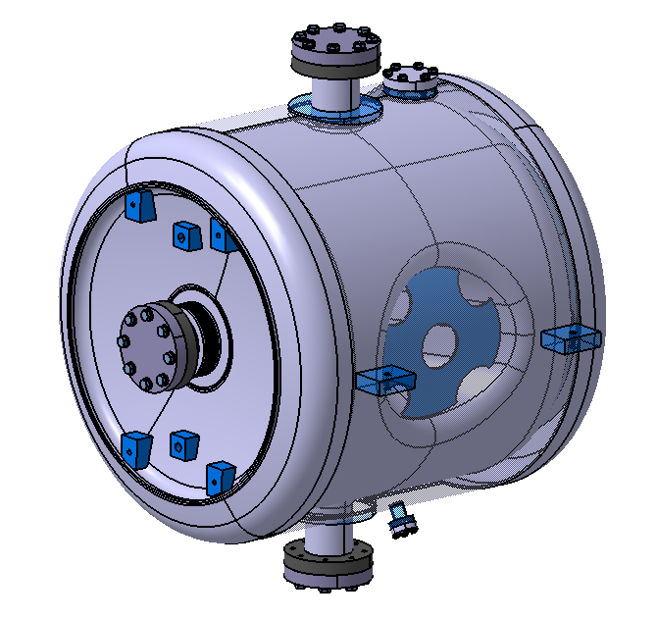
1. Description of the cavity and its helium vessel
1.3 Assembly
Welded connections
1 Bellows
Welded connections
Total weight : ~70 Kg

Slide 6
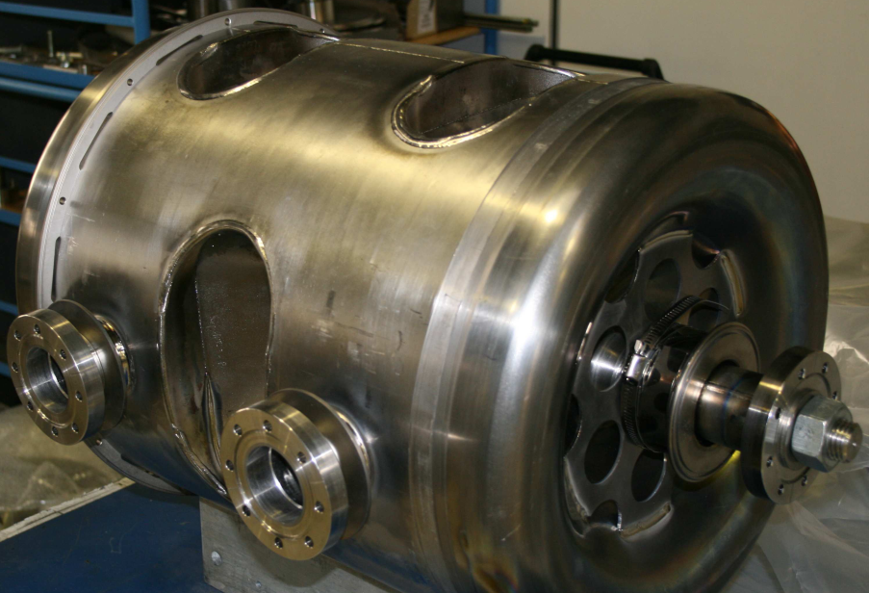
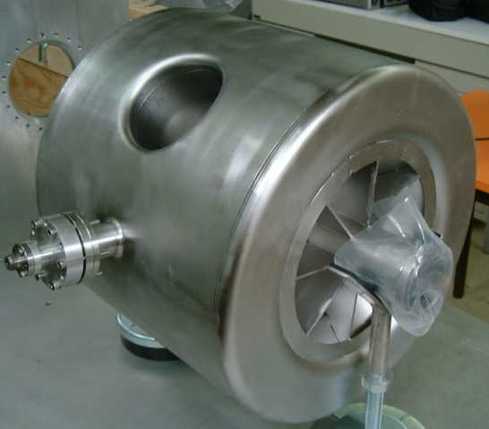
2. RF design
2.1 Starting points
SPOKE BAR GEOMETRY : feedback from the two Single-Spoke resonators and the Triple-Spoke resonator fabrication (EURISOL)
Spoke bar base (H field area):
no racetrack shape→ 3D weld seams are not easy (Spoke bar-to-cavity body connection)
no cylindrical shape→ Hpk too high
→Conical shape is chosen
Spoke bar center (E field area): →racetrack shape is ok

Slide 7
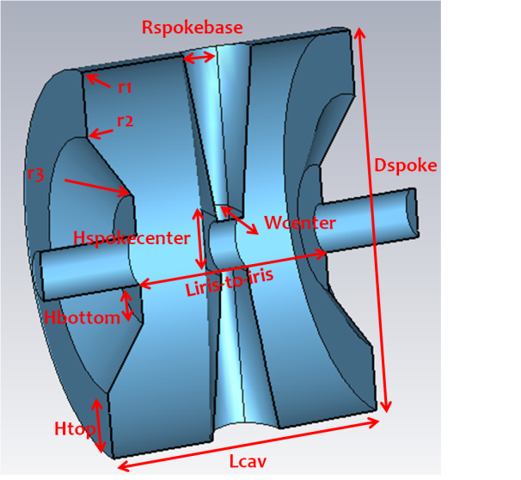
2. RF design
2.2 RF parameters [1]
CST MicroWave Studio 2012
Model created with the 3D CAD tools of MWS
Symetries: ¼,
BC: Magnetic planes,
Tetrahedral mesh, Nb tetrahedrons~10 000
1st mode calculated (TM010)
Optimisation of a dozen parameters
GOALS
Epk/Eacc < 4.4
Bpk/Eacc (mT/MV/m) < 8.3

Slide 8
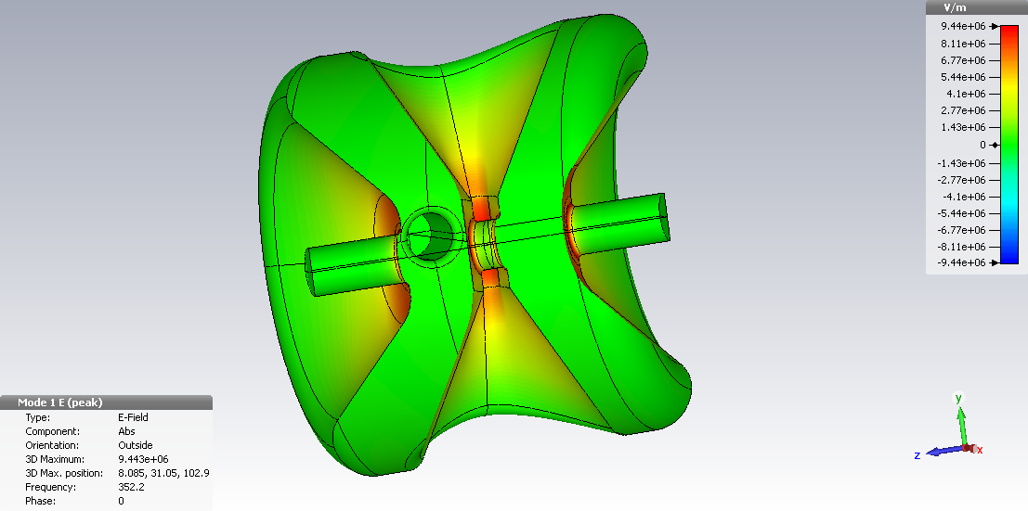
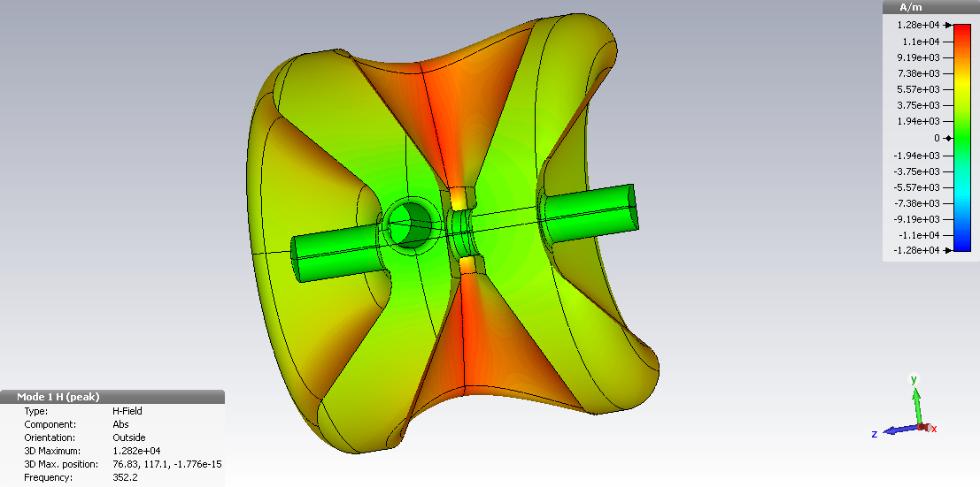
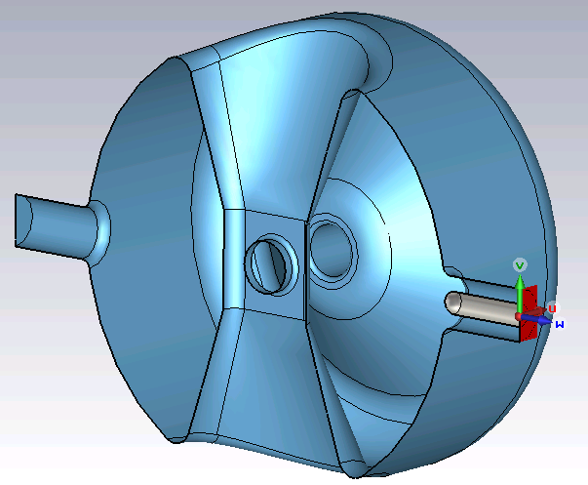
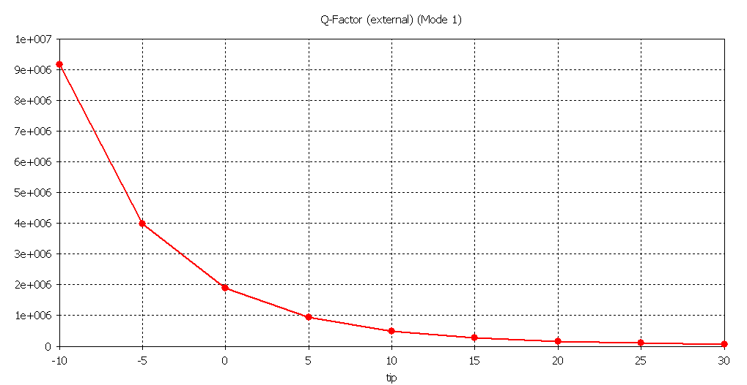
2. RF design
2.2 RF parameters [1]
3.1 RF parameters
Epk
Optimized RF parameters
Frequency [MHz] | 352.2
Optimal beta | 0.37
Vo.T [MV/m] @ 1 Joule & optimal beta | 0.693
Epk/Ea | 4.29
Bpk/Ea [mT/MV/m] | 7.32
G [Ohm] | 109
r/Q [Ohm] | 217
Qo @ 2K for Rres=20 nΩ | 5.2 E+09
Pcav for Qo=2 E+09 & 6.4 MV/m [W] | 9.35
Lcav=435mm
Bpk
Qext~2.2E+06
∅port=56mm, Z=50Ω

Slide 9
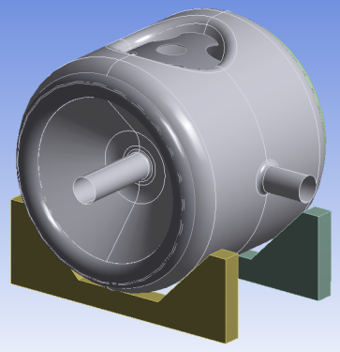
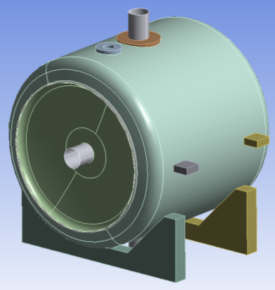
3. Static calculations
3.1. Description of the different loaded cases
Leak tests during fabrication
Bare cavity (=1st fabrication step)
Cavity with its helium vessel (=Cavity completed)
Keep stresses < 50 MPa
Test inside the cryomodule
Cooling down at 4K
Define the critical pressure during cool down process
Mechanical-vibration modes analysis
Check sensitivity to microphonics
Frequency shift by pulling on beam tubes
Define the sensitivity for the tuning system
Helium bath pressure fluctuation
RF sensitivity due to the Lorentz forces
Define a range for the pressure and Lorentz detuning factors
Bare cavity
Jacketed cavity

Slide 10
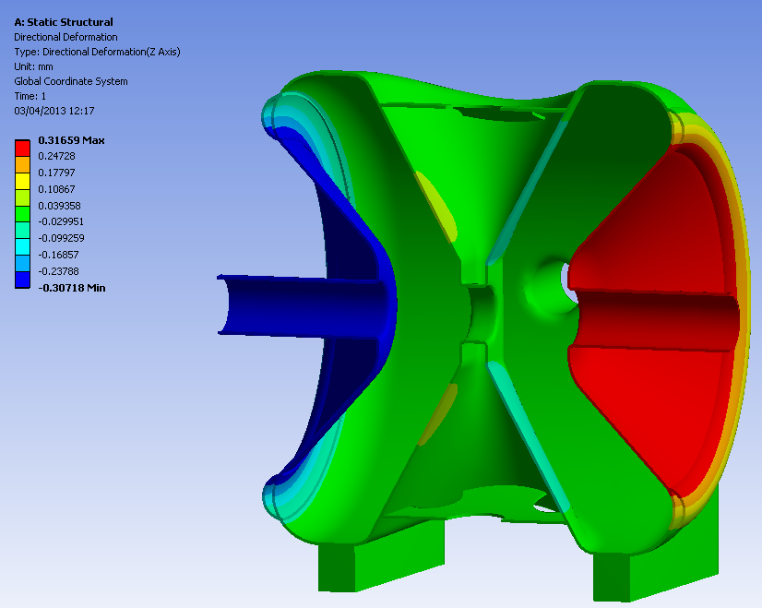
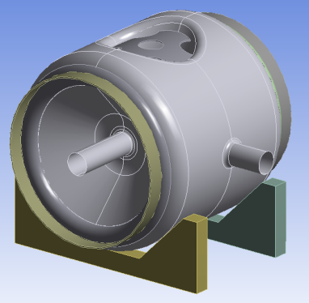
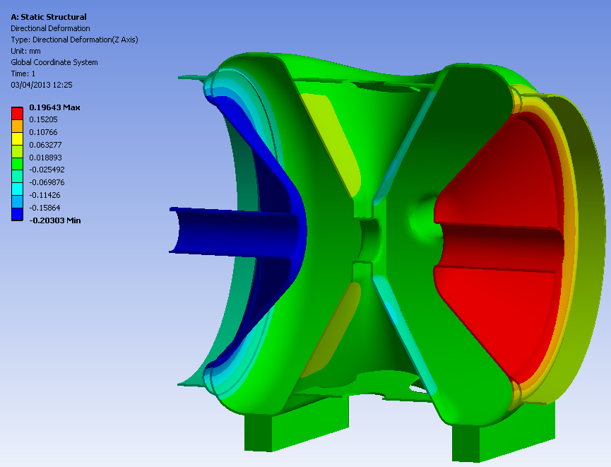
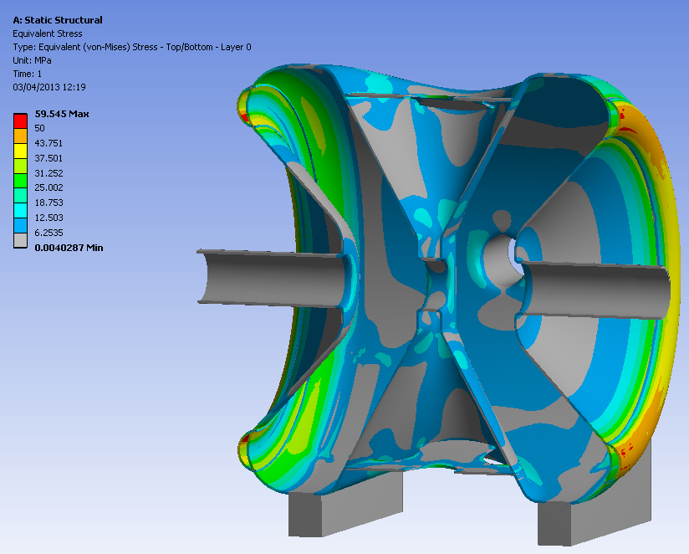
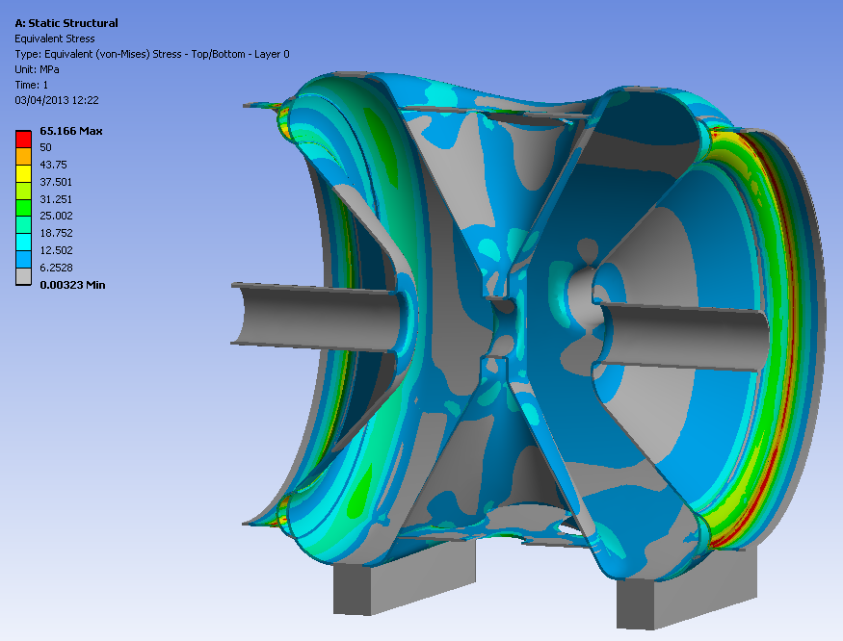
3. Static calculations
3.2 Leak test of the cavity without helium vessel (1 bar external load)
Without ring stiffener
With ring stiffener
Uz_{max} = 0.2 mm
Uz_{max} = 0.32 mm
On cavity end-cups :
42 MPa
On cavity end-cups :
30 MPa
Donut ribs: 60 MPa max
> 50 MPa
Donut ribs: 63 MPa max
Ring ribs: 65MPa max
> 50 MPa
Max stress on cavity walls < Yield stress limit

Slide 11
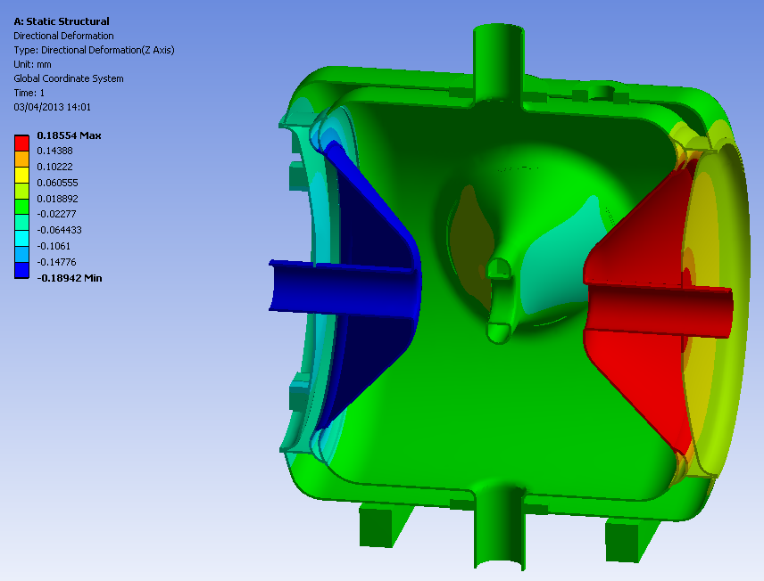
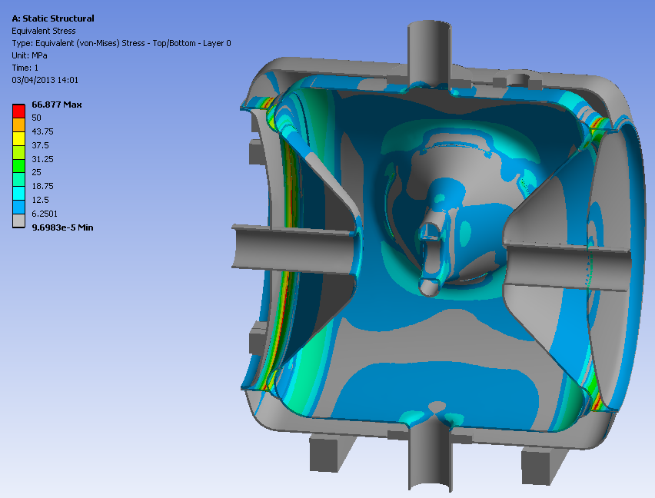
3. Static calculations
3.3 Leak test of the cavity with its helium vessel
Cavity under vacuum/He vessel P=1bar
Cavity P=1 bar/ Helium vessel under vacuum
Uz_{max} = 0.54 mm
Uz_{max} = 0.19 mm
Uz_{max} = 0.1 mm
On one cavity end-cup : 27 MPa
35 MPa max stress
at the spoke bar-to-rib junction
> 50 MPa
> 50 MPa
Donut ribs: 65 MPa
Donut ribs: 67 MPa
Max stress on cavity walls < Yield stress limit

Slide 12
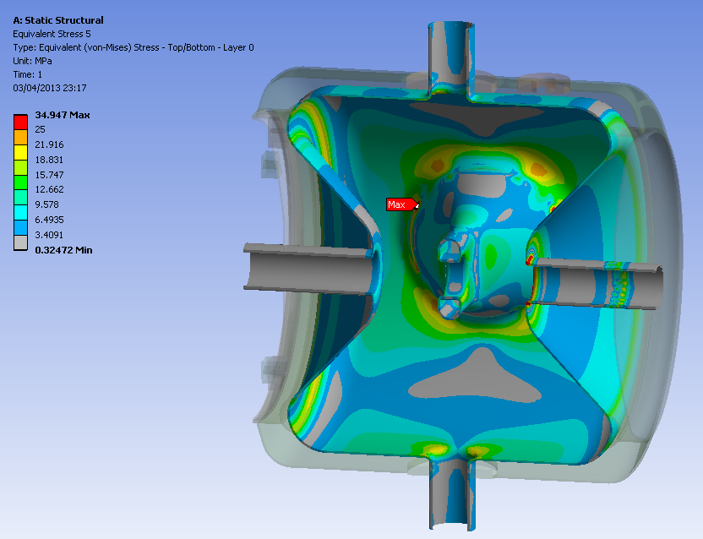
3. Static calculations
3.4 Pressure sensitivity in the cryomodule
35 MPa at the spoke bar-to-rib junction
Cavity with its helium vessel inside the cryomodule:
Cooling down (Helium bath at 4K)
0 bar in the cavity
1 bar in the helium vessel
0 bar in the cryomodule
Boundary conditions in the cryomodule
Helium vessel maintained by 4 slideways
Middle position fixed by an invar rod
The CTS (Cold Tuning System) is free during the cooling down
30 MPa at the iris area
Umax = 0.11 mm
➔ The maximum pressure is around 1,6 bar (<-> Yield strength Re (Niobium) = 50 MPa)

Slide 13
3. Static calculations
Mode 232 Hz
3.5 Mechanical-vibration modes
Mode 380 Hz
Beam tubes boundary conditions: free-free
Mode | Frequency | Location
1 & 2 | 232 Hz | Beam tube at CTS side
3 | 320 Hz | Spoke bar
4 & 5 | 380 Hz | RF ports
6 & 7 | 420 Hz | Helium vessel
8 | 430 Hz | Spoke bar
9 | 450 Hz | Helium vessel
10 | 480 Hz | RF ports
11 | 495 Hz | Helium vessel
12 | 500 Hz | 2 beam tubes
Mode 320 Hz
Mode 500 Hz
Critical modes in bold
The 1^{rst} critical mode (mode 3) >> 50 Hz

Slide 14
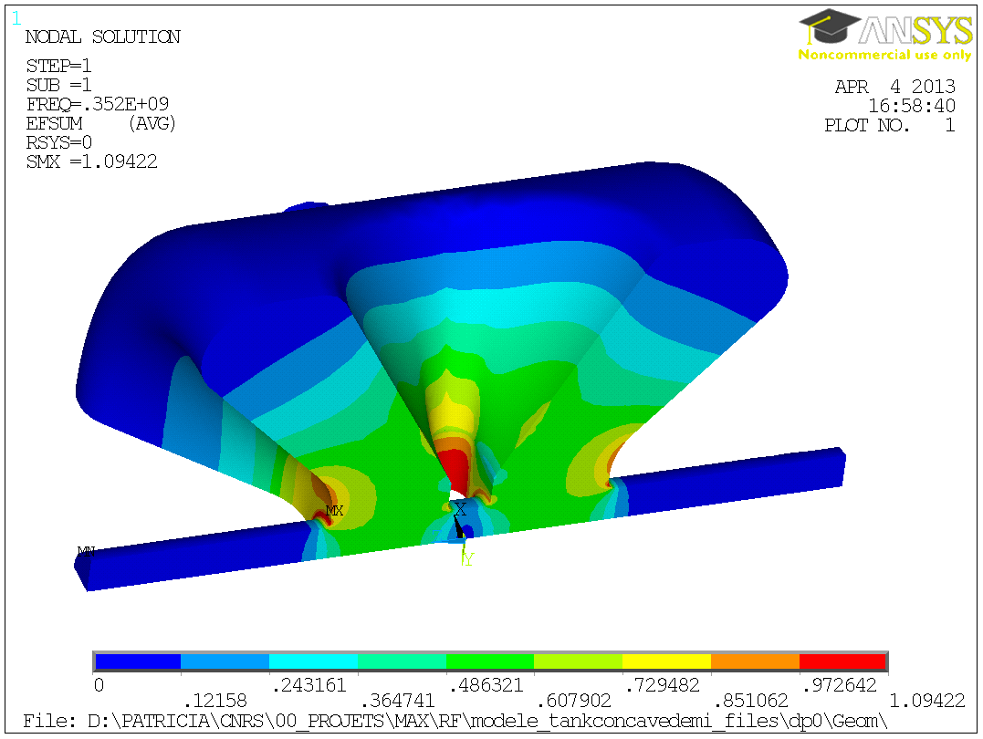
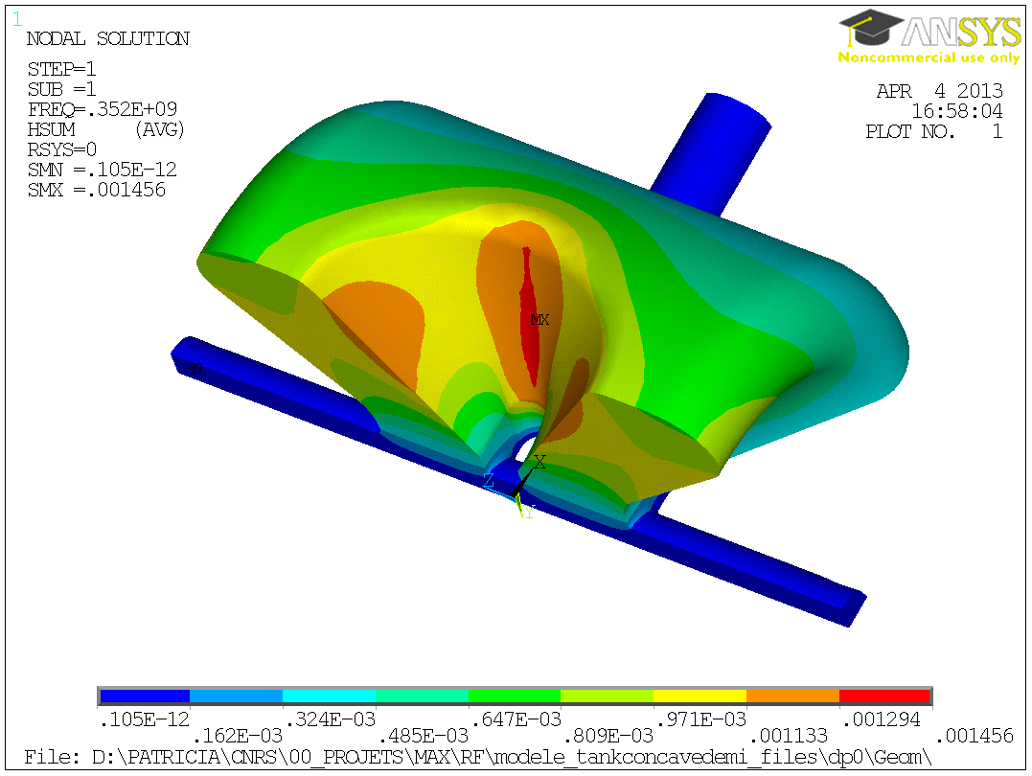
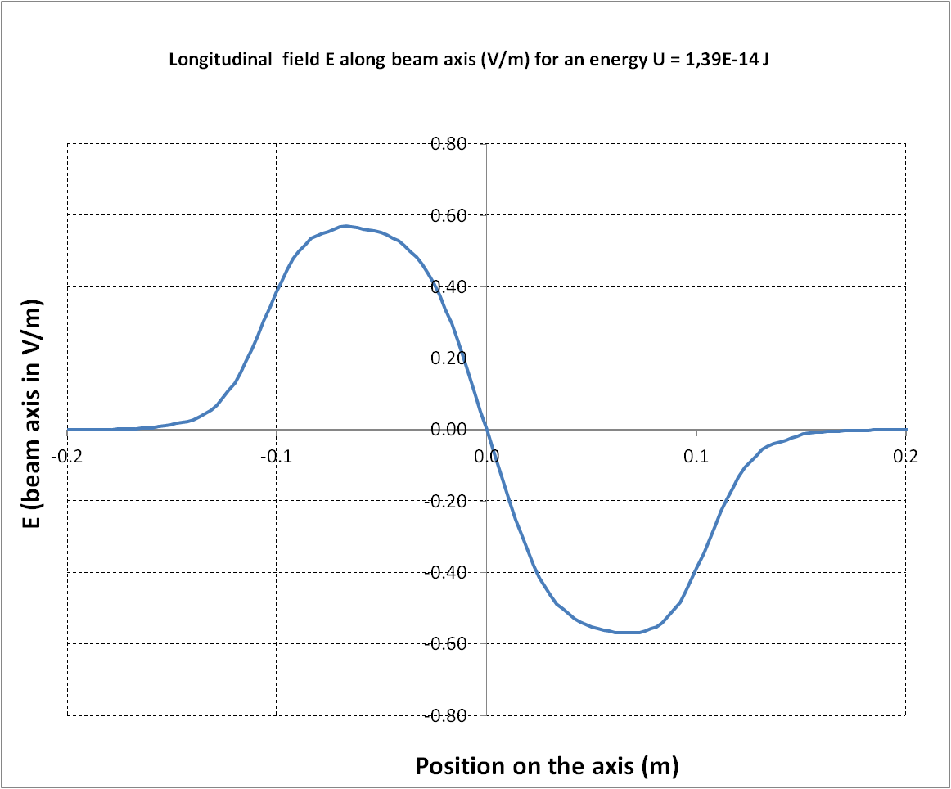
4. RF-Mechanical coupled simulations
4.1 RF Parameters
 | ANSYS
Frequency [MHz] | 352,2
Beta | 0.37
Bpk/Eacc [mT/(MV/m)] | 7,06
Epk/Eacc | 4.22
G [Ohm] | 109
r/Q [Ohms] | 217
Lacc = Ngap.β.λ/2 [m] | 0.315
Temperature (K) | 2
Q₀ Cu@ 300K | 22313
Q₀ Nb@ 2K | 1.01*10¹⁰

Slide 15
4. RF-Mechanical coupled simulations
4.2 RF Sensitivity for cavity tuning
Tuning sensitivity
Δf/Δz = 156 kHz/mm (*)
Kcav >15 kN/mm
380 MPa / mm
CTS blocks
Remark : 0,13mm max allowable at ambient temperature
* The CTS blocks are reinforced by stiff bars (not included in this model). Hence, we assume no possible rotation of the blocks.

Slide 16
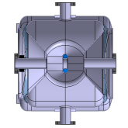
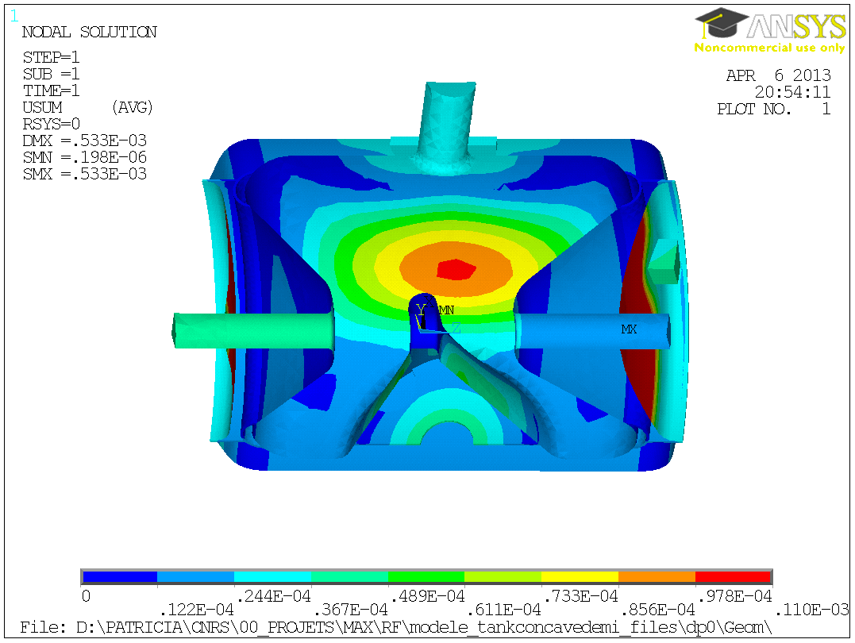
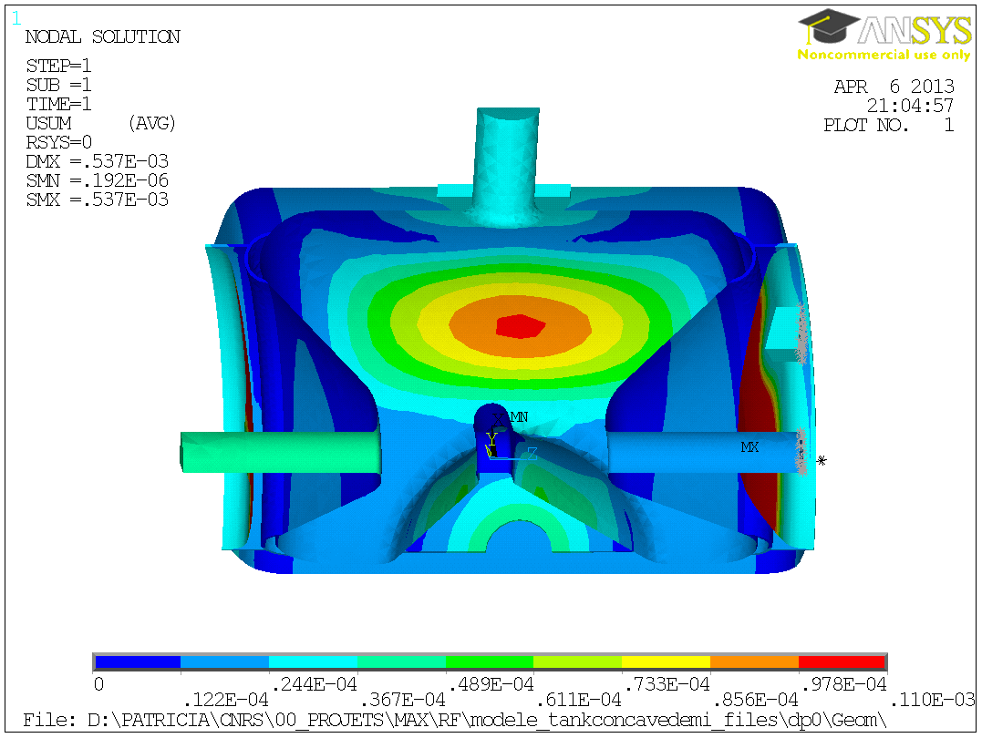
4. RF-Mechanical coupled simulations
4.3 Helium bath pressure fluctuation
The holding support of the cavity inside the cryomodule will have an influence on its deformation. Here, we only consider the coupler port fixed along Z axis.
1 bar
Without CTS
With CTS
0 bar
0 bar
beam tube and CTS support rigidly linked along Z axis
Sensitivity to He pressure Kp [ Hz/mbar] without CTS | +7.65
Sensitivity to He pressure Kp [ Hz/mbar] with CTS | +14
Nota: bandwith Δf =160 Hz

Slide 17
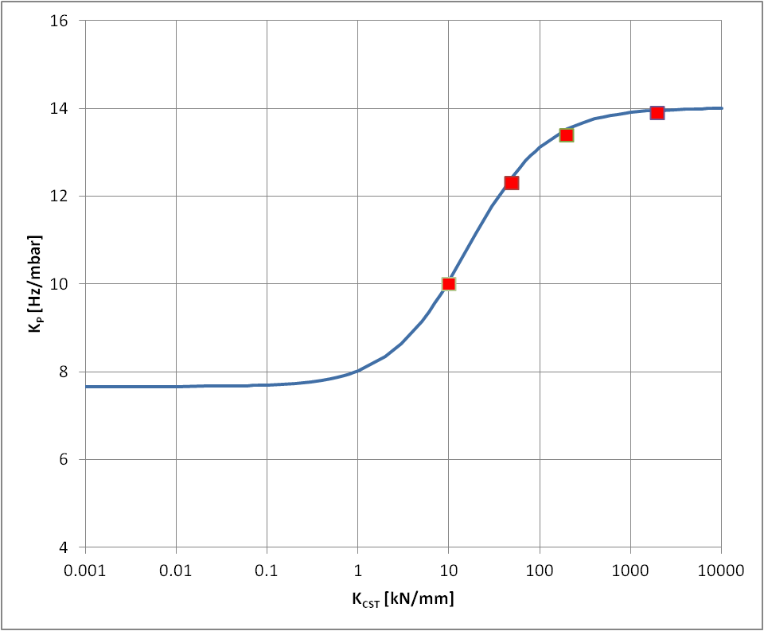
4. RF-Mechanical coupled simulations
4.4 Helium bath pressure fluctuation
EVOLUTION OF K_{P}
Kp [ Hz/mbar] (fixed ends) | +14
Cavity stiffness Kcav [kN/mm] | 16
Longitudinal sensitivity [kHz/mm] | 156
+14
+7.65
FEM result with a specific CTS stiffness

Slide 18
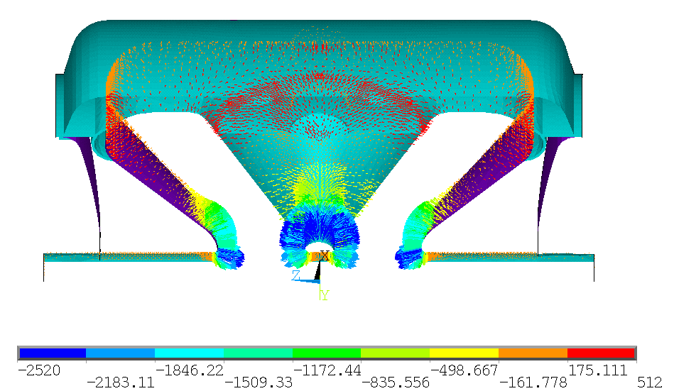
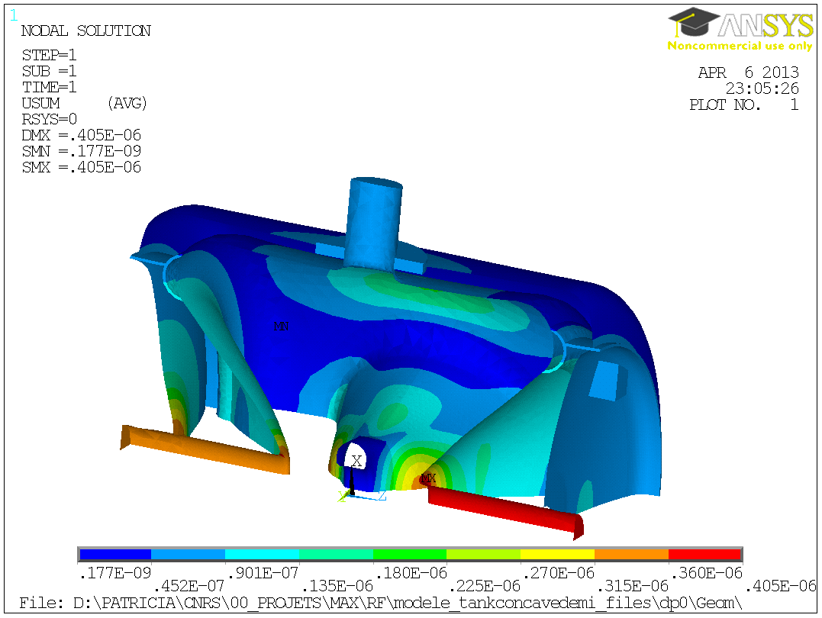
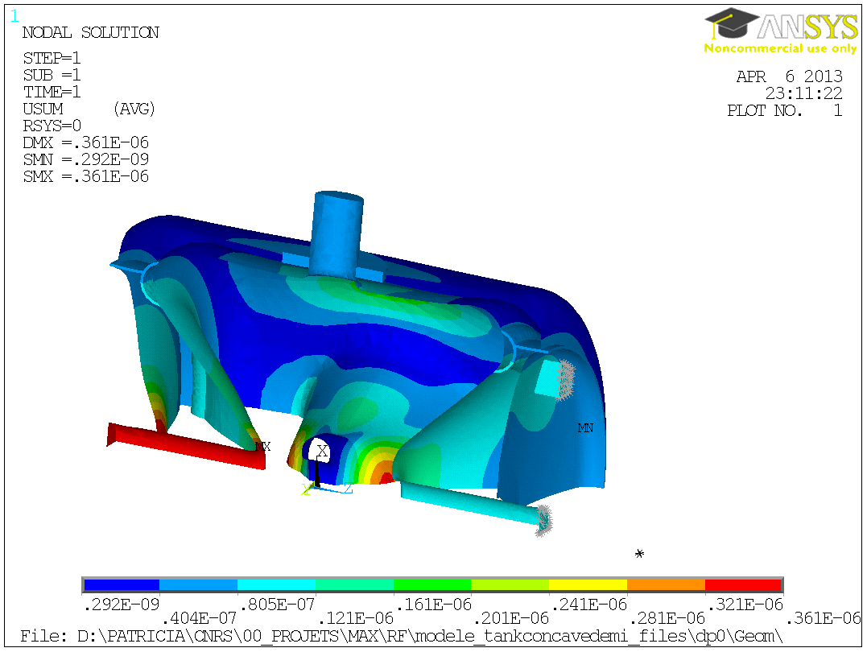
4. RF-Mechanical coupled simulations
4.5 Lorentz Forces detuning factor
Lorentz Factor: K_{L} = Δf / E²acc
For 8MV/m
K_{L} [Hz/(MV/m)²] (without CTS) | K_{L} =-6.0 | Δf = -384 Hz
K_{L} [Hz/(MV/m)²] (with CTS) | K_{L} =-5.28 | Δf = -338 Hz
Radiation pressure in Pa for 8MV/m
In both cases, the coupler port is fixed along Z axis
Without CTS
With CTS
beam tube and CTS blocks linked along Z axis

Slide 19
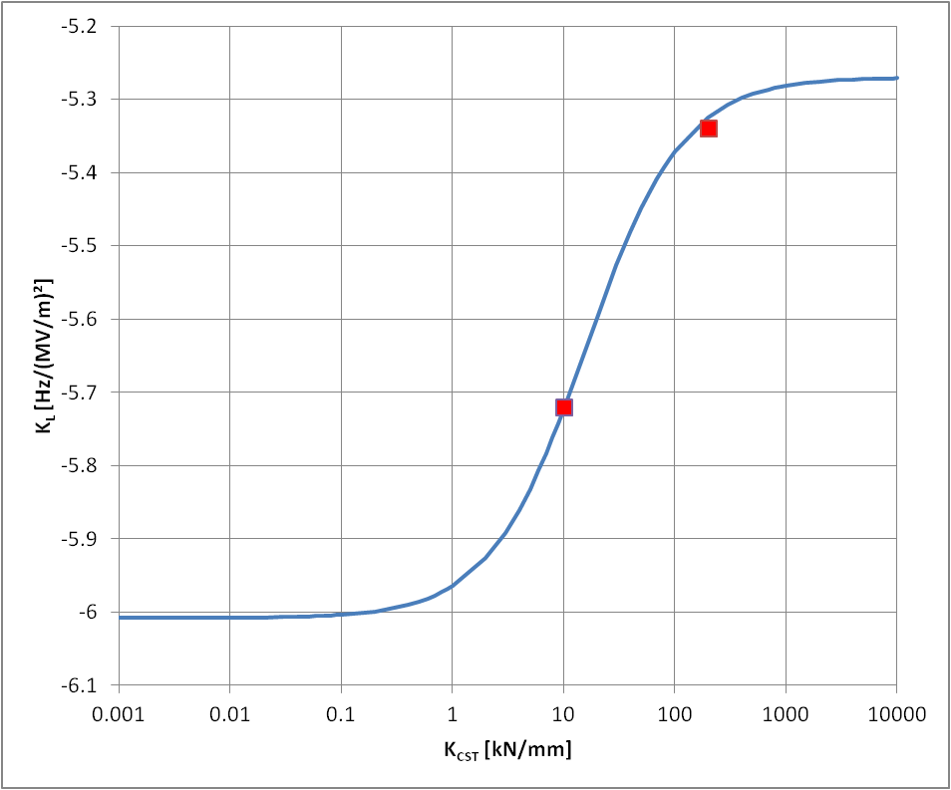
4. RF-Mechanical coupled simulations
4.6 Lorentz Forces detuning factor
EVOLUTION OF K_{L}
K_{L} [Hz/(MV/m)²] (fixed ends) | -5.28
Cavity stiffness Kcav [kN/mm] | 16
Longitudinal sensitivity [kHz/mm] | 156
-5.28
-6.
FEM result with a specific CTS stiffness

Slide 20
5. Next…
1/ Design is finished
2/ Niobium ordered from NINGXIA for 1 cavity. Fabrication finished on 20th April 2013
3/ Detailed technical drawings of the cavity started
4/ Call for tender publication: July 2013

