Slide 1
CERN SM18 RF Test Facility
Helium distribution
T. Koettig, R. v. Weelderen, O. Pirotte,
P. Maesen, M. Therasse
SLHiPP meeting 17. - 18. April 2013

Slide 2
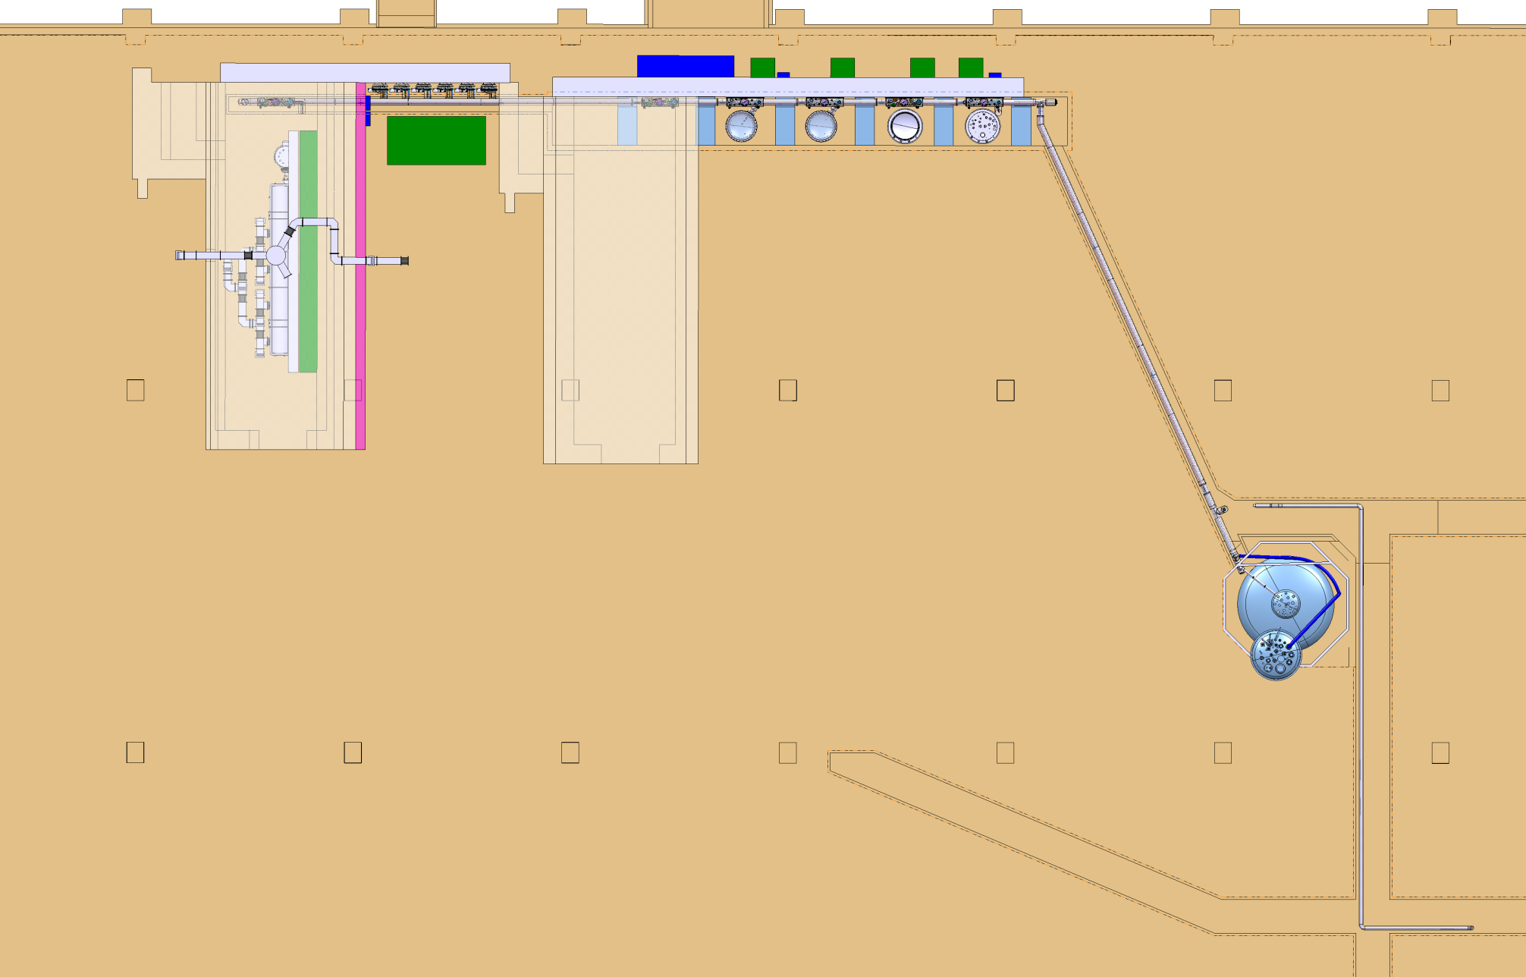
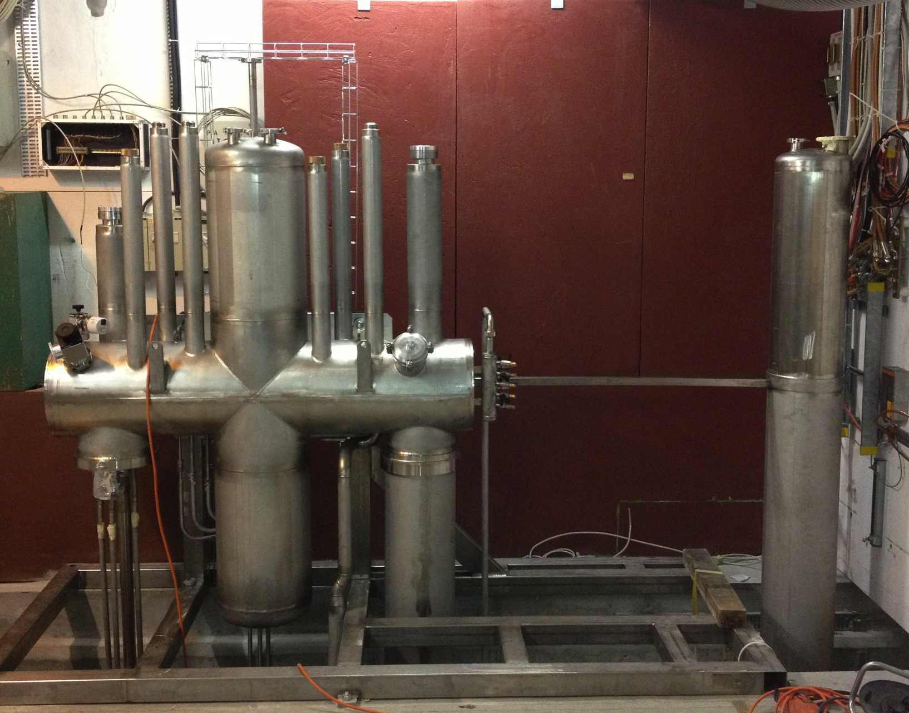
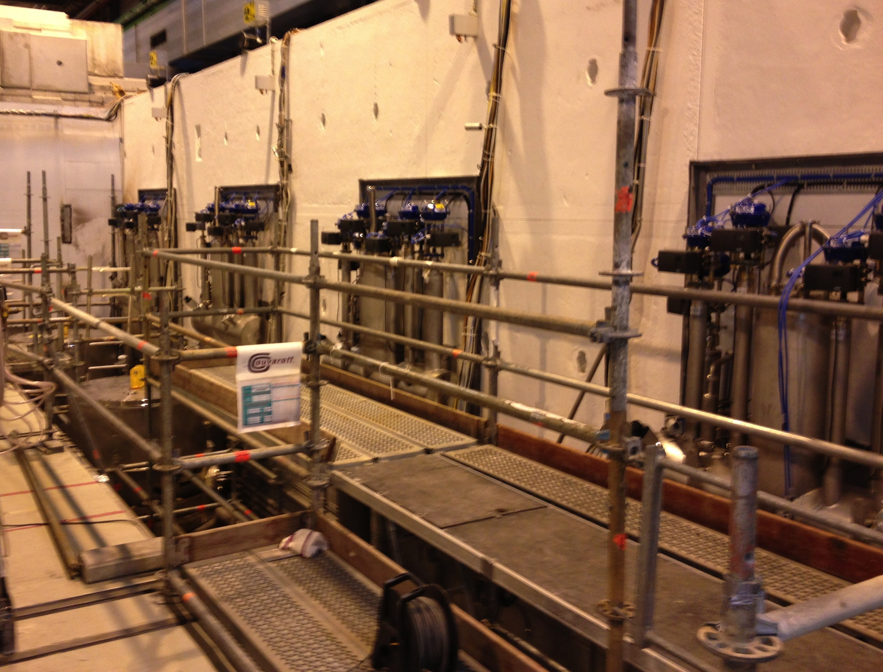
Cryogenic Infrastructure Upgrade
RF Test facility area
V3
V4
V5
V6
New helium transfer line
Vertical test stands
V3 to V6 for cavities
M7
M9
Horizontal test stands
M7 and M9 for cryomodules
He supply
from 25 m³
liquid tank
Courtesy J. Mouleyre
Top view of the CERN SM18 RF test area, showing the new cryogenic infrastructure.

Slide 3
SM18 RF TF : General PID for 2013
M7 Service module
where we measure TL performance

Slide 4
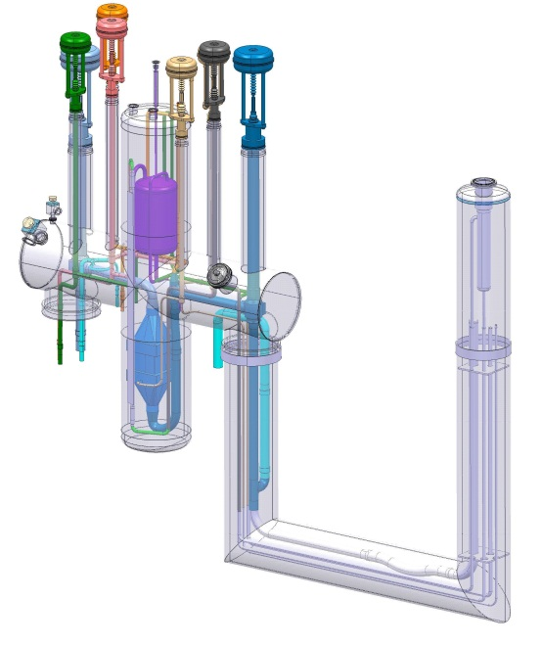
SM18 RF TL - performance test
QLKRF M7 @ 2 K

Slide 5
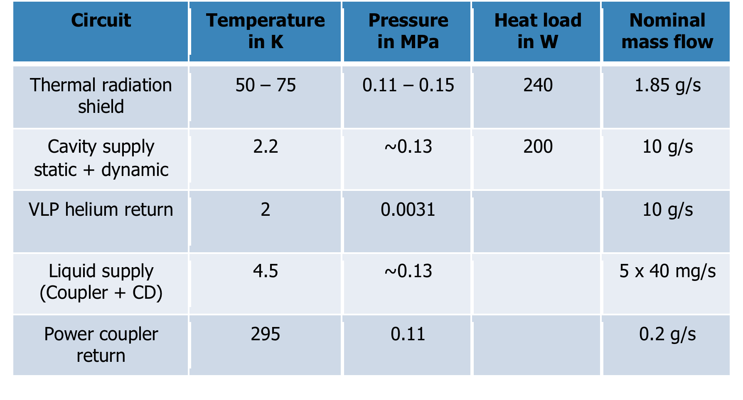
Parameters SPL CM
Specifications of SPL CM connected to M7 helium distribution:
SPL valve box supplies helium at max. 1.5 bara for the cavity and shield circuit.

Slide 6
M7 PID

Slide 7
Summary
Accomplished tasks:
Commissioning of the new cryogenic infrastructure in SM18 RF test area.
Functional specification of the helium distribution system incl. PID.
Definition of the safety device equipment of the transfer line.
Open tasks:
Start cryogenic operation of vertical test stands V5 and V3.
Cryogenic performance measurement of the new transfer line.
Define the interconnection to clients in the horizontal test stands (SPL, Hie-Isolde, Crab, LHC).
Integration study for cryogenics in the horizontal bunkers.

Slide 8
Thank you for your attention

Slide 9
SM18 RF TL performance

