Slide 1
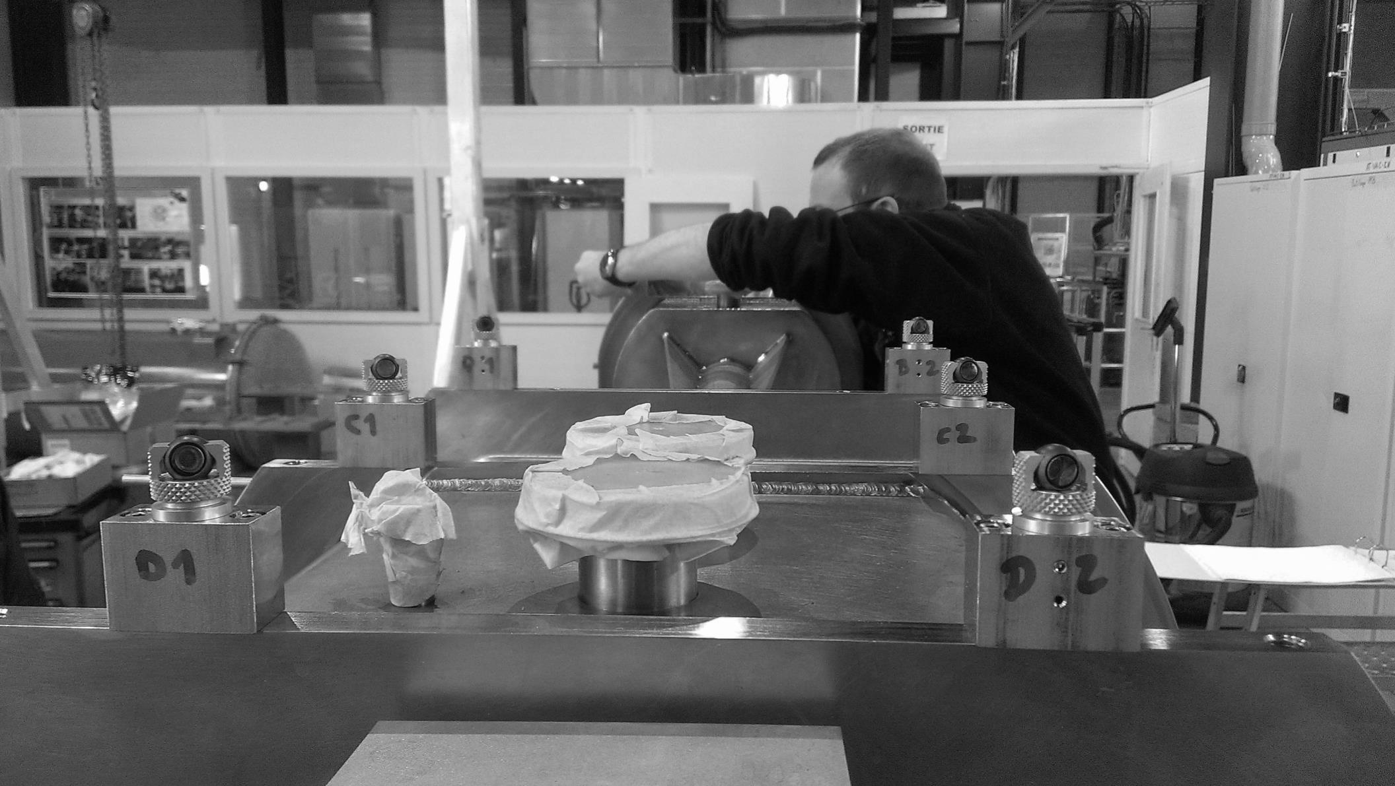

SPL Mock-up aligment issues
Wojciech Żak, on behalf of the Cryomodule Development Team
wojciech.zak@cern.ch
W. Zak TE-MSC-CMI
SLHiPP3 – Louvain-la-neuve 2013

Slide 2
Outline
1
Introduction of myself
SPL Mock-up
Idea of the Optical Wire Position Monitor
R&D of the OWPM
Future tasks
W. Zak TE-MSC-CMI
SLHiPP3 – Louvain-la-neuve 2013

Slide 3

Something about me
Name: Date of birth: 01.05.1987
Wojciech Place of birth: Pszczyna
Surname:
Żak
Higher education:
Masters degree in Power Engineering obtained at
Cracow University of Technology (Mechanical Department)
Specialization: Power engineering systems and facilities
CERN experience:
01.06.2011-31.07.2012 TECHNICAL STUDENT
01.08.2012-31.01.2013 UPAS
01.02.2013-? FELLOW CERN/ESS
Language skills:
Polish, English, French (une peu), German (nicht so gut)
W. Zak TE-MSC-CMI
SLHiPP3 – Louvain-la-neuve 2013

Slide 4
Mock-up
Mechanically representative of 1 cavity
Real DWTs and interfaces to VV
Cooled by liquid-gas N2
Aimed at validating:
  Cavity supporting scheme
  Alignment measuring devices (OWPM)
  Realignment of cavities via vessel interface
  Thermo-mechanical behaviour
  DWTs active cooling
W. Zak TE-MSC-CMI
SLHiPP3 – Louvain-la-neuve 2013

Slide 5
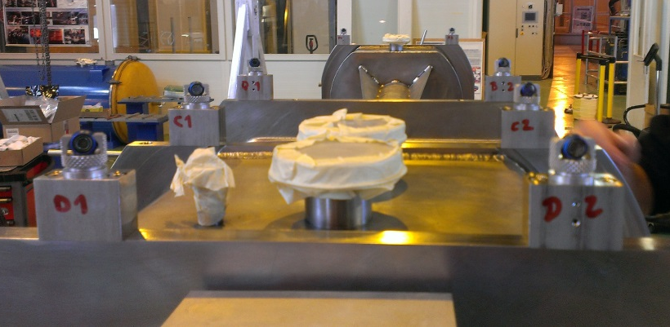
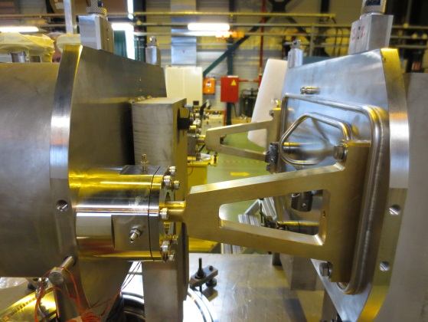
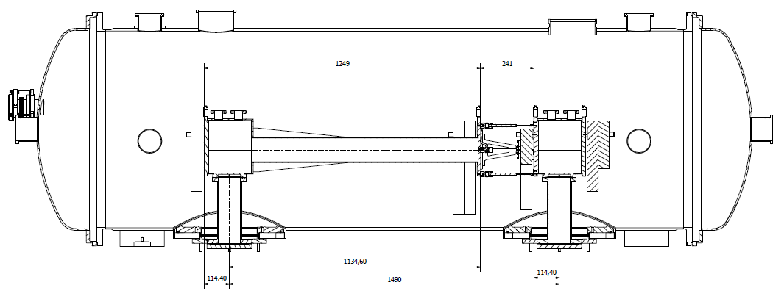
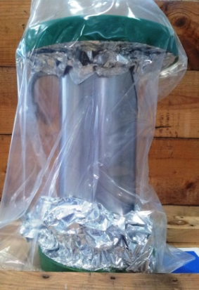
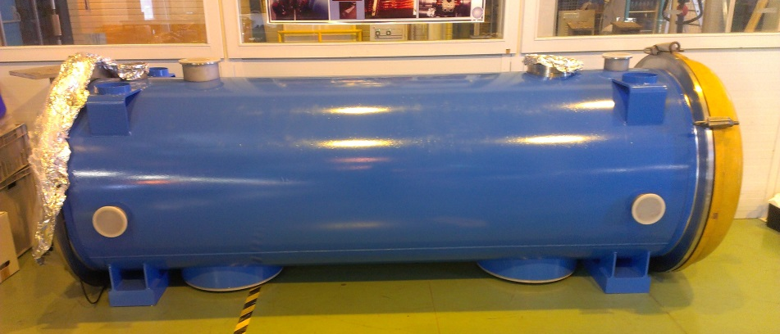
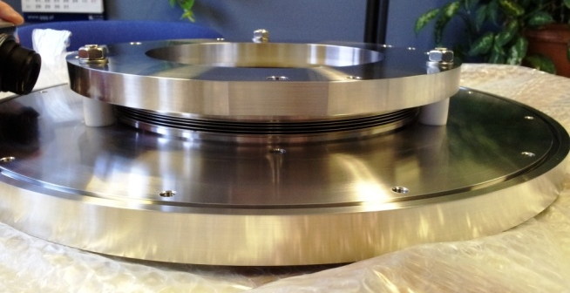
Mock-up
IC support
Laser tracker targets
Vacuum Vessel
DWT
DWT flange
W. Zak TE-MSC-CMI
SLHiPP3 – Louvain-la-neuve 2013

Slide 6
Mock-up – Test program
TEST CONDITION | TEST | COMPONENT / SYSTEM | WHAT | HOW
Room temperature (steady) | Assembly alignment | Assembly not inserted in VV | Obtain assembly alignment at warm (align cavities axes) | Act on DWT lower flange bolts and on ICS bolts to adjust axes of cavities, set zero with laser tracker, then lock
 | Alignment sensitivity | Assembly not inserted in VV | Find out sensitivity of alignment system at warm | Act on DWT lower flange bolts and on ICS bolts in a repeatable way, and check the resulting displacements via laser tracker
 | Vibration test | Assembly not inserted in VV | Check if vibrations destroy alignment | Vibrations can be generated by a shaker, displacement should be checked via laser tracker
Cold temperature (steady)* | Temperature profile | DWTs | Check accuracy of semi-analytical model / FE simulations of gas-cooled DWTs | Read temp sensors along DWT wall for temperature mapping at cold To have different cooling conditions, change gas N2 mass flow inside the circuit by acting on mass flow controller at gas outlet
 | Temperature uniformity | Assembly | Look for temperature differences at cold | Read temp sensors for global temperature mapping at cold
 | Liquid N2 quantity / static heat loads | Cavities | Check of liquid nitrogen level inside cavities to get static heat loads | Read level gages inside cavities, act on control valves of N2 dewar to open/close filling circuit
 | Mechanical loads | DWTs | Check amount of bending / torsional loads, deformations | Read strain gages on DWT wall to get thermo-mech loads
 | Assembly alignment | Assembly | Check assembly alignment at cold | Read OWPM on top of cavity flanges
 | Cavities relative position | Cavities | Check displacements btw cavities flanges | Read displacements sensors on flanges btw 2 cavities
Cool down (transient) | Temperature uniformity | Cavities, ICSs | Check temperature uniformity during liquid N2 filling | Continuous read temp sensors on cavities and ICS for dynamic temp mapping
 | Temperature uniformity | DWTs | Check temperature uniformity during gas N2 filling | Continuous read temp sensors on DWT wall
 | Thermal contractions / stresses | Assembly | Check movements / stresses during cool-down | Continuous check of OWPM, strain gages on DWT wall, ICS and cavity, and displacement sensors btw cavities
W. Zak TE-MSC-CMI
SLHiPP3 – Louvain-la-neuve 2013

Slide 7
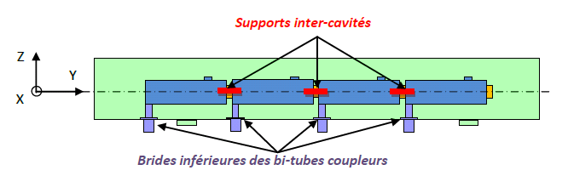
Optical Wire Position Monitor (OWPM)
SPL SCM Cavity position monitoring specs:
Static position or slow movements: absolute movements (x,y,z) of each of 4 cavities during steady state operation and cool-down/warm-ups (300-2 K)
Vertical range 0-2 mm
Precision < 0.05 mm
Resolution < 0.01 mm
Possibly vibration measures (0-1 kHz)
Stretched wire
Opto-coupler sensors
Last cavity support
W. Zak TE-MSC-CMI
SLHiPP3 – Louvain-la-neuve 2013
Courtesy of V. Parma

Slide 8
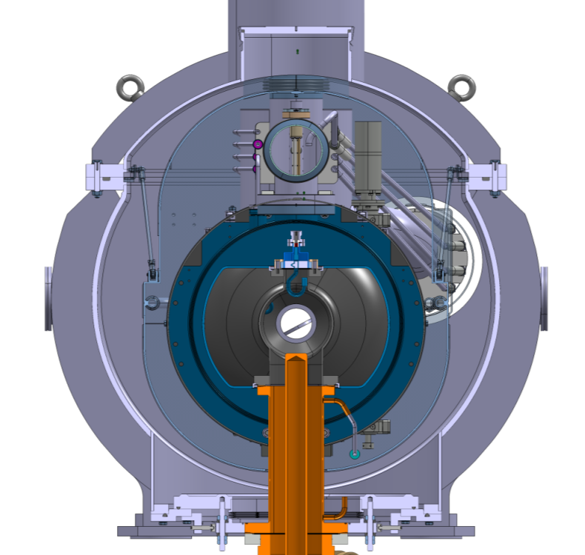
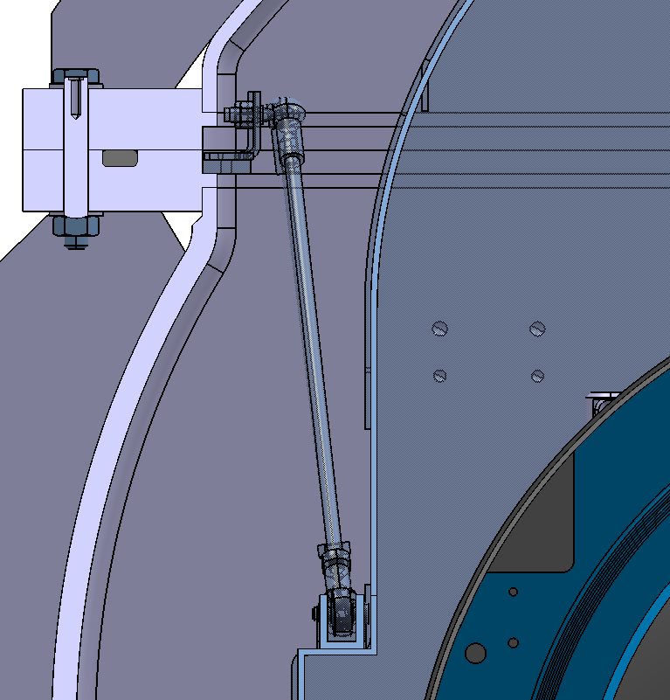
OWPM position on the SPL SCM
Thermal shield
interface
Stretched wire measuring system interface
Courtesy of CNRS
W. Zak TE-MSC-CMI
SLHiPP3 – Louvain-la-neuve 2013

Slide 9
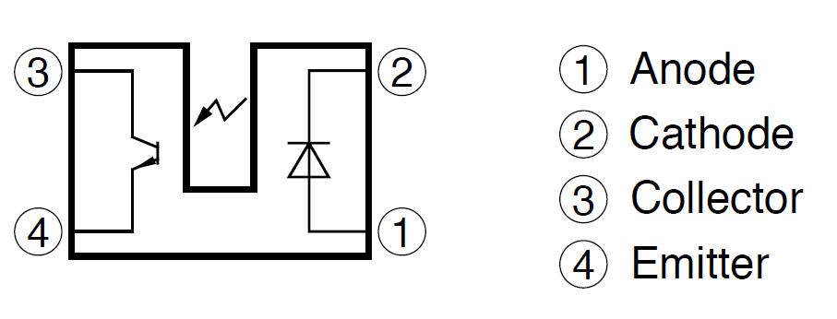
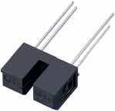
SHARP GP1S56TJ000F
GP1S56TJ000F is a standard, phototransistor output,
transmissive photointerrupter with opposing emitter and
detector in a case, providing non-contact sensing. For
this family of devices, the emitter and detector are inserted
in a case, resulting in a through-hole design.
This device is unique because it uses position pins
to insure accurate placement on the PCB, and has the
short profile.
SHARP
GP1S56TJ000F
Courtesy of M. Guinchard
W. Zak TE-MSC-CMI
SLHiPP3 – Louvain-la-neuve 2013

Slide 10
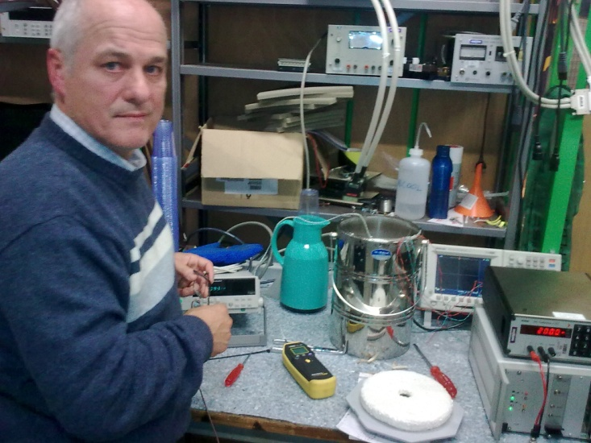
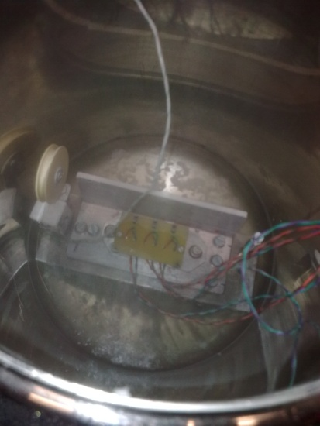
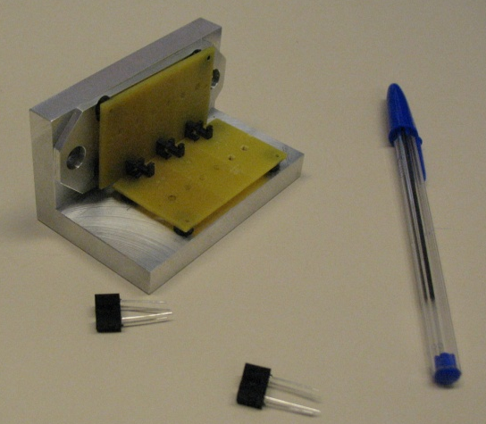
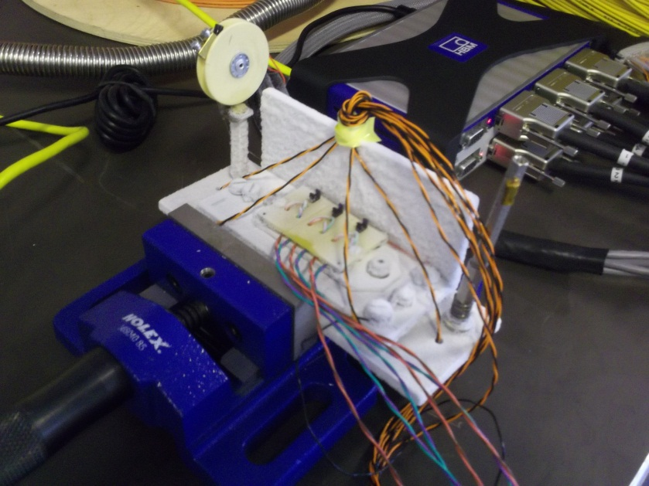
Photo-interrupter as displacement measurement devices: R&D in progress
Basic principle
Operating tests in LN2
Courtesy of J. Perez
Multiple interrupters examples
W. Zak TE-MSC-CMI
SLHiPP3 – Louvain-la-neuve 2013
10

Slide 11
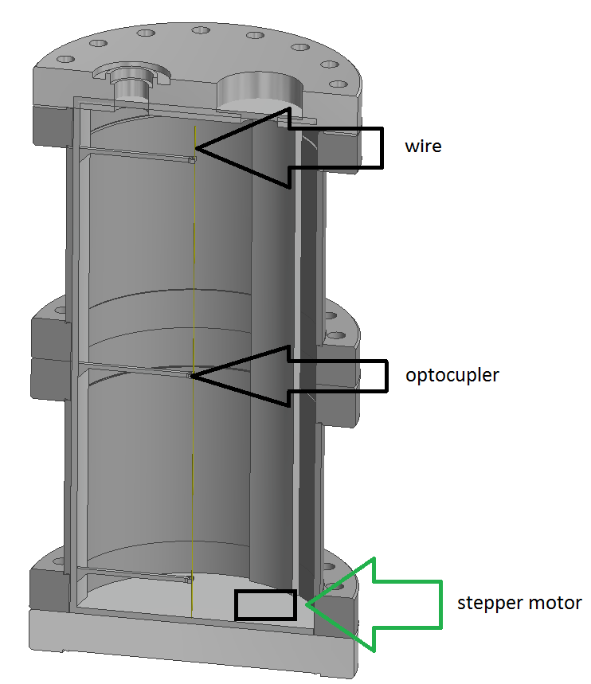
New test concept
Small cryostat merged in liquid N2
Under vacuum
“Movable” wire
The Aim of the test:
Find out if we can obtain uninterrupted signals from the optocouplers
W. Zak TE-MSC-CMI
SLHiPP3 – Louvain-la-neuve 2013
11

Slide 12
Future tasks
Everything depends on the results obtained from our new test mock-up
In case we obtain satisfying result we will proceed with mounting the system on the SPL mock-up
If this solution fails we will have to look for something different (for example WPM for XFL)
W. Zak TE-MSC-CMI
SLHiPP3 – Louvain-la-neuve 2013

Slide 13
Thank you for your attention!
W. Zak TE-MSC-CMI
SLHiPP3 – Louvain-la-neuve 2013

Slide 14
Spare slides
W. Zak TE-MSC-CMI
SLHiPP3 – Louvain-la-neuve 2013

Slide 15
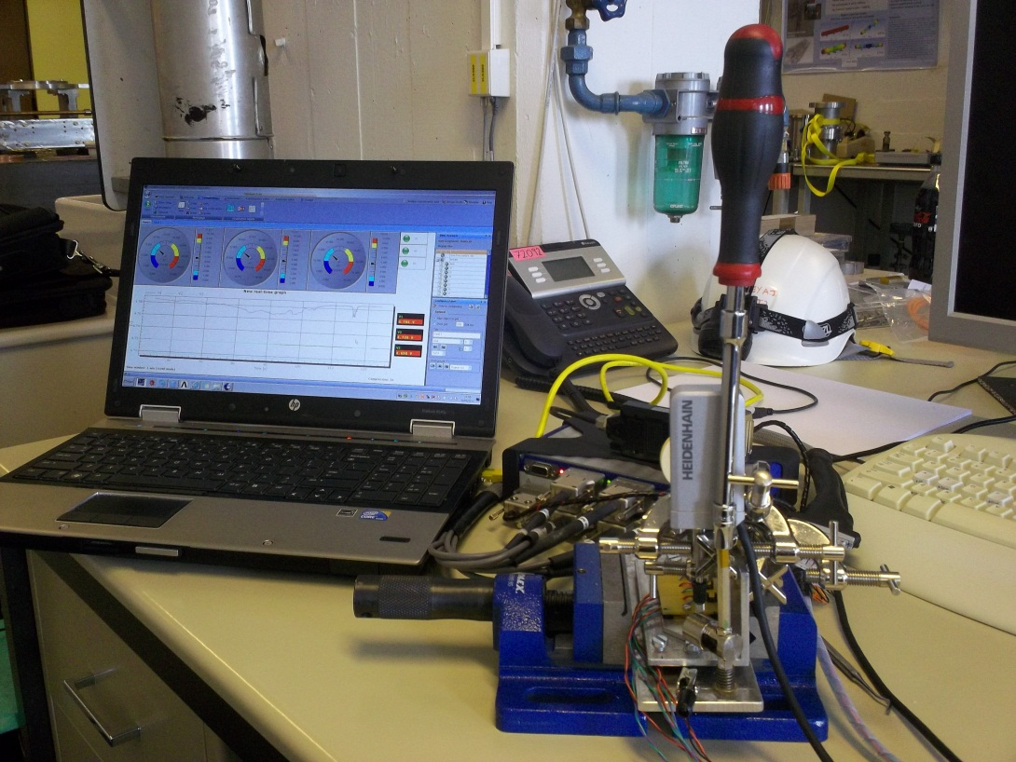
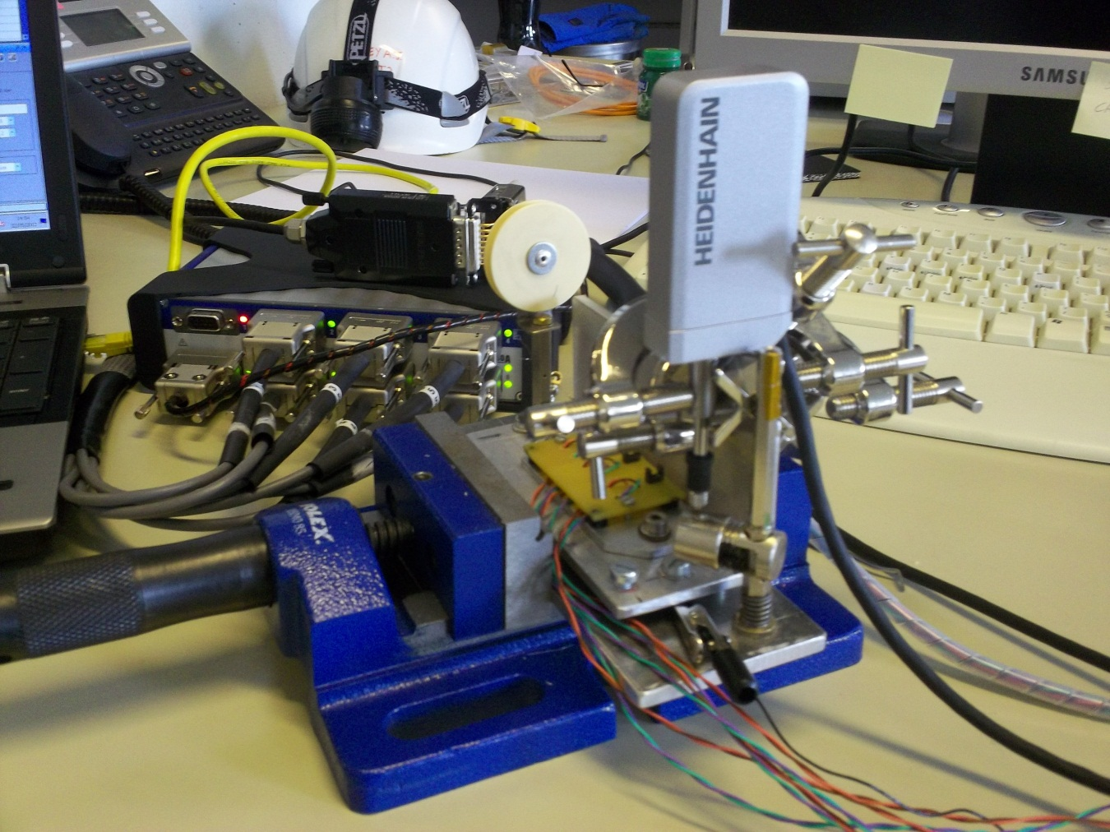
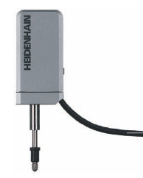
Calibration with a reference sensor
HEIDENHAIN-METRO
Length Gauges with ± 0.2 µm Accuracy
Courtesy of M. Guinchard
W. Zak TE-MSC-CMI
SLHiPP3 – Louvain-la-neuve 2013

Slide 16
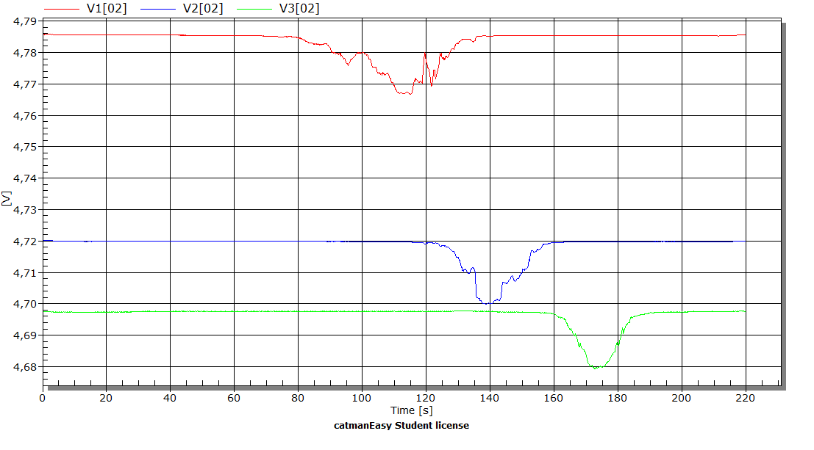
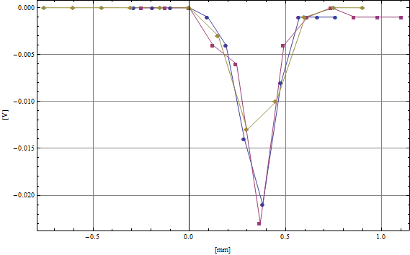
Functional tests
Courtesy of M. Guinchard
W. Zak TE-MSC-CMI
SLHiPP3 – Louvain-la-neuve 2013

Slide 17
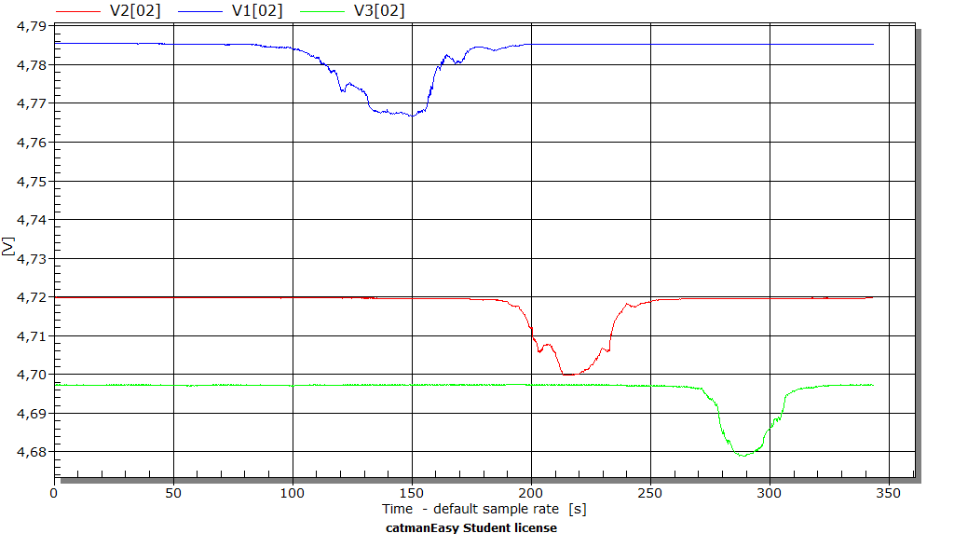
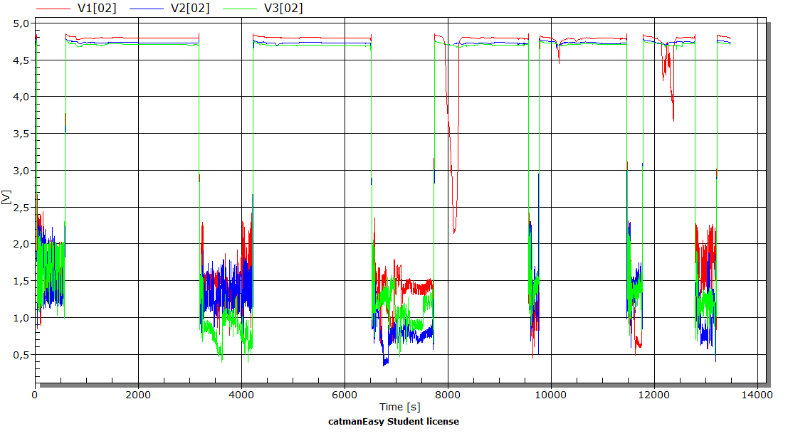
Functional tests at 77 K
Courtesy of M. Guinchard
1
2
3
4
5
6
1
2
3
5
6
4
W. Zak TE-MSC-CMI
SLHiPP3 – Louvain-la-neuve 2013

Slide 18
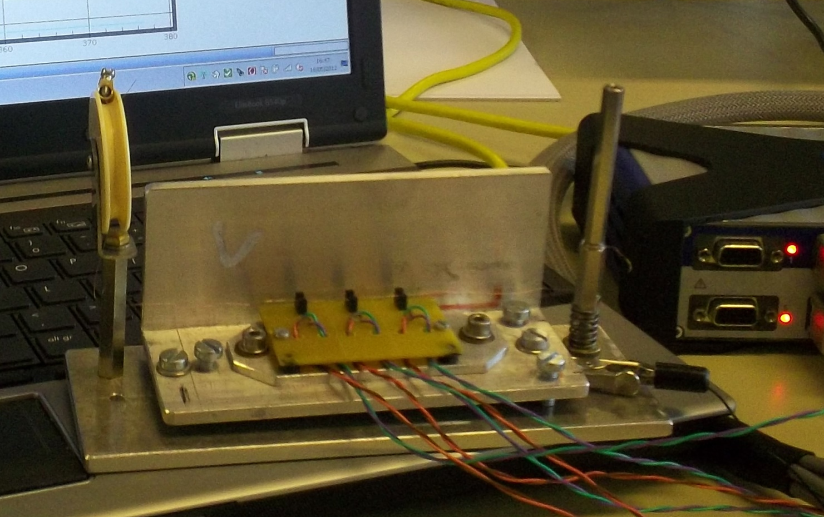
Functional tests at 77K
Courtesy of M. Guinchard
Deformations which can not be compensated for are:
support,
mounting system,
mounting bracket cable,
support of the thermal compensation circuit wire.
The last two elements are fundamentally changing the geometry of the system, making it impossible to make the validation of measurements
!
Thermal deformation measurement system are so large that finding the correctness or incorrectness of its operation is impossible.
W. Zak TE-MSC-CMI
SLHiPP3 – Louvain-la-neuve 2013

