Slide 1


Elliptical Cavity Cryomodule Technology Demonstrator (ECCTD) overview
2013 April, 17th
Christine Darve
704 MHz SRF LINAC Lead Engineer
and
WP5 (elliptical cavity) ESS liaison

Slide 2
Outlines
Main actors and parameters
Hardware development
ECCTD program
See related talks by
Gilles Olivier : "Engineering design of the ESS elliptical cryomodule”
Mamad Eshraqi:”ESS design options”
John Weisend: “ESS cryogenics”
Synergy with Spoke and SPL cryomodules:
Sebastien Bousson: ”Engineering design of the ESS spoke cryomodule”
Rossana Bonomi: “Status of the SPL short cryo-module development”
Notes:
one Unit=ECCTD

Slide 3
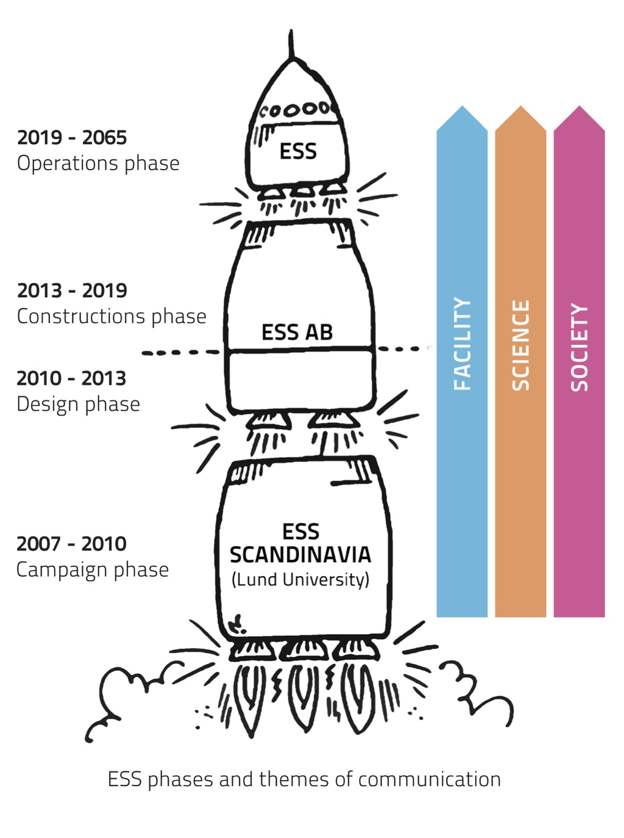
The ESS philosophy
Vision & Raison d’être: Science for Society
Mission:
  Design, construct and operate
  the worlds-leading neutron source
  Manage the company business
Core Values:
  Excellence; Openness; Sustainability
ESS philosophy:
  “Greenfield thinking on a greenfield site”
Goal: to deliver first neutrons before this decade is out
→ Goal oriented project
Notes:
Openness (emotional value)
- trust, transparency and adaptiveness
= successful innovation culture
Excellence (visionary value)
- elicit the very best that people have to give = world-class outcome of science and engineering

Slide 4
Pierre Bosland: WP5 leader
Christine Darve: ESS liaison
CEA/CNRS team
Cryostat
Design & Procurement
IPNO
G. Olivier
G. Devanz
Conception & simulation
J. Plouin
M. Desmons
G. Ferrand
RF engineering
M. Desmons
A. Hamdi
D. Roudier
E. Jacques
Tooling - Assembling
N. Bazin
Cavity
Tuner & Magn. shield
F. Peauger
Couplers
M. Luong
Chemical treatments and clean room preparation
  F. Eozénou
  C. Sevouin
  Y. Gasser
IPNO team
J.P. Thermeau
M. Pierens
SIS
Francoise Gougnaud
Vacuum
P. Carbonnier
Cryogenics
B. Renard
P. Sahuquet
D. Braud
ESS: Nuno Ellias, Anders Johansson, Miha Rescic, Garry Trahern, ICS, Cryo, vacuum, test stand, etc
WP4: Sebastien Bousson/ Steve Molloy
clean room
J.P. Poupeau
C. Servouin

Slide 5
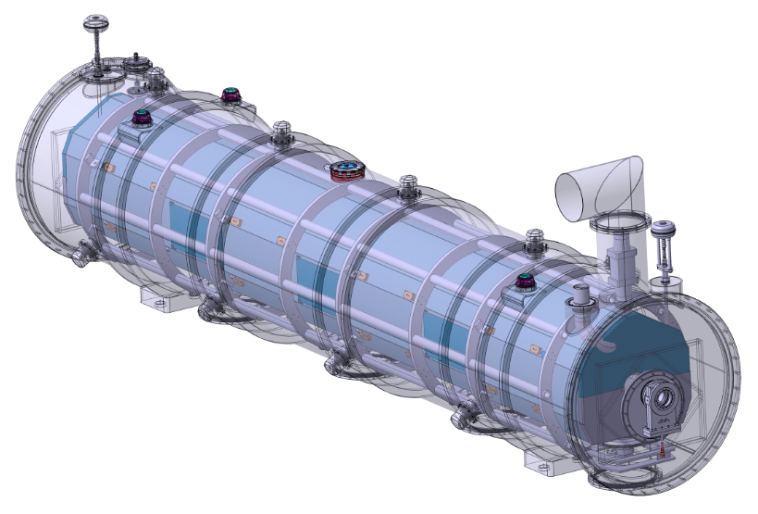
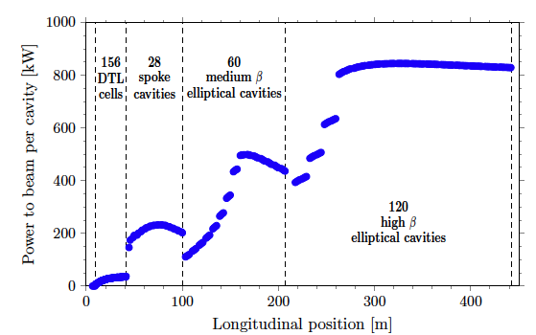
Cryomodule stakeholders - Interfaces
ESS lead engineers and work-package leaders
Cryomodule designers
Cavity package designers
Control command (Control Box, PLC, LLRF, MPS)
Instrumentation teams
Safety team
RF team
Component assembly teams
ESS system engineer, QA
Survey experts
Test stand service
Toolings
Transport
Conv. Fac.
Cryogenic distridution
Control system
Cryogenic distribution
Beam Diagnostic
Beam Optics
Beam Vacuum
October 2012 Baseline
Radio-frequency

Slide 6
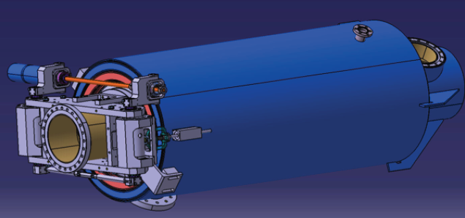
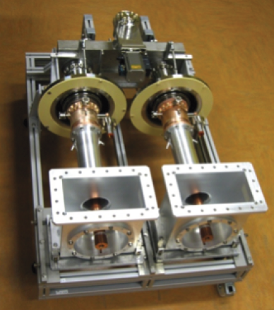
Elliptical cavities for ESS
(see Mamad Eshraqi’s talk)
P_{RF} max = 1.2 MW <= HIPPI power coupler
Piezo tuner <= Saclay V tuner (HIPPI / SPL tuner)
Titanium helium vessel (Thickness: 5 mm), Flanges material: NbTi
L_Pulse x rep rate = DC : 2.86 ms x 14 Hz = 4 %
5-cell high beta (0.86)
6-cell medium beta (0.67) [S. Molloy]
Mustang’s proposed parameters
  Power: 1 MW (2019),5 MW (2025),
  Peak surface field ⟶ 45 MV/m
  Energy ⟶ 2000 MeV ⇒ Current ⟶ 62.5 mA
Adapted
to ESS cavities

Slide 7

Cavity Cryomodule Technology Demonstrator
One full scale cell of 704 MHz high- and medium-beta cavity cryomodule
A staged approach towards the ESS Linac tunnel installation
Validate the RF, mechanical, thermal and vacuum design performances
Demonstrate the industrialization process by validating component life-cycles
Develop ESS 704 MHz SRF linac operating procedures
Validate control command strategy (Control box, PLC, EPICS, LLRF)
Test the ESS integration and interface with cryogenics, vacuum
Train and collaboration building
→ Similar process for the spoke cryomodules

Slide 8
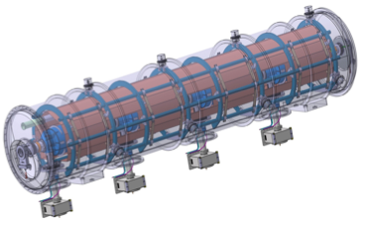
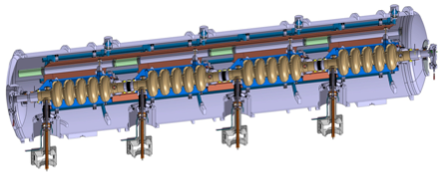
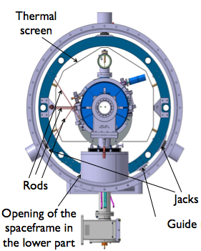
Elliptical cavity string and cryomodule package
Quantity as per October 2012 Baseline
Space-frame
  Elliptical Cavities Cryomodule Technology Demonstrator results by the end of 2015 → start pre-series
5-cell elliptical cavity
Helium tank
Power coupler and biais sys
Cold tuner
A uniform cryomodule package for the medium and high beta elliptical cavities
Notes:
Against multipacting – biais system
One modulator + 2 klystrons , possible IOT for HB

Slide 9
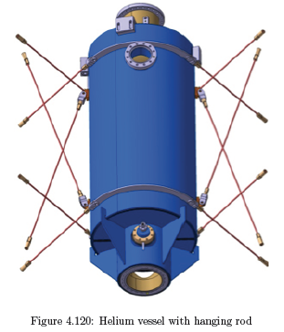
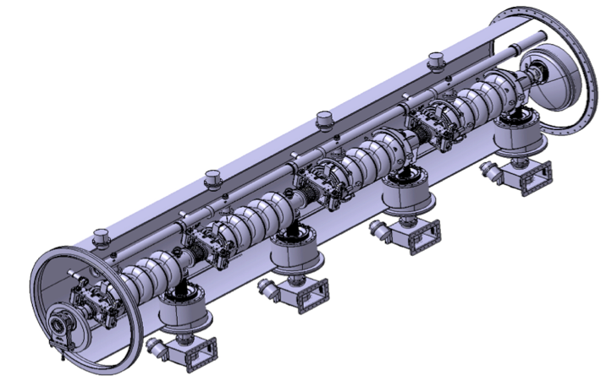
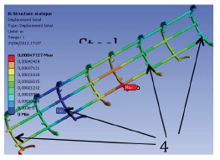
The 704 MHz cryomodule contains
(See Gilles Olivier’s talk)
  Four 704 MHz elliptical cavity helium tanks equipped
  with their fundamental power couplers and cold tuning systems
  The supporting and mechanical systems
  The vacuum vessel, thermal and magnetic shieldings
  to insulate the cavity packages from the ambient condition
  The cryogenic distribution (hydraulic circuits, jumper connection)
  to interface the cavity packages with the cryogenic valve box (CTL, cryoplant)
  The instrumentation, control equipment and the safety devices
  No HOM couplers !
Notes:
The supporting and mechanical systems : interface cavity packages in the test area than in the tunnel

Slide 10
Cryomodule instrumentation – detailed view
Instrumentation function
  Monitoring
  Control
  Interlock
  Alarms

Slide 11
ESS Cryomodule constraints and risks
Integrated hazards due to operating environment:
  Cryogenic temperature: 2 K (Helium II), cryogenic vessel, pressure vessel
  Sub atmospheric condition 31 mbar saturated, leak-tightness
  Magnetic environment (14 mGauss)
  Radiation environment (high intensity proton beam)
Main challenges:
  Cost reduction and Quantity
  Quality: science and innovative using SRF cavities
  Short time project scale
  Transfer technology to industry for industrialization series production

Slide 12
Standards and ESS Safety Culture
Engineering standards
CEN, European Committee for standardization
SIS, Swedish Standard Institute
ISO, International Organization for standardization
  → e.g. European Directive 97/23/CE; EN ISO 4126, PED
  ESS guidelines for pressure vessel modeled after FNAL, European and CERN expertise
Radio-Protection and Rad-hard equipment
As low as reasonable achievable (ALARA)
Passive and active safety measures (safety barrier)
Personnel Protection System, Machine Protection System (IEC61508)
  Risk analysis and reliability study
  Safety reviews
  Quality Assurance

Slide 13
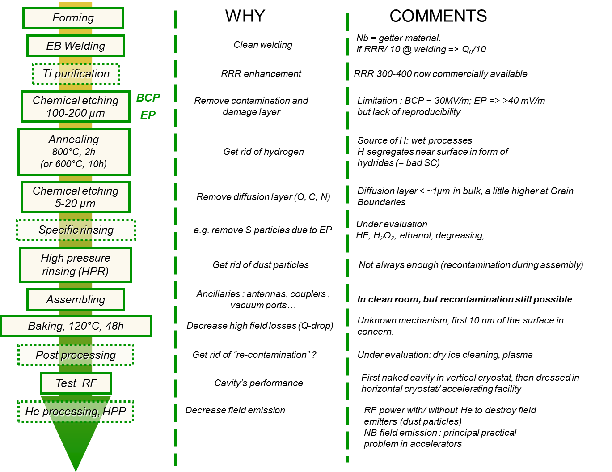
Cavities’ fabrication scheme
Courtesy of Claire Antoine/CEA
Notes:
Remove dust
Baking: shifts high field dissipation to higher field

Slide 14
Cavities’ fabrication scheme vs surface and material properties
Courtesy of Claire Antoine/CEA
Mechanical properties, grain size, strain hardening…
Purity issues
Surface composition and surface morphology
Surface composition
Surface cleanliness
Surface composition
Surface cleanliness
8/04/2013
Claire Antoine ESS Lund
| PAGE 14
Notes:
Against FE
Thermal break down
High field dissipations
Surface resistance
High RRR not required for superconductivity
But for thermal stabilization of defects

Slide 15
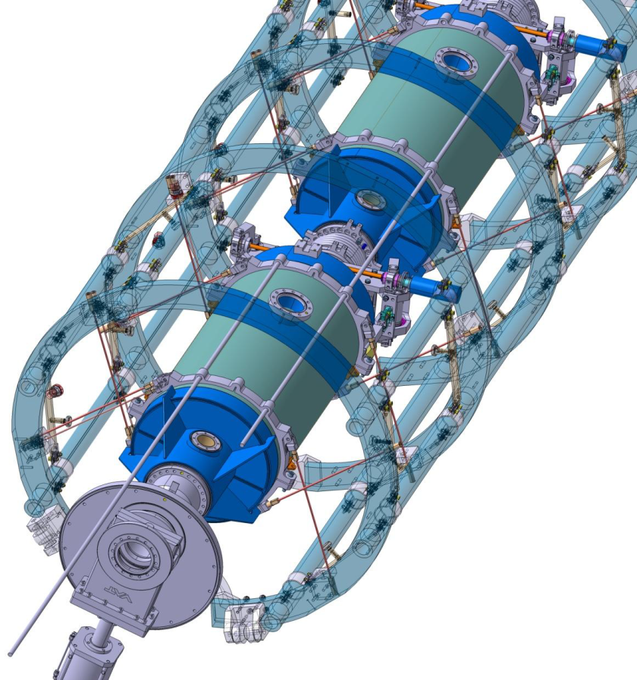

Courtesy of Pierre Bosland/CEA
Cavity fabrication
High pressure rinsing
In clean room (ISO5 or ISO4)
Chemical treatment
Transport
Validation test of the cavity in vertical cryostat
Cryomodule components fabrication
Cryomodule reception and storage
Qualified cavity storage
Cavity string assembling in clean room
Cryomodule assembling
Validation test of the cryomodule
Processed couplers storage
Tools fabrication
Cryomodule storage
Coupler RF processing
Space frame
Tuning system
Assembling in clean room
Magnetic shield
Cryomodule on beam line
TA6V rods in X pattern to keep the beam axis at the same position during cool down
Power coupler fabrication
Beam valves and extremity flange
Notes:
Mechanical – Lorenz force detuning
RF –
QA contol

Slide 16
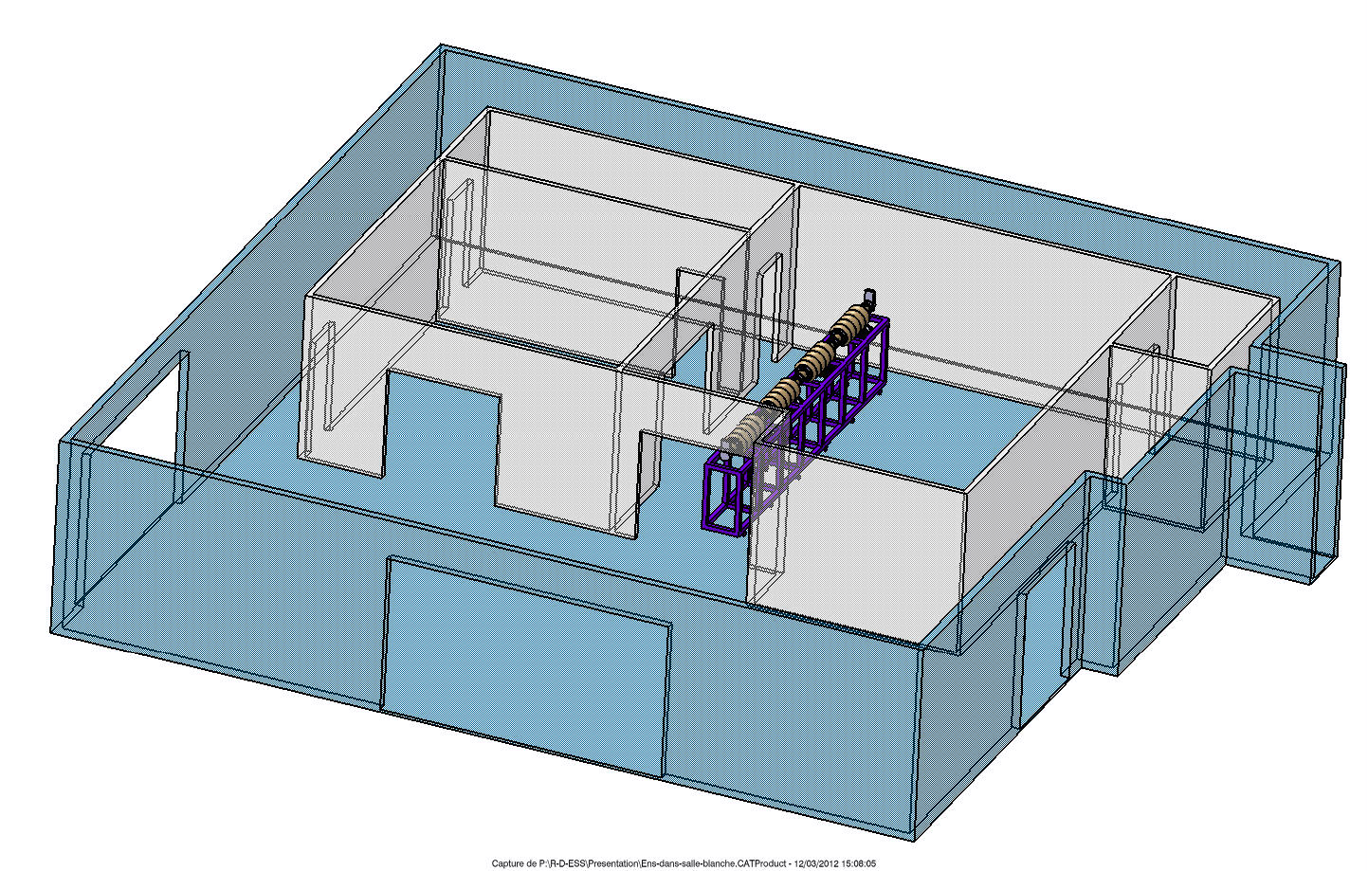
The CEA ISO 5 new clean room
Availability of the clean room: June 2013
IS0 7
26,1 m²
Water cleaning
High Pressure Rinsing
HPR
IS0 5
51,85 m²
➔ Development of the cryogenics and RF bunker to test the final ECCTD @ CEA Saclay
Additional implementation
ESS tunnel valve box
ESS tunnel control system

Slide 17
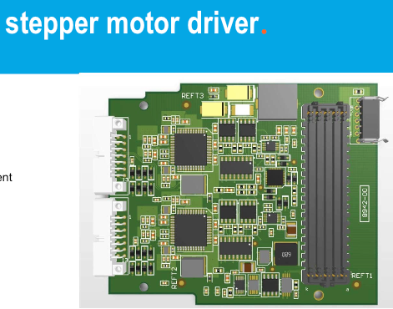
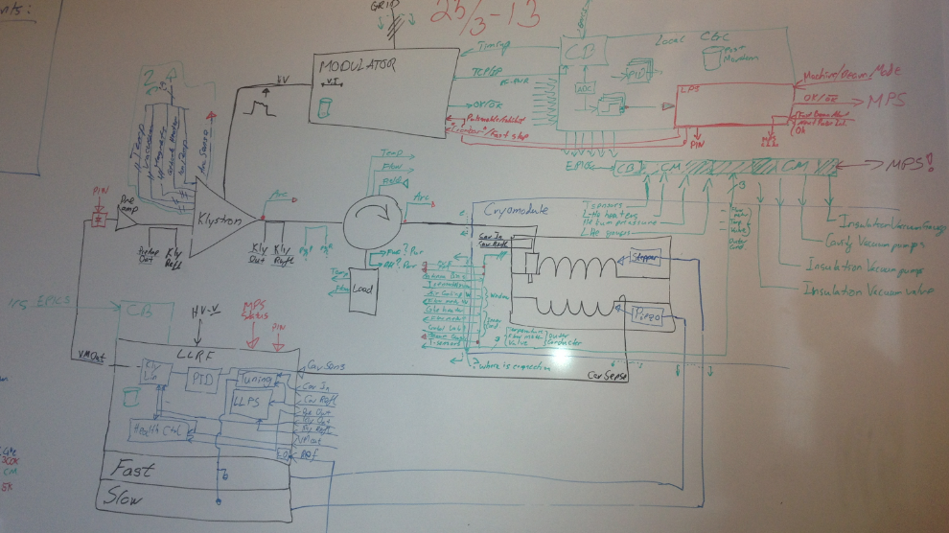
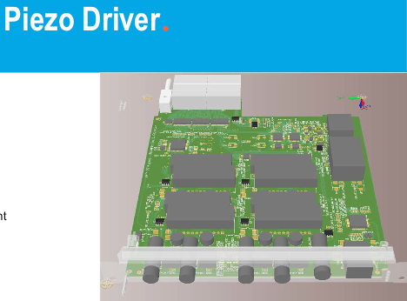
ESS Linac control system and PLC
In the framework of the ECCTD project, a ESS general control system shall be developed between CEA and ESS expertise
Aim to extrapolate the same system to the ESS linac tunnel control system
Propose a common architecture

Slide 18
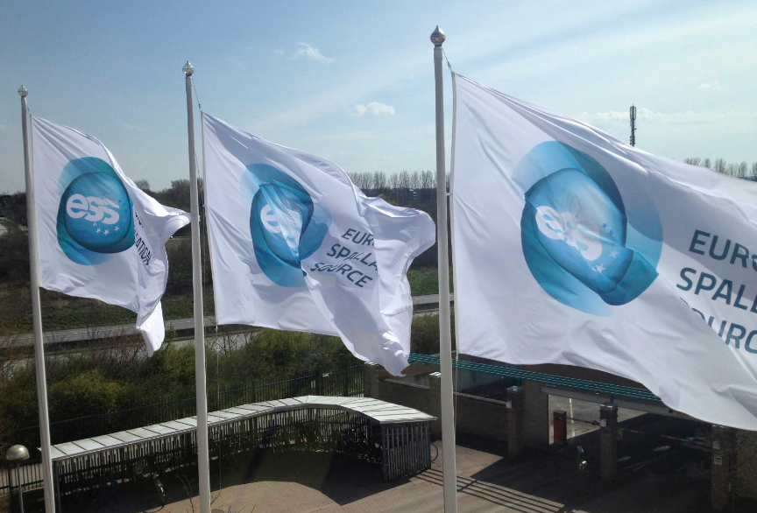
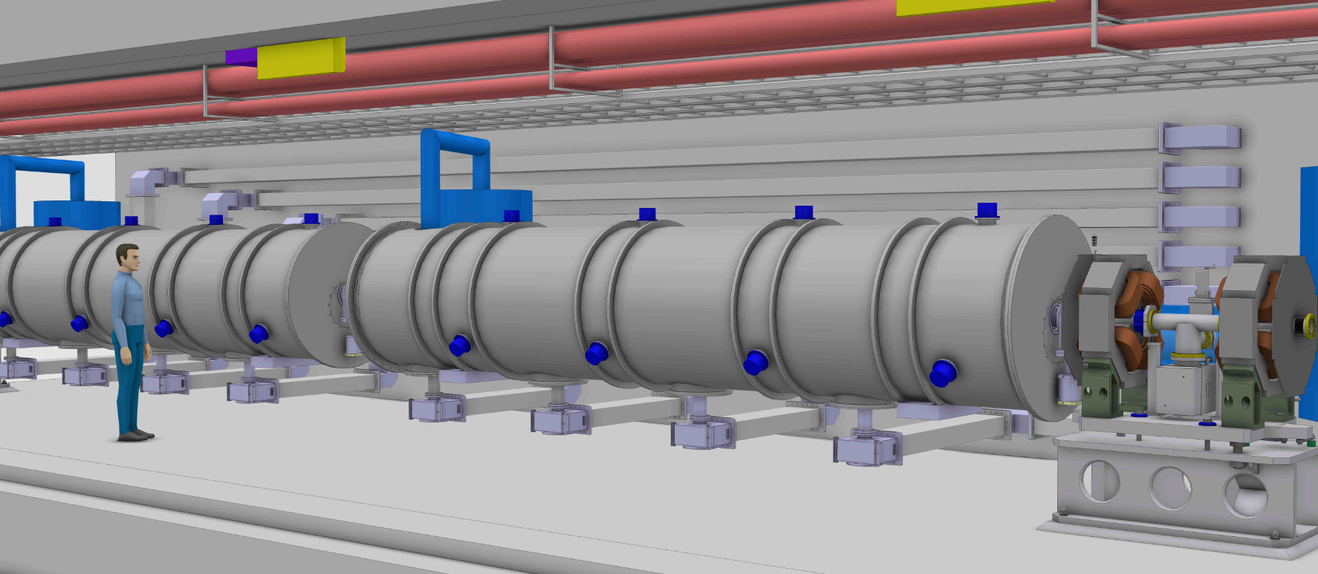
Conclusion
The ECCTD to validate the elliptical cavity components and beyond…
… thanks to the expertise of worldwide collaborations

