Slide 1
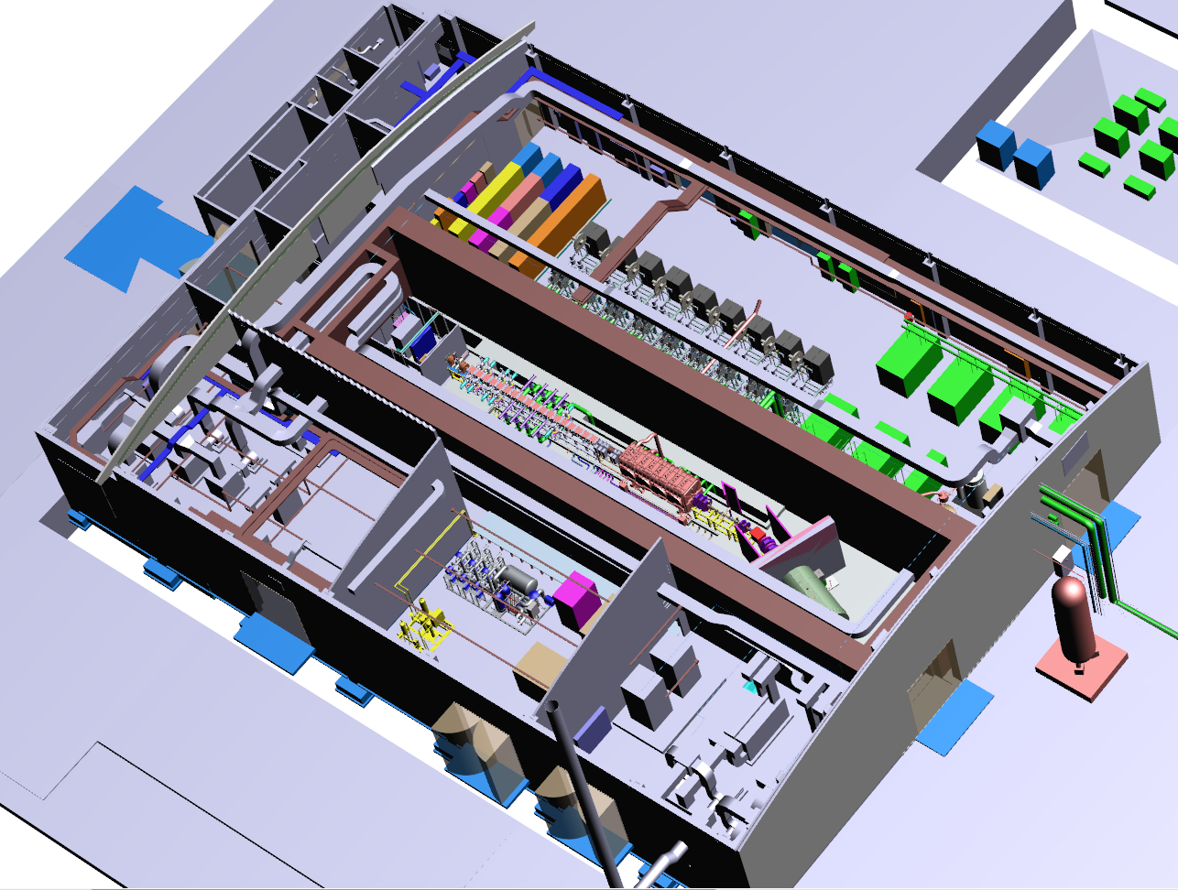
LIPAc status & design
Linear IFMIF Prototype Accelerator (LIPAc)

Slide 2
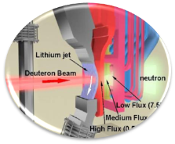



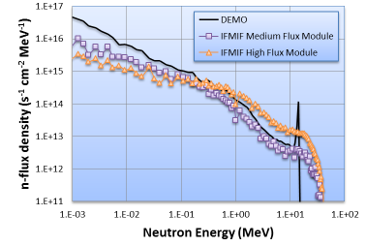
IFMIF & LIPAc objectives
aims at generating materials irradiation test data for DEMO and future fusion power plants
based on an accelerator-driven, D-Li neutron source to produce high energy neutrons
at sufficient intensity and irradiation volume
High >20 dpa/an 0.5 L
Medium > 1 dpa/an 6 L
Low < 1 dpa/an 8 L
Deuteron source
140 mA, 100 keV
SRF Linac 40 MeV
(Half Wave Resonators)
Lithium Target
25 mm thick
15 m/s
Test Cells
RFQ 5 MeV
2 accelerators, 2 x 125 mA, 2 x 5MW
Beam shape
200 x 50 mm²
Total neutron flux ∼ 10¹⁸ n/m²/s
with a broad energy peak near 14 MeV
LIPAc = prototype for IFMIF
includes all critical accelerator components
to be tested at nominal beam current at BA site

Slide 3
Procurement sharing
System | Coordinating | Contributing
Injector | CEA
RFQ | INFN-LNL
MEBT | CIEMAT
Cryomodule | CEA | CIEMAT
HEBT & Beam Dump | CIEMAT
RF Power System | CIEMAT | CEA / SCK•CEN
Cryogenic Plant | CEA
Beam Diagnostics | CEA | CIEMAT
Local Control System | CEA | CIEMAT / INFN
Conventional Facilities | JAEA
Central Control System | JAEA
RFQ couplers | JAEA
Components of the prototype accelerator provided by European Institutions
(design, construction, acceptance tests)
Infrastructure (building, auxiliaries, etc) provided by JAEA

Slide 4
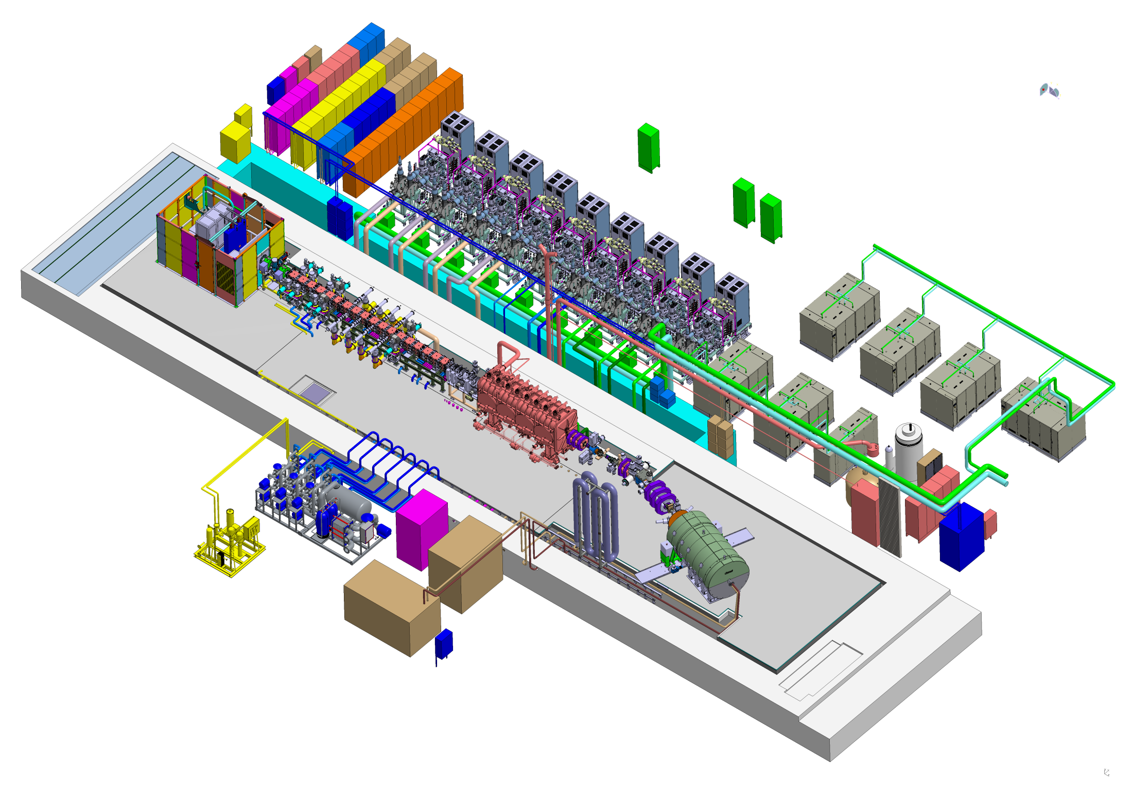
accelerator components mockup
RF System 18 RF chains
Injector
100 kV
RFQ & MEBT
5 MeV
Cryomodule
9 MeV
HEBT & Beam Dump
Cryogenic plant
125 mA 9 MeV deuteron beam (1.125 MW)

Slide 5
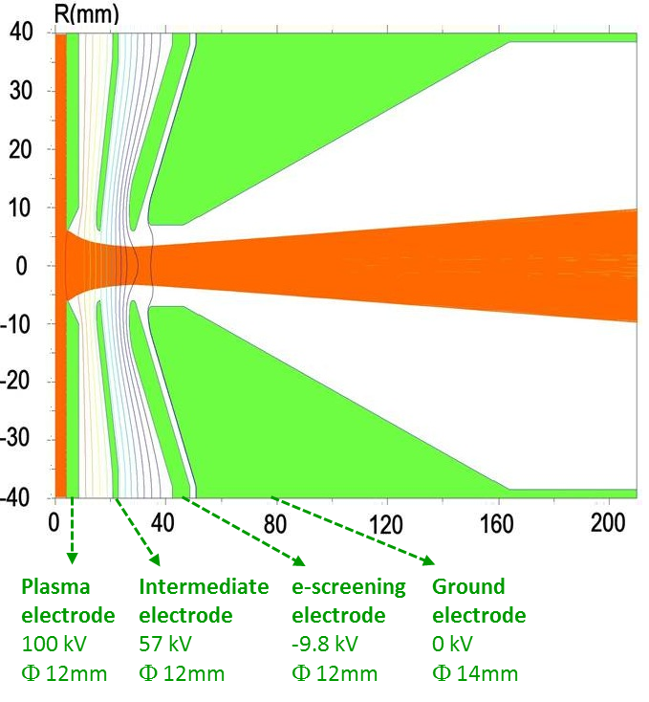
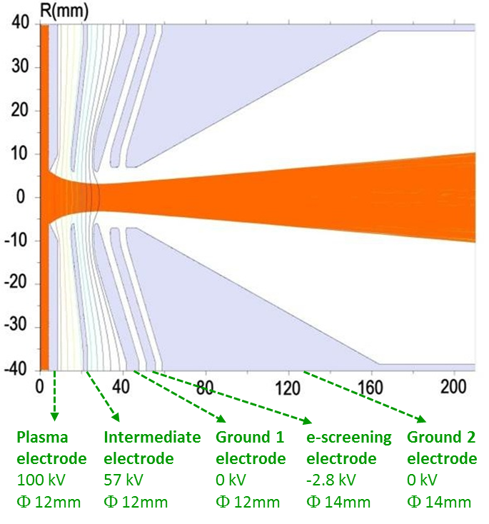
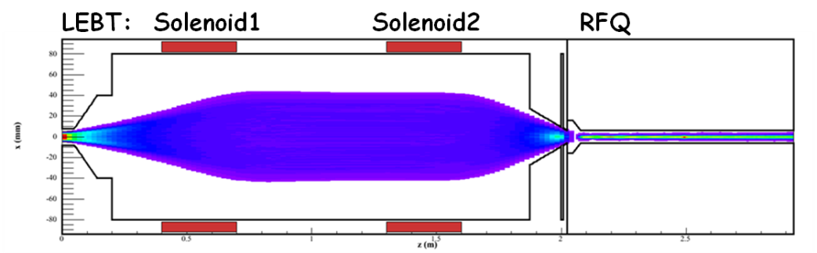
Low energy < 5 MeV
Injector (Ion source, LEBT) beam dynamics
CEA
ECR ion source
Extraction: 140 mA D+ ⇒ 175 mA total (80% D⁺, 15% D₂⁺, 5% D₃⁺)
New 5-electrode extraction system
after sparking issues at 100 kV
Initial 4-electrode extraction system
LEBT no beam loss, optimum injection into RFQ
high level of space charge compensation all along the LEBT line
to meet the requirements: emittance (0.25 π mm mrad) + RFQ matching
injection of specific gas in HEBT (krypton ∼ 4.10⁻⁵ hPa) predicted by calculations
HV electrode in front of the RFQ to trap the electrons (e-repeller)

Slide 6
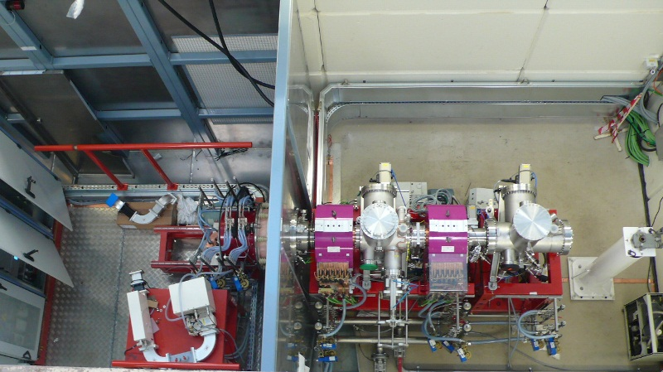
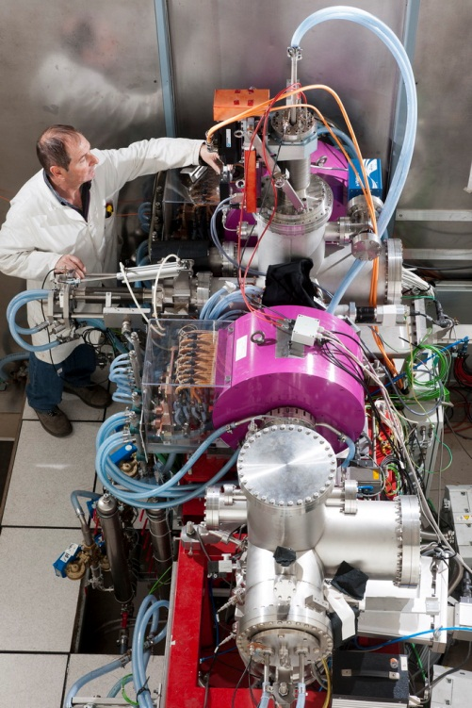
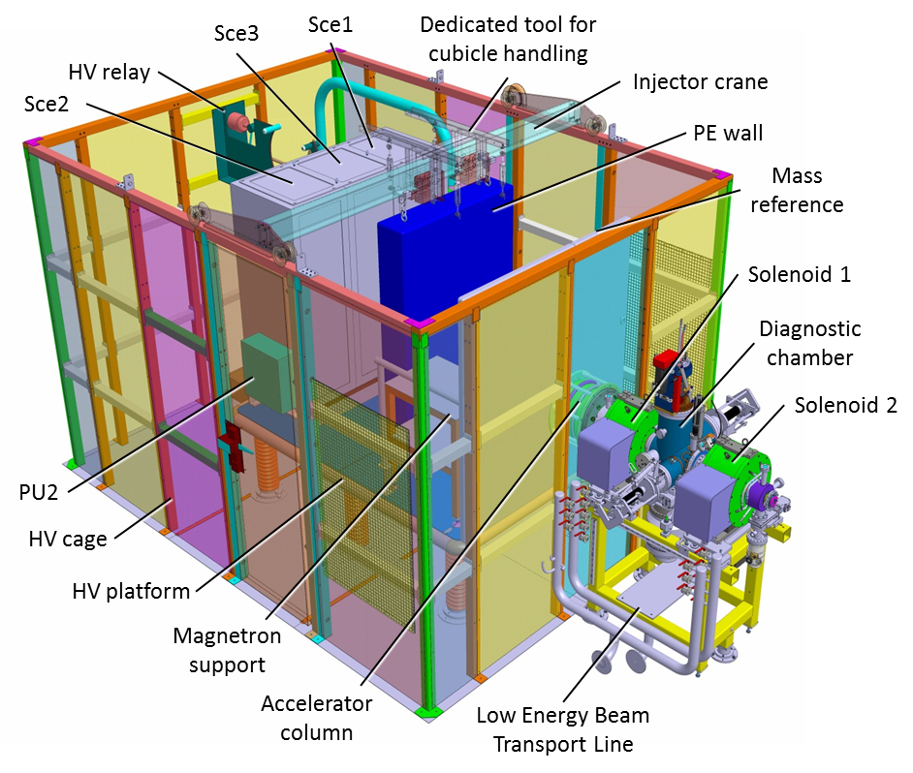
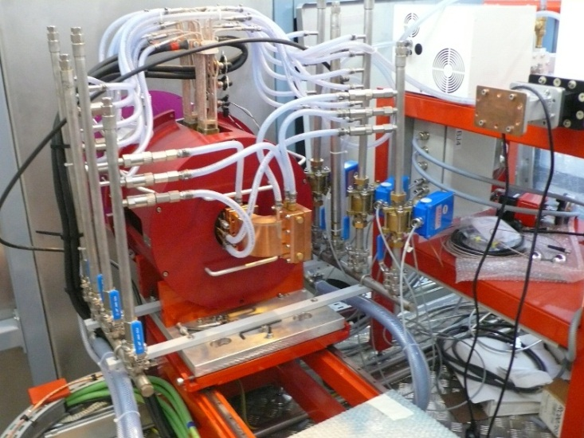
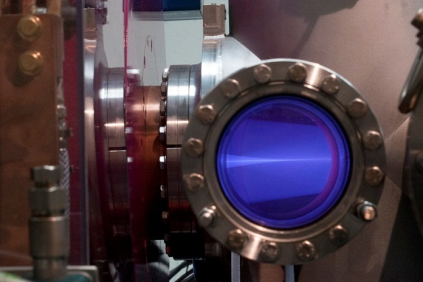
Injector
Injector at CEA-Saclay
Equipped LEBT
Ion source on HV platform
View-port after 1st solenoid

Slide 7
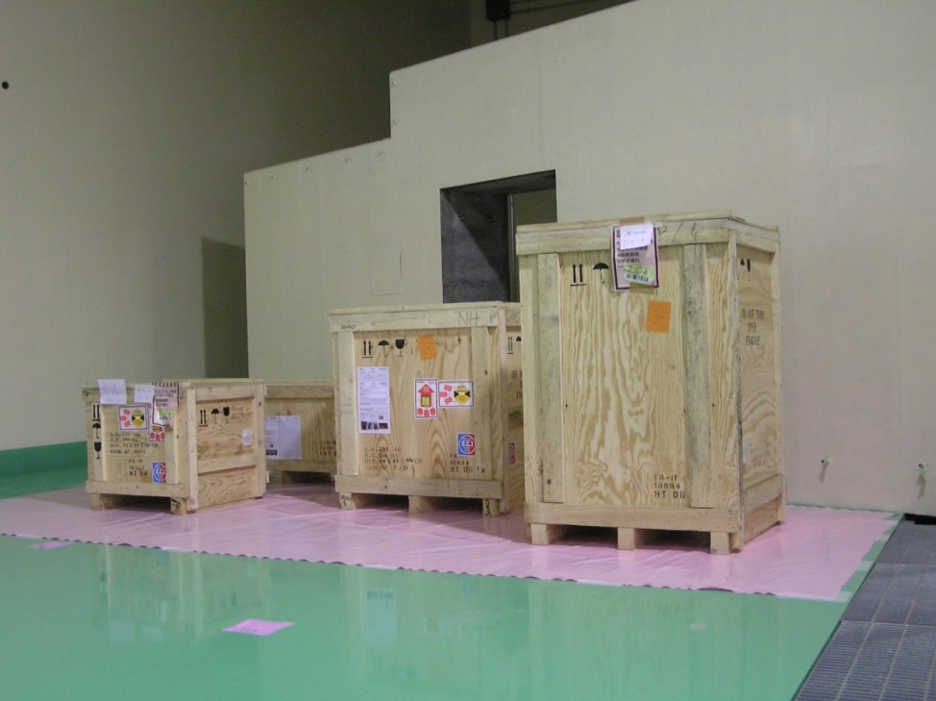
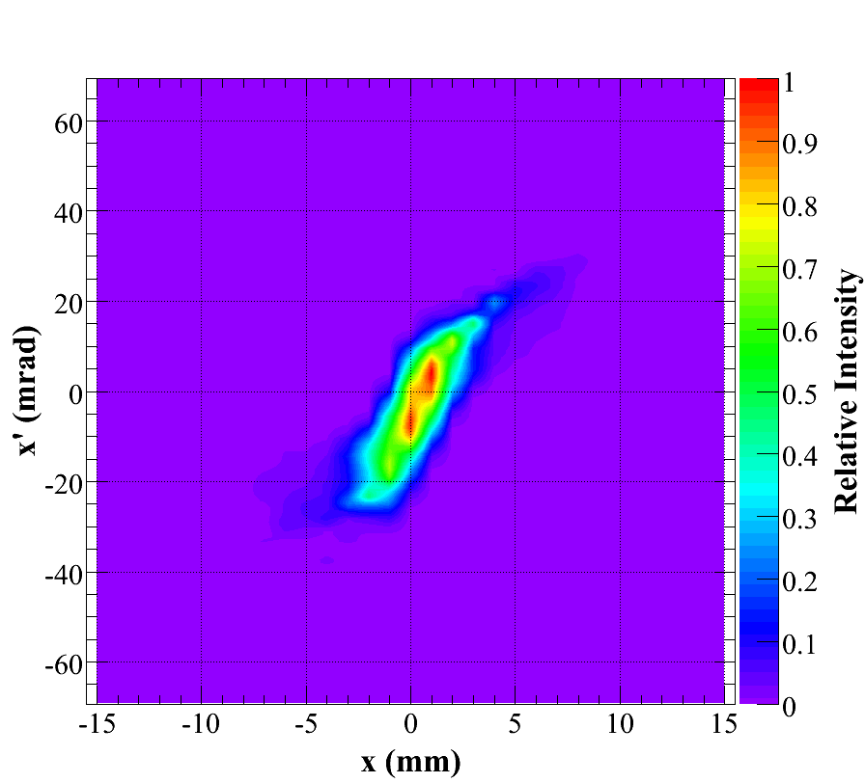

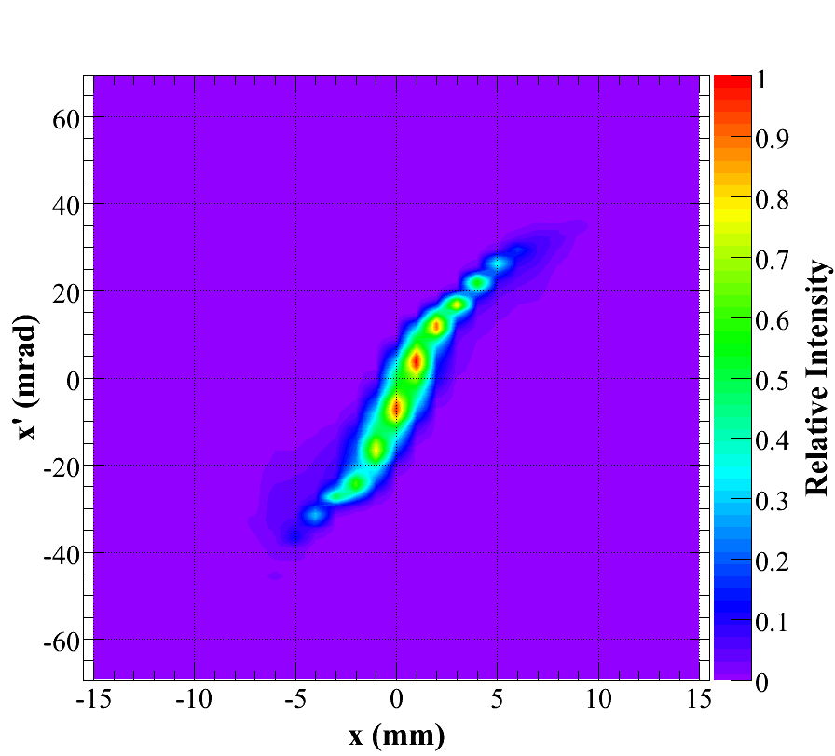
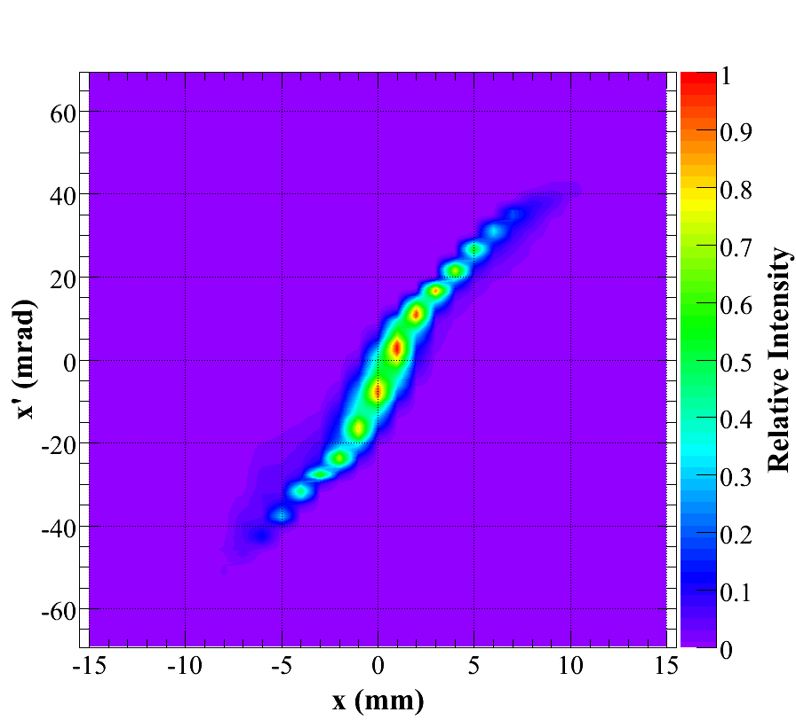
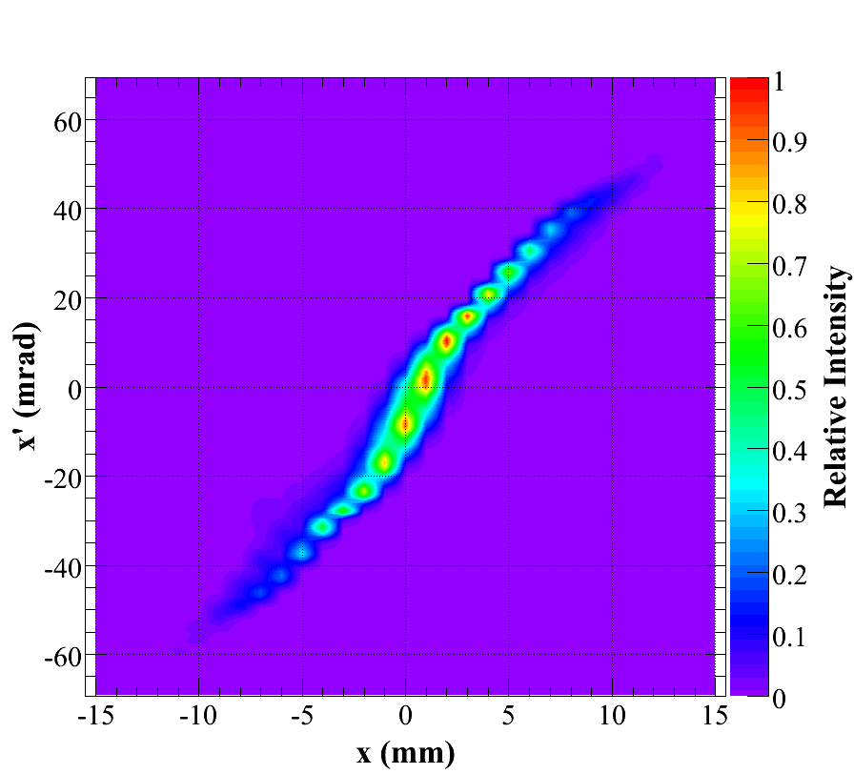
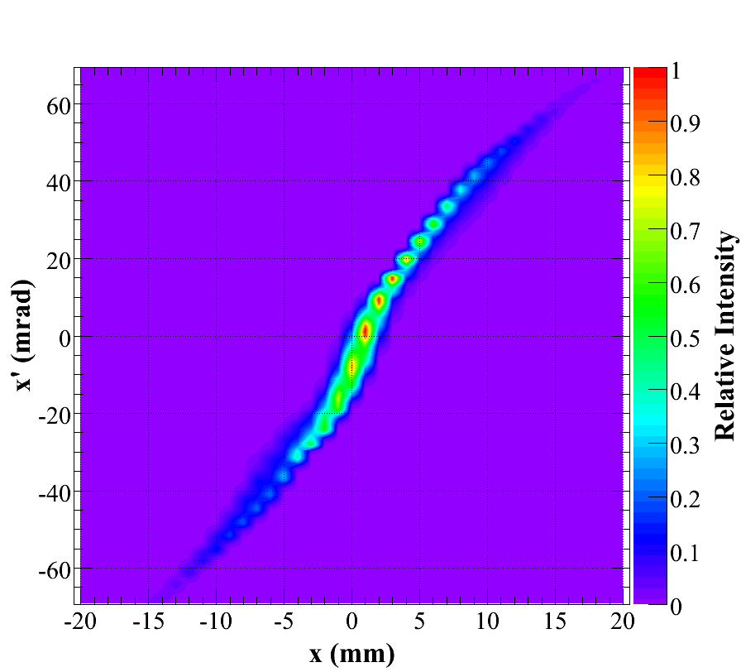
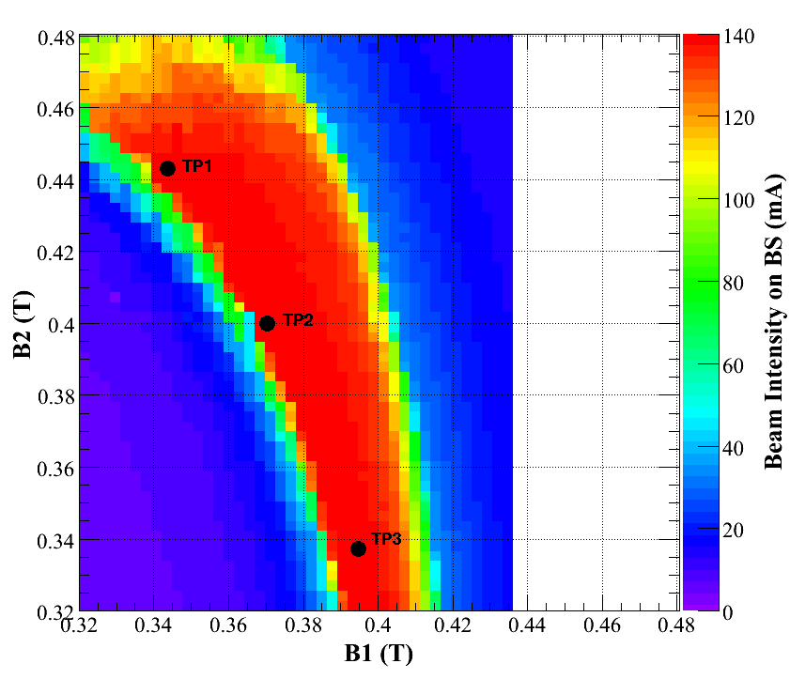
Injector D⁺ beam tests
Injector meets the specifications at low duty cycle
No showstopper to reach the specifications with continuous beam
emittance measurement at high duty cycle to be improved
Injector arrived at Rokkasho
end of March 2013
100 mA 0.14 π
110 mA 0.15 π
120 mA 0.16 π
130 mA 0.17 π
140 mA 0.20 π
Emittance evolution with beam current
10% duty cycle
From 100mA to 150mA
150 mA 0.26 π
Optimal tuning for emittance coincides
with correct matching to RFQ (lowB)

Slide 8
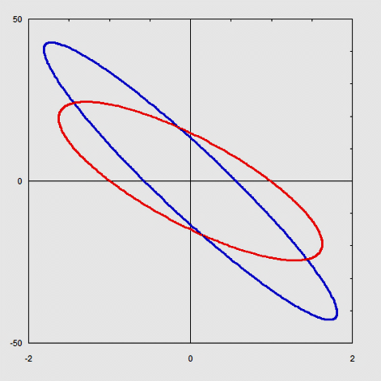
RFQ design
  Main parameters selected
  Increasing voltage
  following an analytic law
Strong focusing (B=7)
to keep the tune depression > 0.4
for better control of space charge
Min. beam loss & main resonances avoided in the accelerator section
modulation
Voltage/100 (kV)
B
Av. aperture (cm)
Small aperture (cm)
This design allowed to obtain
a good transmission with good margin
But a lower focusing parameter B at the RFQ entrance will make easier the beam injection from the LEBT (less demanding for the solenoids)
Shaper GB Accelerator
43 mrad
X'
Convergent beam
at the RFQ input
A low-B RFQ studied and adopted
24 mrad
X
Studies of the transmission of the couple LEBT+RFQ showed a more comfortable tunable range

Slide 9
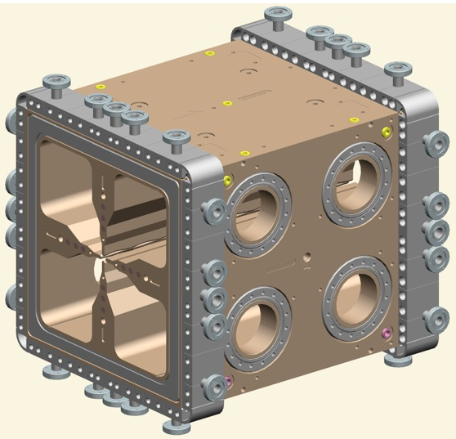
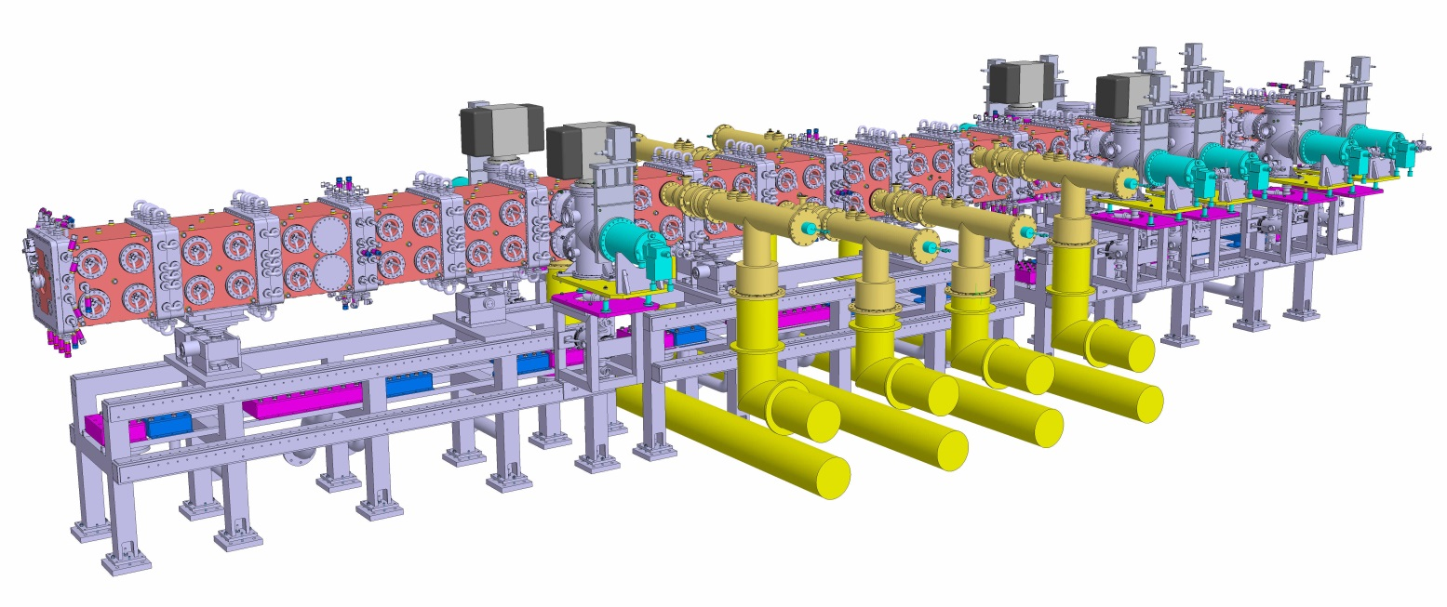
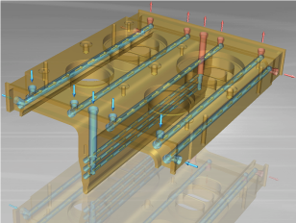
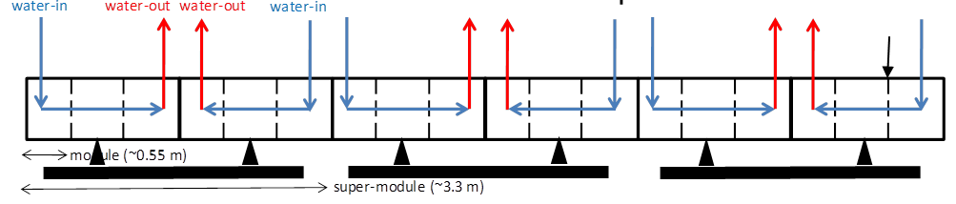
RFQ technology
18 Cu modules ∼10 m 10 cryo-pumps
22 slug tuners/quadrant 8 couplers
INFN
cryo pumps
RF couplers
Cooling system ∼ 600 kW RF power
28 channels longitudinally drilled along the RFQ modules
3 independent circuits for frequency tuning & field profile control

Slide 10
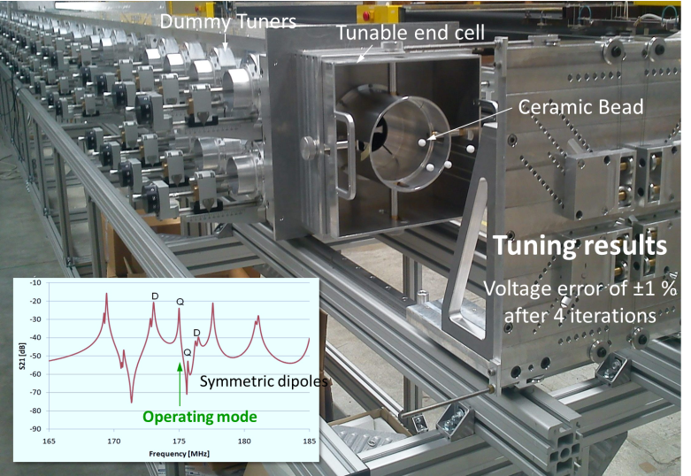
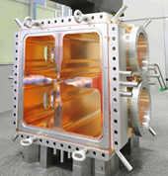
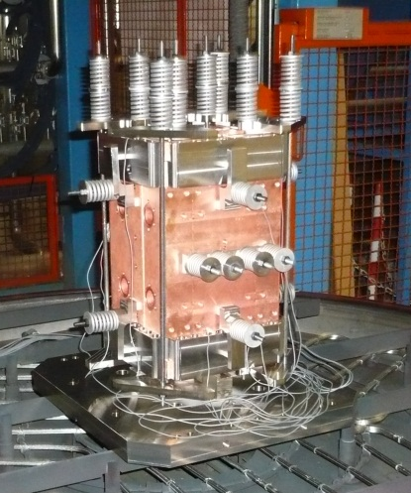
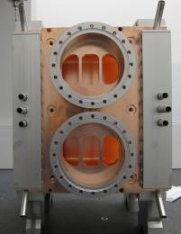
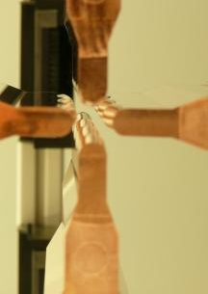
RFQ technology
Full scale Al mockup to validate tuning procedure & mode stabilization by means of beadpull measurements
technological prototype machined at INFN and local industries, brazed at CERN
2 prototypes scale ½
brazed in 1 single step
Vacuum ports
Skid prototype
Vanes

Slide 11
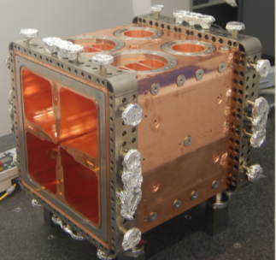
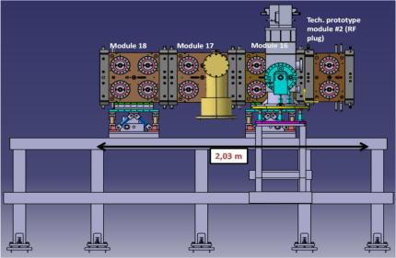
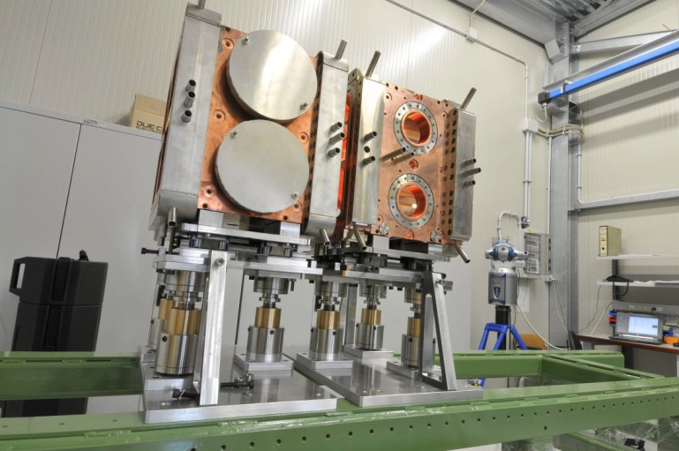
RFQ fabrication and tests
Fabrication tolerance
target = 50 μm acceptance criteria = 100 μm
1st module : 100 μm max deformation measured
2nd module : -25 μm 1st brazing +13 μm 2nd brazing
3 modules (plus RF plug) completed for high power tests at Legnaro in July 2013
module #16 (High Energy SM)
machined & brazed

Slide 12
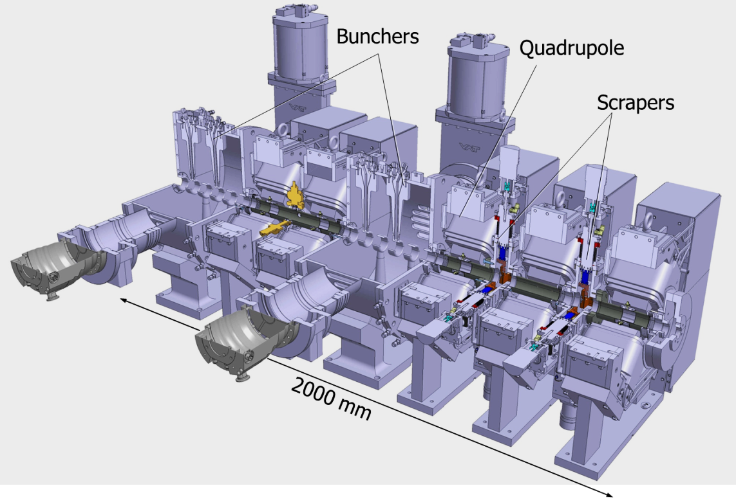
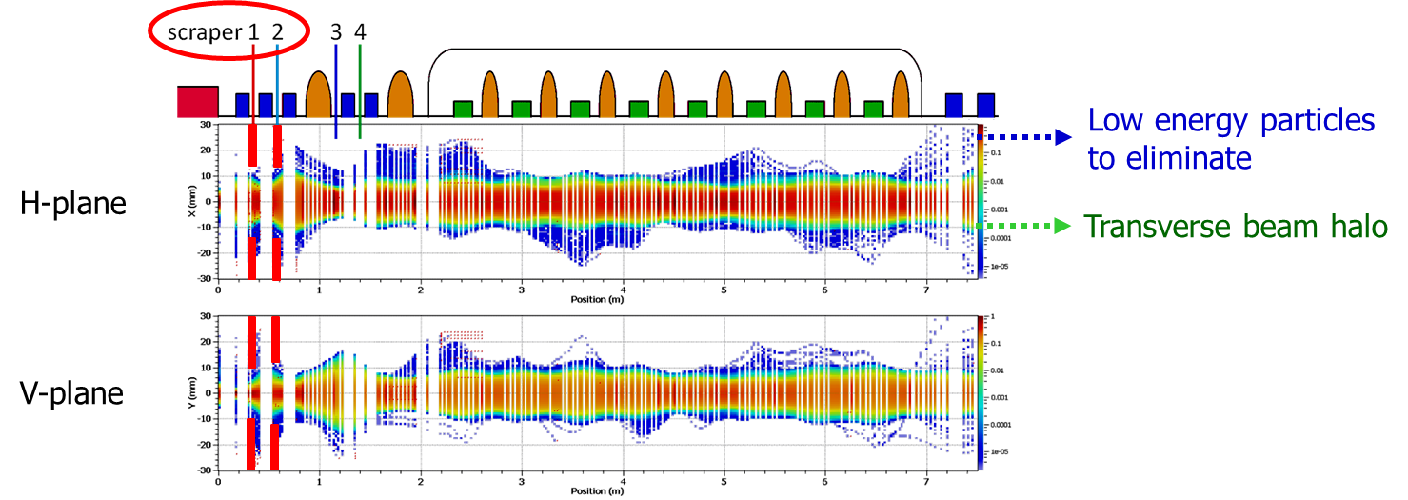
MEBT design & beam dynamics
CIEMAT
very compact ∼ 2 m, many components
5 quadrupoles & steering coils
2 bunchers, 2 movable scrapers
BPMs (in the center of quads)
turbomolecular pumps on bunchers
(1300 l/s /buncher)
Scrapers: to clean the beam from transverse halo and off-momentum particles (non-accelerated in the RFQ) before the SRF Linac
designed for 500 W beam power deposition
beam dynamics prediction < 10 W

Slide 13
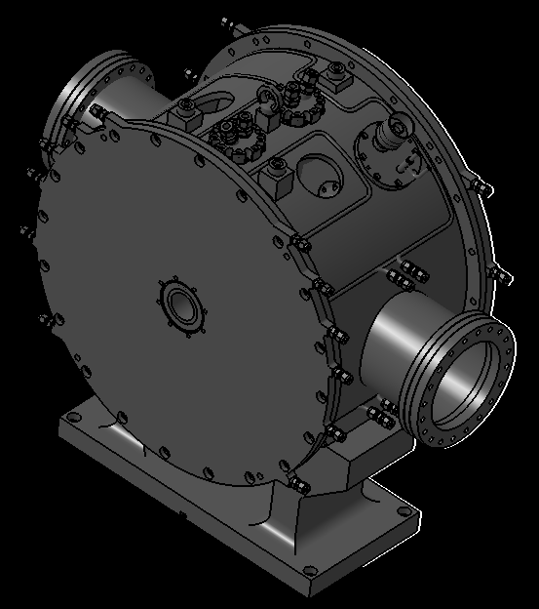
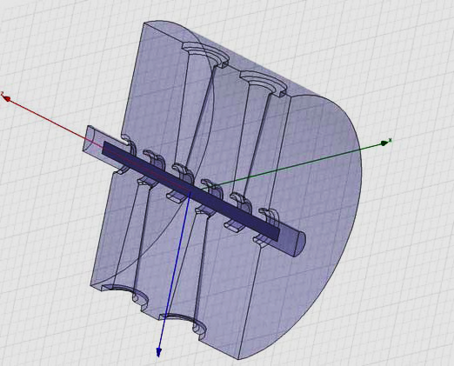
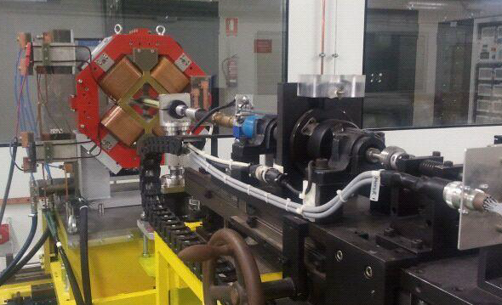
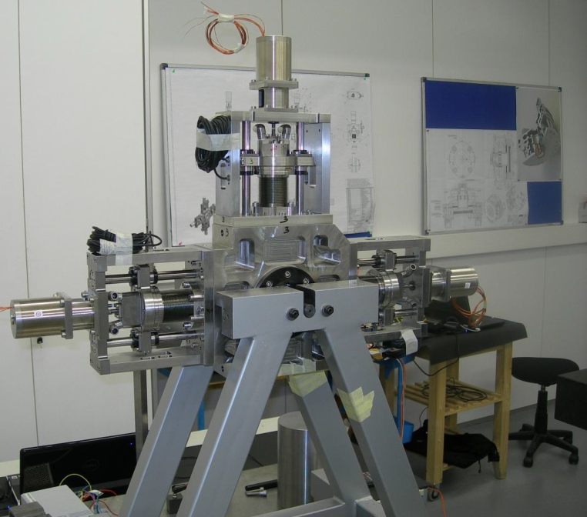
Medium Energy Beam Transport
MEBT
Bunchers: 5-gap IH structure
Start of manufacturing in Dec-2012
Power tests planned in Aug-2013
Voltage EoLT = 350 kV
Cavity length < 350 mm
CW & pulsed mode operation
Quadrupole: prototype completed
validated on a magnetic test bench
Scraper: manufacturing completed,
assembly & tests finished end March 2013
courtesy of AVS
Magnetic test at ALBA/CELLS

Slide 14
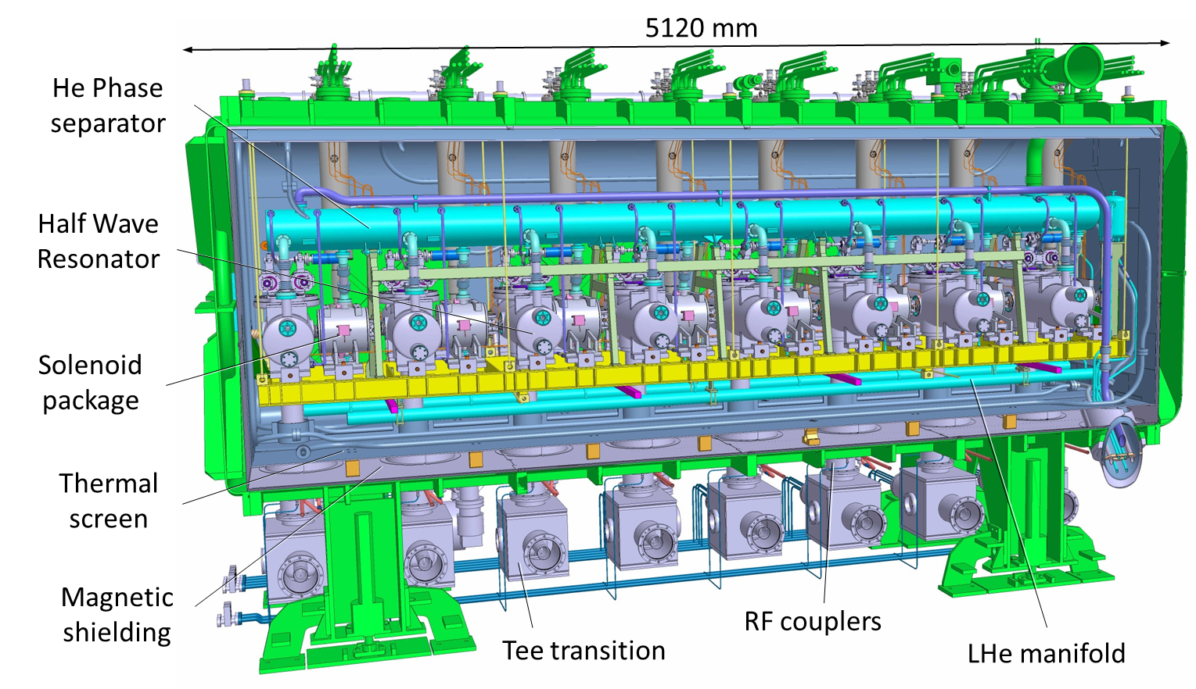
SRF Linac
Cryomodule
CEA (coord) CIEMAT
8 resonators (β=0.094)
Tuning system
Coaxial coupler
8 solenoid packages
SC magnet (6 T)
Steerers and BPM

Slide 15
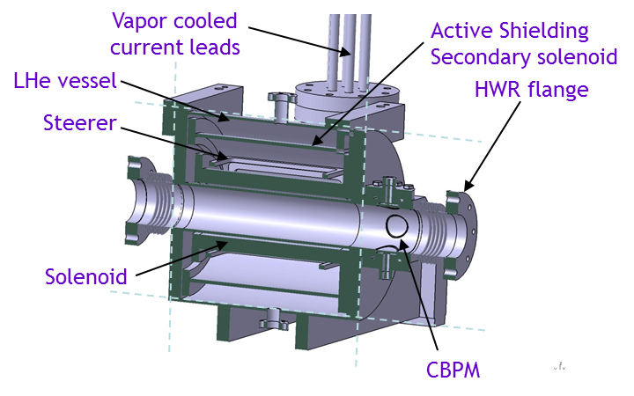
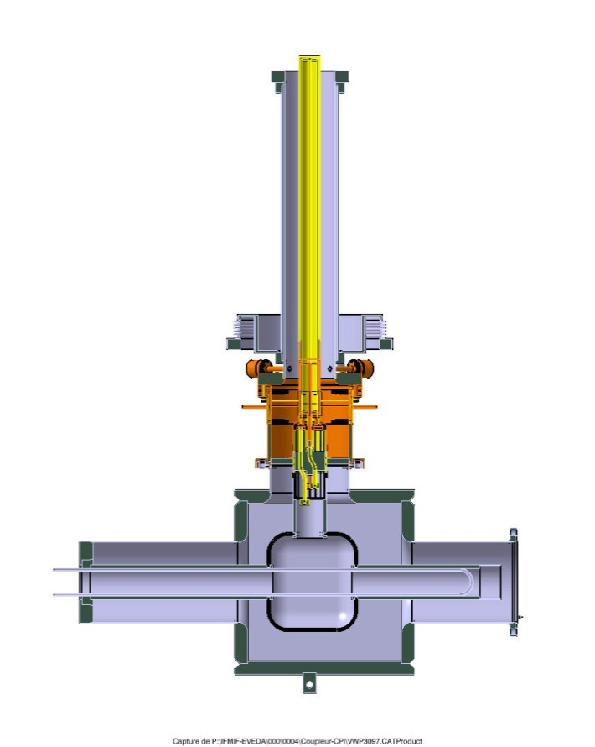
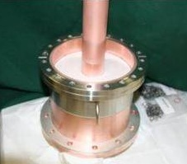
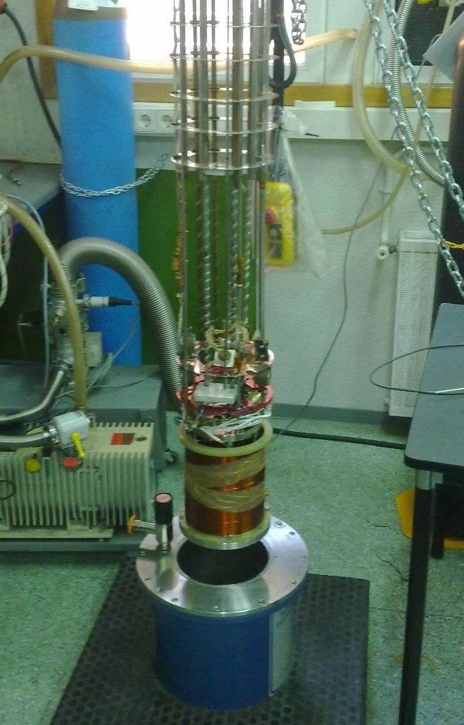
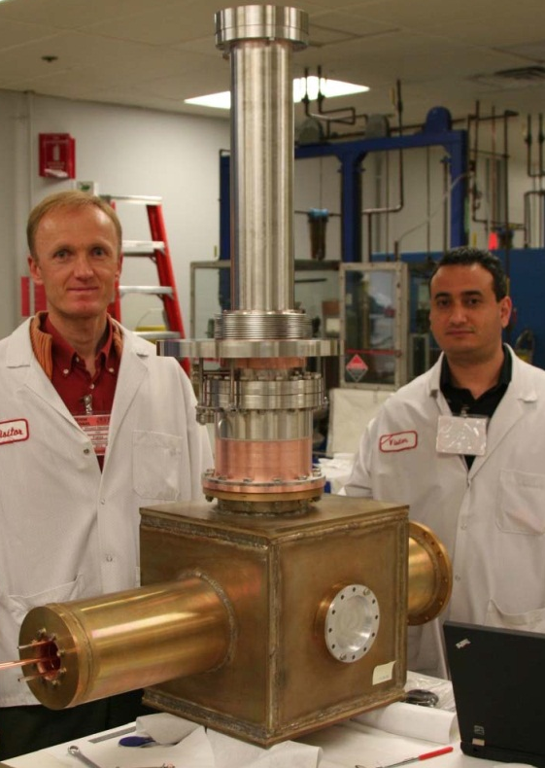
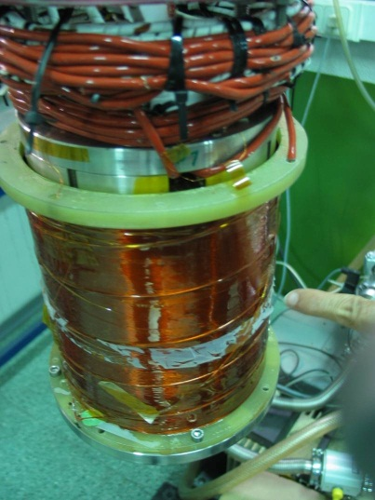
Solenoid package
Solenoid and Coupler
2 prototypes completed, tested when RF power
Source and test-bench will be available (April 2013)
4 K, vacuum
Antenna
water-cooled
Outer conductor GHe
Connection bellows with vacuum tank
Tee Transition
water-cooled
300 K, P_{atm}
Cold tests @4.2 K Quench at ∼260 A (210 A nominal)
Checked with steering coils
Test in horizontal position planned in Dec-2012

Slide 16
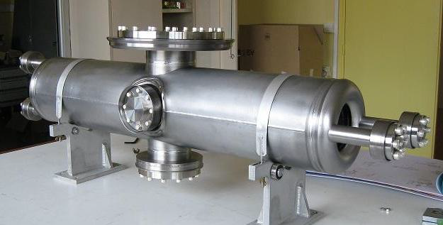
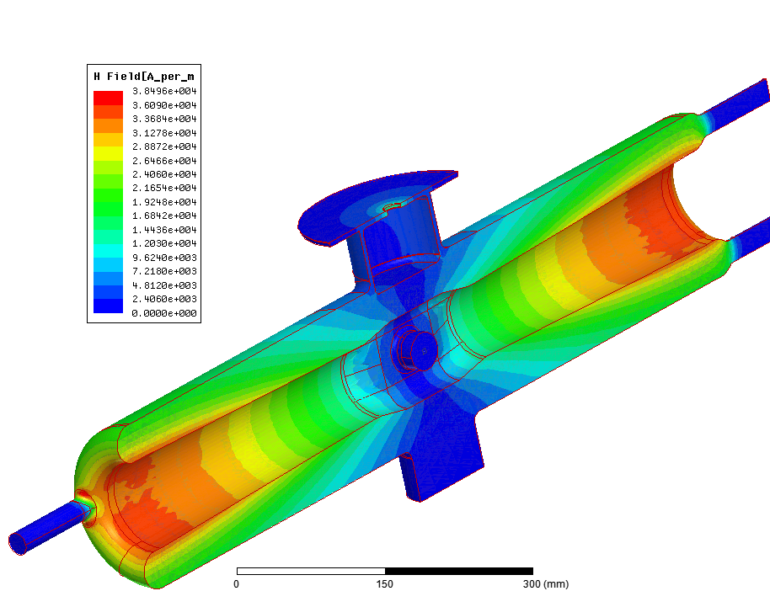
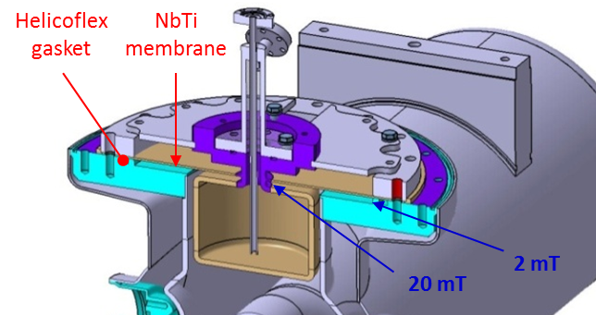
Superconducting Cavities
Two cavity prototypes completed in Summer 2010, delivered in Sept'10
Original tuner design: relied on a capacitive plunger with a large membrane to allow an elastic deformation of ±1 mm
First troubles during cryogenic tests reported in May 2011
A0 plunger design
Potential risks
high peak magnetic field at membrane center
Helicoflex gasket in region of significant field
NbTi flange: poor thermal conductivity
Fabrication issue: neck region contains two NbTi/Nb welds in a recessed area
Nb plunger

Slide 17
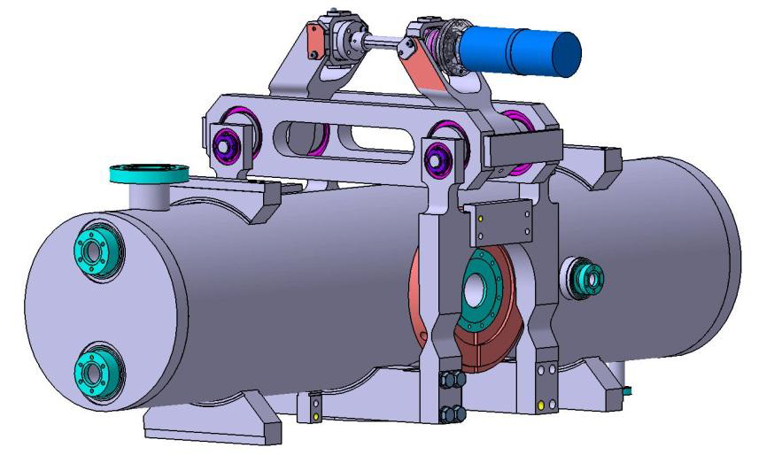
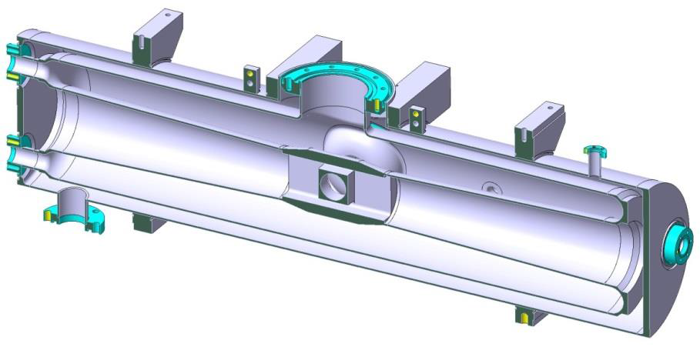
Compression plunger
Following up the recommendations of a Review Panel (June '12)
new design based on conventional compression tuner principle developed
Tuner only acts in one direction (compression)
Tuning force 8000 N / nose
Disengaged system during cooldown & warmup
titanium
He inlet
niobium
He outlet
beam axis
Given the rigidity of the resonator, this solution implies a lengthening of the cryomodule lattice ∼ 10 cm to ease the tuner integration between He tank & solenoid

Slide 18



Cavity qualification
Plunger port closed
Nb disk EB welded
P02 qualified ⇒ RF design of HWR therefore validated
LHe 1.5 bar max
Cavity licensing (High Pressure Vessel)
stress analysis by an authorized engineering company
⇒ all stresses allowable according to ASME code
Allowable stress S = Min [ S_{u} / 4 ; S_{y} / 1.5 ]
internal P = 1.5 bar inside the He vessel @300K
internal P + load of 8 kN on beam flange @4.4K
8 kN / beam flange
Ex. membrane stress max 60.8 MPa < 150 MPa @4.4K

Slide 19


HEBT Line & Beam Dump
Bending magnet (20°)
to avoid n-radiation in upstream elements
CIEMAT
Diagnostics-Plate
to characterize the beam
Magnetic beam expander
to limit power density on BD < 200 kW/cm²
Cryogenic pump
Lead shutter
closed during beam shutdown to shield residual gamma rays from activated beam dump
Scraper
to protect the last portion
of the vacuum pipe in front of the beam dump
Cryogenic pump

Slide 20


Beam Dump
Water shield tanks
CIEMAT
Iron shield
Beam dump with its local shielding
water + polyethylene (neutron)
iron (gamma)
Cooling
pipes
Articulated collar
Bellow
Inner Cu cone
Polyethylene
shield
cartridge
Cartridge
Inner & outer cones = Cu (edp)
Cooled by liquid water (high v, 3 bar)
T ~100 ºC not too far from boiling
Remote disconnection system

Slide 21




Beam Dump prototypes and tests
HEBT & Beam Dump in final stage of detailed design
Cone prototypes built:
electron beam welding and electro-deposition
Hydraulic test cooling circuit
1.5m edp prototype
2.5m ebw prototype
Al mandrel
with Cu tip
SS flange
Hydraulic circuit: to study the fluid-dynamics aspects
of the beam dump cooling (vibrations,heat transfer coef estimation, flow and pressure measurements,…)
demoulding
Contract notification in Summer 2013 for cartridge, BD tank & cooling system

Slide 22


Beam Instrumentation
CEA-CIEMAT
Diagnostics Plate
Current monitors (ACCT, DCCT, FCT)
Beam Position monitors x 20
Beam Profile monitors (ionization & fluorescence)
Beam Loss monitors (ion chambers)
Micro-Loss monitors (diamond)
Bunch length monitor (Residual gas, GSI-like)
Interceptive: SEM grid + slits (Espread, Emit)
100 keV
5 MeV
9 MeV
End of procurement before end 2013 for all diagnostics

Slide 23
Installation & Commissioning
2012
2013
2014
2015
2016
2017
Q1
Q2
Q3
Q4
Q1
Q2
Q3
Q4
Q1
Q2
Q3
Q4
Q1
Q2
Q3
Q4
Q1
Q2
Q3
Q4
Q1
Q2
Q3
Q4
Site preparation
Injector
RFQ
MEBT
critical path
Sequence of installation & beam commissioning
pulsed proton, deuteron, up to cw
Injector
RFQ + MEBT + D-Plate
Cryomodule + D-Plate + HEBT + BD
Full LIPAc
SRF Linac
HEBT & BD
Diag RFQ
Diag SRF
RF Power systems
Start of commissioning
Full Accelerator
Cryoplant
LIPAc commissioning
End of BA Agreement

Slide 24
Conclusions
INJECTOR (1st LIPAc accelerator component) has been delivered end of March 2013
RFQ planned to be delivered in October 2014, assuming end of RFQ modules fabrication in February 2014
But some other critical accelerator components deserve special attention to keep the schedule on track, as SC cavities and bunchers

Slide 25

Beam power landscape for hadrons accelerators
average beam current vs. energy
power ∝ current × energy
based on SRF technology
IFMIF = multi-MW class hadron accelerator, but differently from other high power accelerators,
stands in the low energy (a few tens of MeV) and high intensity region
⇒ high space charge regime with radio-activation hazard due to deuteron beam

Slide 26
END

Slide 27




Injector diagnostics
Beam Intensity: Large ACCT (Φ 178 mm) at the RFQ entrance with specific magnetic shielding
Beam Profile and species fraction (Doppler shift method): use of rad-hard CID cameras and CCD camera outside the vault with fiberscope
Emittance: Allison scanner to sustain 17 kW beam power
Space charge compensation: 4 Grid Analyzer to measure the energy of secondary ions or electrons repelled out of the beam
Bergoz
ACCT
BEAM
FGA design for IFMIF injector

Slide 28

Chopper addition
Need of pulsed mode with sharp rise/fall times
(to limit transient current which would be lost downstream)
with beam perfectly matched to the RFQ input conditions all along its duration
But ECR ion source: not able to produce such beam pulses
RF cutting technique in the RFQ: could jeopardize the RFQ operation
electrostatic chopper located in the Injector LEBT
(between the 2 solenoids)
In addition, this option enables the use of interceptive diags
Available port
EMU

Slide 29






A few Diagnostics…
Beam Profilers development
IPM
FPM
Principle: ionization of the residual gas
Residual gas pressure: few 10⁻⁸ to 10⁻⁵ mbar
Resolution ∼ 1 mm Profile rate ∼ few Hz
Apertures >10 cm for DP >15 cm for HEBT
Principle: fluorescence by interaction of the beam with the residual gas
2 read-out prototypes tested
    ICID (Intensified Charge Injection Device) camera (MCP + CID)
    PMT: multi anode 32 channels linear array
Campaign tests at CNA cyclotron Sevilla:
D⁺: 9 MeV and H⁺: 18 MeV
      Test at GSI (5 MeV.A, mA)
IPM in front of BD
ICID camera
Extrapolation to LIPAc (125 mA) OK
new tests done at Sevilla (Oct 2011)
…improved profile measurements
Challenges: Large aperture (15× 15 cm²)
Radiation hardness ∼ 7 kSv/h (neutrons)
ceramic (HV + strip plates) field uniformity

Slide 30



RF Power system
RFQ
Bunchers
HWR
Prototype RF module (1 x 200kW)
ready in March'13
First RF module (2 x 100kW)
ready in May'13
Solid-state amplifier (16kW))
ready for buncher tests in August'13
Prototype RF module (Oct'12)
RF module (2 RF chains)

Slide 31

Cryoplant
Procurement arrangement not yet signed, however
EDR uploaded and approved (end 2011)
Call for tender launched in October'12
PC (Power Coupler for cavity)
CL (Curent Leads for solenoid)
Process Flow Diagram
Heat loads estimation

