Slide 1
Infrastructure and processing of SPL cavities
3rd Open Collaboration Meeting on Superconducting
Linacs for High Power Proton Beams

Slide 2
Outline:
Reminder
Cleanroom refurbishment
High pressure water rinsing:
High pressure cabinet
Ultra pure water production
Cavity diagnostic:
Kyoto/Kek Optical inspection
OST and T-mapping
Cavity process
Conclusion

Slide 3
Reminder:
- CERN Clean room is 20 years old (designed for LEP)
Cleanliness is essential to reach gradient > 20 MV/m
Aim of the refurbishment:
Further increase clean room quality and add an extension
High Pressure Rinsing inside clean room
Deploy new cavity diagnostic strategy
Group activities in one place

Slide 4
Existing facility at SM18
Cleanroom facility
RF facilities
Work in progress
Cryogenic
Magnet
SM18, plan

Slide 5
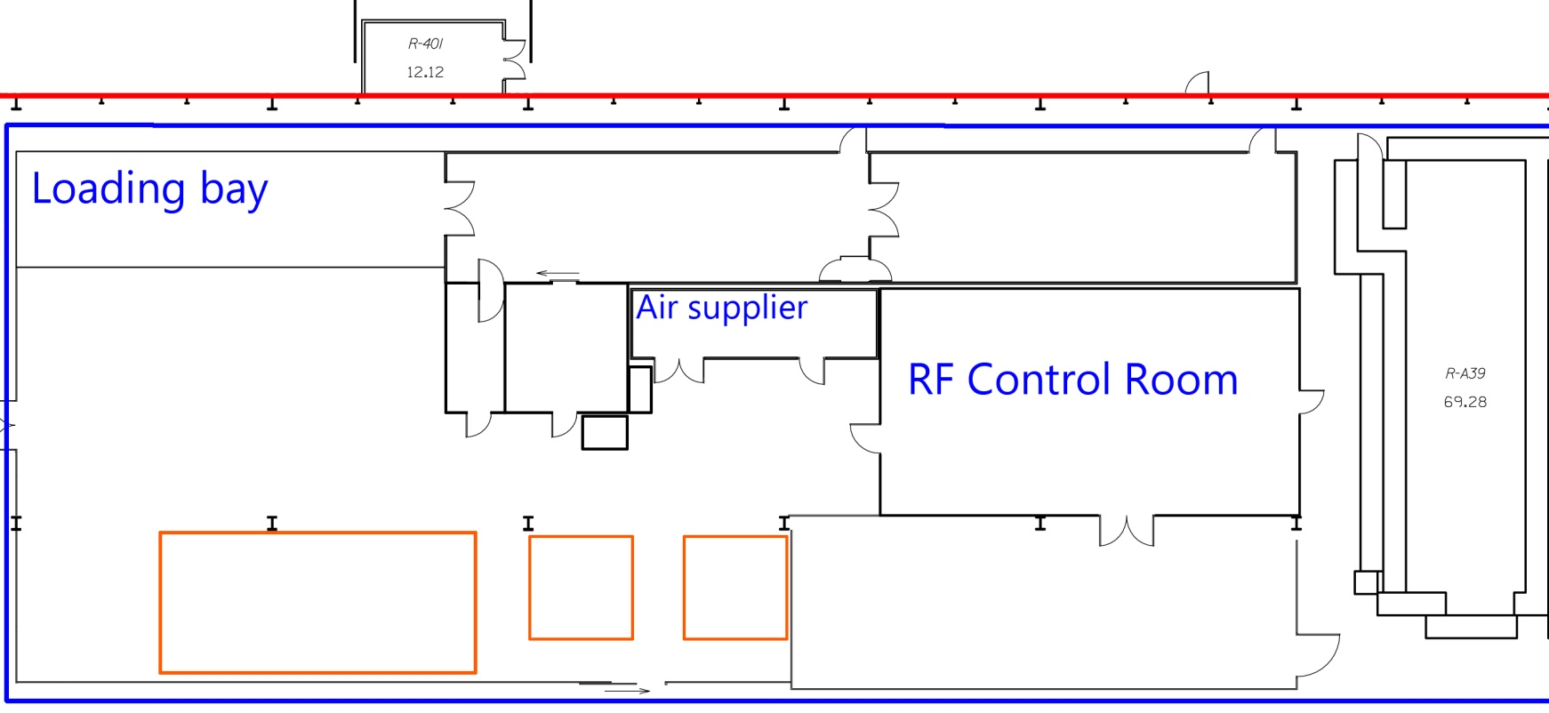
Cleanroom refurbishment
Upgrade layout presented in 2012
Top view of cleanroom upgrade
ISO 5
ISO 4
ISO 4/5
UPW
HPR
Optical Insp
ISO 5
HIE Isolde - ISO 5
UPW : Ultra Pure Water
HPR : High Pressure Rinsing
Air supplying system was an issue
3D preview of cleanroom upgrade

Slide 6
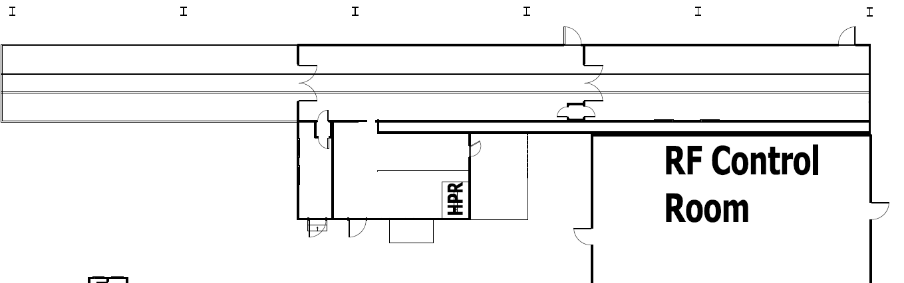
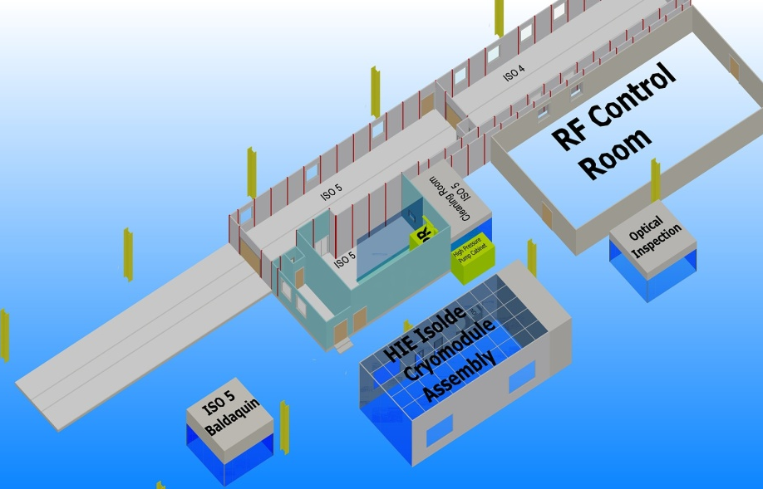
Cleanroom layout (Updated)
ISO 5
ISO 4
ISO 5
ISO 4
Top view of cleanroom upgrade
Extension of the rinsing room.
Creation of a preparing room outside of the facility.
Upgrade will be done by Daldrop, initial builder of the facility.
Upgrade foreseen by the end of 2013
3D preview of cleanroom upgrade

Slide 7
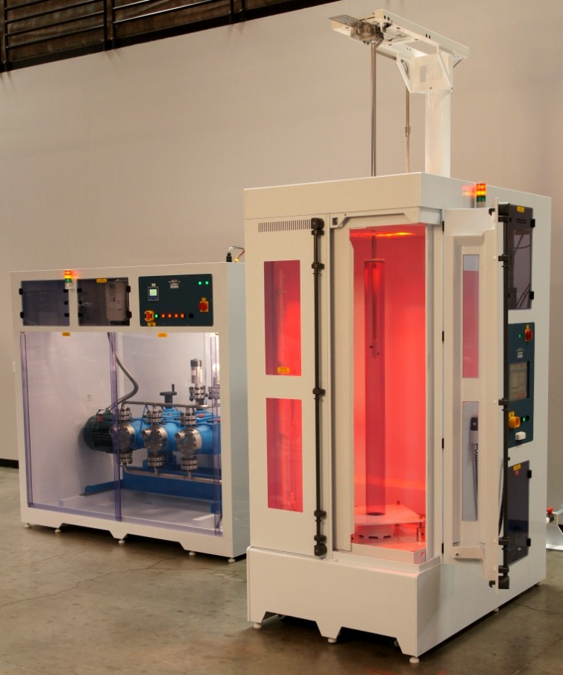
High Pressure Rinsing: High pressure cabinet
HPR from SPEC (US), in use at BNL.
HP pump (140 bar, 1.1 m³/h)
@ 3 stages to prevent vibration.
Rinsing cabinet with top wand
design (needed in SM18).
Cabinet will have a pass
trough design => load/unload from
different cleanroom classes.
Drying of the cavity by blowing hot N₂.
Delivery foreseen in September
Rinsing nozzle to be designed.
Rinsing cabinet and its HP pump

Slide 8
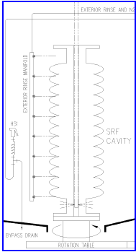
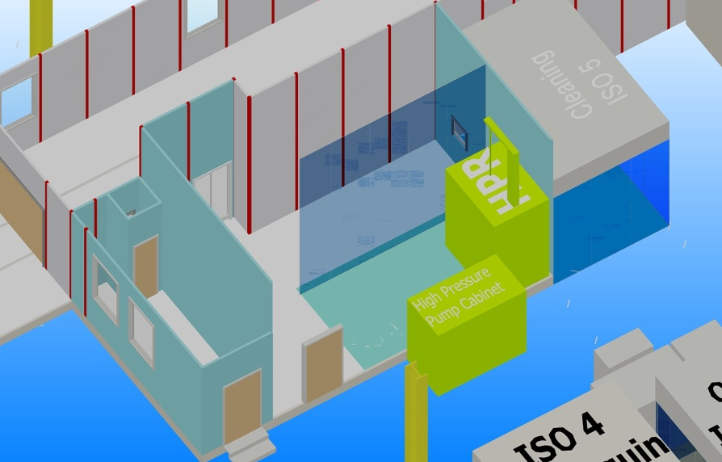
High Pressure Rinsing: High pressure cabinet
Rinsing room close up.
Sequence foreseen:
Cavity preparation for rinsing in ISO 5.
Rinsing of the outside.
Rinsing of the inside.
Pre-drying with hot N₂.
Final drying in ISO 4.
Assembly for RF test.
ISO 5
ISO 4
ISO 5
Path of the cavity into the cleanroom
Rinsing cabinet scheme
3D preview of the Rinsing room

Slide 9
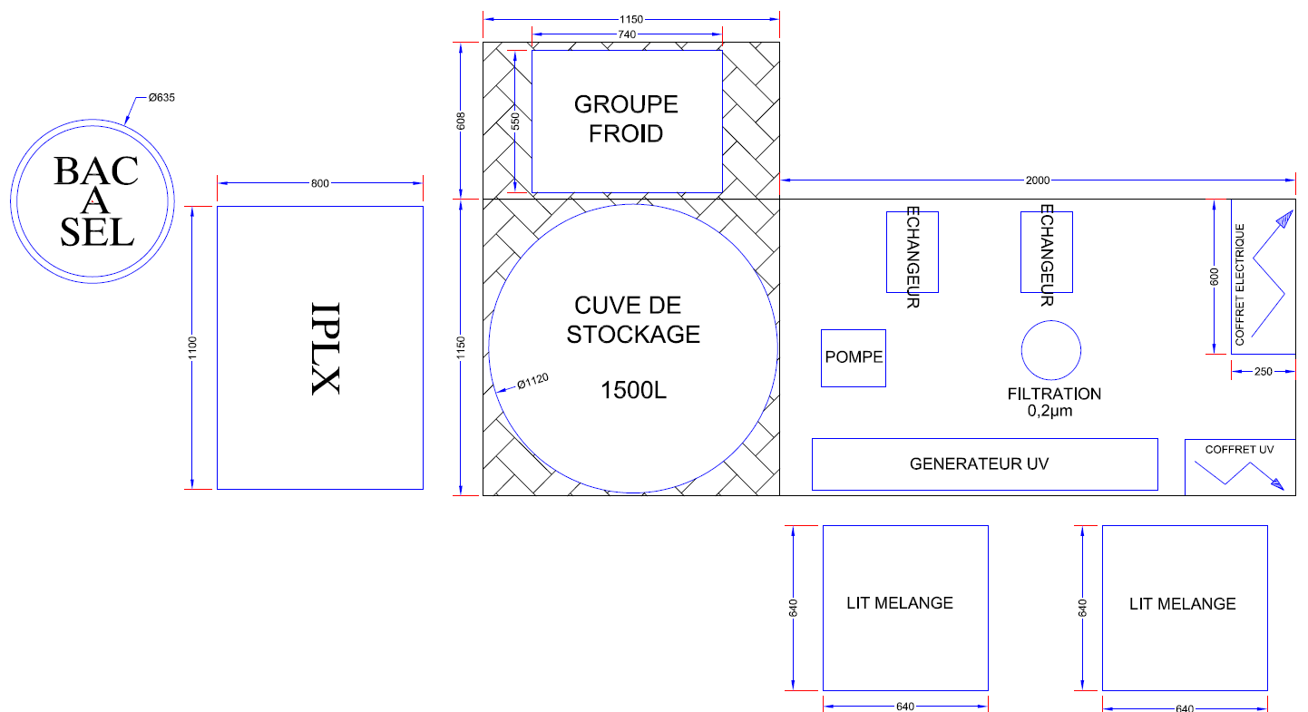
High Pressure Rinsing: Ultra Pure Water production
Pre-design of the installation, done by Veolia France
Production capacity of 1 m³/h.
UV lamp (185 nm) to prevent bacteria growing and
decrease Total Organic Carbone (TOC):
C_{X}H_{Y}O_{Z} -> CO₂ + H₂0 -> H₂CO₃ -> H⁺ + HCO³⁻
HCO³⁻ absorbed by
polishing resin.
Need to cool down
the recirculation
water due to the
temperature in
SM18.
Delivery in August
2013
UPW production and distribution loop

Slide 10
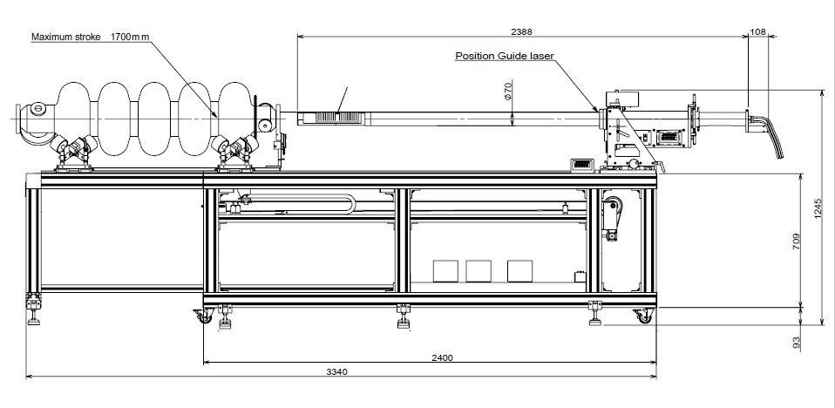
Optical Inspection (Kyoto/KEK system)
Camera:
3488 x 2616 pix
@ 2.5 ips
26.1 Mo/picture
Cavity can:
Slide
Rotate
Camera can:
Rotate over 180°
Kyoto/KEK system with an SPL cavity
Illumination system close-up

Slide 11
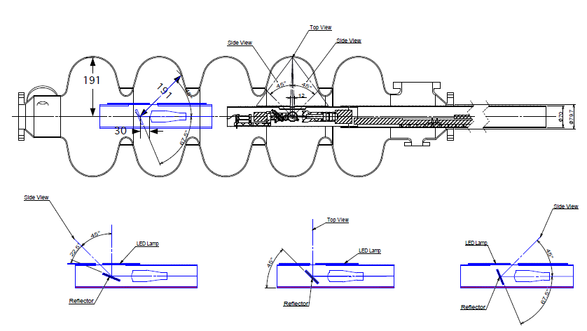
Optical Inspection
Optical head in detail
Optical head principle

Slide 12
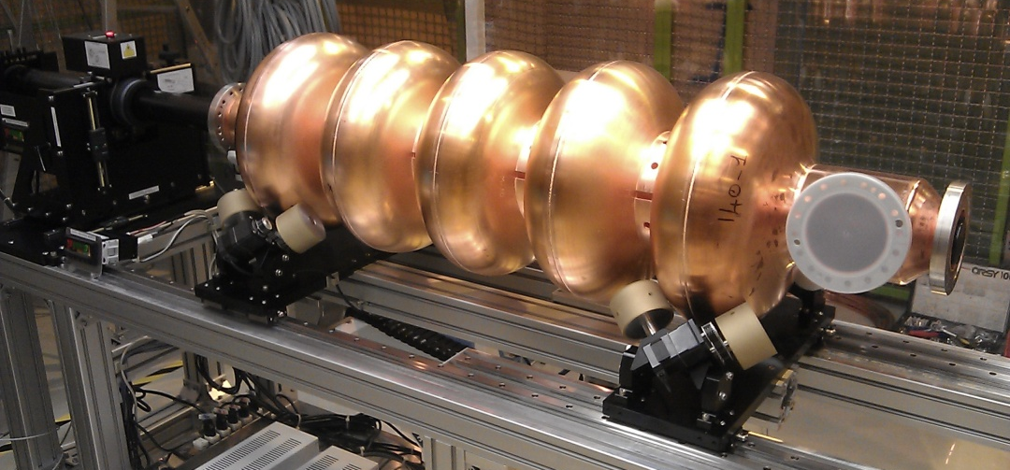
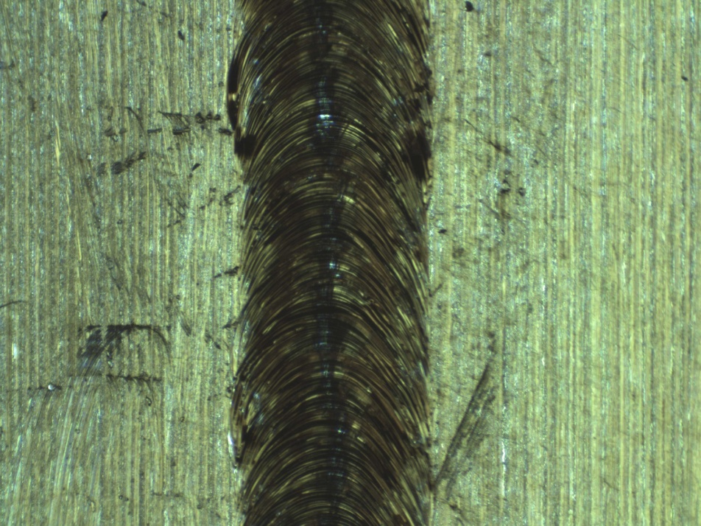
Optical Inspection (SPL01 Cu)
Use to perform the functional test of the bench and get experience.
First picture of an equator welding.
Easier illumination on copper.
SPL copper mock up on the bench for the first test
Equator EB welding (Cu cavity)

Slide 13
Optical Inspection (SPL01 Nb)
Resolution 2 µm/pix.
Image size = 6.9 mm X 5.2 mm.
Scratch or crack observed inside the cut off.
Inspection done by A. Benoit.
X-ray view of the defect
Optical view of the defect by images assembly

Slide 14
Optical Inspection (SPL01 Nb)
Crack on SPL01 Nb cut off
Nb structure close up SPL01

Slide 15
Optical Inspection
Get a code to automate the inspection:
Autofocus (operational since last week)
Step motion (semi automatic but trough labview)
Auto illumination
Get a code to automate the analysis:
Colour correction
Image assembly
Contour detection to find defects

Slide 16
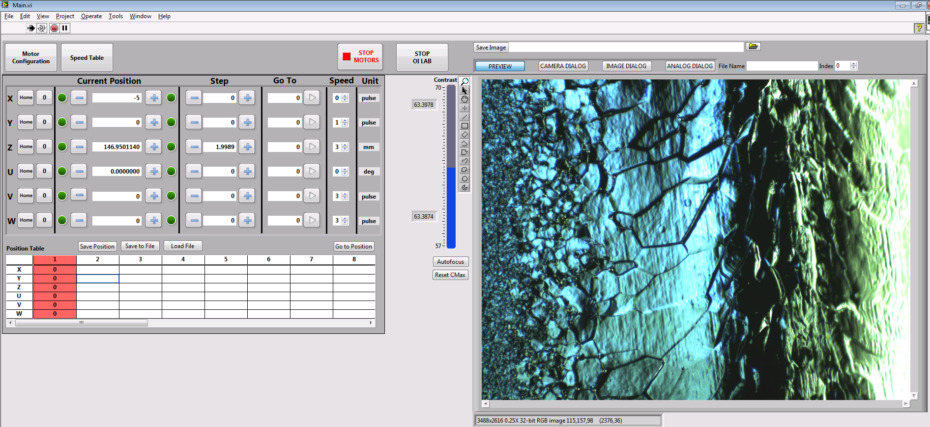
Optical Inspection
Motion control of the bench
OILab (Optical Inspection Labview) preview
Image acquisition

Slide 17
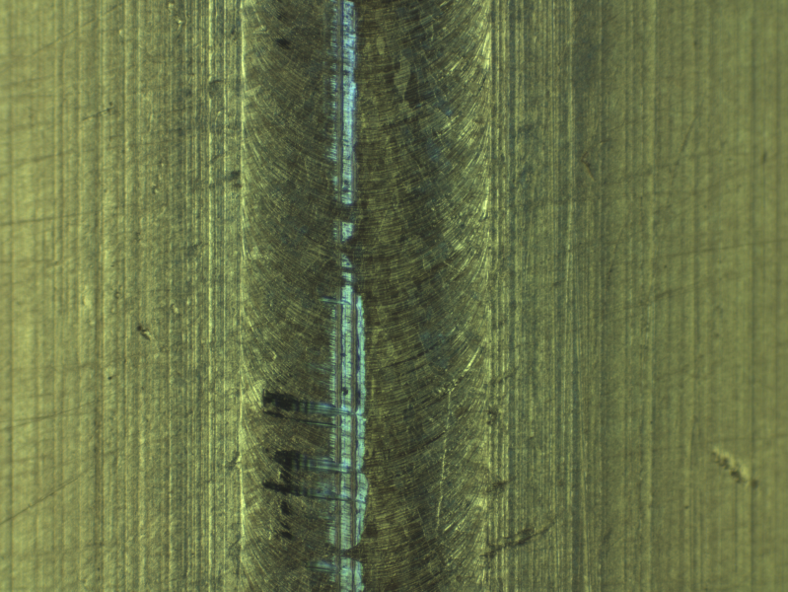
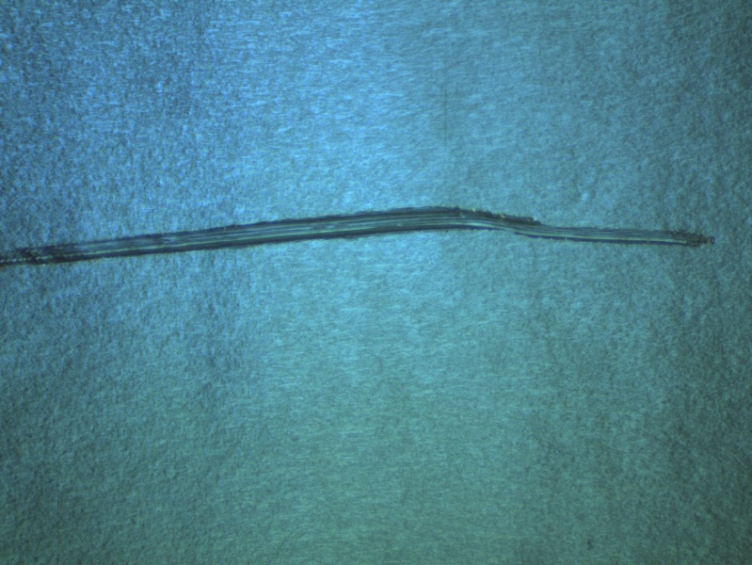
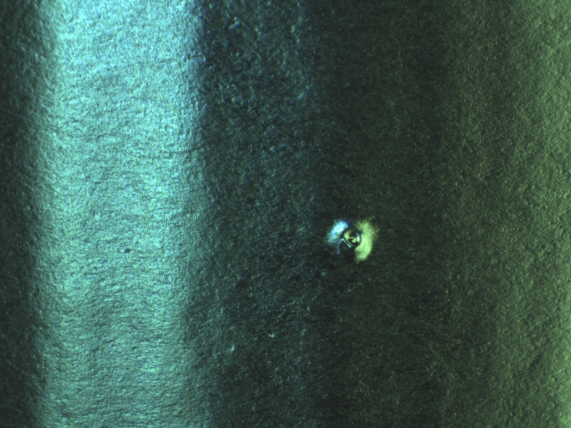
Optical Inspection: defect collection
Defect during SPL mock up assembly
Scratch coated cavity (HIPIMS)
Cat eye defect on coated cavity (HIPIMS)
Black marks on coated cavity (HIPIMS)

Slide 18
Diagnostics Update Summary for SLHiPP-3
Fast second sound experiment & Quench analysis
Setup: 3 Heaters (attached & dis-attached below, and above) a 2 mm niobium plate
When heat flux exceeded ~ 4 W/cm² at 2 K, a thermal boundary layer is generated and boiling peaks are initiated -- heat transfer in a non-pure second sound transfer zone in helium I & II.
No effect of the niobium in the measurement
Cavity quench signals also carry characteristics with noisy peaks that come before the ‘real 2nd sound’ arrives. This could possibly explain the fast signal observed by major labs.
The time determination (velocity) of these noisy peaks is however very challenging. Filtering method has been used but with minimal effect.
Temperature mapping ‘Octopus’
Hardware:
2nd version circuit modification – one microprocessor replacing 3 for 96 channels with faster acquisition ability
New acquisition board (now under assembly): date of completion estimate end of April
Search for manufactures to make the required ~3000 sensor packages (5-cell)
New sensor package: hidden Maganin wires and semiconductor pins for better fixation and durability (on-going)
Software:
Microprocessor programming (on-going) completion estimate: May
Test Estimate: (1/3 Octopus) June - July

Slide 19
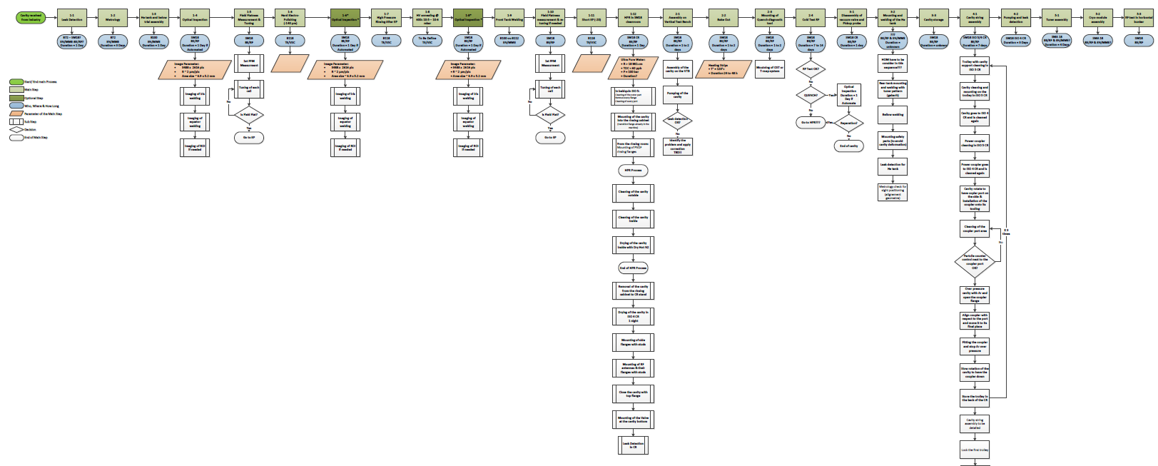
Cavity process
Cavity string & cryomodule assembly
Cavity preparation for RF test
Cold RF test
Storage
Still a lot to detail for each main step in green.
Dark green steps are optional and R&D related.

Slide 20
Conclusion
Every part of the upgrade has been accepted by CERN
A lot to do in 2013 in terms of infrastructure in parallel of LHC LS1 (long shutdown 1)
Optical inspection made good progress, we are now waiting for full automation of the bench
Good results from the second sound that explain fast quench signal however further work needs to be done to insure better quench localisation
Second version of T-map has been improve for better performance, we need now to get the 3’000 sensors made
Cavity process is going to be validate (main steps) next week

Slide 21
Acknowledgment:
K. Schirm
O. Capatina
N. Valverde
F. Pillon
M. Therasse
A. Benoit
K. Liao
I. Santillana
L. Abel
Thank you for your attention

Slide 22
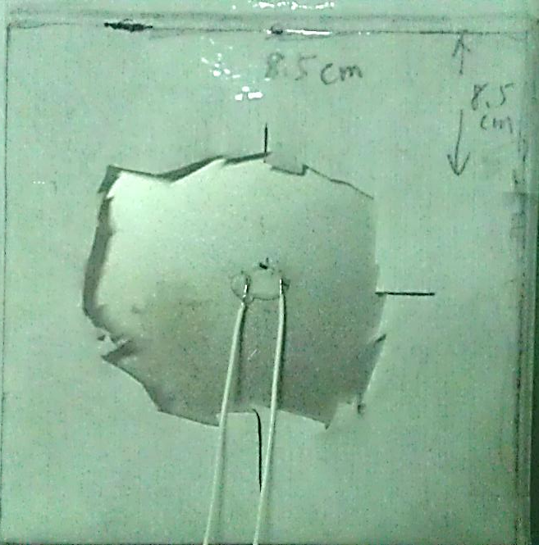
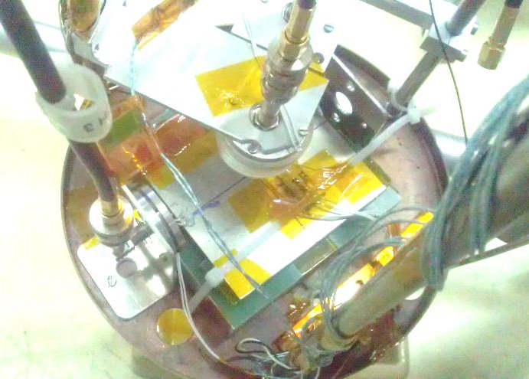
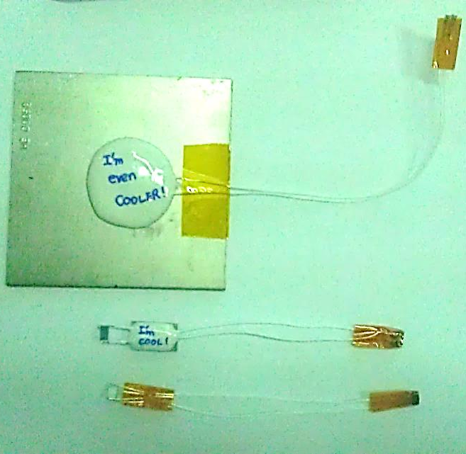
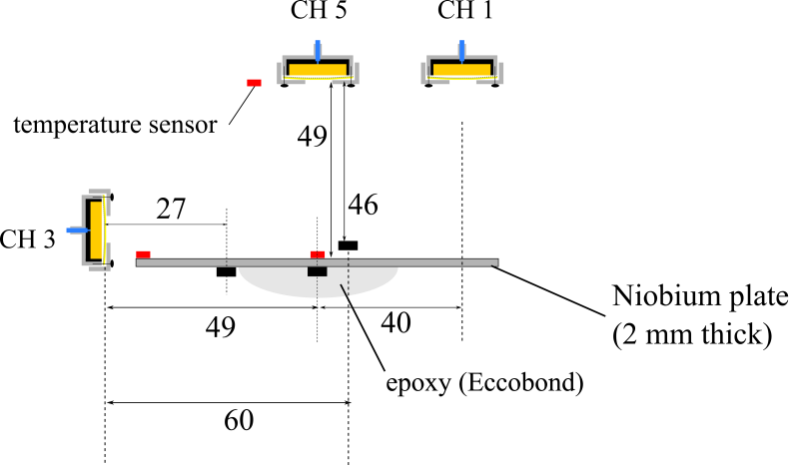
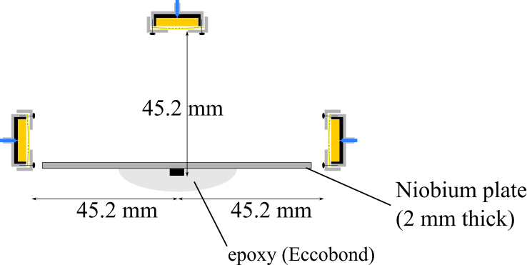
Diagnostics Update for SLHiPP-3 Search for fast quench signals (1)
Results:
Heaters above the niobium plate: the second sound travels at the smallest distance are received in the first place towards all OSTs.
Heaters below (attached and dis-attached) the niobium plate: did not travel through the niobium (not through the direct/shortest path). Instead, the signal first received by the OSTs get reflected by the bottom platform and goes up (all via the shorter path of the two (left and right))

Slide 23
Diagnostics Update for SLHiPP-3 Search for fast quench signals (2)
Reconstruct correct second sound signal by filtering
Filter out channel noise (when nothing is connected)
Filter out boiling (acoustic) signals
Reconstruct a ‘clean & pure’ second sound signal
→ The fast quench signal becomes clearer, the high velocity (~33 m/s) is decreased down to ~26 m/s, however still a lot faster than the correct second sound value (17 m/s at 2 K).
Re-constructed signal
Original signal

Slide 24
Diagnostics Update for SLHiPP-3 Search for fast quench signals (3)
T. Shimazaki , et al., “Second sound wave heat transfer, thermal boundary layer formation and boiling: highly transient heat transport phenomena in He II”, Cryogenics 35 (1995) 645451

Slide 25
Diagnostics Update for SLHiPP-3 Quench signal v.s Second sound signal
To determine the start of the second sound signal
Second sound signal first prominent peak (not necessarily the biggest peak)
Auto-correlation method does not apply to all signals in terms of first starting peak determination

