Slide 1
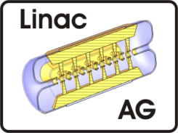
Injector Development for MYRRHA
3nd Open Collaboration Meeting on Superconducting Linacs for
High Power Proton Beams (SLHiPP-3)
Louvain-la-Neuve
17.-18. April 2013
Holger J. Podlech
M. Amberg, D. Mäder, R. Ratzinger, A. Schempp, R. Tiede, M. Vossberg, C. Zhang
C. Lenz, M. Busch, F. Dziuba, A. Seibel
Institute for Applied Physics (IAP)
University of Frankfurt, Germany

Slide 2
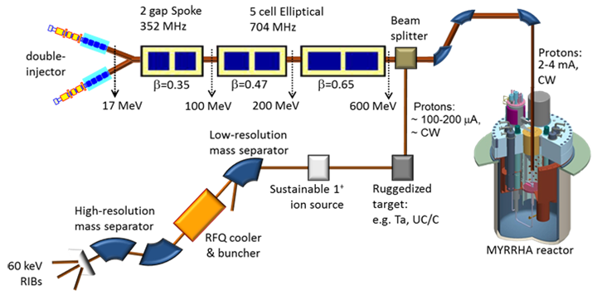
The MYRRHA Proton-Driver

Slide 3
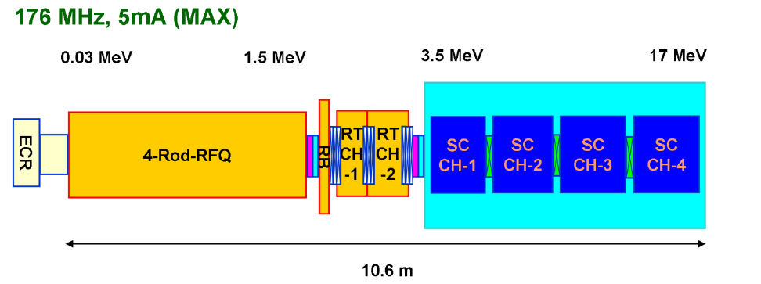
Present Scheme of the MYRRHA Injector
1.5 MeV 4-Rod RFQ
Dynamics based on KONUS
Room temperature CH-cavities
Superconducting CH-cavities
Notes:
Aufbau eines Teststandes

Slide 4
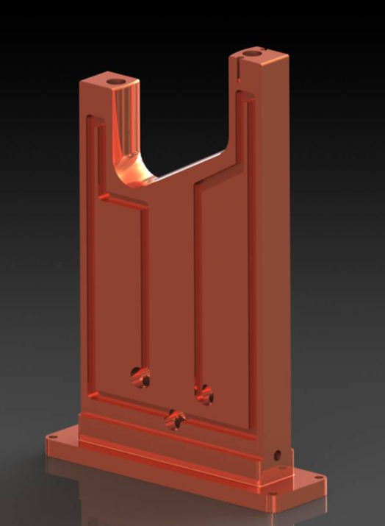
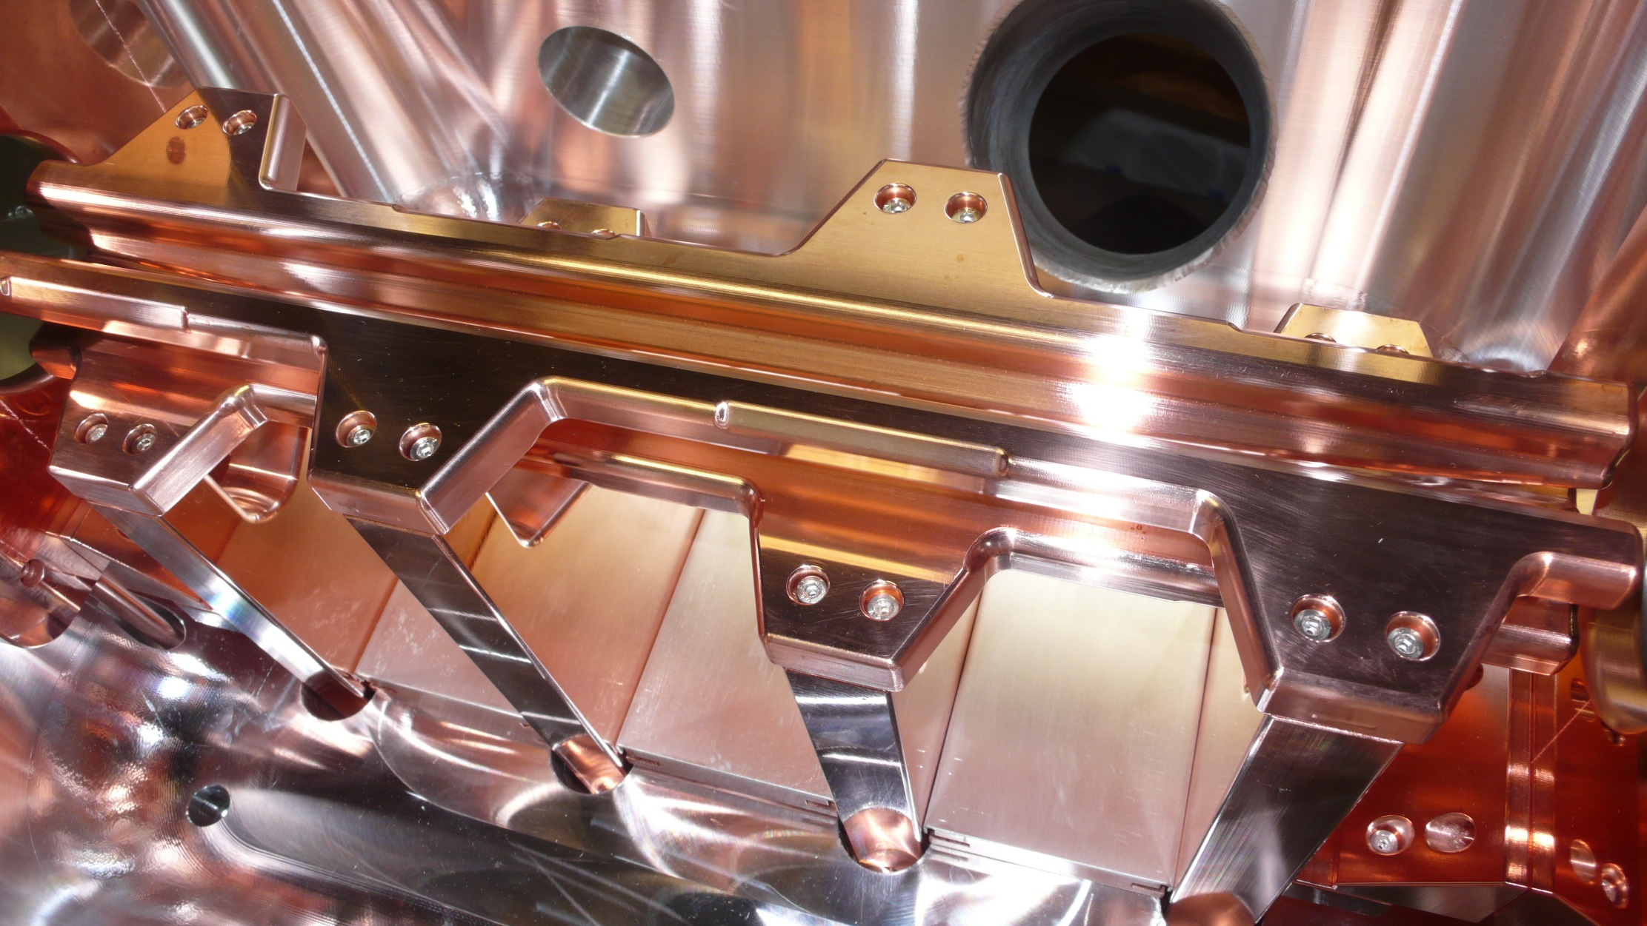
1.5 MeV RFQ
Optimized stem cooling
Parameter | Unit | Value
Cavity type |  | 4-Rod
Frequency | MHz | 176.1
E_{in} | keV | 30
E_{ou}t | MeV | 1.5
Length | m | 4
Q (estimated) |  | 3800
R_{p} (estimated) | kΩm | 67
U | kV | 40
P/L | kW/m | 25
P | kW | 100
Short Protoype has been built
Q=4300
R_{p}=90 kΩm
P/L=19 KW/m
Ready for RF tests
Goal: 50 kW/m
Notes:
Aufbau eines Teststandes

Slide 5
MAX CH-Prototype (room temperature)
Notes:
Aufbau eines Teststandes

Slide 6
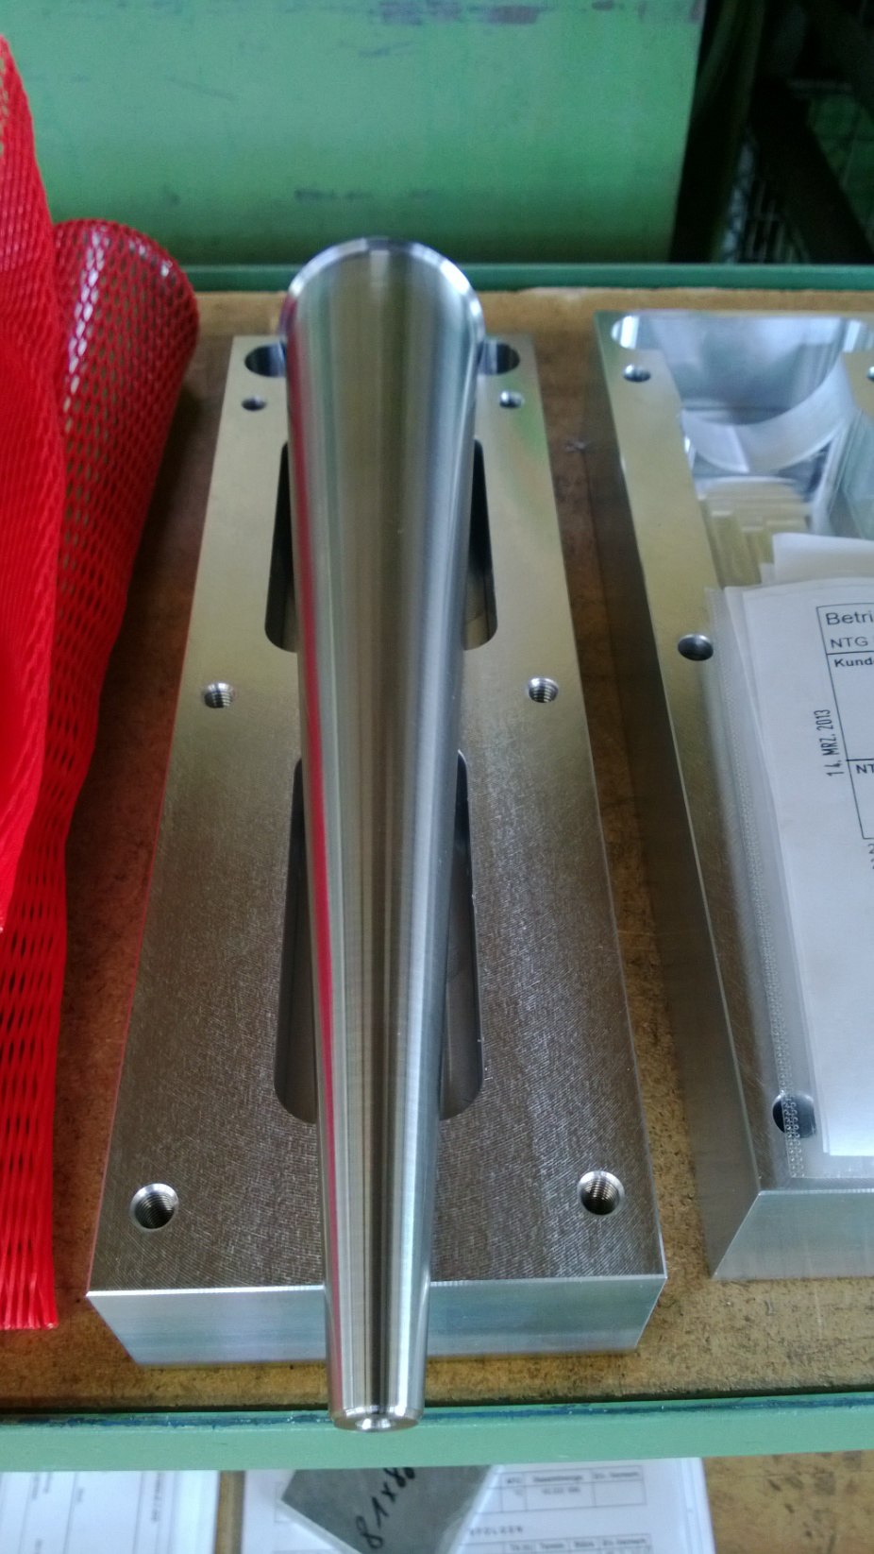
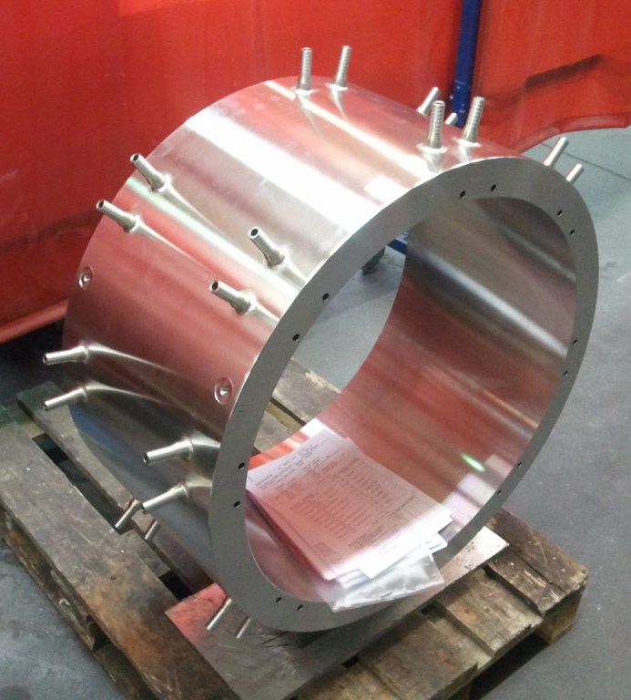
MAX CH-Prototype rt
RF and beam tests until
end of 2013
Notes:
Aufbau eines Teststandes

Slide 7
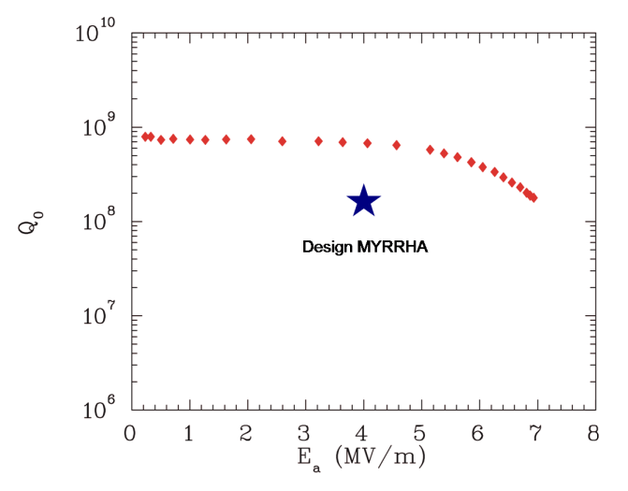
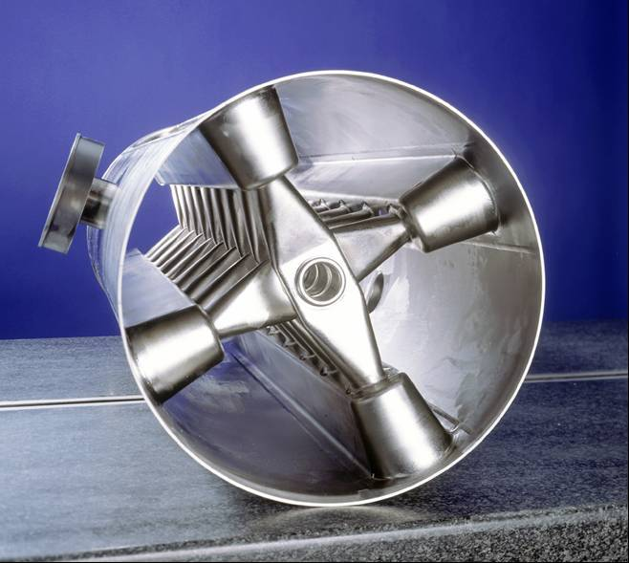
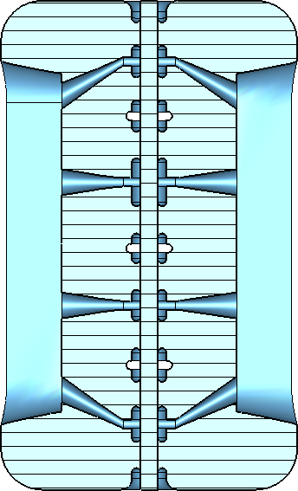
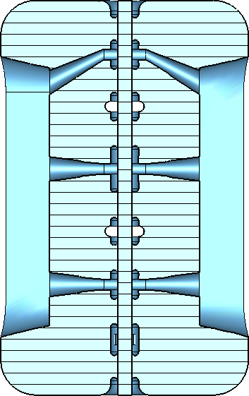
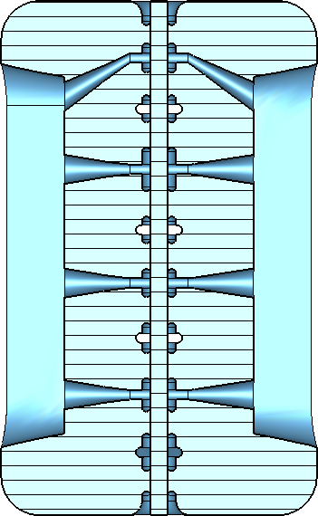
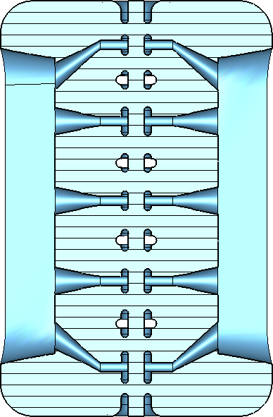
MYRRHA sc CH cavities
First CH (sc) prototype
CH5
CH6
CH4
CH3
Notes:
Peakfelder, Statistikprogramm
Predesign CH4-CH6
Rippen, mechanische Stabilität
CH3 → CH6, weniger Spalte, weniger Kapazität, größerer Radius (Thomsonsche Schwingungsforme))
KONUS Strahldynamik, Rebunching & Beschleunigen

Slide 8
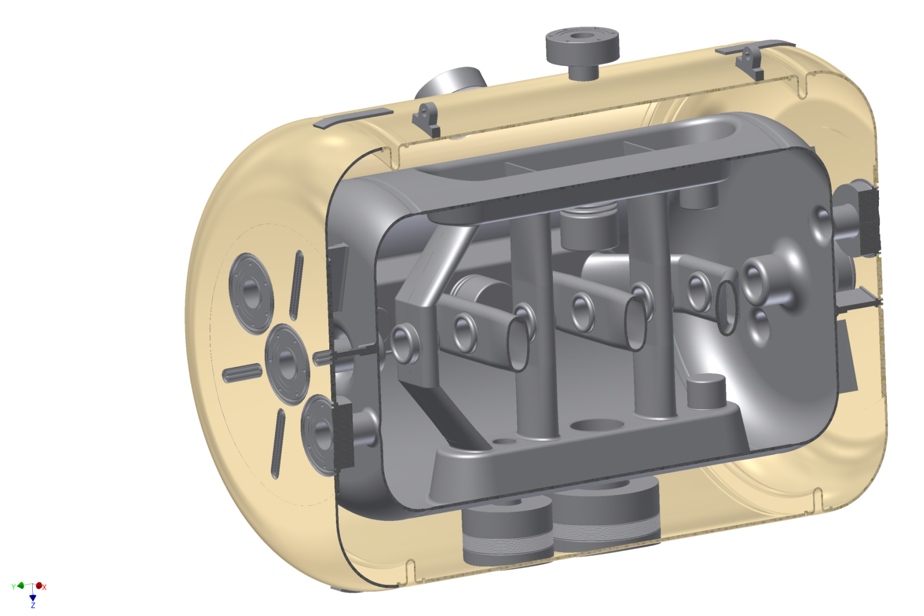
325 MHz CH-Prototype
β | 0.1545
Frequency (MHz) | 325.224
Cells | 7
Length βλ-def (mm) | 505
Diameter (mm) | 348
E_{a} (MV/m) | 5
E_{p}/E_{a} | 5.1
B_{p}/E_{a} [mT/(MV/m)] | 13
G (Ω) | 64
R_{a}/Q₀ (Ω) | 1248
R_{a}R_{s} (Ω²) | 80000
Bellow Tuner
Static Tuners
Praparation Flanges
Helium Vessel
Coupler Flanges

Slide 9
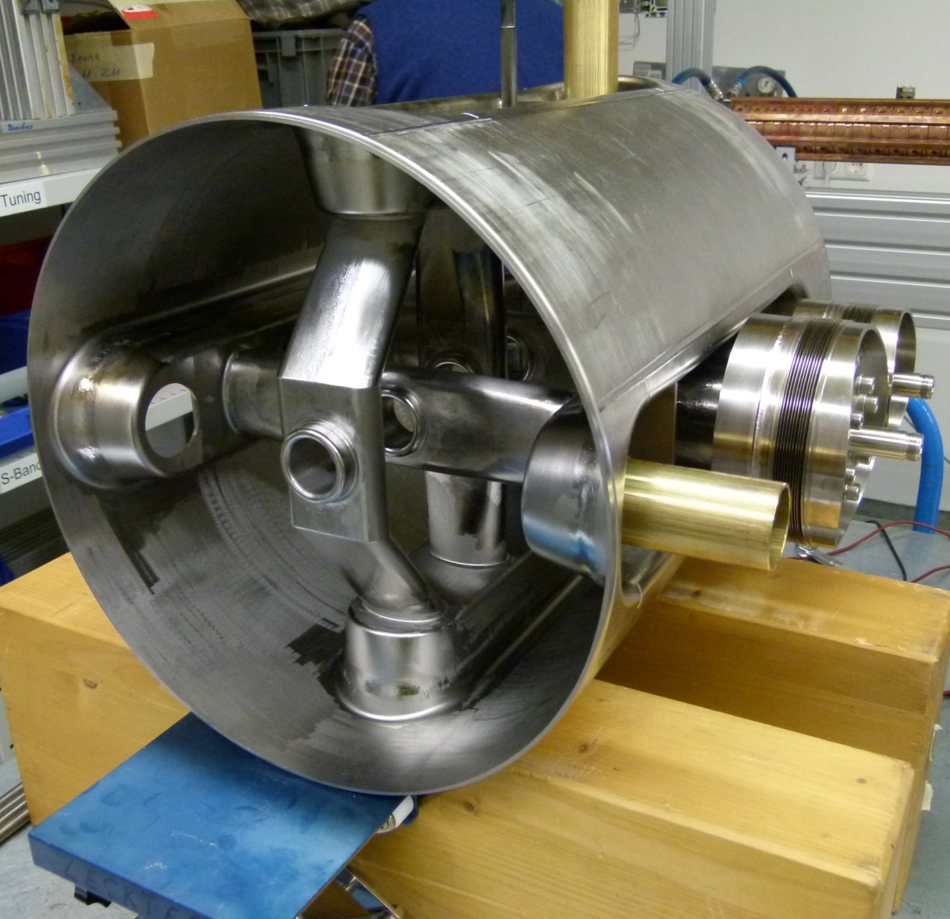
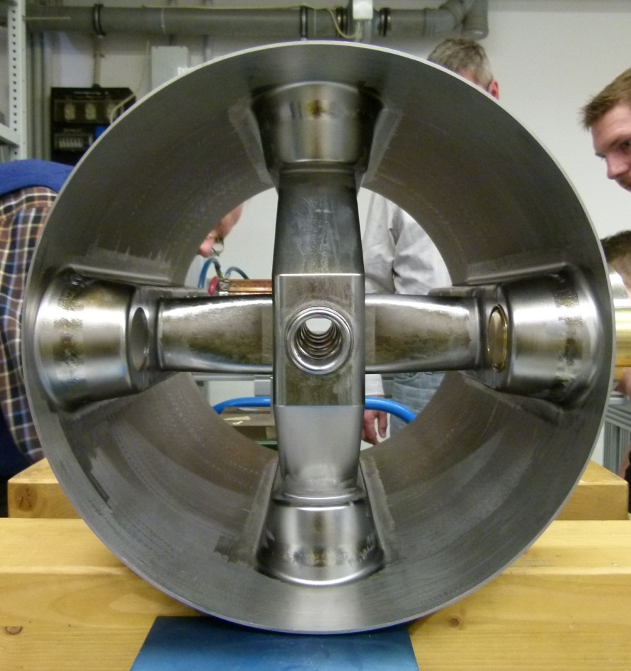
325 MHz CH-Prototype

Slide 10
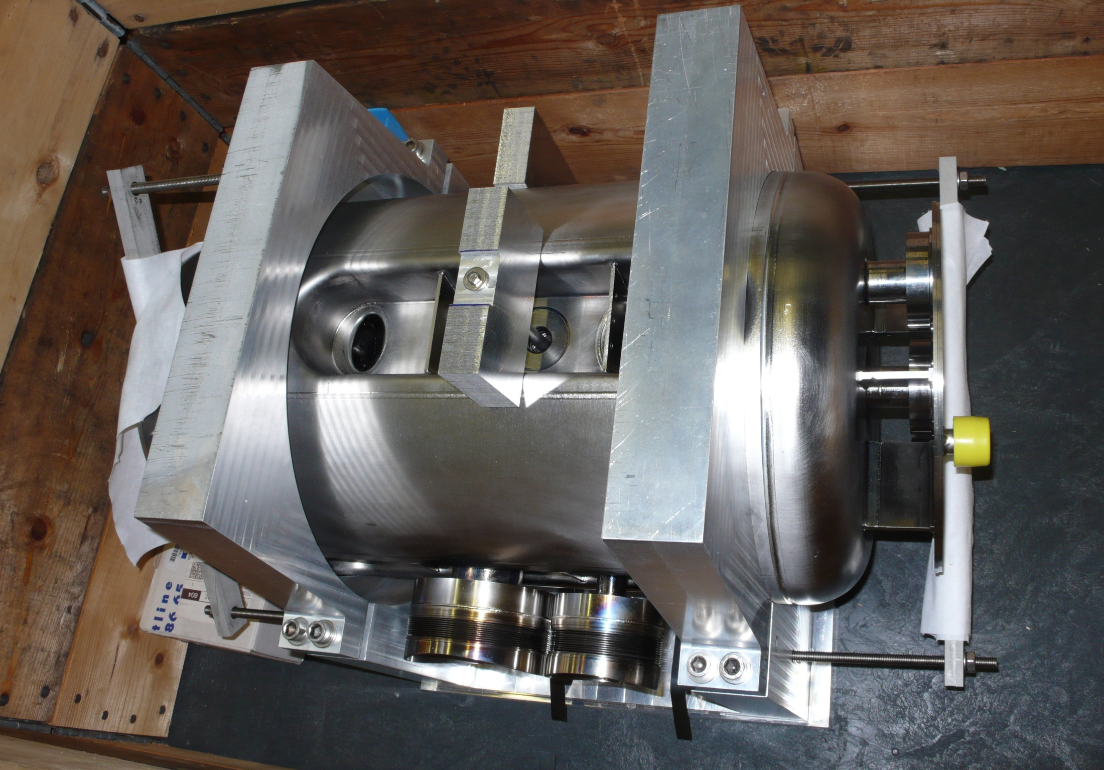
325 MHz Cavity during Fabrication at RI
Delivered without preparation
(no BCP, no HPR)
and without flanges (!)
→ Contaminated surface

Slide 11
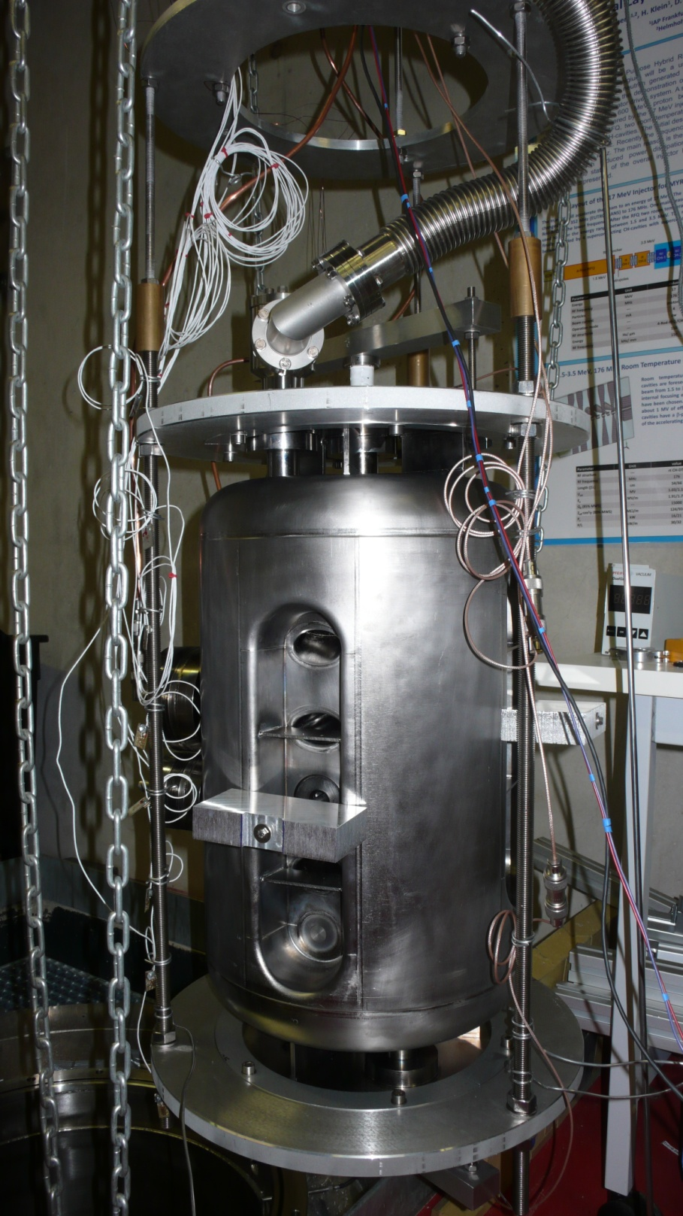
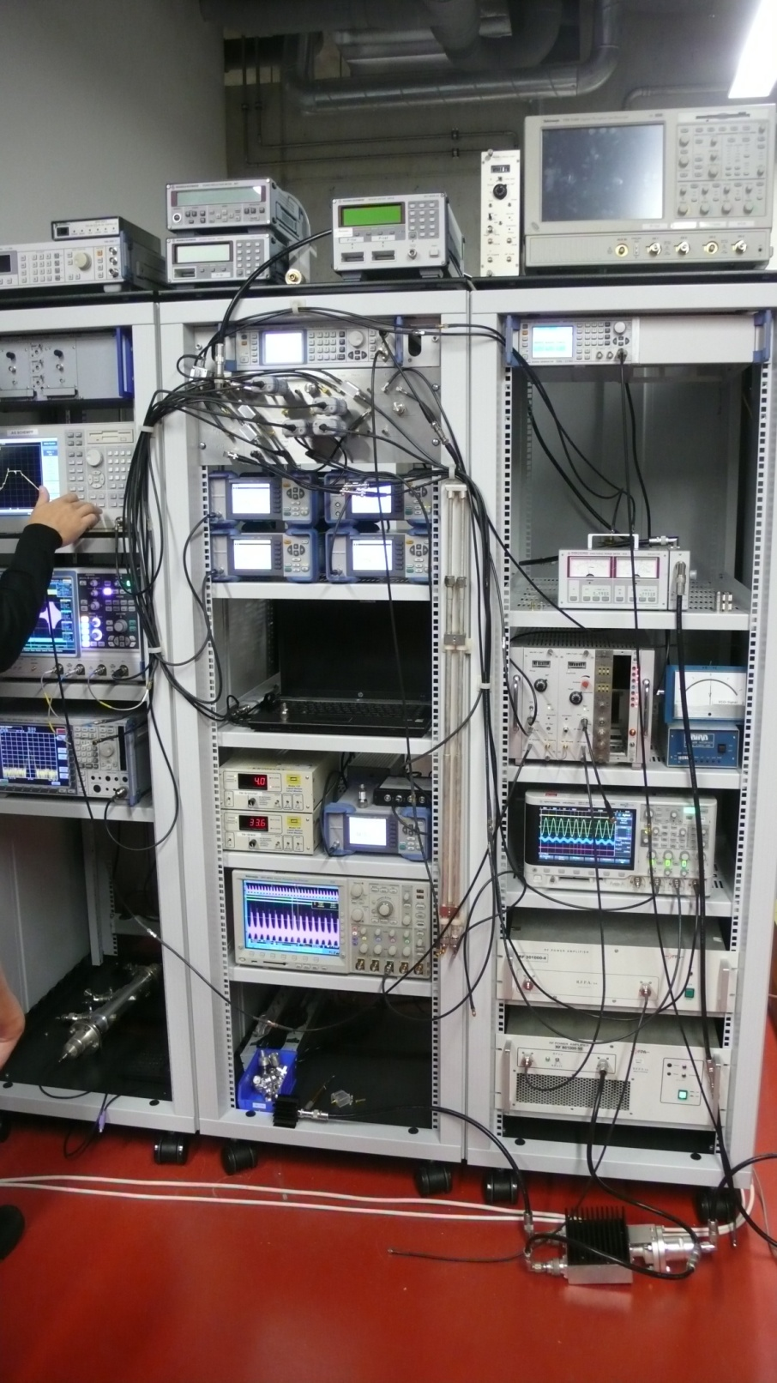
First Cryogenic Test at IAP Frankfurt

Slide 12
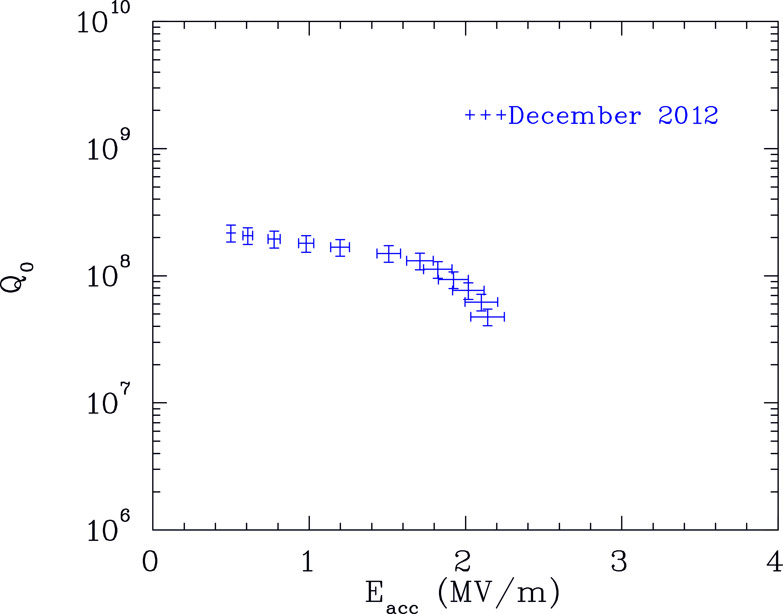
325 MHz Cavity: Cryogenic Test
no BCP, no HPR

Slide 13
Disadvantages of Present Design
Sensitivity of longitudinal dynamics
Available space for diagnostics
Investigation of an alternative design based on a more „conventional“ solution with negative synchronous phase
Notes:
Aufbau eines Teststandes

Slide 14
New Design
Negative synchronous phase
Based on CH-cavities
Room temperature part: 1.5-3.5 MeV
Superconducting part: 3.5-17 MeV
5-gap cavities
Goal: More space for diagnostics
Goal: Simpler cavities
More cavities but cheaper per cavity
Shorter cryo modules with warm quadrupoles
Notes:
Aufbau eines Teststandes

Slide 15
New Design: Scheme and Diagnostics
0.03 MeV
1.5 MeV
3.5 MeV
RFQ
B
C1
C2
C3
C4
B
ECR
LEBT
D
D
3.5 MeV
17 MeV
SC1
SC2
SC3
SC4
SC5
SC6
Steerer
Phase probe/Beam pos. monitor
Current transformer
Faraday cup
Halo Monitor
Collimator
Beam profile monitor
Notes:
Aufbau eines Teststandes

Slide 16
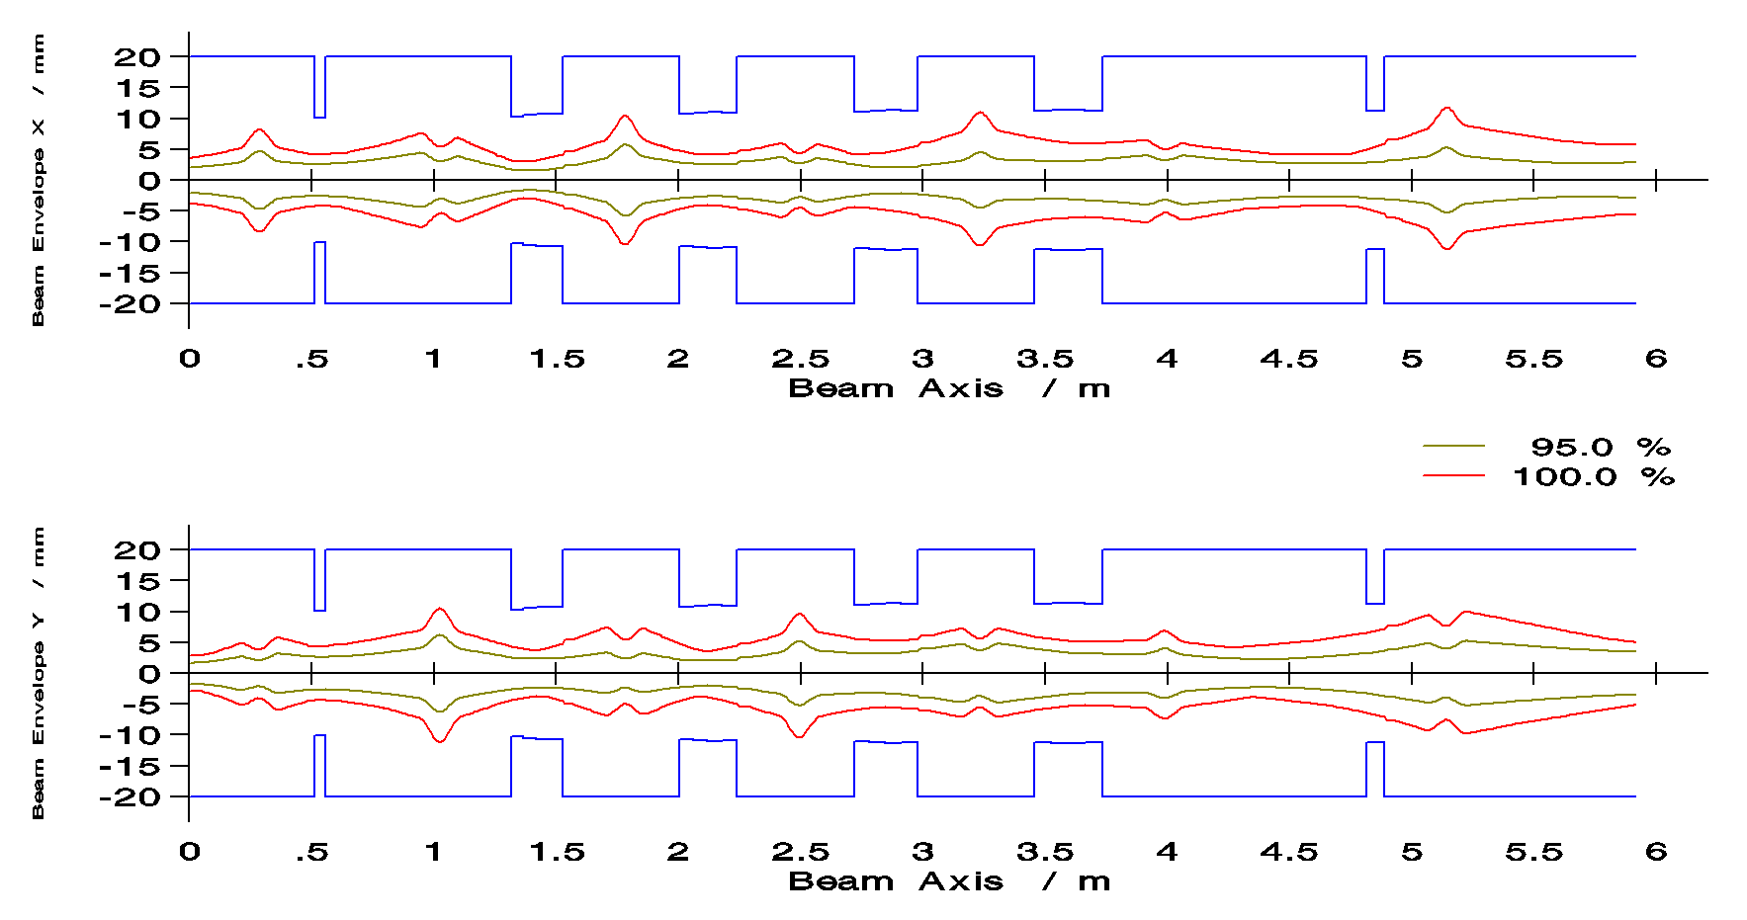
Preliminary Beam Dynamics Results - New Design injection into first cryo module
Notes:
Aufbau eines Teststandes

Slide 17
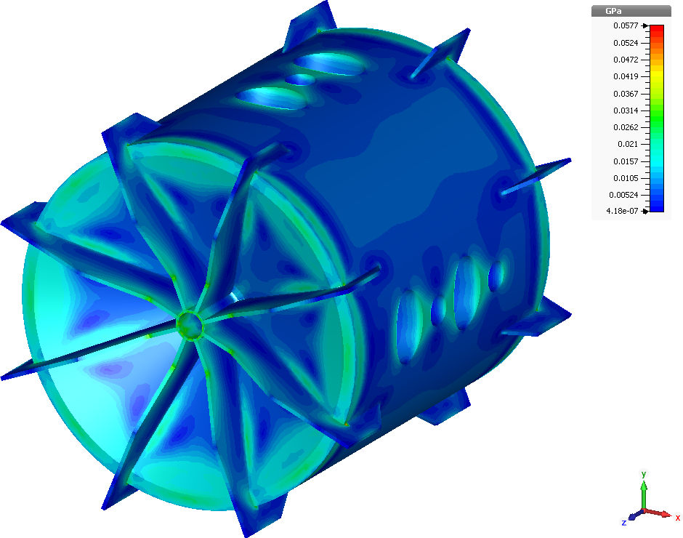
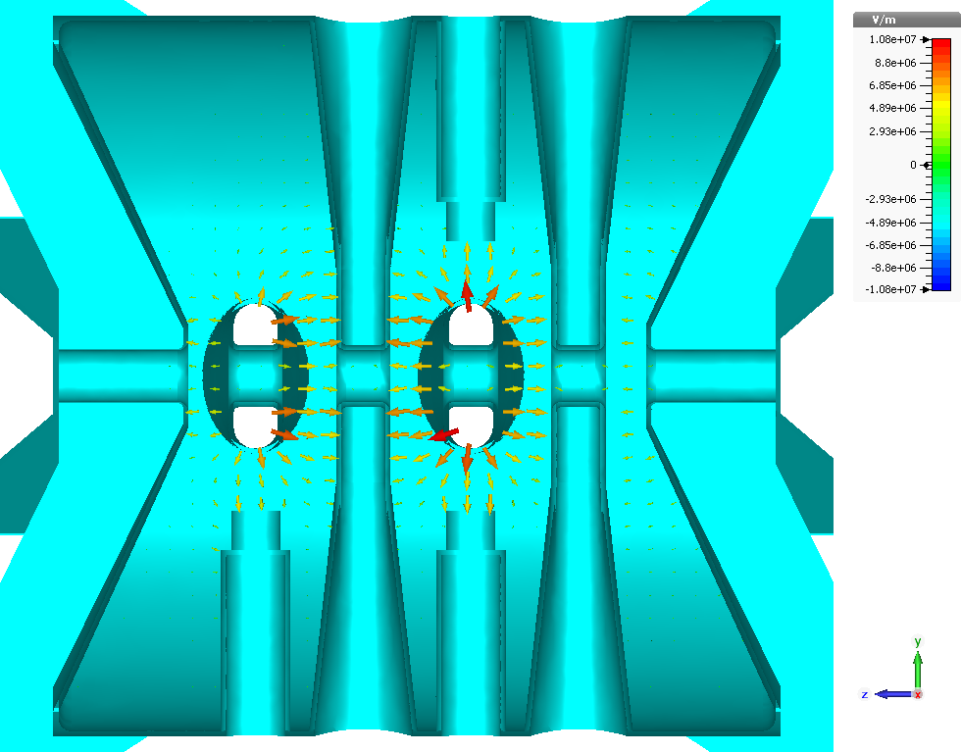
Cavities for the Alternative Design
Prototype is planned to be constructed
Parameter | Unit | CH-1
Beta |  | 0.0966
Frequency | MHz | 176.1
Gap number |  | 5
Length (5 βλ/2) | mm | 411
Cell length | mm | 82.3
Aperture | mm | 40
U_{a} | MV | 1.64
Accelerating gradient | MV/ m | 5
E_{p}/ E_{a} |  | 4.4
E_{p} | MV/m | 22

Slide 18
Thank you
Notes:
Aufbau eines Teststandes

