Slide 1
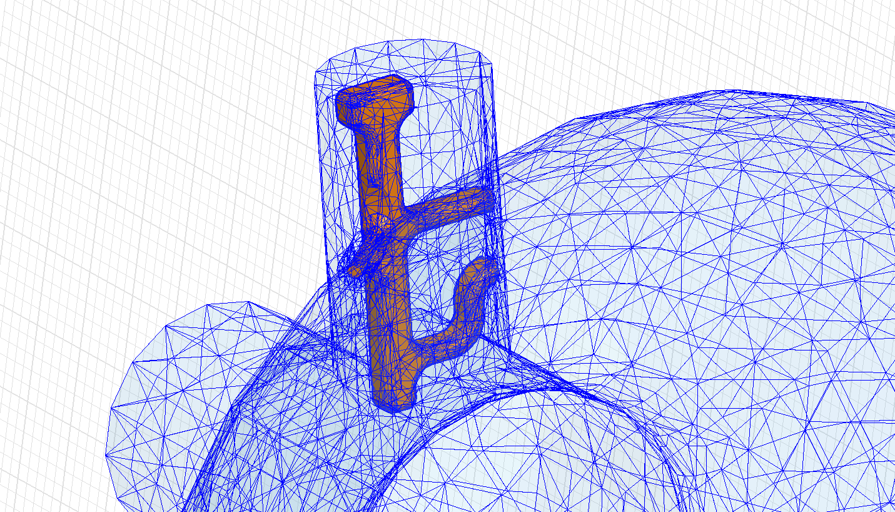
HOM couplers for CERN SPL cavities
Comparison of different design approaches
Work supported by the Wolfgang-Gentner-Programme of the Bundesministerium für Bildung und Forschung (BMBF)

Slide 2
Outline
Overview
Design Requirements
Design Approaches
Heat Loss
Summary
Outlook

Slide 3
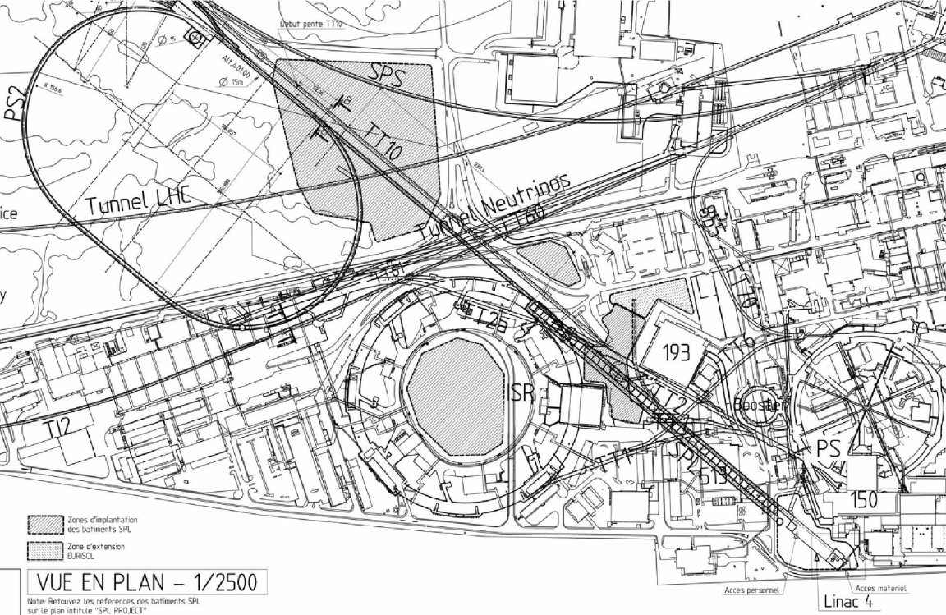
Overview
Present
Optional Future
LP-SPL: Low Power-Superconducting Proton Linac
PS2: High Energy PS (~ 5 to 50 GeV – 0.3 Hz)
HE-LHC: “High Energy” LHC (≥ 14 TeV/ring)
1978
Proton flux / Beam power
50 MeV
Linac2
Linac4
SPS
160 MeV
1975
PS2
1.4 GeV
PSB
LP-SPL
4 GeV
1959
26 GeV
PS
PS2
PS
50 GeV
SPL
450 GeV
SPS
2008
LHC /
HE-LHC
7 TeV
LINAC4
R. Garoby, SPL Seminar 2012

Slide 4
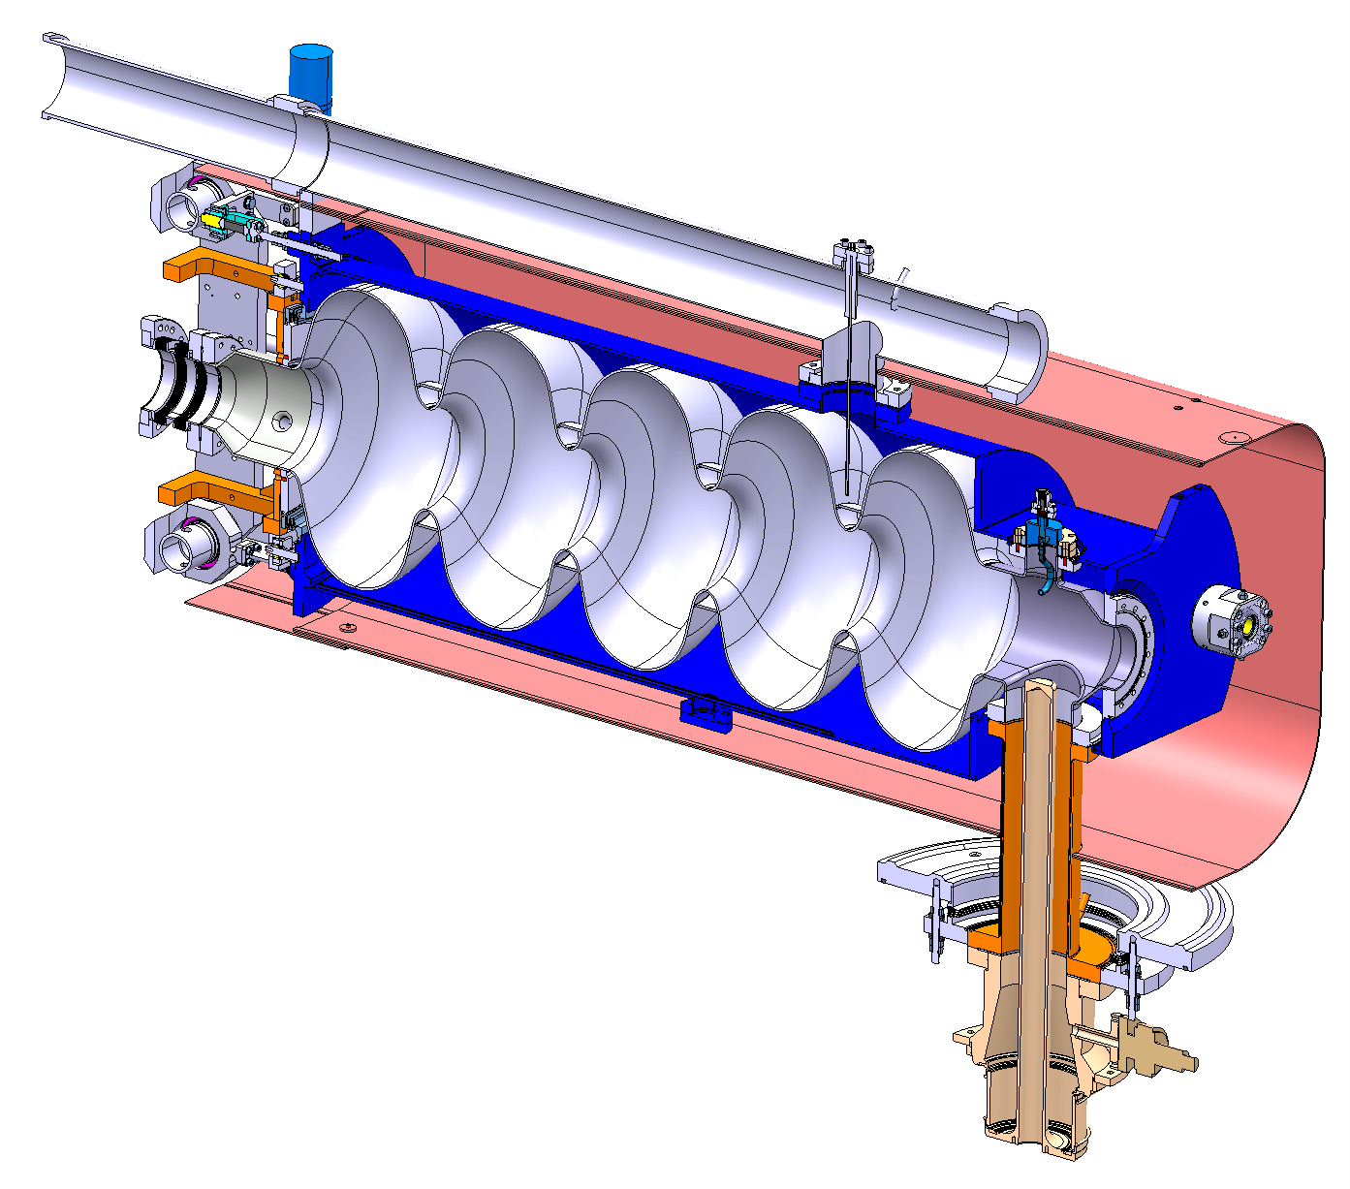
Overview
Bi-phase helium tube
Helium Tank
Bellows
CEA’s tuner
Bulk Niobium 5 Cells cavity
Magnetic shielding
HOM Coupler
Inter-cavity support
Double walled tube
RF Power Coupler
O. Capatina, SPL Seminar 2012

Slide 5
Overview
HOM-Coupler used to extract or dissipate unwanted, higher order modes in the cavity induced by the beam
Resonant circuit
Antenna
Extracted power
Cavity
HOM-Coupler
Very high impedance for the notch frequency (704.4MHz)
Low impedance for “all” other modes

Slide 6
Design Requirements
3 MeV
50 MeV
102 MeV
160 MeV
750 MeV
4/5 GeV
H⁻ source
RFQ
chopper
DTL
CCDTL
PIMS
β=0.65
β=1.0
Schematic layout of the linac
(Conceptual design of the SPL II)
352.2 MHz
704.4 MHz
Monopole modes with the highest R/Q¹
For SPL only the monopole modes are interesting
Dipole modes with the highest R/Q¹
In case of recirculators or synchrotrons should be also considered
¹ M.Schuh, F. Gerigk. “Influence of higher order modes on the beam stability in the high power superconducting proton linac“, Phys. Rev. ST Accel. Beams, 2011

Slide 7
Design Requirements
3 MeV
50 MeV
102 MeV
160 MeV
750 MeV
4/5 GeV
H⁻ source
RFQ
chopper
DTL
CCDTL
PIMS
β=0.65
β=1.0
Schematic layout of the linac
(Conceptual design of the SPL II)
352.2 MHz
704.4 MHz
Monopole modes with the highest R/Q¹
TM₀₁₁,π
TM₀₁₁,π
TM₀₂₀,2/5π
TM₀₁₁,4/5π
TM₀₁₁,4/5π
TM₀₂₁
TM₀₂₂,π
TM₀₂₀,1/5π
TM₀₁₁,3/5π
2 frequency regions relatively closed to each other
Narrowband coupler
3 frequency regions which are widely spread
Broadband coupler or application of multiple couplers
¹ M.Schuh, F. Gerigk. “Influence of higher order modes on the beam stability in the high power superconducting proton linac“, Phys. Rev. ST Accel. Beams, 2011

Slide 8
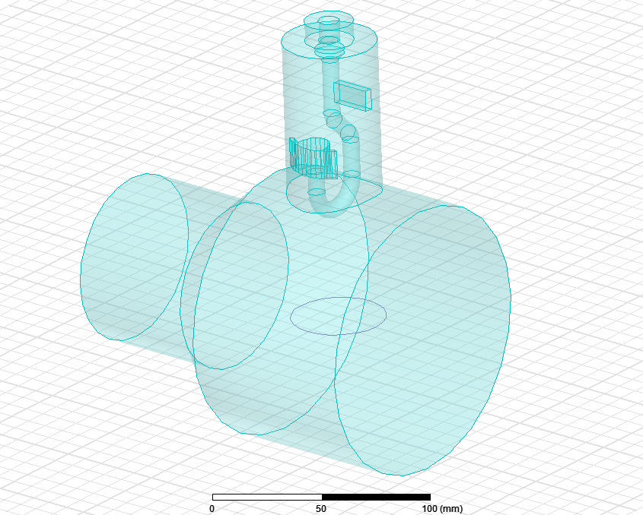
Design Approaches
Number of factors such as operational frequency, power dissipation, multipacting, field emission, surface resistance & heating evaluation as well as personal preference → different approaches
Hook coupler
2-inductive stub coupler (rescaled TESLA-style)
Beam pipe
Hook coupler with additional inductive stub
Cavity
Broadband coupler with probe

Slide 9
Design Approaches
Coaxial port (50 Ohm)
Capacitive coupling for impedance matching
Mutual inductance of the resonant circuits
fixing of the whole inner conductor
may support liquid helium for cooling
Notch capacitor couples to the outer conductor
Notch inductance which together with the red labeled capacitance creates the notch filter
E- and H-field coupling
Every part of the coupler (also the non labeled) affects more or less its frequency dependent impedance characteristic
9

Slide 10
Design Approaches
Initial estimation for design by transmission line models
Approximation
by lumped circuit model
Calculation of the lumped circuit elements for a desired frequency spectrum
Initial
design
Transformation in Transmission Lines gives the lengths of the coupler parts
10

Slide 11
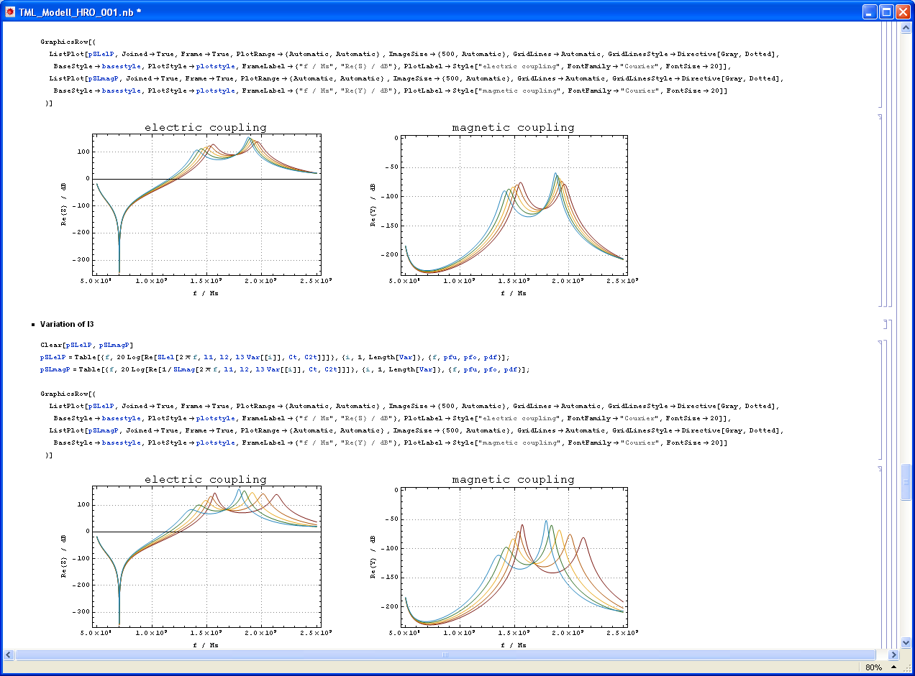
Transmission Line Model
Transmission Line Models reduce the problem to a few parameters
Fast and easy computation of the impedance characteristic (with e.g. Mathematica)
Only a rough estimation of the 3D-Model but helpful tool to provide a first design
Very useful to get an idea of the parametric dependencies
Subsequently the optimization will be done with CST MW, HFSS, …
11

Slide 12
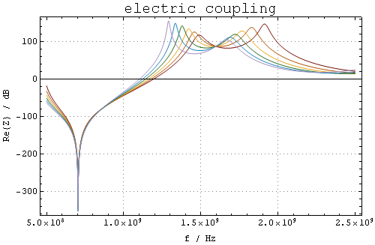
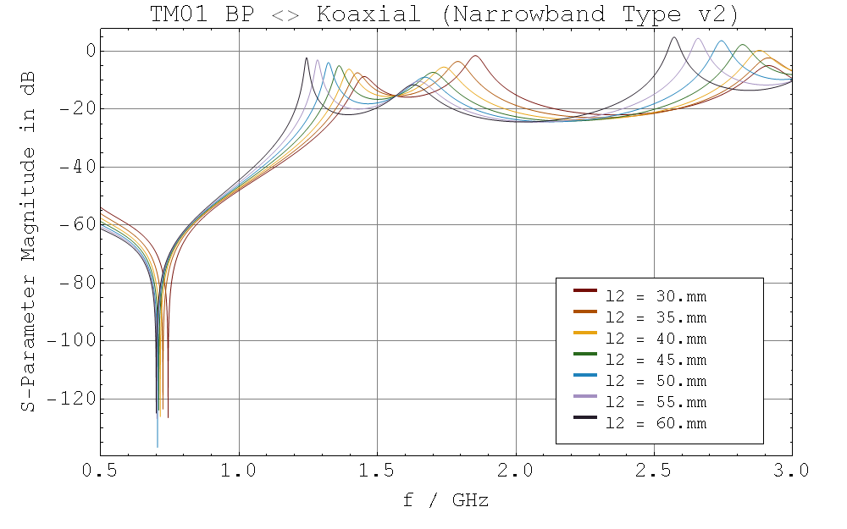
Transmission Line Model
Example for a parametric dependency (3D-Simulation and TML-Model)
TML-Model
TM01 - TEM (Narrowband type v2)
l1
Splitted modes of the two coupled resonant circuits
l1
l1
l1
l1
l1
l1
l1
Notch filter
Simplified 3D-Model

Slide 13
Transmission Line Model
Circuit equivalents for the different design approaches
Narrowband coupler with hook
2-Stub coupler (narrow/ broad)
Broadband coupler with probe
1-Stub coupler (narrow)
Notch filter

Slide 14
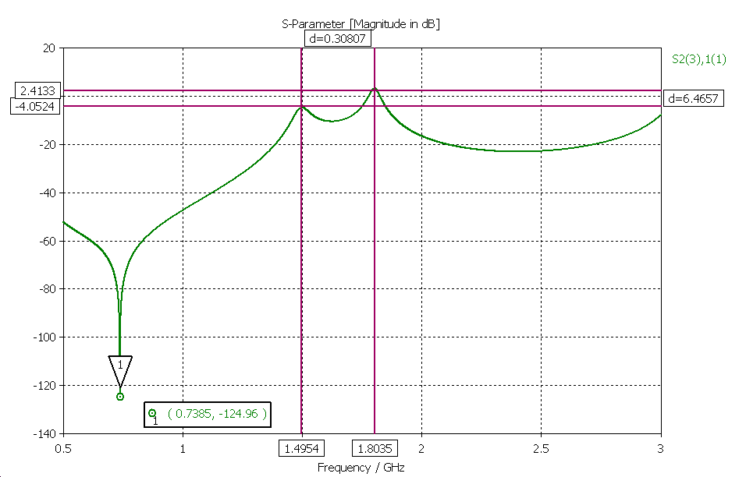
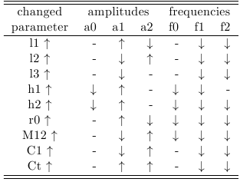
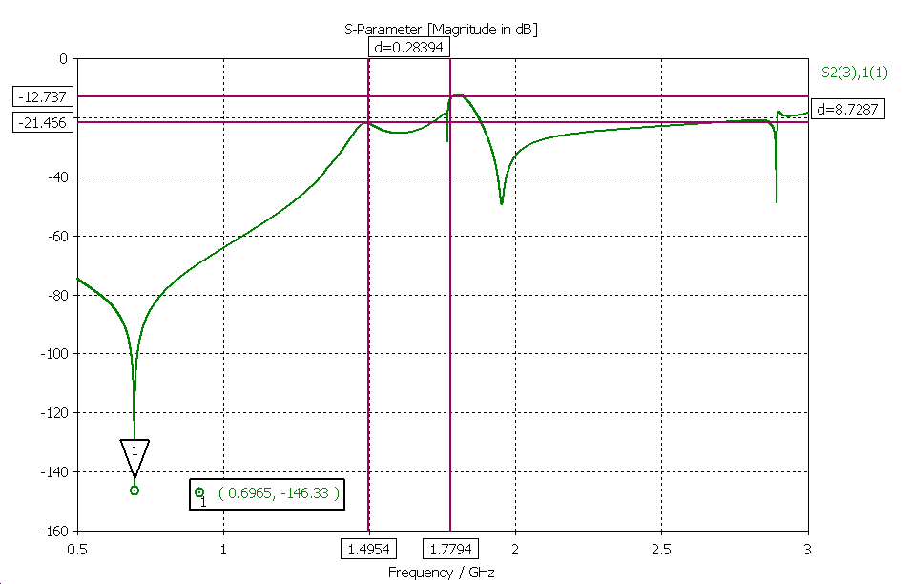
Narrowband Coupler with Hook
Optimization of the narrowband coupler for beta = 0.65
TM01 – TEM [dB]
Ct
l3
C1
l2
M12
l1
h1
simplified model
h2
TM01 – TEM [dB]
r0
1.5 mm distance
Notch filter
Design only suitable for small band width
In case of beta = 1.00 coupler could only be optimized for one frequency
Hook is difficult to cool
model including beam pipe

Slide 15
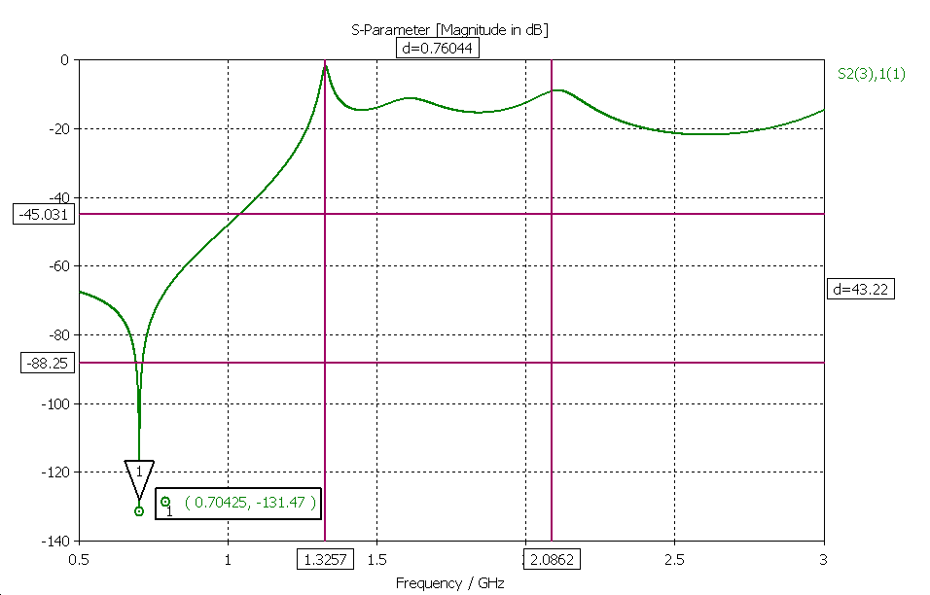
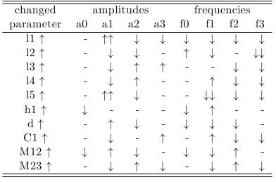
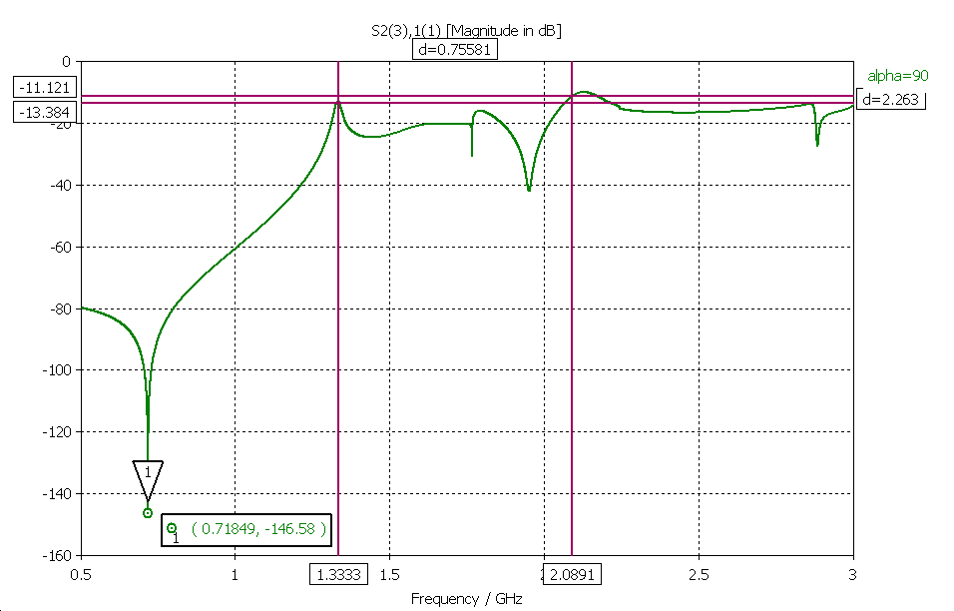
Broadband Coupler with Probe
Optimization of the broadband coupler for beta = 1.00
TM01 – TEM [dB]
l4
C1
l3
M23
l2
d
h1
simplified model
TM01 – TEM [dB]
l1
M12
Notch filter
0.5 mm distance
l5
Larger bandwidth with 3 resonances
Sharper transition frequency region
Better to cool
model including beam pipe

Slide 16
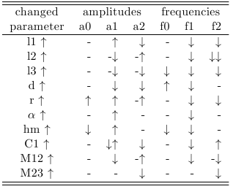
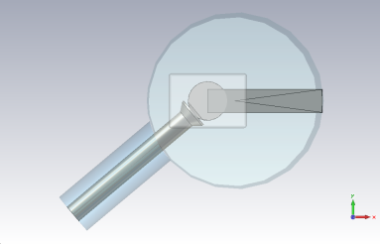
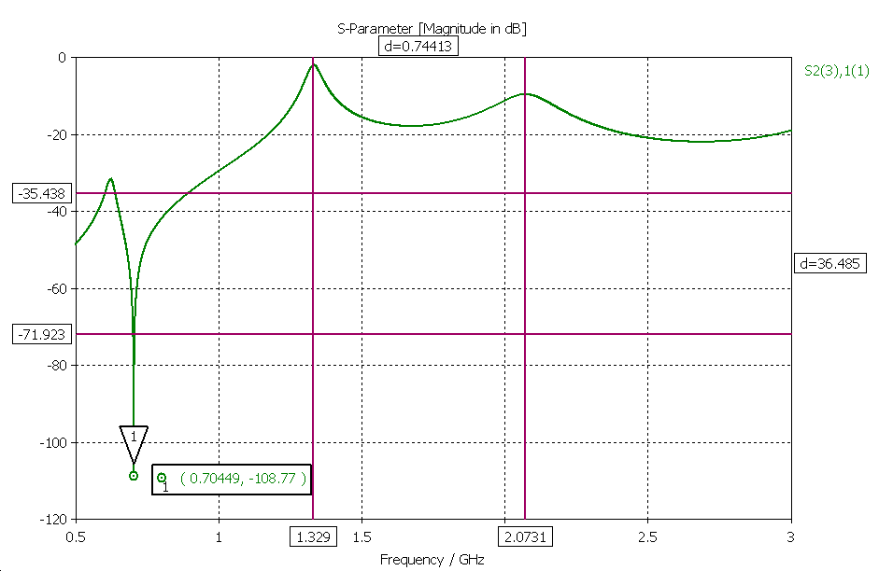
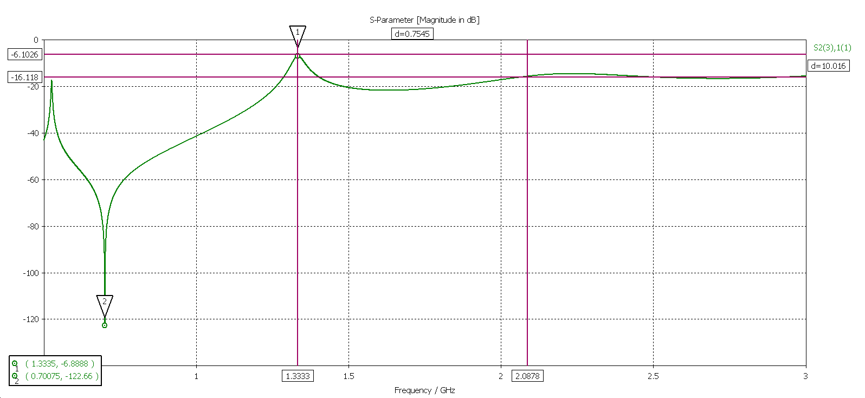
2-Stub Coupler
Optimization of the 2-Stub coupler for beta = 1.00 (broadband)
0.5 mm distance
Lower damping of the accelerating mode
l3
C1
M23
l3
C1
M23
Higher damping of the higher order modes (< 2.5 GHz)
hm
hm
l2
M12
l2
M12
l1
r
d
l1
r
Notch filter
d
α
TM01 - TEM [dB]
TM01 - TEM [dB]
difficult to adjust

Slide 17
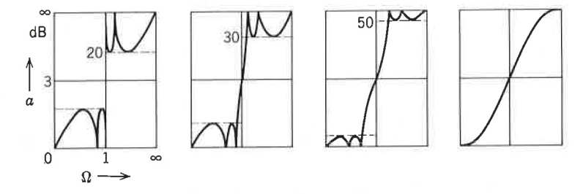
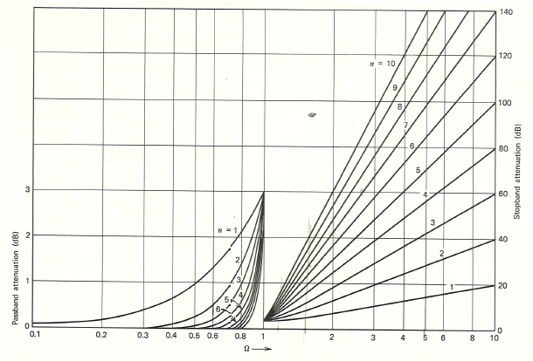
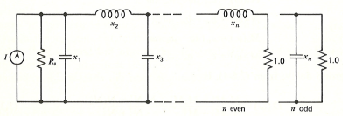
Higher Order Filter
Previous designs not suitable for the first dipole band (sharper transition frequency region is required)
modes that are very closed to 704.4 MHz
Sharper transition frequency region at the costs of lower damping in stop band and higher damping in pass band
Sharper transition frequency region also possible by using filters of a higher order → more complex design
Figure 1: Attenuation of some Chebyshev filter (n=5)¹
Figure 2: lumped circuit of a n-th order low pass²
Figure 3: Attenuation of Butterworth filter of different order n²
¹ A. I. Zverev, “Handbook of Filter Synthesis“, John Wiley & Sons New York, p. 68, 1967
² H. J. Blinchikoff, A. I. Zverev, “Filtering in the Time and Frequency Domain“, John Wiley & Sons New York, p. 107-111, 1976
17

Slide 18
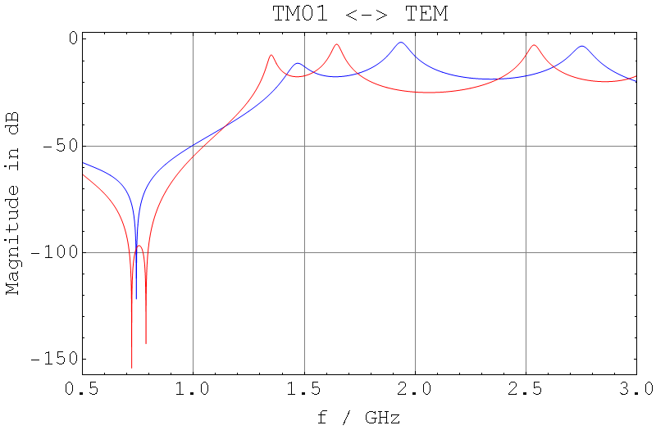
Higher Order Filter
Increasing the order by using of an additional coupling inductance
This results also in a double-notch^{1,2} (no adjustment necessary)
TM01 - TEM
double-notch effect by 2nd inductive stub
¹ A. Ainsworth, R. Calaga, et al., “HOM Coupler Optimisation for the Superconducting RF Cavities in ESS “, Proceedings of IPAC2012, 2012
² W. Xu, .et al. , “New HOM coupler design for high current SRF cavity “, Proceedings of IPAC2012, 2012
18

Slide 19
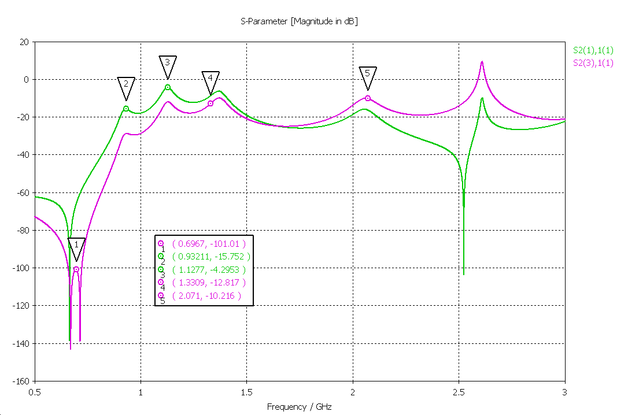
Higher Order Filter
Together with a second capacitor the coupler achieve an appropriate broad band characteristic with sharp transition frequency region
TM01 - TEM
TE11 - TEM
1.8 mm distance
monopole HOMs
dipole HOMs
optimized model
19

Slide 20
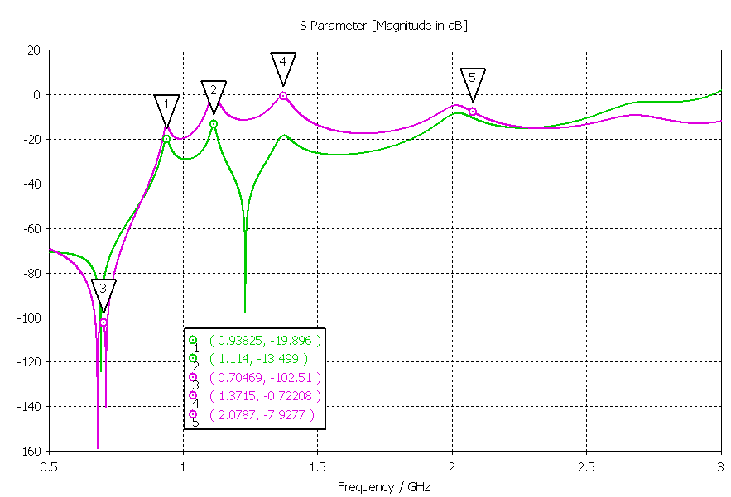
Higher Order Filter
In the same manner the broadband coupler can be modified
Transmission of monopole HOMs is higher (5 - 10dB)
TM01 - TEM
TE11 - TEM
0.8 mm distance
monopole HOMs
dipole HOMs
optimized model
20

Slide 21
Heat Losses
H-Field of fundamental mode @ 704.4MHz as indicator for thermal losses
Surface resistant difficult to determine due to the residual resistant^{1,2} (tolerance range of +/-100%)
$$P=\frac{1}{2}RS∯{HH^{∗}}ds$$
x 3500
G = 280 Ω
Q₀ = 5x10⁹
Rs = 56 nΩ
Parameter | Tesla design | Broad band coupler | Hook coupler
Surface losses | 1.212 mW | 0.954 mW | 0.836 mW
Bmax | 9.2 mT | 9.0mT | 9.8mT
Emax | 11MV/m | 10.5MV/m | 9.5MV/m
worst case estimation for fundamental mode
¹ G. Ciovati, et al., “Residual Resistance Data From Cavity Production Projects at Jefferson Lab“, IEEE TRANSACTIONS ON APPLIED SUPERCONDUCTIVITY, 2011
² T. Junginger, et al., “RF and Surface Properties of Superconducting Samples“, CERN-ATS-2011-037, 2011

Slide 22
Heat Losses
Consideration of some higher order modes
mode | TM011, π | TE111, 3/5π | TE111, 4/5π | TM011, π | Hybrid
magnitudes of H-field
frequency | 704.4 MHz | 915 MHz | 940 MHz | 1331MHz | 1409 MHz
Bmax | 9.2 mT* | 0.108 | 0.093 | 0.045 | 0.016
surface loss | 96 μW* | 87 x 10⁻⁶ | 58 x 10⁻⁶ | 5.65 x 10⁻⁹ | 0.39 x 10⁻⁶
output power | 14 mW* | 1 | 1 | 1 | 1
surface loss per 1W output | - | 87 μW | 58 μW | 0.016 μW | 0.394 μW
x 2000
Rs = 56 nΩ
*scaled to 25MV/m and 4% duty cycle

Slide 23
Summary
Hook coupler (1 inductive stubs)
2-Stub coupler (narrow/ broad)
Small bandwidth
Maybe considered for medium beta cavities
Very sensitive to Multipacting¹
Difficult for active cooling
Very appropriate for cooling
Less sensitive to Multipacting¹
adjustable Notch frequency
Broadband coupler with probe
Double-notch designs
Larger bandwidth (3 resonances)
Lower damping of HOMs
Preferred for high beta cavities
appropriate for active cooling
Can be realized with hook as well as with probe antenna
Notch filter with large band width
Sharp transition frequency region
More complex designs
¹ S. Molloy, R. Ainsworth, R. Ruber,. “Multipacting Analysis for the Superconducting RF Cavity HOM Couplers in ESS“, Proceedings of IPAC2011, 2011

Slide 24
Outlook
Further designs will be considered
Coupled electromagnetic and thermodynamic simulations
Multipacting analysis
Mechanical design
Building of the first prototypes and experimental analysis
Thank you for your attention

