Slide 1




Engineering Design of the ESS Spoke Cryomodule
Denis Reynet - Sébastien Bousson
On behalf of the IPNO team
CNRS/IN2P3/ IPNO – Paris-Sud University

Slide 2
Outlook
  Cryomodule design activity at IPNO
  Requirements for the ESS spoke cryomodule
  Cryomodule features
  Cryomodule assembly sequences
  Heat loads
  Prototype cryomodule planning
  Conclusion

Slide 3
Cryomodule Design Activities at IPNO
Same lab but different design core team and design choices specific to each project (with sometimes some idea permeation between the different teams… hopefully only for the good ones !)

Slide 4
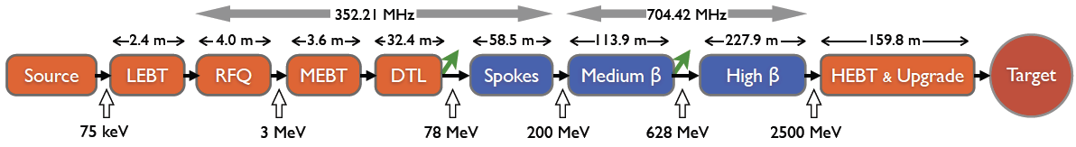
ESS Linac layout
FDSL 2012_10_02
Section | Cavity β | Total number of Modules | Cavity frequency | # Cavity per module | # Cavity per section | Cryomodule length | Section length
Spoke | 0.50 | 14 | 352 MHz | 2 | 28 | ~ 2.9 m | 58.5 m
Medium-beta | 0.67 | 15 | 704 MHz | 4 | 60 | ~ 6.7 m | 113.9 m
High-beta | 0.92 | 30 | 704 MHz | 4 | 120 | ~ 6.7 m | 227.9 m
Total |  | 59 |  |  | 208 |  | ~ 400 m
The foreseen design changes are almost not affecting the spoke part , except for the required power to be transmitted to the beam and increase of the cavity voltage.

Slide 5
Spoke cryomodule requirements
Main requirements:
  Host two double spoke cavities
  Nominal temperature operation: 2K
  Power couplers located at the bottom
  Optimized cryogenic heat loads
  Max pressure < 1.5 Bar
  Beam height, tunnel height
Cryomodule interfaces to take into account:
Beam tube
RF distribution (wave guide / coaxial)
Cryogenic distribution
Alignment & interface to the ground
Instrumentation, PLC
Vacuum system
Safety
Tooling

Slide 6
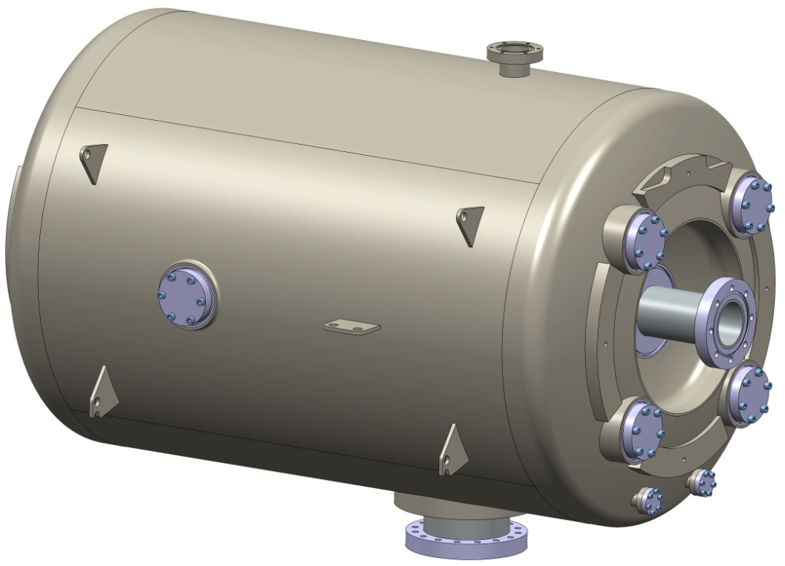
Physical interfaces with the cavity
Main features:
Beam tube (cold/warm transition, bellow between the 2 cavities)
Supporting system / Vacuum vessel
Power coupler
Cold tuning system
Magnetic shielding
Cryogenic distribution
Alignment
Other items:
all required tooling for cavity preparation, processing & assembly

Slide 7
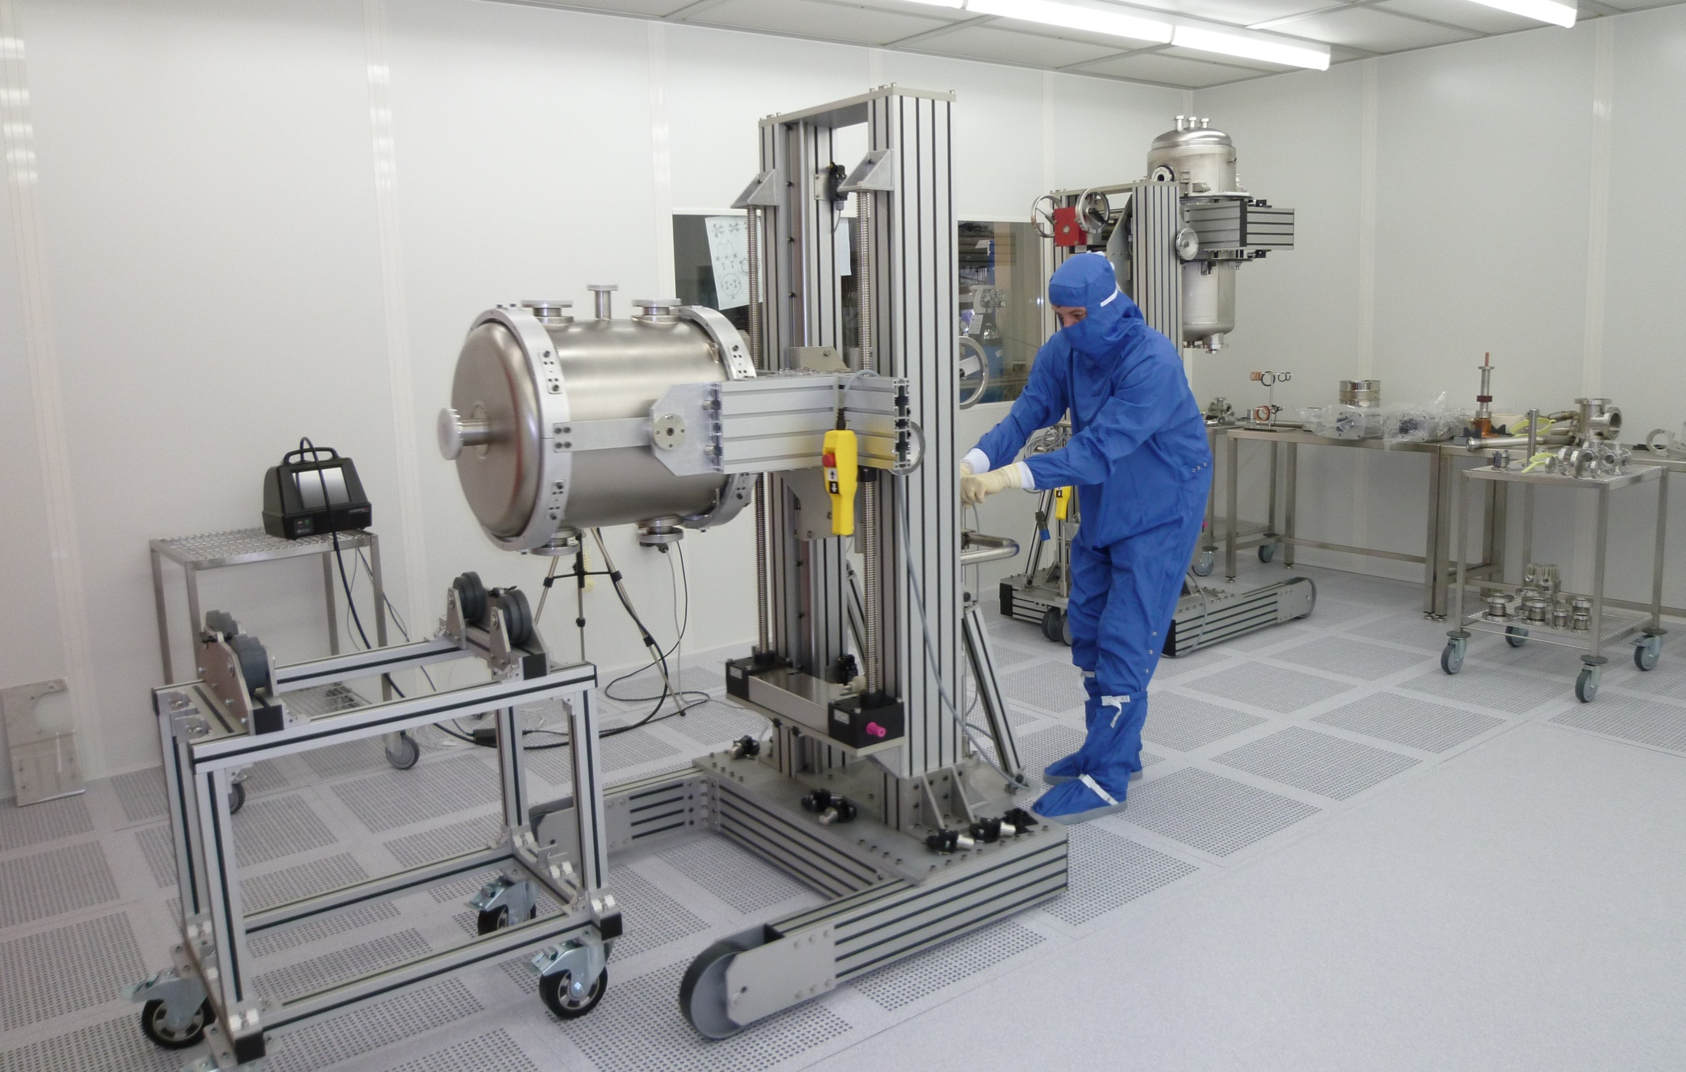
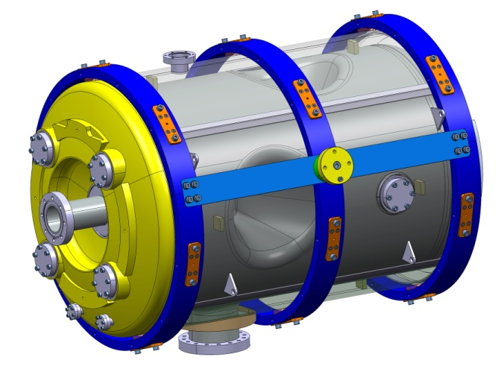
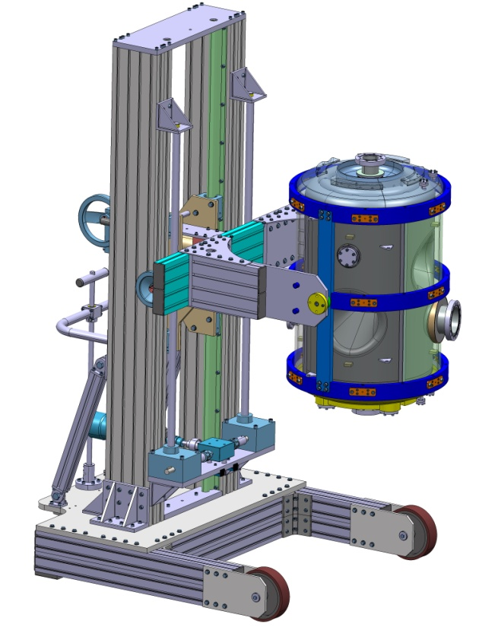
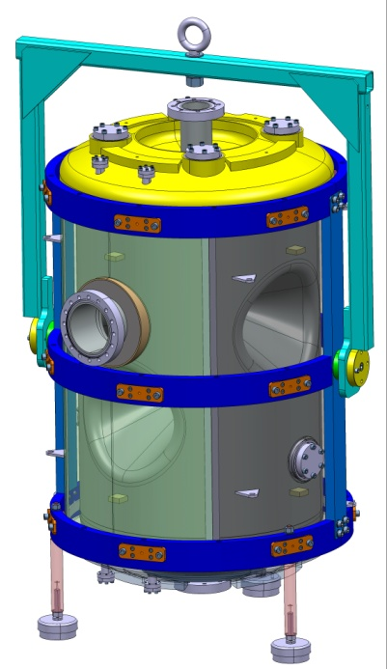
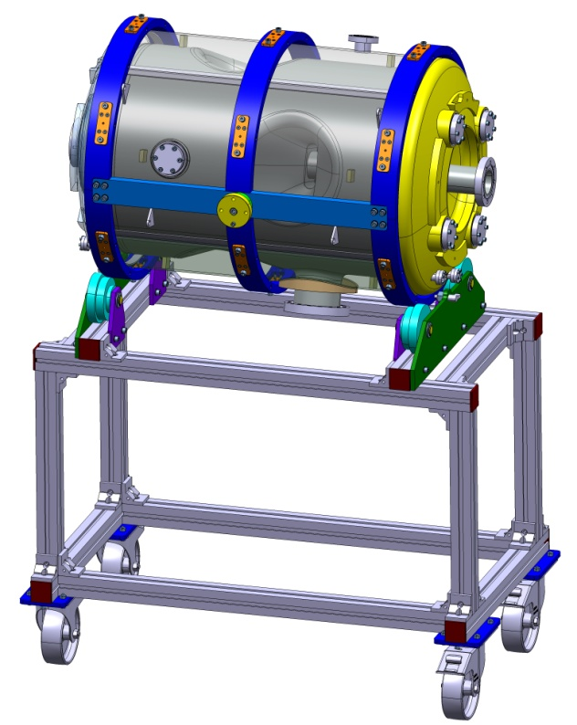
Cavity assembly into the clean room 1/2

Slide 8
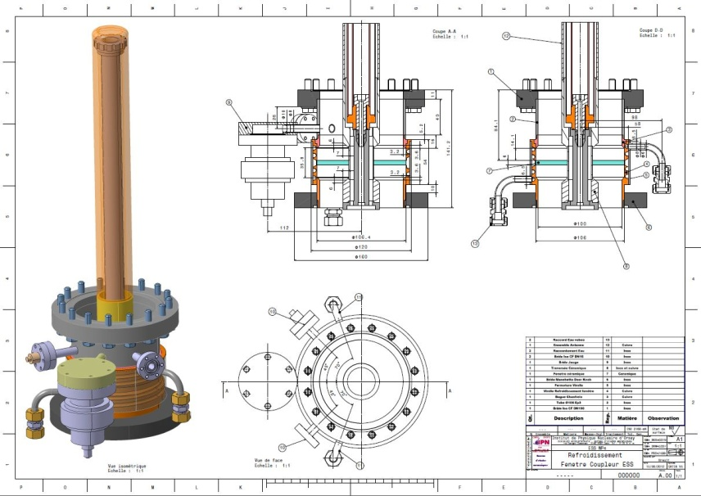
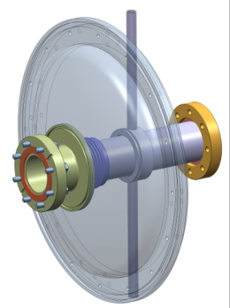
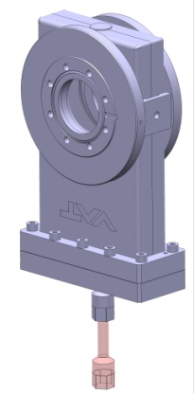
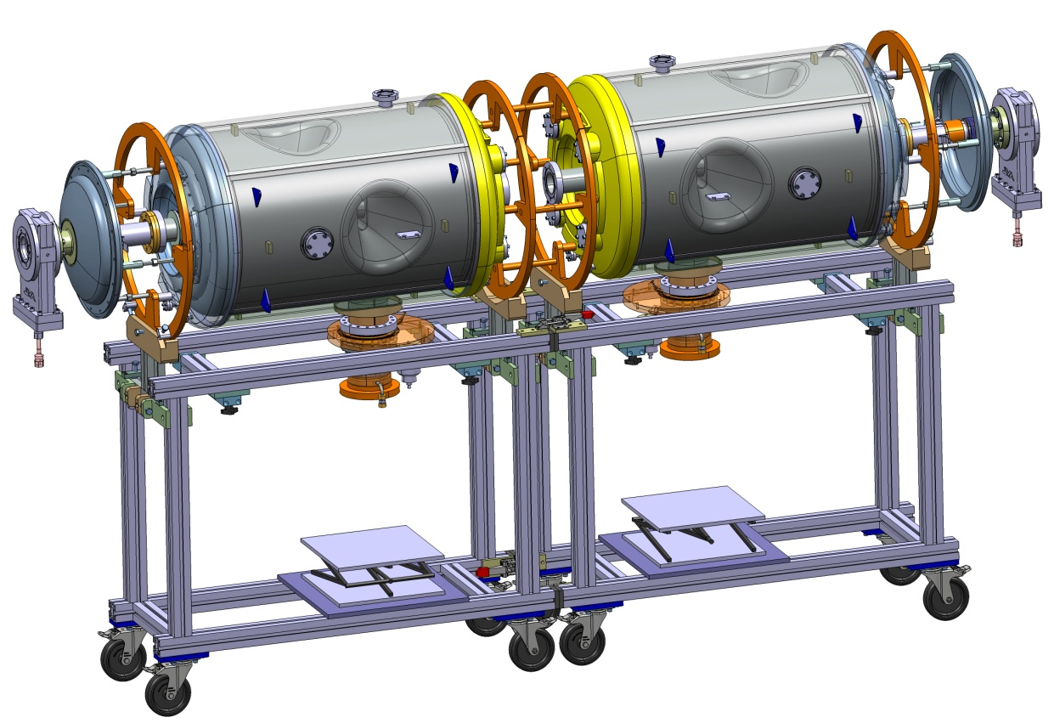
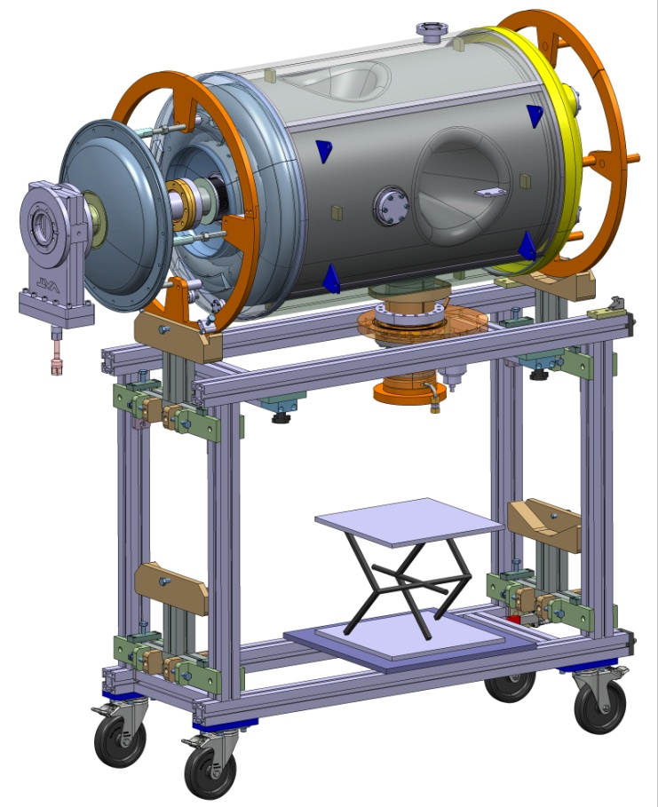
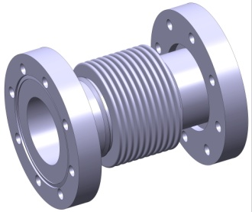
Cavity assembly into the clean room 2/2
Standard UV Valve
Active C\W transition
And small dishED End
Power Coupler
Standard Bellows

Slide 9
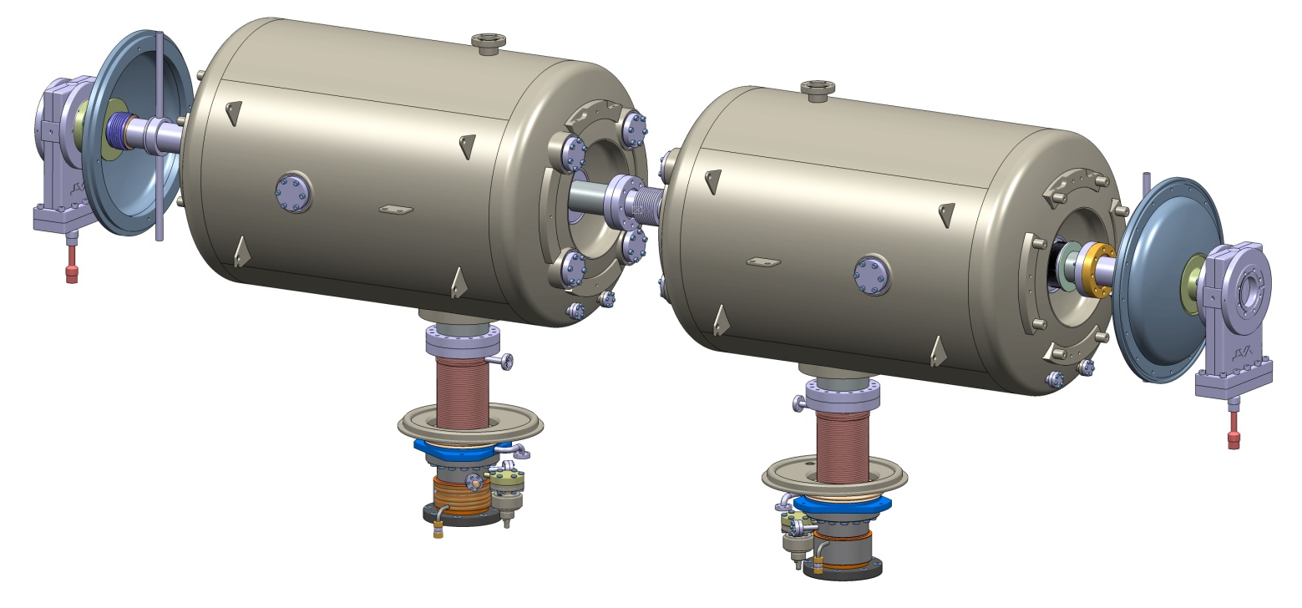
Cryomodule assembly sequences
1 – Cavity string after clean room assembly
Cavities will be under vacuum after clean room assembly
Toolings are compensating from the pressure forces and supporting the different sub-assembly
Warm valves (actuator dismountable)
Small dish ends assembled in clean room

Slide 10
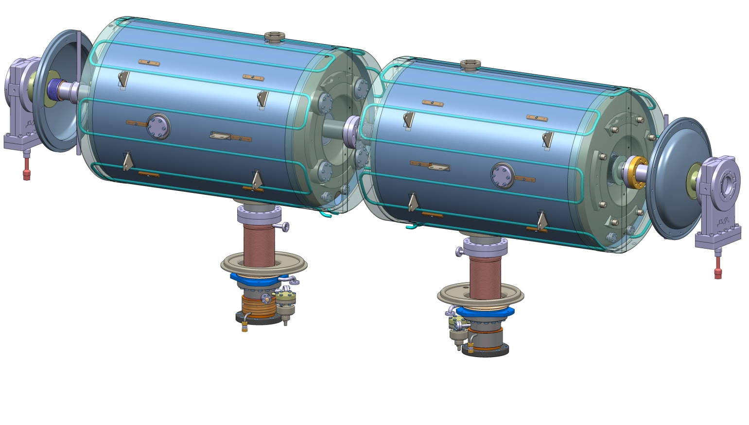
Cryomodule assembly sequences
2 – Magnetic shielding
Cold magnetic shielding (cryoperm type)
Baseline: active cooling (SS piping) to insure cryoperm efficiency at the cavity normal state -> superconducting transition

Slide 11
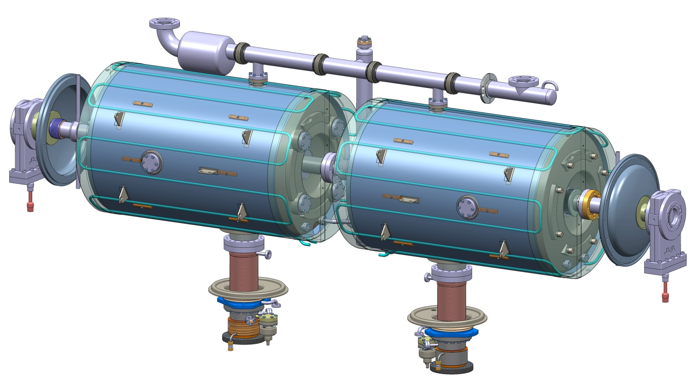
Cryomodule assembly sequences
3 – Cryogenic distribution
3 circuits: 2K for the cavity, 50K for thermal screen, ~5 K for power coupler outer conductor cooling
The biphasic tube + LHe level could be tested independently from the assembly. Access to LHe level gauge integrated on vacuum vessel for maintenance

Slide 12
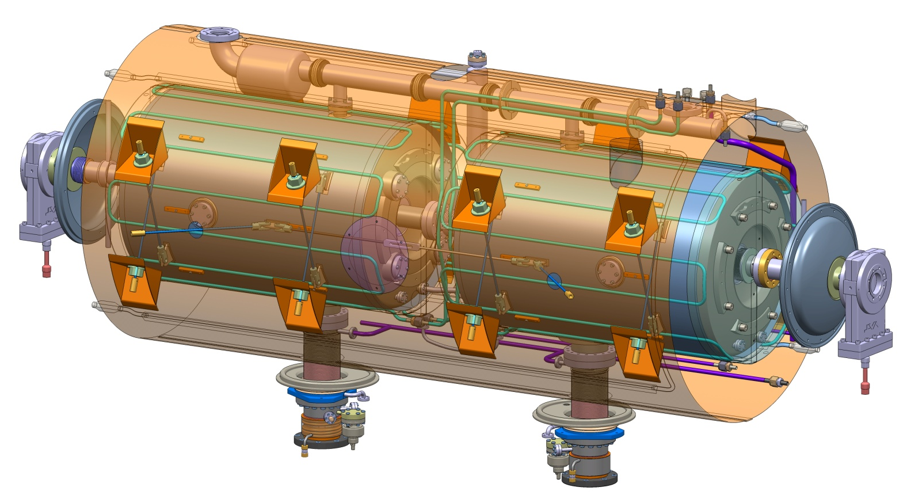
Cryomodule assembly sequences
4 – Supporting rods and thermal screen
Cavity string supported by means of antagonist rods (TA6V)
Thermal screen divided into 2 half parts
The aluminium thermal shield is maintained with an elastic liaison insured by TA6V rods

Slide 13
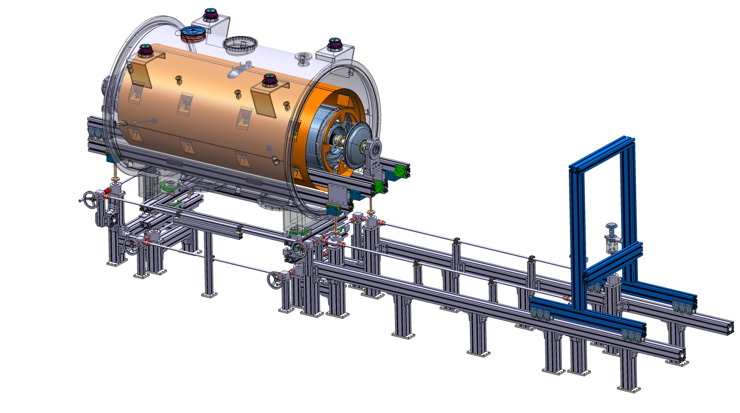
Cryomodule assembly sequences
5 – Introduction in the vacuum chamber

Slide 14
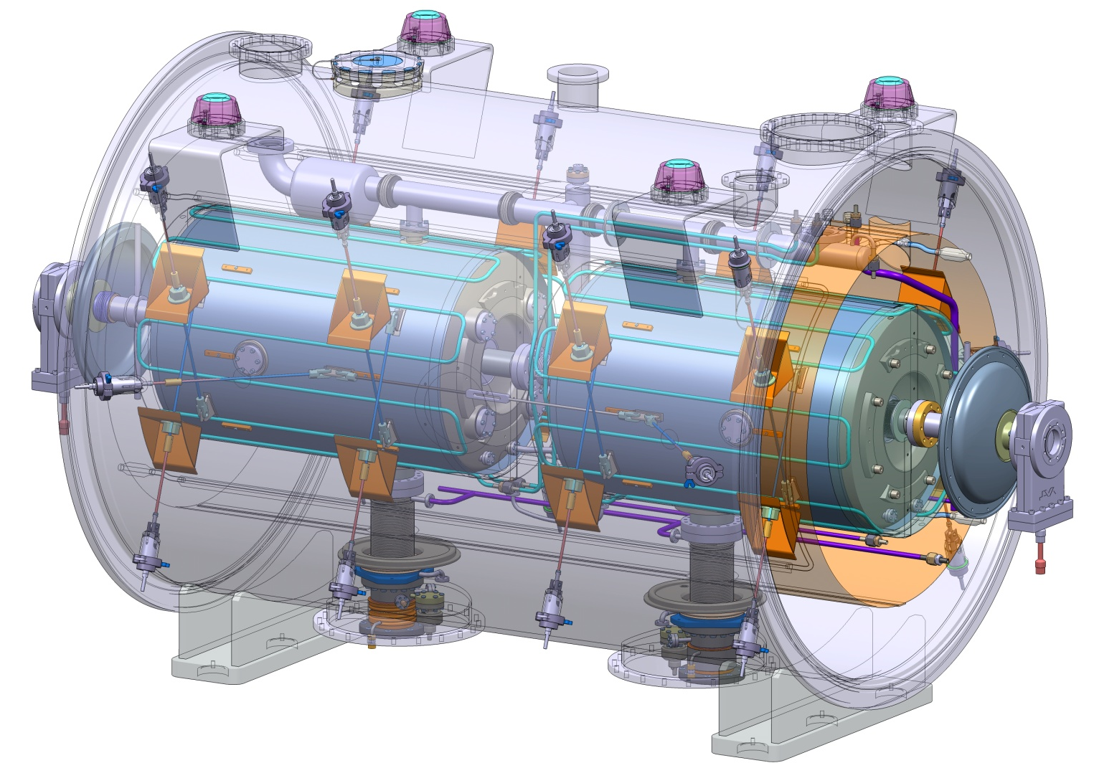
Cryomodule assembly sequences
6 – Attaching the cavity string to the vacuum tank
Rods to be installed (TA6V) – A total of 8 per cavity
Possibility for external adjustments (at Patm, under vacuum, @ cryo T)

Slide 15
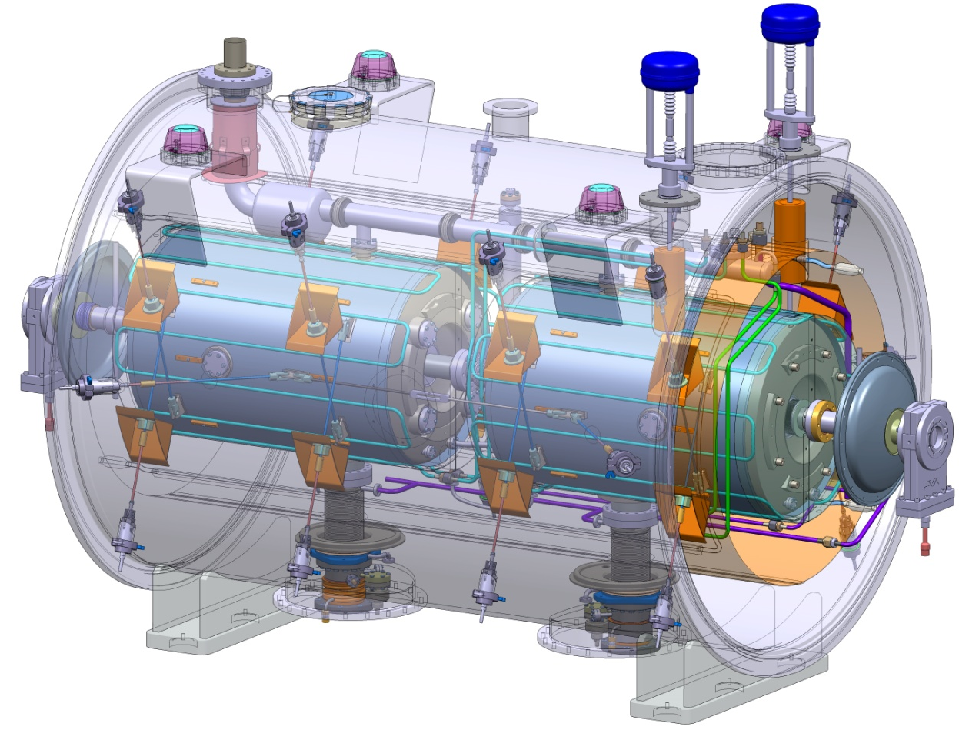
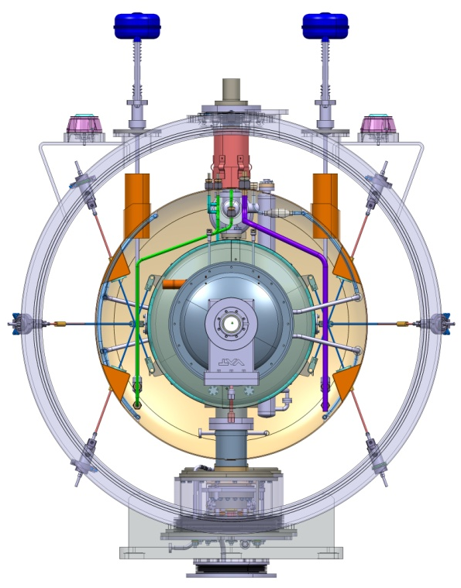
Cryomodule assembly sequences
7 – Final cryogenic piping assembly
Installation of burst disks, cryo valves & screening
Cryogenic lines connection (VCR type for prototype, welding for series ?)
In-situ leak test of cryo lines

Slide 16
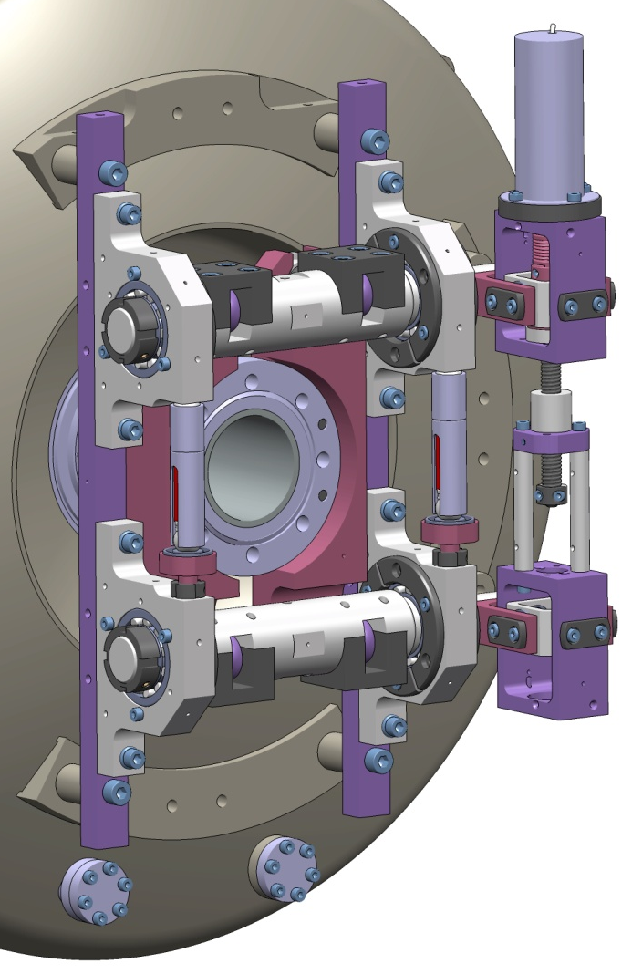

Cryomodule assembly sequences
8 – Cold tuning system assembly from both side & final 50 K circuit assembly (C/W transition, active cooling)

Slide 17
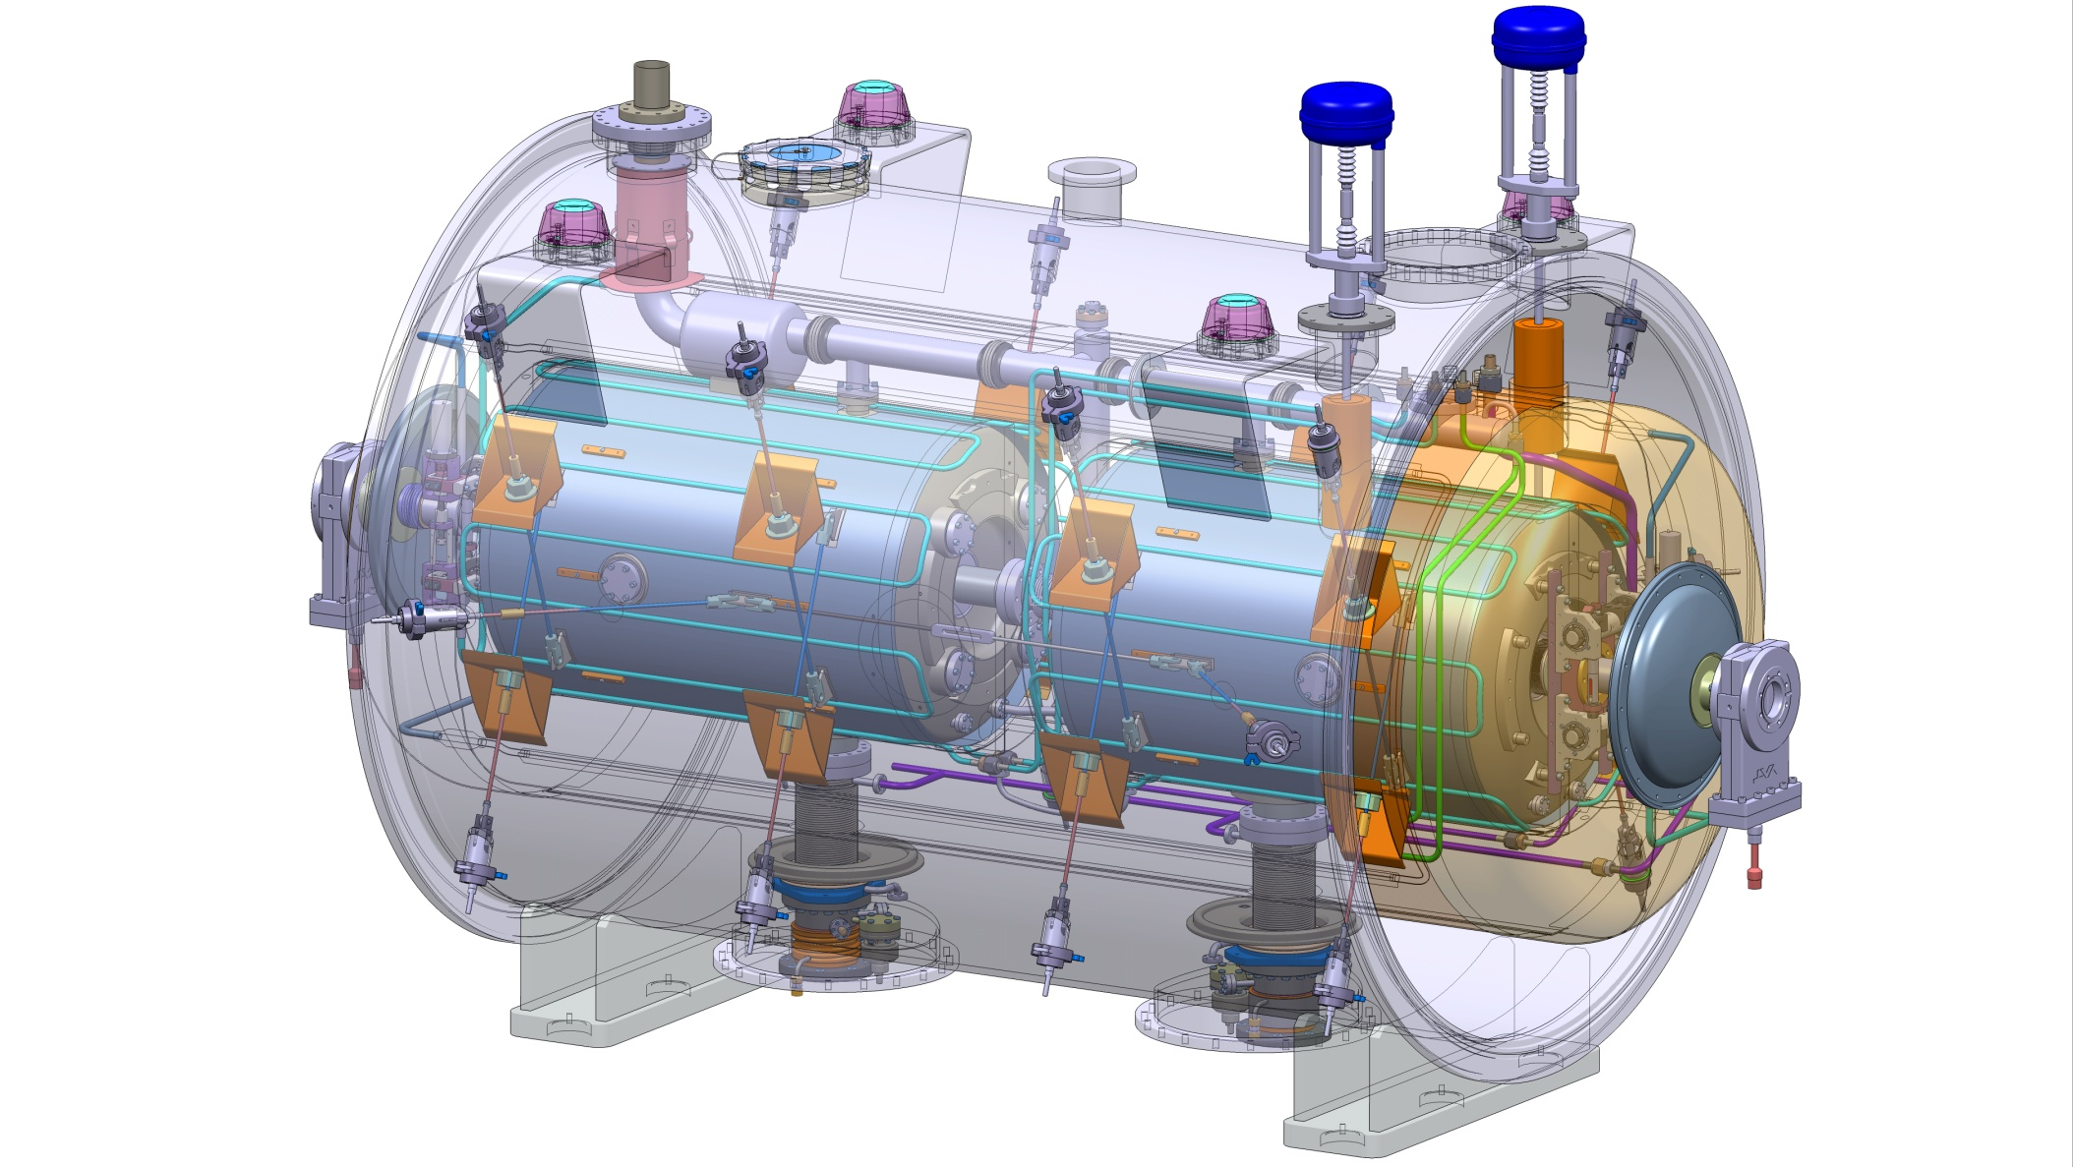
Cryomodule assembly sequences
9 – Assembly of the thermal screen lateral parts (dished ends) – cooling by conduction

Slide 18

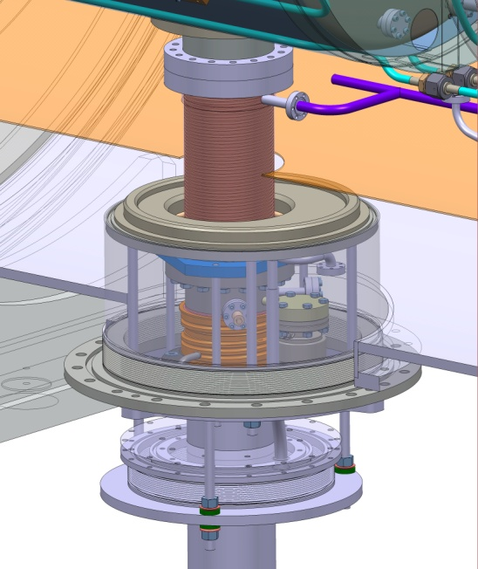
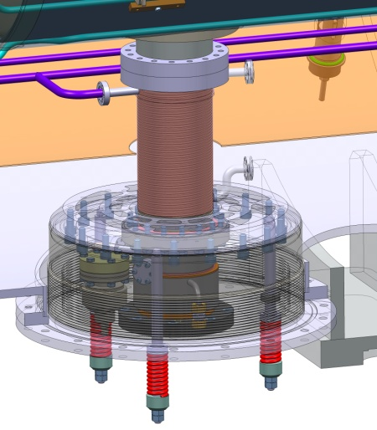
Cryomodule assembly sequences
10 – Assembly of the pressure compensation system: 2 options
Barometric compensation
Springs
A mock-up of the system will be fabricated to test the system.

Slide 19
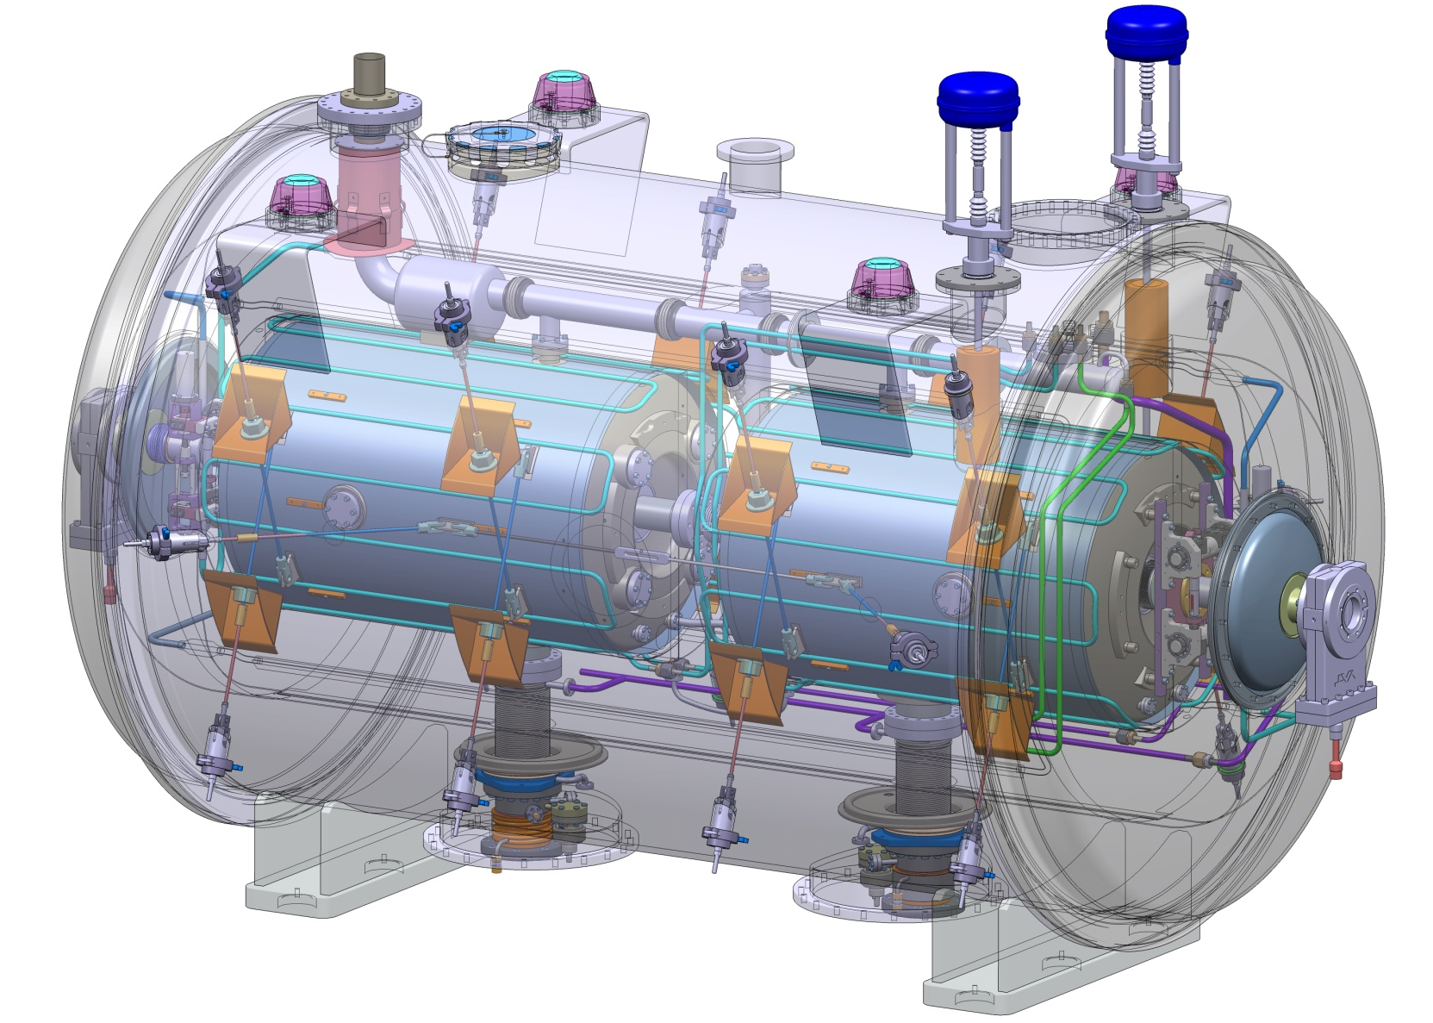
Cryomodule assembly sequences
11 – Vacuum vessel closure

Slide 20
Cryomodule Main Dimensions

Slide 21
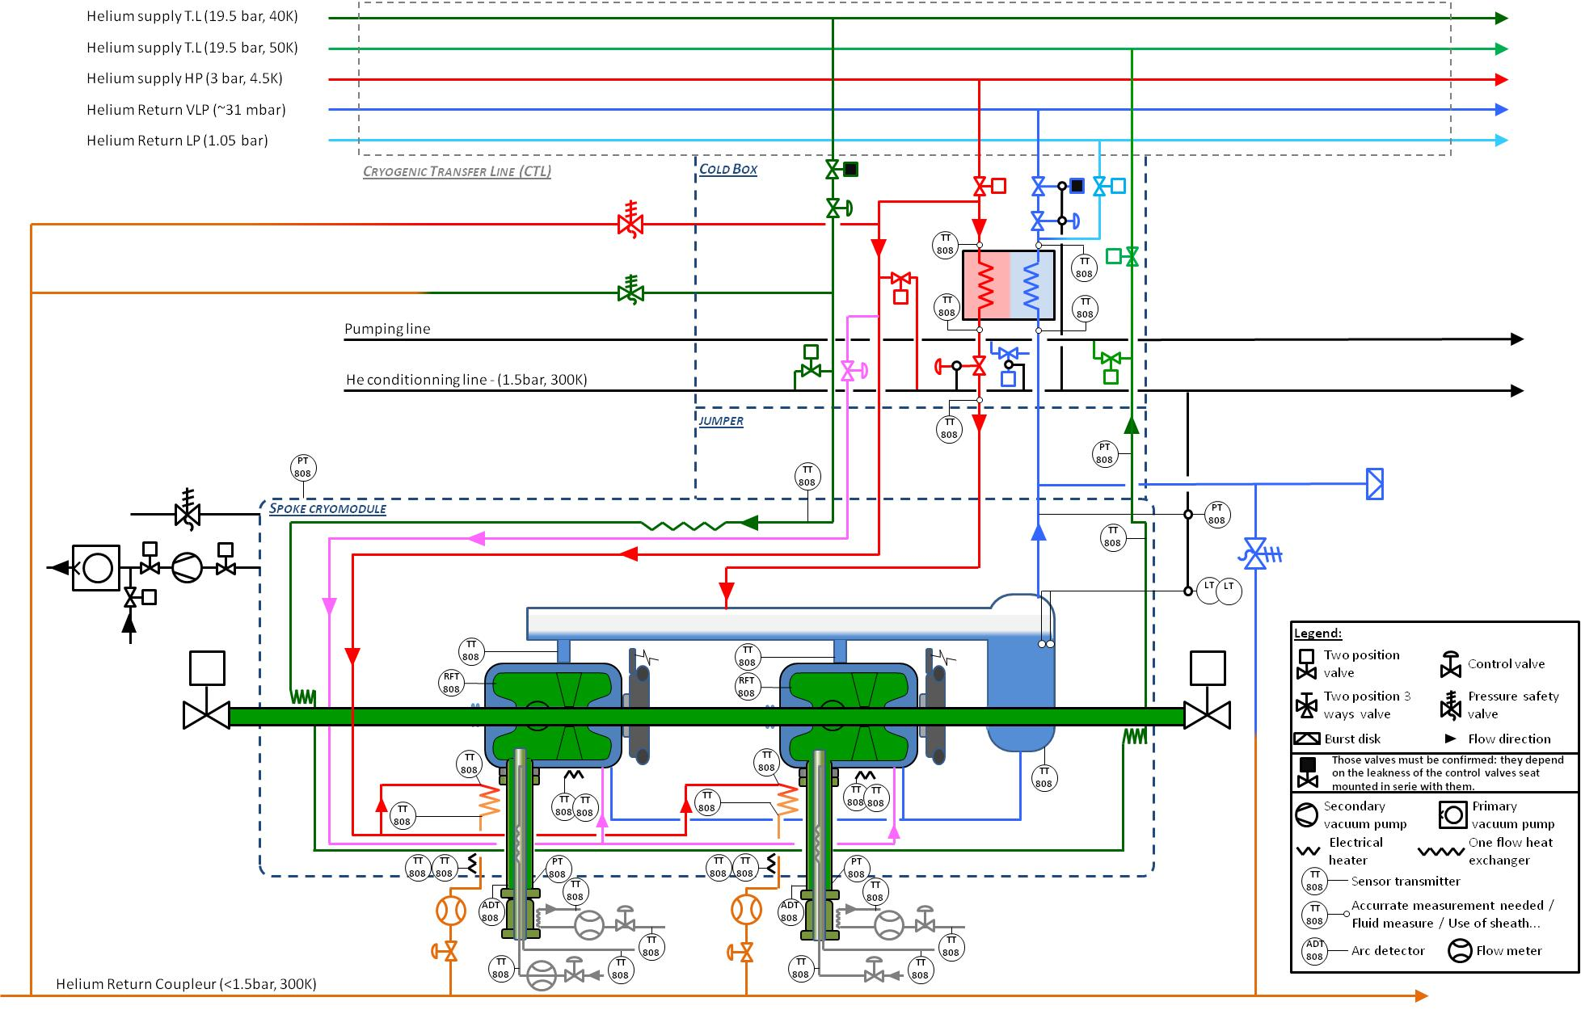
Cryomodule PID
P. Duthil

Slide 22
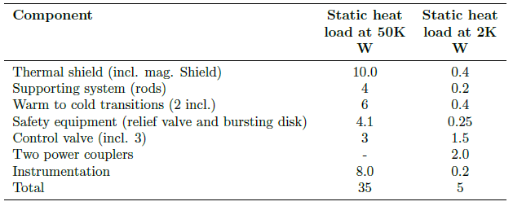
Cryomodule heat loads
Static heat load
Dynamic heat load
CW Equivalent to 2 W / cavity at 2 K
+ beam losses…

Slide 23
Remaining work to be done…
Detailed cryogenic distribution & final cryo valves localization
Jumper connection, valve box
Instrumentation
Alignment procedure
Cryostating tooling

Slide 24
Spoke Prototype Cryomodule Planning
ESS SPOKE PROTOTYPE CRYOMODULE | 2012 |  |  |  | 2013 |  |  |  | 2014 |  |  |  | 2015
 | Q1 | Q2 | Q3 | Q4 | Q1 | Q2 | Q3 | Q4 | Q1 | Q2 | Q3 | Q4 | Q1 | Q2 | Q3 | Q4
DESIGN
Spoke cavities
Ancillaries (CTS, Coupler)
Cryomodule
PRODUCTION
Spoke Cavity Fabrication
Nb production for 3 cavities
IPNO 3 cavities production
Ancillaries Fabrication
Power couplers production
Cold tuning systems production
Cryomodule parts production
PARTS TESTING
Vertical Test of the 3 IPNO Cavities
Cavity package test @ high power @ UU (Freia)
Power coupler conditionning
CTS tests
CRYOMODULE ASSEMBLY
CRYOMODULE TESTING
Low power test at IPNO
High Power tests at UPPSALA

Slide 25
Many thanks to the colleagues from IPN Orsay contributing to the Spoke developments for ESS:
S. Brault, P. Duchesne, P. Duthil, N.Gandolfo, F. Leseigneur, G.Olry, E.Rampnoux, D.Reynet, JP Thermeau

Slide 26
And a little bit of advertisement….

Slide 27


Slide 28

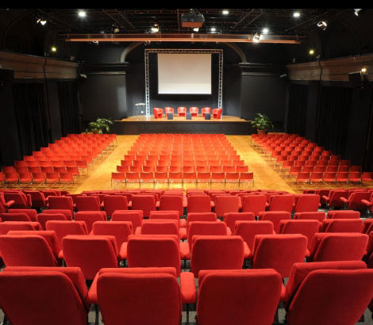

Registration is opened since 11 Feb. 2013
Abstract Submission deadline: 14 June 2013
Early Registration ends: 14 June 2013
Late Registration ends: 4 September 2013
Deadline for students / young scientists support application: 10 May

