Slide 1
Double Spoke Cavity β = 0.50 for ESS
(RF and) Mechanical Studies

Slide 2
Contents
1. Description of the prototype
2. Static calculations
2.1 Analysis on different configurations
2.2 Finite Element Model for stress analysis
2.3 Static results
2.4 Mechanical vibration modes
3. RF-Mechanical coupled calculations
3.1 Finite Element Models
3.2 RF parameters
3.3 Sensitivity for cavity tuning
3.4 Helium bath pressure fluctuation
3.5 Lorentz forces detuning factor
3.6 Summary of the results
4. New optimizations (feedback from MYRRHA cavity design)
4.1 Critical pressure during cool down
4.2 Manufacturing of the cavity
5. Status about the prototypes fabrication

Slide 3
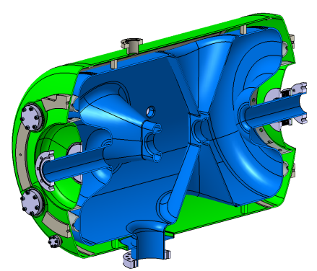
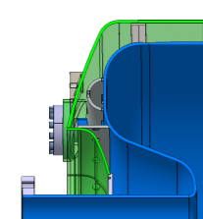
1. Description of the prototype
Pick-up Port
Cavity
Material: Niobium
Thickness: 4mm
Donut at each end cup of the cavity
Needed for leak tests
4 HPR ports on one end cup of the cavity
Better cleaning of the cavity
Helium vessel
Material: Titanium grade 2
Thickness: 4mm
Helium vessel made with standard dished end-cups
Rings linking the cavity to the helium vessel
Reduce critical stress areas around the small ports
Reduce K_{P} and K_{L}
4 HPR Ports
Bellows
Coupler port
Ring
(left and right side)
Donut
(left and right side)
The fabrication of 3 prototypes with this geometry has started 1 month ago

Slide 4
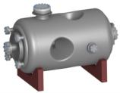
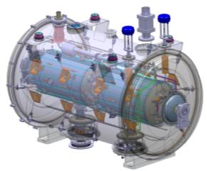
2. Static calculations
2.1. Description of the different loaded cases
Leak tests during fabrication
Bare cavity (=1st fabrication step)
Cavity with its helium vessel (=Cavity completed)
Maintain stresses < 50 MPa
Test inside the cryomodule
Cooling down at 4K
Define the critical pressure during cool down process
Mechanical-vibration modes analysis
Check sensitivity to microphonics
Frequency shift by pulling on beam tubes
Define the sensitivity for the tuning system
Helium bath pressure fluctuation
RF sensitivity due to the Lorentz forces
Define a range for the pressure and Lorentz detuning factors
Bare cavity
Cavity + helium vessel
Cryomodule

Slide 5
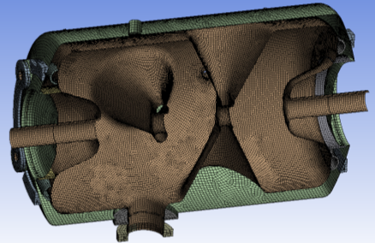
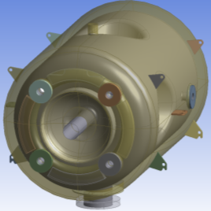
2. Static calculations
2.2 Finite element model for stress analysis
FEM model (Mechanical ANSYS V14):
Cavity
Helium vessel
Meshed with shell elements
Donut
Ring
4 HPR flanges
2 Pick-up and coupler flanges
Stiffeners of the helium vessel
Blocks of the helium vessel
⇒ Meshed with solid elements
1
2
4
3
Properties of materials (at room T°):
Niobium: Titanium:
E = 107 Gpa E = 105 GPa
ν = 0,38 ν = 0,3
ρ = 8570 kg/m3 ρ = 4510 kg/m3
Re = 50 MPa Re = 350 MPa
Rm = 125 MPa Rm = 460 MPa
5
6
7
8

Slide 6
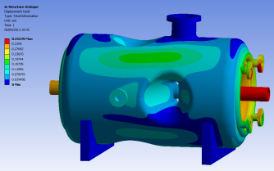
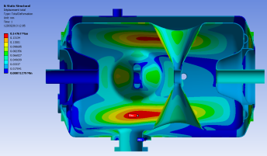
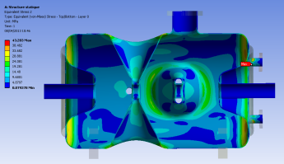
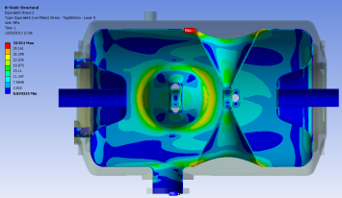
2. Static calculations
2.3 Static Results
Case 1: Leak test
Case 2: Cooling down
0.32mm
0.15mm
37 MPa
(End cup)
43 MPa (HPR port)
34 Mpa (top of the Spoke bar)
→Donut needed to get stresses on the cavity < 50 MPa:
(σ_{max} = 37 MPa)
→ Critical pressure during the cooling down test:
Pcrit = 1,47 bar (σ_{max} = 34 MPa)

Slide 7
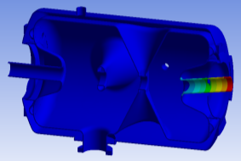
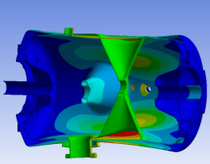
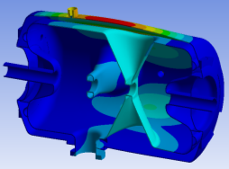
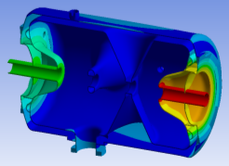
2. Static calculations
2.4 Mechanical-vibration modes
Mode 1: 212 Hz
Boundary conditions: free-free
Mode 3: 265 Hz
N° | Frequency | Mode
1 & 2 | 212Hz | Beam tube on CTS side
3 & 4 | 265Hz & 275Hz | Spoke bar/Helium vessel
5 & 6 | 285Hz | Coupled mode Cavity/Helium vessel
7 | 313Hz | Helium vessel
8 to 11 | 315Hz to 365Hz | Coupled mode Cavity/Helium vessel
12 | 396Hz | beam tubes
Mode 5: 285Hz
Mode 12: 396Hz
1st critical mode (mode 3) >> 50 Hz

Slide 8
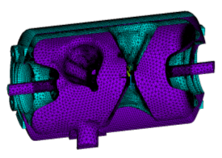
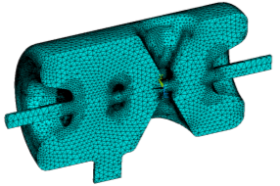
3. RF-Mechanical coupled calculations
3.1 Finite element models
Coupling mechanical and electromagnetic simulations with ANSYS V14 (Mechanical APDL & EMAG):
Mechanical FEM model:
Cavity
Helium vessel
⇒ Meshed with shell elements
Donut
Rings
HPR Flanges
Stiffeners of the helium vessel
⇒ Meshed with solid elements
Hypothesis: 1 symmetry plane
Electromagnetic FEM model:
7. Inner volume of the cavity
⇒ Meshed with solid elements (HF119)
Nota :
The shell elements of the cavity walls coincide with the faces of solid elements of the interior volume
All connections between components are realized with coincident nodes

Slide 9
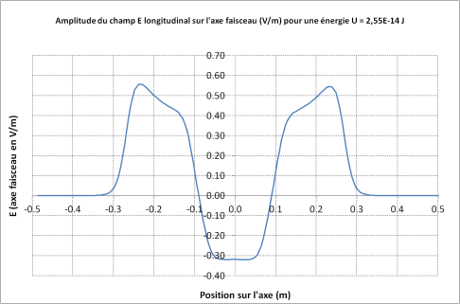
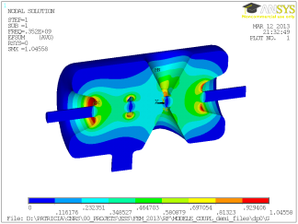
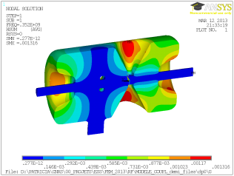
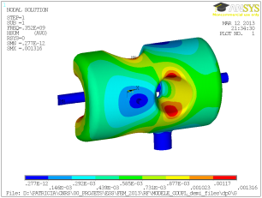
3. RF-Mechanical coupled calculations
3.2 RF Parameters
 | ANSYS
Frequency [MHz] | 351,76
Beta | 0.5
B_{pk}/E_{acc} [mT/(MV/m)] | 6,84
E_{pk}/E_{acc} | 4.33
G [Ohm] | 127
r/Q [Ohms] | 424
L_{acc} = N_{gap}.β.λ/2 [m] | 0.639
Temperature (K) | 2
Q₀ Cu@ 300K | 26469
Q₀ Nb@ 2K | 1.19*10¹⁰

Slide 10
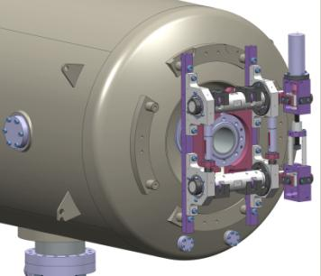
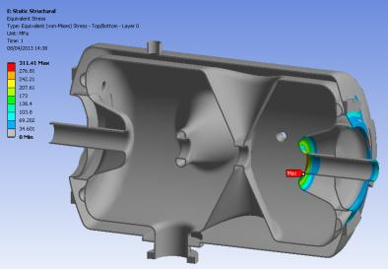
3. RF-Mechanical coupled calculations
3.3 RF Sensitivity for cavity tuning
Tuning sensitivity
Δf/Δz = 135 kHz/mm
K_{cav} = 20 kN/mm
311 MPa / mm
View of the Cold Tuning System in vertical position
At 2K: the tuning range is +173 kHz (<-> 1.28 mm of max displacement not to exceed 400 MPa)
311 MPa

Slide 11
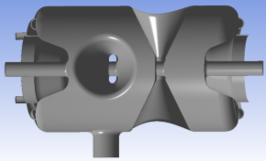
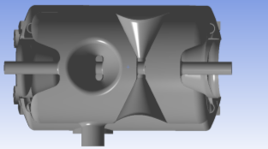
3. RF-Mechanical coupled calculations
3.4 Helium bath pressure fluctuation (1/3)
First case: Cavity without helium vessel
Sensitivity to He pressure Kp [ Hz/mbar]:
2 boundary conditions
Free ends | -113.
Fixed ends | -18.
P = 0
P = 1
Second case: Cavity with helium vessel
Sensitivity to He pressure Kp [ Hz/mbar]:
2 boundary conditions
Free ends | +16.5
Fixed ends | +17.9
P = 0
P = 1
P = 0

Slide 12
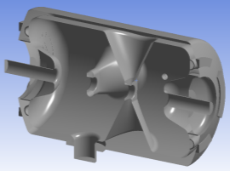
3. RF-Mechanical coupled calculations
3.4 Helium bath pressure fluctuation (2/3)
Third case (cryomodule configuration taking into account the CTS stiffness):
One beam tube is free
(The end cup of helium vessel is welded to the beam tube)
The Cold Tuning System is fixed on the end cup of the helium vessel
The coupler port is fixed along the beam axis
Again, 2 boundary conditions:
Cavity without CTS (free ends)
The 2 beam tubes are free
Cavity with an infinitely stiff CTS (free – CTS stiffness)
The beam tube is linked to the CTS blocks (along the beam axis)

Slide 13
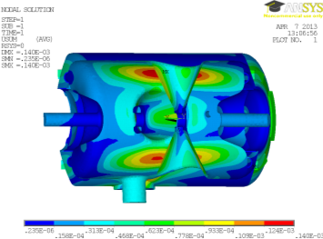
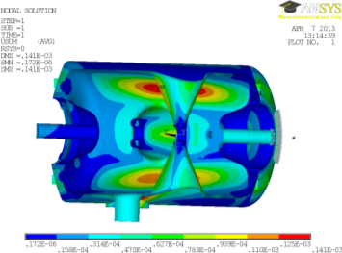
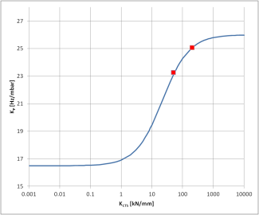
3. RF-Mechanical coupled calculations
3.4 Helium bath pressure fluctuation (3/3)
Cavity without CTS
Sensitivity to He pressure K_{P} [ Hz/mbar] (without CTS) | +16.5
Sensitivity to He pressure K_{P} [ Hz/mbar] (with stiff CTS) | +26
Kp may be calculated as a function of the CTS stiffness:
Tuning sensitivity
Δf/Δz = 135 kHz/mm
K_{cav} = 20 kN/mm
With :
Cavity with infinitely stiff CTS
FEM result with a specific CTS stiffness

Slide 14
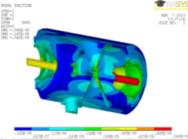
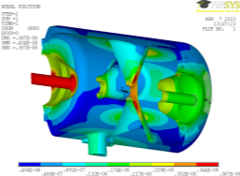
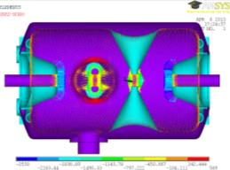
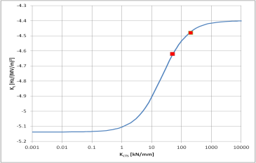
3. RF-Mechanical coupled calculations
3.5 Lorentz forces detuning factor
Cavity without CTS
Cavity with infinitely rigid CTS
Radiation pressure in Pa for 8MV/m:
For 8MV/m
K_{L} [Hz/(MV/m)²] (without CTS) | K_{L} =-5.13 | Δf = -328 Hz
K_{L} [Hz/(MV/m)²] (with CTS) | K_{L} =-4.4 | Δf = -282 Hz
Kp may be calculated as a function of the CTS stiffness:
FEM result with a specific CTS stiffness
With :
Tuning sensitivity
Δf/Δz = 135 kHz/mm
K_{cav} = 20 kN/mm

Slide 15
3. RF-Mechanical coupled calculations
3.6 Summary of the results
Main mechanical parameters of the prototype cavity
Thickness of the cavity walls | 4 mm
Critical pressure | 1.47 bar
Stiffness of the cavity | 20 kN/mm
Tuning sensitivity Δf/Δz | 135 kHz/mm
Sensitivity to helium pressure fluctuation K_{P} without CTS with CTS | +16.5 Hz/mbar +26.0 Hz/mbar
Lorentz forces detuning factor K_{L} without CTS with CTS | -5.13 Hz/(MV/m)² -4.4 Hz/(MV/m)² | For 8MV/m: Δf = -328 Hz Δf = -282 Hz

Slide 16
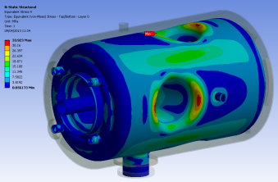
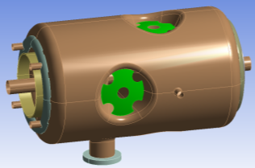
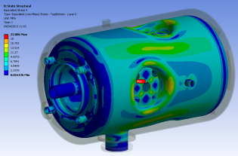
4. New optimizations
4.1. Increasing the critical pressure at 4K
On the prototype : The maximum stresses are located at the top of the spoke bar
34 MPa
Option: stiffeners on the base of the spoke bar
Cavity stiffness [kN/mm] | 20
Tuning sensitivity [kHz/mm] | 135
K_{P} [ Hz/mbar] Without CTS With CTS | +13.0 +23.9
K_{L} [Hz/(MV/m)²] Without CTS With CTS | -5.10 -4.26
Stiffeners
18 MPa
Critical pressure during operation: 1.47 bar ➔ 2.77 bar

Slide 17
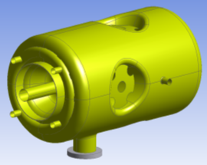
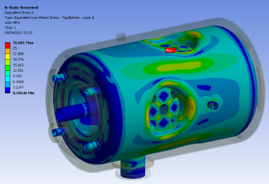
4. New optimizations
4.2. To facilitate the manufacturing processes
On the prototype : The metal forming operations (spinning & deep drawing) with 4.2mm thick sheets are not straight forward processes.
34 MPa
Option: Reducing the thickness to 3mm while keeping new stiffeners at the top of the spoke bar
Cavity stiffness [kN/mm] | 10.5
Tuning sensitivity [kHz/mm] | 123
K_{P} [ Hz/mbar] Without CTS With CTS | +22.5 +35.0
K_{L} [Hz/(MV/m)²] Without CTS With CTS | -7.28 -6.05
Stiffeners
all niobium parts in 3mm
25 MPa
Critical pressure during operation : 1.47 bar ➔ 2 bar

Slide 18
5. Status about the prototypes fabrication
Niobium material has been controlled at IPN. No problem→ shipment to manufacturers mid of May.
Fabrication of 3 prototypes (Start= mid of March):
a/ 1 cavity at SDMS (France)
b/ 2 cavities at ZANON (Italy)
Lead time: 13 months for both manufacturers. Delivery of all cavities in April 2014
Kick-off meetings: done beginning of April.
Intensive exchanges about technical “issues”:
End-cups : in one or two pieces…
Donut → new stiffener shape
Stiffeners on the spokebase
Beam tubes and central drifts: from sheets, blocks or tubes (→pb of coaxiality and cavity-to-helium vessel junction)
Spoke bar-to-cavity body junction: rounded shape

