Slide 1
The ESS Cryogenics System
J. G. Weisend II

Slide 2
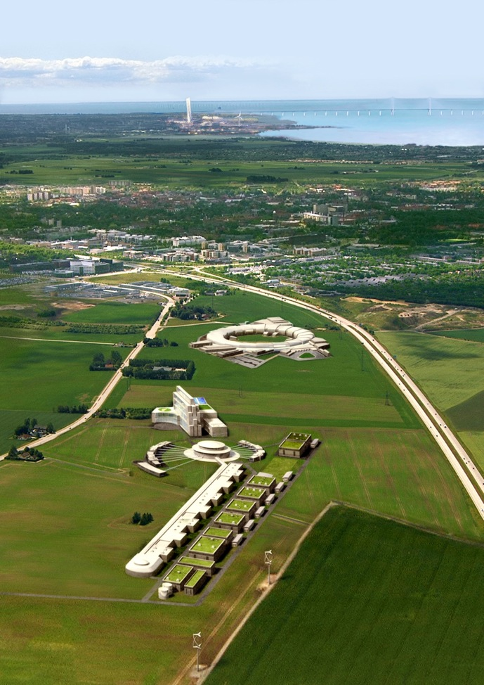
ESS Overview
A 482.5m long, 5MW, proton linear accelerator at 2.5 GeV, 5 mA
2.86 ms pulses, ≈14Hz (60 ms period)
A solid metal target
22 neutron instruments
To support a 5000-strong user community
450 staff
Capital Cost 1,478 M€(2008)
Operating Cost 103 M€ p.a.
Decommissioning Cost 344 M€
First neutrons 2019
Full operation 2025

Slide 3
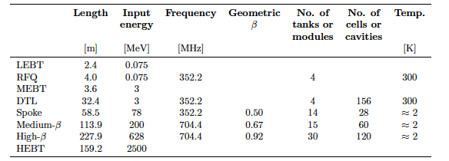
LINAC layout
3

Slide 4
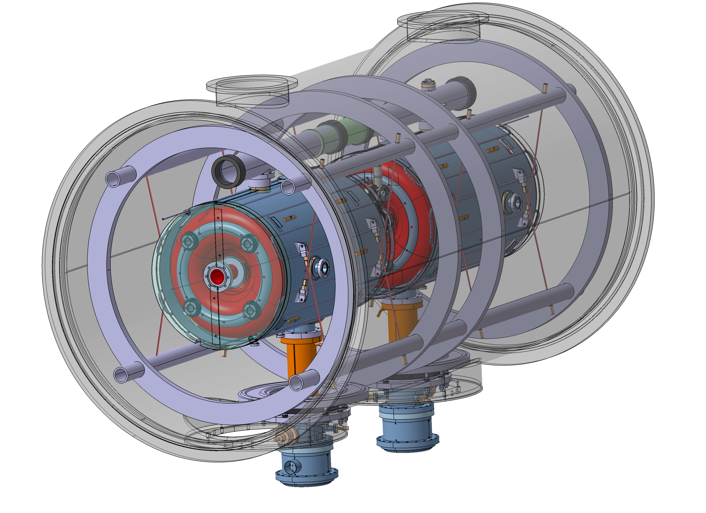
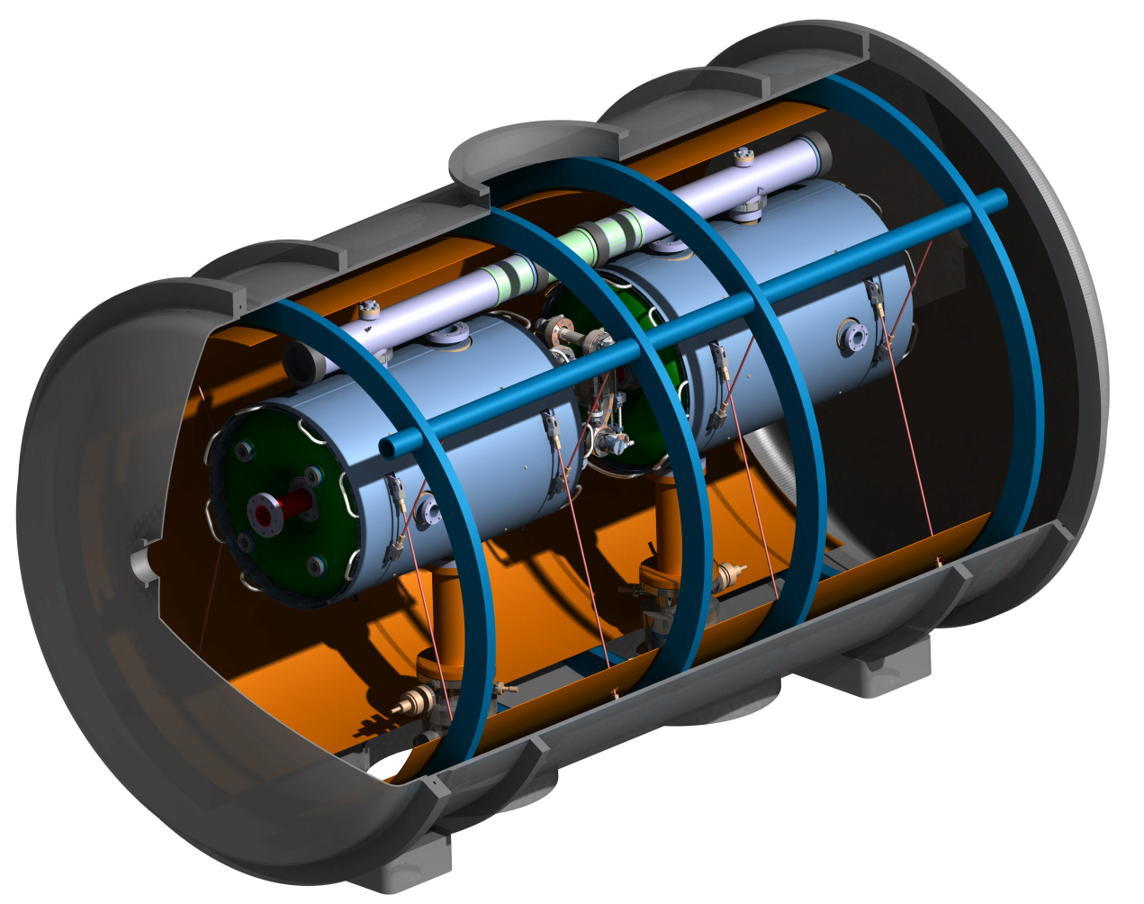
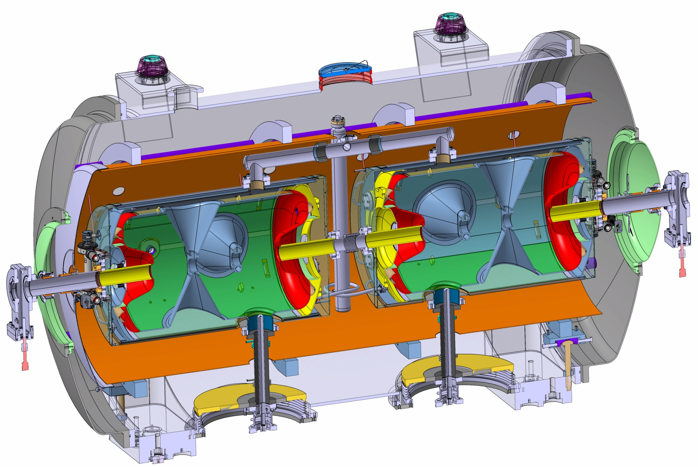
Spoke Cryomodules
The fully equipped spoke cryomodules provide operating conditions (vacuum, cryogenics) to the spoke resonators.
2 double-spoke resonators per cryomodule
14 cryomodules in total to cover Energy range between 79 MeV to 201 MeV
Operation at 2 K
Dimension : 2.9 m long , 1.3 m diameter
Space-frame
Cold tuner
Power coupler
Notes:
ii) Plans for the remaining part of 2012 (and beginning of 2013 if appropriate)
Cryo → Freeze the cold Linac operating parameters
→ ESS Linac flow scheme
→ Sizing of components (e.g. distribution lines)
Spokes → Complete technical design detail (proto test expected 2015)
Elliptical →Develop component stand alone test to verify the expected heat load
→ Complete the conceptual design and Initiate the fabrication drawing
iii) Issue that needs attention
Spoke → Prototype development depends on the availability of resonator
Elliptical → Critical path for current ESS schedule
e.g. availability of the infrastructure
→ Freeze the parameters of the medium- and high-beta cavities packages in order to freeze the cryomodule design
e.g. HOM use

Slide 5
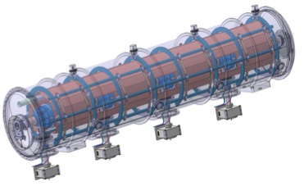
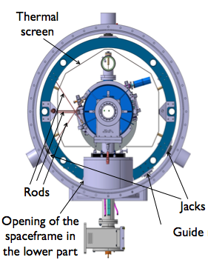
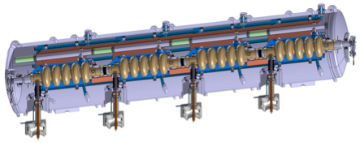
Elliptical Cryomodules
Space-frame
5-cell elliptical cavity
Helium tank
Power coupler
Cold tuner
Elliptical Cavities Cryomodule Technology Demonstrator results by the end of 2015 → start pre-series
Notes:
ii) Plans for the remaining part of 2012 (and beginning of 2013 if appropriate)
Cryo → Freeze the cold Linac operating parameters
→ ESS Linac flow scheme
→ Sizing of components (e.g. distribution lines)
Spokes → Complete technical design detail (proto test expected 2015)
Elliptical →Develop component stand alone test to verify the expected heat load
→ Complete the conceptual design and Initiate the fabrication drawing
iii) Issue that needs attention
Spoke → Prototype development depends on the availability of resonator
Elliptical → Critical path for current ESS schedule
e.g. availability of the infrastructure
→ Freeze the parameters of the medium- and high-beta cavities packages in order to freeze the cryomodule design
e.g. HOM use

Slide 6
Cryogenics Plays an Important Role at ESS
Cooling for the cryomodules (2 K, 5 – 8 K and 40)
Cooling for the Target LH₂ Moderator (16 K)
Liquid Helium and Liquid Nitrogen for the Neutron Instruments
Cooling for the cryomodule test stands (2 K, 5 – 8 K and 40 K)
This is accomplished via 3 separate cryoplants

Slide 7
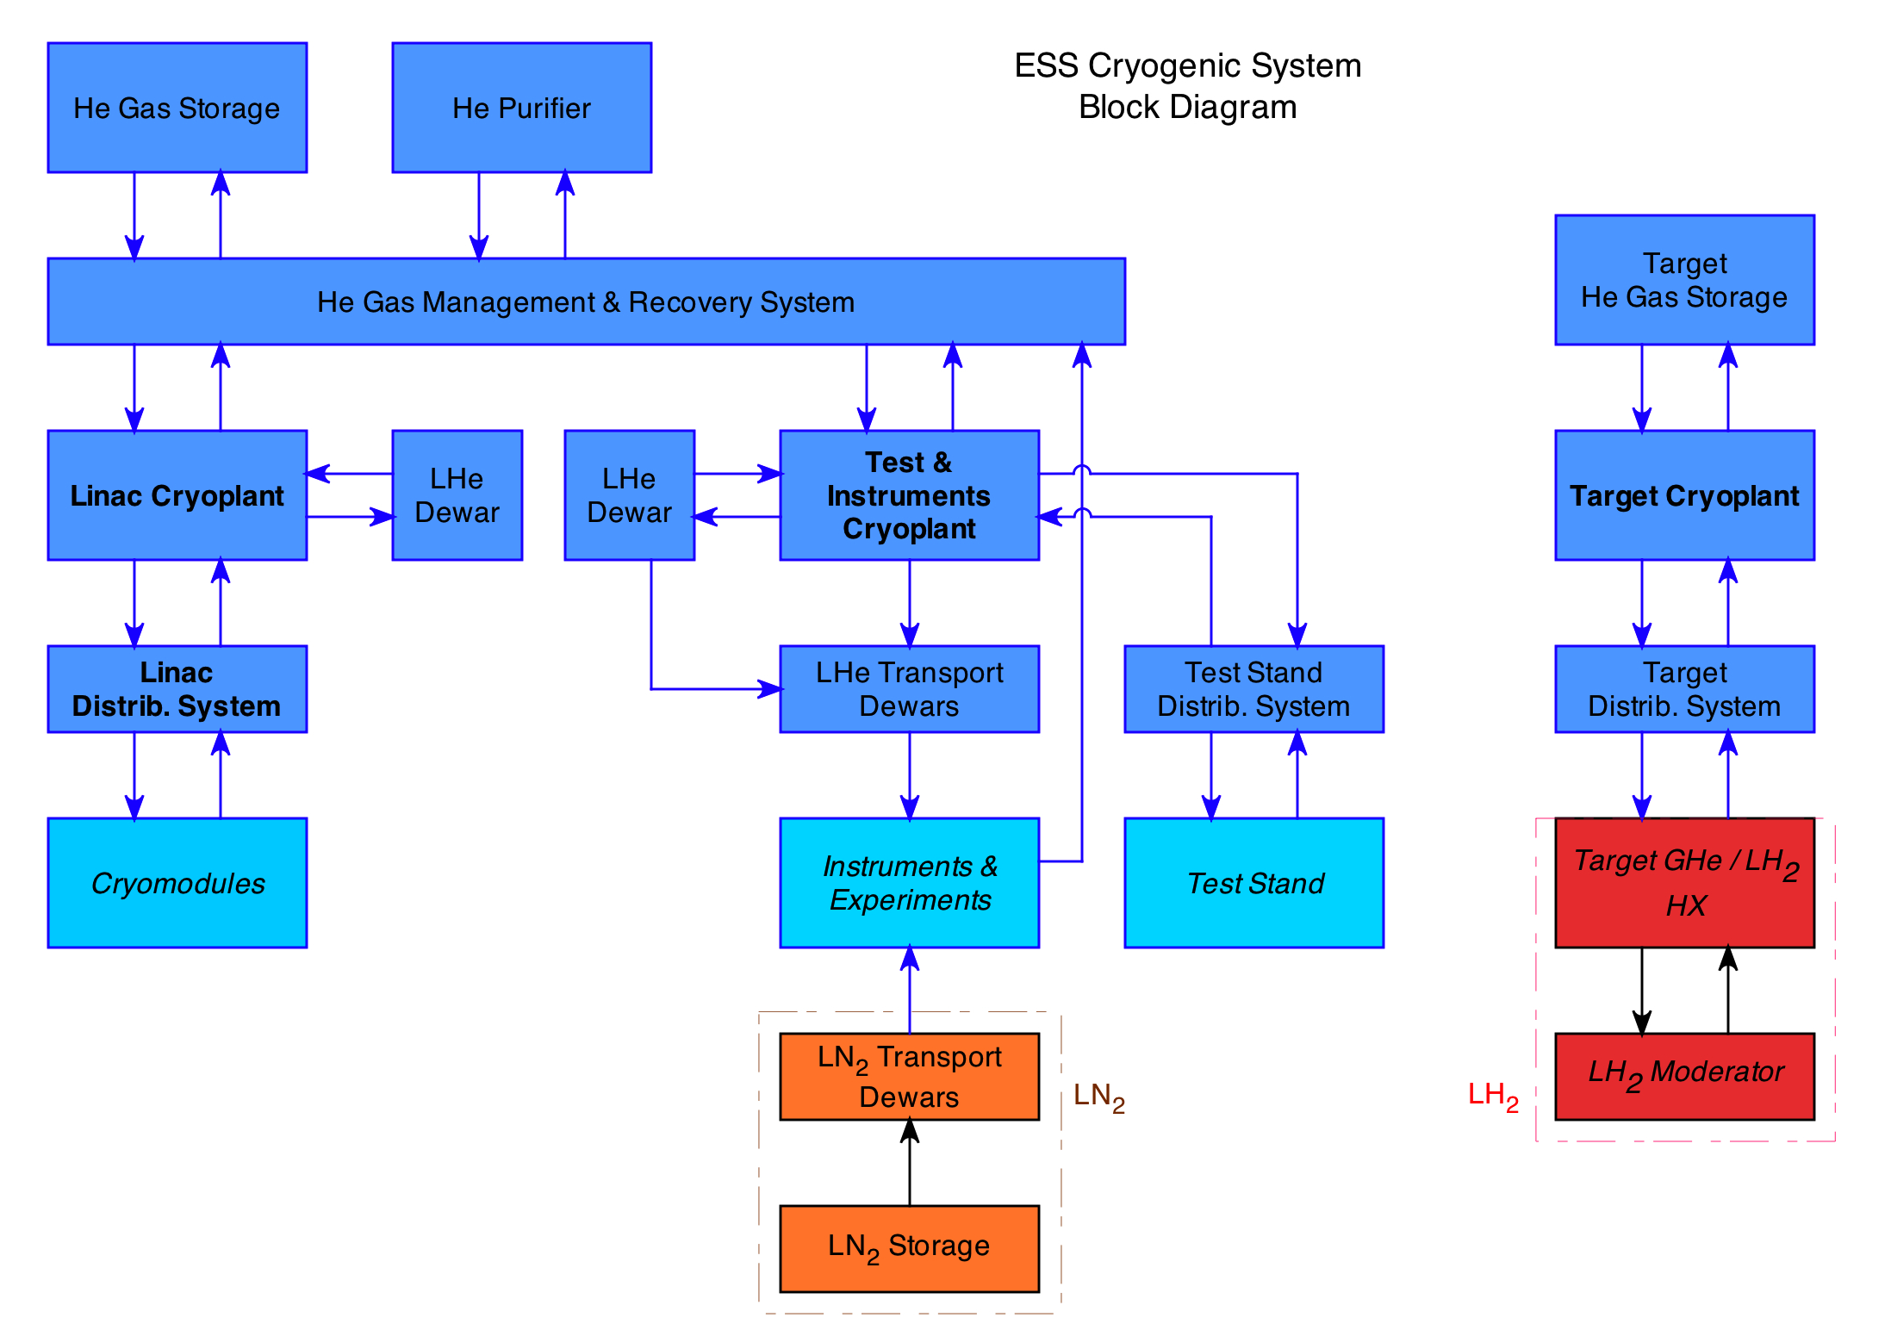
ESS Cryogenics System

Slide 8
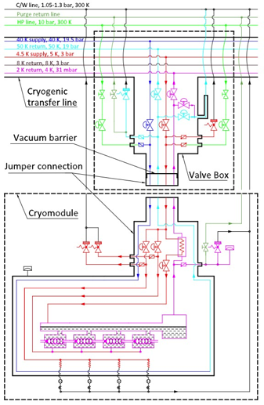
Accelerator Cryogenics
Distribution system delivers single
phase Helium at 4.5 K & 40 K
2 K helium produced at
each cryomodule
Sub atmospheric vapor pumped off
to cryoplant
4.5 K – 300 K cooling of couplers

Slide 9
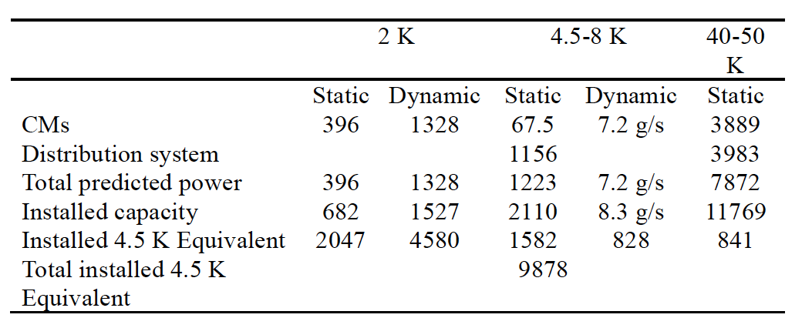
Accelerator Heat Loads
Note Large Dynamic vs. Static Loads at 2 K

Slide 10
Accelerator Cryoplant
Roughly 10 kW @ 4.5 K Eq. includes capacity margin
Uses combination cold & warm compression for 2 K production (LHC approach)
Turn down capacity & ability to recover from trips quickly are key Issues
Industry studies will be carried out in 2013
Plant will be ordered in 2014, ready in 2017

Slide 11
Target Cryoplant
Provides up to 25 kW of cooling at 16 K via supercritical helium
Hydrogen circuit is separated from Helium circuit via a heat exchanger
Due to the possibility of tritium contamination of the helium, the helium system for the target cryoplant is completely separate from the other cryoplants
Last plant to be ordered (2015) and commissioned (2018)

Slide 12
Test & Instruments Cryoplant
Provides cooling for cryomodule test stands (initially) and liquid helium for the neutron instruments during ESS operations
Liquid Helium to instruments will be supplied via portable dewars – boil off He gas will be collected, purified and reliquefied
For the cryomodule testing plant will produce 4.5 K and 40 K Helium. 2 K Helium will be produced at the cryomodules as in the accelerator
Low pressure return vapor is expected to be pumped by warm vacuum pumps
Expected capacity is ~ 500 W at 4.5 K, 200 W at 40 K
This will be more than sufficient to proved 50 l/h of liquid during ESS operations
First plant to be ordered in 2014 and required by 2016

Slide 13
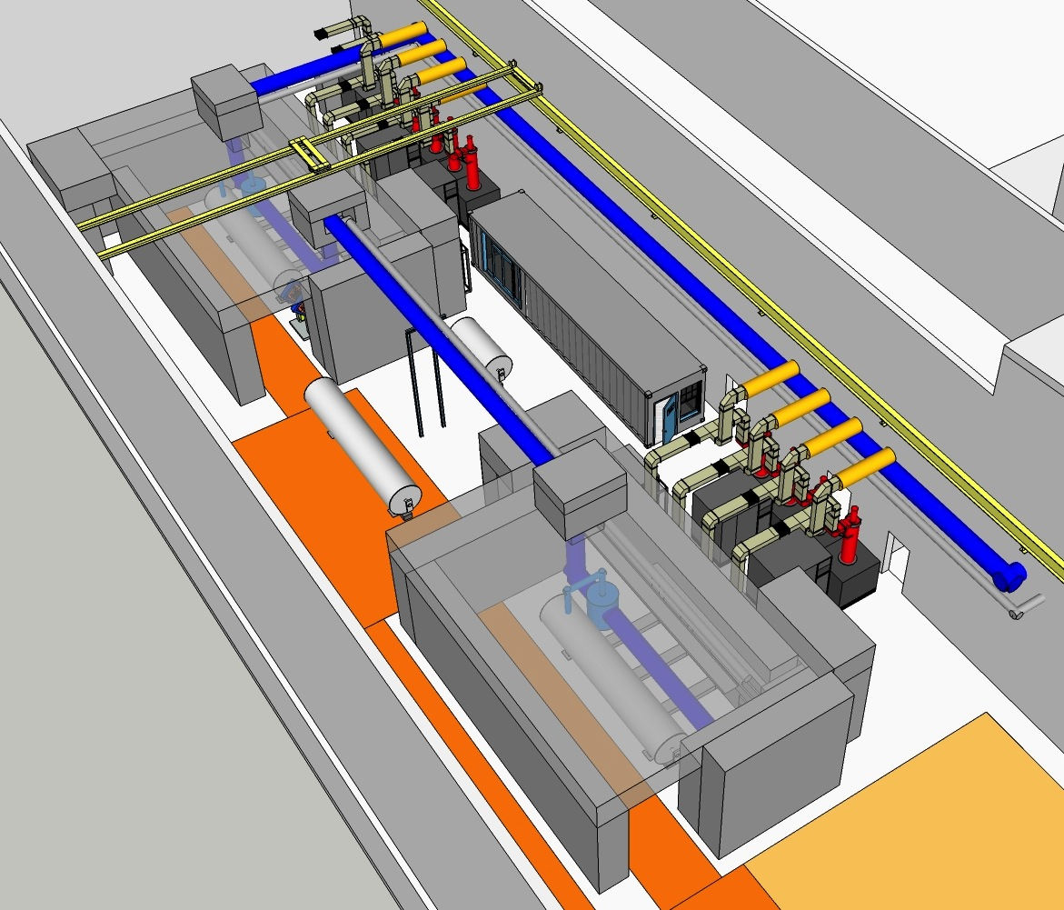
ESS Test Stands

Slide 14
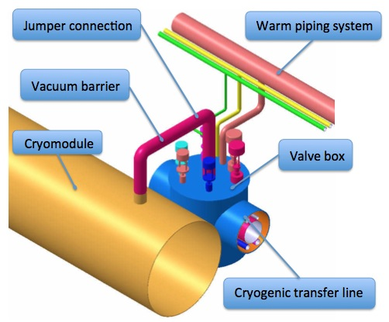
Distribution System
Allows warm up and cool down of one or more cryomodules
w/o affecting remaining cryomodules
Connection between distribution line & cryomodule is done via fixed connections and not bayonets
Lower heat leak and cost
Operating Modes defined
Initial P&ID complete
Sizing & conceptual design is well underway
Separate isolation vacuums in the distribution lines and cryomodules

Slide 15
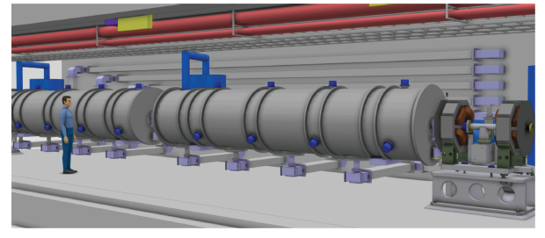
View of ESS Tunnel

Slide 16
Gas Management, Purification & Storage
Provides a central system for storage, purification and gas handling for both the Accelerator and Test & Instruments cryoplants
Goal is to ensure all helium used is recovered, cleaned and reliquefied
Estimated liquid helium inventory in the accelerator is 12,000 l
Planned storage
Gas at 2 MPa – 12,000 l (LHe equivalent)
“dirty” & “clean” storage likely
20,000 l LHe storage - for second fill and loss compensation
5,000 l LHe storage for Instruments supply backup
LN₂ storage requirements are TBD

Slide 17
Gas Management, Purification & Storage
System will include a low temperature (LN₂) system for purification of Helium gas
System will include instrumentation for the monitoring of He purity
Significant engineering & design remains to be done
This system is important to the success of the rest of the ESS cryogenics facility
Early parts of the system including the purifier need to arrive with the T&I cryoplant

Slide 18
Controls
For the 3 cryoplants: controls and programming including the PLC will be carried out by the plant vendors
Integration of the Cryoplant PLCs to the the Integrated Control System (ICS) will be done via EPICS using ESS controls staff. This group will also provide data logging, alarms, HMI etc.
For the Distribution System & Gas storage System all controls (including at the PLC level) will be done by ESS Controls experts

Slide 19
Reliability & Availability
ESS has very high (95%) availability requirements
Meeting these needs with the cryogenic system is possible with sufficient work and planning
Backup power for controls and instrument air systems
Backup Helium compressors where appropriate
Strict attention to oil removal & helium purity
Backup LHe storage for instruments and rapid refill
Design of plants to optimize recovery from trips (LHC experience)
Failure mode studies (underway)

Slide 20
Sustainability
ESS is dedicated to developing a sustainable laboratory. The rubric is: responsible, recoverable and renewable
Responsible: minimize energy usage
Choices in cryogenic design, plant efficiency & turn down capability
Recoverable: Waste Heat from compressors used in Lund District Heating system
Renewable – use renewable energy sources as possible

Slide 21
Recyclable
Simplified heat flow between ESS and Lund District Heating system
ESS
Lund District Heating System
Heat pump
Heat pump

Slide 22
Summary
Cryogenics is a key enabling technology of the ESS
Solutions are within the current state of the art but require custom designs and significant attention to detail – turn down capability & recovery from trips
Challenges include: meeting availability requirements, incorporating sustainability and an aggressive schedule
There is much work to be done and significant opportunities for outside collaborations

