Slide 1
Session 3 summary
speakers | from | Title
Shixian Peng | Peking U. | H- source - challenges in terms of emittance and current, upgradability
Takanori Shibata | JPARC | Status and numerical study of J-PARC RF H- source
Mats Lindroos | ESS | Flexibility for upgrade and design choices for proton linacs
Deepak Raparia | BNL | H- stripping
Phi Nghiem | CEA | Characterization of a high intensity beam

Slide 2
S. Peng
H⁻ Ion source around the world
Lab | Source type | Cs | Current (mA) | Pulse length(ms) | Rep Rate (Hz) | Duty Factor(%) | Normalized Emittance | Power Efficiency(mA/kW)
Fermi | Magnetron Multicusp W-filam. | Yes No | ~80 5~10 | 0.1 CW | 15 CW | 0.15 100 | 0.3 - - | 50 1
BNL | magnetron | Yes | ~100 | 0.6 | 10 | 0.4-1 | 0.4 | 67
ISIS CSNS | Penning | Yes Yes | ~60 ~50 | 1 0.5 | 50 25 | 5 1.25 | 0.7 0.5 | 6 --
DESY | Multicusp ext. RF | No | 80 | 0.15 | 8 | 0.12 | 0.26 | 2
LINAC4 | Multicusp ext. RF | Yes | 50 | 0.4 | 0.8 | 0.03 | 0.3 | 1.1
J-PARC | Multicusp LaB₆ filam. Multicusp int. RF | No Yes | 30 80 | 0.5 0.5 | 25 25 | 1.25 1.25 | 0.18 0.3 | 2
KEK LANL | Multicups Surface Convertor | Yes | 18 |  |  | 12 | -- | 3
SNS | Multicusp int. RF Multicusp ext. RF | Yes Yes | 41 50 | 1 1 | 60 60 | 6 6 | 0.26 0.2 | 1.6
JAERI | Multicusp W-filament | Yes | 60 | 1 | 50 | 5 | 0.23 | 2
TRIUMF CIEA/… | Multicusp- Filament | Yes Yes | 20 18 | CW CW | CW CW | 100 100 | 0.7 0.77 | 3 5
CEA | ECR | No | 3.5 | 1 | 10 | 1

Slide 3
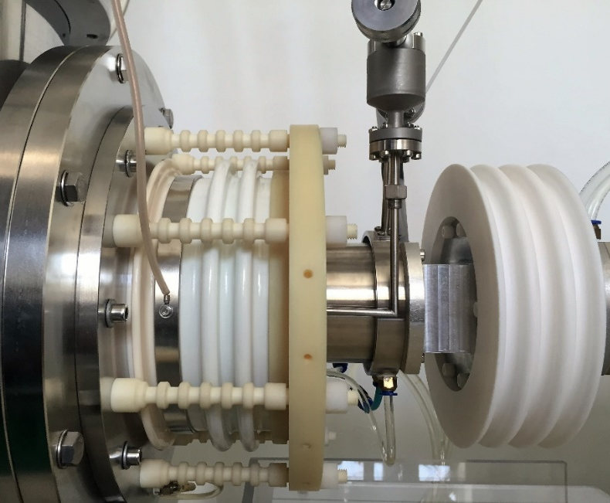
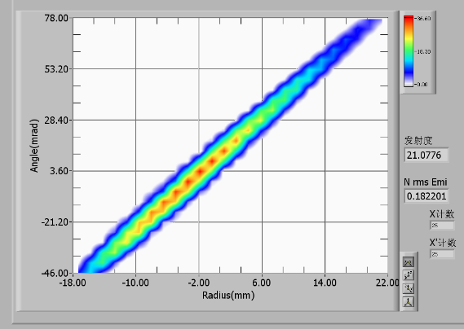
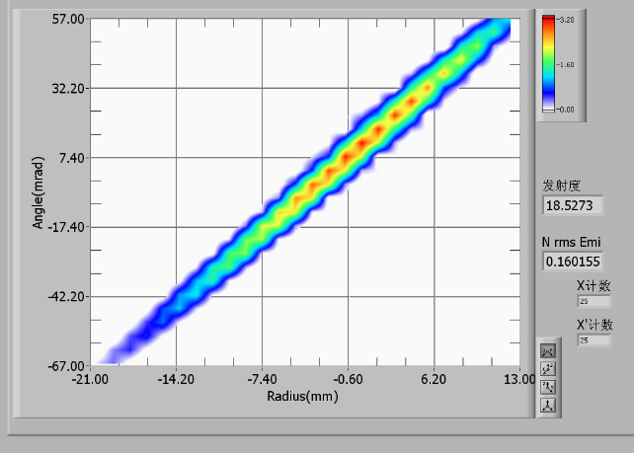
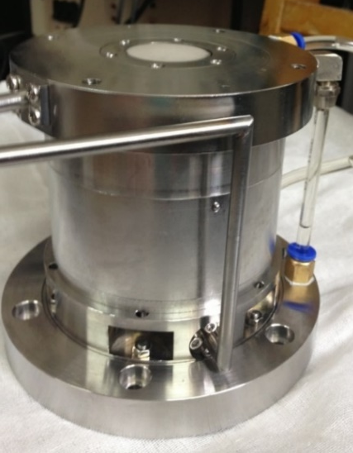
Best Results from PKU H⁻ Source
S Peng
High Voltage Region
230mm
CW Mode
Parameter
RF power 1000 W
Pressure 4.0E-3 Pa
Ex. Voltage -35 kV
Sec. Voltage 2 kV
Pulsed Mode Parameter
Pulsed 100Hz/1ms
RF(Peak) 2100 W
Pressure 4.5E-3 Pa
Voltage -35 kV
Second 2kV
Ratio of H⁻/e: 4.7
H⁻ current: 29mA
Power efficiency: 29 mA/kW
ε_{RMS,norm}：0.18 pi.mm.mrad
Ratio of H⁻/e: 4.4
H⁻ current: 45mA
Power efficiency:21.4 mA/kW
ε_{RMS,norm} : 0.16 pi.mm.mrad

Slide 4
T Shibata
1) Status of JPARC H- source and studies of current upgrades
Interesting plot correlating intensity and emittance as function of extraction electrode aperture
2) Numerical study of plasma physics and oscillations
Successful benchmark of plasma oscillations at 2x RF frequency
Promising though computational intensive
Knowledge of beam parameters at source extraction is fundamental for realistic modelling of accelerator and beam loss predictions
Unfortunately simulation codes currently disconnected : plasma codes, beam formation/extraction codes, beam transport codes etc…

Slide 5
M Lindroos
Complete report on ESS project status
Important to build flexibility in machines already in the design and construction phase
Importance of IK contributions

Slide 6
H- stripping (D Raparia)
Physical Processes
- Striping by Residual gas
- Stripping by Foil
Field Stripping
- Stripping by Magnetic/Electrical fields
- Intra Beam Stripping
- Stripping by Back Body Radiation

Slide 7
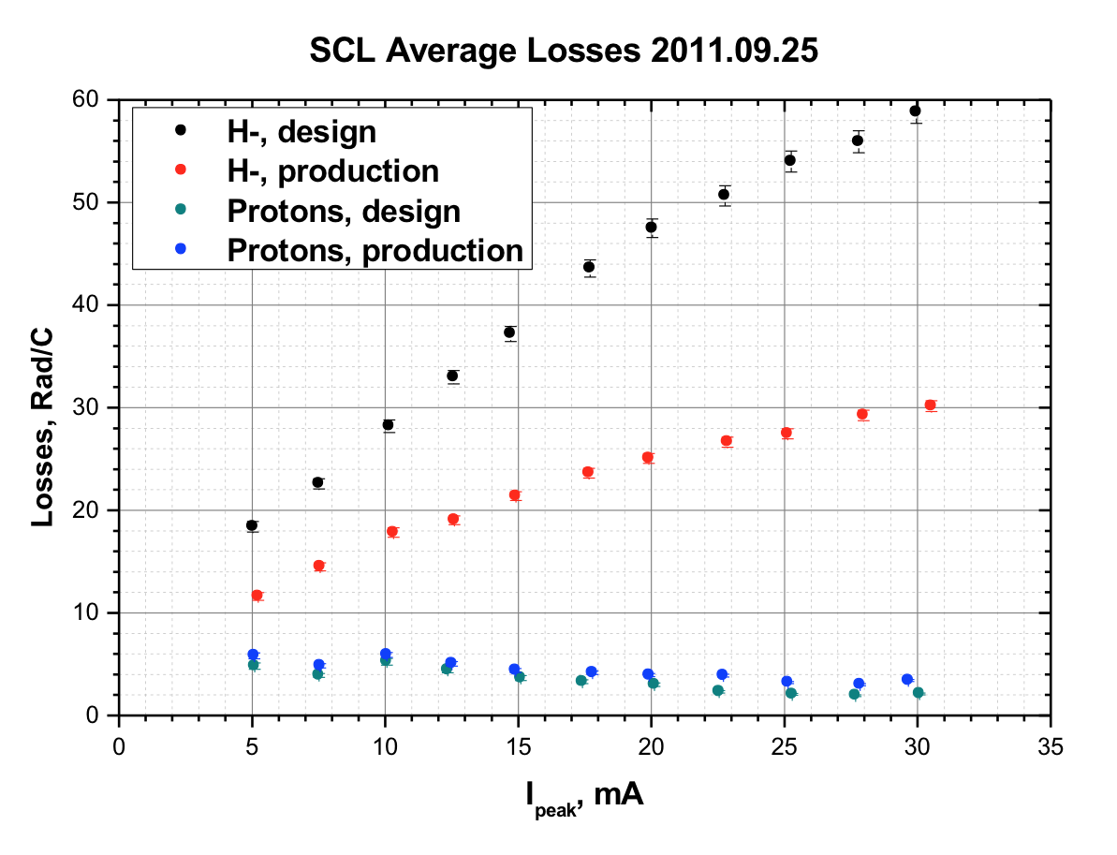
SNS SCL losses vs. Peak Current
D Raparia
H-, strong focusing optics
H-, week focusing optics
Proton, strong & week focusing optics
H- beam was stripped by foil after RFQ and match to linac by quads in MEBT for proton run for this comparison.
First Observation of Intrabeam Stripping of Negative Hydrogen in a Superconducting Linear Accelerator,” A.Shishlo, J. Galambos, A. Aleksandrov, V. Lebedev, and M. Plum, Phys Rev Letters 108, 114801 (2012).

Slide 8
SNS Activation
SNS to ESS
Intensity Factor 2.5
Energy Factor 1.4
IBS Factor 3.5
D Raparia

Slide 9
Conclusions
D Raparia
H- injection into the ring outweighs all the stripping issues in the linac and transport line.
During last decade Intra beam stripping and black body radiation stripped were identify as topics should be consider during design.
H- stripping has not limited the performance of linac yet.
Use of stripped electron can be explore more.

Slide 10
Phi Nghiem: Characterization of high intensity beams
Beam Characterization
For high intensity beam
1) Characterize the beam by its actual number of particles
2) Characterize the beam by its projections onto a few axes
3) Characterize the beam by its core and halo separately

Slide 11
1) Conventional multi-particle:
For IFMIF-LIPAc, D⁺, 125 mA CW, 40 MeV
Actual number of particles: 5 10⁹
→ 170 processors for 25 days, storing 38 To
→ confirm losses < 10⁻⁷
→ representative statistics of microlosses
Consequences of cavity errors (1°, 1%) on losses
for SPIRAL2, D⁺, 5 mA CW, 40 MeV
2.5 10⁶particles, number of linacs: 1000
→ 150 processors for 7 days
→ Losses due to RFQ: 30%, due to cavity errors:70%
« Brute force », need very fine description of optics elements, realistic input particle distribution
2) Projections on few axes :
~ 2 projections are enough for describing the core
→ ~ 6 projections are enough for describing inaddition the external parts
→ ~ 10 - 30 parameters for 2D
BUT: how to go to 4D, 6D ?
P Nghiem

Slide 12
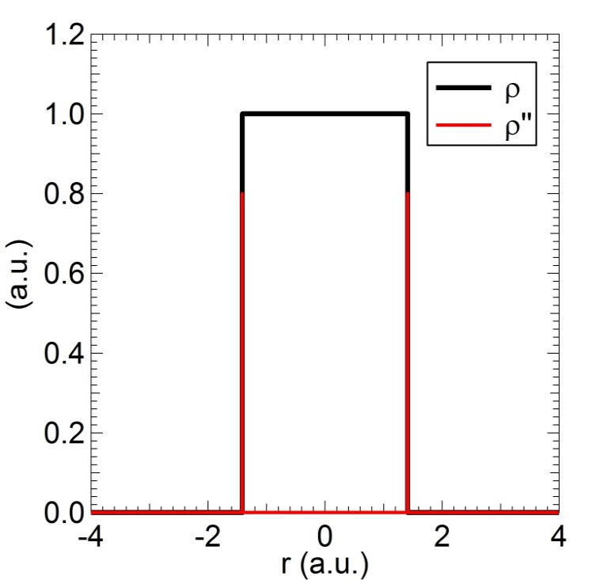
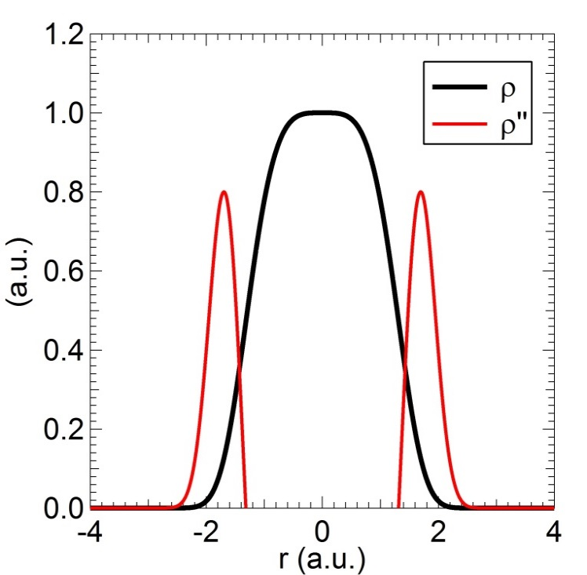
P Nghiem
Beam Characterization
by Core and Halo (2)
For 1D: Core-Halo limit based on density profile
Appl. Phys. Lett. 104, 074109, 2014
Extreme case:
Core: uniform, sc force strictly linear
Halo: tenuous, sc force nonlinear
→ core-halo limit: very steep (infinite)
variation of the slope
General case:
Continuously varying density
Core-Halo limit: steepest variation of
the slope → max of 2nd derivative
→ Core & Halo are submitted to two
different space charge force regimes
Phys. Plasmas 22, 083115, 2015: This core-halo limit ≡ good indicator of beam internal dynamics

Slide 13
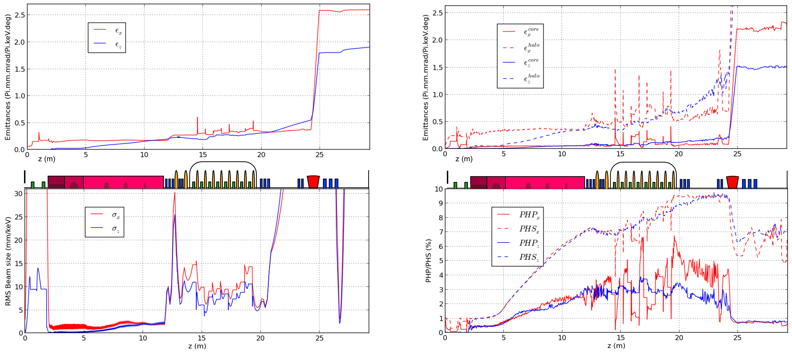
Beam Characterization
by Core and Halo (6)
P Nghiem
Classically
Advanced
more insight in physical properties of the beam
but compared to above methods, fine details are lost

Slide 14
Many thanks to all speakers!

