Slide 1
Gradient limitations in pulsed superconducting cavities, imposed by power couplers, RF systems, Lorentz force detuning compensation
8-9 November 2016
ESS, LUND
Franck PEAUGER

Slide 2
Outline
Cryomodule
  Power couplers
  Elliptical cavities
  Fast tuning systems
RF system
Conclusion
for ESS systems

Slide 3
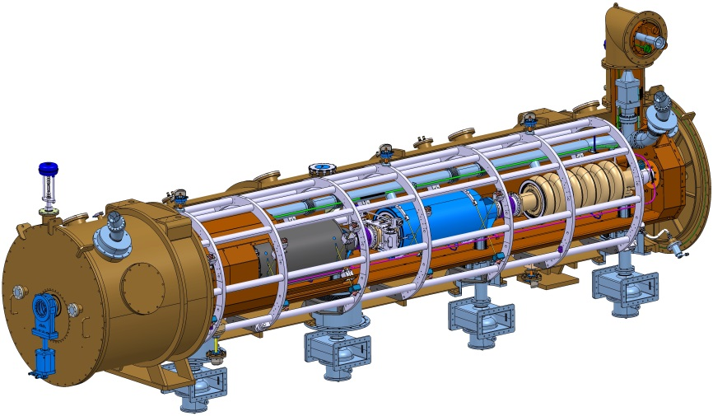






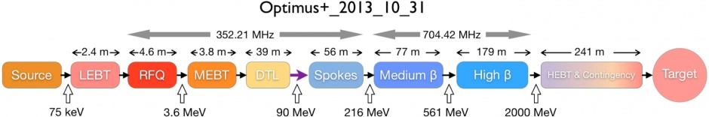
Medium and High β cryomodules for ESS
One of the most important In-kind contribution of France to the ESS machine construction
Will follow the successful “massive” XFEL cryomodule integration at CEA

Slide 4
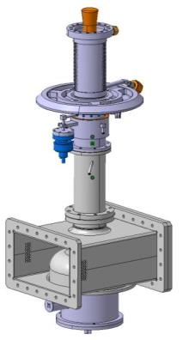
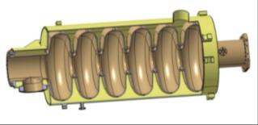
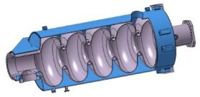
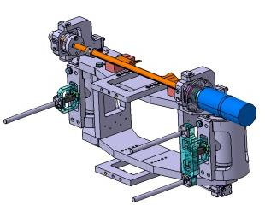
Critical components
Cavities
Power coupler
Diameter 100 mm
Peak power 1.1 MW
Antenna water cooled
External conductor cooled with SLHe
Doorknob transition equipped with a polarization system (anti-multipactor)
Medium beta 6 cells
High beta 5 cells
 | Medium | High
Geometrical beta | 0.67 | 0.86
Frequency (MHz) | 704.42
Maximum surface field in operation (MV/m) | 40 | 44
Nominal Accelerating gradient (MV/m) | 16.7 | 19.9
Nominal Accelerating Voltage (MV) | 14,3 | 18,2
Q₀ at nominal gradient | > 5e9
Cavity dynamic heat load (W) | 4,9 | 6,5
Cold tuning system
Cold motor and planetary gearbox (1/100e) (slow tuning)
Max range: ± 3 mm
Tuning range: ~ 600 kHz
Resolution: ~1 Hz
2 piezo (fast tuning)
3.2 ms pulse length
tuning range at 2K: 400 Hz (2 µm)
No HOM couplers
Half cells, beam pipes and ports in bulk Niobium RRR > 250
He tank in Titanium
Flanges in NbTi with hexagonal aluminium gaskets
Assembly by electron beam welding (no brazing)

Slide 5
Upgrade cases
Crymodule upgrade
Without disassembly
1
With disassembly
- Cavity string back in clean room
Cost and schedule increase
Same design
- New surface treatment
2
New design
3

Slide 6
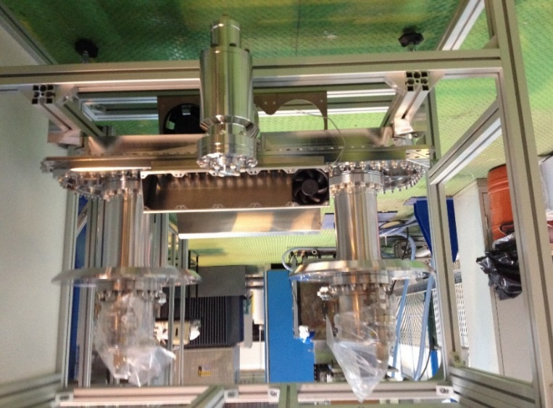
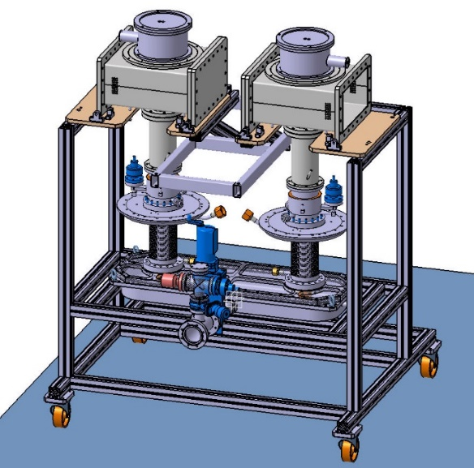
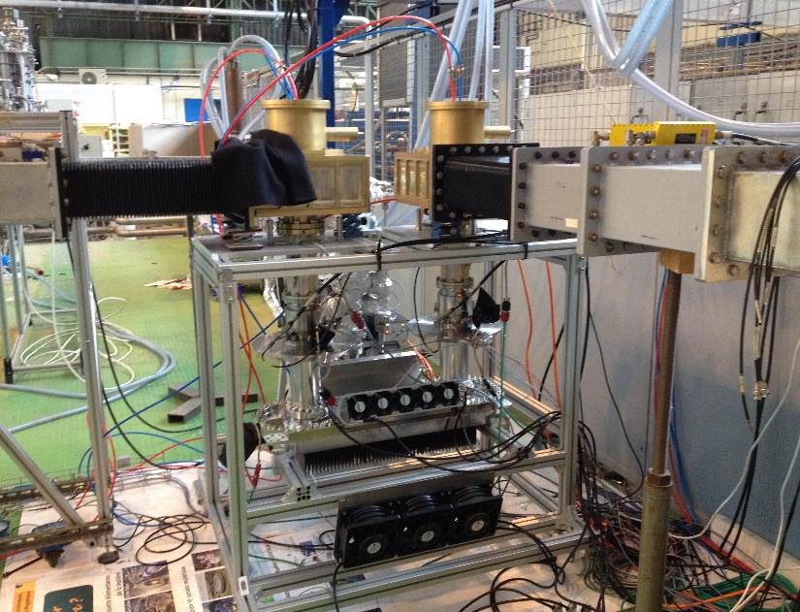
Power couplers: latest test results
Four couplers were successfully conditioned up to 1.1 MW at 3.6 ms – 14 Hz
  Tests performed in Sept. and Oct. 2016
  Two different suppliers
  Assembly in ISO5 clean room at CEA
  Baking at 170°C
  RF conditoning on match load and short circuit

Slide 7
Power couplers: latest test results
C. ARCAMBAL
No limitation found !
(limited by the klystron amplifier which saturates at 1.2 MW)

Slide 8
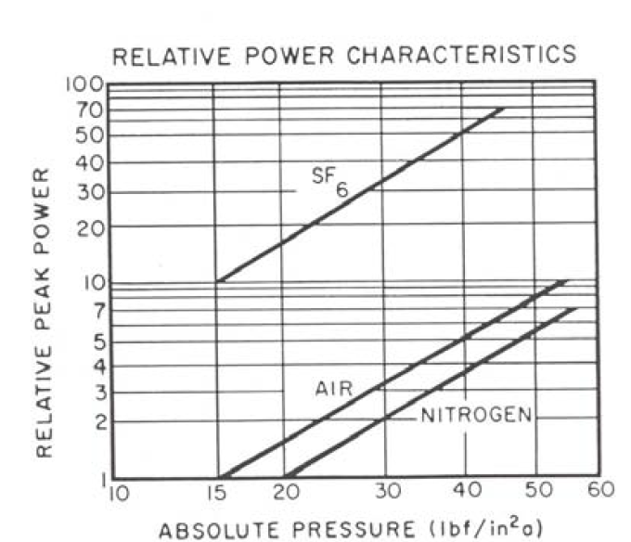
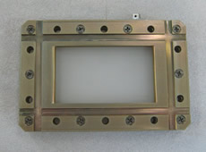
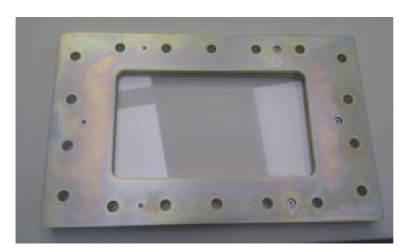
Power couplers: possible limitation and upgrades
Peak electrical surface field in the ceramic window area, involving breakdowns on air side
  SF6 or N2 pressurization
  Adding of kapton or quartz windows
Case
1

Slide 9
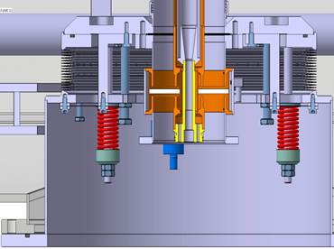
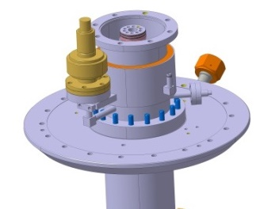
Power couplers: possible limitation and upgrades
Enlarge diameter of the coaxial waveguide
  Exists in klystron amplifier
  Drawbacks:
    new design
    increase of the cryogenic heat loads (already at 1 W with 23 mg/s SHe at 5K)
    mechanical impact on the vacuum vessel (large footprint of vacuum gauge does not help!)
Case
3
Coupler flange
Vacuum gauge
Ceramic window
Cryomodule vacuum vessel flange

Slide 10
Power couplers: testing possibilities
Test to failure needed
  New RF power source delivering 1.6 MW available at CEA end of 2017 (to be able to test 2 pairs in parallel in the series contruction phase)
  Combining the two klystrons to go up to 2.7 MW !
HV modulator
Existing
Water Load
RF driver
Coupler pair
Water Load
3.9 dB – 90° splitter
To be developped
1.1 MW klystron
Circulator
Trigger + interlock
2.7 MW maximum
Φ
Phase shifter
1.6 MW klystron
Planned in 2017

Slide 11
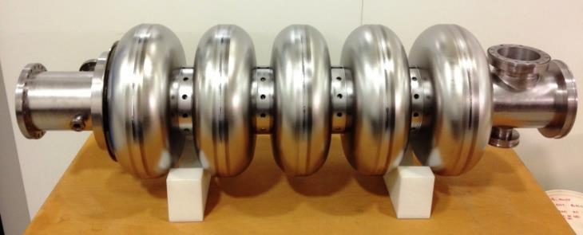
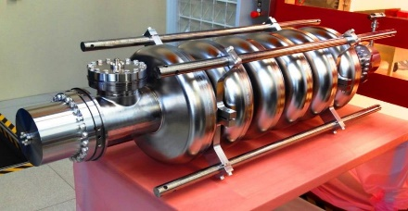
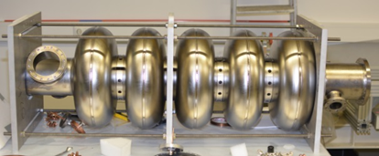
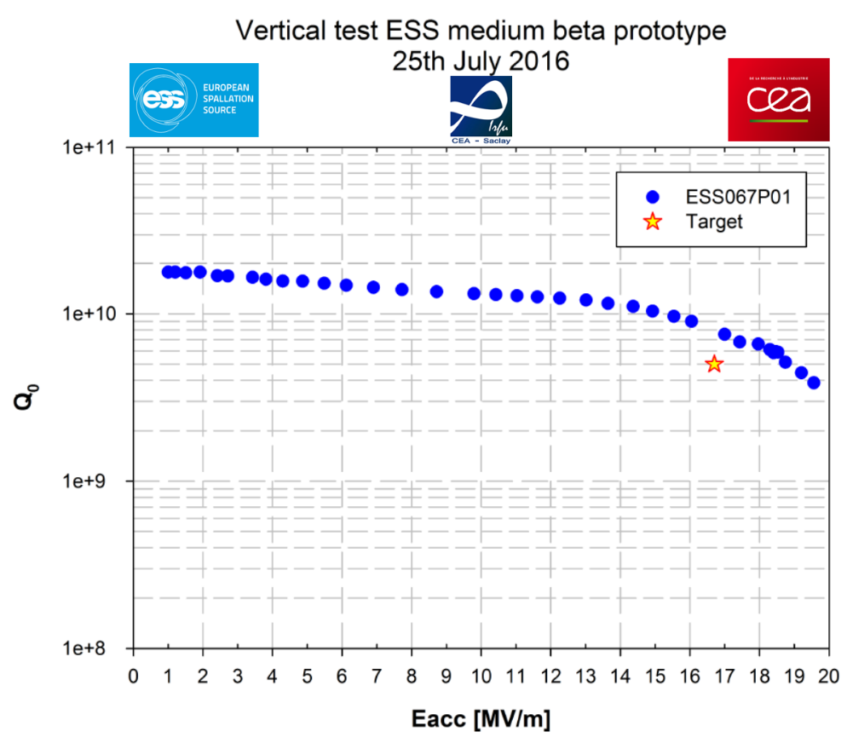
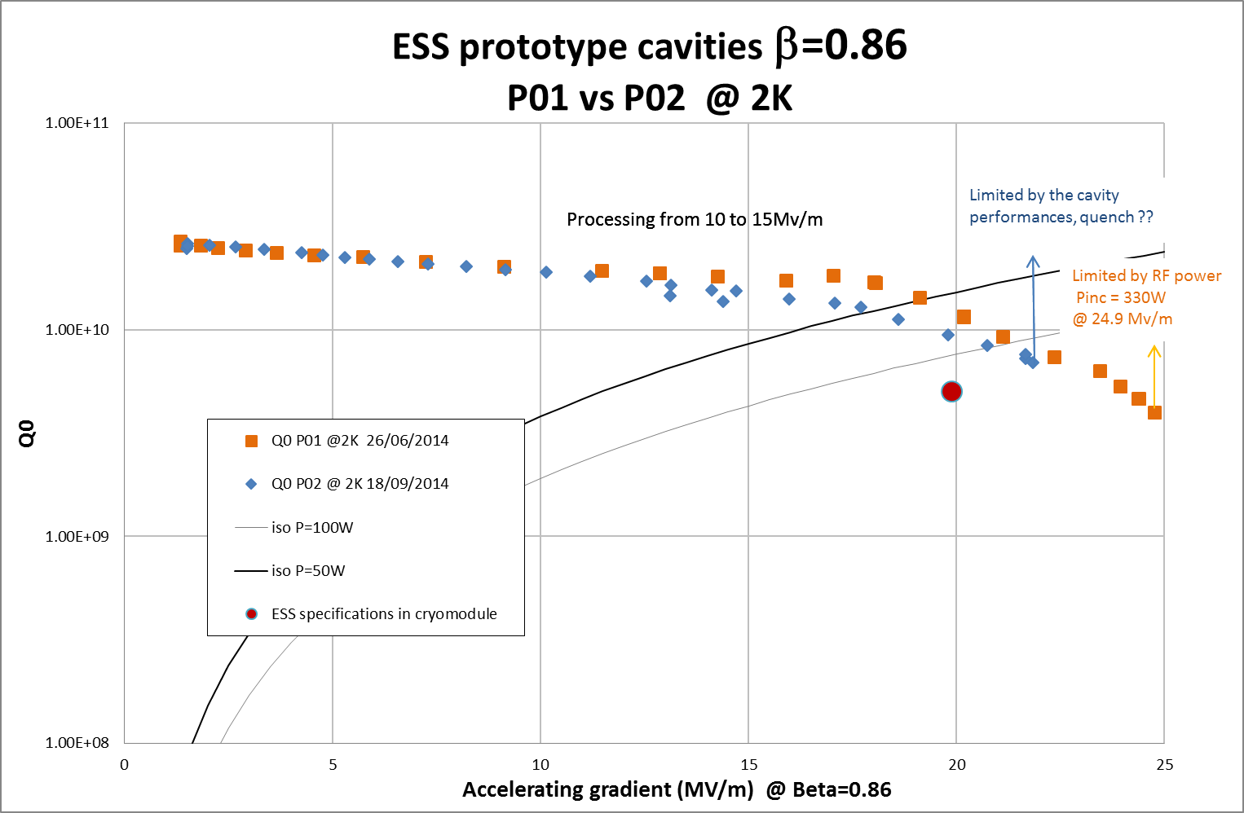
Elliptical cavities: vertical test results
E. CENNI
Three cavities reached the ESS requirements, with Buffered Chemical Polishing (BCP)
Clear limitation by Q0 drop and quench

Slide 12
Elliptical cavities: possible improvements
Flash BCP at low temperature
  explored on Spoke cavities by IPN Orsay
  Using water inside the Helium tank for cooling
120°C baking
  Standard procedure for XFEL/ILC cavities, not yet tested on ESS cavities
  new oven available at CEA (re-use of a vertical cryostat for magnets)
Electropolishing
  also standard XFEL/ILC cavities; should increase Epk and push further field emission limit
  vertical set-up available at CEA, CERN, KEK
    tried on 704 MHz “High gradient” cavities (former SPL)
  Horizontal set-up: industry?
  Fluid dynamic simulations probably needed before any test
Thermal exchange with helium bath
  external chemistry
N2 doping
  establish collaborations
Case
2

Slide 13
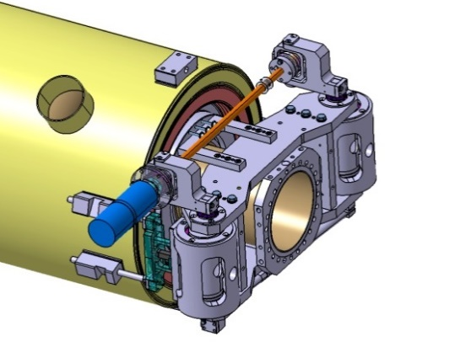
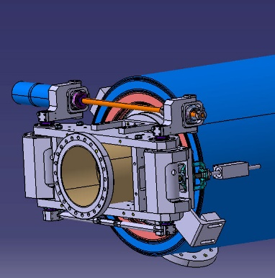
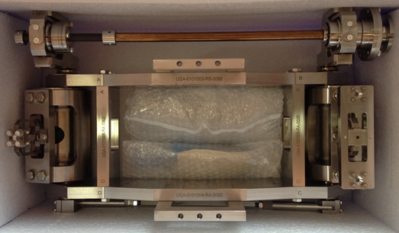
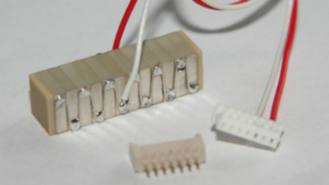
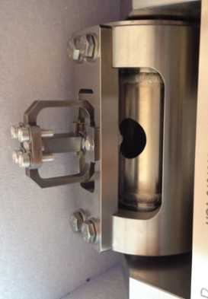
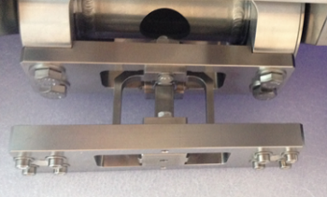
Lorentz Force Detuning (LFD) compensation
G. DEVANZ
Critical aspect on ESS
  very long pulse : 3.2 ms
Present design
  Saclay V type tuner
  Two piezo stacks in parallel
  NOLIAC 30 mm length
  encapsulated in two different frames
  +1 kHz max.
Not yet tested on an ESS cavity
But proof of principle done on the CARE/HIPPI program

Slide 14
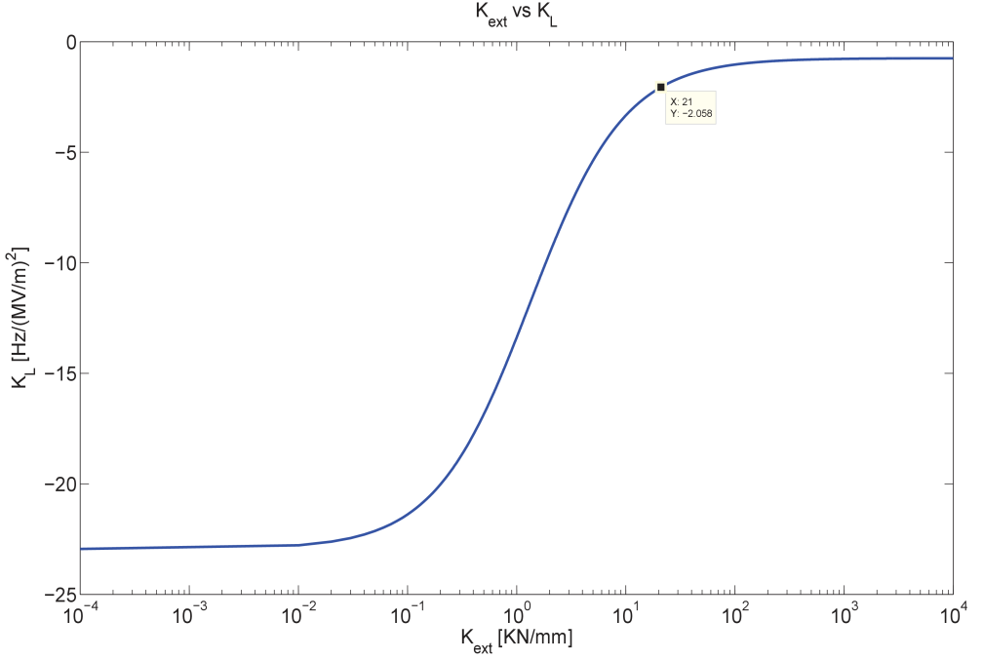
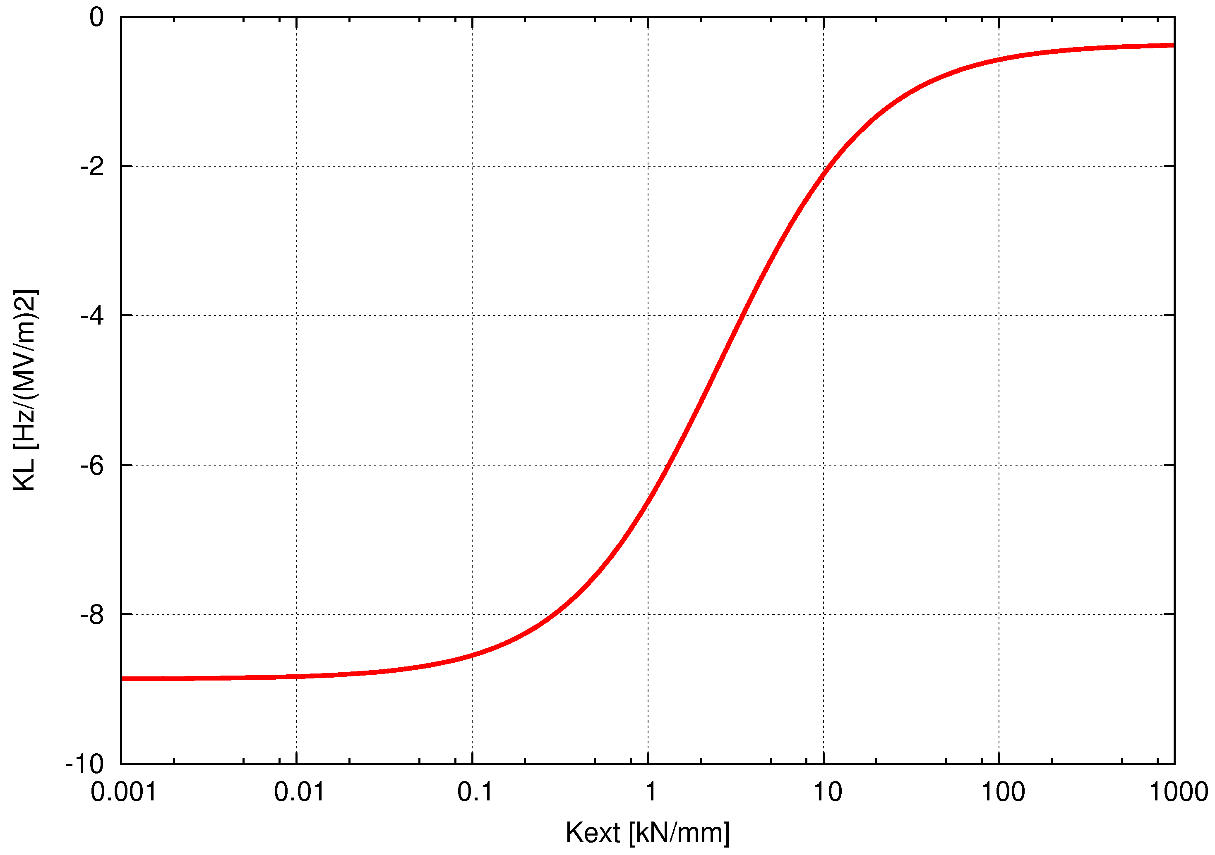

Static LFD
Designed stiffness of the tank: K_{tank} = 75 kN/mm
Measured stiffness of the tuner: K_{tuner} = 30 kN/mm
Total external stiffness (tank + tuner): K_{ext} = 21 kN/mm
Medium beta
High beta
$$K_{L}=K_{L∞}+\frac{∆f}{∆z}\frac{\vec{F_{∞}}.\vec{u_{z}}/E_{acc}²}{K_{ext}+K_{cav}}$$
Fixed ends
Free ends
For K_{ext} = 21 kN/mm
→ K_{L} = -2 Hz/(MV/m)²
→ ΔF = -557 Hz @ 16.7 MV/m = 0.6 ΔF = 0.6 F/Qx
→ ΔL_{piezo} = - 2.6 µm
For K_{ext} = 21 kN/mm
→ K_{L} = -1 Hz/(MV/m)²
→ ΔF = -396 Hz @ 19.9 MV/m = 0.4 ΔF = 0.4 F/Qx
→ ΔL_{piezo} = - 2 µm
(Δf/Δz=214 kHz/mm)
(Δf/Δz=197 kHz/mm)

Slide 15
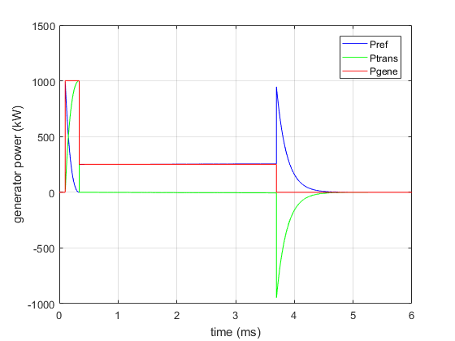
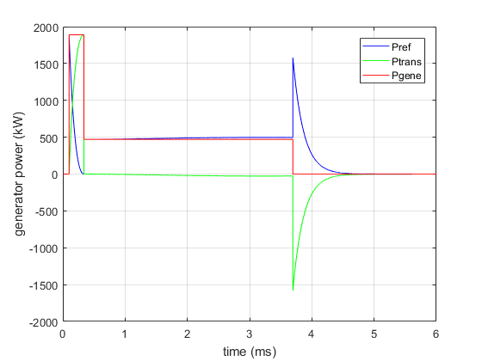
LFD compensation in pulse mode
T. HAMELIN
Simulations
High beta cavity
Without beam
Higher gradient needs more power from the generator (klystron amplifier)
  Eacc = 19.9 MV/m
  Eacc = 27.3 MV/m

Slide 16
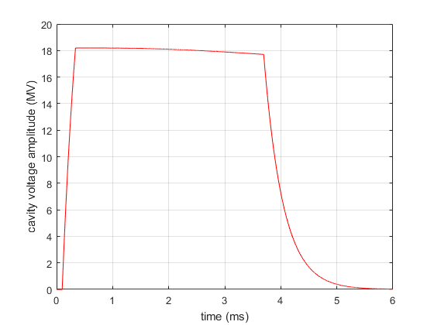
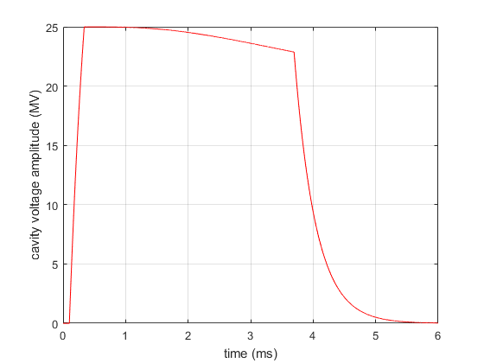
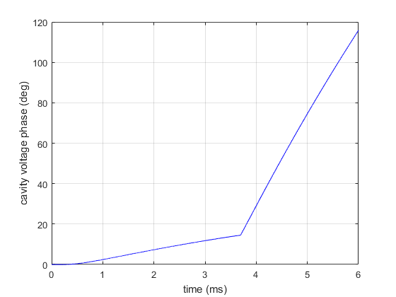
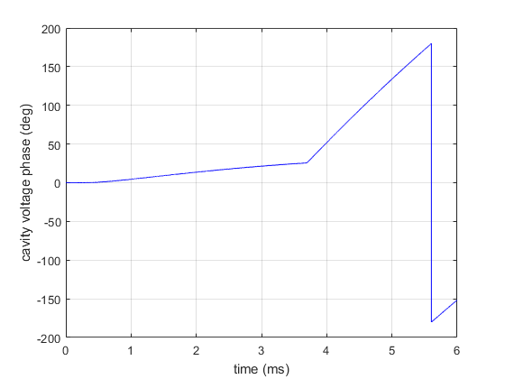
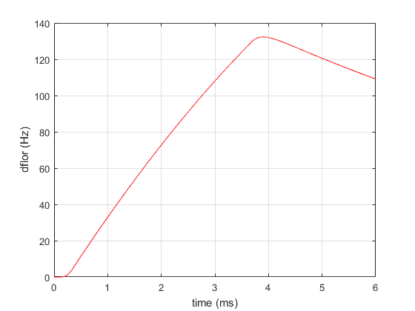

LFD compensation in pulse mode
T. HAMELIN
  Eacc = 19.9 MV/m
  Eacc = 27.3 MV/m
Simulations
High beta cavity
Higher gradient will directly increase the detuning effect in pulse mode
-
-

Slide 17
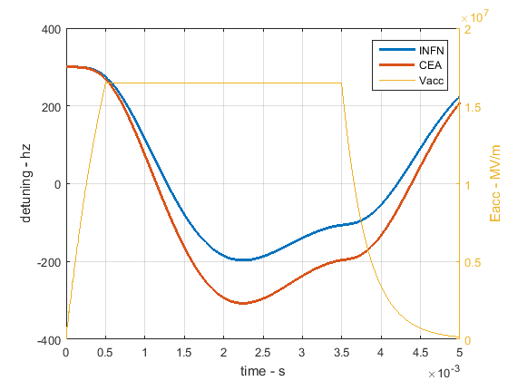
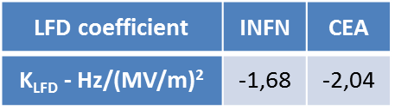
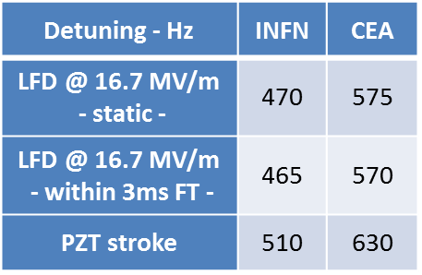
LFD compensation in pulse mode
Simulations (another model)
Medium beta cavity
Different behavior for 2 different cavity design
Output from cavity simulator
R. PAPARELLA (INFN LASA), SLHIPP#6 meeting

Slide 18
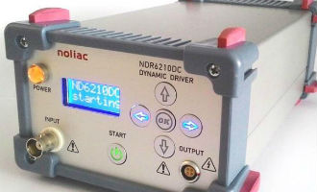
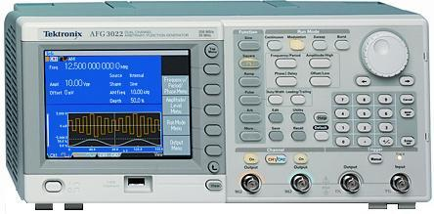
Testing the fast tuning system capabilities
O. PIQUET
Manual optimization foreseen on first cryomodule prototype
Experimental approach
will give realistic study cases for LLRF system developers
X 4
X 4
Piezo
Arbitrary waveform generator
Tektro AFG3022
Voltage amplifier NOLIAC
NDR 6220
Cryomodule
interface
Cavity
Piezo
Trigger
Pulse piezo
(Volt)
RF pulse
(without beam)
successive
trapézoïdal shape pulses
Pre-trigger

Slide 19
LLRF system for LFD compensation
LUND UNIVERSITY
LLRF system developed for ESS
FPGA based, ADC, down sampling, µTCA
PI or feed-forward regulation algorithms
Some tests on the cryomodule will be obligatory before installation in the tunnel
LFD compensation and LLRF performances are closely linked to high power RF overhead delivered by the amplifier and available for the regulation

Slide 20
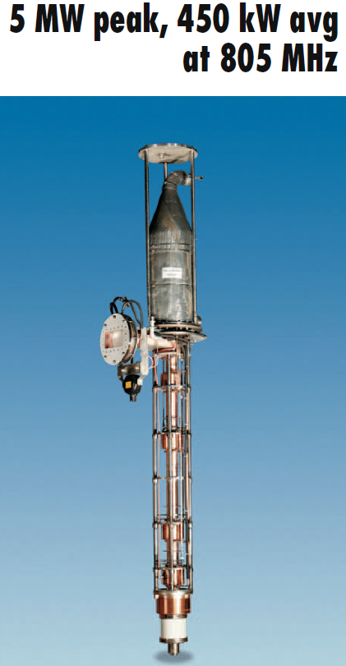
RF power system (klystron and modulator)
RF system for the 704 MHz superconducting linac can provide 1.6 MW maximum
RF system for the 805 MHz normal conducting linac (CCL)
  5 MW pk – 450 kW average long pulse klystron developed
  4 positions in the gallery, 10 tubes fabricated
  beam voltage and current: 135 kV, 70 A
  Pill-box window TE10 mode
  Hypervapotron cooled collector
Circulator and water loads
  must handle 5 MW pk – 450 kW average 5 MW –
    not obvious
Modulator
  Modularity will help to reach a higher voltage (from 100 to 135 kV)
  redesign or change of components probably needed
THALES
  Close to state-of-art
http://ieeexplore.ieee.org/document/1591440/

Slide 21
Conclusion
Cryomodule limitations
  clear for maximum gradient of elliptical cavities
  not clear for couplers – need a test to failure
  not clear for fast tuners
RF system
  5 MW system developed for SNS
Don’t forget…
  Magnetic shielding
  Control system
  Fully dressed cavity test in horizontal cryostat
Remark: performance limitations are more often due to available resources to do tests

Slide 22
Thank you

