Slide 1
H⁻ Source: Challenges in Terms of Current and Emittance, Upgradability
Shixiang PENG
State Key Laboratory of Nuclear Science and Technology
Institute of Heavy Ion Physics
Peking University
Email: sxpeng@pku.edu.cn

Slide 2
Contents
H⁻ Source Research Motivation at PKU
Challenges in Terms of Current and Emittance, Upgradability
PKU 2.45GHz Microwave Driven Cs-free Volume H⁻ Sources
Summary and Prospect

Slide 3
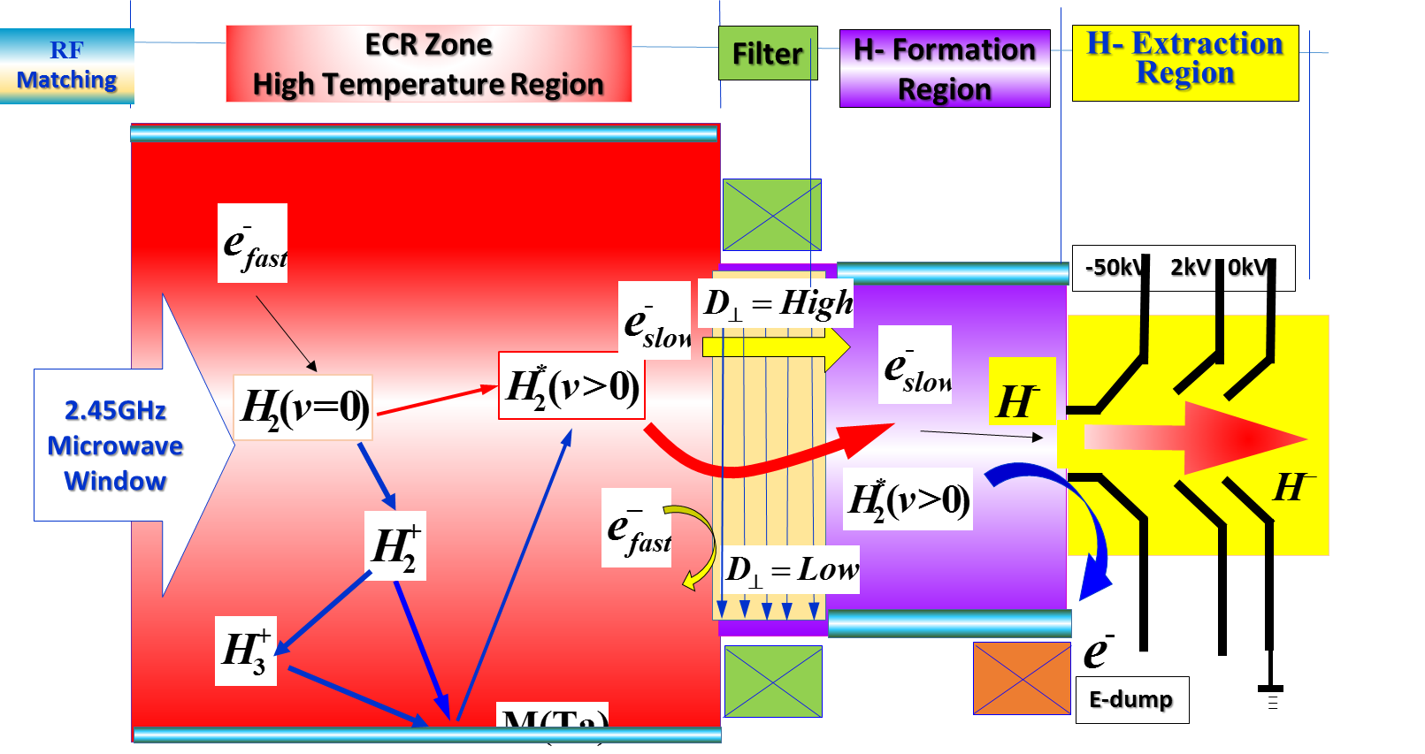
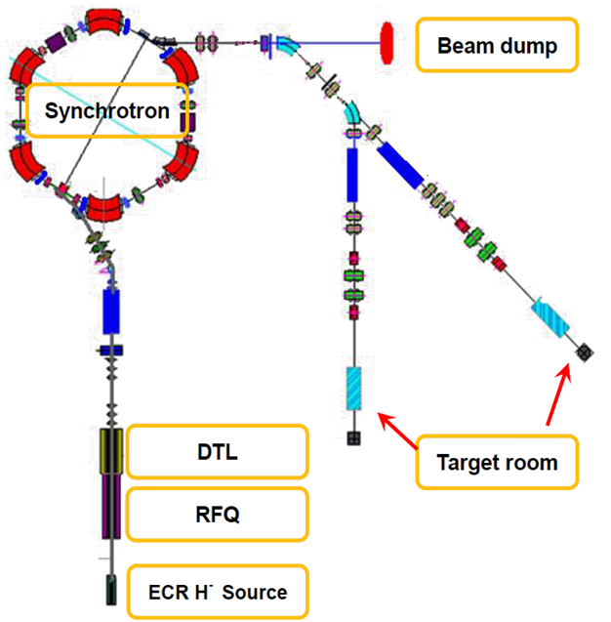
                Research Motivation(1)
Layout of Tsinghua advanced proton source(Xi’PAF)
Purpose
Study of Space Radiation Effects, Medical Application…
Main parameter
Energy range: 60~230 MeV
Intensity: 2×10¹¹ ppp
Subsystem parameter
H⁻ Source : 50 keV/10 mA
ε_{rms}:< 0.2 π·mm·mrad
Time schedule: 100Hz/1ms
Cs-free type
RFQ: 3 MeV
DTL: 7 MeV
Synchrotron: 60~230 MeV
G.R. Li, etc., The 12th Symposium on Accelerator Physics,15 August 2014, Lanzhou University

Slide 4
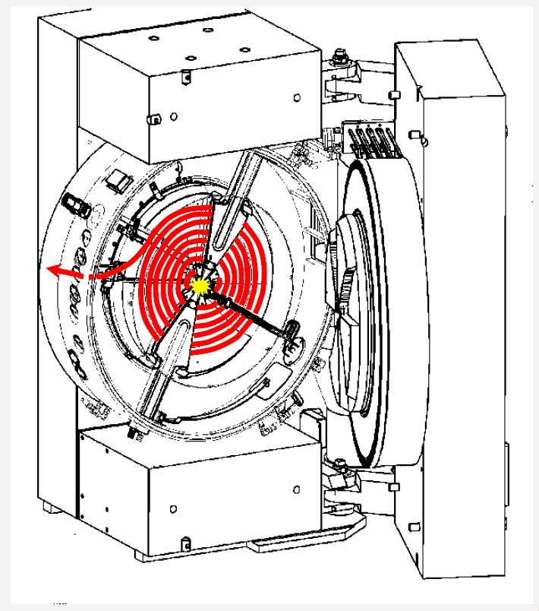
                Research Motivation(2)
PET trace Cyclotron (External H⁻ ion source)
Facility Requirement:
H⁻ ion beam: 5mA/30keV
Normalized 4 rms emittance of < 0.6 π mm mrad.
Beam operation mode: CW
Source structure: Cs-free
Source size: the smaller the better.
PET: Positron Emission Computed Tomography

Slide 5
Contents
H⁻ Source Research Motivation at PKU
Challenges in Terms of Current and Emittance, Upgradability
PKU 2.45GHz Microwave Driven Cs-free Volume H⁻ Sources
Summary and Prospect

Slide 6
·
H⁻ Sources for Accelerators
Surface Production
Volume production
Filament-driven
(TRIUMF, Jyväskylä, J-PARC, CIEA)
Penning Source
(RAL, CSNS)
Challenges
Current
Emittance
High Duty factor & Its Variable
Power efficiency
Lifetime
…
H⁻
Surface conversion
(LANL, KEK)
RF-driven
(DESY,SNS,CERN)
ECR-driven volume ?
Magnetron
(FNAL, BNL, ANL, DESY)

Slide 7
H⁻ Ion source around the world
Lab | Source type | Cs | Current (mA) | Pulse length(ms) | Rep Rate (Hz) | Duty Factor(%) | Normalized Emittance | Power Efficiency(mA/kW)
Fermi | Magnetron Multicusp W-filam. | Yes No | ~80 5~10 | 0.1 CW | 15 CW | 0.15 100 | 0.3 - - | 50 1
BNL | magnetron | Yes | ~100 | 0.6 | 10 | 0.4-1 | 0.4 | 67
ISIS CSNS | Penning | Yes Yes | ~60 ~50 | 1 0.5 | 50 25 | 5 1.25 | 0.7 0.5 | 6 --
DESY | Multicusp ext. RF | No | 80 | 0.15 | 8 | 0.12 | 0.26 | 2
LINAC4 | Multicusp ext. RF | Yes | 50 | 0.4 | 0.8 | 0.03 | 0.3 | 1.1
J-PARC | Multicusp LaB₆ filam. Multicusp int. RF | No Yes | 30 80 | 0.5 0.5 | 25 25 | 1.25 1.25 | 0.18 0.3 | 2
KEK LANL | Multicups Surface Convertor | Yes | 18 |  |  | 12 | -- | 3
SNS | Multicusp int. RF Multicusp ext. RF | Yes Yes | 41 50 | 1 1 | 60 60 | 6 6 | 0.26 0.2 | 1.6
JAERI | Multicusp W-filament | Yes | 60 | 1 | 50 | 5 | 0.23 | 2
TRIUMF CIEA/… | Multicusp- Filament | Yes Yes | 20 18 | CW CW | CW CW | 100 100 | 0.7 0.77 | 3 5
CEA | ECR | No | 3.5 | 1 | 10 | 1
Acknowledgement
T. Roser(BNL), J. Lettry(CERN), T. Rutter, D. Faircloth & S. Lawrie(ISIS, RAL), M. P. Stockli & R.F Welton(SNS) ，Y. Belchenko, A. Ueno (J-PARC), H.F. Oyang(CSNS), D. Bollinger(FNAL), X.L. Jia(CIEA), H. Etoh(JAEA), R. Gobin(CEA/Saclay),V. Dudnikov……

Slide 8
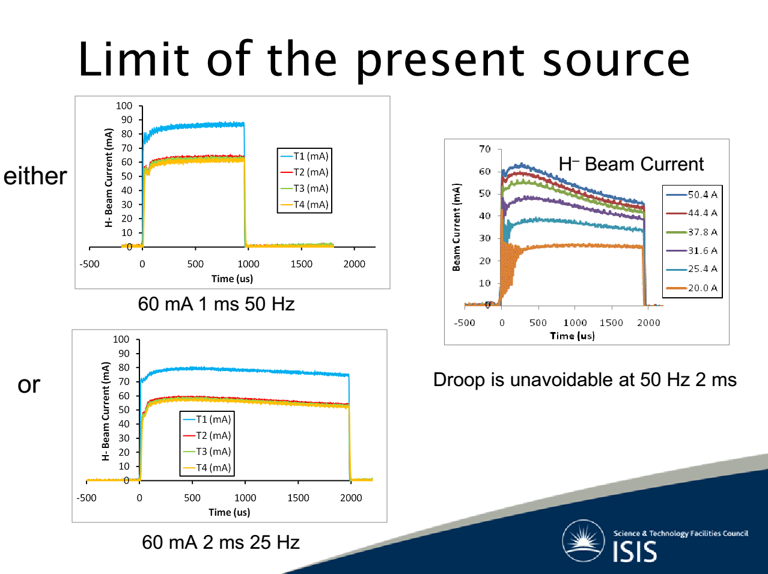
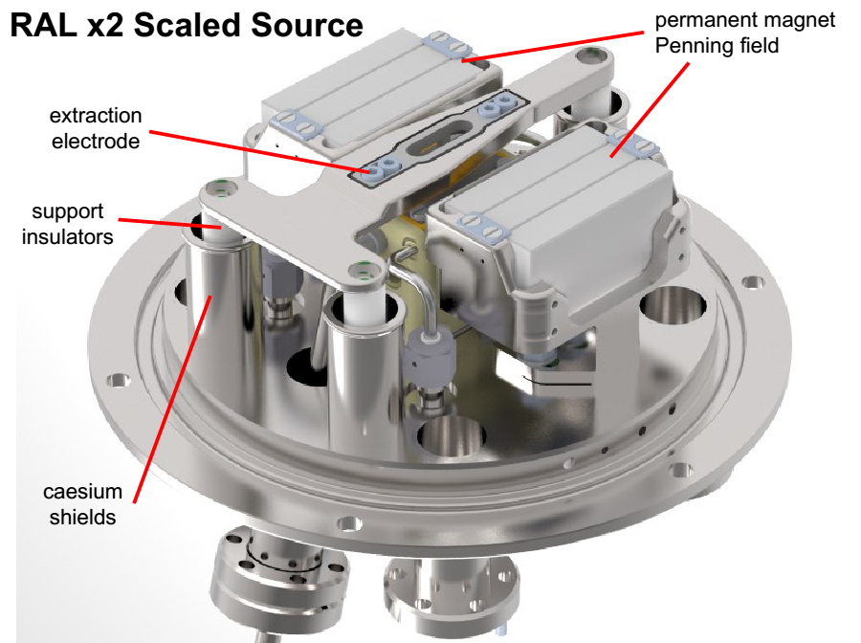
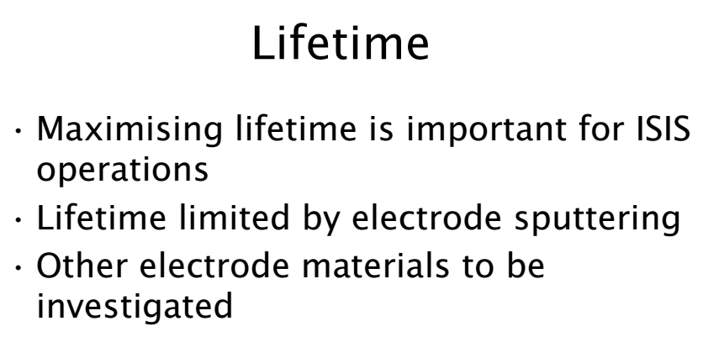
RAL Penning Source
COURTESY Dan Faircloth, RAL

Slide 9
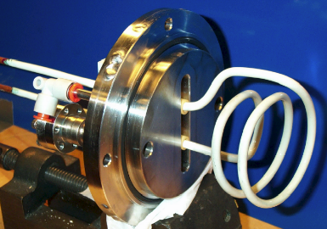
SNS RF Driven Volume H⁻ Source
Internal Antenna Source
COURTESY M. Stockli, SNS
e-dump
multicusp magnets
Gas inlet
Cs collar
H⁻ beam
plasma
RF antenna
filter magnets
view port
60mA, 6%，Cs-seeded
ε: 0.26pi.mm.mrad
RF Power: ~60kW
Antenna lifetime: Several weeks
dumping magnet

Slide 10
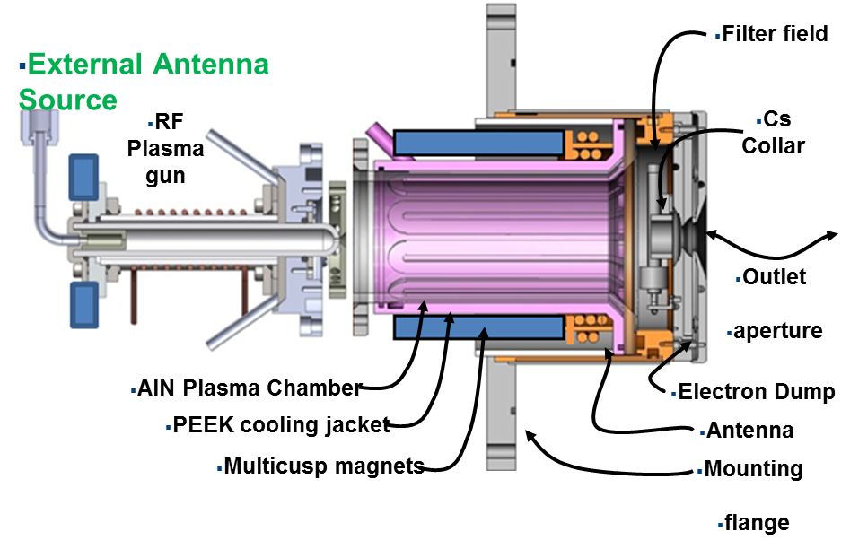
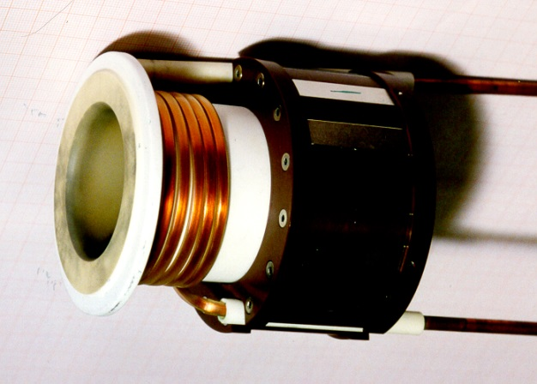
SNS RF Driven Volume H⁻ Source
External Antenna Source
COURTESY R. Welton, SNS
50 mA, 6%,
Cs-seeded
Cs- seeded
RF Power: 50-60 kW
RSI 87, 02B146 (2016)

Slide 11
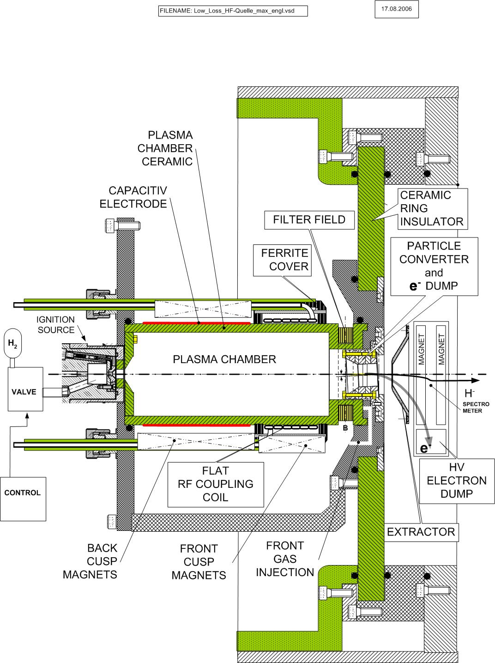
DESY RF Driven Volume H⁻ Source
Jens Peters, DESY
80 mA
0.12 % → 6%
ε: 0.25pi.mm.mrad
35 keV
RF: ~30kW
NO Cs
×

Slide 12
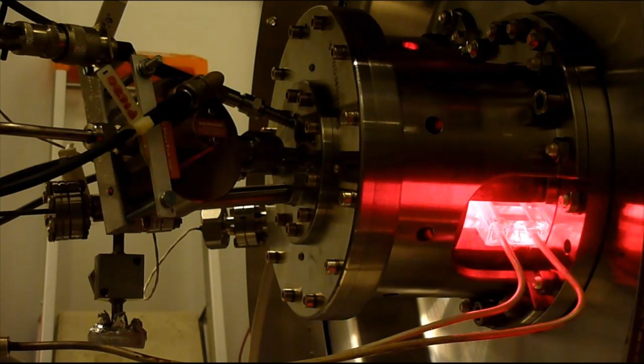
CERN RF Driven Volume H⁻ Source
Courtesy Jacques Lettry, CERN
50 mA
0.1 %
RF Power: ~45kW
ε_{norm, rms}: 0.34pi.mm.mrad

Slide 13
All about H⁻ ion Source
Horst Klein (20th ICFA Workshop summary).
“The ion sources, and especially the H⁻ sources, are still somewhat a black magic. ……Concerning the different types of ion sources, I think the most promising candidates for H⁻ are the Penning ion source and the volume source (Large Volume SPS). The ECR source may be a hope for the future”.
Intuition and hand experience are important components for H⁻ sources development.
A learning period for new team is ~8 years.

Slide 14
Contents
H⁻ Source Research Motivation at PKU
Challenges in Terms of Current and Emittance, Upgradability
PKU 2.45GHz Microwave Driven Cs-free Volume H⁻ Sources
Summary and Prospect

Slide 15
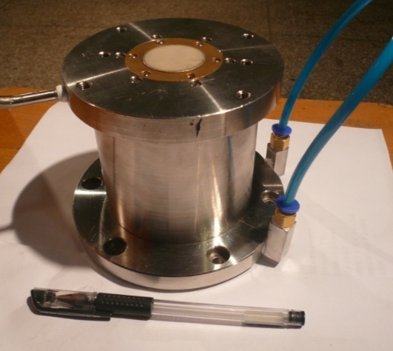
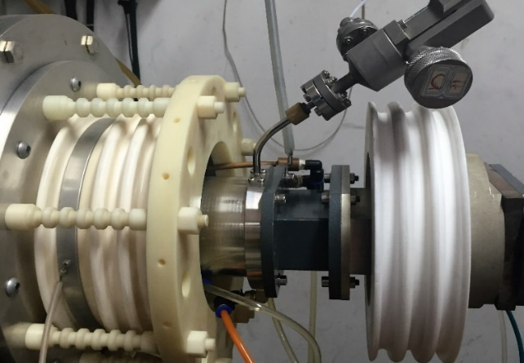
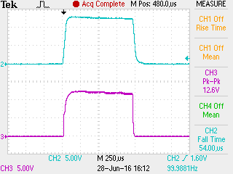
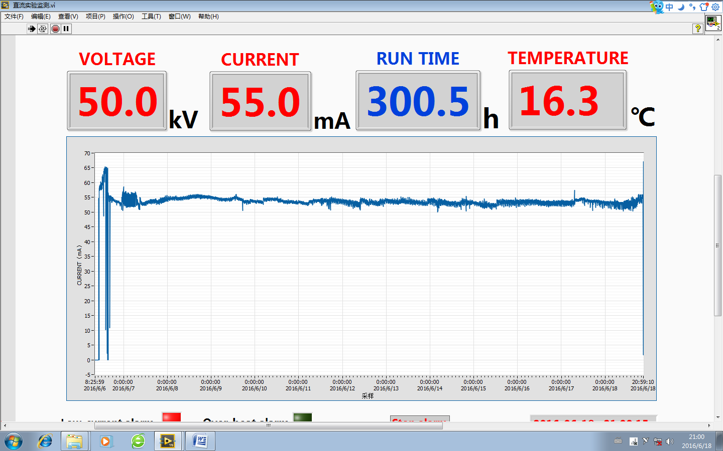
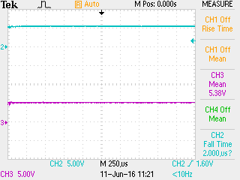
PKU 2.45 GHz PMECR H⁺ Ion Source
Standard 2.45GHz PMECR Ion Source
Pulsed mode
130mA@50kV φ6mm
Ion | H⁺ | D⁺ | He⁺ | O⁺
I(mA) | 130 | 83 | 65 | 70
Project | DWA/CIADS | PKUNIFTY | Coupled RFQ | SFRFQ
Stability of CW H⁺ beam
  53.8mA@50kV
  φ6mm
  RF power 500 W
294.6 h
@103h,CEA/Saclay
*Shi-Xiang Peng, et al., Chinese Physics B, Summited (2016/8)

Slide 16
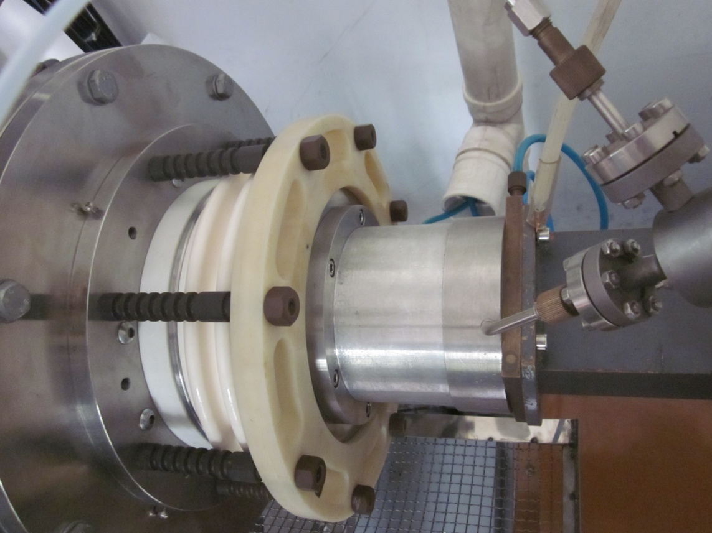
PKU Cluster H₂⁺/ H₃⁺ ECR Ion Source ^{[1]}
H₂⁺ 42mA(20mA[2]), 54%
H₃⁺ 20mA (2.9mA[3]), 55%
Cluster Source
Yuan Xu et al., Rev. Sci. Instrum. 85, 02A943 (2014).
R. Miracoli et al., Rev. Sci. Instrum. 83, 02A305 (2012).
N. Joshi, M. Droba, O. Meusel, U. Ratzinger, NIM A 606 310–313 (2009).

Slide 17
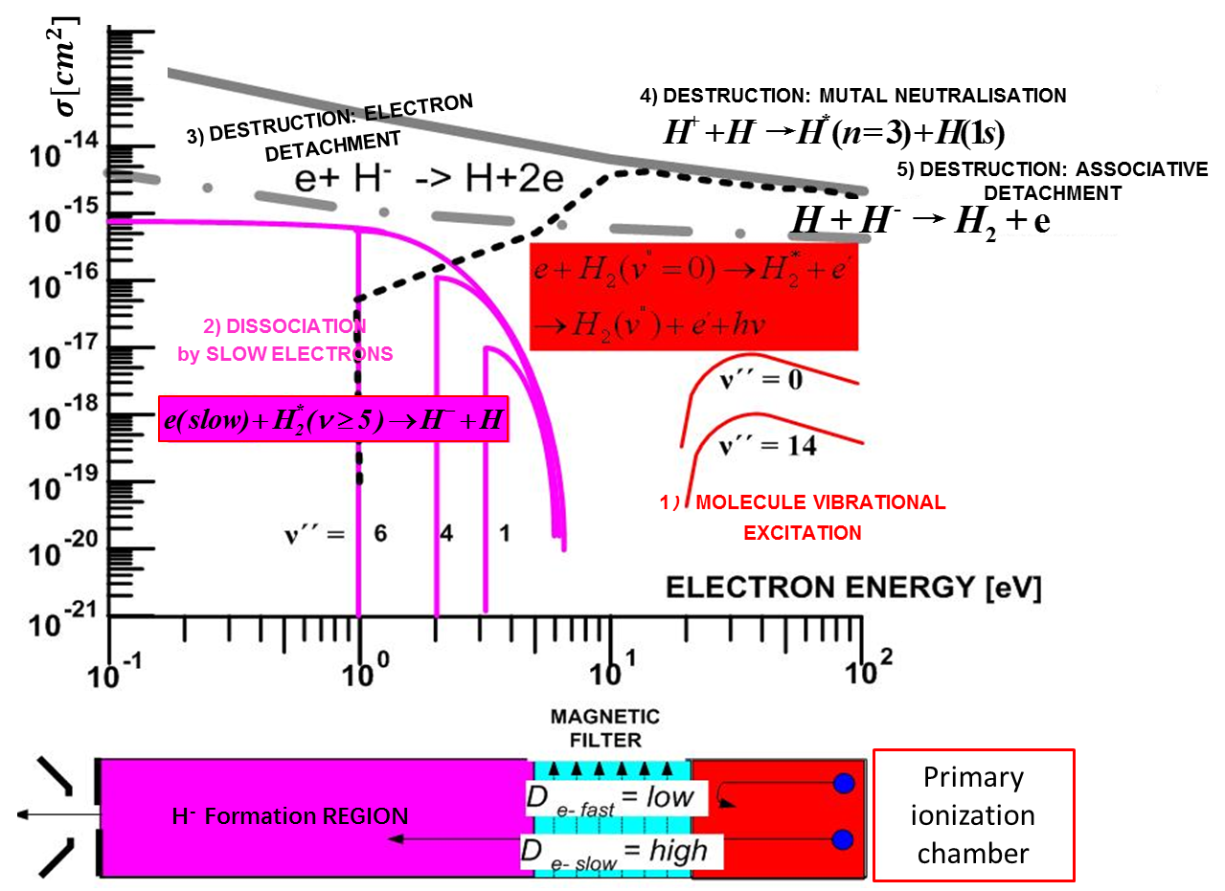
                Cross Section of H⁻ Generation Process
Jens PETERS, ICIS 07, August 26-31, 2007, Jeju, Korea

Slide 18
                Topics for a Volume H⁻ Source Design
Cs or Cs-free
Electron generation or heating (RF/Filament/ ECR)
Electron selection filter
Gas distribution
Collar in cold region
Liner material
Electron co-extraction suppressing
RF Breakup before cold region
Plasma bias
Extraction system structure
Space charge effect
…

Slide 19
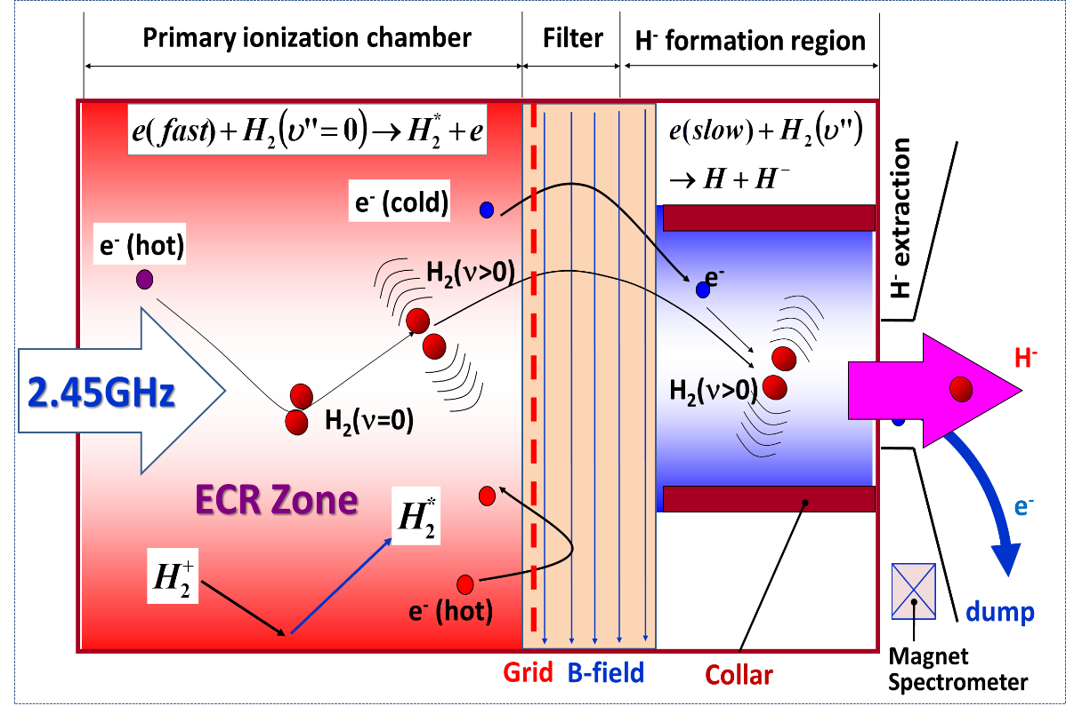
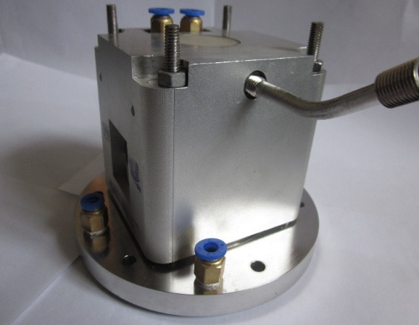
PKU Microwave Driven Cs-free H⁻ Sources
1)Prototype H⁻ Source 2012/10/28 - 2012/11/7
100mA@50kV H⁺
Prototype source
Haitao Ren, Shixiang Peng*, MOPFI034, Proceeding of IPAC13, Shanghai, China, May 12-17, 2013: 360-362.

Slide 20
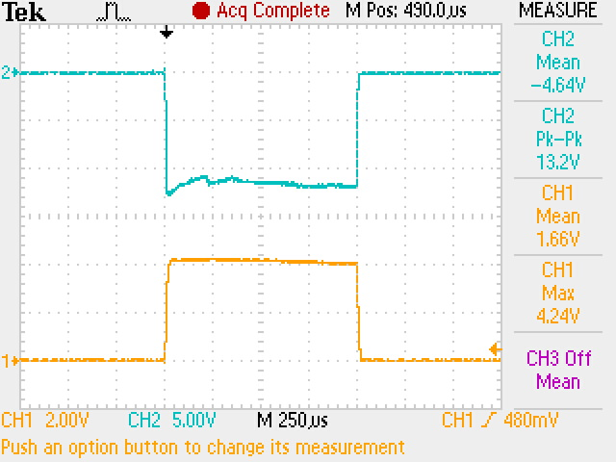
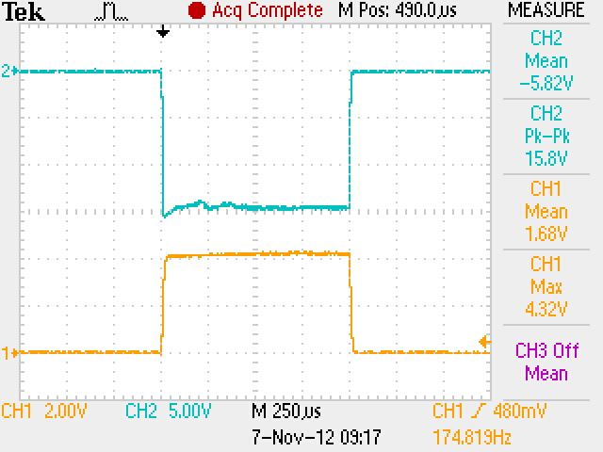
Results from Prototype H⁻ Source
Operation parameters
Pressure 4.6 × 10⁻³ Pa
FR power 4.58 kV × 41 mA
Time Schedule 166Hz/1 ms
Plasma Electrode：-35kV
Second Electrode: 2kV
Current at FC1：12 mA
Operation parameters
Pressure 4.6 × 10⁻³ Pa
FR power 4.58 kV × 41 mA
Time Schedule 166Hz/1 ms
Plasma Electrode：-40kV
Second Electrode: 2.1kV
Current at FC1：15 mA
RF:2.8kW
Extracted at 35kV
Extracted at 40kV
12mA
H⁻ Beam
15mA
H⁻ Beam
Trigger Signal
Trigger Signal

Slide 21
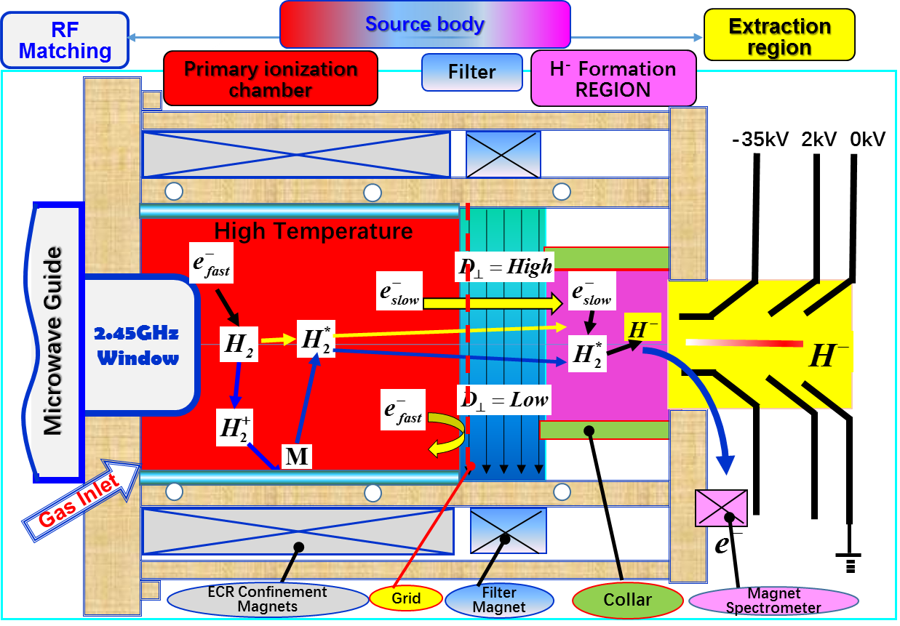
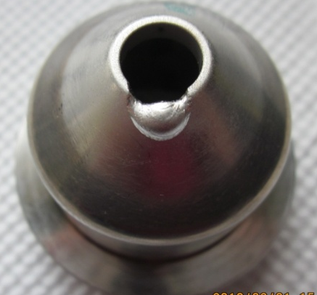
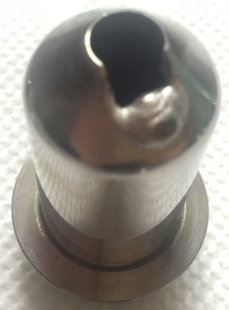
Unfinished missions and Lessons learned
No Emittance Results
No CW H⁻ Beam
No long term test
…
E-dump - B Field configuration and its location;
Sparks elimination - extraction system with water cooled, suitable material for electrodes and its protection;
RF Breakup method- W-grid will be the weakest part inside the source body;
Higher Current and Higher Efficiency and the Source Stability, etc.

Slide 22
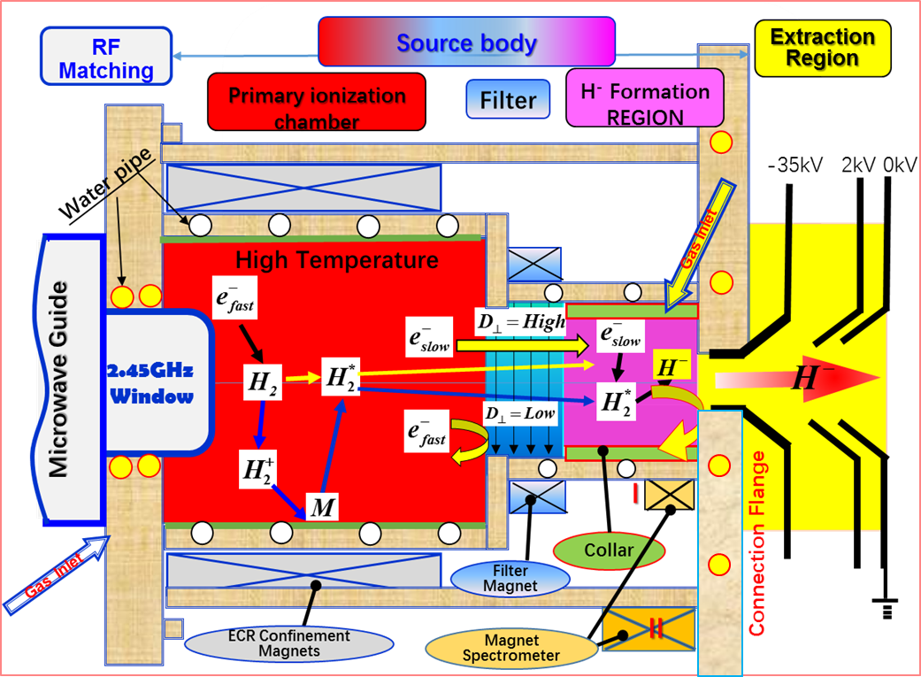
2) Formal H⁻ Source (since 2013/3)
S. X. Peng*, Y. Xu, H. T. Ren, etc. WEPWA027, IPAC2015, Virginia, May 3-8, 2015
S. X. Peng*, H. T. Ren, Y. Xu, etc. AIP Conference Proceedings 1655, 070005 (2015)
S. X. Peng*, T. Zhang, H. T. Ren, etc. Rev. Sci. Instrum. 87, 02B125 (2016)

Slide 23
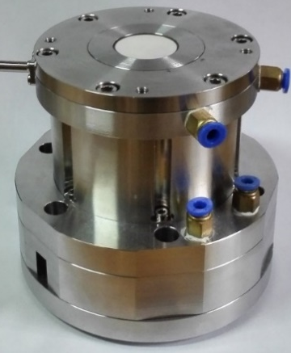
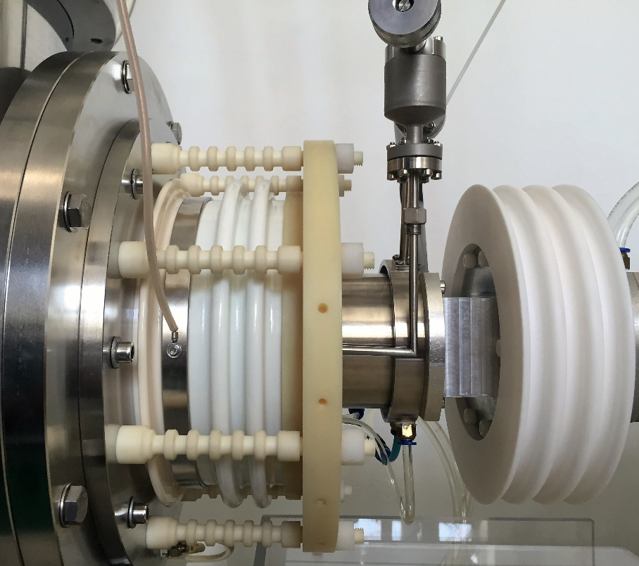
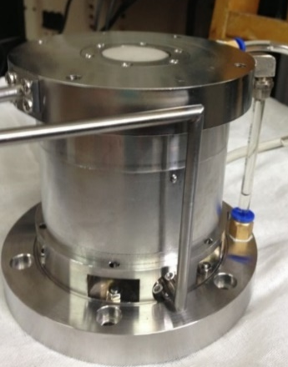
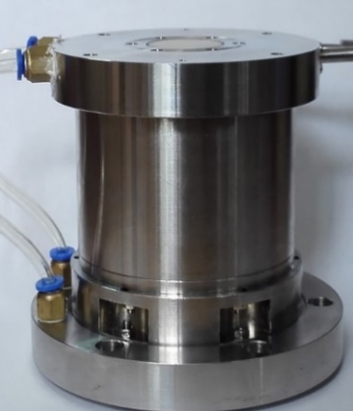
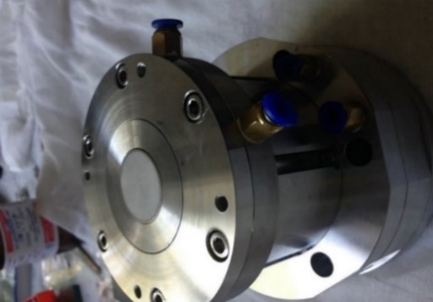
H⁻ Source Bodies and their best results (Before Sept. 2015)
High Voltage Region
230mm
No.1
No. 2
No. 3
No. 4
Source Number |  | No.1 | No.2 | No.3 | No.4
Water Cooling | RF Window | No | Yes | Yes | Yes
 | Plasma Chamber | Poor | Yes | Yes | Yes
 | Connection Flange | No | No | Yes | Yes
 | Extraction | No | Poor | Yes | Yes
E-Dump Position |  | I | II | II | I
Current (mA) | CW | 8 | 10.8 | 25 | 29
 | Pulsed(100Hz/1ms) | 16 | 20 | 35 | 45

Slide 24

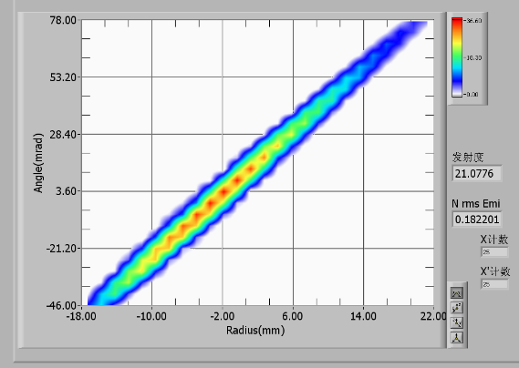
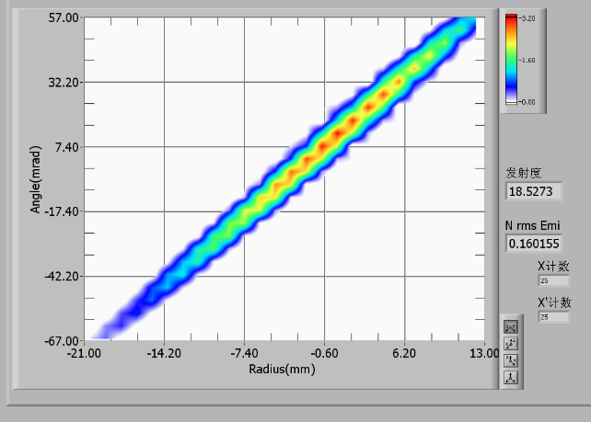

Best Results from PKU H⁻ Source
High Voltage Region
230mm
CW Mode
Parameter
RF power 1000 W
Pressure 4.0E-3 Pa
Ex. Voltage -35 kV
Sec. Voltage 2 kV
Pulsed Mode Parameter
Pulsed 100Hz/1ms
RF(Peak) 2100 W
Pressure 4.5E-3 Pa
Voltage -35 kV
Second 2kV
Ratio of H⁻/e: 4.7
H⁻ current: 29mA
Power efficiency: 29 mA/kW
ε_{RMS,norm}：0.18 pi.mm.mrad
Ratio of H⁻/e: 4.4
H⁻ current: 45mA
Power efficiency:21.4 mA/kW
ε_{RMS,norm} : 0.16 pi.mm.mrad

Slide 25
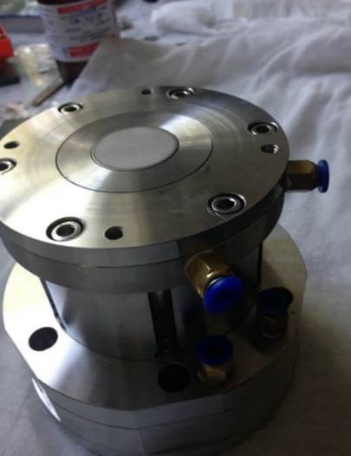
Duty Factor Variation Possibility
No.3
No.4
Peak RF Power :
1800W
Duty factor | H⁻ (mA) | Power Efficiency(mA/kW)
20% (1ms+4ms) | 35 | 19.4
14.3%(1ms+6ms) | 34 | 18.9
10%(1ms+9ms) | 35 | 19.4
5%(1ms+19ms) | 34.2 | 19
3.3%(1ms+29ms) | 33 | 18.3
2%(1ms+49ms) | 30.5 | 16.9
1%(1ms+99ms) | 29 | 16.1

Slide 26
Summary and Prospect
RF driven Volume H⁻ source can produce several tens mA beam at low duty factor(<6%). Several ones are used to deliver beams for accelerators. They need tens kW RF power.
Filament driven source was the only one that can produce 20 mA CW H⁻ beam in the world. Lifetime of the filament is an important issue for discussion.
Penning source has been developed at RAL that can produce 60 mA H- beam with duty factor of 5%. Current and lifetime are still needed to be improved.
At PKU, 2.45Microwave driven H⁻ sources were developed.
CW mode: 29 mA at 35kV. Power efficiency: 29 mA/kW. ε_{norm,} _{RMS}: 0.18 π.mm.mrad.
Pulsed Mode: 100Hz/1ms, 45 mA at 35 kV. Power efficiency: 21 mA/kW； ε_{norm,} _{RMS}: 0.16 π.mm.mrad.
Operation duty factor can be easily changed from 1% to 100%.

Slide 27
Next Step
Improvements, such as plasma electrode bias, Diamond like material liner, etc., will be done for higher current.
Long term operation test will be done in the future.
……

Slide 28
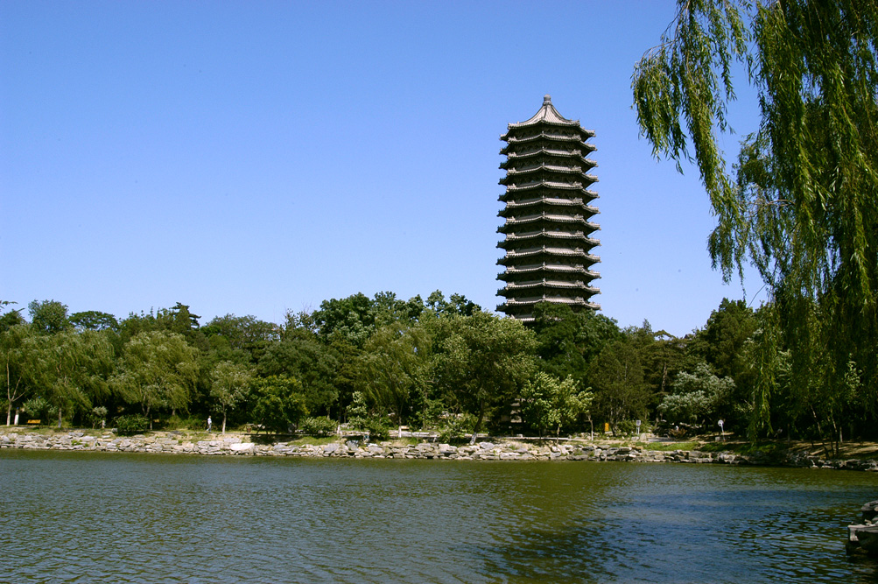
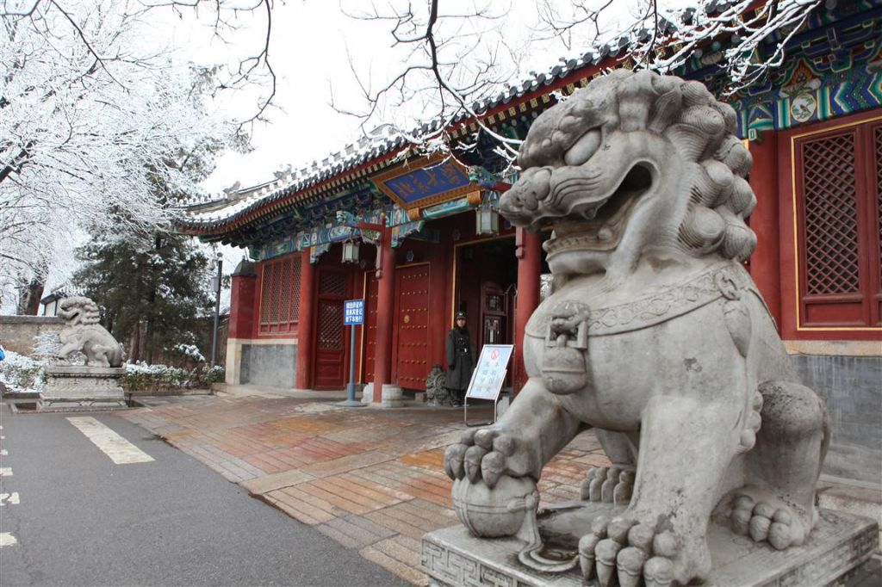


Thank you for your attention!
谢谢关注！
28

