Slide 1
Doubling the Beam Power of 45 Year Old H- Linac at Brookhaven
D. Raparia
Brookhaven National Laboratory
Upgrading Existing High Power Proton Linac
ESS, Lund, Sweden
November 8-9, 2016

Slide 2
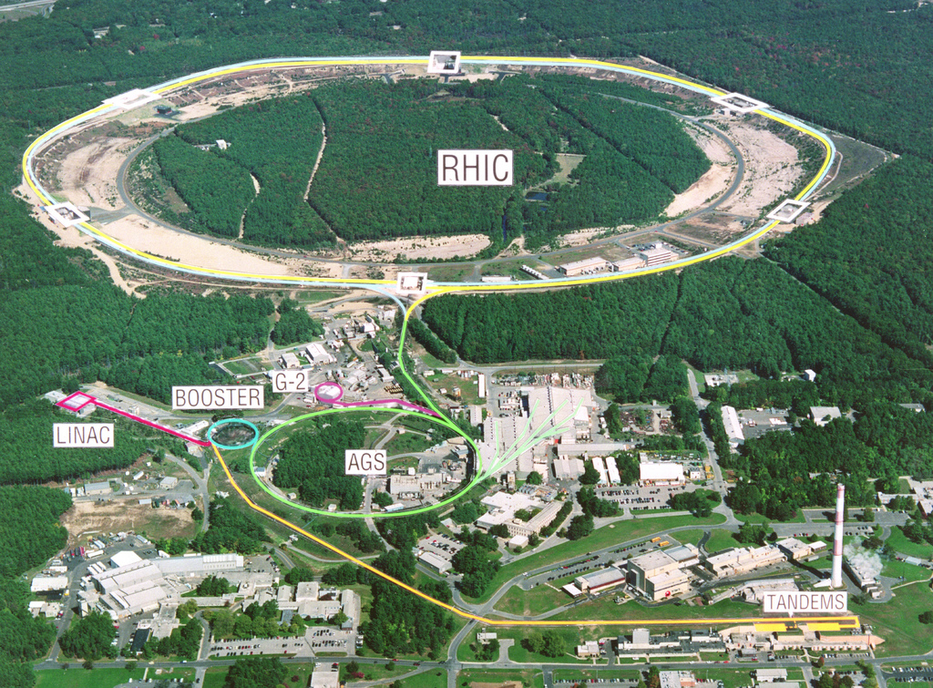
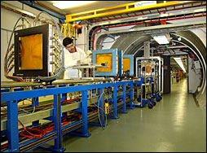
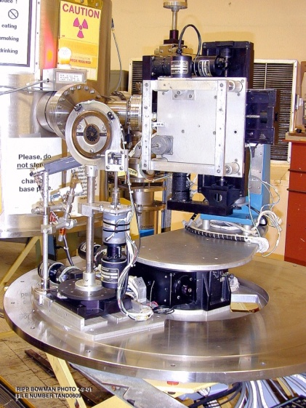
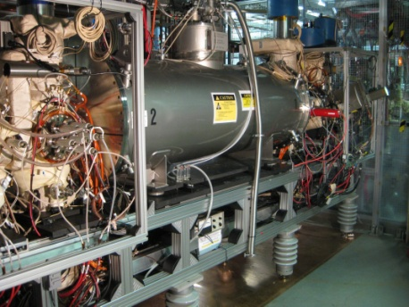
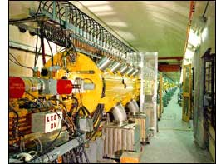
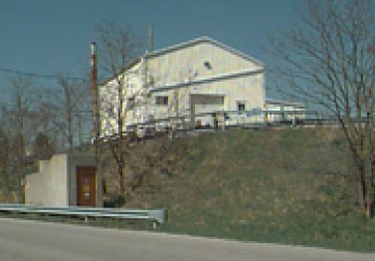
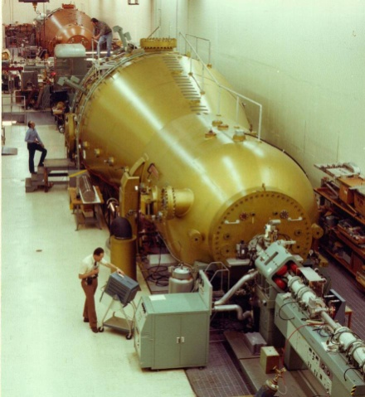
Polarized H- for RHIC
Heavy ions for RHIC
Heavy ions for NASA Space Radiation Lab
Many (or all) of these can be running simultaneously!
H- for Isotope Production
Heavy ions for the Single-Event Upset Facility
NSRL – biological effects of space radiation
SEU – Radiation effects on electronics
EBIS
BLIP – medical isotopes
200 MeV Linac
Two 14 MV Tandem Van de Graaffs

Slide 3
Outlines
Introduction
Past Upgrades and Reliability
Intensity Upgrade Phase I
Loss Detection & Mitigation
RF Structure Cooling Limitation
RF Upgrades
Conclusion

Slide 4
Acknowledgements
G. Atoian, B. Briscoe, F. Carlino, T. Flanagan, D. Gassner, P. Ingrassia, T. Lehn, V. Lodestro, A. McNerney, G. Omar, J. Ritter, A. Zelenski

Slide 5
LINAC Beam Parameters
Frequency 201.25 MHz
Injection Energy 0.750 MeV
Final Energy* 10-200 MeV
Peak Current 57 mA/ ~ .5 mA P^
Pulse Length 480 μs
Repetition Rate 6.67 Hz
Number of Tank 9
Length 144.8 m
Total Peak RF Power 22 MW
*Energy can be changed energy pulse to pulse

Slide 6
Linac Beam Parameters
BLIP
RR 6.67 Hz,
Pulse width ~ 480 µs,
Peak Beam current ~ 57 mA
Max integrated current 165 μA
Beam time 92.5% /super Cycle
RHIC/Booster
To booster one pulse every super cycle (Pulse width 226 µs)
To HEBT one pulse every super cycle (Pulse width 302 µs)
Super Cycle ~ 4 sec , Peak current ~ 500 µA
Beam time 7.5%/super Cycle
NSRL
Beam time 7.5%/super Cycle

Slide 7
Linac upgrades History
1970: Built for Proton , peak current 100 mA, beam pulse length 200 μs, RF pulse length 400 μs
1977: 5 Hz operation
1984: Switch to H-
1986: Add Polarized H-
1990: Replacement of Cockcroft-Walton By RFQ
1994: New timing system
1996: Pressurized coax, RF system: 50 kV power supply, new RF control system, new amplitude phase servo, and LEBT modification
2000: addition of OPPIS

Slide 8
Linac upgrade history ( continue)
2009: LEBT/MEBT reconfiguration short MEBT
2010: Short LEBT at 45 Deg
2015: New beam loss monitor , replacement tetrode 7651 with 5 kW solid state amplifiers
2016: intensity upgrade phase I, digital LLRF

Slide 9
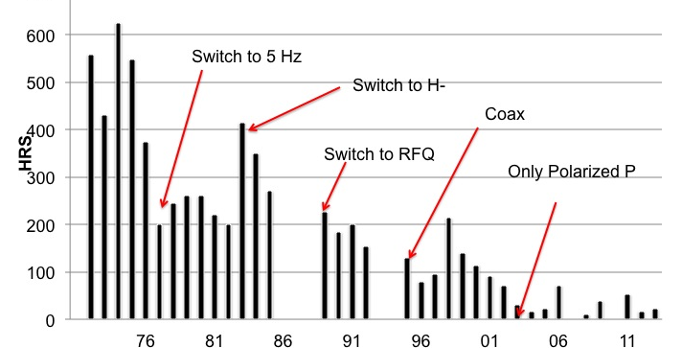
Linac Down time in Hrs

Slide 10
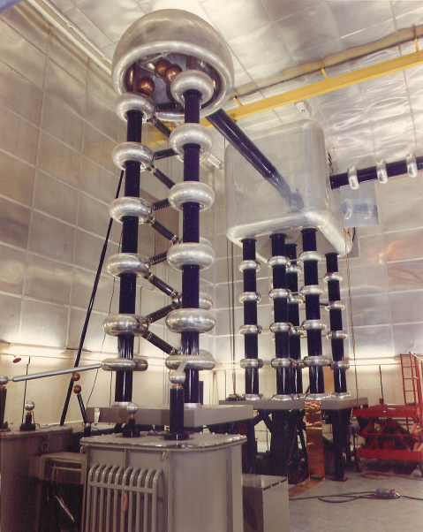
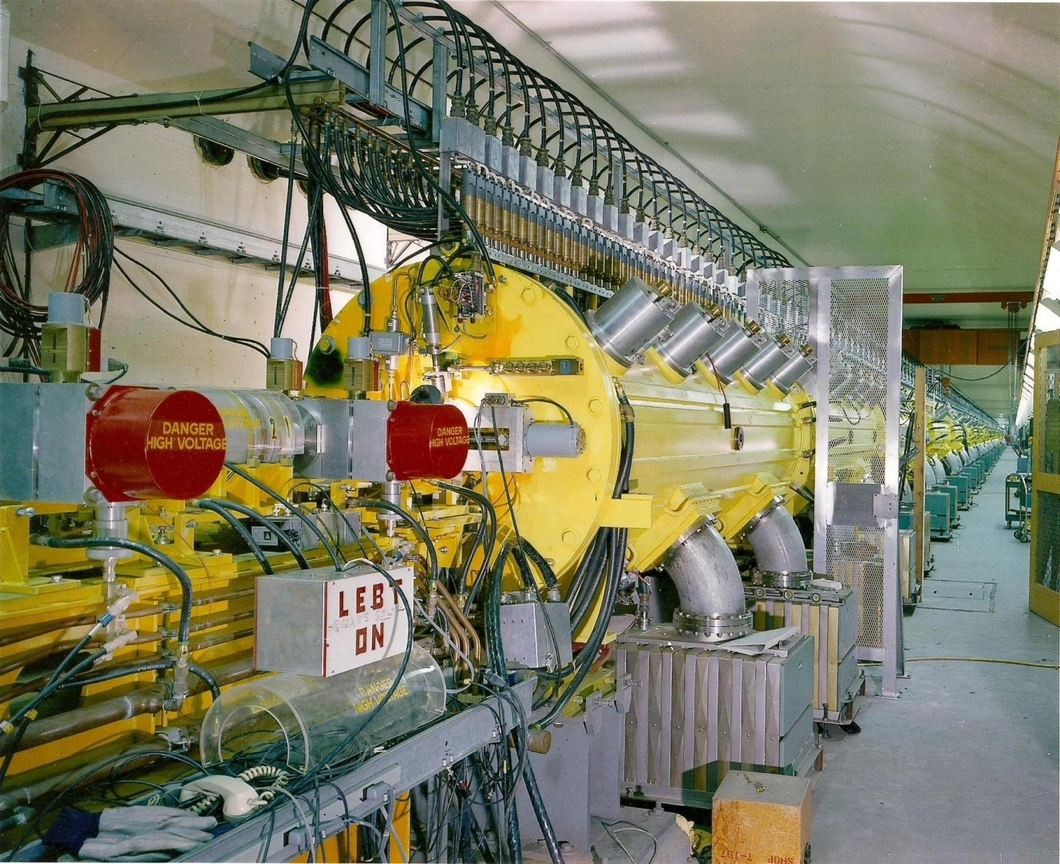
1972 BNL Linac 200 MeV
Cockcroft-Walton 750 KeV
Drift Tube Linac (Alvarez Linac) 200 MeV
J. D. Cockcroft and E.T.S Walton, Proc. Roy. Soc. 136A, 619 (1932)
L. W. Alvarez, et al, Rev. Sci. Ins. 26, 111 (1955)

Slide 11
2002 Addition of Optically Pumped Polarized Ion Source (OPPIS)
B
B
B
DTL
H
S
S
RFQ
Q
C
Q
S
D
Q
Q
B
B
B
H
Polarized
J. Alessi, M. Okamura, D. Raparia, T. Roser, C.D.P. Levy, A. Zelenski, T. Takeuchi, Y. Mori, `` Design
of a 35 keV LEBT for the New High Intensity OPPIS at BNL”, PAC 1999

Slide 12
Modification In 2009 at BNL
35 keV
7 m
750 keV
DC
B
B
B
DTL
H
S
S
RFQ
Q
C
Q
S
D
Q
Q
H
Reduced MEBT length by 90% meters
750 keV
Polarized
35 keV
0.7 m
B
DTL
H
S
E
Q
S
C
S
S
RFQ
Q
Q
Q
E
H
B
Q
Quadrupole
Buncher
S
Solenoid
C
Chopper
S
Beam Stop
E
ES Lens

Slide 13
Changes in 2010 at BNL
B
DTL
E
Q
S
C
S
S
RFQ
Q
Q
Q
S
E
H
H
Reduced LEBT length from 4 meters to 2 meters
B
Q
Quadrupole
Buncher
S
Solenoid
C
Chopper
S
Beam Stop
E
ES Lens

Slide 14
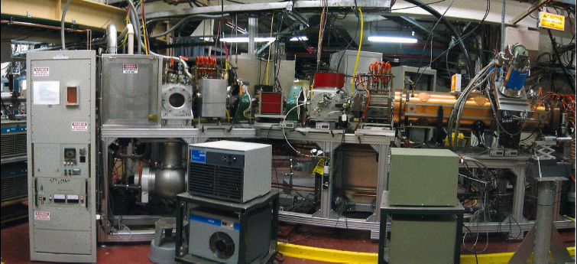
LEBT in 2010
High Intensity
H- ion source
Dipole
Solenoid
RFQ

Slide 15
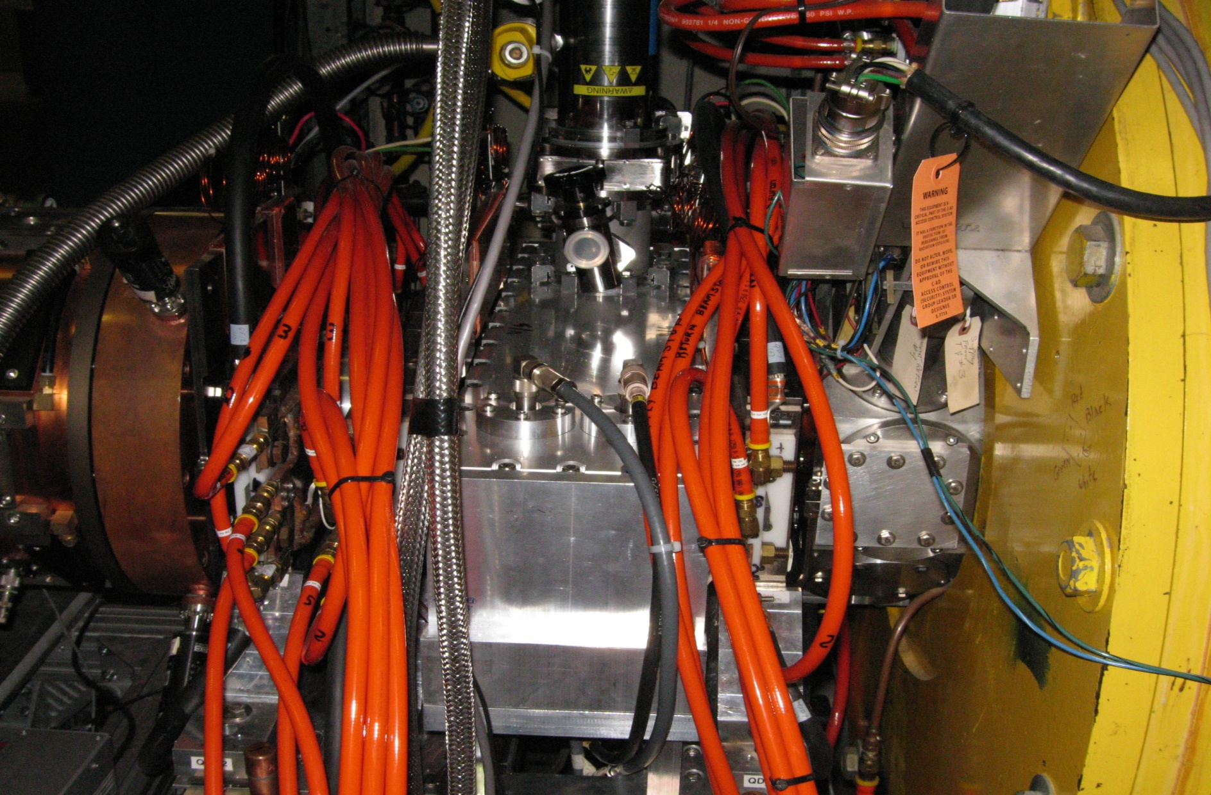
NEW MEBT 2011
DTL
RFQ
BUNCHER
QUADRUPOLE

Slide 16
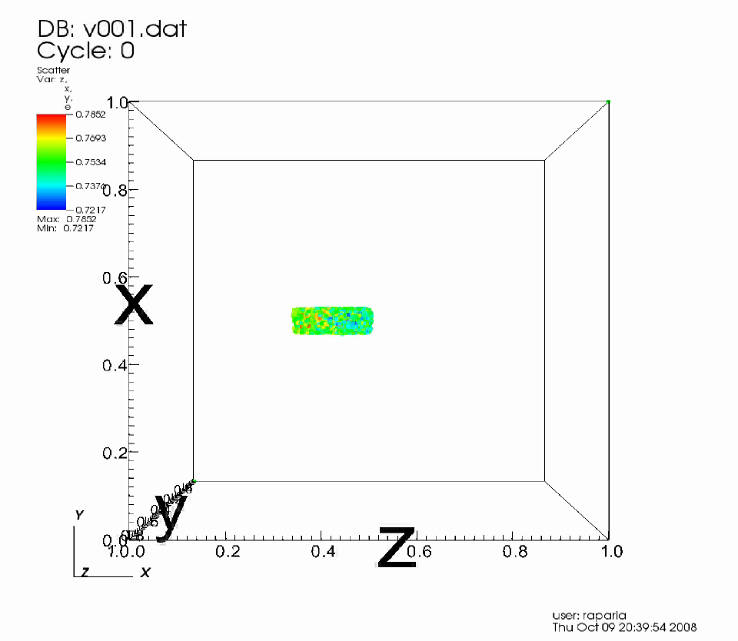
Bunch Through OLD MEBT and LINAC
βλ

Slide 17

Bunch Through New MEBT and Linac
βλ

Slide 18
Benefits Reconfiguration of LEBT/MEBT
Transmission of linac increase 55% to 85 %
P^ 95% Normalized Emittance (H/V) reduce to 4.5/5.5 from 10.7/15.9
Residual radiation decreased by order of magnitude.

Slide 19
Upgrade –Phase I (2014-2016)
Increase beam current by 15%.
5% through ion source and Low Energy Beam Transport / Medium Energy Transport improvements.
10% through RF flattop increases and beam triggering.
Evaluate the proposal to double the Linac beam current
  Evaluate and prototype quadrupole pulse modulators flattops for 900 μs beam
  Evaluate conditions of water cooling channels in drift tubes and accelerator cavities
  Prototype RF system for 1100 μs pulse length
  Recommend Phase 2 requirements for 240 μA average linac beam current.
Completion FY-2016 operations

Slide 20
Doubling the Linac Current
( after 2016 )
Note design Duty Cycle for the Linac RF is 0.4%, for Beam 0.2%
2013 2016 Phase 1 Phase 2
Peak Beam current 42 mA 57 mA 45 mA 45 mA
Max Avg Beam current 120 μA 173 μA 140 μA 240 μA
Beam Pulse Length 450 μs 480 μs 480 μs 900 μs
RF Pulse Length 650 μs 615 μs 670 μs 1100 μs
RF Duty Cycle 0.43% 0.43% 0.44% 0.73%
Rep. Rate 6.67 Hz 6.67 Hz 6.67 Hz 6.67 Hz

Slide 21
Loss detection
We have Long Radiation Monitors ( Argon filled tubes) to
detect losses. LRM can detect beam losses and
interrupt beam with few micro second
Not very sensitive below 100 MeV
We installed Beam Loss Monitors based on Neutron detector

Slide 22
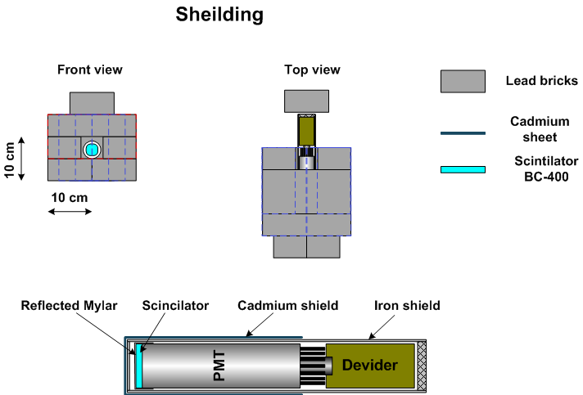
Beam Loss Monitor
Atoain

Slide 23
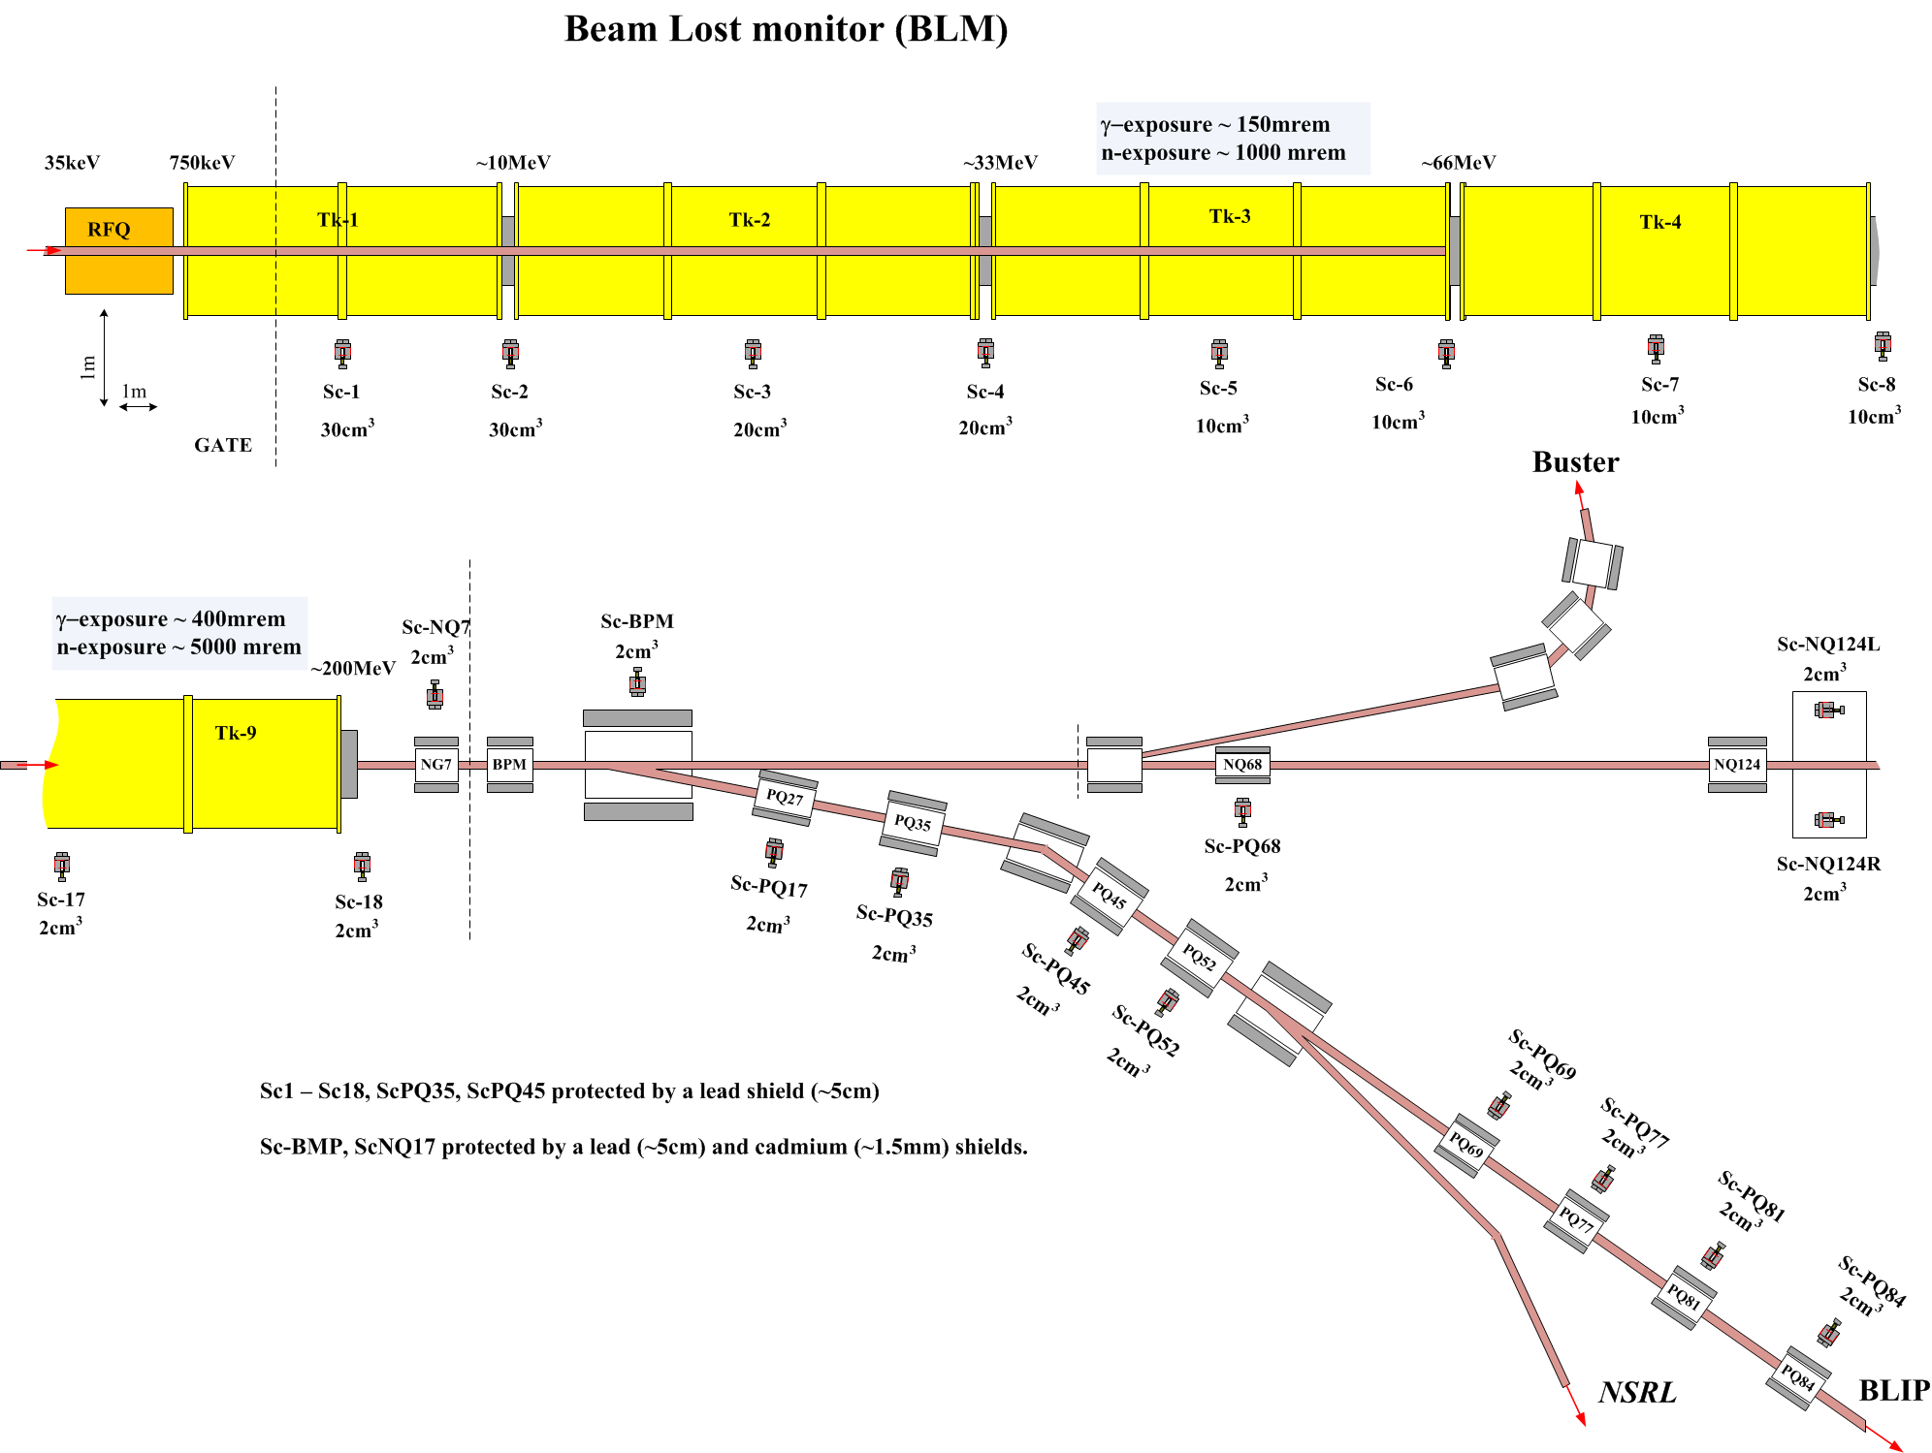

Slide 24
BLPM Setup
Atoain

Slide 25
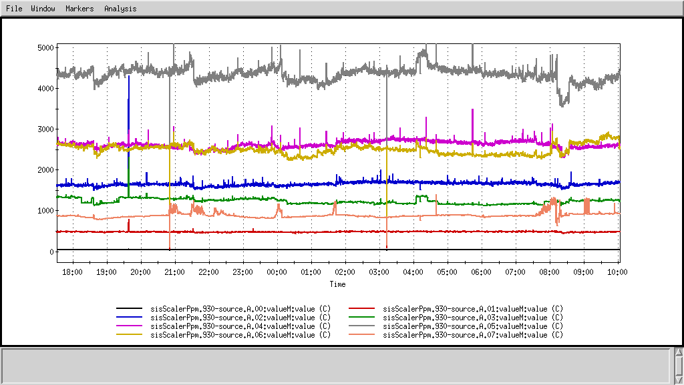
BLM Test
Grigor, Gould, Zelenski
Beam Current 120 uA
Sc 6
Sc 7
Sc 5
Sc 4
Sc 3
Sc 8
Sc2
Sc1

Slide 26
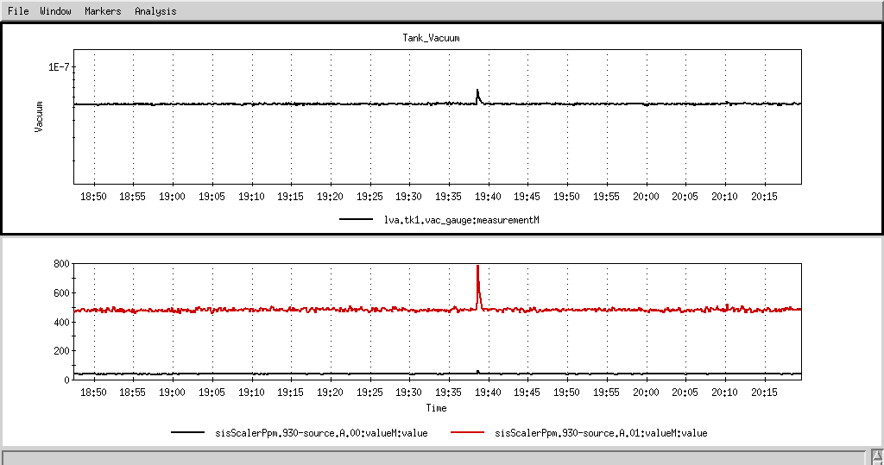
Gas Stripping Losses are Detectable
~7.2e-8
~5.3e-8

Slide 27
Optimization of Source and LEBT

Slide 28
H- Space Charge Neutralization in LEBT
High Intensity
H- ion source
Dipole
Solenoid
RFQ

Slide 29
LEBT at 35 keV
During Neutralization time phase space rotate
sol
sol
X’
τ_{N} ~ 100μs
H- beam
X
LEBT for 120 mA H-
Magnetic (solenoid) focusing
H⁻ ionizes residual gas and capture positive nucleus this is called space charge neutralization
H⁻ stripping
IS
SOL
SOL
RFQ

Slide 30
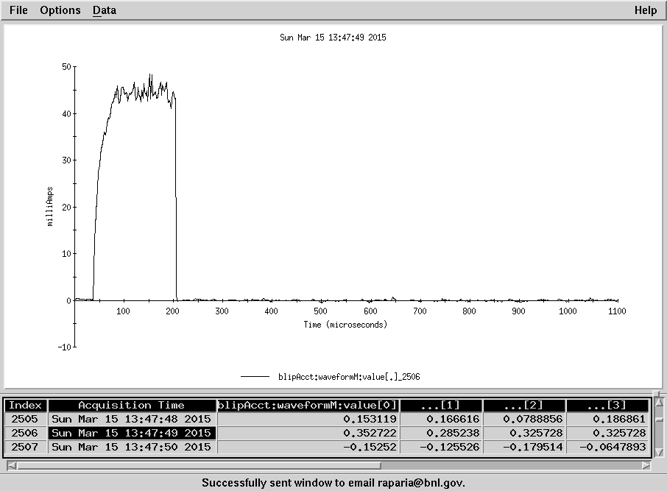
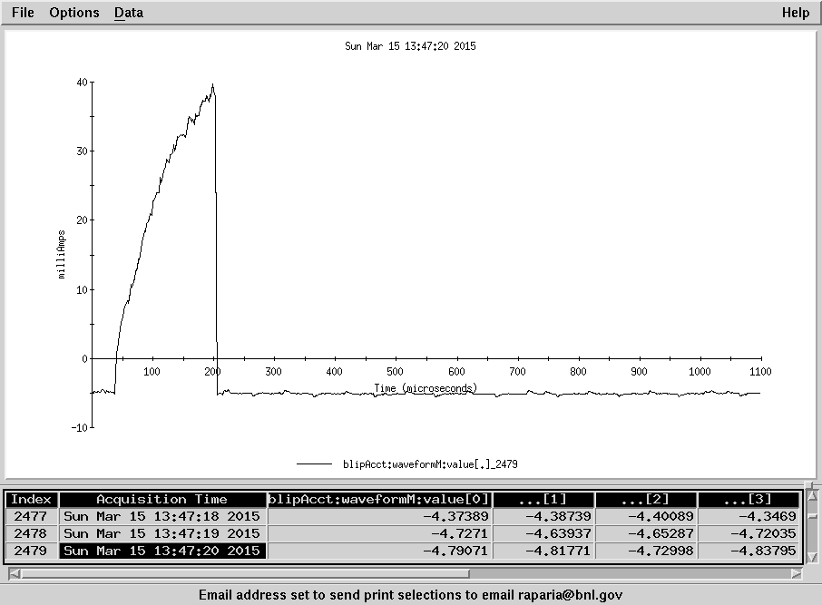
Xenon Gas Effect
Xenon
Av. Cur. 42.3 uA
No Xenon
Av. Cur. 20.7 uA

Slide 31
Beam position manipulation with in RF envelop

Slide 32
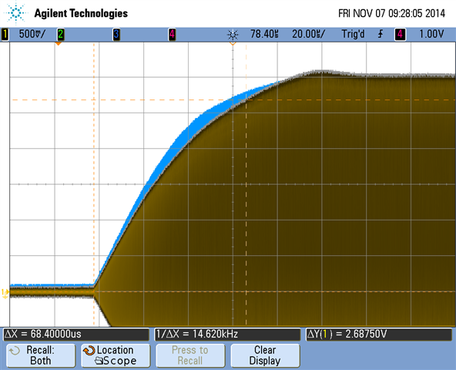
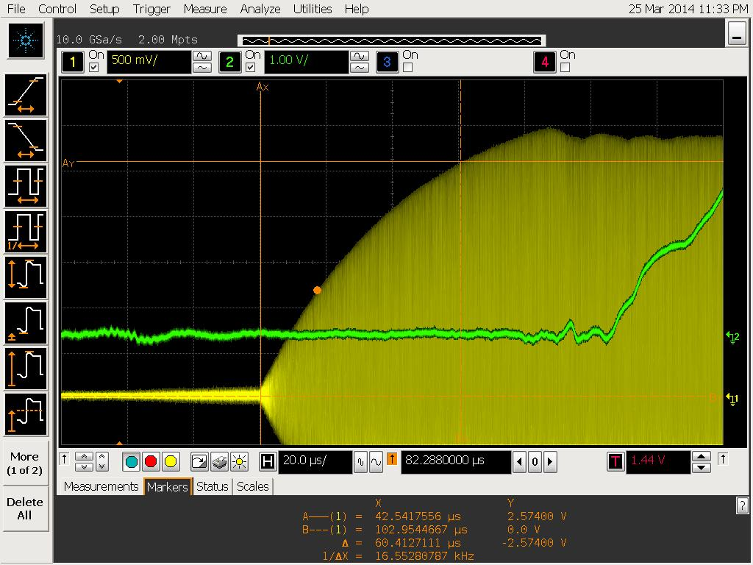
Beam position manipulation with in RF envelop
LoDestro, Briscoe
Rise time Optimization
Tank8: Rise time (90%) 60.4 μs
Beam delay 106.22 μs
over +10 deg legs

Slide 33
Subsystem Evaluations

Slide 34
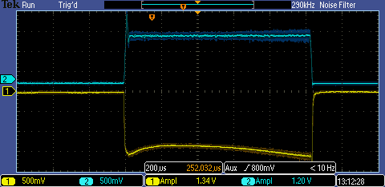
Ion source
We have demonstrated 1 millisecond long pulse from the source at the test stand. We are testing 1 millisecond long pulse from ion source for long-term stability in this summer.
Yellow trace (1) discharge voltage,
Blue trace (2) discharge current (~12A)

Slide 35
Pulse Magnet system
Tests were done on a spare quadrupole magnet to evaluate the cooling water requirements for the increased duty factor, and it was found that increased water flow cooling is not required.
Modification of the existing quadrupole power supplies was evaluated and it was determined that it will be more cost effective to implement a complete redesign of the supplies with modern electronic components that do not use the “ resonant” charge approach. Power supply vendors were contacted and preliminary design proposals were evaluated, and indicate that requirements can be met.

Slide 36
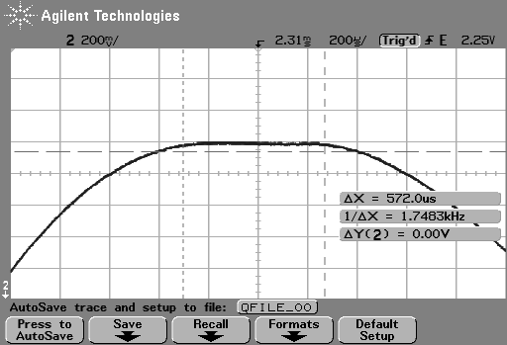
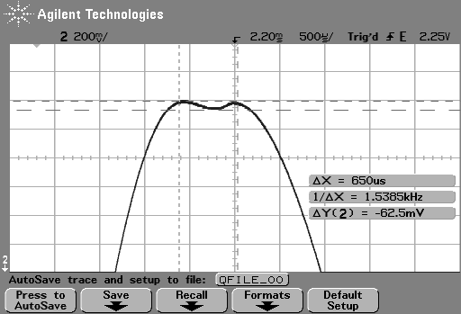
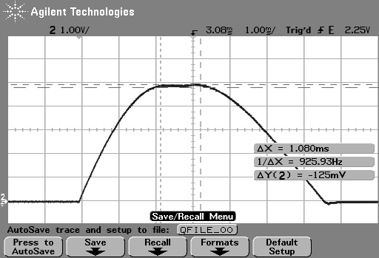
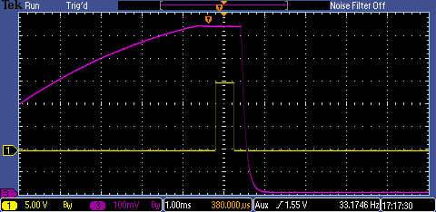
Quad PS Test for Doubling the Pulse Length
250 Amps Peak Current Lodestro, Briscoe
Existing quad pulsers can’t handle the extended pulse width
Original specification 0.1% current regulation over 200 μs beam, =25 mA
Normal Pulser 570 μs FT ∆I 2A, 0.8% Doubled Cap Bks 890 μs FT ∆I 2.5A, 1.0%
Doubled Cap Bks 1.08 ms FT ∆I 6.25A, 2.5% MEBT Transistor Pulser Design, 1ms FT ∆I <0.5A, 0.2%

Slide 37
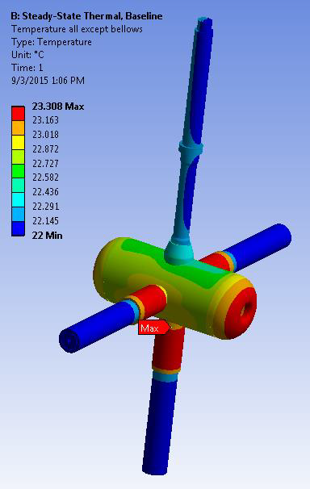
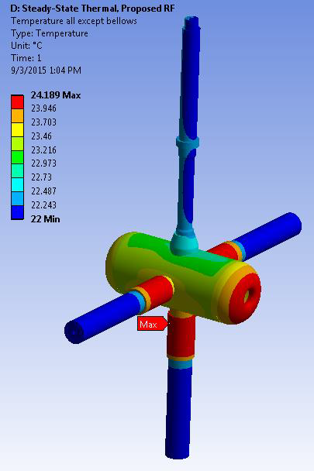
Cooling requirements
Calculations have been completed for a “high power” cavity and indicate that the existing cooling water flows and pressures are sufficient to maintain dimensional stability under the planned increase in duty factor.
Present
Upgrade

Slide 38
DT thermal analysis
Component | Present Max Δ T(°C) | Present Max Δ L (in) | Upgrade Max Δ T(°C) | Upgrade Max Δ L (in)
DT total | 1.30 | - | 2.18 | -
DT, X (axial) | - | 0.0003 | - | 0.0005
DT, Y&Z | - | 0.0002 | - | 0.0004
Stem 1& DT water | 0.27 | NA | 0.42 | NA
Stem 2 water | 0.004 |  | 0.007
Stem 3 water | 0.004 |  | 0.007
Stem 4 water | 0.004 |  | 0.007

Slide 39
Condition of existing cooling channels
The conditions of water quality and flow channels were evaluated for three typical cavities and only minor anomalies were found. We have found couple of drift tube flow measure were completely block providing no water flow to drift tubes. We also found several side stamp water channel were clogged.

Slide 40
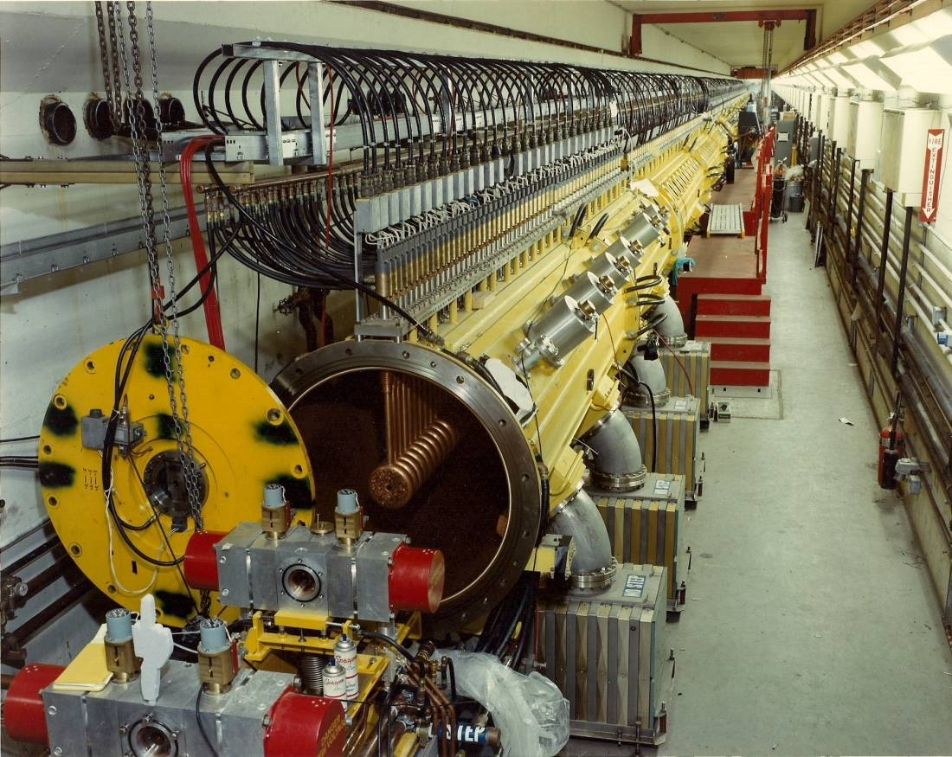
Drift Tube Tank 1

Slide 42
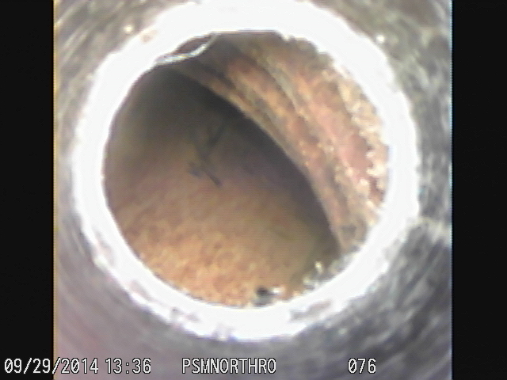
Water channel in tank and quad examination with borescope

Slide 43
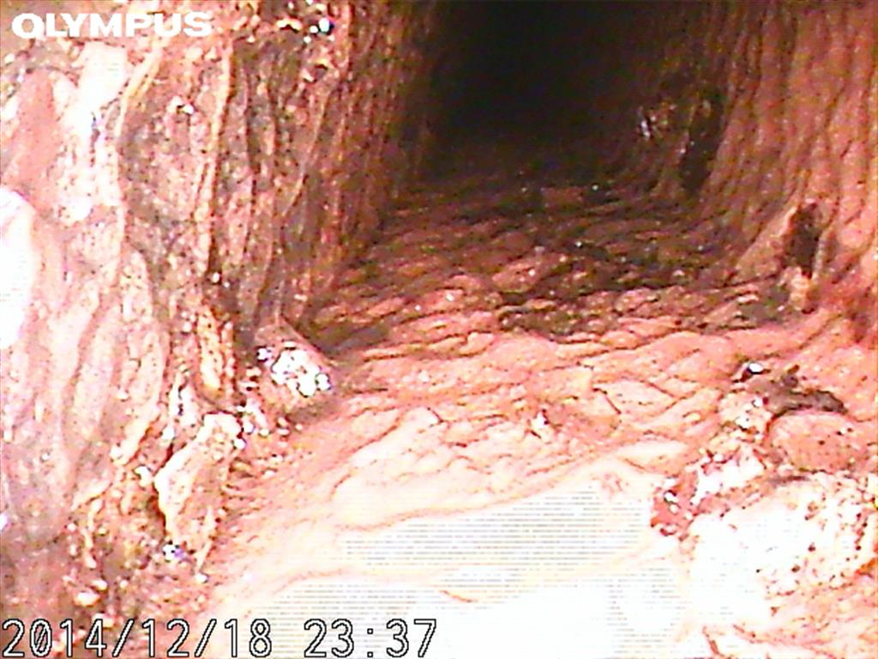
Outer cooling channel completely coated in Sludge

Slide 44
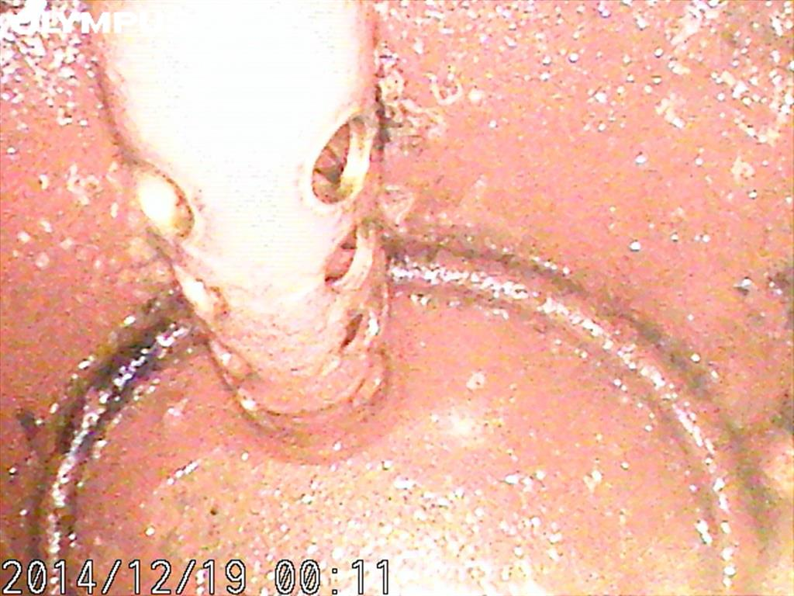
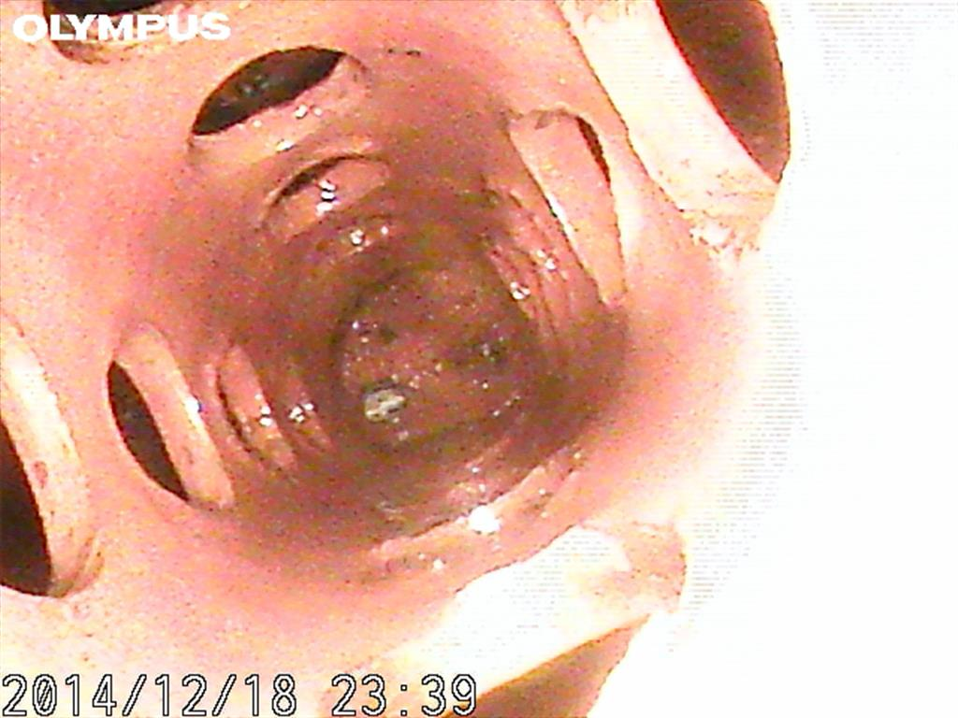
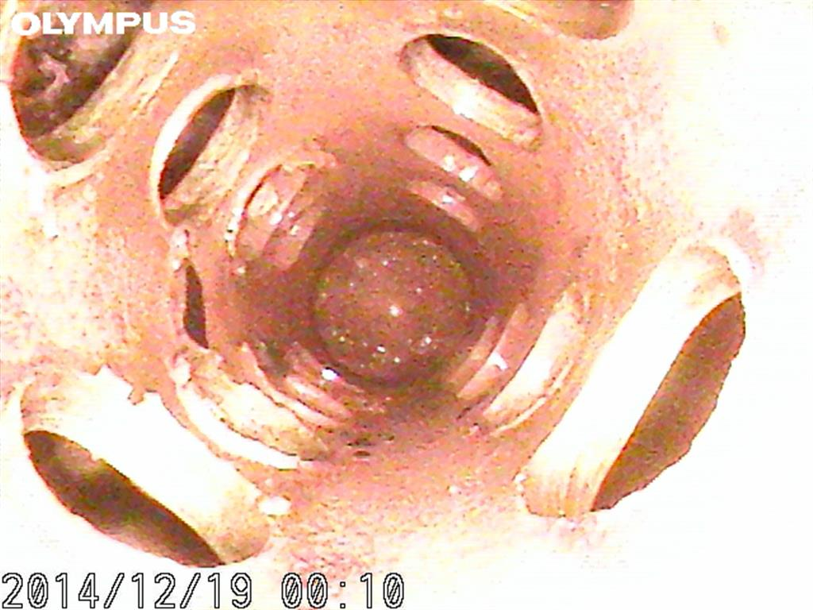
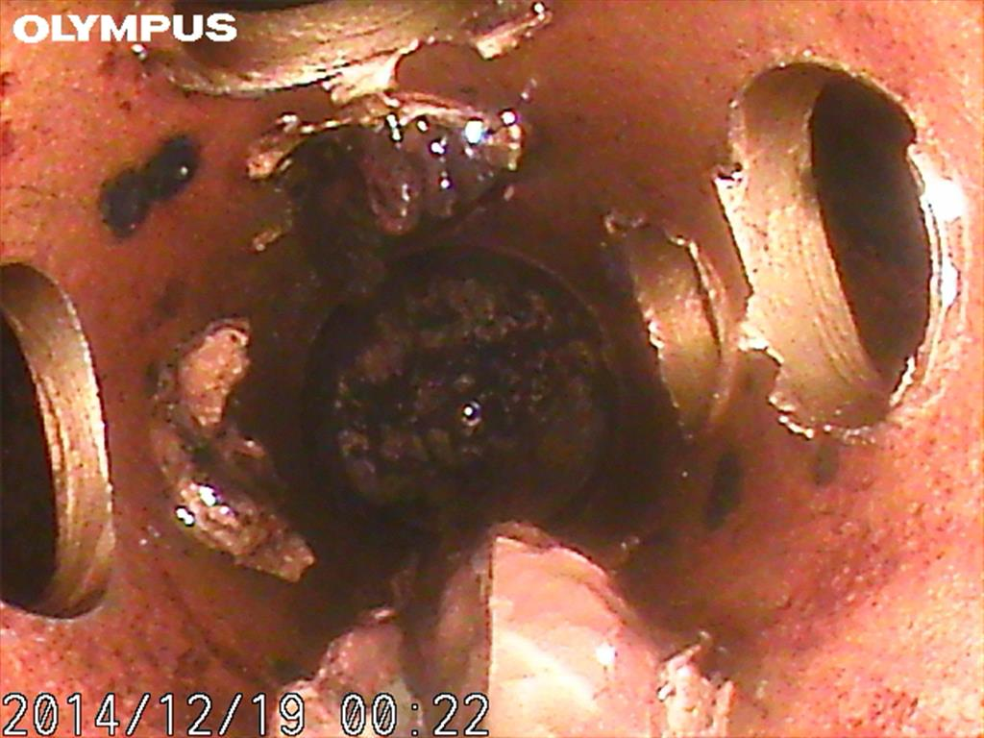
Side Stem Clear and Clean

Slide 45
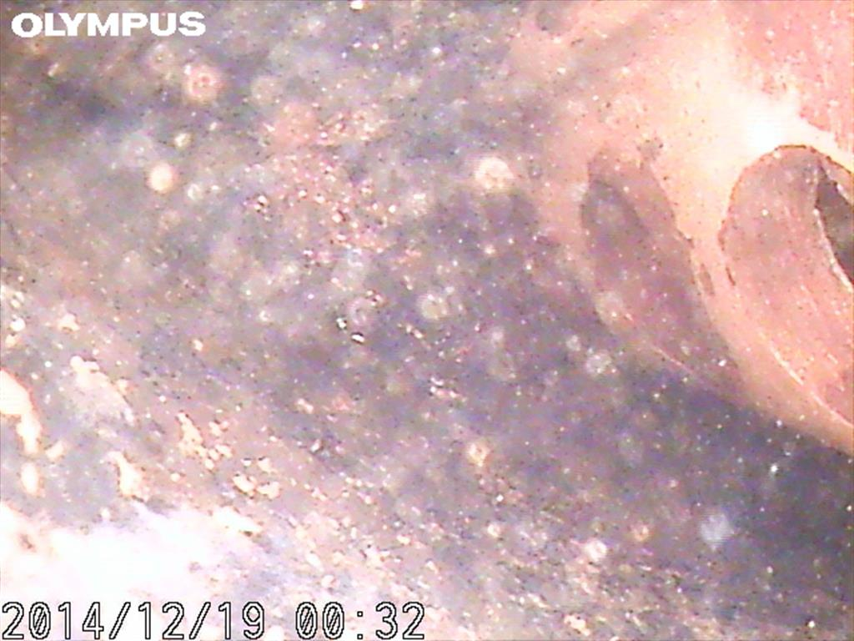
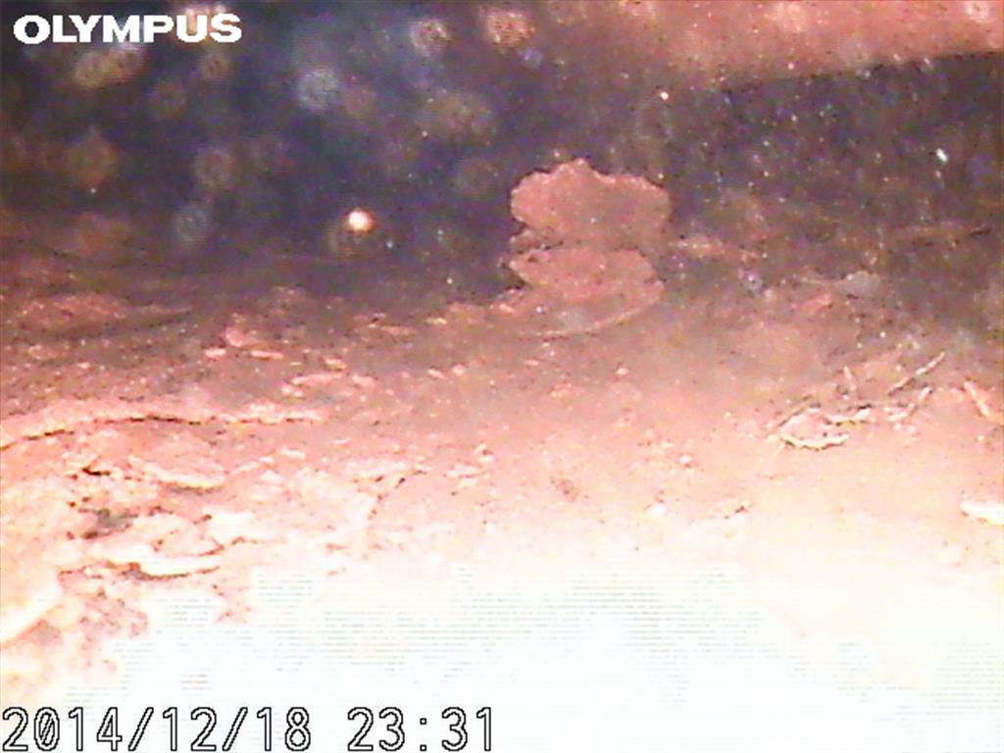
Side Stem Dirty and Clogged

Slide 46
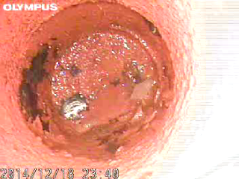
Side Stem 16B Video”, shows a clear water path no trapped water

Slide 47
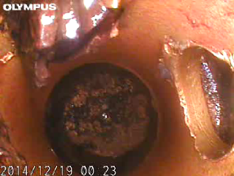
Side Stem 20B Video”, shows a water path that is not yet clogged but you can observe the buildup of sludge.

Slide 48
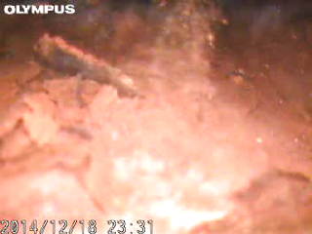
Side Stem 6B Video”, shows lots of sludge floating in trapped cooling water. The cooling system was drained so any areas probed containing water would indicate a local blockage.

Slide 49
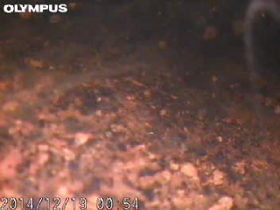
“Side Stem 4B Video”, same as 6B however view to the end to see a clear view of a blockage

Slide 50
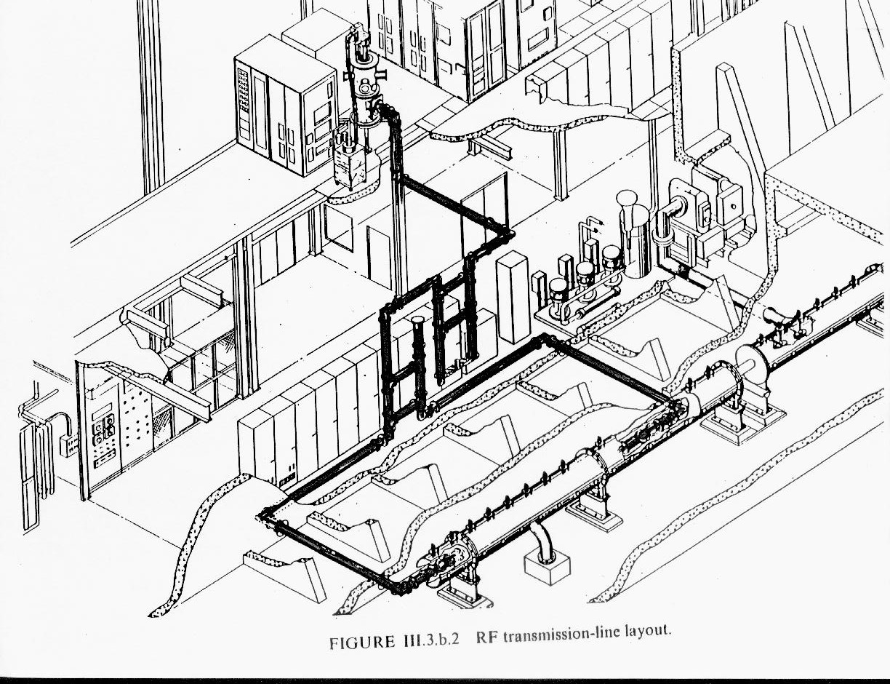
R F Power for Linac

Slide 51
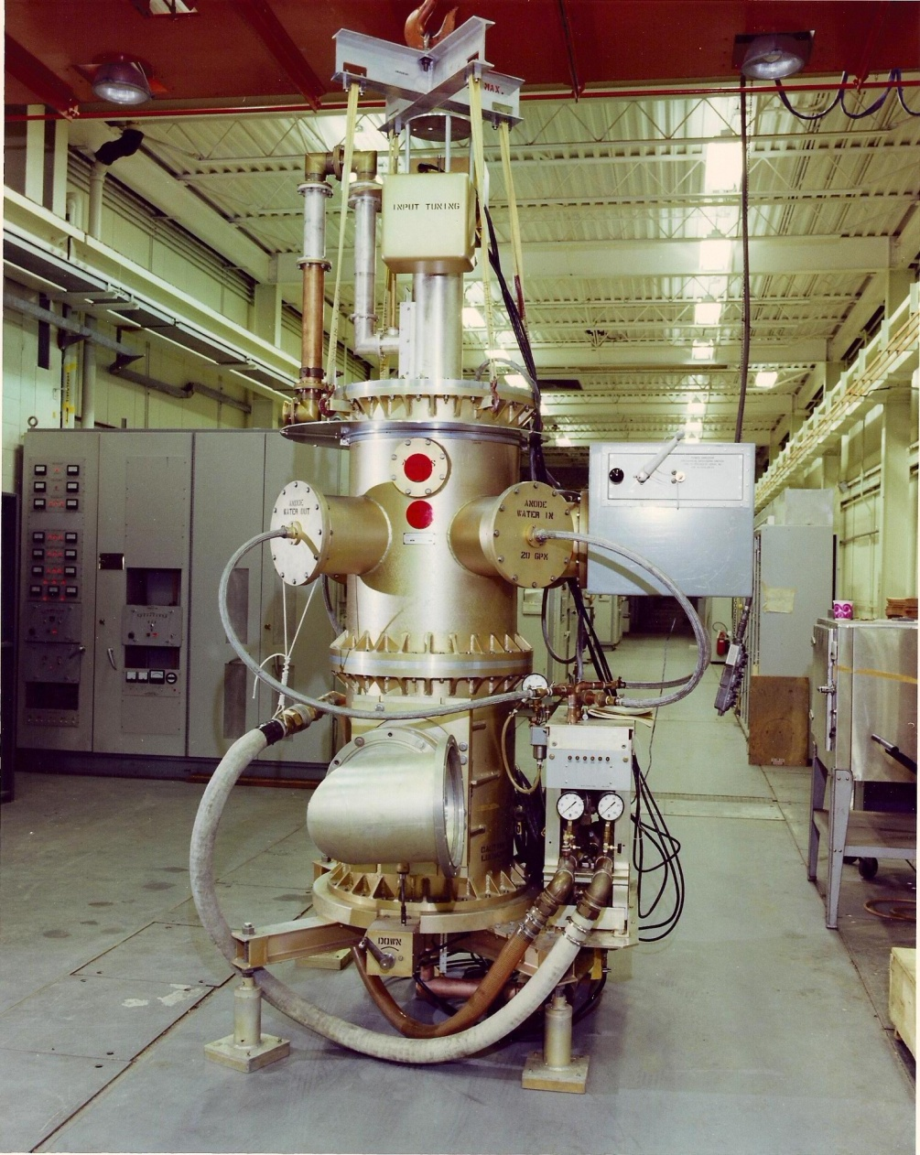
RF Tubes for BNL LINAC
Solid state AMP
7835

Slide 52
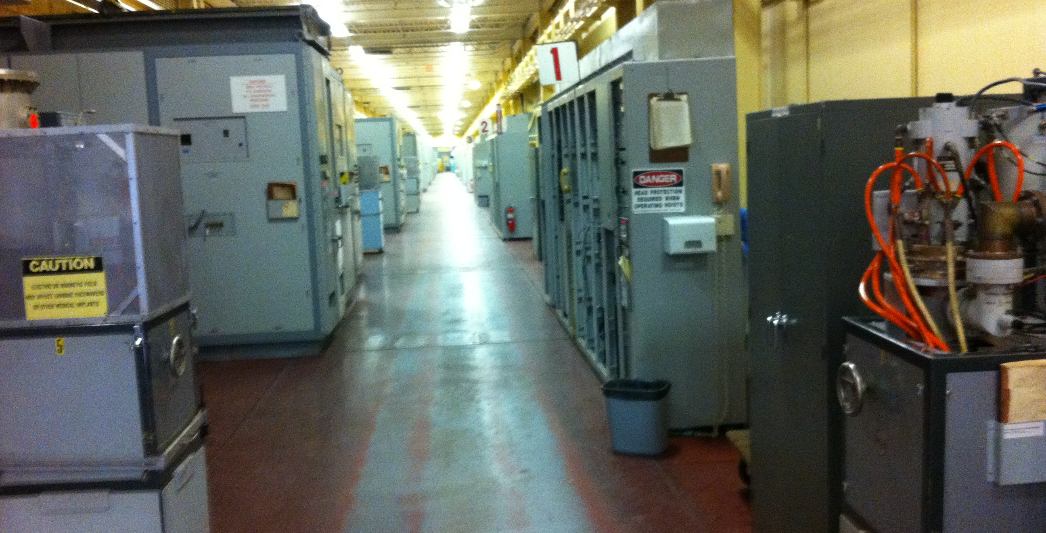
RF Gallary

Slide 53
RF System
Redesigning several elements of the Modulator that supply pulsed dc power to the 7835 RF power amplifier anode. A prototype of each unit was built and successfully tested in the 10th RF system. They are listed below:
4CW 25,000 anode power supply (3 kV)
4CW 25,000 cathode power supply (4 kV)
Modulator A7 low level electronics

Slide 54
RF System
The stand-by 10th RF system was modified to operate at an RF pulse width of 1100 μs. This was accomplished by:
Increasing the 250 kW driver capacitor bank from 25 to 40 mF by replacing the original capacitors with ten 4 mF capacitors.
Increasing the 7835 power amplifier anode power supply capacitor bank from 50 to 84 mF by replacing original capacitors with thirty two 2.62 mF capacitors.

Slide 55
Utilities and Shielding
There is enough margin in water cooling and power distribution to to accommodate factor of x2 upgrade in intensity
Original building was design for 540 uA average current

Slide 59
Conclusions
During last 45 year of operations, linac has gone through several upgrade, which resulted better beam performance, higher reliability, and low residual radiations
We have just finished Phase I of intensity upgrade, which resulted 50% more integrated current and 35 more average current.
All the subsystem requirements for the intensity upgrade phase II are well understood and we are ready for upgrade.

