Slide 1

Characterization of a
high intensity beam
P. A. P. NGHIEM
N. CHAUVIN, L. Ducrot, W. SIMEONI Jr., M. VALETTE, D. URIOT
ESS workshop: "Upgrading Existing High Power Proton Linacs", Nov 8-9th, 2016

Slide 2
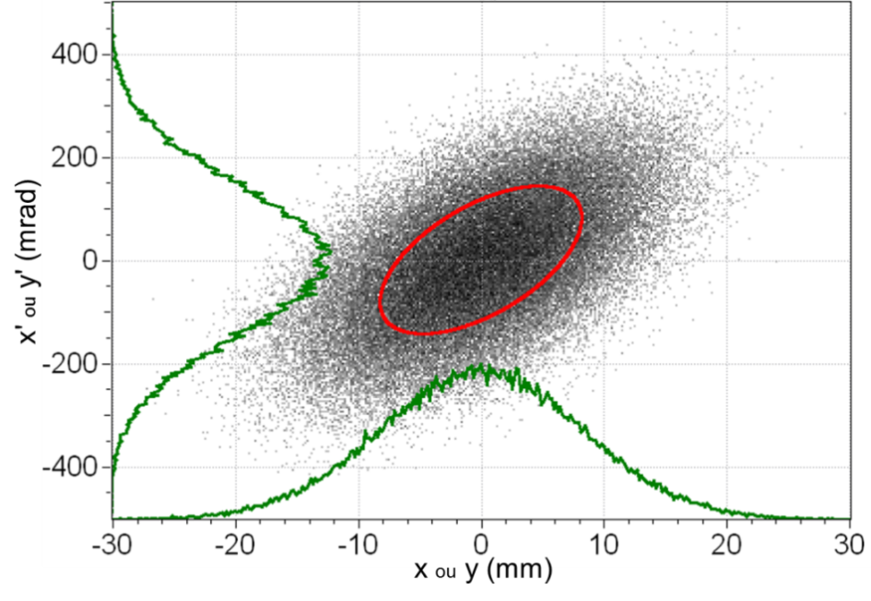
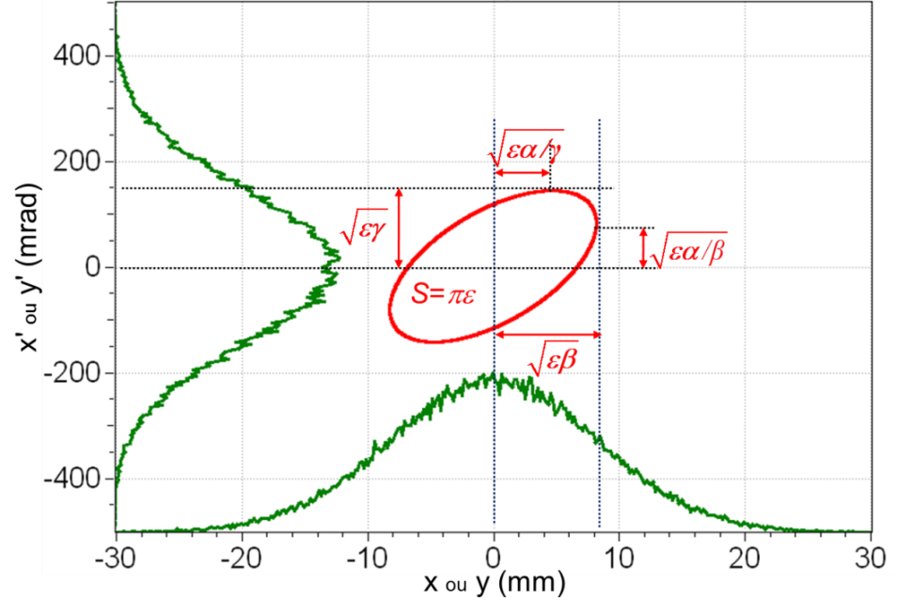
The two classical ways
Classically
Coordinates 10⁵⁻⁶ particles in 6D phase space
→ 10⁶ parameters
→ very big number → num. simulations
Concentration ellipse
RMS ε, α, β (,γ)
→ 3 global parameters
High intensity
More particles
Higher space charge and power
→ 10⁹ particles → 6 10⁹ parameters
→ huge number
RMS ε, α, β (,γ)
Not enough !!
Distribution dependent

Slide 3
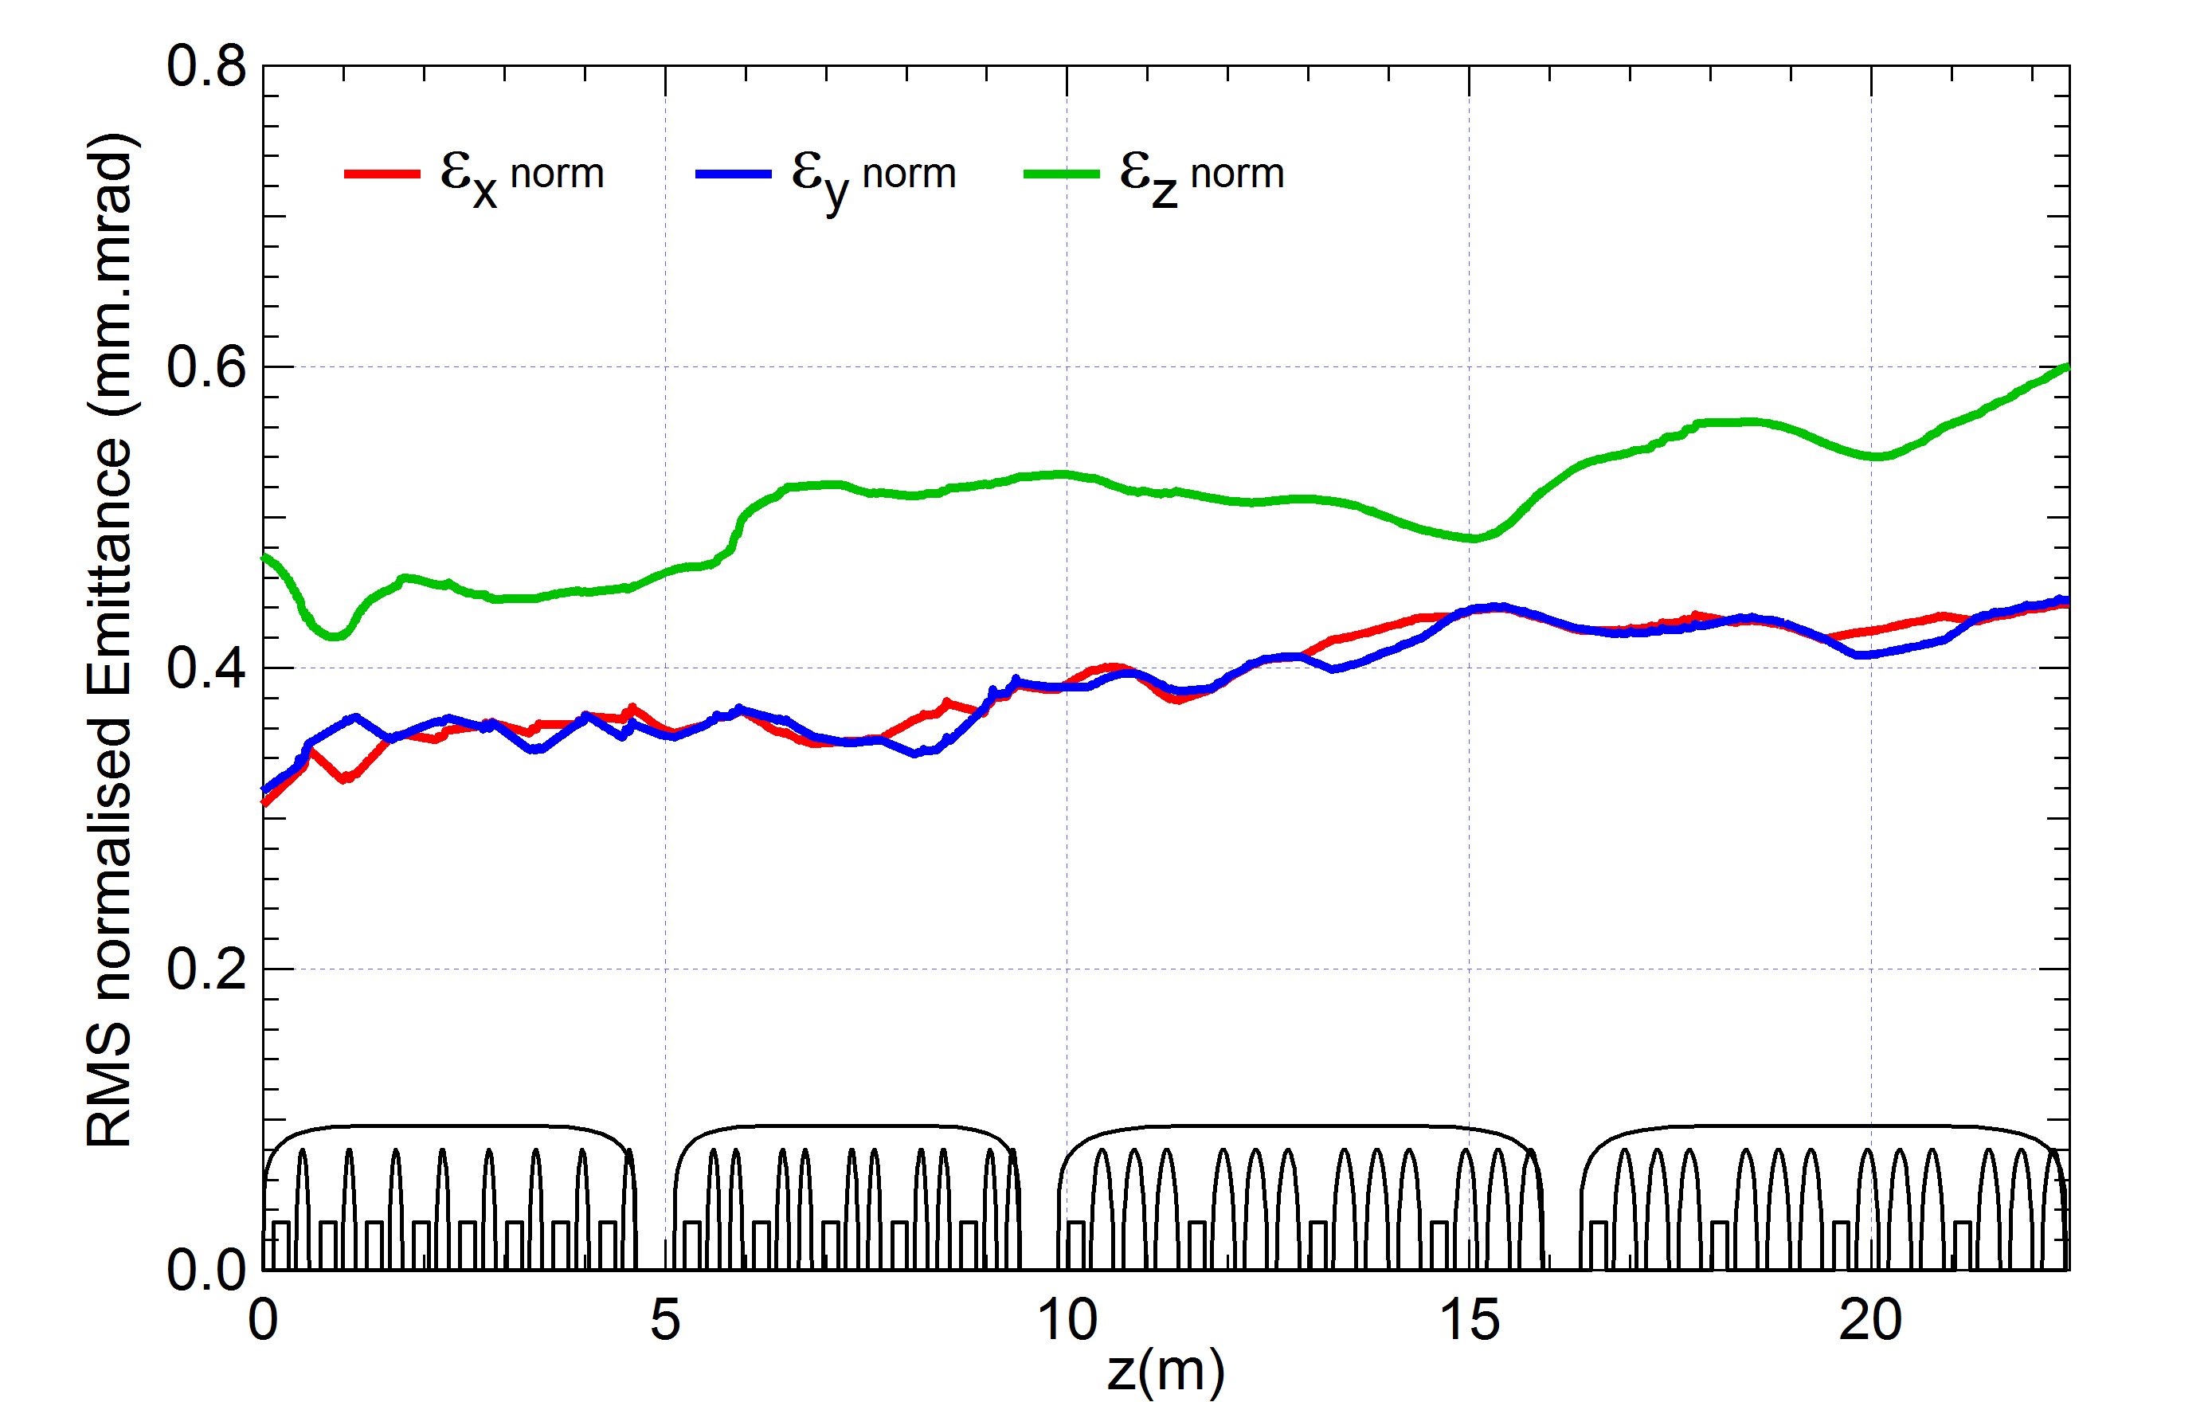
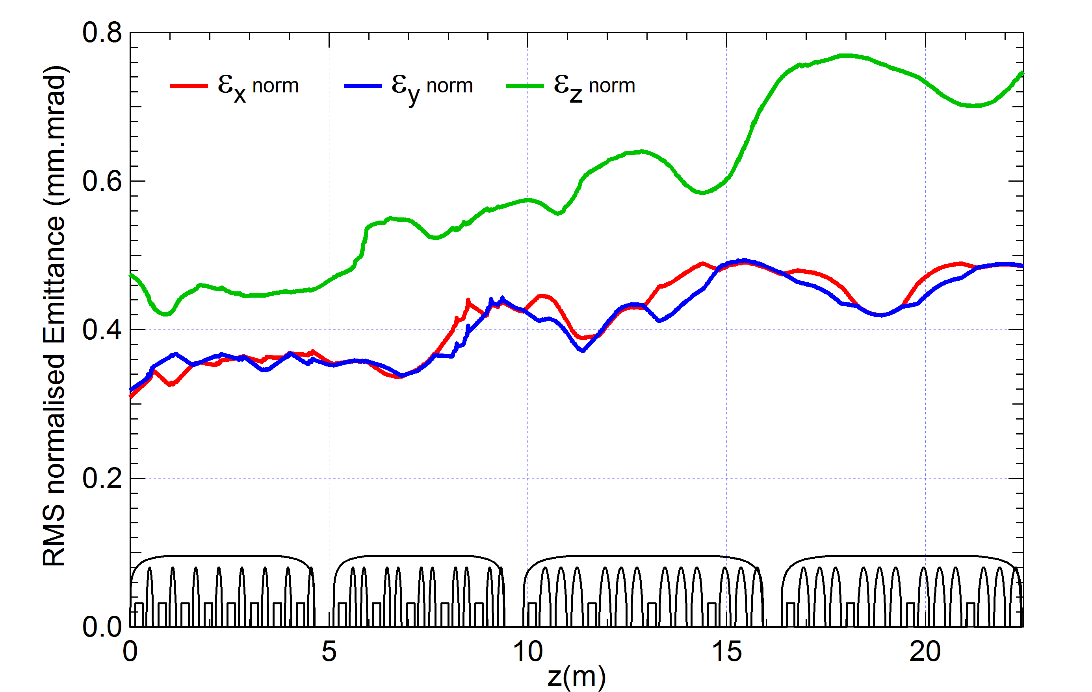
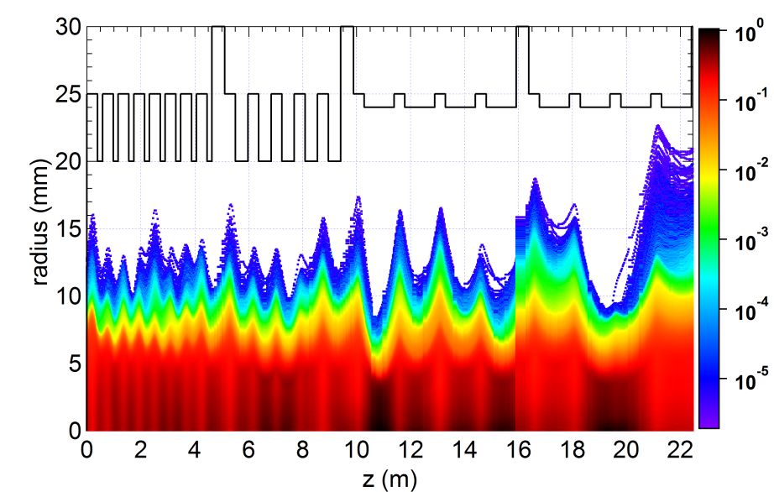
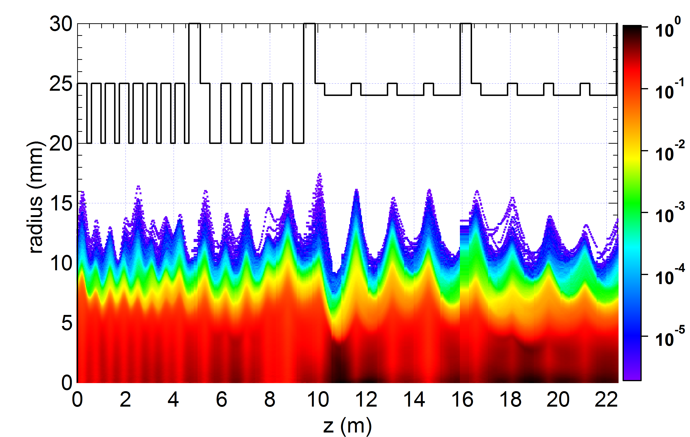
Beam Optimization
Example: IFMIF SRF Linac (Laser Part. Beams 32, 10-118, 2014)
Smaller emittance: Bigger size
Bigger emittance: Smaller size

Slide 4
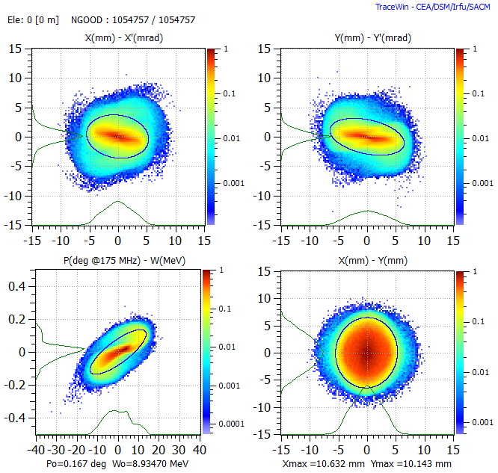
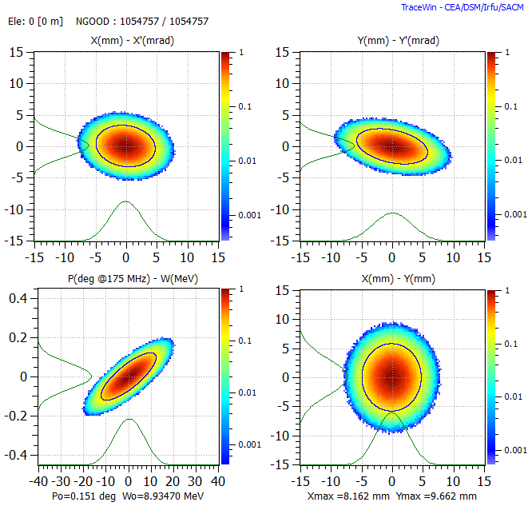
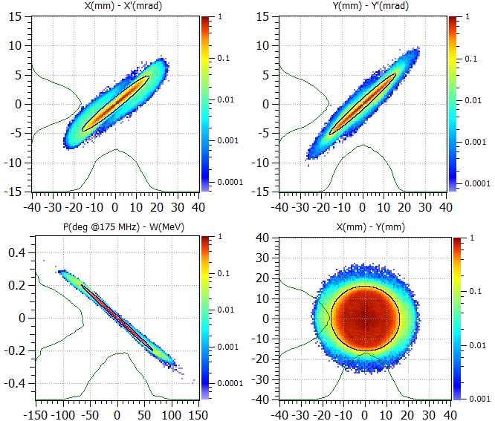
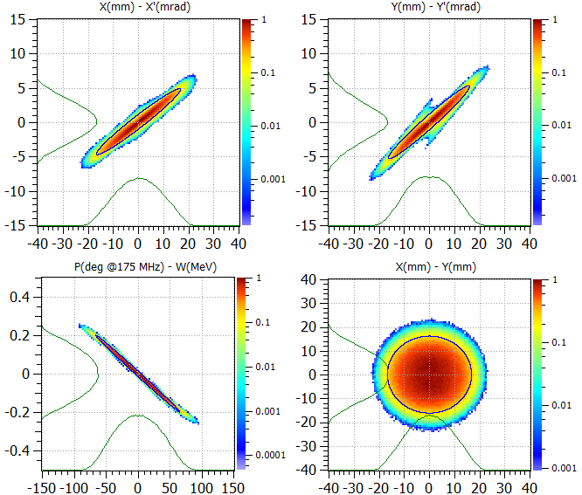
Beam transport
HEBT entrance
exactly same α,β,γ,ε
"Nominal" distribution
Gaussian distribution
3.5 m downstream
through 3 quadrupoles:
significantly different beam outputs
α,β,γ,ε

Slide 5
Beam Characterization
For high intensity beam
1) Characterize the beam by its actual number of particles
2) Characterize the beam by its projections onto a few axes
3) Characterize the beam by its core and halo separately

Slide 6
1. Beam characterization
by the actual number of particles

Slide 7
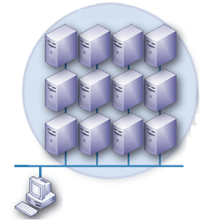

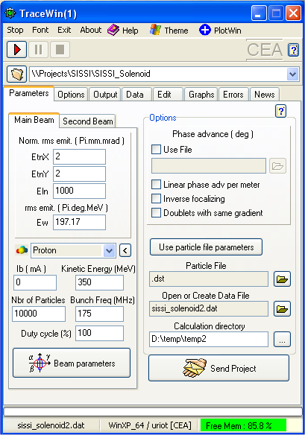
Massive simulations (1)
Principle : share simulations on many computers
Cloud / LHC grid
PCs
Linux / Windows / Mac
Multi-core or not
Cluster(s)
TraceWin code
Roscoff 2015

Slide 8
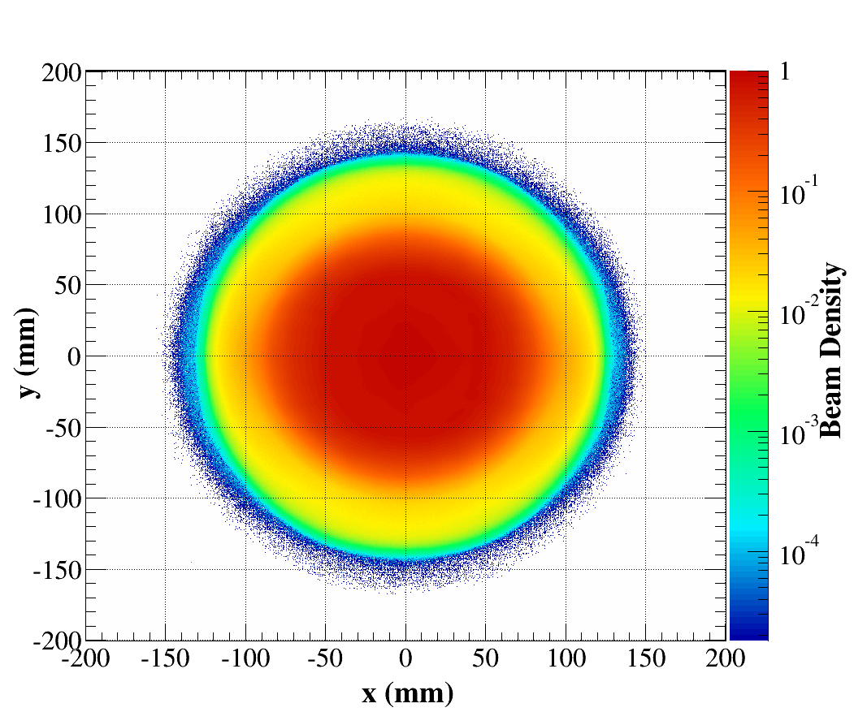
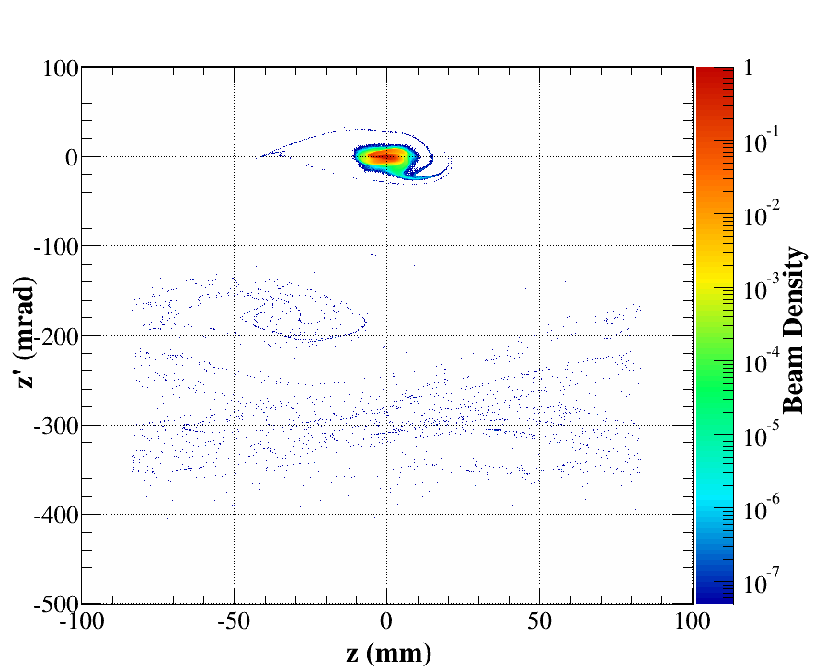
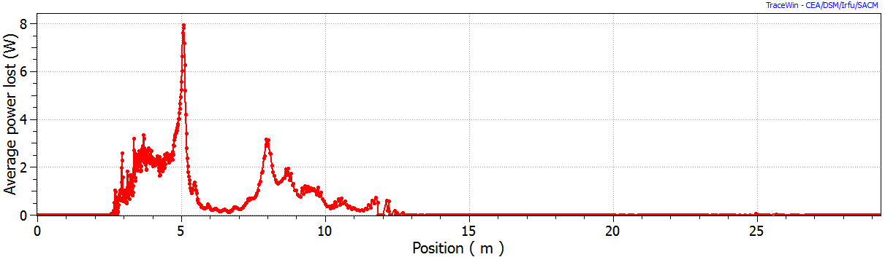
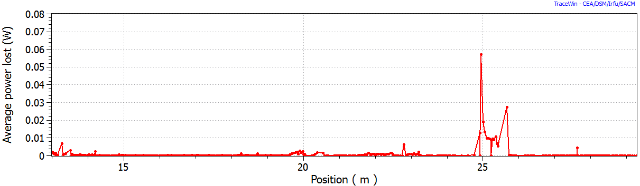
Massive simulations (2)
(WEPOY032, IPAC'16)
Share particles on many computers
For IFMIF-LIPAc, D⁺, 125 mA CW, 40 MeV
Actual number of particles: 5 10⁹
→ 170 processors for 25 days, storing 38 To
→ confirm losses < 10⁻⁷
→ representative statistics of microlosses
Phase spaces on the beam dump (1.1 MW)
zoom
Losses (W) along accelerator

Slide 9
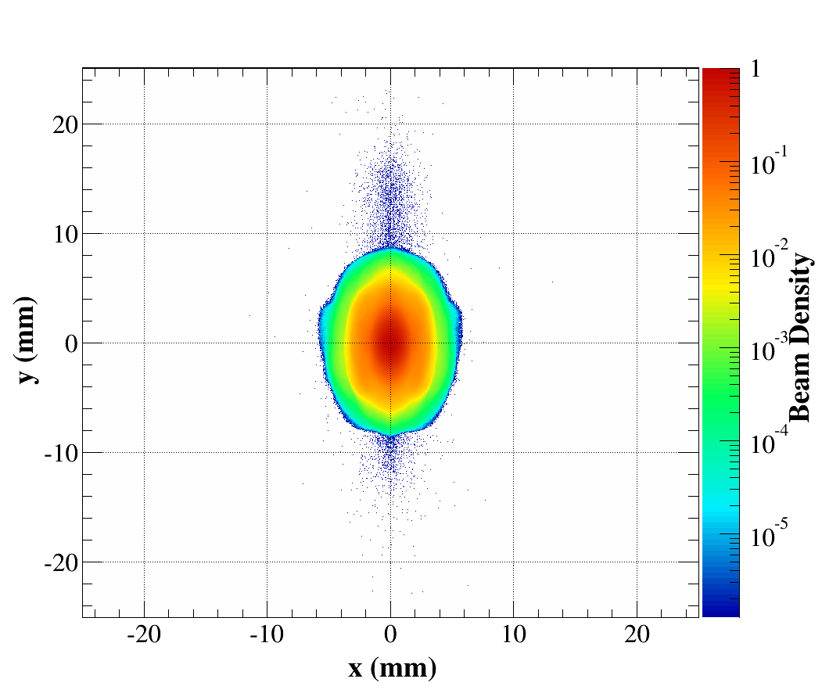
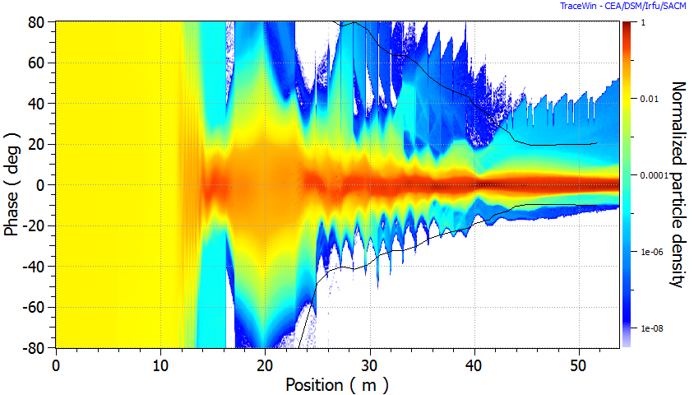
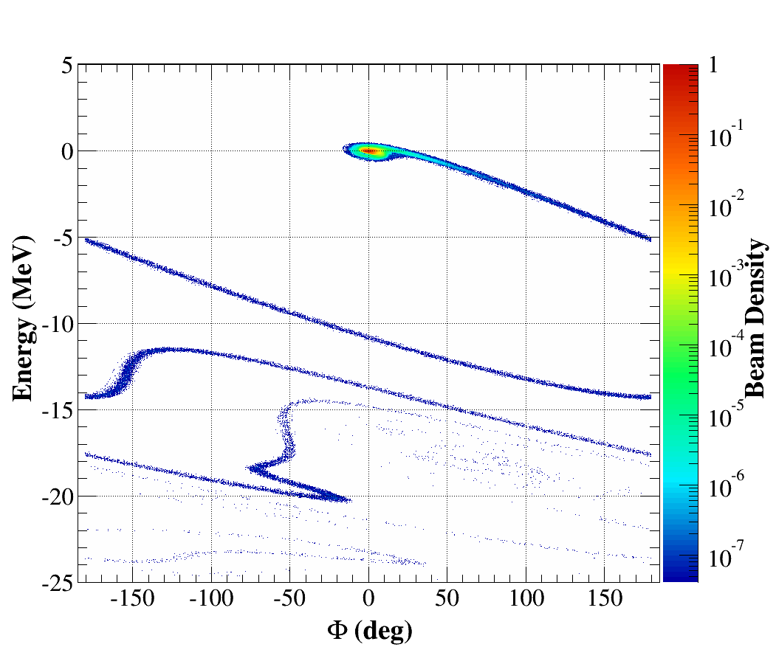
Massive simulations (3)
Share linacs on many computers, for error studies
Consequences of cavity errors (1°, 1%) on losses
for SPIRAL2, D⁺, 5 mA CW, 40 MeV
2.5 10⁶particles, number of linacs: 1000
→ 150 processors for 7 days
→ Losses due to RFQ: 30%, due to cavity errors:70%
Cumulative results of 1000 linacs

Slide 10
Massive simulations (4)
Allow very precise and detailed analyse of certain physical phenomena:
Halo formation and evolution
Microloss location (10⁻⁶ of the beam)
More and more realistic beam transport
Need very fine description of optics elements, realistic input particle distribution

Slide 11
2. Beam characterization
by its projections onto a few axes

Slide 12
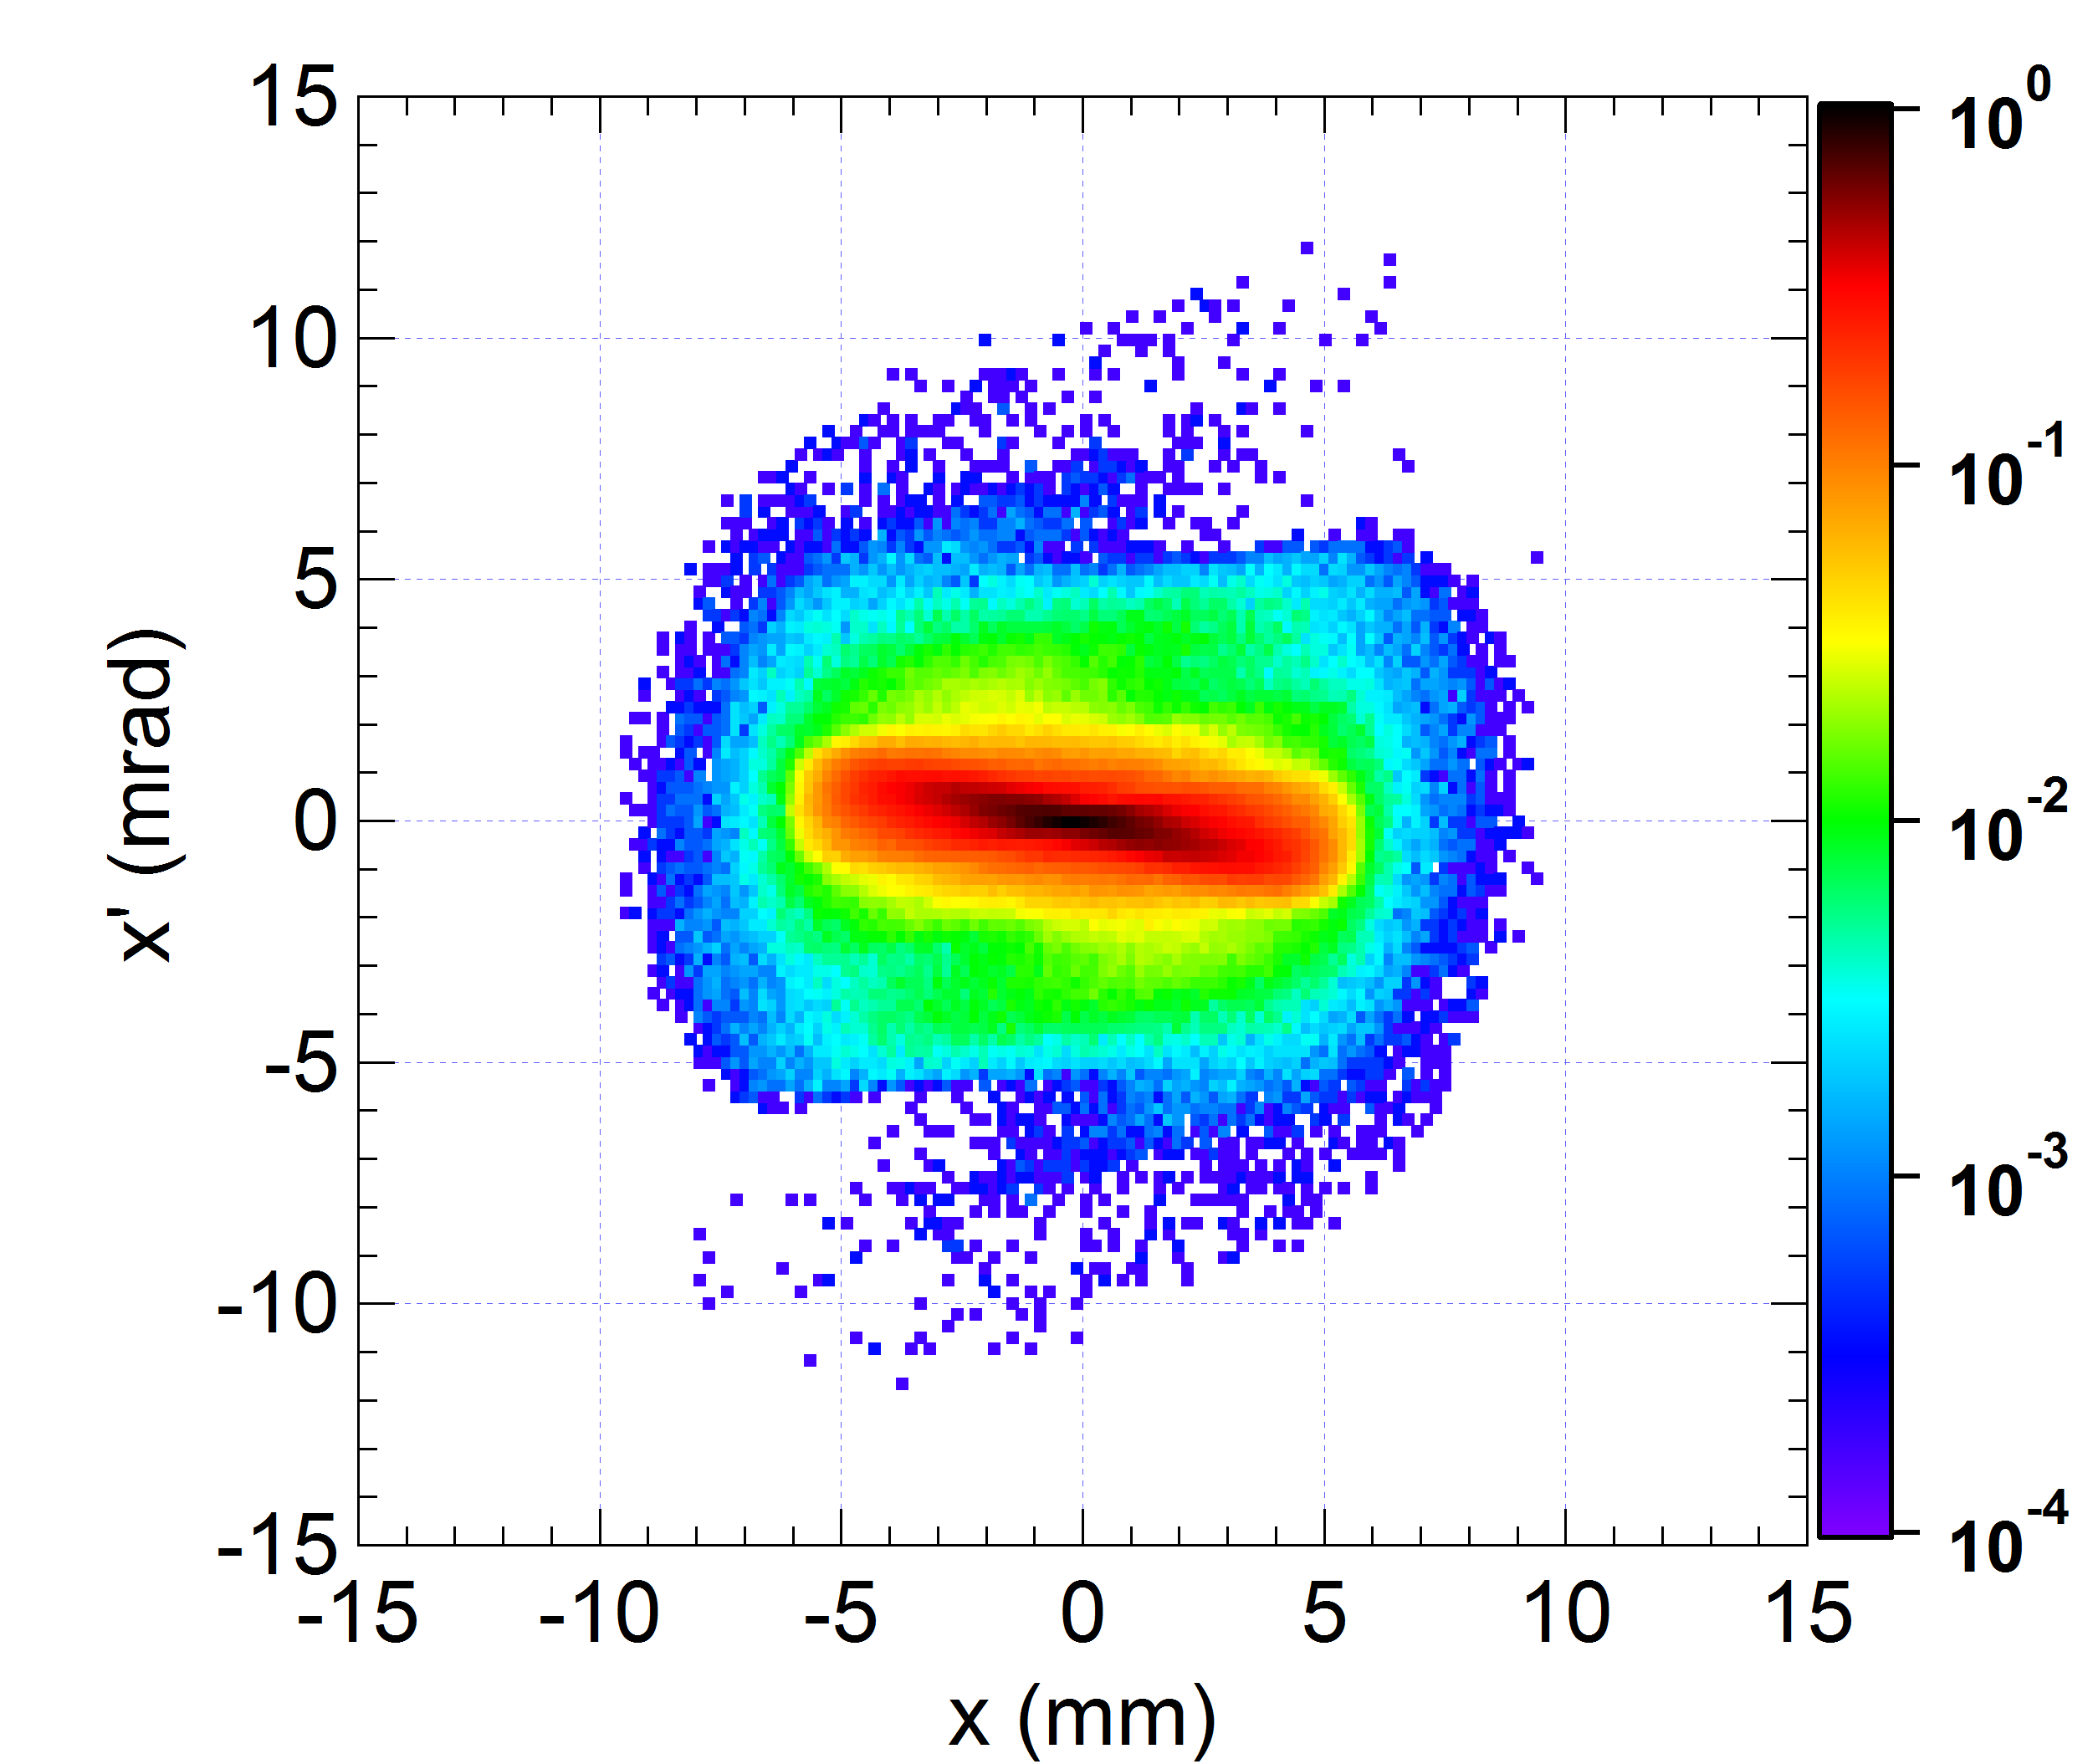
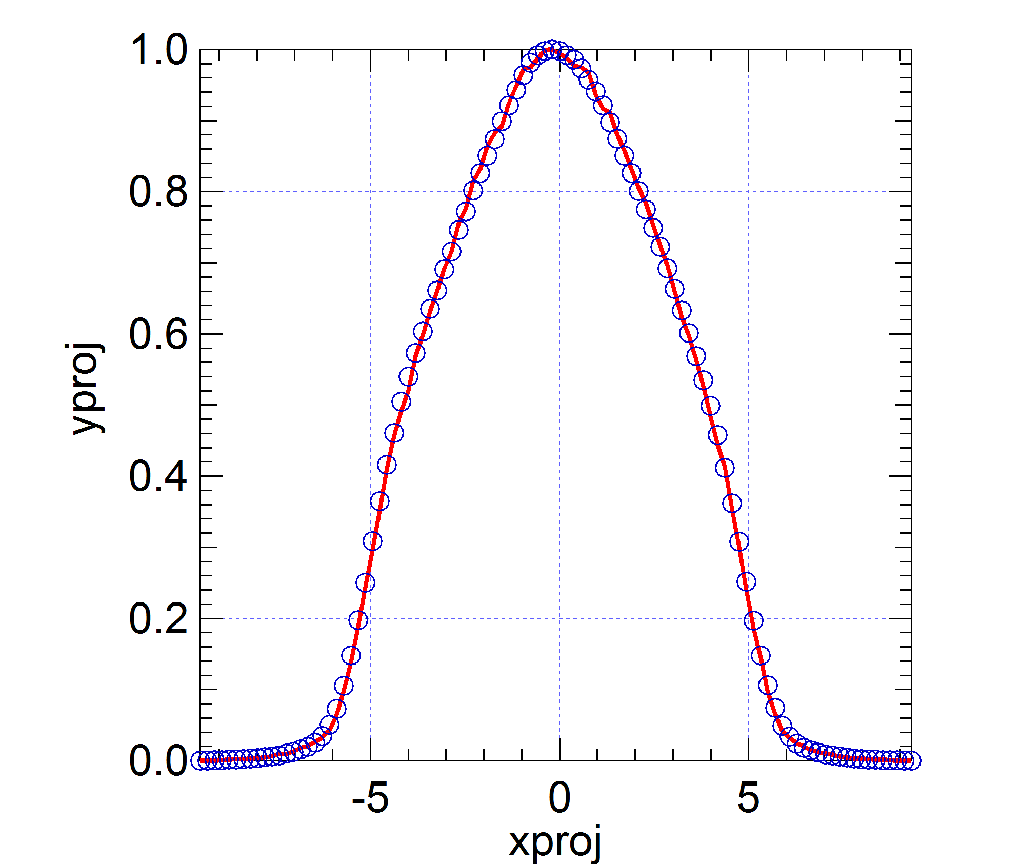
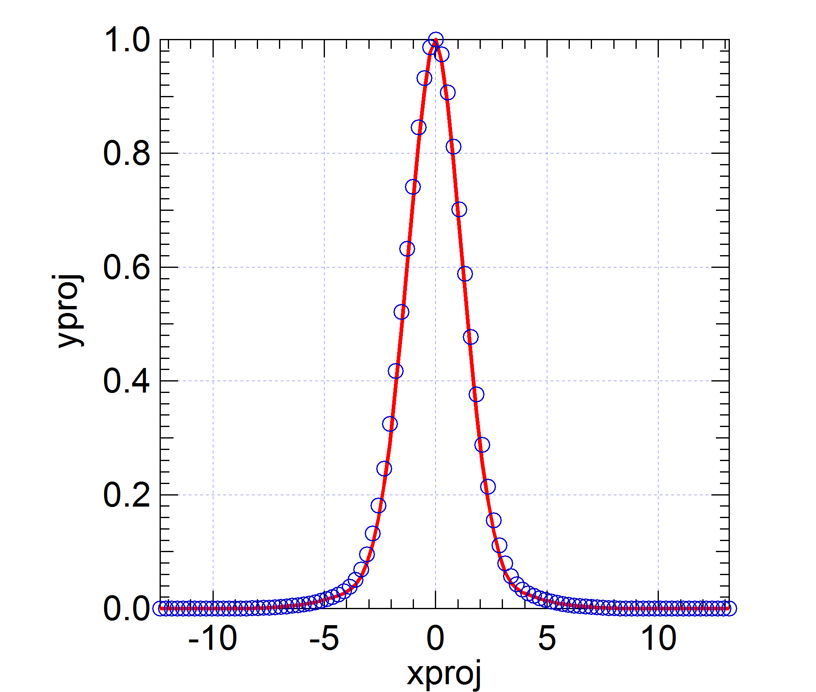
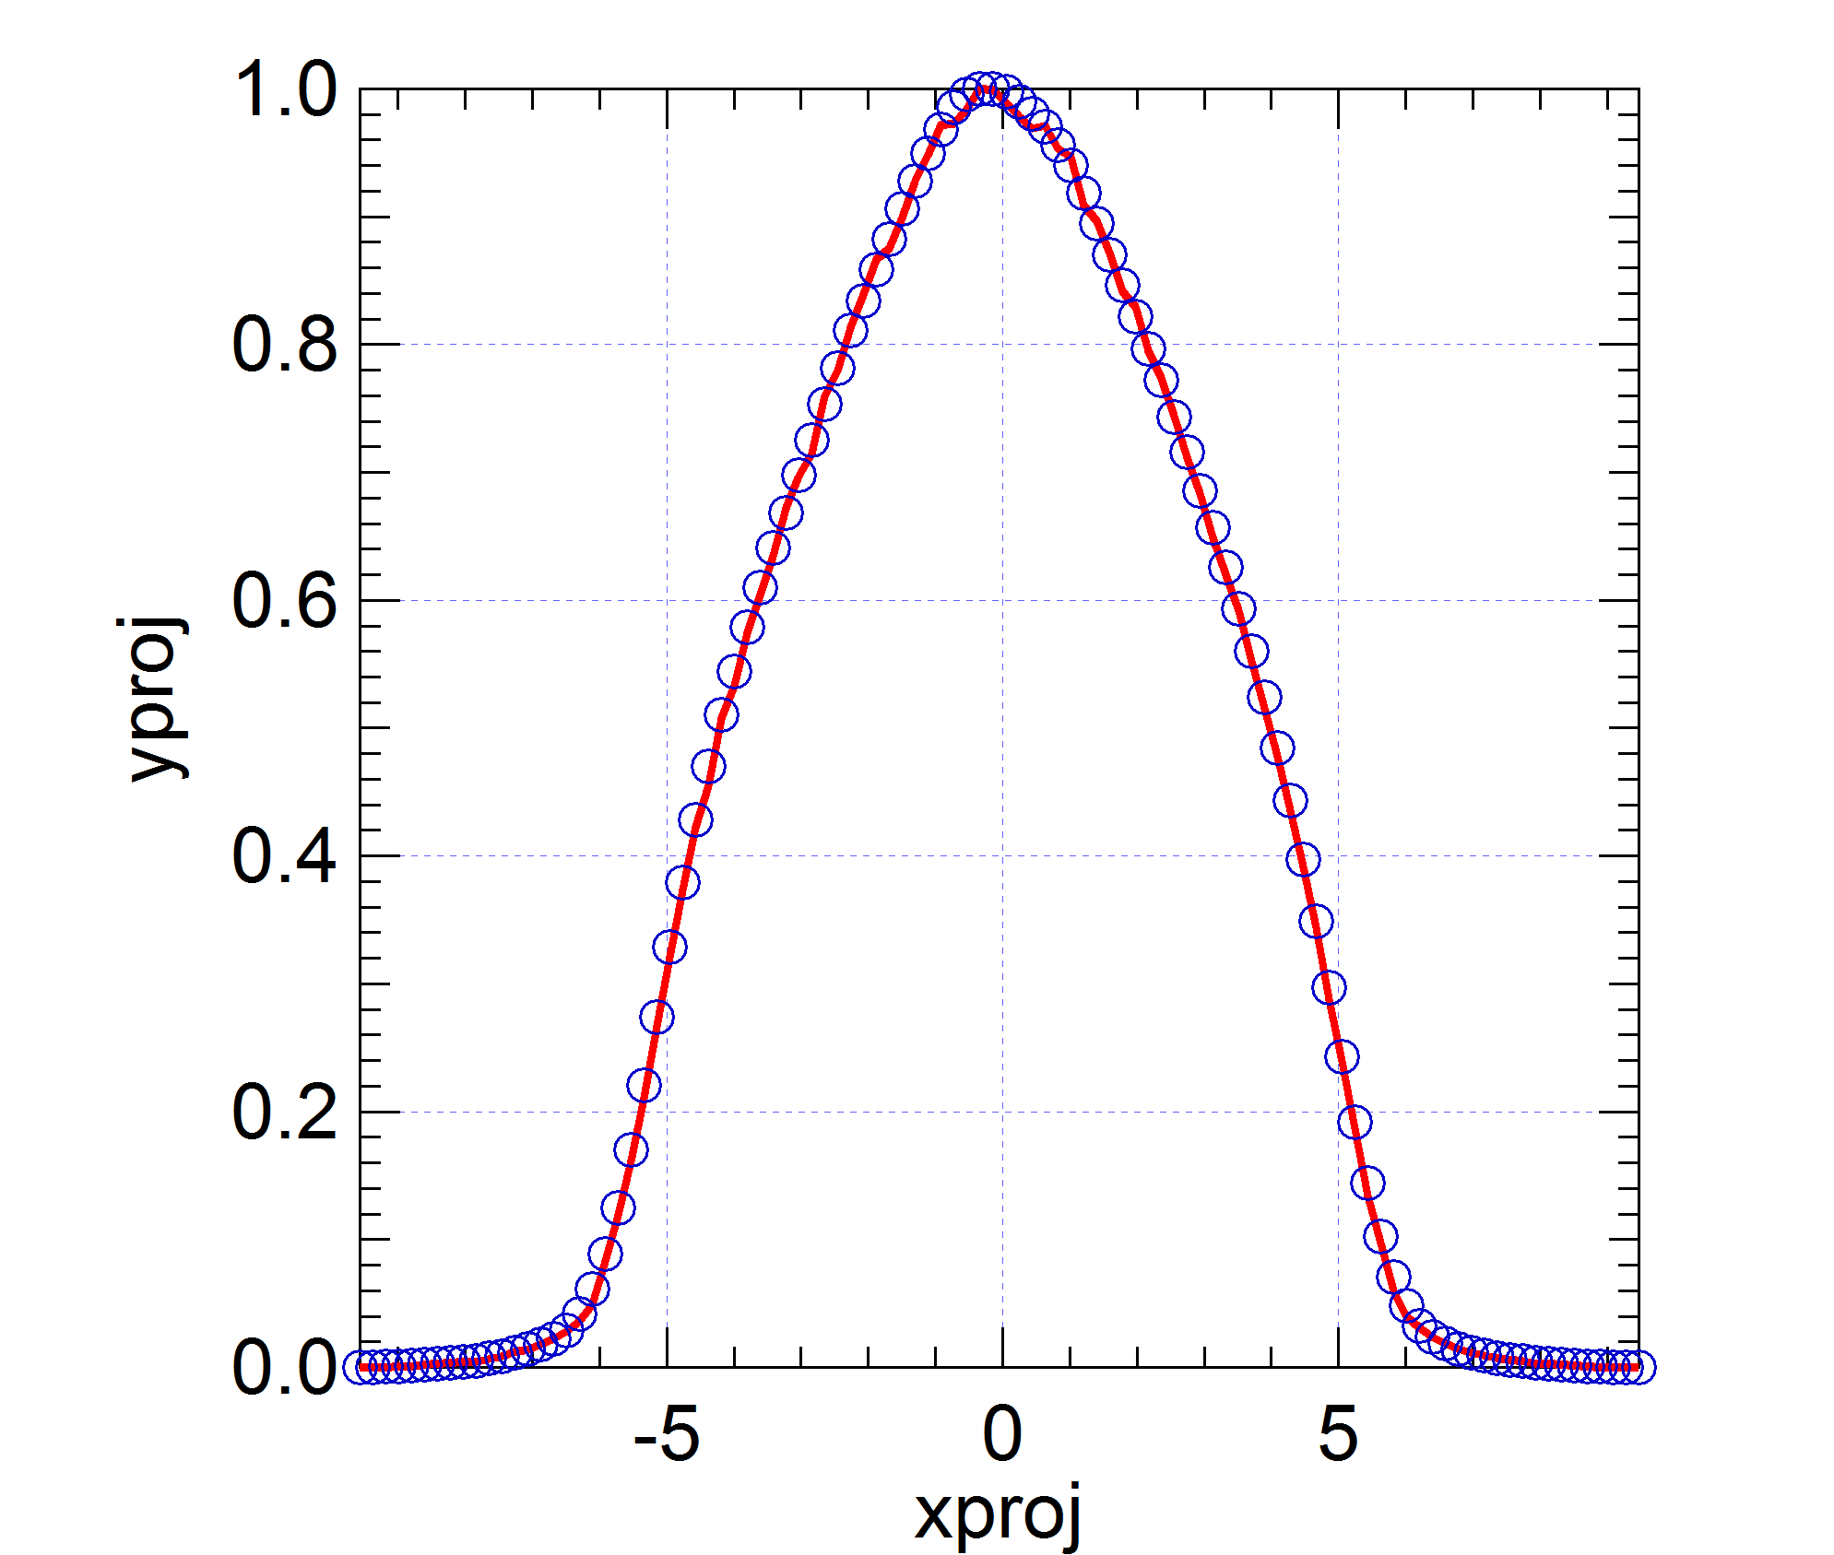
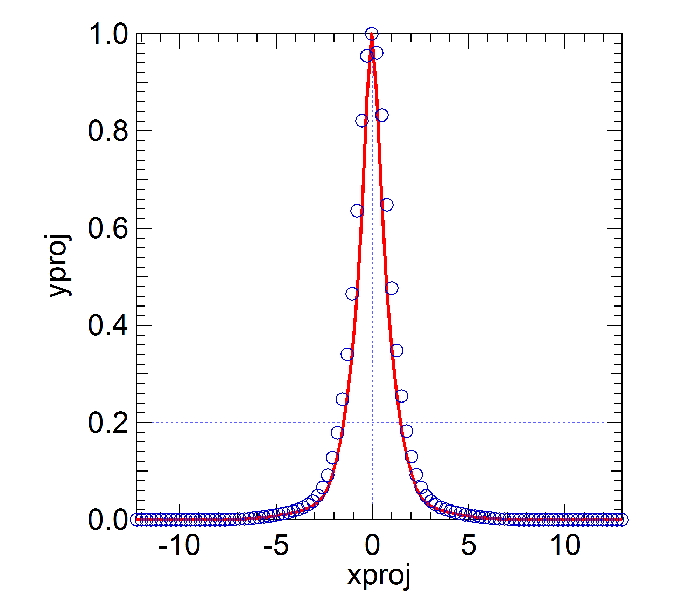

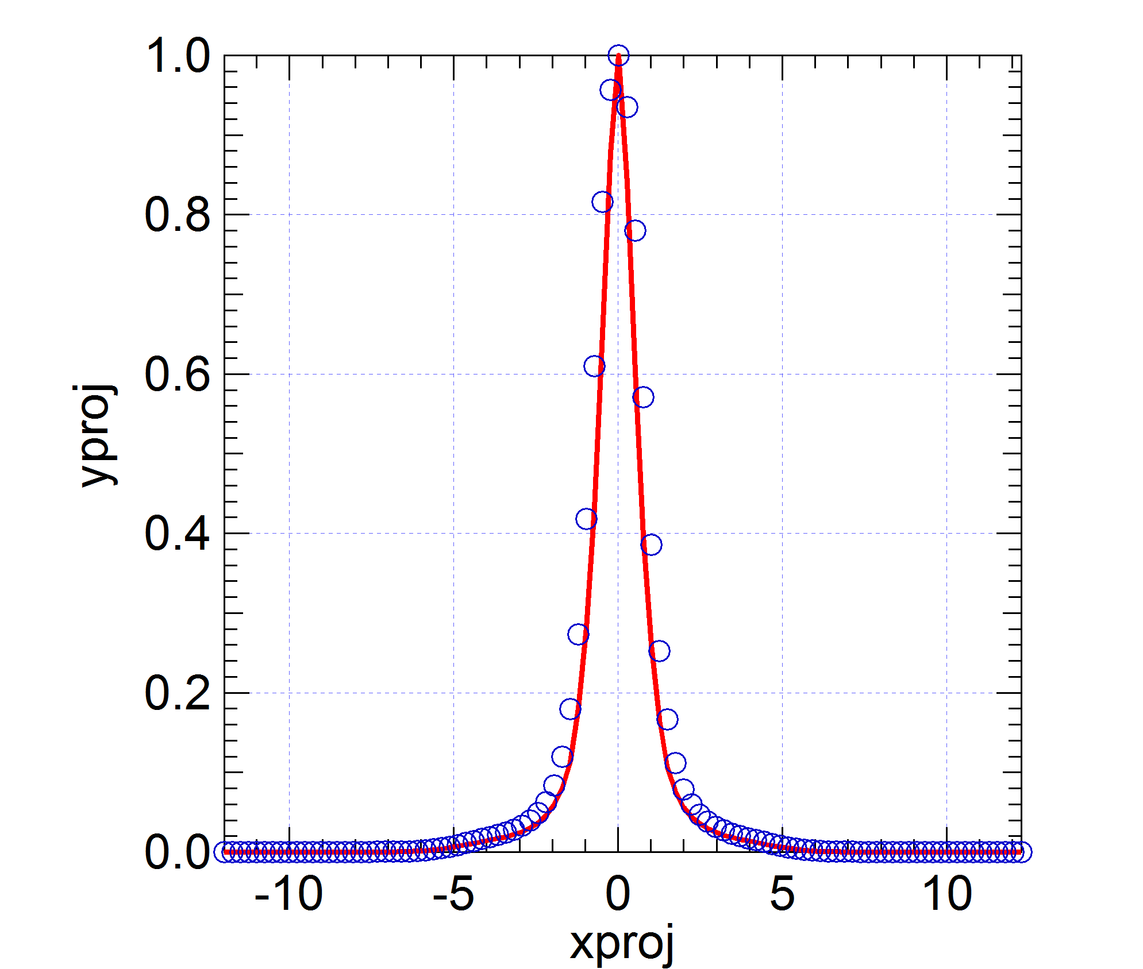
Beam Characterization
by projections on a few axes (1)
Objective: Reconstructing the whole distribution from
the only knowledge of its projections onto a few axes
Add supplementary hypothesis: where there is no data,
the shape is the most regular possible
→ the dist. can be described by the least number of parameters
→ the dist. should have a Maximum ENTropy → MENT
MENT method thoroughly developed in
G. Minerbo, Computer Graphics and Image Processing 10, 48-68 (1979)
then currently used in e.g.
C.T. Mottershead, IEEE Transactions on Nuclear Science NS-32 (1985)
D. Reggiani & M. Seidel, Proc. of IPAC'10, MOPE065, Kyoto, Japan (2010)
K.M. Hock et al., Nucl. Instru. Meth. Phys. Res. A 642, 36-44 (2011)
K.M. Hock et al., Nucl. Instru. Meth. Phys. Res. A 753, 38-55 (2014)
Quick convergence, in less than 5 iterations

Slide 13
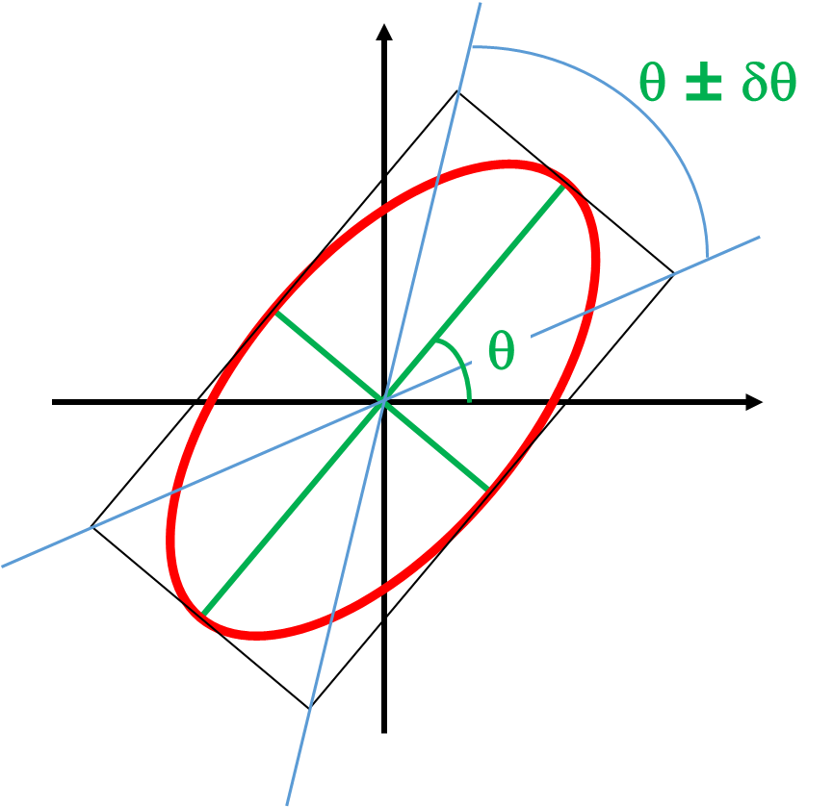
Beam Characterization
by projections on a few axes (2)
For correctly describing a given beam, the questions are:
- what is the minimum number of projections ?
- which projections to consider ?
We recommend:
1) Reconstruct the distribution with 4 axes regularly
positioned within 360°, i.e. 0°, 45°, 90° and 135°.
2) Calculate the concentration ellipse of the obtained distribution
then determine its axis angle θ and aperture δθ
3) Reconstruct finally the distribution with projection axes
regularly positioned within θ ± δθ,
and the same number of axes perpendicular to those ones.

Slide 14
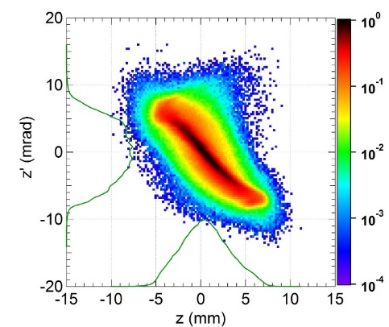
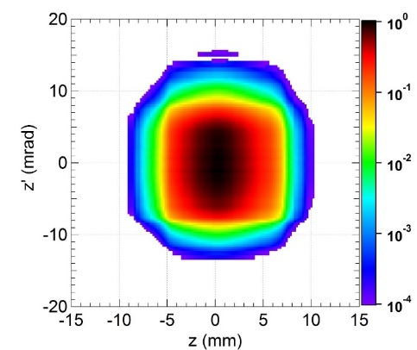
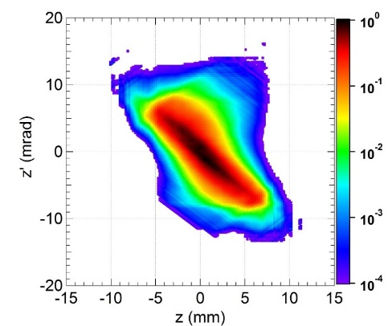
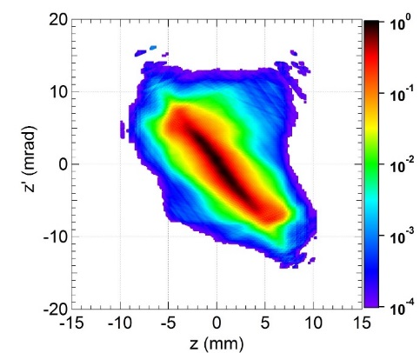
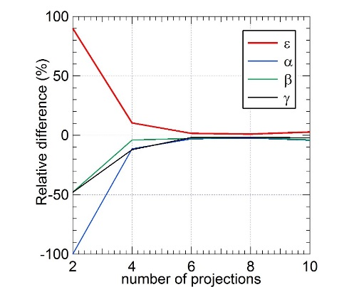
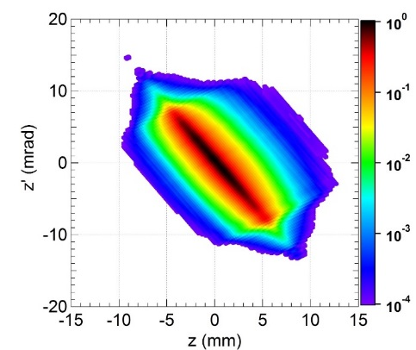
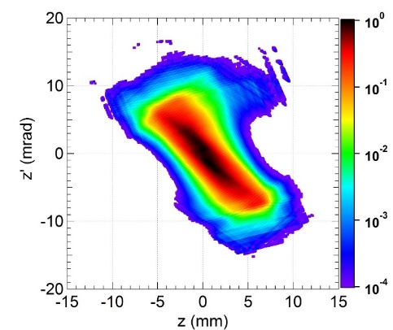
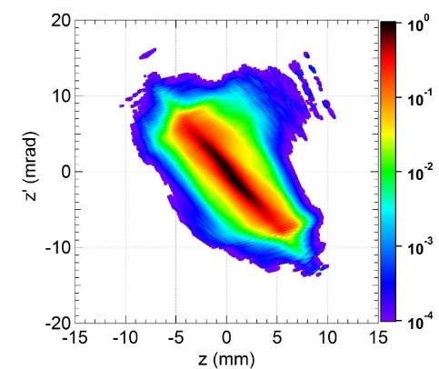
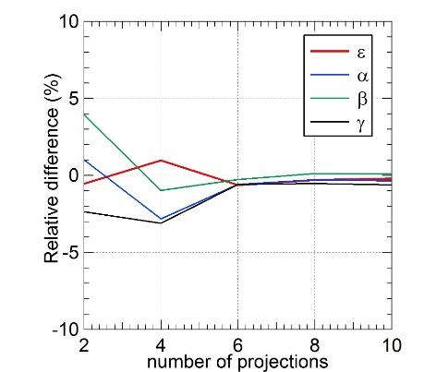
Beam Characterization
by projections on a few axes (3)
IFMIF-LIPAc MEBT exit
Actual distribution
Projections within 360°
2 projections
4 projections
6 projections
Projections
within
-57° ± 15°
and ⊥

Slide 15
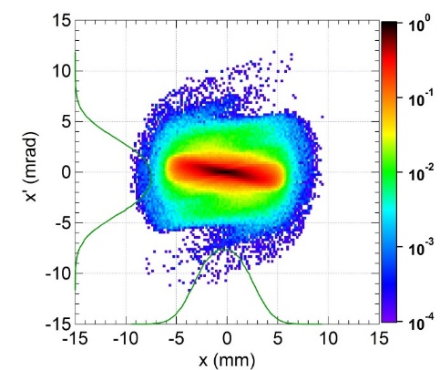
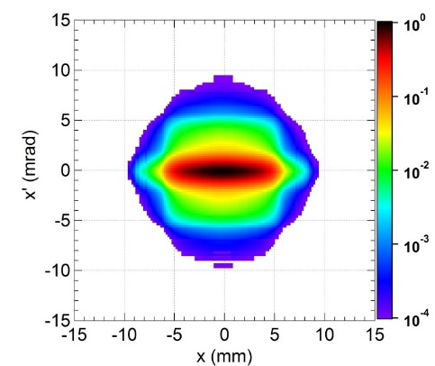
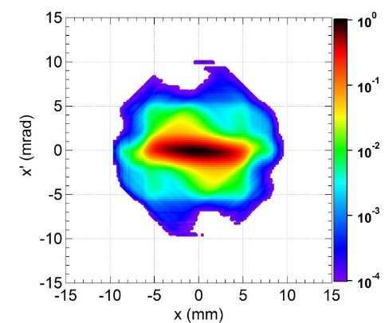
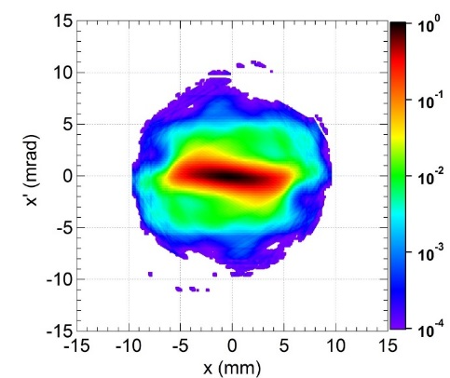
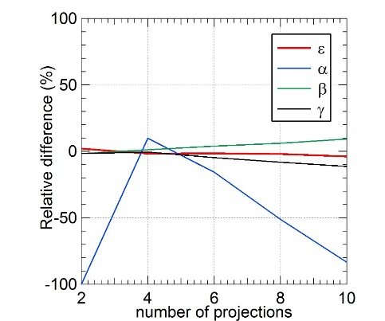
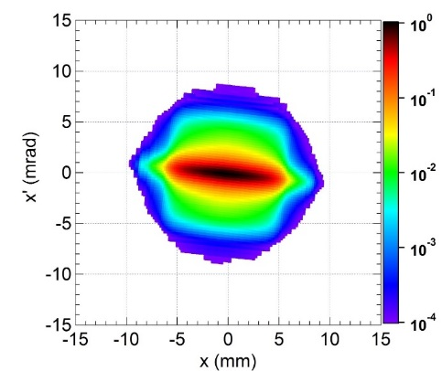
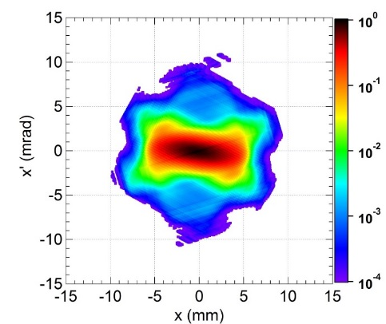
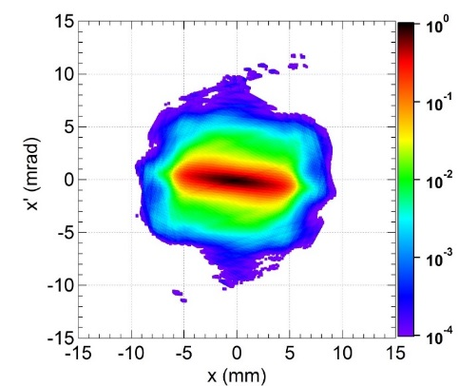
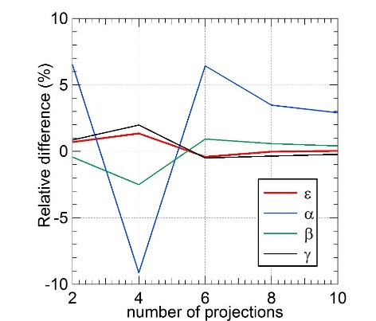
Beam Characterization
by projections on a few axes (4)
IFMIF-LIPAc SC-Linac exit
Actual distribution
Projections within 360°
2 projections
4 projections
6 projections
Projections
within
-6,1° ± 22,8°
and ⊥

Slide 16
Beam Characterization
by projections on a few axes (5)
Reconstruct a distribution from its projections → MENT method:
Projection axes correctly chosen in direction and angle range
→ ~ 2 projections are enough for describing the core
→ ~ 6 projections are enough for describing inaddition the external parts
→ ~ 10 - 30 parameters for 2D
BUT: how to go to 4D, 6D ?
MOPOR032, IPAC'16

Slide 17
3. Beam characterization
by its core and halo separately

Slide 18
Beam Characterization
by Core and Halo (1)
Further reduce the number of parameters :
describe the beam by the global characteristics of its CORE and its HALO separately
Fine details are lost BUT more insight in physics of the beam
High intensity beam : competition of internal forces (space charge)
and external forces (focusing)
Result: growth or decay of Core or Halo

Slide 19
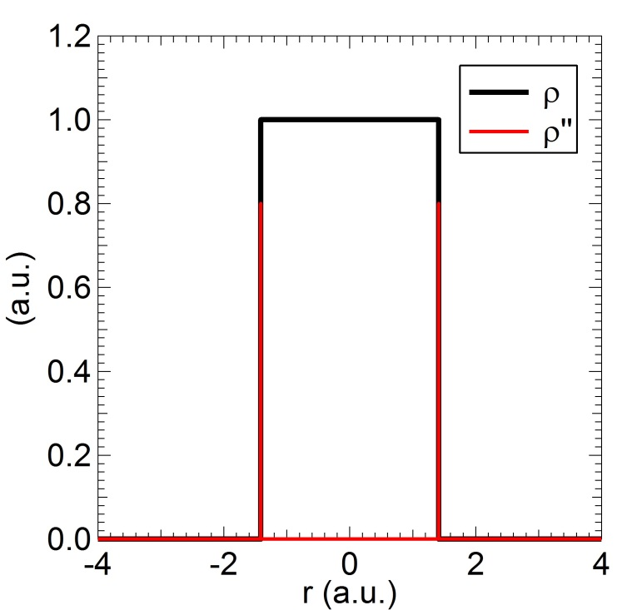
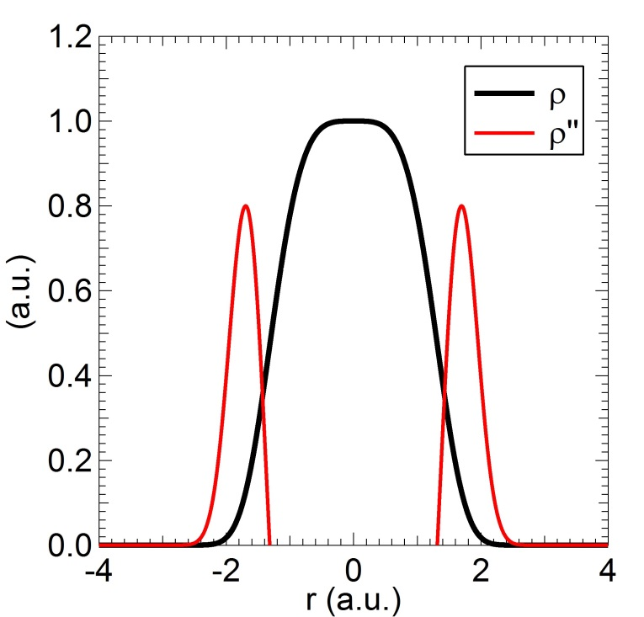
Beam Characterization
by Core and Halo (2)
For 1D: Core-Halo limit based on density profile
Appl. Phys. Lett. 104, 074109, 2014
Extreme case:
Core: uniform, sc force strictly linear
Halo: tenuous, sc force nonlinear
→ core-halo limit: very steep (infinite)
variation of the slope
General case:
Continuously varying density
Core-Halo limit: steepest variation of
the slope → max of 2nd derivative
→ Core & Halo are submitted to two
different space charge force regimes
Phys. Plasmas 22, 083115, 2015: This core-halo limit ≡ good indicator of beam internal dynamics

Slide 20
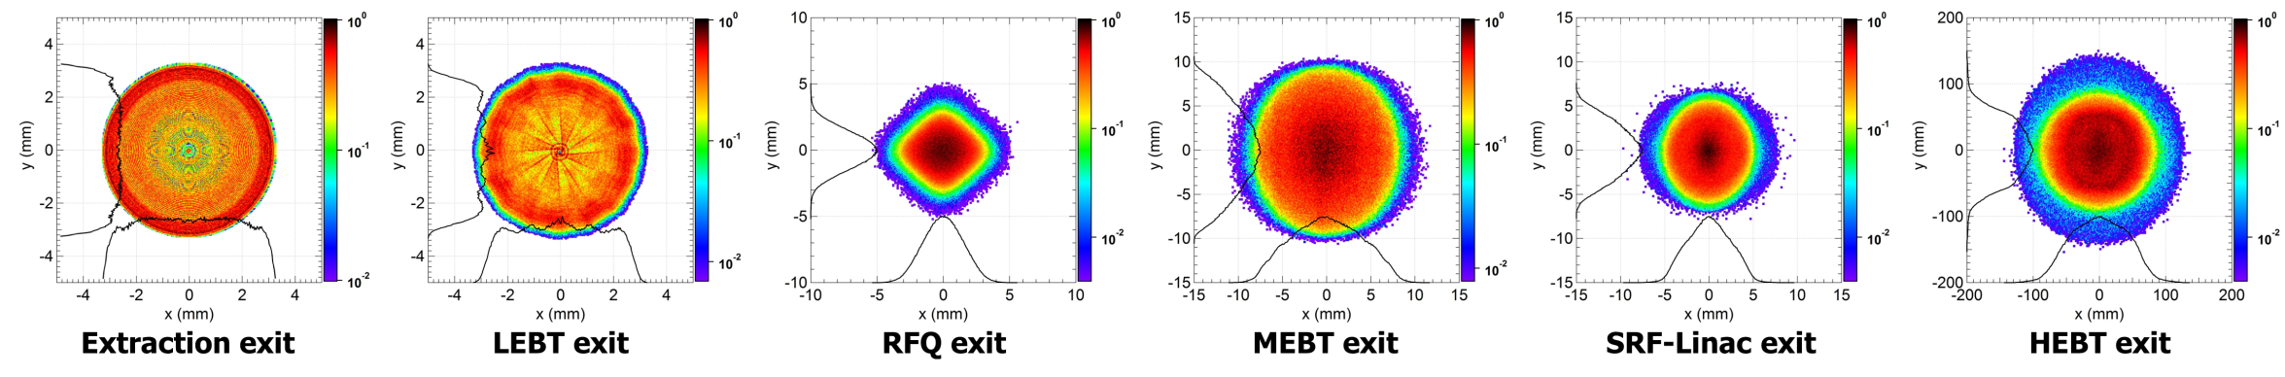
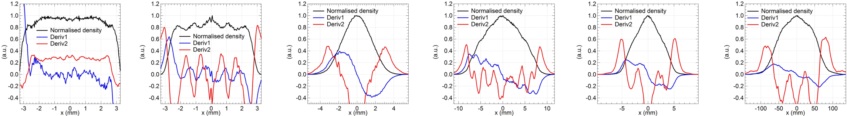
Beam Characterization
by Core and Halo (3)
Example: Beam along the IFMIF prototype accelerator

Slide 21
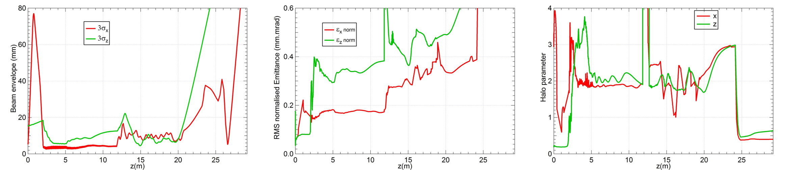
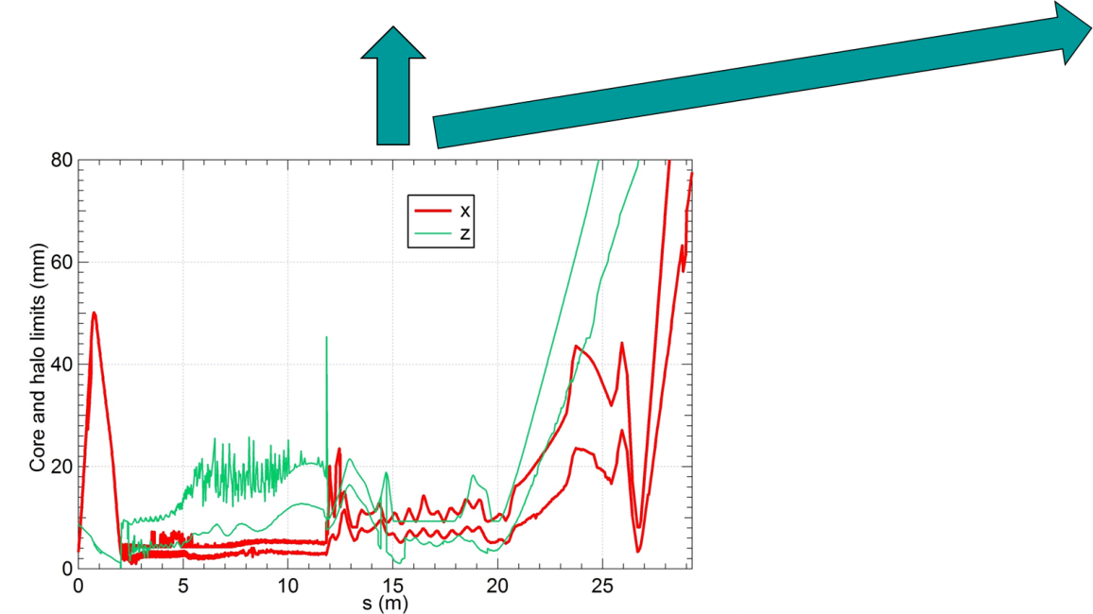

Beam Characterization
by Core and Halo (4)
Example: Beam along the IFMIF Prototype accelerator
Classically
PHS
PHP
Advanced

Slide 22

Beam Characterization
by Core and Halo (5)
MOPWA010, IPAC'15: Extension to 2D
"Wheel algorithm": Max of second derivative
along many sections
Core-Halo limit contour
PHS, PHP
Emittance ε and Twiss parameters α, β, γ
of the core and the halo separately
THPMR014, IPAC'16:
This Core-Halo limit contour is consistent
with the well-established halo formation dynamics

Slide 23

Beam Characterization
by Core and Halo (6)
Classically
Advanced

Slide 24
Summary
Characterization of high intensity beam:
1) By the actual number of particles
precise and detailed description of halo formation, microlosses
but needs massive simulations and more realistic input distribution
2) By projections onto a few axes
truththful description of 2D distribution with reasonable number of parameters
but how to go to 4D, 6D ?
3) By global properties of the Core and the Halo separately
more insight in physical properties of the beam
but compared to above methods, fine details are lost

Slide 25
Extra

Slide 26




Two different beams...

Slide 27


Same Emittance but different Halos
ε = 3.30, α = -0.40, β = 0.95
ε = 3.30, α = -0.40, β = 0.96

Slide 28


ε α β
Global 3.30 -0.40 0.96
Core 3.15 -0.41 1.00
Halo 8.95 -0.46 1.00
PHS=28.9% PHP=3.2%
ε α β
Global 3.31 -0.40 0.95
Core 1.40 -0.39 1.01
Halo 7.56 -0.40 0.93
PHS=90.1% PHP=30.9%

