Slide 1
Linac Upgrade Scenarios for the ISIS Spallation Neutron Source
Upgrading Existing High Power Proton Linacs Workshop
08.11.2016, ESS, Lund
Ciprian Plostinar, STFC

Slide 2
Overview
Can the accelerating gradient be increased?
Can the beam current be increased?
Can the beam energy be increased?

Slide 3
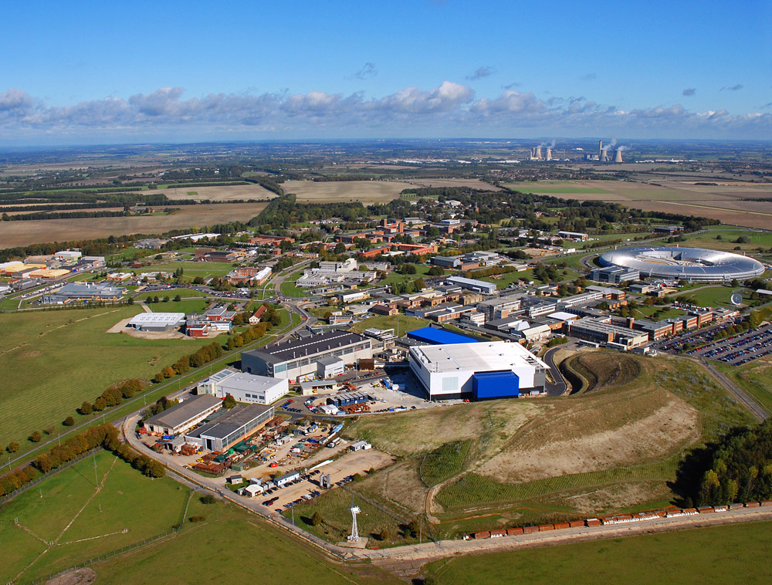
ISIS @ RAL

Slide 4
ISIS @ RAL
Inaugurated in 1984
Accelerator:
H⁻ Ion Source
70 MeV Linac, 202.5 MHz
800 MeV proton synchrotron
~230 μA (2.9*10^13 ppp)
50 Hz, 184 kW
148 kW to TS-1 (40 Hz)
36 kW to TS-2 (10 Hz)

Slide 5
ISIS @ RAL

Slide 6
ISIS @ RAL
Some “Recycled” Components
ISIS was originally expected to have an operational lifetime of 20 years
ISIS is the prototype for modern spallation facilities
Its scientific success will probably double its lifetime
Neutron demand from users
Maintenance, refurbishment, investment
Short/Medium Term Upgrades
Medium/Long Term Upgrades

Slide 7
The ISIS Linac
Ion Species | H⁻
Energy | 70.4 | MeV
Frequency | 202.5 | MHz
Pulse Length | 200-250 | μs
Peak Current | 25 | mA
Repetition Rate | 50 | Hz
Duty Cycle | 1-1.25 | %
Total Length | 55 | m
H⁻ Source
202.5 MHz
LEBT
RFQ
DTL
HEDS
35 keV
665 keV
~70 MeV

Slide 8
The ISIS DTL
 |  | Tank 1 | Tank 2 | Tank3 | Tank4
Input Energy | MeV | 0.6647 | 9.90 | 30.4 | 49.7
Output Energy | MeV | 9.90 | 30.4 | 49.7 | 70.4
Accelerating Gradient (E₀) | MV/m | 1.6 – 2.2 | 2.45 – 2. 55 | 2.3 – 2.4 | 2.6
Synchronous Phase | Deg | -30 | -30 | -30 | -30
Max. Surface Electric Field | Kilpatrick | 0.67 | 0.81 | 0.84 | 0.87
Number of Cells |  | 56 | 41 | 27 | 24
Tank Diameter | cm | 93.4 | 92.71 | 81.28 | 88
Drift Tube Diameter | cm | 18 | 17.78 | 17.78 | 16
Aperture Diameter | cm | 2.5 | 3.81 | 3.81 | 3
Stems/Cell |  | 1 | 2 | 2 | 1
Total Length | m | 7.15 | 11.95 | 11.25 | 12.1
665 keV
9.9 MeV
30.4 MeV
49.7 MeV
70.4 MeV
7.15m
11.95m
11.25m
12.1m
Tank 1
Tank 2
Tank 3
Tank 4

Slide 9
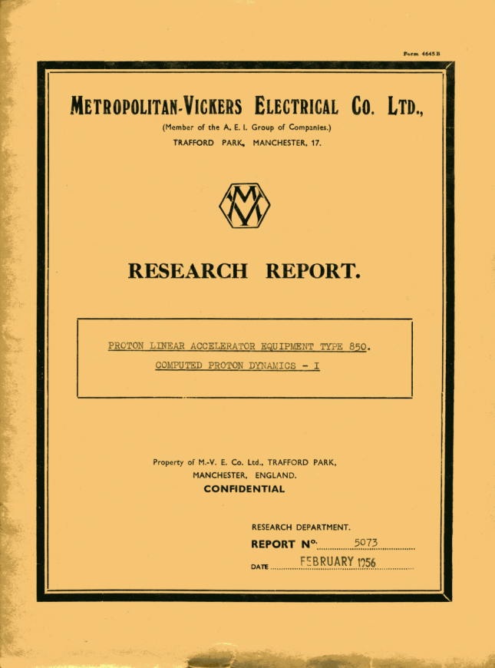
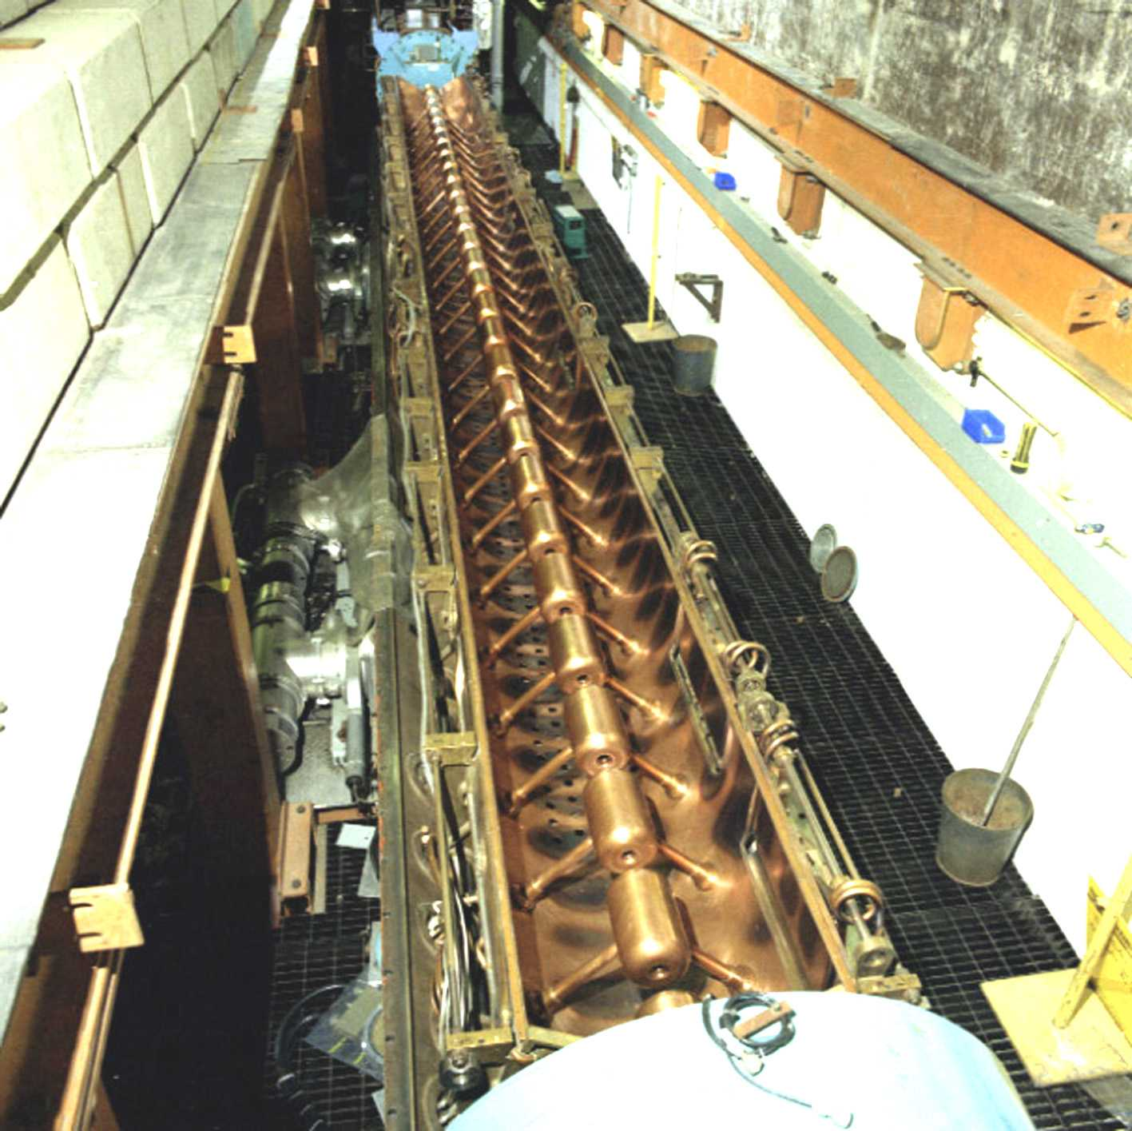

Slide 10
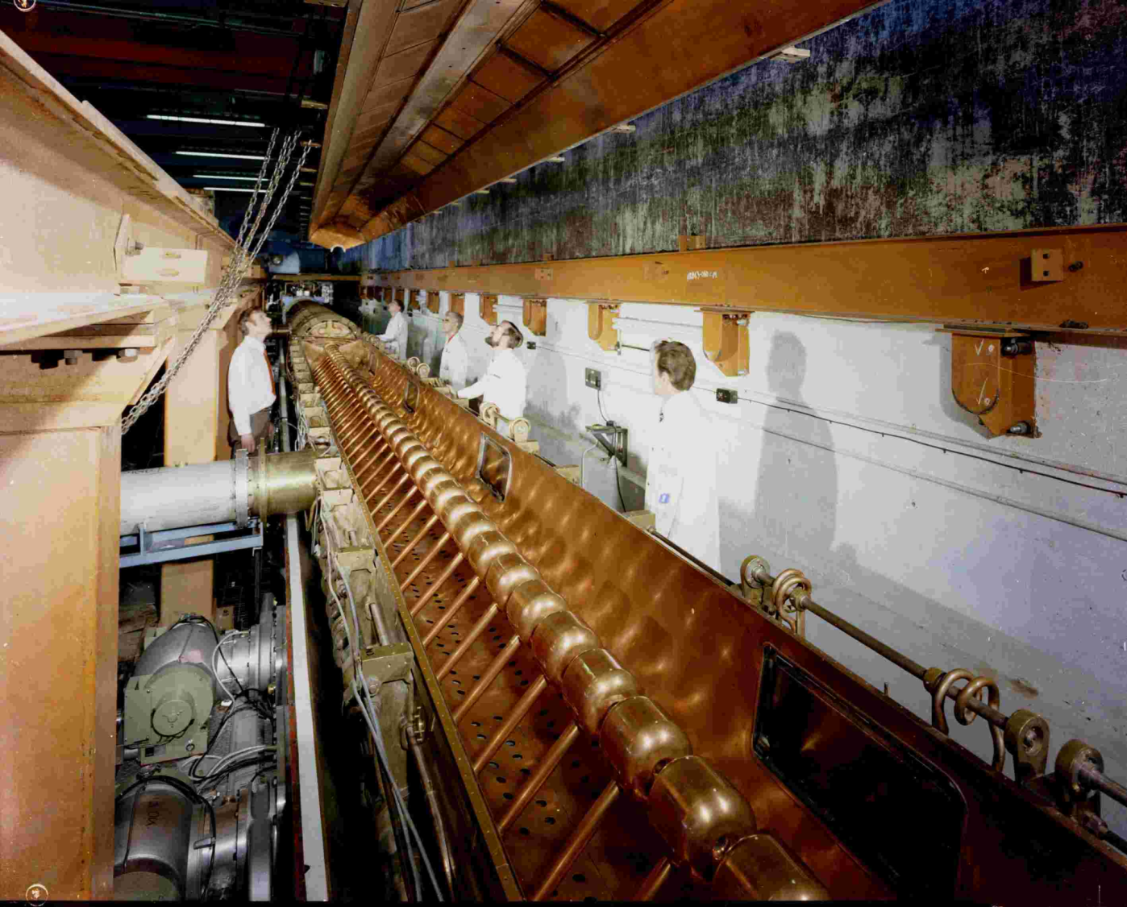

Slide 11
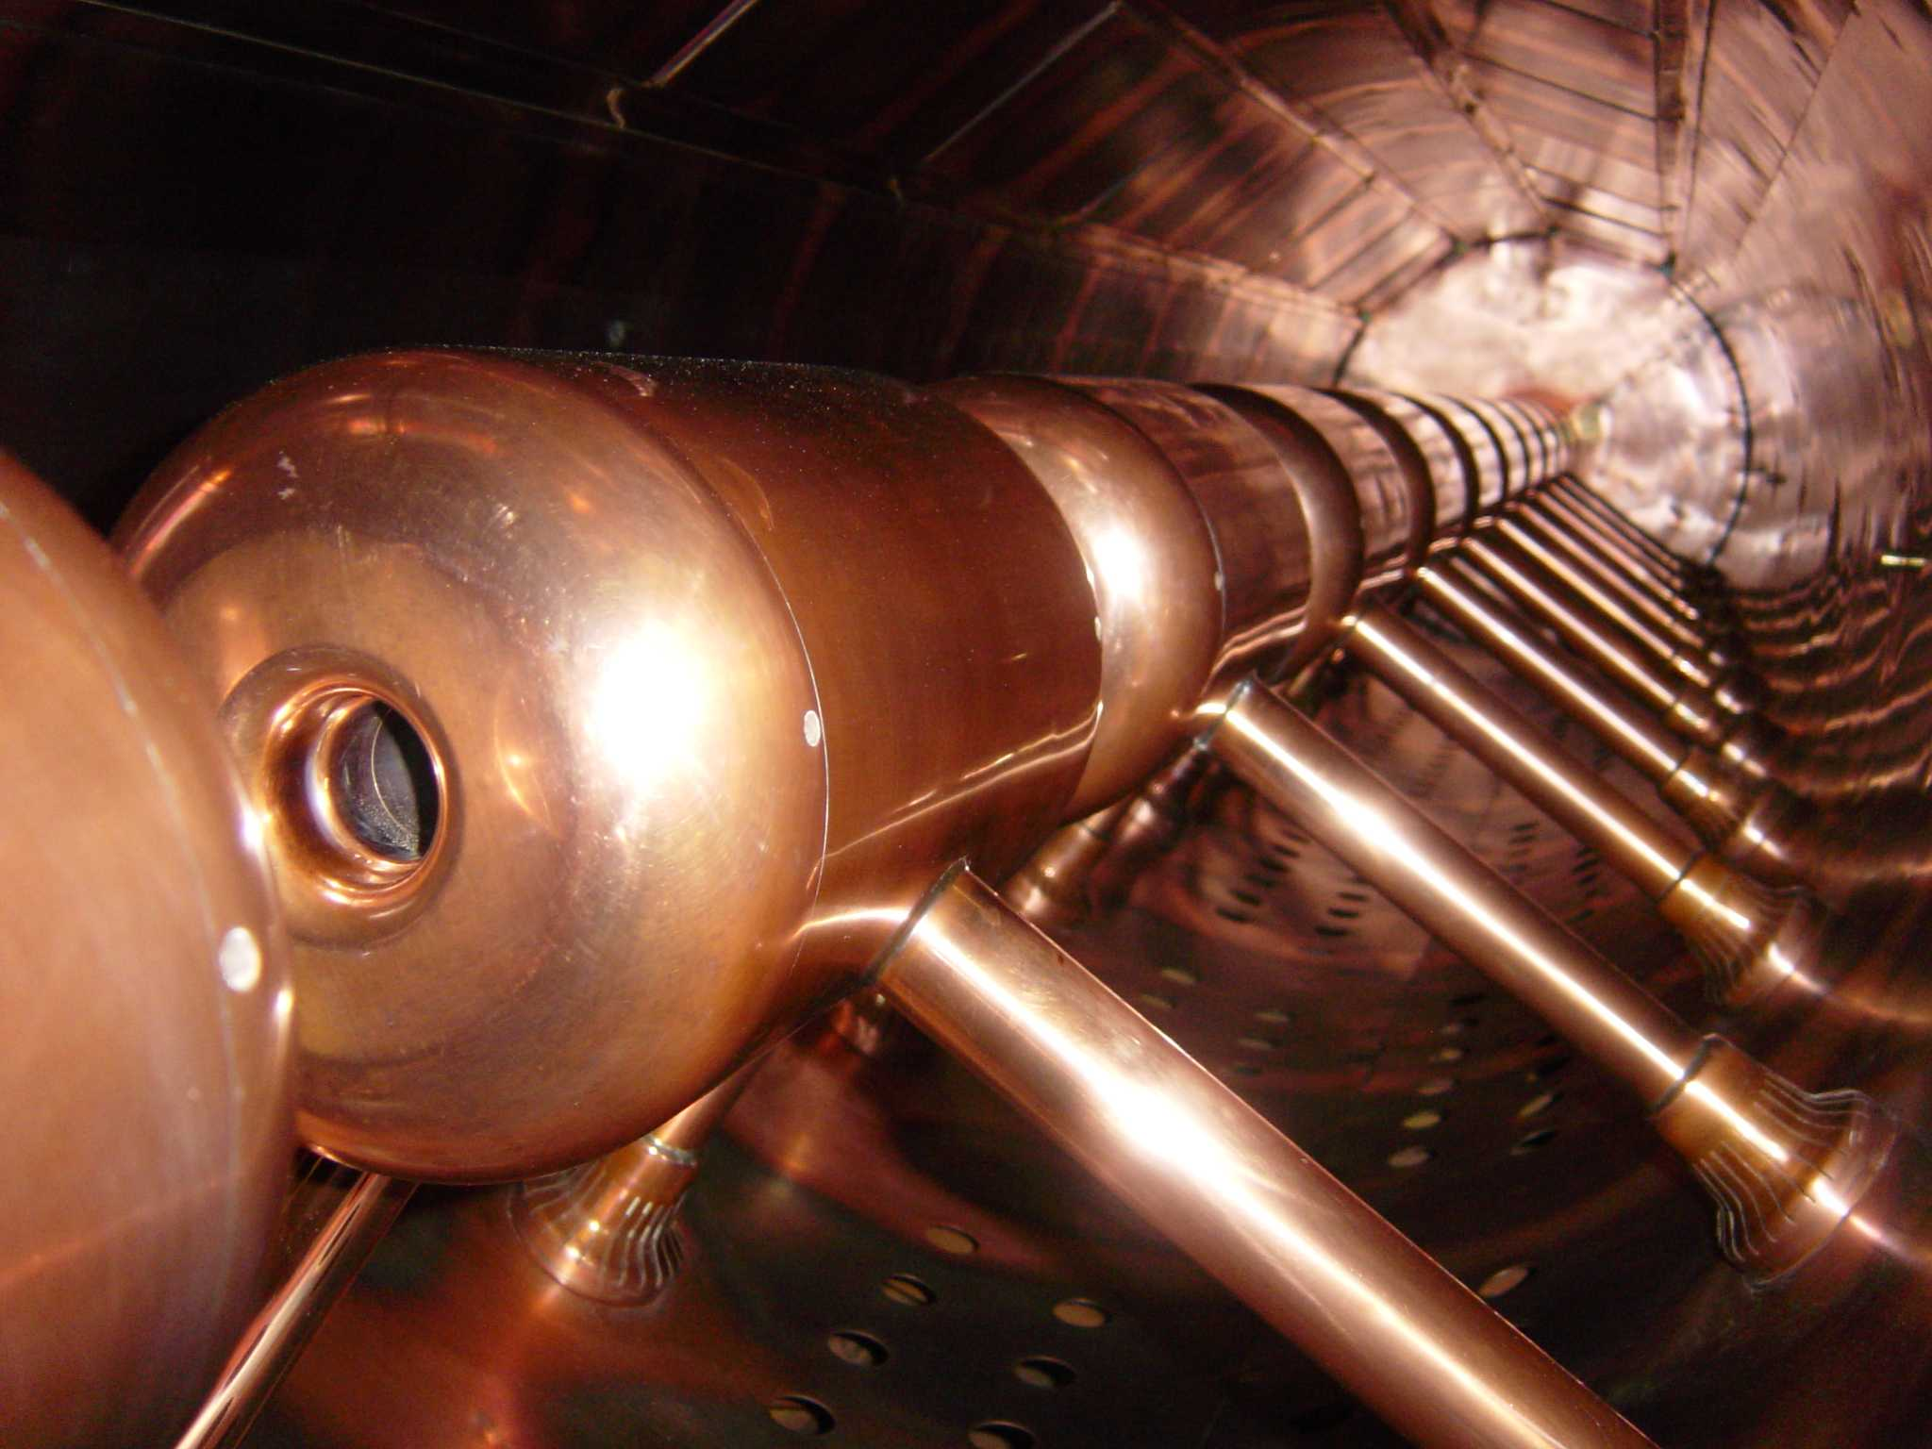

Slide 12
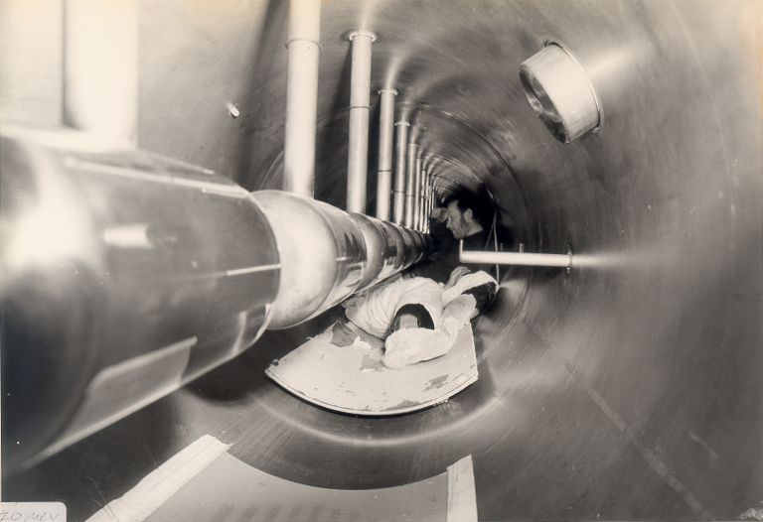

Slide 13
Short/Medium Term: Tank 4 Replacement
50 – 70 MeV, 12 m
Manufactured in the 1970s
Showing its age
Maintenance almost impossible
Replacement effort underway
Prevent catastrophic failure
Like for like
Higher accelerating field (Kilp=0.87) and output energy would have required an injection upgrade as well

Slide 14
Short/Medium Term: Tank 4 Replacement

Slide 15
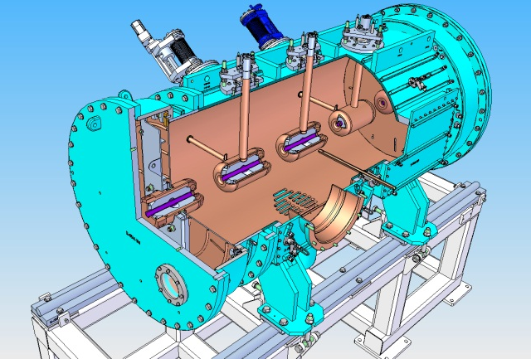
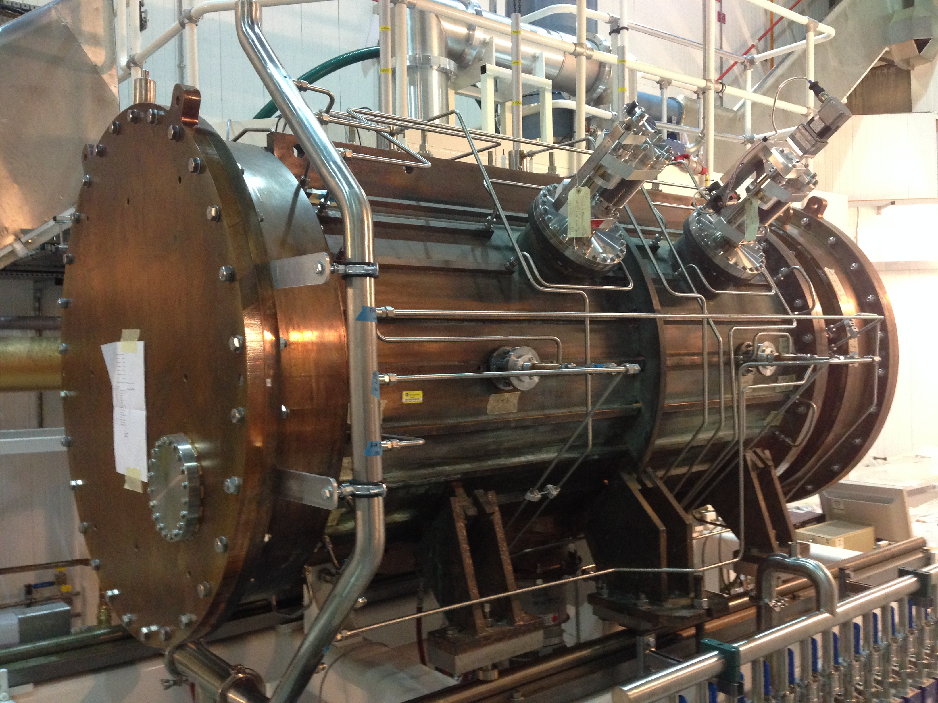
Short/Medium Term: Tank 4 Replacement
A complete 2m section has been built
Re-engineered for better access (6x2m sections)

Slide 16
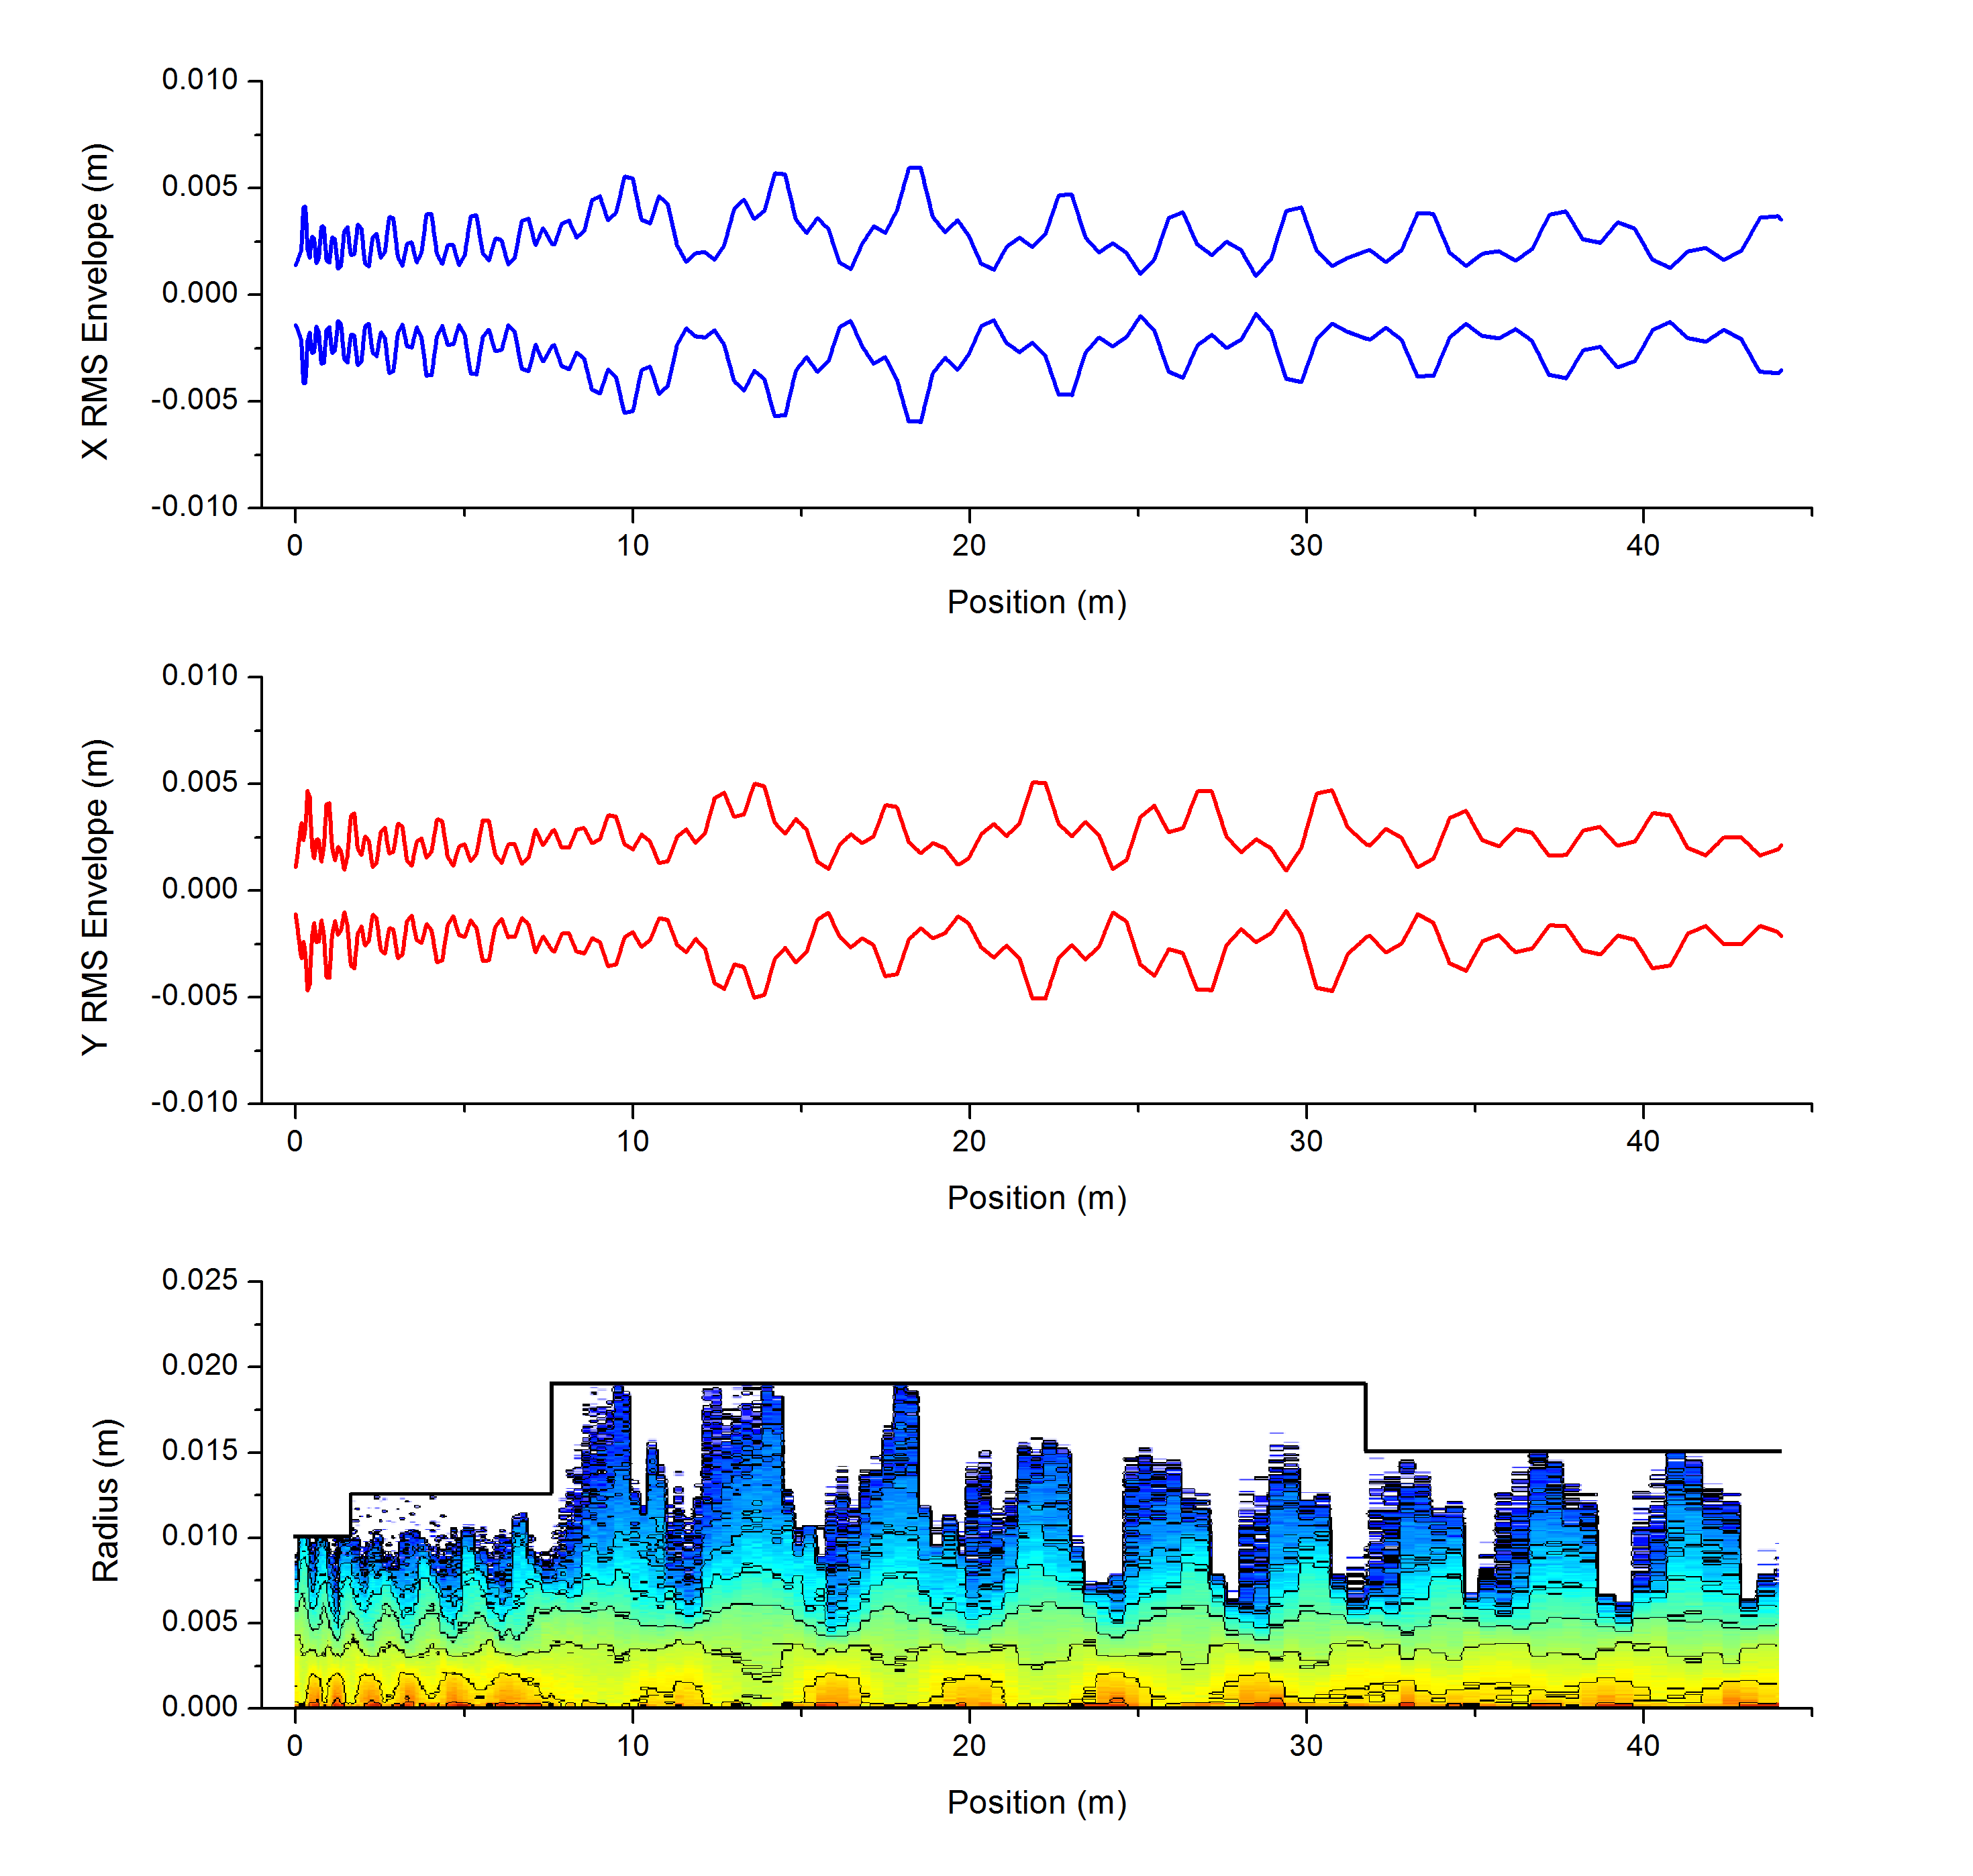
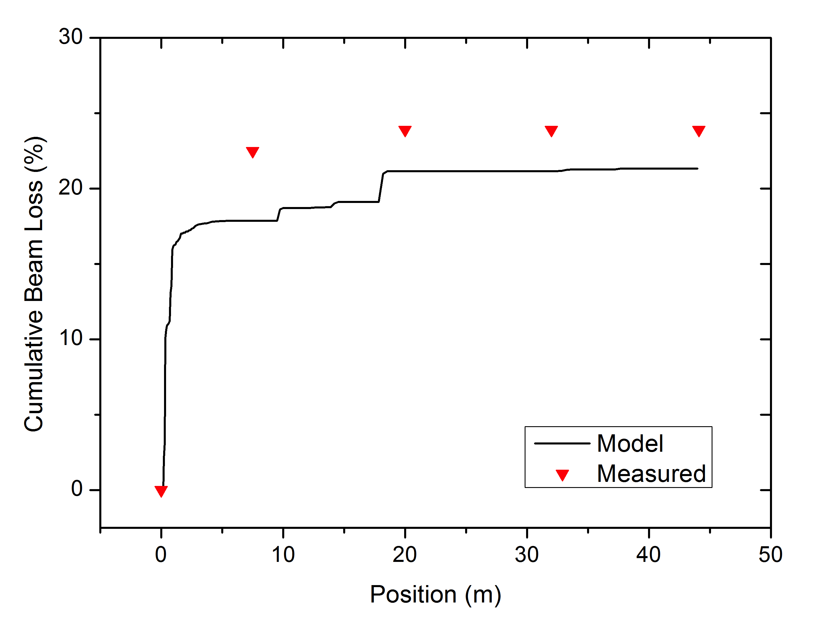
Short/Medium Term: New MEBT
RFQ to DTL beam mismatch
~20% beam loss in Tank1.

Slide 17
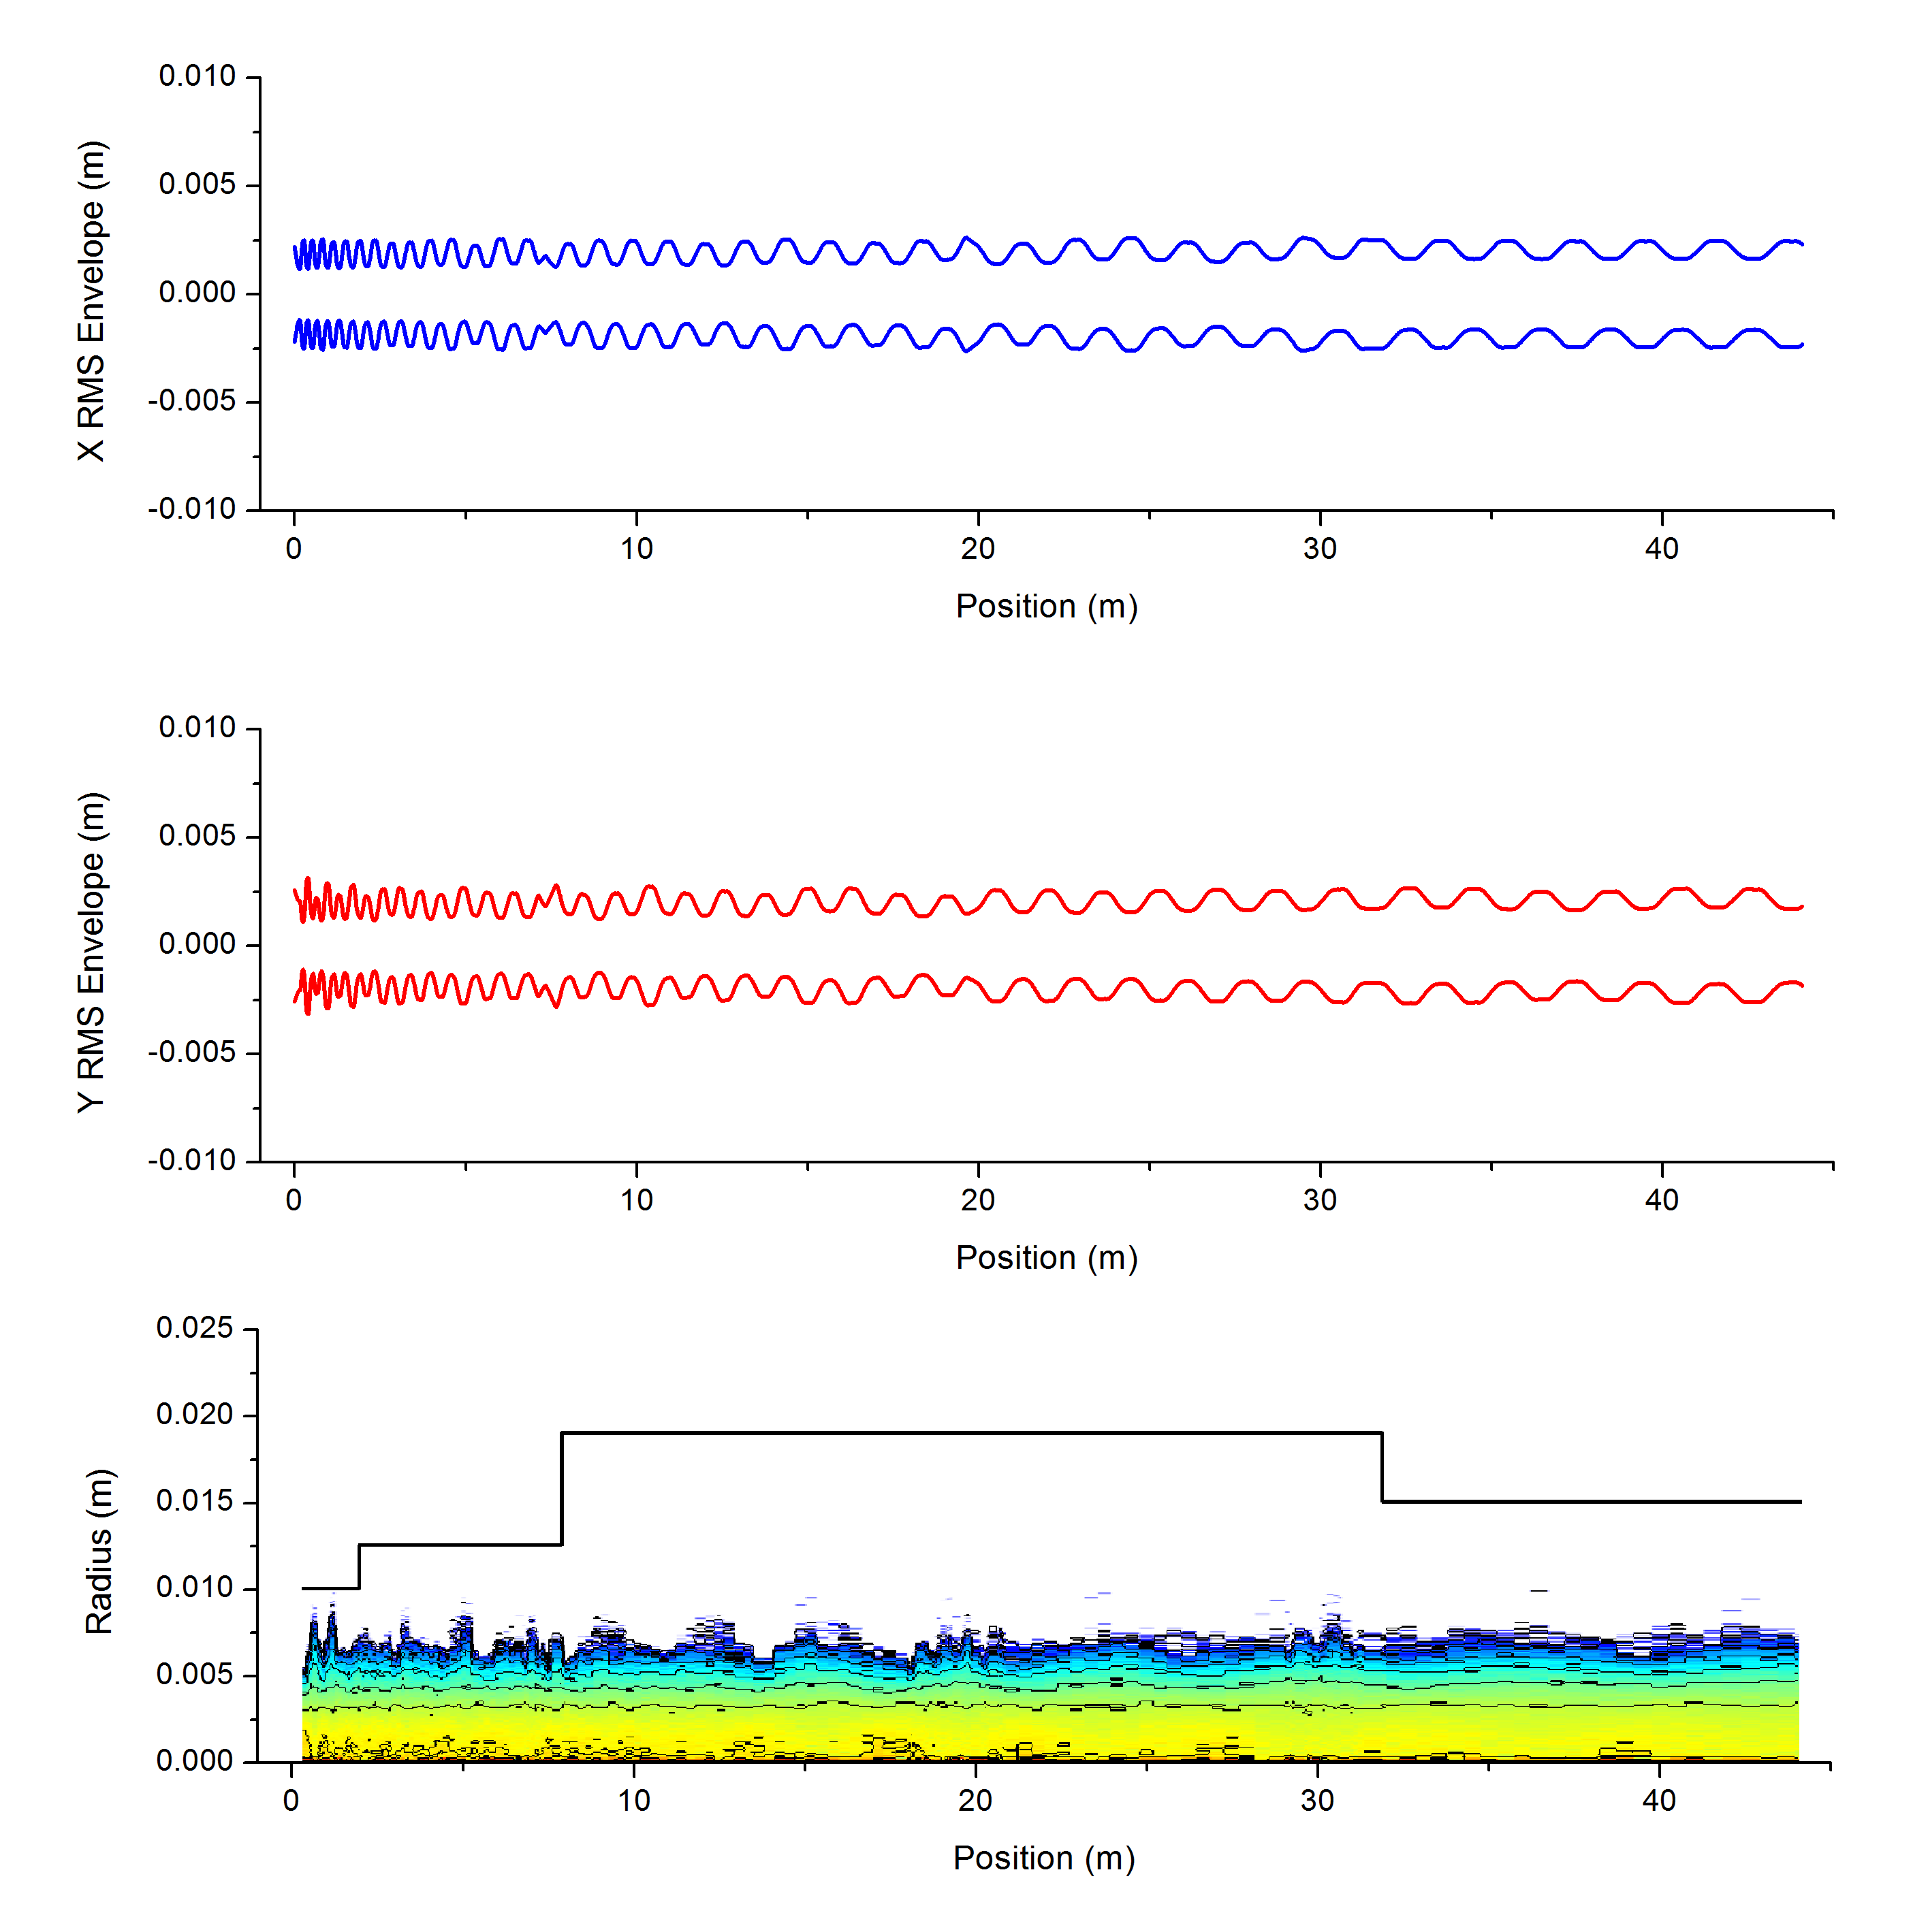
Short/Medium Term: New MEBT
New MEBT Layout with chopper
Would allow increasing beam current to ~30 mA
RF systems can cope

Slide 18
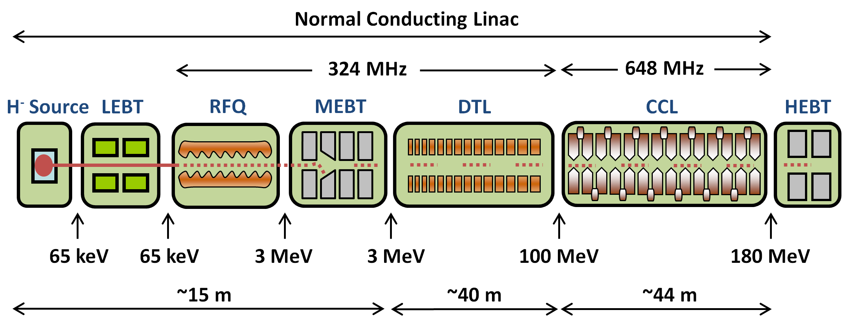
Long Term Plans: Two Linac Upgrade Options
180 MeV Normal Conducting
800 MeV Superconducting

Slide 19
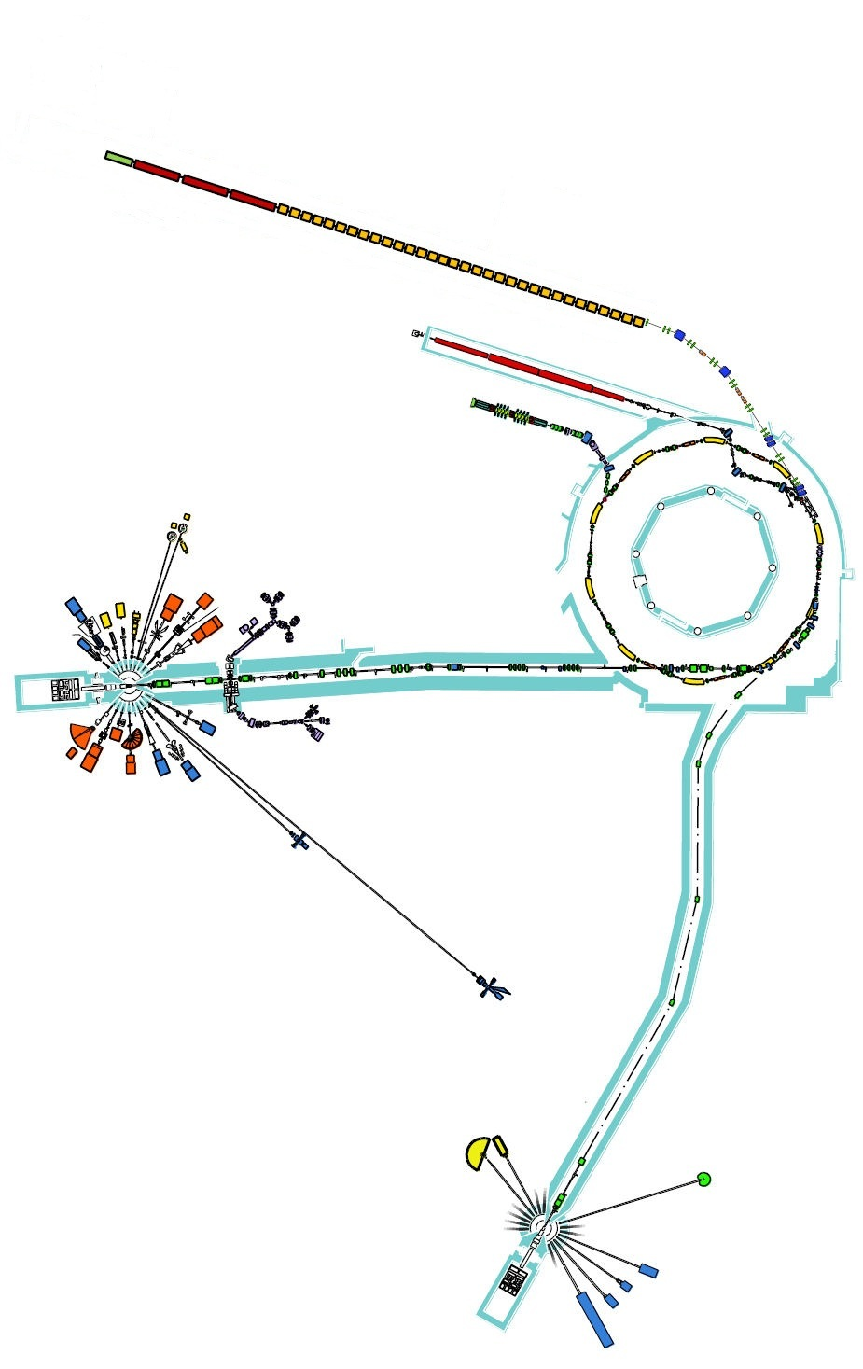
180 MeV Linac
Ion Species | H⁻
Output Energy | 180 | MeV
Frequency | 324/648 | MHz
Pulse Length | 0.1 – 1 | ms
Peak Current | 60 | mA
Repetition Rate | 50 | Hz
Duty Cycle | 0.5 – 5 | %
Average Beam Power | 54 - 540 | kW
Accelerating Structures | RFQ, DTL, CCL
Accelerator Length | ~99 | m

Slide 20
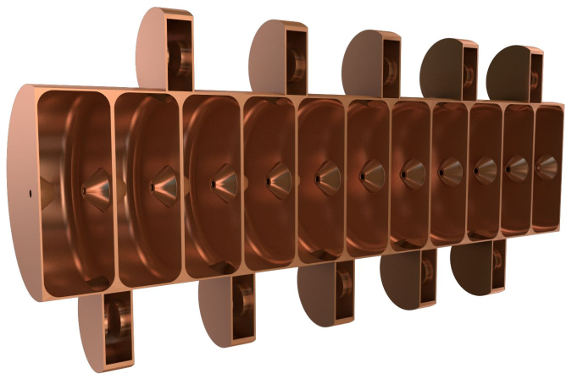
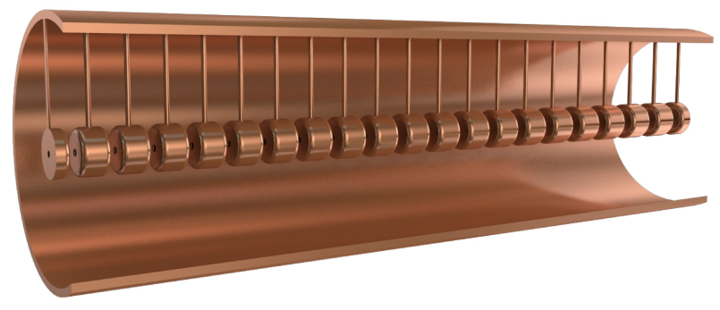
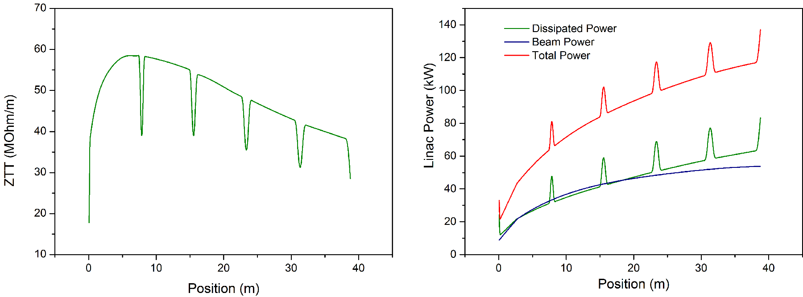
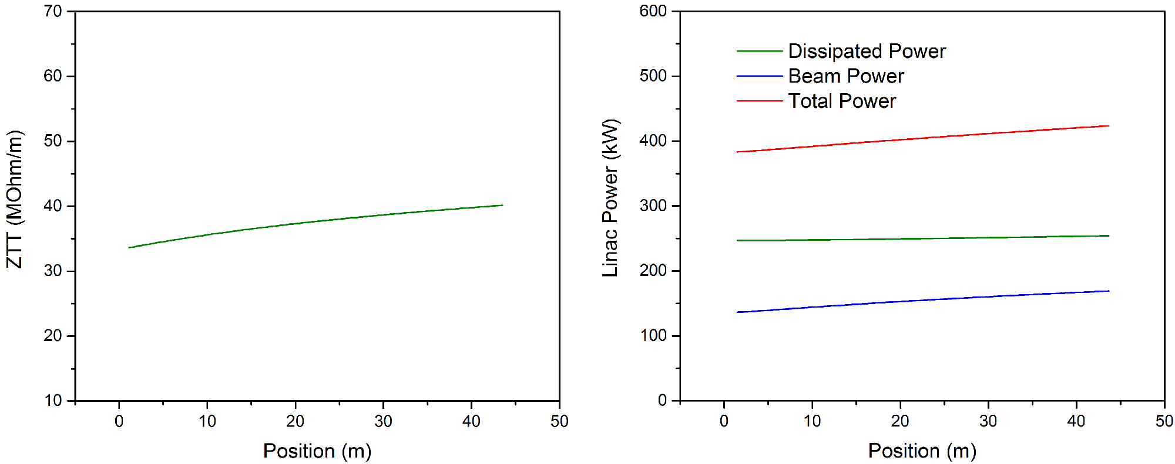
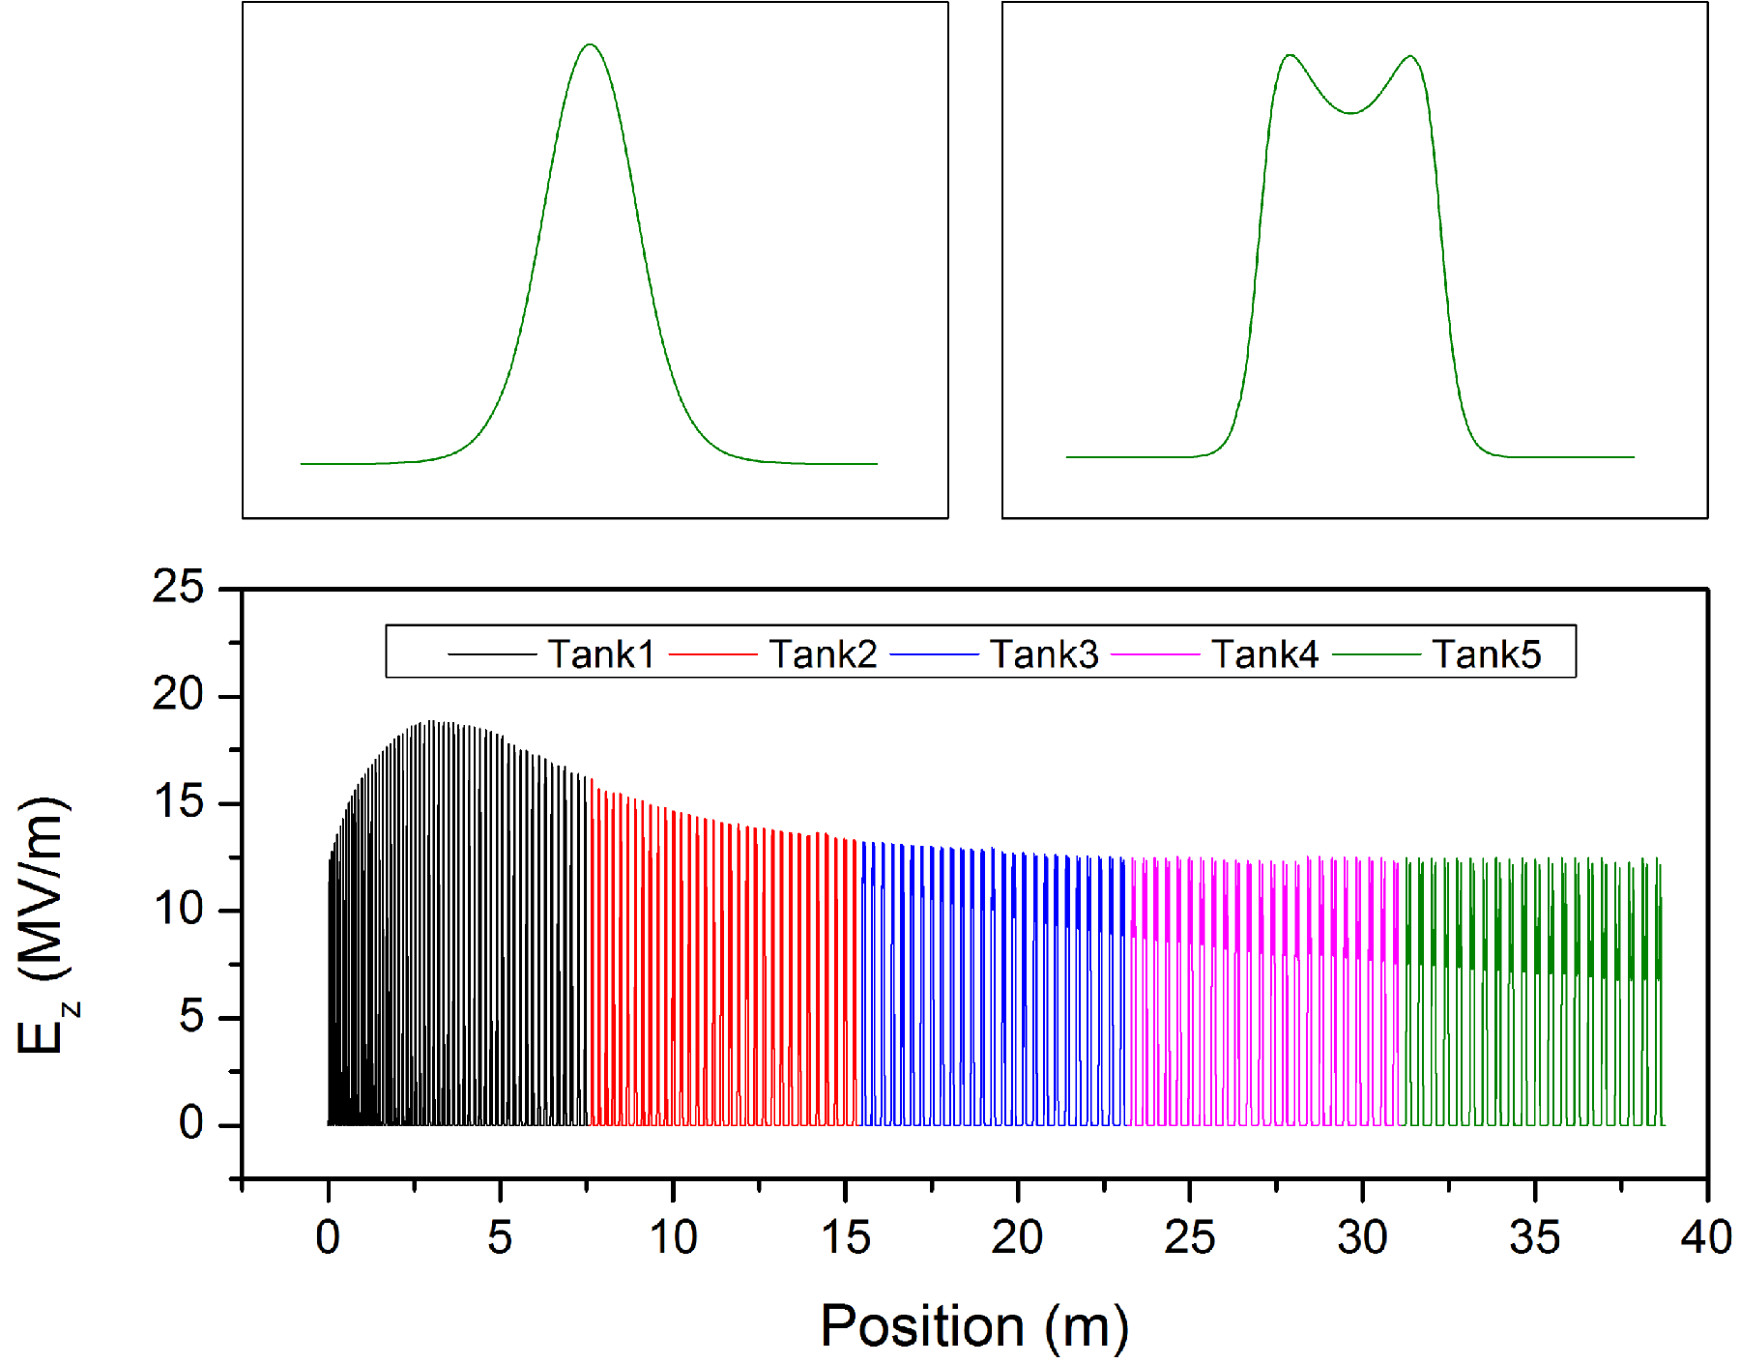
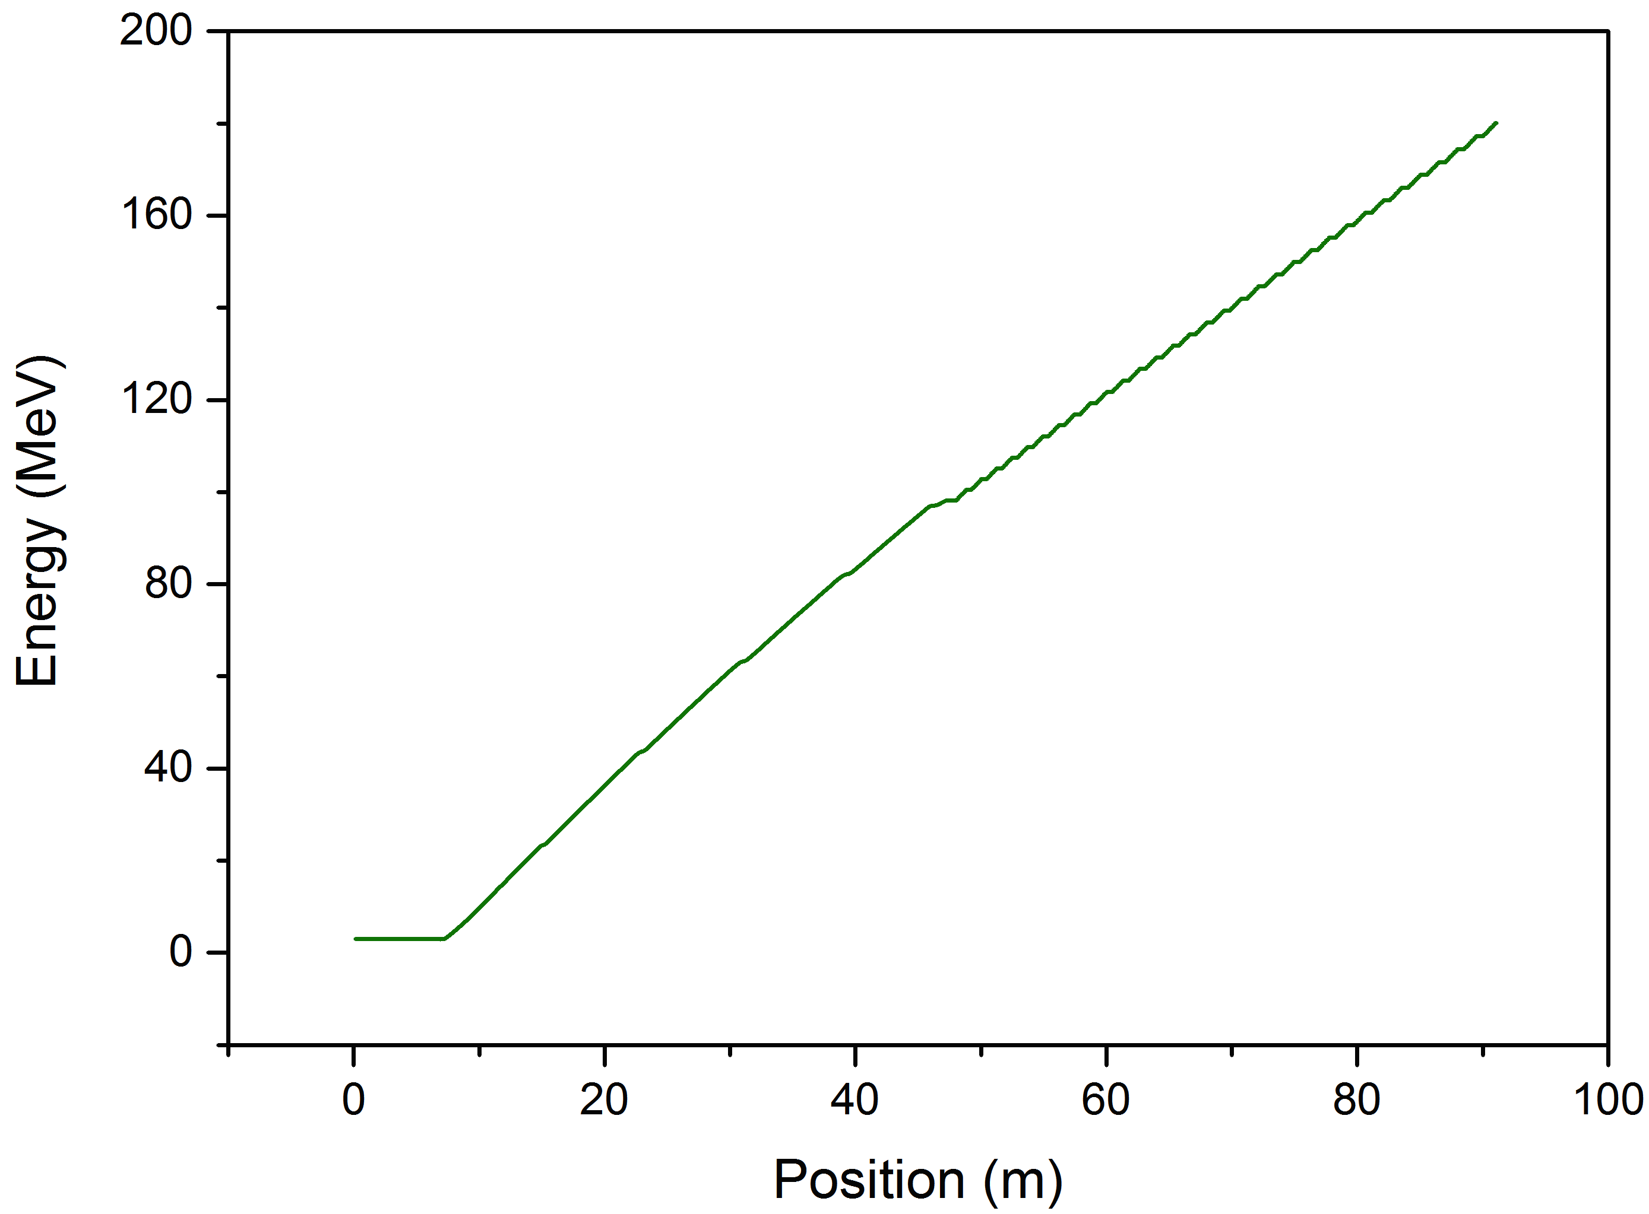
180 MeV Linac

Slide 21
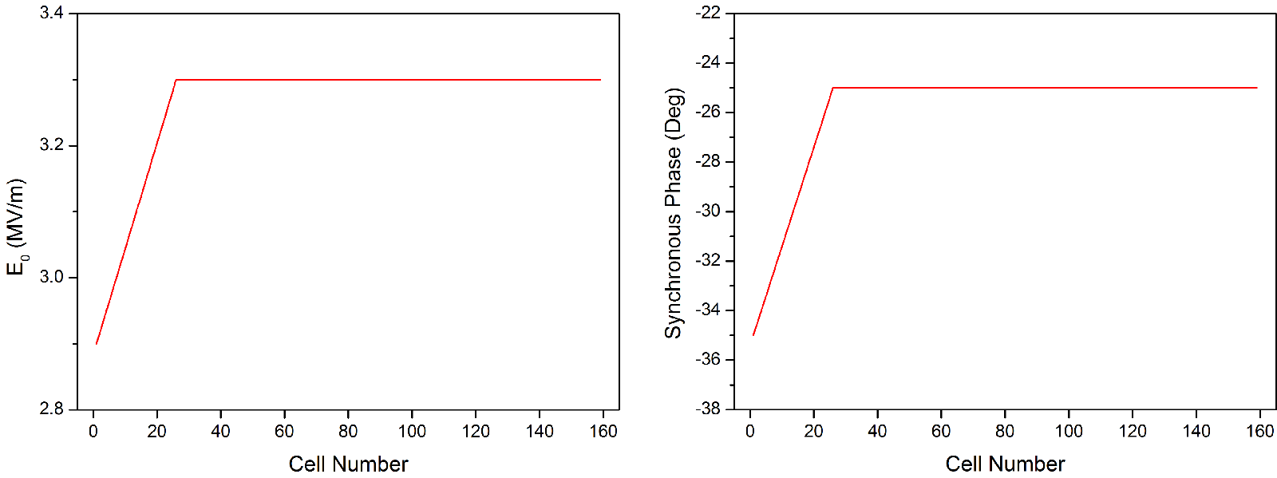
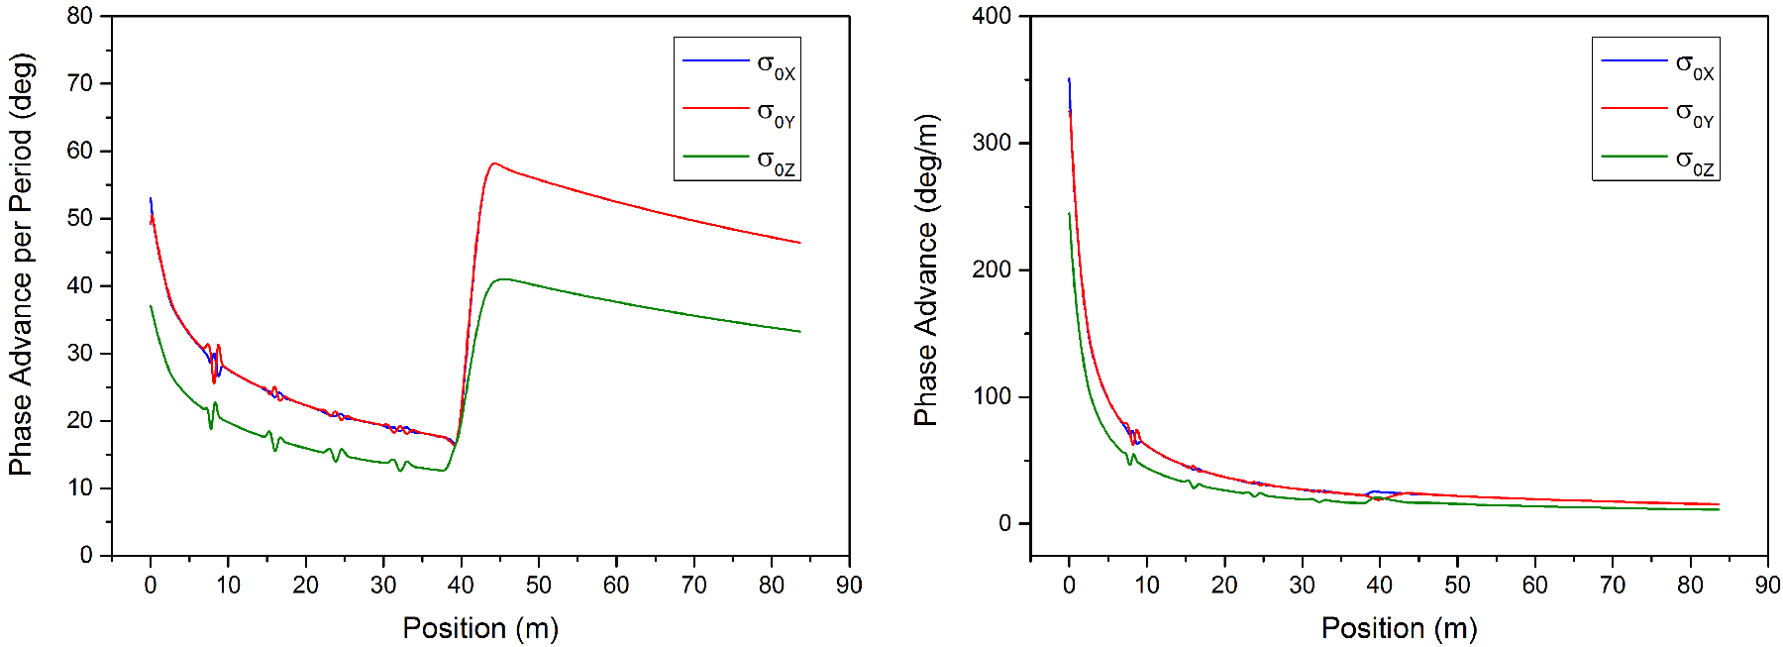
180 MeV Linac

Slide 22
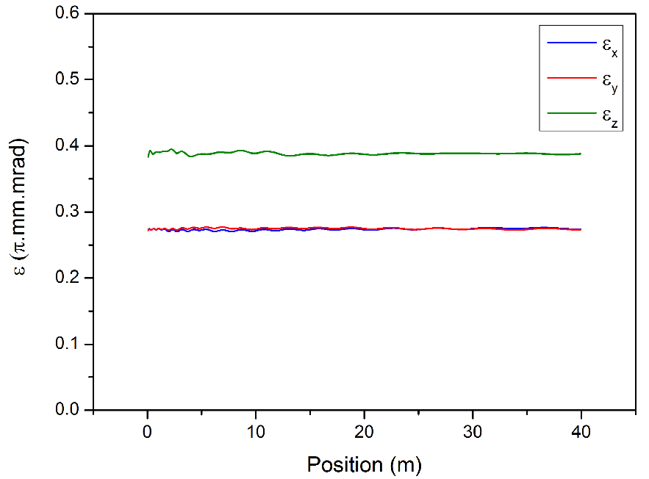
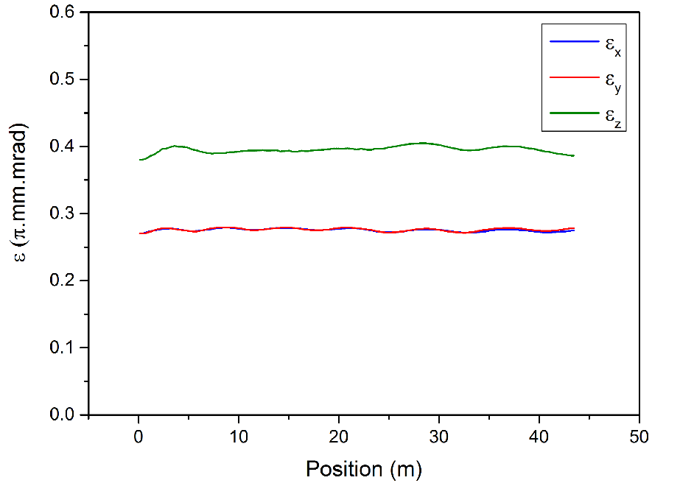
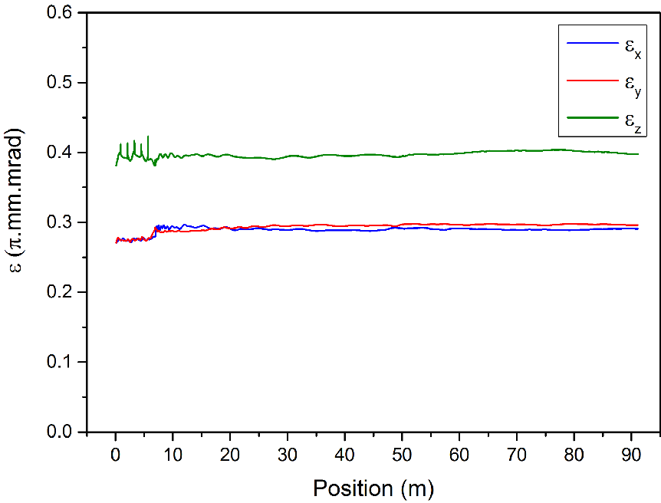
180 MeV Linac

Slide 23
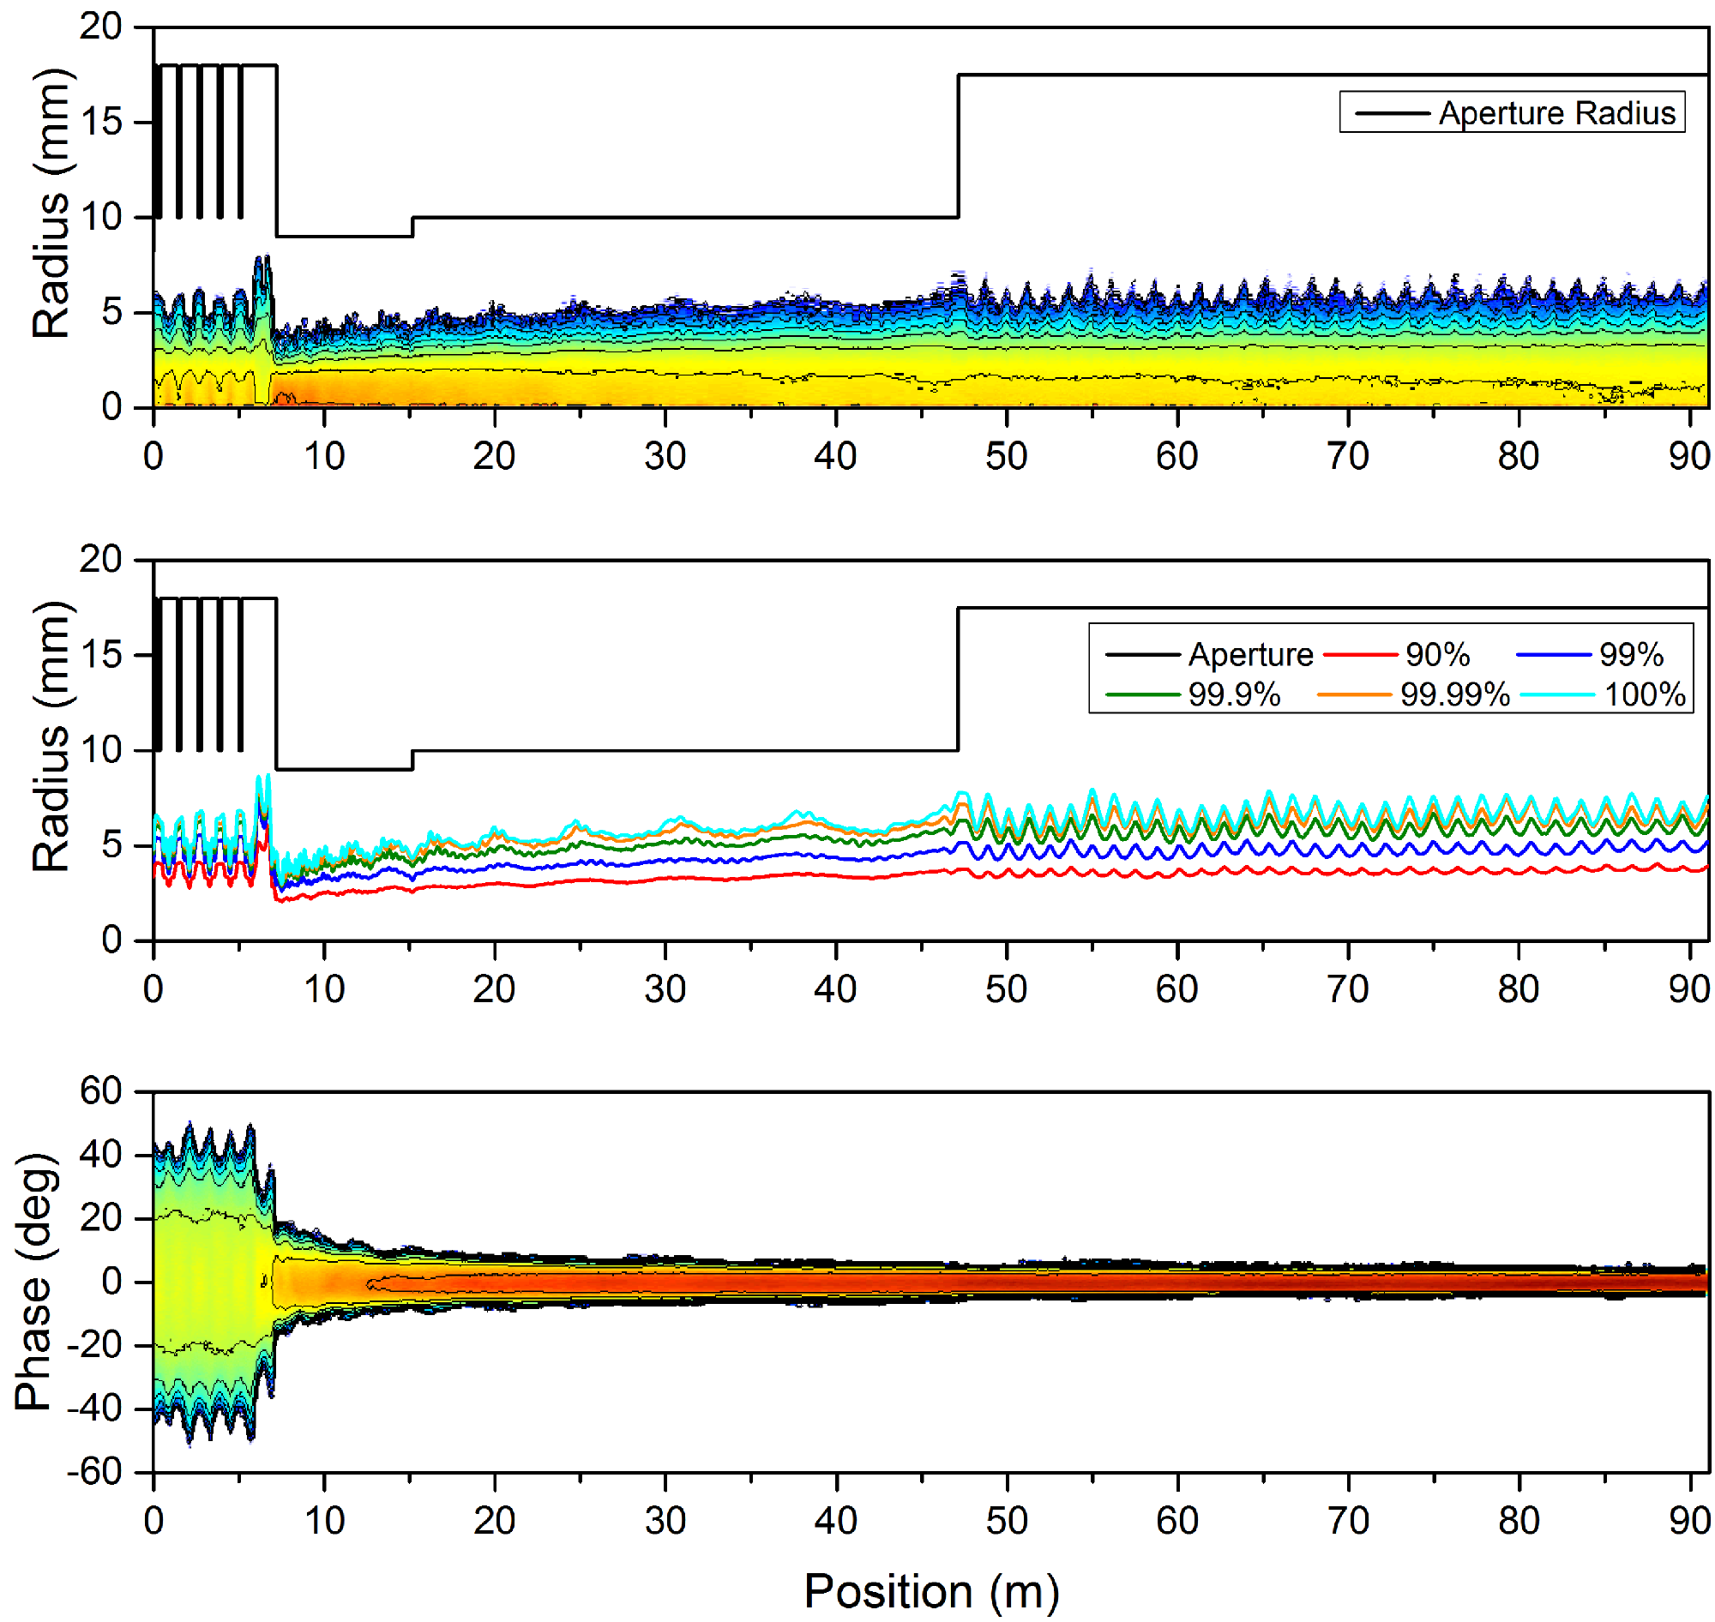
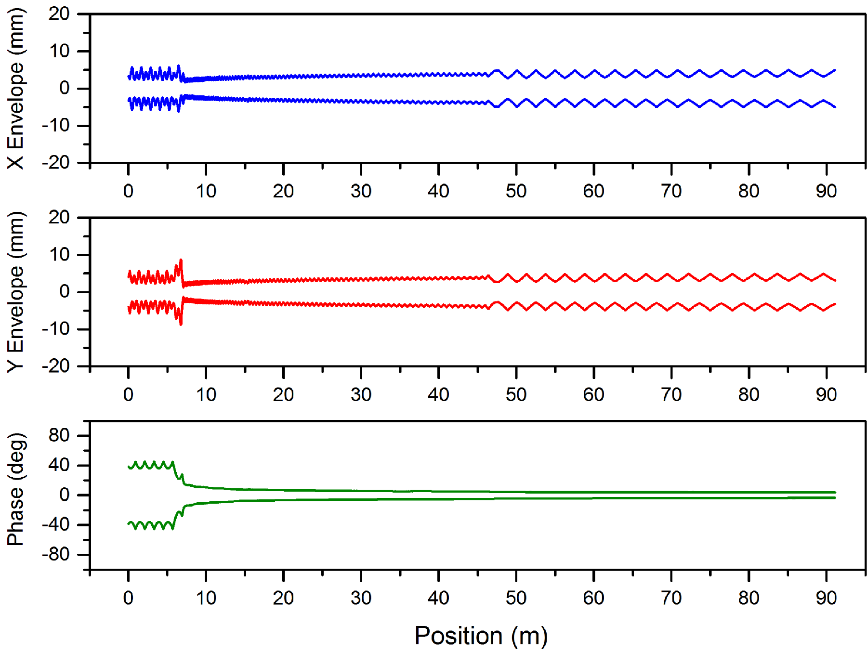
180 MeV Linac

Slide 24
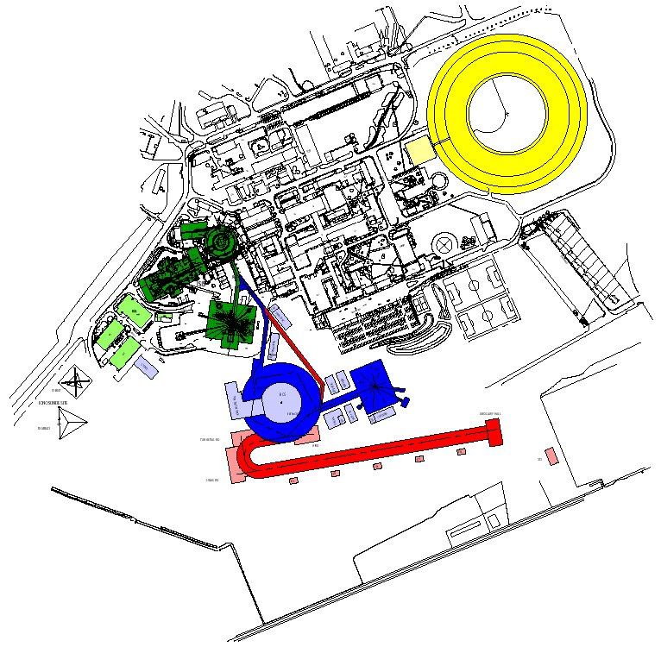
800 MeV Linac
Ion Species | H⁻
Output Energy | 800 | MeV
Frequency | 324/648 | MHz
Pulse Length | 0.1 – 1 | ms
Peak Current | 60 | mA
Repetition Rate | 50 | Hz
Duty Cycle | 0.5 – 5 | %
Average Beam Power | 240 - 2400 | kW
Accelerating Structures | RFQ, DTL, CCL, SCL
Accelerator Length | ~244 | m

Slide 25
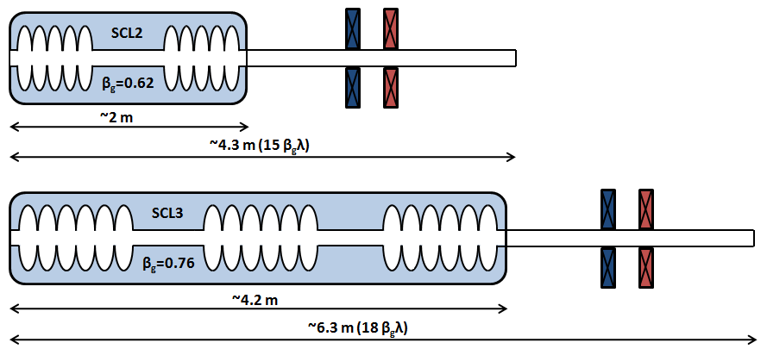
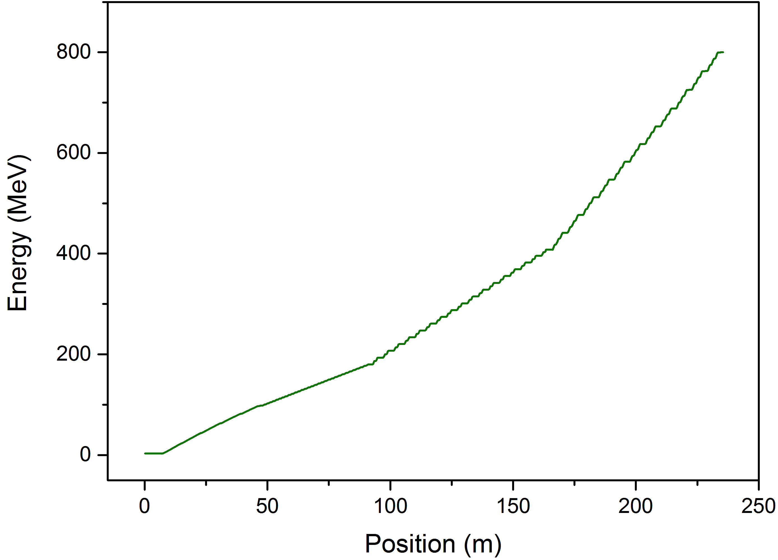
800 MeV Linac

Slide 26
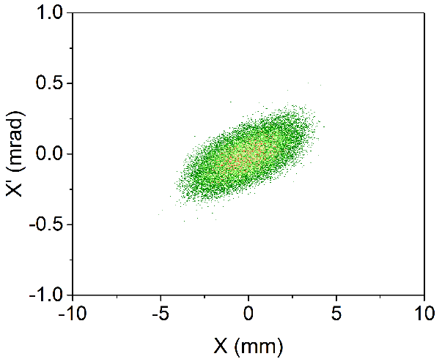
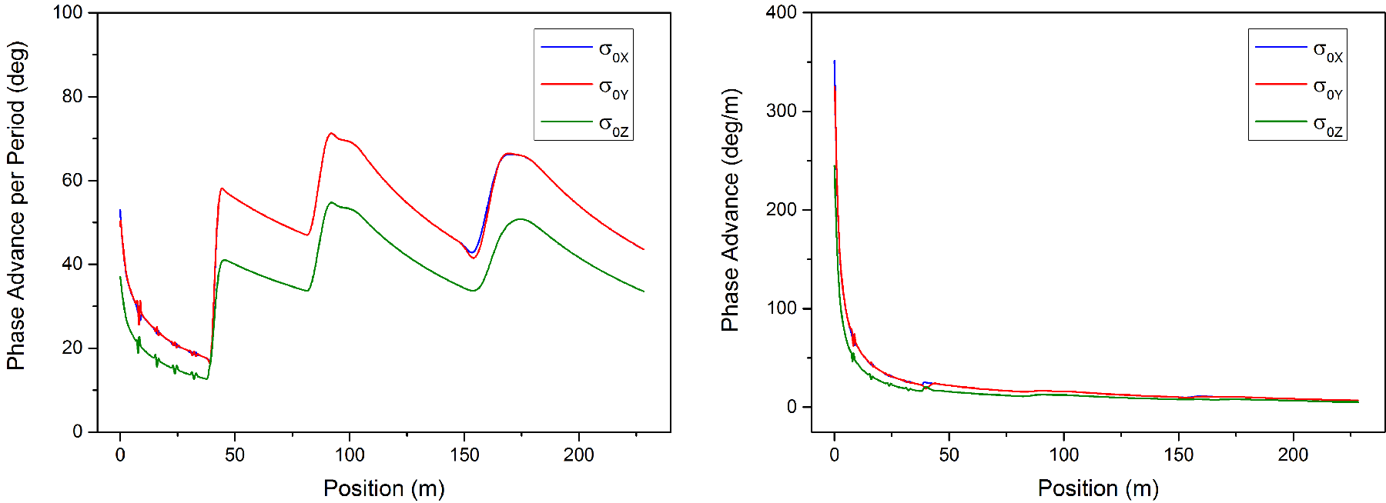
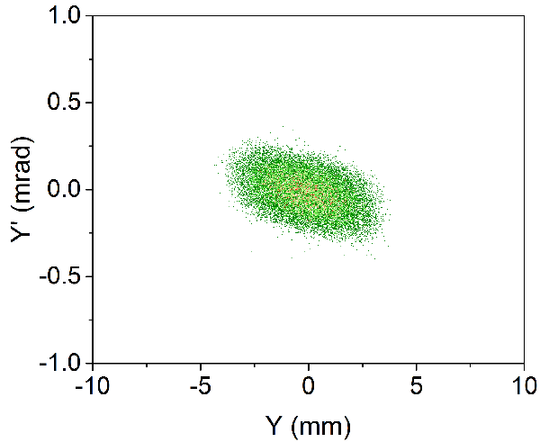
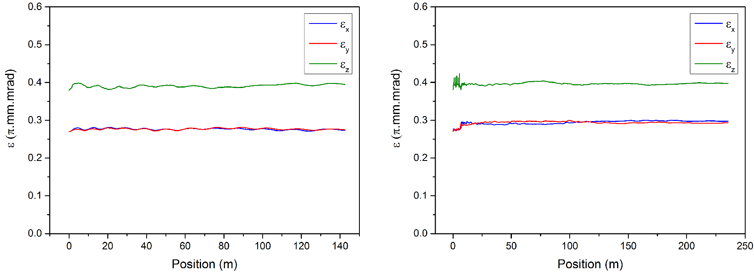
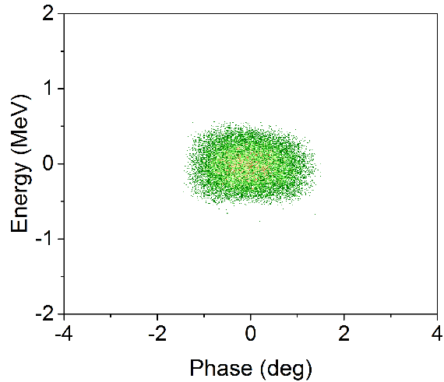
800 MeV Linac

Slide 27
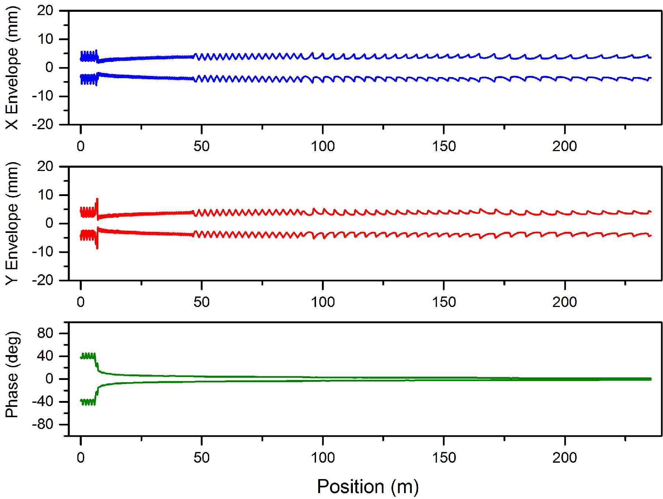
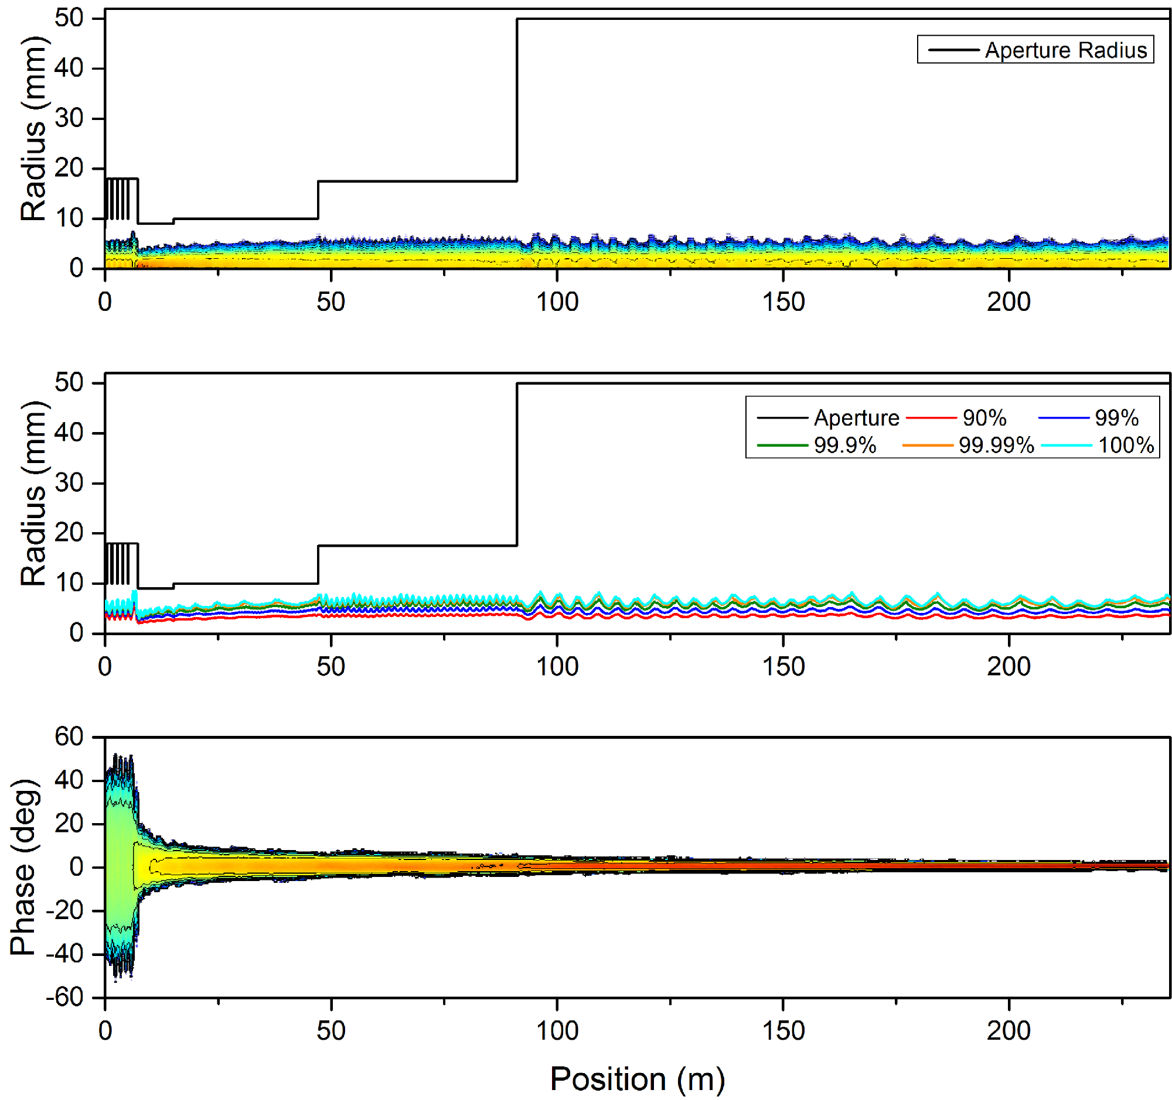
800 MeV Linac

Slide 28
Conclusions
Can the accelerating gradient be increased?
Current machine: No/Maybe* - Tank4
Upgrade machines: Yes
Can the beam current be increased?
Current machine: Yes
Upgrade machines: Yes
Can the beam energy be increased?
Current machine: No/Maybe* - Tank4
Upgrade machines: Yes

