Slide 1
H⁻ Stripping.
D. Raparia
Brookhaven National Laboratory
Upton, NY, USA
Upgrading Existing High Power Proton Linac
ESS, Lund, Sweden
November 8-9, 21016

Slide 2
Outlines
Introduction
Physical Processes
- Striping by Residual gas
- Stripping by Foil
Field Stripping
- Stripping by Magnetic/Electrical fields
- Intra Beam Stripping
- Stripping by Back Body Radiation
Use of Stripped Electrons
Conclusions

Slide 3
H- Ion
e
P
e
Hydrogen atom with an extra electron
H⁻ , first electron binding energy 13.6 eV, second loosely bound 0.75 eV
H⁻ generated with ion source generally with help of Cs

Slide 4
Why H- ?
Circulating H+
In 1966 Budker proposed to increase Intensity in the circular accelerators by charge exchange by stacking multiple turns of ions into the same physical space
Stripping foil
Injected H-
-G. I. Budker, et al,`` Experimental study of Charge Exchange injection” 1966
-D. Raparia, et al,`` Efficient Capture of 20,000 Turn from TRIUMF”, IEEE Tran. Nucl. Sci. NS -32, 2456,1985
-D. Raparia, `` Estimate of the Number of Foil Hit for Charge Exchange Injection”, PAC 2011
Megnetron Ion Source, 100 mA @ 35 keV

Slide 5
Why H- ? (Physicist)
To beat the Liouville theorem while injection to a ring
which state: “The particle density in the phase space is constant in conservative forces “
Liouville’s can be circumvented by use of dissipative forces e.g. to strip an H- beam with a foil and merge it with a proton beam. The interaction with foil is the dissipative force.

Slide 6
Why H- ? (Engineer)
P circulating and P injection
Either come out with the same
Angle at different positions, or
At the same position with
different angle=> emittance
growth
Magnet
r’
r’
r
r

Slide 7
Why H- (Engineer)
P circulating , H- injection
H-
p
Both beam at the same
position and angle,
No emittance growth
Foil
r’
r

Slide 8
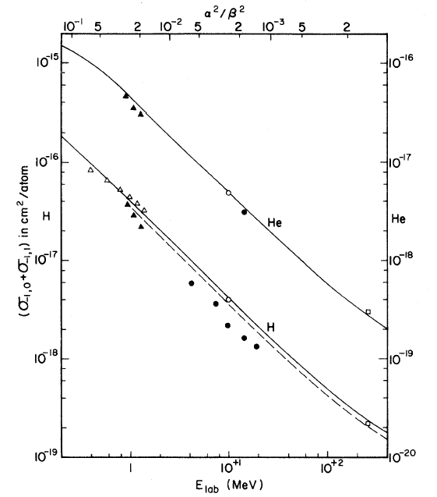
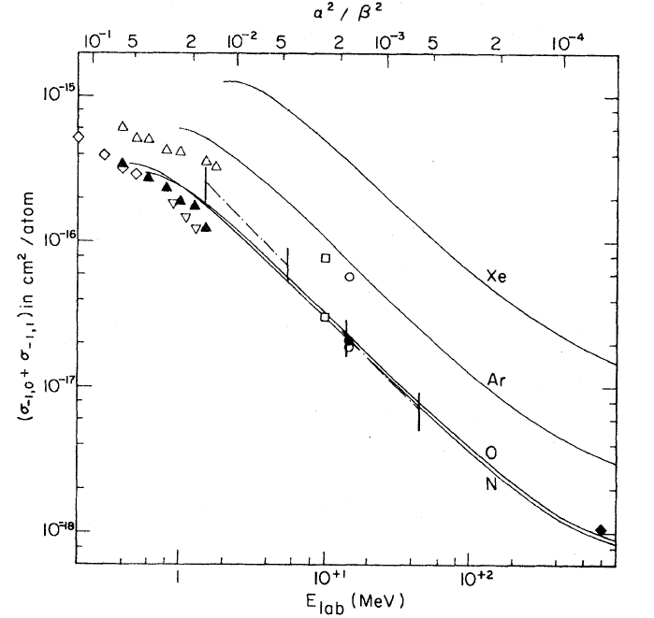
Residual Gas Stripping
Total electron cross section ,single (H⁻ to H⁰) and double (H⁻ to H⁺) stripping ( ~1/β²)
Up tp 10 MeV
G. H. Gillespie
Phy. Rev. A 15
563 (1977)
G. H.. Gillespie
Phy. Rev. A 16
943 (1977)

Slide 9
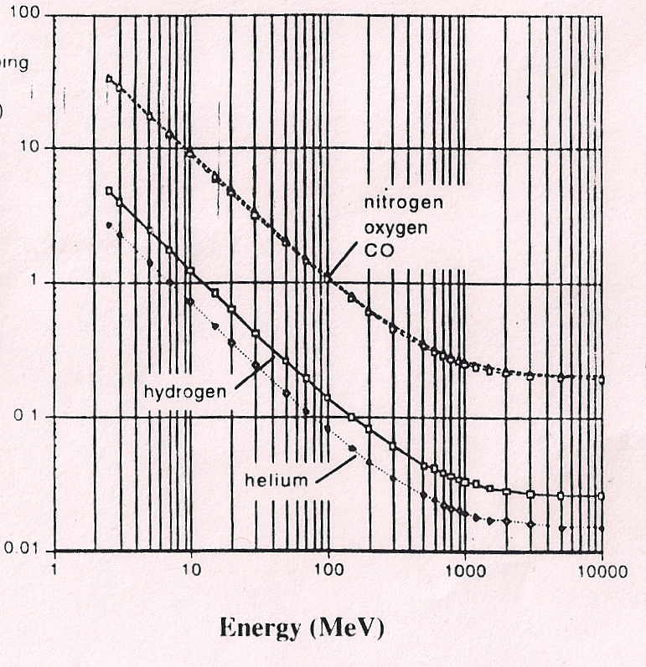
Residual gas stripping (cont..)
Y scale: Arb. unit
P: 10⁻⁸ Torr(H₂)
Life time of H-
Frac_loss/m
n_{i}(cm³)=3.3 .10^{16.} P(torr)
Total measured electron loss cross section for H⁻ (unit 10⁻¹⁸ cm²)
E (MeV) | H | N | O | AR | Xe
0.035 | 773 | 1490 |  | 1760 | 4180
10 | 2.1 | 30.7 | 32 | 83 | 500
400 | 0.2
800 |  | 1 |  | 3

Slide 10
Residual gas stripping (cont..)
Double stripping has highest probability at low energies and capture into RF bucket and transported to higher energies specially in magnetic LEBT.
Seen at BNL, LANL, J-PARC
Can be avoided to accelerate to higher energies by dipole ( LEBT, BNL), chicane (MEBT, J-PARC), Frequency Jump (SNS) ….

Slide 11
H- Space Charge Neutralization and Stripping in magnetic LEBT
To overcome the space charge forces, magnetic LEBT utilized space charge neutralization be residual gas ions.
During the charge neutralization of the beam, space charge forces changes, resulting change in beam size, matching condition at the following section of accelerator and transmission through the accelerator are continuously changes until beam reached an equilibrium state .
Neutralization time is inversely proportional to residual gas pressure and stripping losses are directly proportional. These are competitive processes, has to be optimized case by case bases.

Slide 12
H- Stripping and Neutralization (cont..)
Left Triangular are represents
Losses due to Neutralization.
Top rectangular are represent
Losses due to the stripping
Total losses due to stripping
And neutralization as function
Of residual gas pressure for
200 cm long LEBT and 500 us
long beam pulse length.

Slide 13
SNS and ESS
Parameter SNS ESS ratio
Power (MW) 1 5 5
Energy (GeV) 1 2 2
Ave. Cur (mA) 1 2.5 2.5
Peak Cur (mA) 33 62.5 1.89
Freq. (MHz) 402.5 352.2 1.14
N (micro Bunch) 3.05e8 7.19e8 2.36
β 0.87 0.95 1.09
γ 2.06 3.13 1.52
βγ 1.79 2.97 1.65
β⁴ γ² 2.43 7.98 3.28
Dose rate (mrem/h) ~ 0.33*(E(MeV)-9)^{1.8} /E (for Cu)

Slide 14
Gas stripping
SNS ESS
mrem/h mrem/h
(x1E-2) (x1E-2)
0-90 MeV 0-10 0-25
90-186MeV 10-20 0.25-0.5
186-1000 MeV 0.02-0.81 0.05-2.025
1000-2000 MeV - 2.025-3.58
HEBT 81.0 358.00

Slide 15
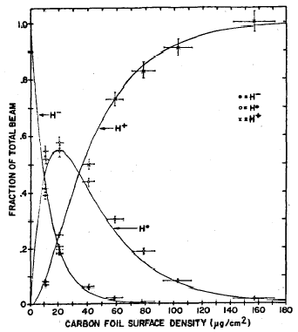
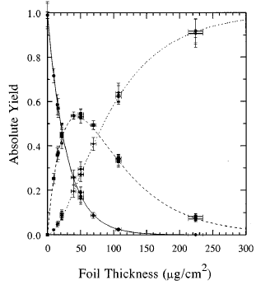
Foil stripping, Carbon foil efficiencies
Webber & Hojvat, 1979
200 MeV
Gulley et al., 1996
800 MeV
H⁺
H⁺
H⁻
H⁻
H⁰
H⁰

Slide 16
Stripping Cross Section
800 MeV 200 MeV 2000 MeV
(10⁻¹⁸ cm²)
σ(−, 0) 0.676±0.009 1.56±0.14 0.529
σ(0, +) 0.264±0.005 0.60±0.10 0.500
σ(−, +) 0.012±0.00 −0.08 ±0.13 0.009
(scale)

Slide 17

Foil Issues
Foil issues: Assuming Carbon Foil SNS ESS
  Stripping efficiencies : (~1/β²) 300 μg/cm² 345 μg/cm²
  Multiple Coulomb scattering (~1/γ²β⁴) 15e-6 Rad 4.57E-6 Rad
  Large angle and Nuclear scattering(β²) 4.25E-6 Rad 5.0E-6 Rad
  Energy straggling (~1/β²) 840 eV 705E-6 eV
  NT 1060 550
  Acceptance 160 300
  Emittance(N, RMS) 0.25 0.25
  Ave. Number foil hit 7 2
  Heating 1100 <800
  Stress and buckling
  Lifetime more SNS
  Radiation 1000mrem/h 1380mrem/h
  Stripped Electron
  Emittance Growth

Slide 18
Magnetic Field Stripping
When H- move in the transverse magnetic filed B it experiences a Lorentz force that band the trajectory and also tends to break it up since protons an electron are bent in the opposite direction and the binding energy of second electron only 0.755eV.
Due to quantum mechanical nature , the breakup is a probabilistic process. In the ion rest frame, stripping force is electric field E that is the Lorentz-transform of the transverse magnetic field B in the lab frame
E [MV/m]=319.7 p(GeV/c]B[T]
=542 MV/m for T=1 GeV H-, B=1 T

Slide 19
Field Stripping (cont.)
Life time ( Scherk’s formula Can J. Phys.v. 57, p. 558 (1979):
Frac. Loss
Plot from M. Plum

Slide 20
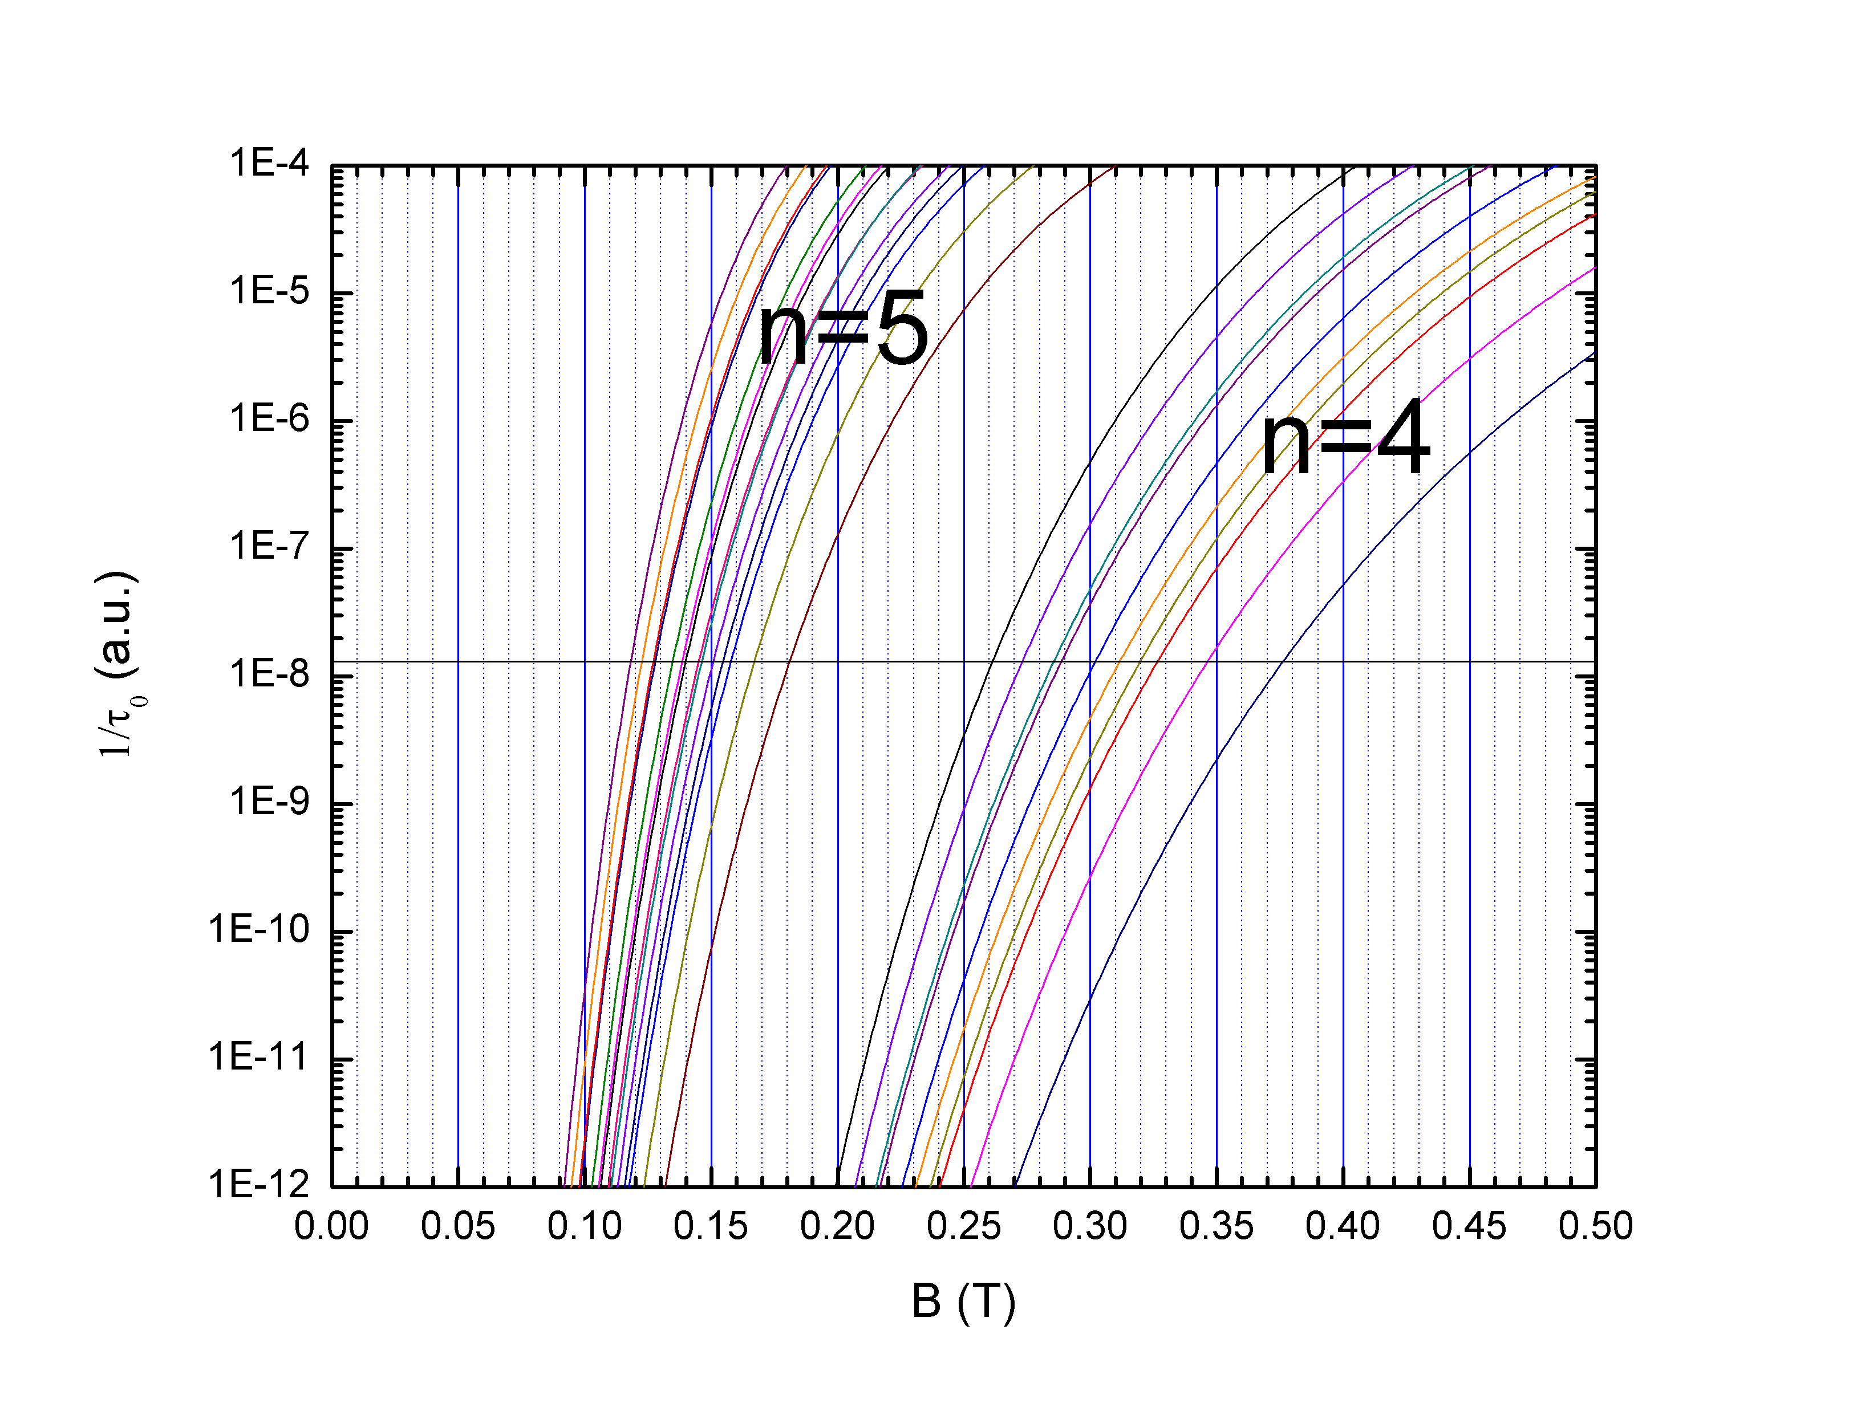
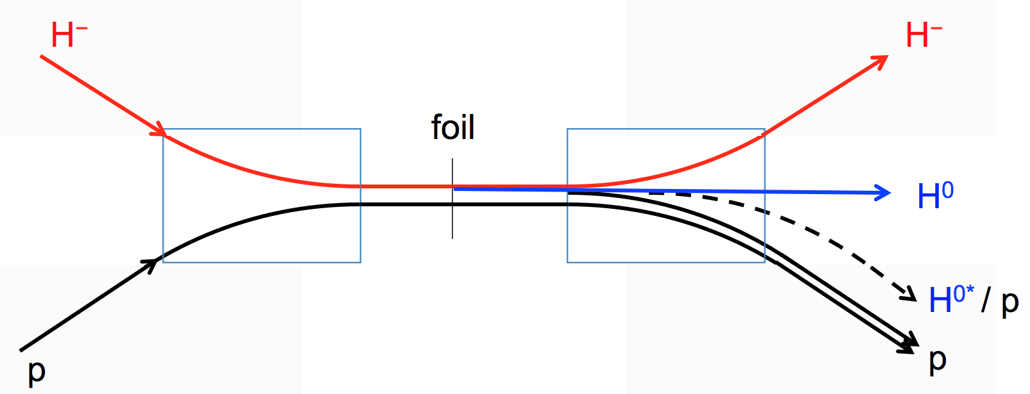
Life time of Stark States
the H⁰ from stripper foil will in different energy level. In the electric filed (Lorentz transform magnetic field), each energy level n of H⁰ split into n(n+1)/2 Stark State
Life time of these state can be calculated, and is dependent of particle energy and magnetic field. Generally >5 state will strip near foil, <2 state won’t stripped.
H^{0*} stripping at 1.0 GeV
Plot from T. Gorlov
Peak field in chicane #3 = 0.14 T
Field at foil = 0.175 T

Slide 21
Blackbody Radiation Striping
During Project X design, it was discover at very high energy (> 4 GeV) Doppler shifted black body radiation will cause H- stripping.
photon distribution
cross section
Plot from W. Chou
0.75 eV

Slide 22
Blackbody Radiation Stripping (cont…)
Energy Dependence
Temperature Dependence
At 305 K (90 F) and 8 GeV, H⁻ loss rate = 0.8 × 10⁻⁶ m⁻¹
Below 4 GeV H- stripping losses are negligible.
Cooling of the beam pipe can reduce losses order of magnitude.
Courtesy of W. Chou

Slide 23
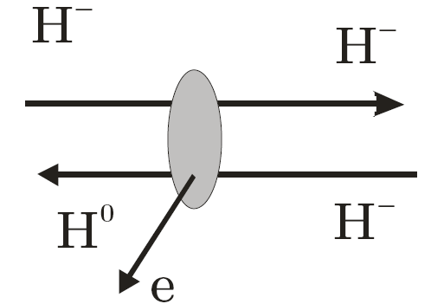
Intra Beam stripping
First observed in LEAR (Chanel,1987 σ=3.6 ±1 x10⁻¹⁵ cm²).
Unexpected loss and activation were discover during SNS power ramp up. V. Lebedev explained, the losses is due to intra beam stripping.
Binary collision inside an H- micro-bunch result in stripping one of their electron and subsequent particle loss. Particle loss rate is proportional to intra beam stripping cross section and square of number of particle in the micro bunch.

Slide 24
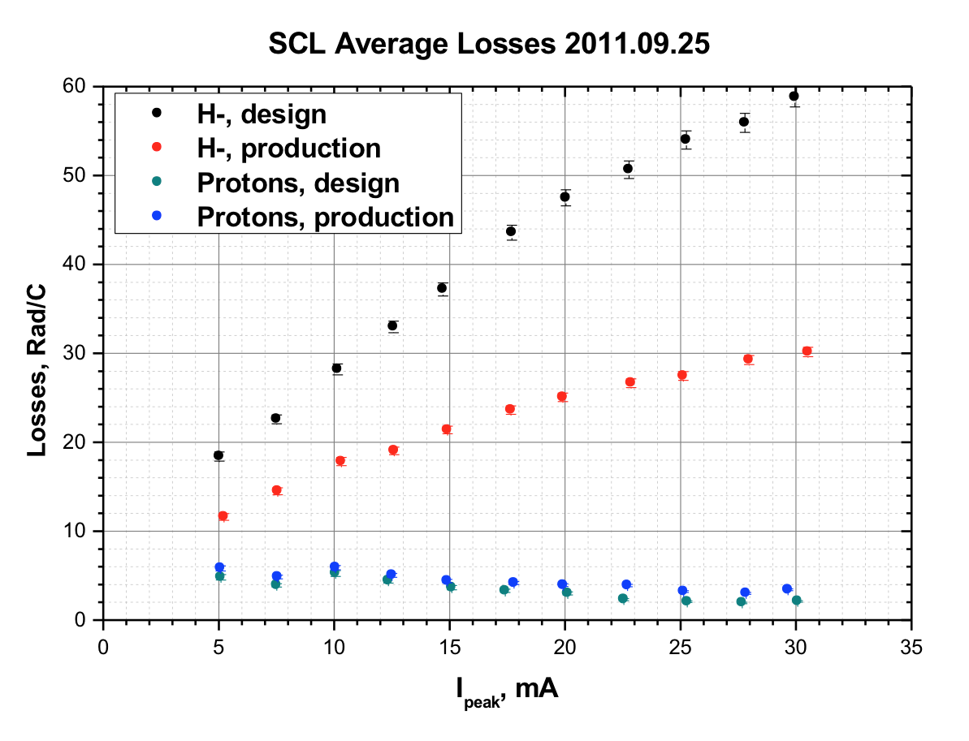
SNS SCL losses vs. Peak Current
H-, strong focusing optics
H-, week focusing optics
Proton, strong & week focusing optics
H- beam was stripped by foil after RFQ and match to linac by quads in MEBT for proton run for this comparison.
First Observation of Intrabeam Stripping of Negative Hydrogen in a Superconducting Linear Accelerator,” A.Shishlo, J. Galambos, A. Aleksandrov, V. Lebedev, and M. Plum, Phys Rev Letters 108, 114801 (2012).

Slide 25
Intra Beam Stripping Mitigations
V. Lebedev et al.
Decreasing the particle density in the phase space
- reducing the frequency (almost linear effect)
- reducing the transverse phase advance per meter to a limit (to compensate RF and space charge defocusing)

Slide 26
Example ESS
N_{ESS}/N_{SNS}= 2.36 (micro bunch)
V_{ESS}/V_{SNS}= 1.49 (assuming same emittance)
θ_{x,y,z(ESS)}/θ_{x,y,z(SNS)}= 0.84 (assuming same emittance)
Loss Factor ~ 3.5
SNS losses 0.05-0.17 nA => 1 – 13 mrem/h
=>ESS Losses =0.18-0.6 nA =>3.8- 85.9 mrem/h

Slide 27
SNS Activation
SNS to ESS
Intensity Factor 2.5
Energy Factor 1.4
IBS Factor 3.5

Slide 28
Uses of stripped electron and H⁰
Profile measurement in three dimension
Emittance measurement in all three dimension
Energy measurement
Energy spread measurement
Space charge potential ( current density) measurement
H- current measurement

Slide 29
Conclusions
H- injection into the ring outweighs all the stripping issues in the linac and transport line.
During last decade Intra beam stripping and black body radiation stripped were identify as topics should be consider during design.
H- stripping has not limited the performance of linac yet.
Use of stripped electron can be explore more.

Slide 30
Backup slides

Slide 31
2010: Profile measurement By LPM at HEBT
Vertical
Horizontal

Slide 32
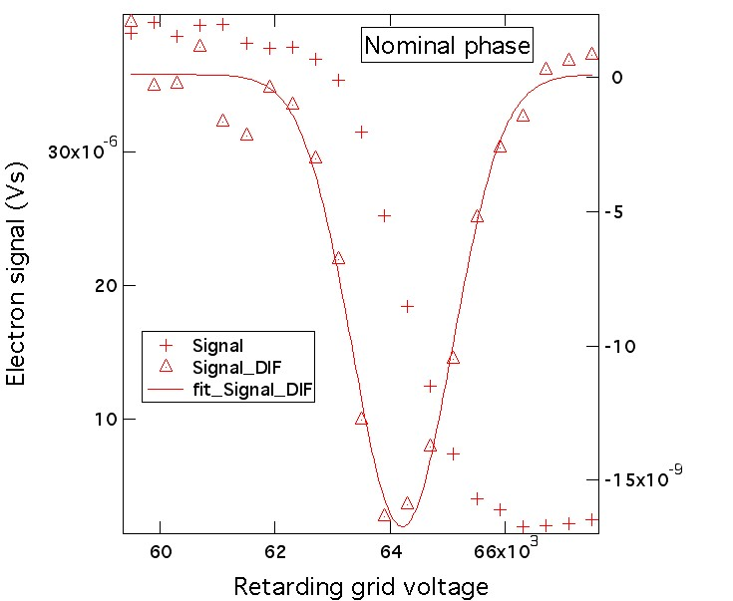
Energy Scan
A Gaussian is fitted to the derivative of the signal vs. grid voltage data. The center (64.2kV) is the average electron energy from the beam motion and the width (σ=0.87kV) is from beam-energy spread and from the space-charge potential spread. The proton energy is m_{p}/m_{e}=1836 times the measured electron energy:
E_{p} = 118 MeV
σ_{p} = 1.6 MeV
Measured electron energy verse time in the pulse
0.6% drop in the energy during 0.5 ms beam pulse

Slide 33
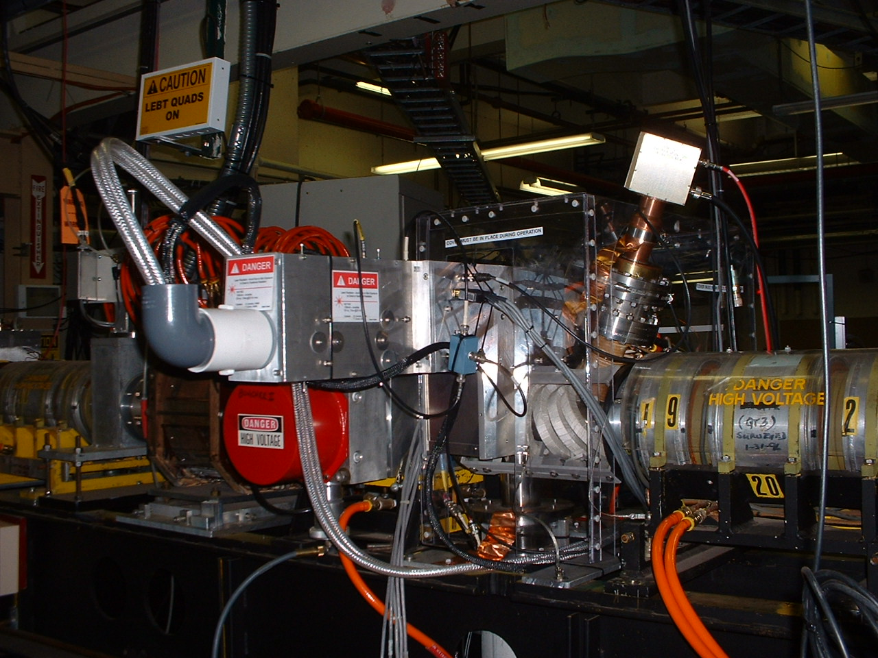
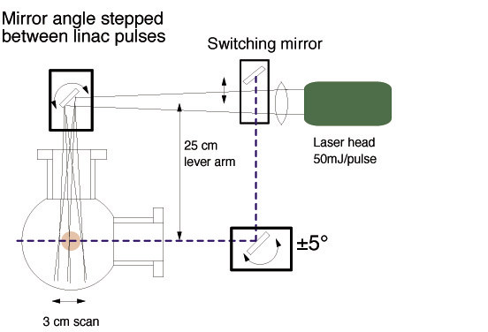
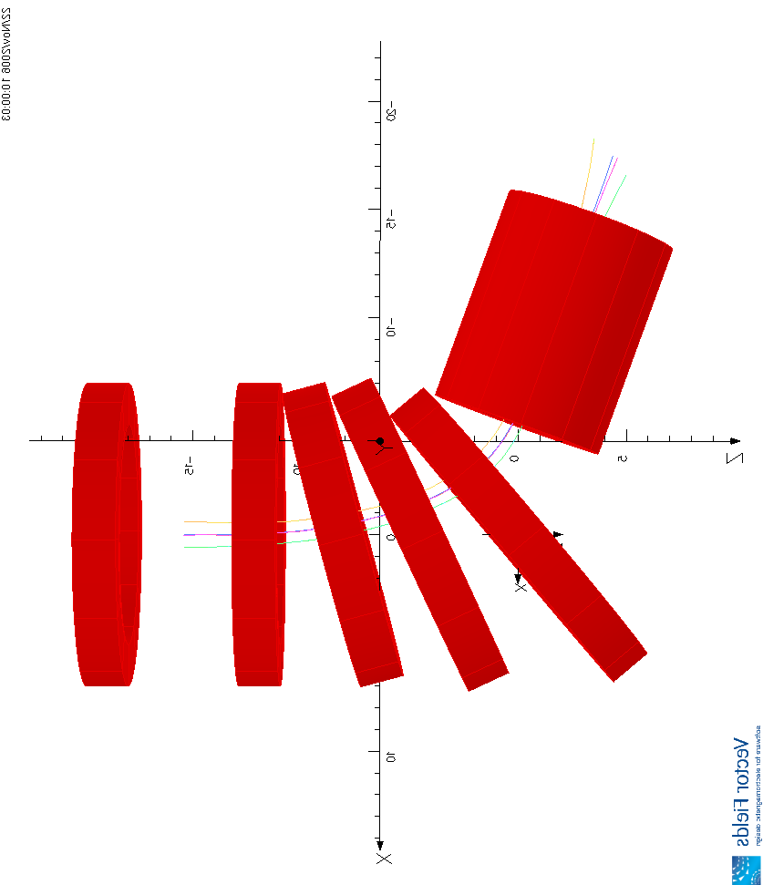
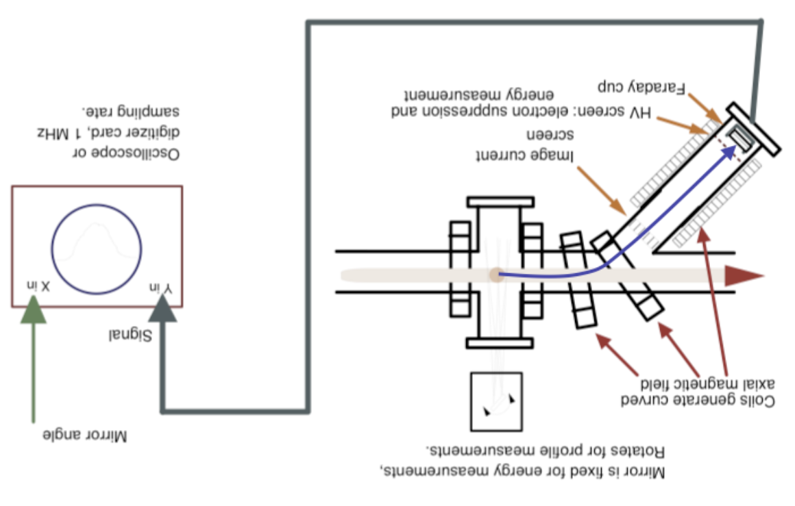
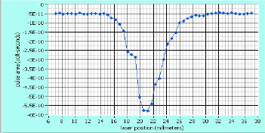
Profile Measurement
Nd:YAG (λ=1064nm)
Transverse Optical System
Labview
H- Beam profile
e from H- are guided by magnetic field
Solenoid Magnetic Field

Slide 34
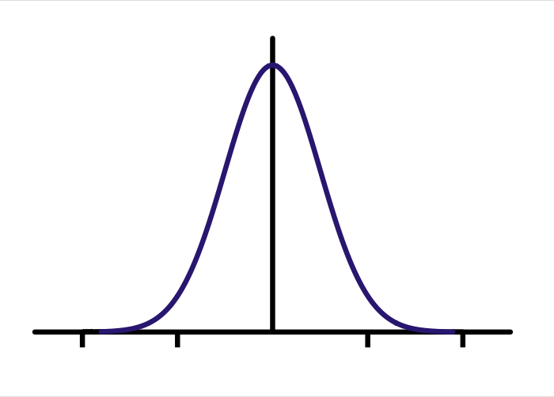
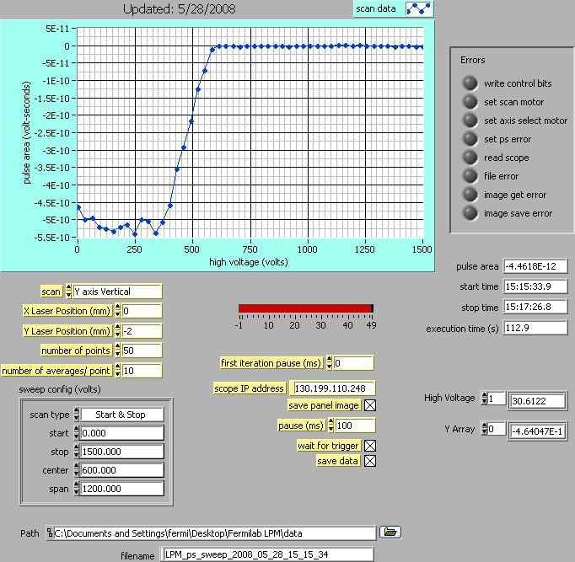
Space Charge Potential DC Beam
T_{e} =T_{e0}+ ϕ
a_{x}=13.5, a_{y}=7.0 mm,
b_{x}=b_{y}= 38 mm
R=(x+y)/2=10.25 mm
V₀(70mA) ~ 200 V
T_{e}=408+200 =~600 V
ϕ
r
E_{e0}=7.5.10⁵/1838
=408 V

Slide 35
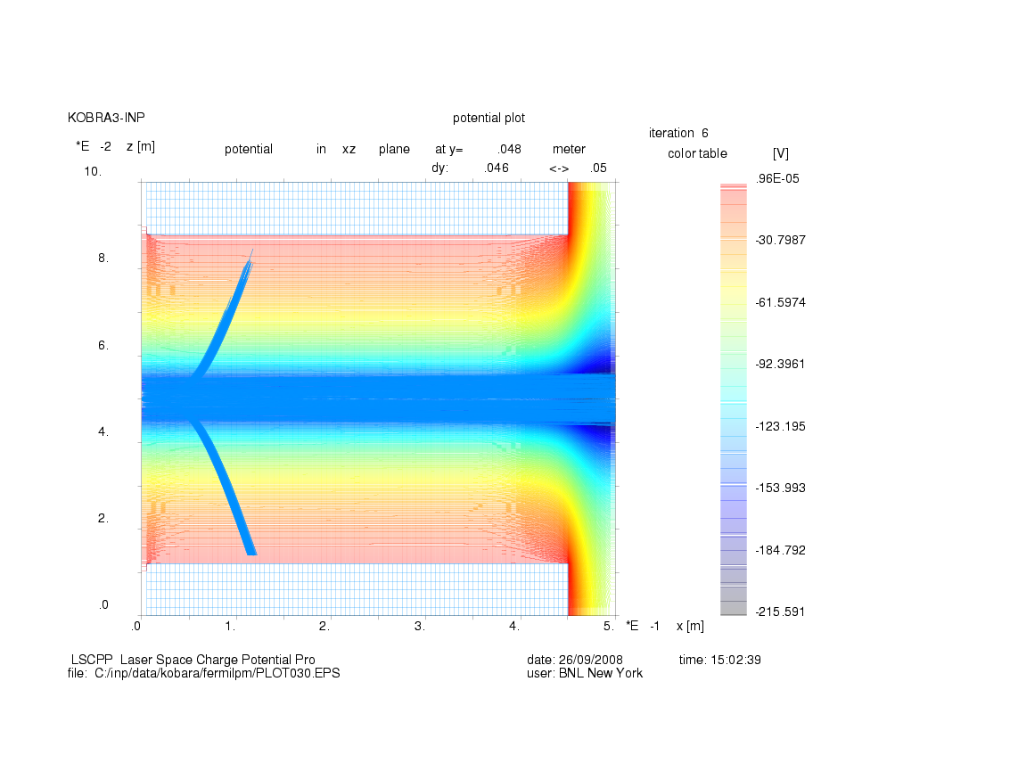
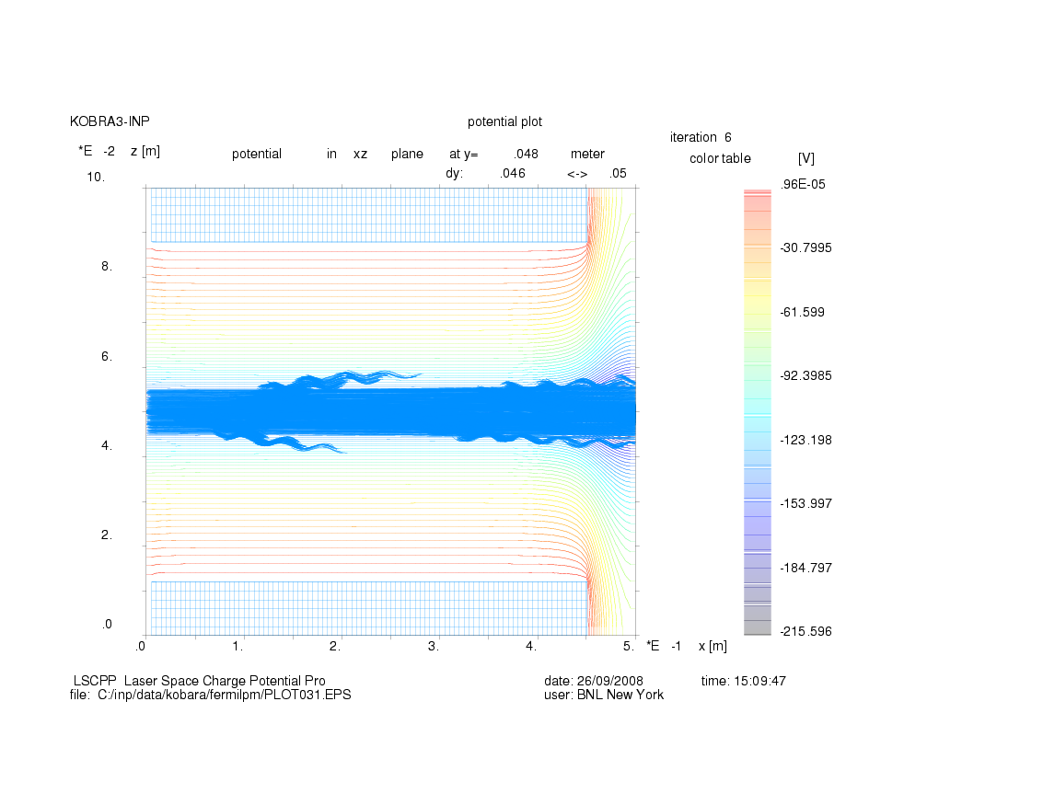
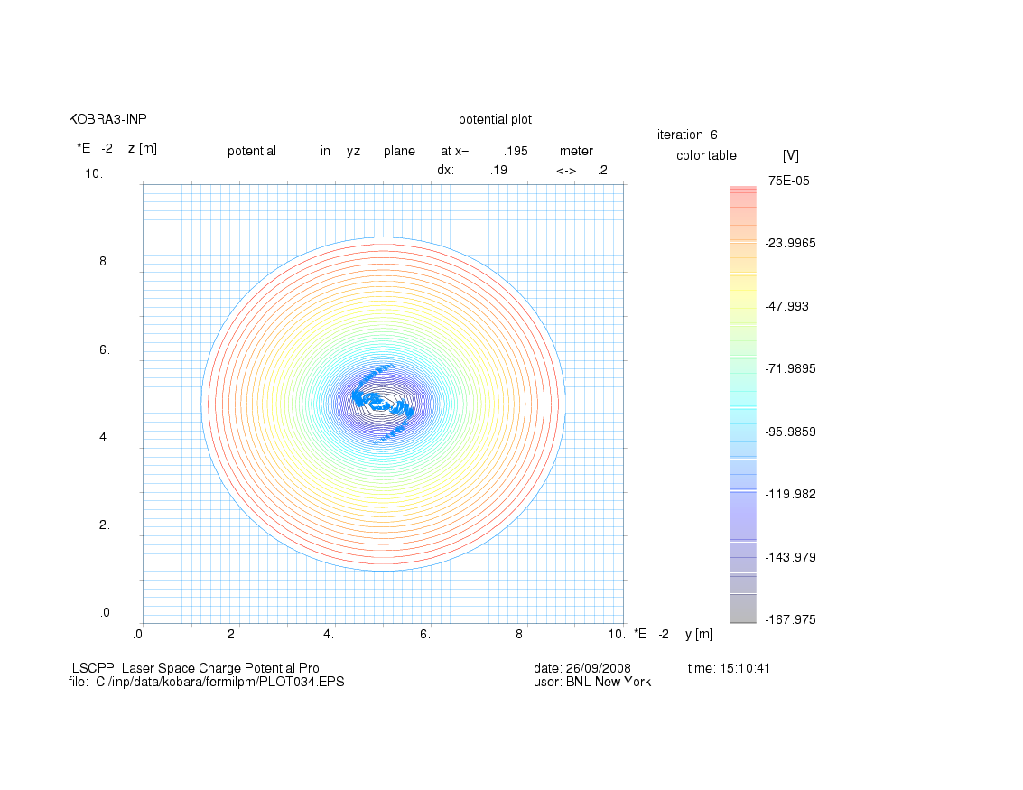
KOBRA Simulations
X-Z Plane
Axial Mag. Field =0
X-Z Plane
Axial Mag. Field =100G
X-Y Plane; Axial Mag. Field =100G

Slide 36
SCP Bunched Beam
Electric Field due to uniform ellipsoid
X-Z Plane
E_{H-} = 750,000 eV
ΔE_{H-}=±20,000 eV
E_{e} = 408 eV
ΔE_{e} =±10.9 eV
SCP Potential in X-Z Plane
LASER

Slide 37
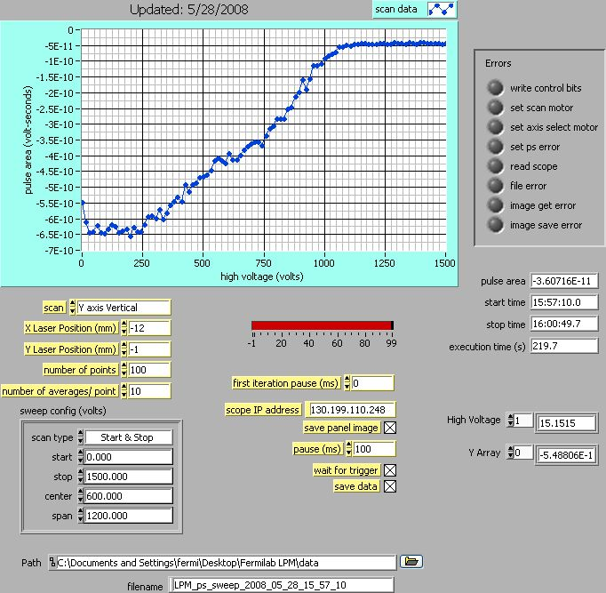
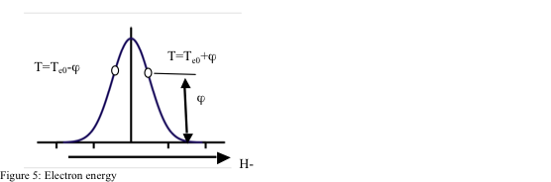
Buncher ON, Full Current

Slide 38
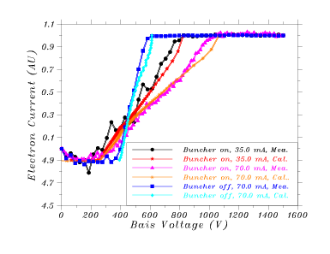

Slide 39
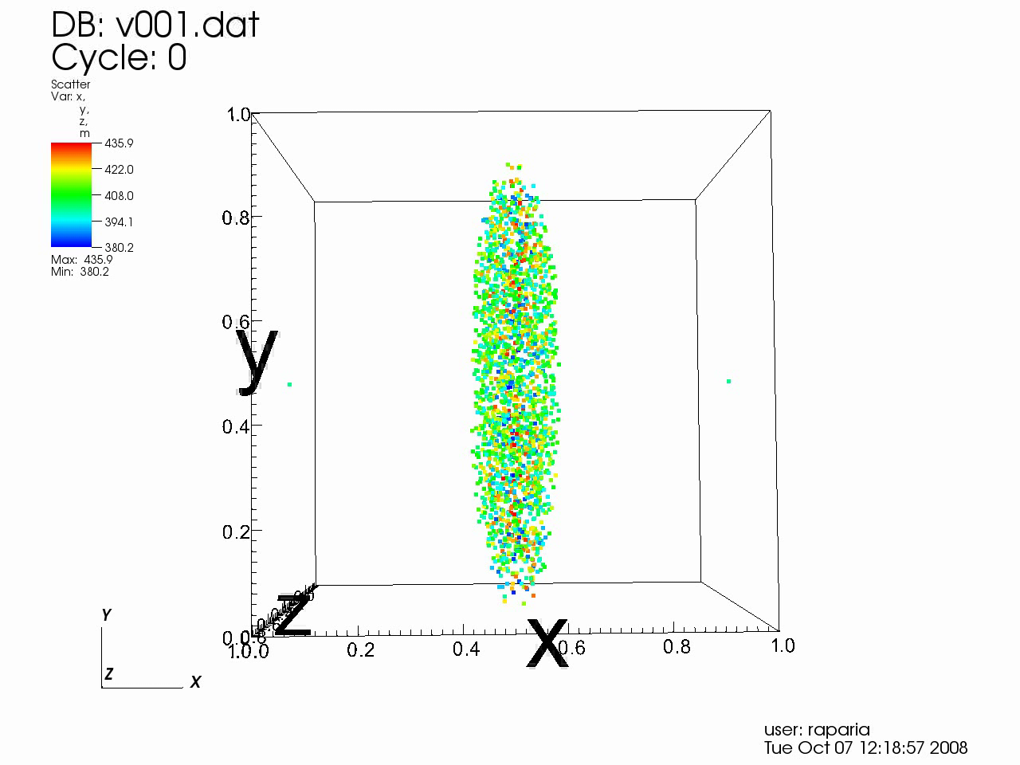
Stripped Electrons in H- Bunch

Slide 40
Energy Measurement
At low energies (ΔE(m_{e}/m_{p}) << SCP)
- Space Charge Potential (SCP)
- Bunch Length and Bunching Factor
At high (Δ E(m_{e}/m_{p}) >> SCP)
- Energy Spread (ΔE)

