Slide 1
Applications to Particle Physics
Lecture at the Nordic Particle Accelerator School 2016
August 2016, Lund, Sweden
Erik Adli
Department of Physics, University of Oslo, Norway
Erik.Adli@fys.uio.no

Slide 2
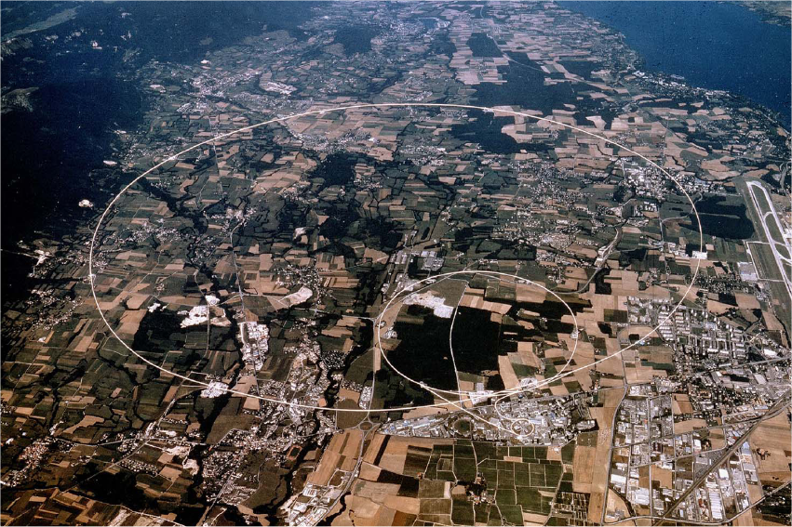
The 27 km LHC at CERN

Slide 3
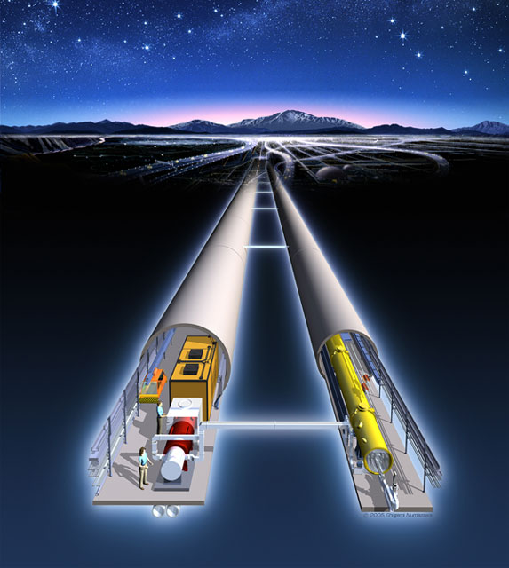
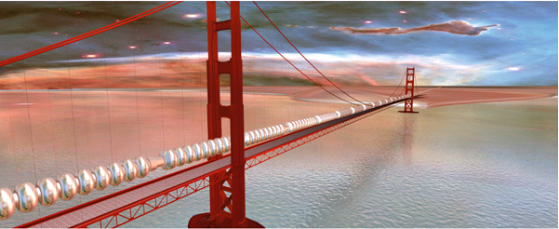
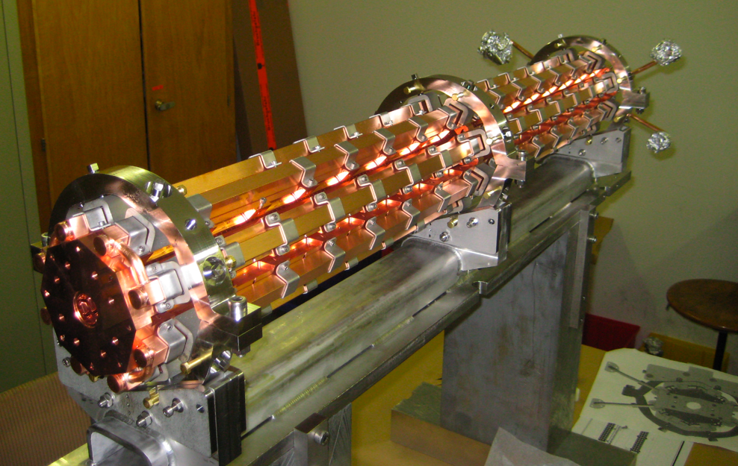
Future colliders
The next big thing? After LHC, high energy, high luminosity, Linear Colliders of several 10 km of length have been proposed – why?

Slide 4
Particle physics

Slide 5
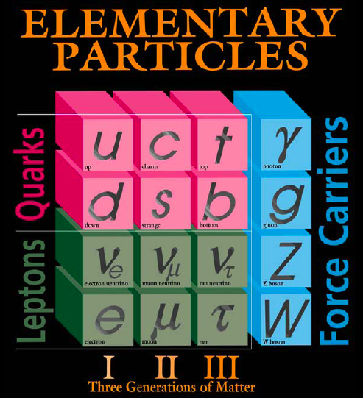
10⁻¹⁸ = 0.000000000000000001
Materiens bestanddeler
meter
10⁻¹⁰
10⁻¹⁴
10⁻¹⁵
10⁻¹⁸
Particle physics: study of fundamental particles and forces (as opposed to atomic physics, nuclear physics, chemistry, material sciences ….)
The Standard Model
of particle physics :
Mathematically consistent framework modeling the world as 3 families of matter particles, plus force carries.

Slide 6
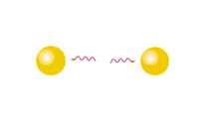
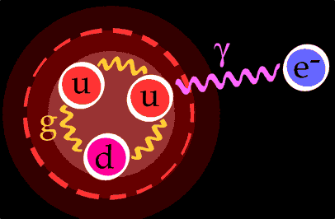

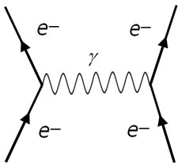
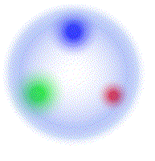

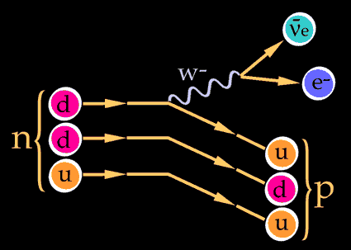
Example of matter and forces, according to the Standard Model
e-
e-
Matter and forces of nature are modeled as particles.
Hydrogen atom
More exotic (and unstable) particles
K- (kaon)
"Feynman diagram"
Beta decay
Proton

Slide 7
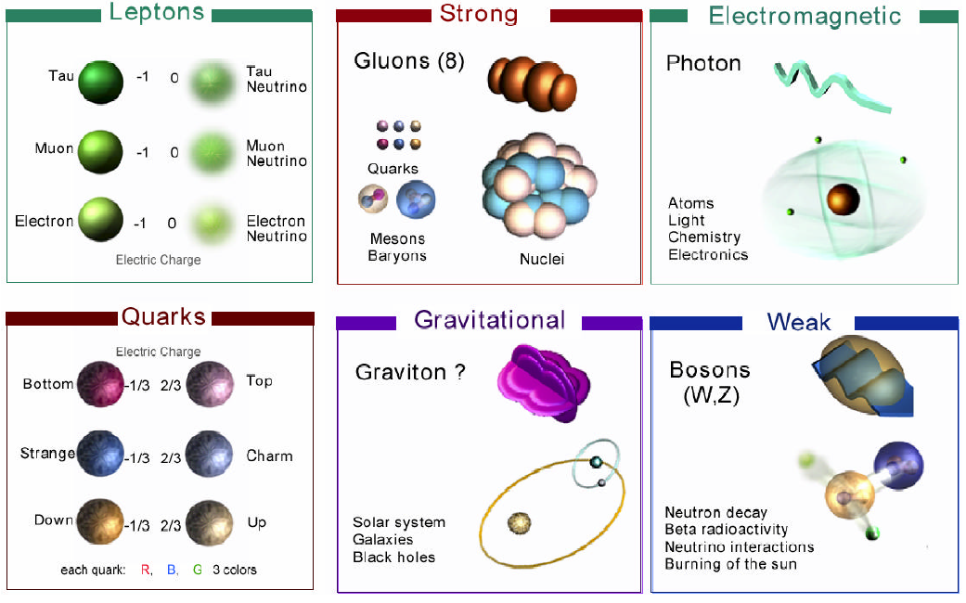
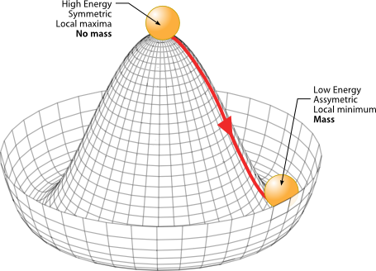
The final piece of the Standard Model, the Higgs Boson, was discovered by the particle collider LHC in 2012.
+ The Higgs Boson

Slide 8
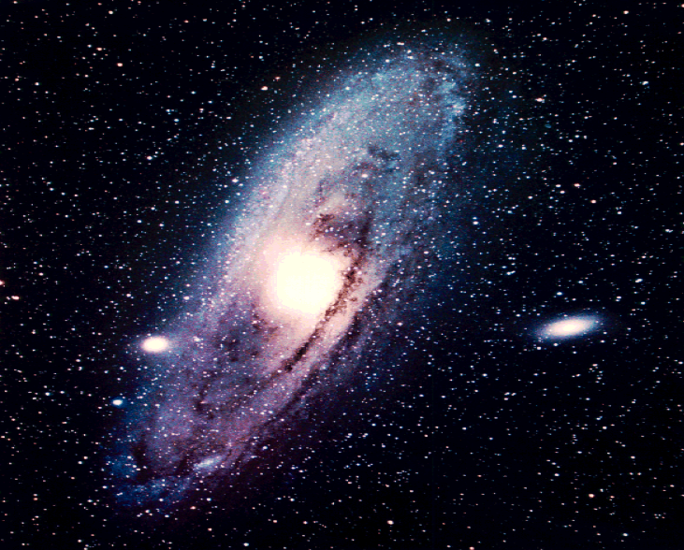
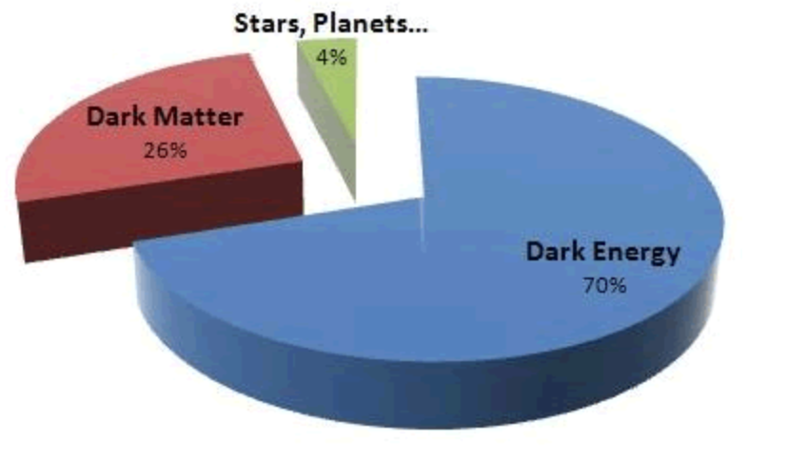
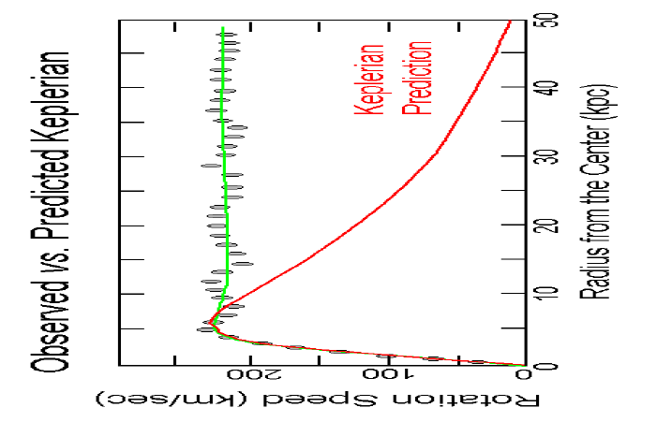
We are far from understanding the universe

Slide 9


Vi vet egentlig ingenting!
Many open questions
Why three families? Anti-matter?
Dark matter, does super symmetry exist?
Nature of neutrinos?
We will need high-energy physics experiments for a long time to come!
Can we unify the description of the forces?

Slide 10
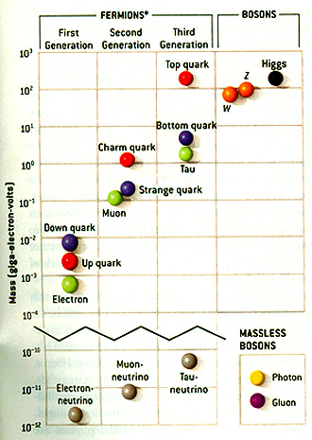
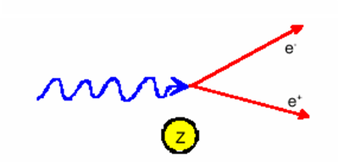
Requirements: Energy
2012
Energy requirement for pair production:
E_{photon} = 2m_{e}c² + E_{k}
1996
2012
1983
1974
1977
~1975
(1968)
Colliders: Heavy particles ⇒ more energetic collisions are required.
E_{CM} >= mc²
1936
1968
Year : Accelerator discovery
Year : Non-accelerator discovery
Probe wavelength: Particles are waves. Wavelength of probe should be smaller than the object you want to study. De Broglie wavelength :
1897
λ = h / p
1962
2000
1956
(~ 1 Å for 100 MeV e-)

Slide 11
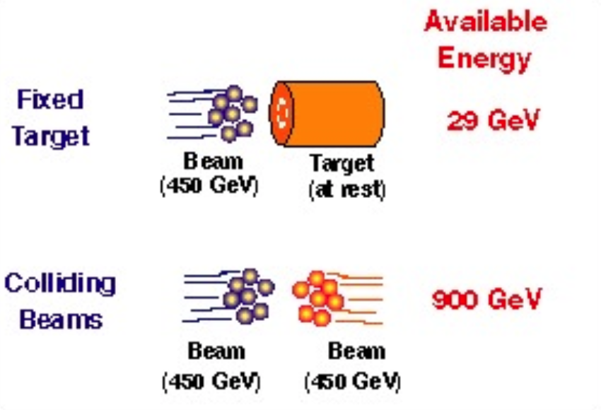
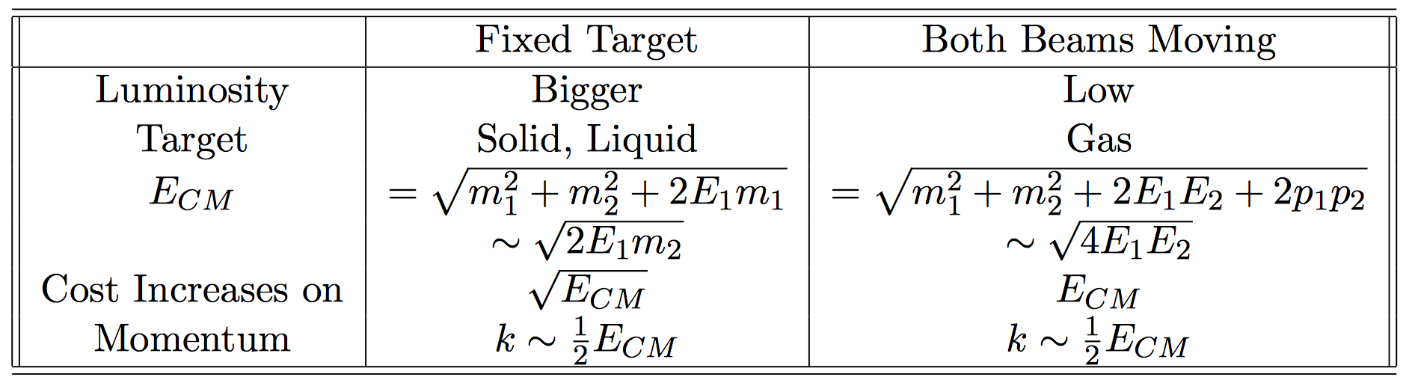
Energy : fixed target versus colliding beams
Colliding beams are needed in order to reach the highest center of mass energies.

Slide 12
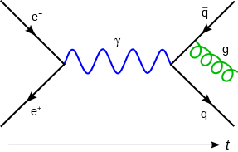
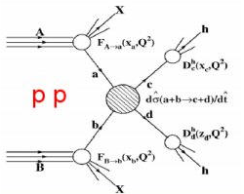
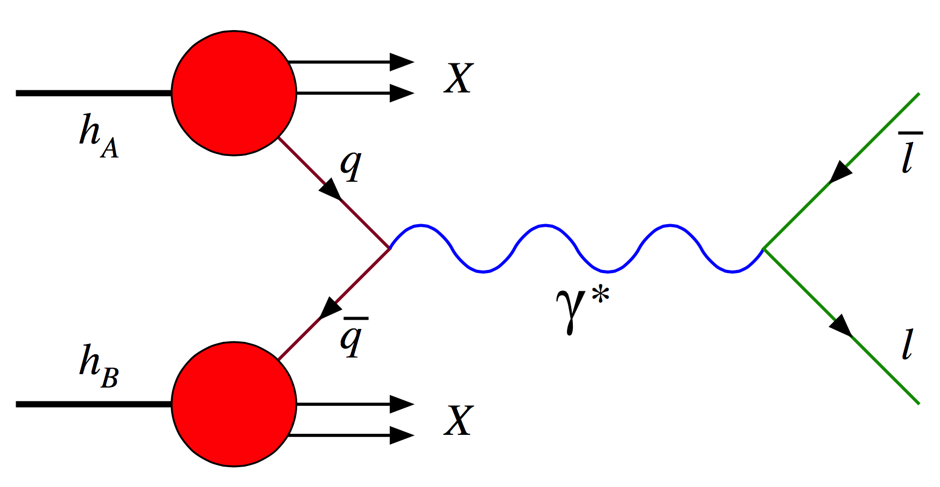
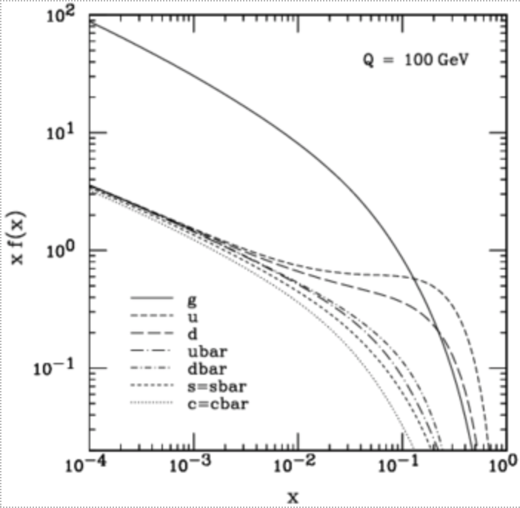
Requirements: particle type
Hadron production from
lepton collisions
Lepton collisions: elementary particles (leptons, muons…)
  Collision process, and initial state known
  Well defined energy
  Lepton collisions ⇒ precision measurement
Hadron collisions: compound particles (protons, ions…)
  Mix of quarks, anti-quarks and gluons: variety of processes
  Parton energy spread
  Hadron collisions ⇒ large discovery range
Lepton production from hadron collisions
  “If you know what to look for, collide leptons, if not collide hadrons”

Slide 13
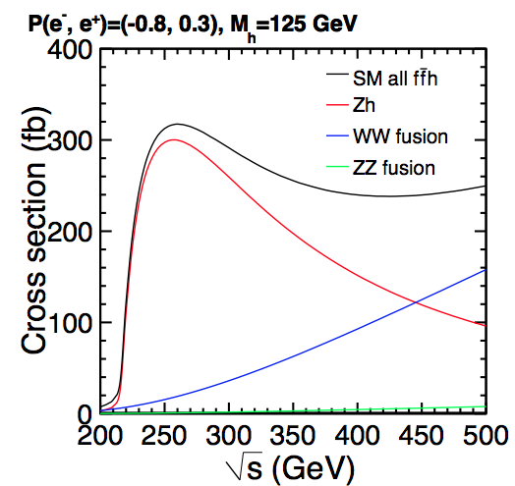
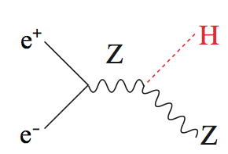

Requirements: luminosity
High energy is not enough, production rate are as important, because the events we are looking for are rare.
The probability for particle physics processes to occur are quantified by “cross section”, σ, an area, with units in “barns”, b = 10⁻²⁸ m^{2.}
The higher the cross section, and the more collisions per second, the higher reaction rate R for a given process is :
The proportional factor, L, called the luminosity [cm⁻²s⁻¹], depends on the colliding beam parameters as :
  n₁, n₂ :particles per bunch
  σ_{x}, σ_{y :} bunch transverse size at the interaction point
  f: bunch collision rate

Slide 14
Main parameters characterizing a high-energy physics accelerator
Particle type
Energy spectrum
Emittance
Focusing
Charge per time
Time structure
…
Luminosity

Slide 15
Review of some basic accelerator concepts

Slide 16
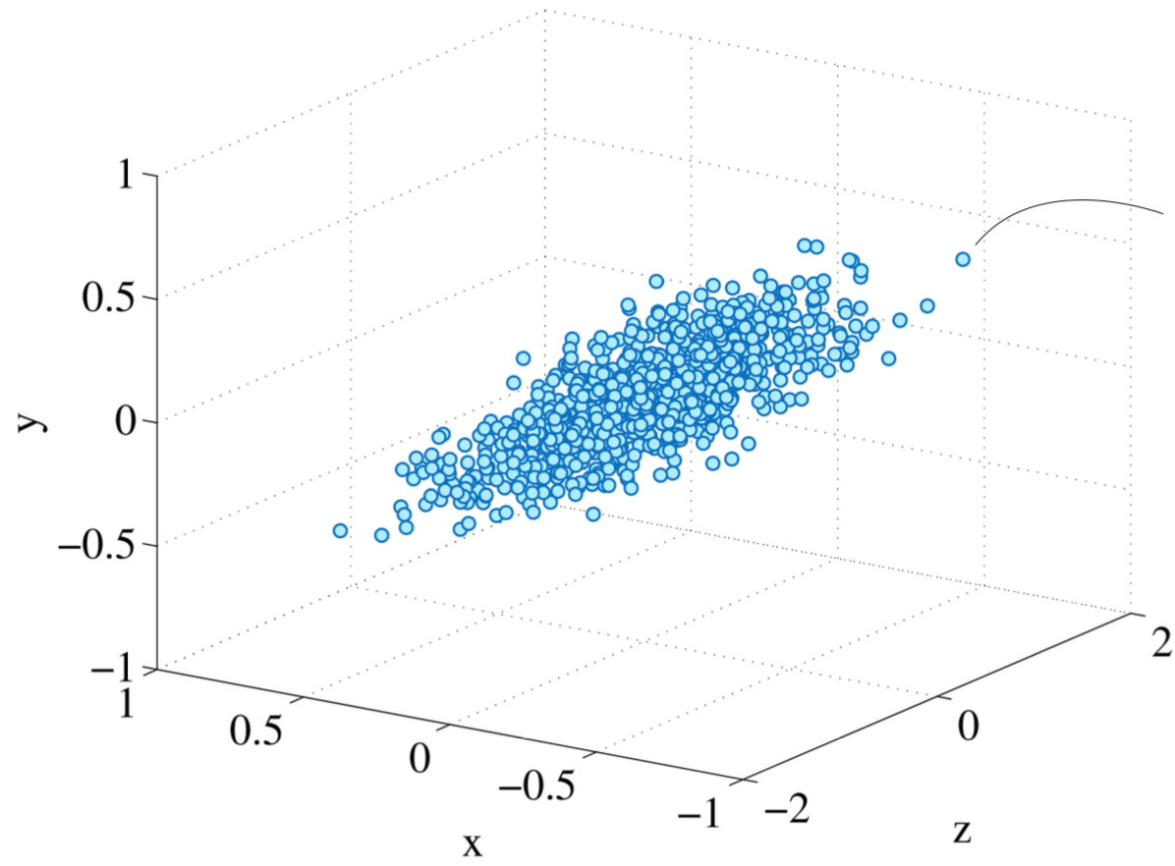
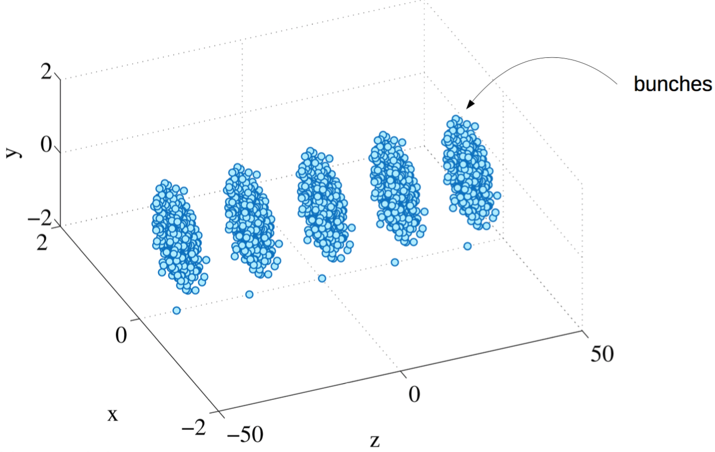
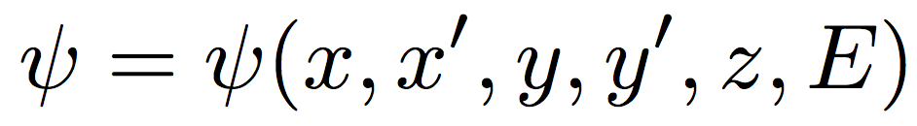
It’s about a beam, in 6D
ψ(x, y, z)
A charged particle beam, taken at a given point in time, can be characterized by a six dimensional distribution, two transverse planes + one longitudinal plane.

Slide 17
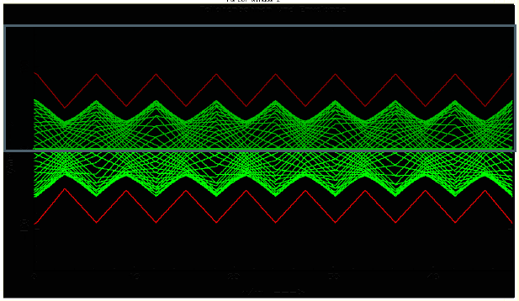
Beam evolution
The rms beam size:
Luminosity :
Beam quality
Lattice design
Notes:
Write on blackboard

Slide 18
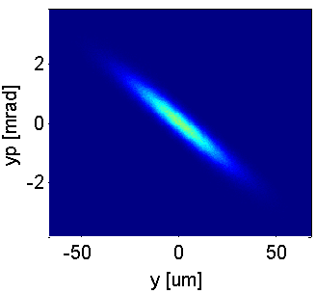
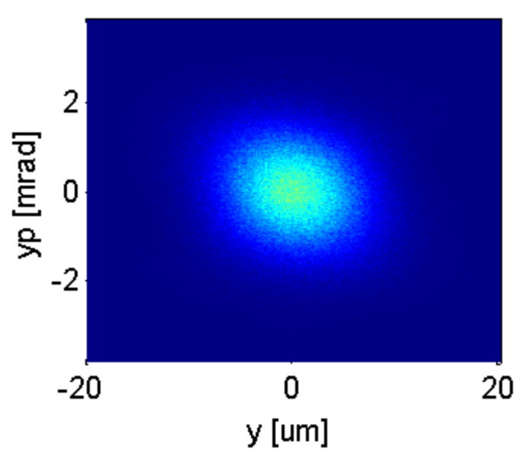
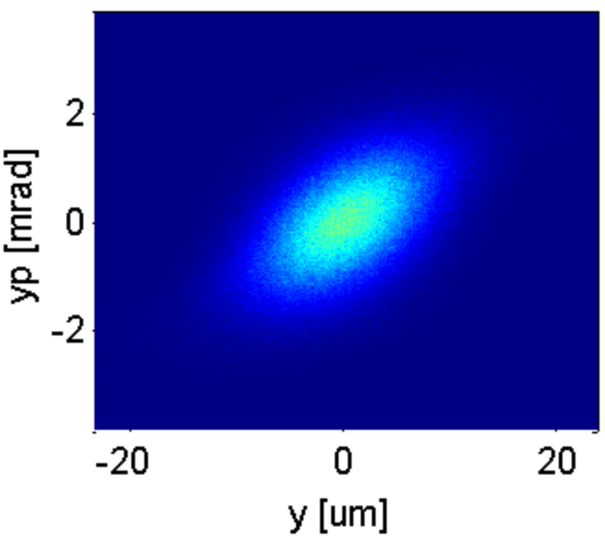
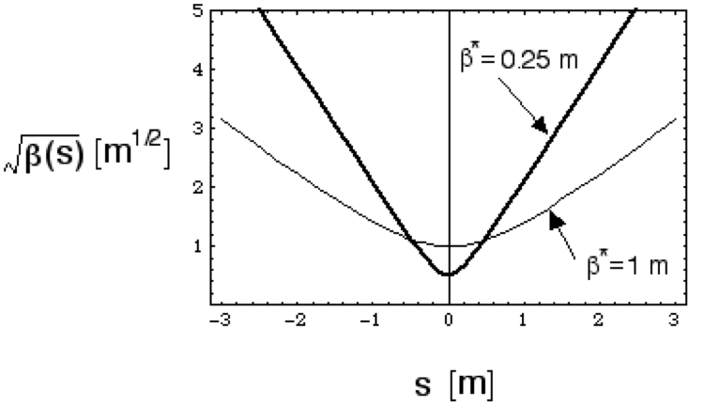
Beta function and emittance
Evolution of the transverse phase-space in free space along the beamline :
σ= √(εβ (s))
Two key concepts that defines a charged particle beam:
Beta function, β(s): how well the beam is focussed. Minimum, β*, at the beam waist.
Emittance, ε: beam quality, phase-space area; ε = √(<y²><y’²> - <y y’>²)

Slide 19
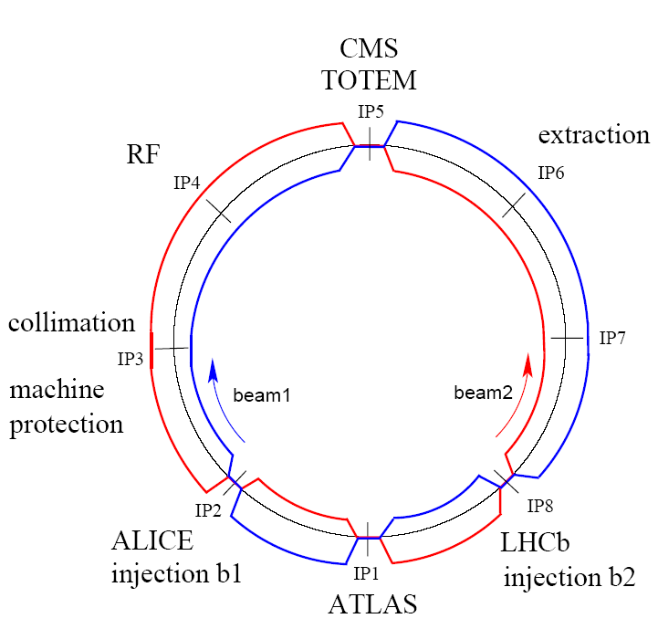
LHC: four collision points

Slide 20
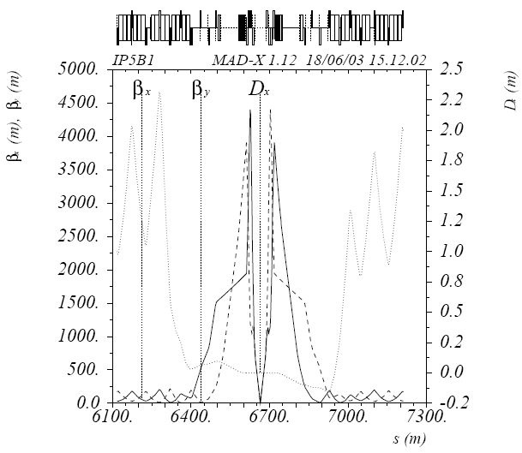


LHC: the collision point
Collision region:
* Very strong quadrupoles,
* close to the interaction point
Upgraded magnet, more beta squeeze, more luminosity.

Slide 21
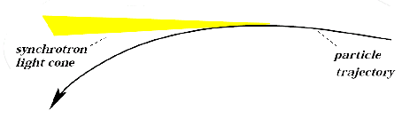
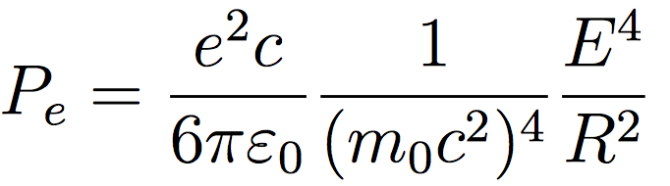
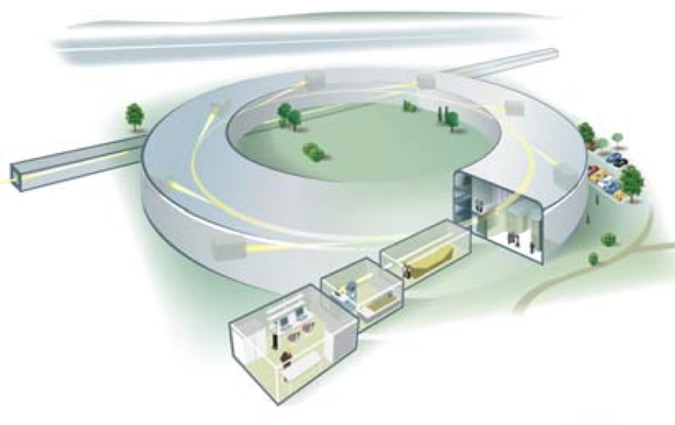


Energy limitation in rings: synchrotron radiation
Synchrotron radiation power loss :
SR: a blessing
and a problem
U: energy loss per turn
C: cost of circular machine
Limiting factor for the LEP energy (E_{cm,max} = 209 GeV). LHC?
Total cost scaling for rings, as you scale energy : ~E²
TeV e- e+ collisions: circular colliders not a practical option
Linear acceleration : ~E with respect to E² for rings

Slide 22

What limits the collision energy of the LHC?

Slide 23
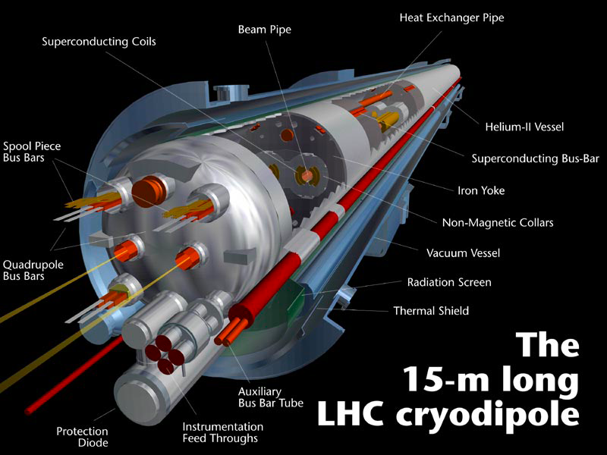
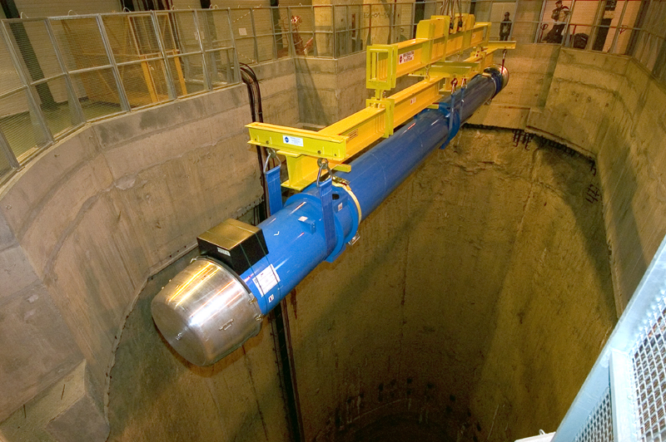
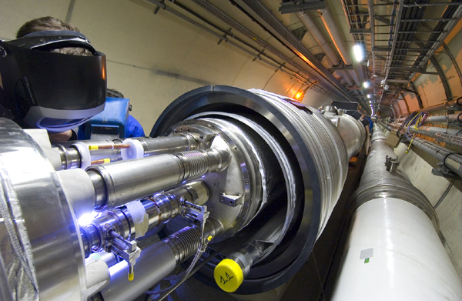
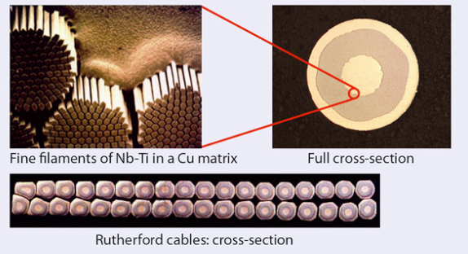
LHC energy: limited by bending magnets
8.3 T maximum field (allows for 7 TeV per proton beam). Generated by a current of 12 kA in the superconducting Rutherford coils.
Developments for higher energy hadron colliders (HE-LHC, FCC) : Nb₃Sn, HTS

Slide 24
Particle colliders

Slide 25
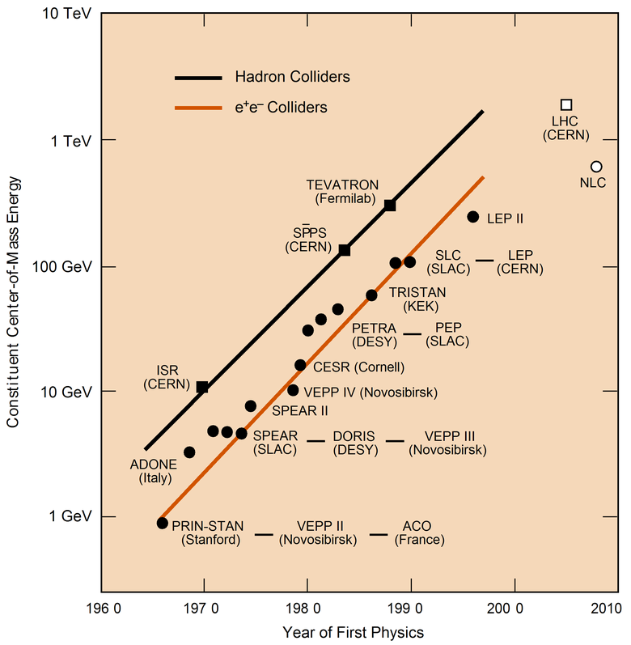
Particle collider Livingstone plot
CLIC
ILC
(...a Europe-centric selection...)
-> all about pushing and overcoming the next limit in luminosity/intenesty and energy/power.
Great success of accelerator physics and technology.

Slide 26
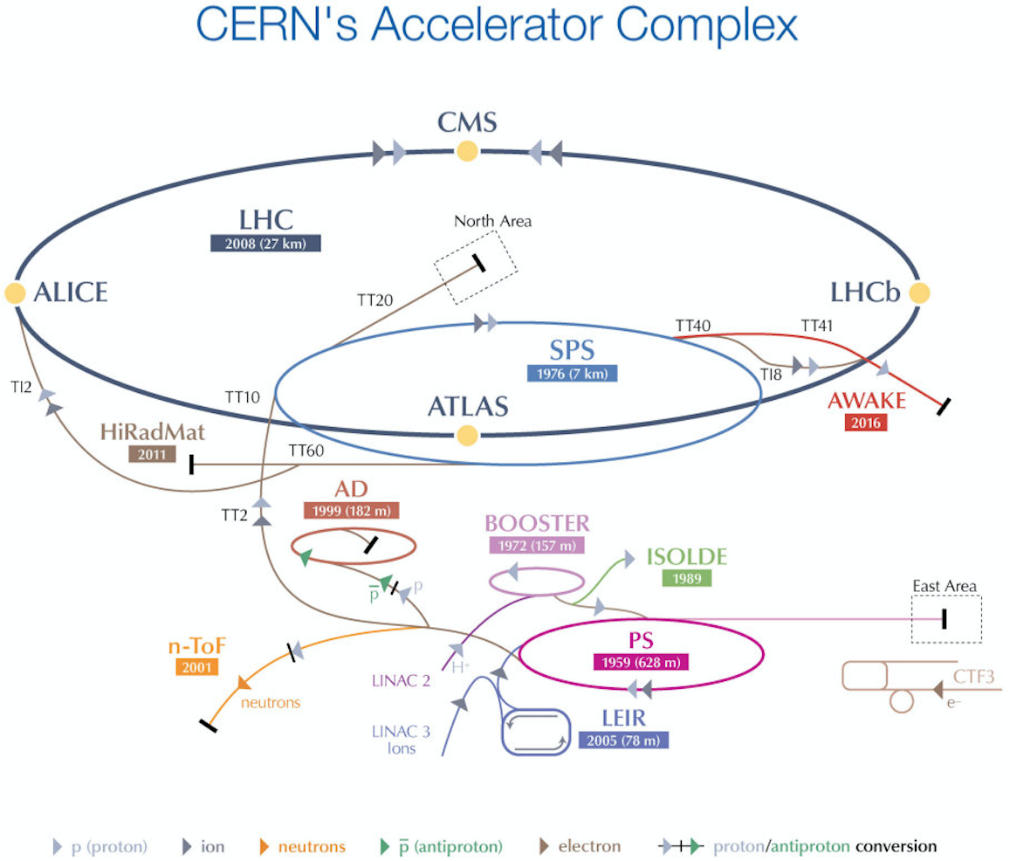

Slide 27
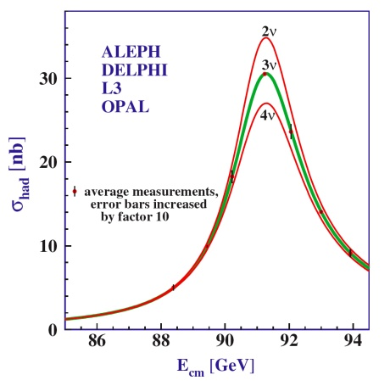
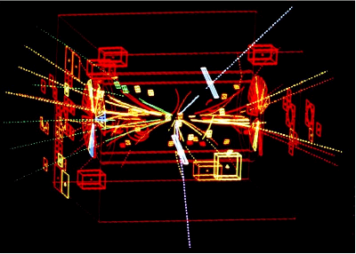

Hadron versus lepton colliders
1983
2000
Hadron collider SppS, √s=540 GeV, W^{+/-} and Z⁰ discovery
Lepton collider LEP, √s_{max}=209 GeV, precision measurements of Z⁰ decay width

Slide 28
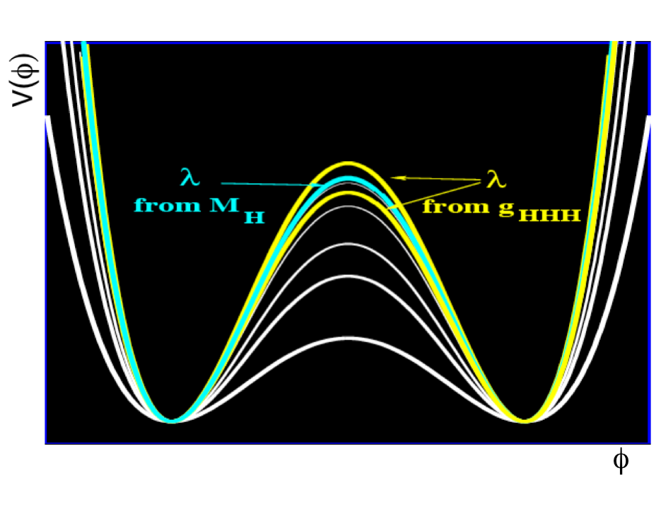
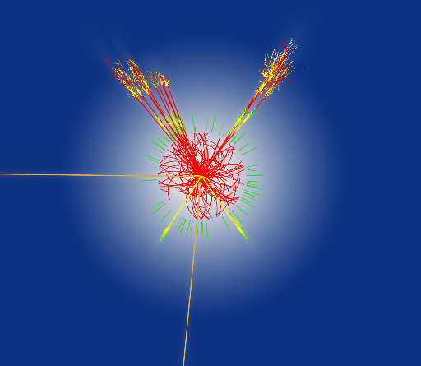
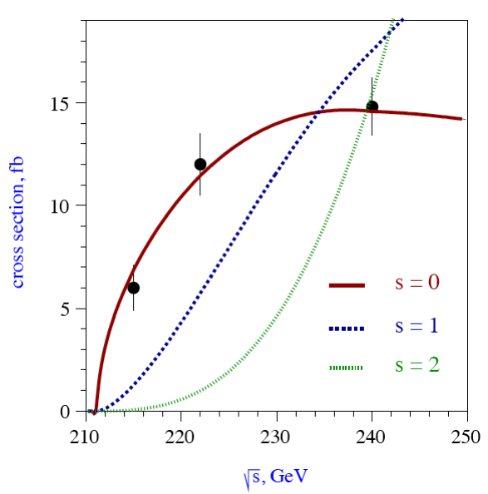
LHC versus future colliders
Linear e- e+ collider : can perform complementary, model independent Higgs physics.
Analogy: Higgs physics
Standard Model Higgs:
scalar spin-0 particle
specific form of scalar potential :
Linear Collider: Precision measurements if the trilinear HHH-coupling (Courtesy of M. Battaglia)
ATLAS and CMS@LHC, discovery of the Higgs boson confirmed in 2012. LHC continues to study properties of the Higgs boson. Precision measurements can be very hard with a hadron collider.
Linear Collider: Higgs spin measurements by energy scan (spin 0 established by LHC by other techniques)

Slide 29
Circular versus linear colliders
We lose two advantages of circular colliders by going linear :
The cavities accelerate only once
...length for TeV scale collisions?
2) The bunches collides only once
Collision energy = 2* linac-length * Cavity gradient
LHC
Linear collider: retain sufficiently high total acceleration voltage (centre of mass energy of ~TeV) and total collisions (luminosity ~10³⁴/cm²/s), while limiting total power to a few 100 MW (nuclear power plant: ~1GW).
Linear collider: need ultra-small beams at the interaction point.
f, collision frequency for LHC: 40 MHz
e+
e-

Slide 30
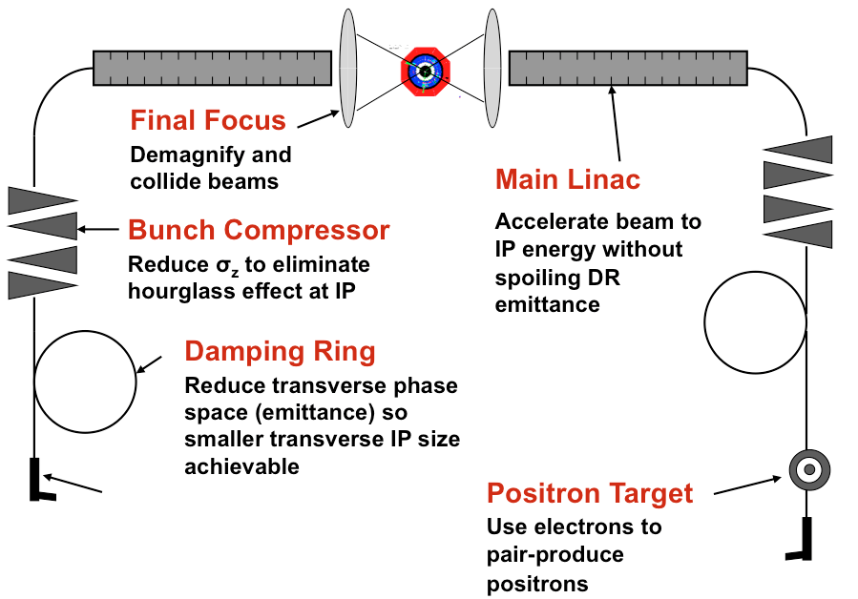
Linear collider ingrediences

Slide 31



Linear Collider Projects
The International Linear Collider, ILC
Main linac technology: super conducting RF 1.3 GHz SW cavities, 31.5 MV/m
Nominal design for E_{CM} = 0.5 TeV (250 GeV to 1 TeV)
The Compact Linear Collider, CLIC
Main linac technology: two-beam scheme. Normal conducting Cu RF 12 Ghz TW cavities, 100 MV/m. Nominal design for E_{CM} = 3 TeV (375 GeV to 3 TeV)

Slide 32

ILC: Japanese proposal
The Japanese scientific community has proposed to host the ILC in Japan, and commit to fund 50% of the material costs (70% of an E_{cm} = 250 GeV first stage). Basically ready to construct as soon as political support is there. Decision may come around 2018.

Slide 33

CLIC : a CERN-centered multi-TeV LC study
Drive Beam Generation Complex
Main Beam Generation Complex
Main & Drive Beam generation
complexes not to scale

Slide 34


CLIC High Gradient research
High gradient limitations :
* Surface magnetic field
  Pulsed surface heating ΔT => material fatigue => cracks
* Field emission due to surface electric field
  RF break downs
  Break down rate (BDR) => Operation efficiency,
  Local plasma triggered by field emission => Erosion of surface
  Dark current capture
  => Efficiency reduction, activation, detector backgrounds
* RF power flow
  RF power flow and/or iris aperture apparently have a strong impact on
  achievable E_{acc} and on surface erosion. Mechanism not fully understood.
CLIC limit: ΔT < 50 K, limits pulse length to few 100 ns
BDR = f(max field, rf pulse length, freq) ~ E_{acc}³⁰t_{p}⁵ (empirical)
Cu Surface after break down
CLIC main linac structure :
12 GHz Cu TW
100 MV/m gradient (loaded)
BDR < 3 x 10⁻⁷/pulse/m
Rf pulse length: t_{p} = 240 ns

Slide 35


The CLIC Two-Beam scheme
Drive beam - 101 A, 240 ns
from 2.4 GeV to 240 MeV
Main beam – 1 A, 156 ns
from 9 GeV to 1.5 TeV
CLIC: “Transformer ratio” of ~1.5 TeV / 2.4 GeV = 15
Demonstrated experimentally at the CLIC Test facility at CERN.
Animation courtesy SLAC ACD group
(A. Candel)

Slide 36

























The CLIC collaboration
CLIC multi-lateral collaboration
48 Institutes from 25 countries
ACAS (Australia)
Aarhus University (Denmark)
Ankara University (Turkey)
Argonne National Laboratory (USA)
Athens University (Greece)
BINP (Russia)
CERN
CIEMAT (Spain)
Cockcroft Institute (UK)
ETHZurich (Switzerland)
FNAL (USA)
Gazi Universities (Turkey)
Helsinki Institute of Physics (Finland)
IAP (Russia)
IAP NASU (Ukraine)
IHEP (China)
INFN / LNF (Italy)
Instituto de Fisica Corpuscular (Spain)
IRFU / Saclay (France)
Jefferson Lab (USA)
John Adams Institute/Oxford (UK)
John Adams Institute/RHUL (UK)
JINR (Russia)
Karlsruhe University (Germany)
KEK (Japan)
LAL / Orsay (France)
LAPP / ESIA (France)
NIKHEF/Amsterdam (Netherland)
NCP (Pakistan)
North-West. Univ. Illinois (USA)
Patras University (Greece)
Polytech. University of Catalonia (Spain)
PSI (Switzerland)
RAL (UK)
RRCAT / Indore (India)
SLAC (USA)
Thrace University (Greece)
Tsinghua University (China)
University of Oslo (Norway)
Uppsala University (Sweden)
UCSC SCIPP (USA)
Notes:
36

Slide 37


Slide 38


Slide 39
Conclusions
The synchrotron LHC at CERN is the world's largest accelerator. It is currently running close to its design energy (14 TeV) and design luminosity (10³⁴ /cm²/s). It will run for at least 15-20 years more, with its technology continuously upgraded
Several projects, linear colliders or very large synchrotrons, are on the table as options for the next high-energy physics machine after the LHC.
Regardless of machine chosen, the next generation projects have plenty of interesting physics and technology challenges for young accelerators physicists and engineers to overcome.

Slide 40
Extra

Slide 41
Parameters: LEP, LHC and CLIC
CERN-based colliders, nominal parameters :
 | LEP | LHC | CLIC
Particle type | e⁺ and e⁻ | p, ions (Pb, Au) | e⁺ and e⁻
Max. collision energy | 209 GeV | p: 14 TeV ^{(~} 2-3 TeV mass reach, depending on physics) | 3 TeV
Time structure | 4 bunches circulating, 50 MHz collsion rate | 2800 bunches circulating, 40 GHz collision rate | 312 micro-bunches, colliding at 50 Hz repeition rate
Luminosity | Peak: 10³² cm⁻²s⁻¹ Integrated L in total : ~ 1000 pb⁻¹ (per experiment) | 10³⁴ cm⁻²s⁻¹ (IP1 / IP5) Integrated L up to now : ~ 27 fb⁻¹ (per experiment) | 10³⁴ cm⁻²s⁻¹

Slide 42

History: SLC
One e+ e- collider have been in operation, the Stanford Linear Collider (SLC) from 1989 to 1998
E_{cm} = 91 GeV (Z⁰), gradient 17 MV/m, L~10³⁰/cm²/s, single bunch collisions at 120 Hz, σ_{x}~1.5 um, σ_{y}~0.5 um
Very challenging to operate, but brought under control by hard work and careful accelerator physics studies, in particular ring and linac instabilities
Valuable proof of principle and lessons learned

Slide 43


Linear collider challenges
Energy reach
  Typical accelerator gradient ~10 MV/m -> ~100 km site for 1 TeV collisions
Structures: large accelerating gradient with low breakdown rate
Luminosity
Luminosity per power is the key figure of merit for a linear collider
Beam acceleration: ~10 MW of beam power with high gradient and efficiency
--- compare to “1 TW” LHC type beam: reduce transverse dim. by a factor ~10⁵
Generation of ~10 nm vertical emittances by radiation damping
Preservation of ultra-small emittances through main linacs :precise static alignement, beam-based alignmen. Advanced feedback and feed-forwards. Stability of nanometer range.
Chromaticity corrected final focus with beta function on the order of 100 um : very strong final doublet magnets. Sextupoles to compensate chromatic aberrations. Stability of sub-nanometer range.

Slide 44

Requirements: time structure
Time structure may be driven by accelerator (collective effects) and/or detector (read-out) constraints.
Circular collider time structure : constant collision rate
Example for LHC, nominal parameters
charge delivered in bunches at 25 ns spacing
16 nC charge in each bunch
LHC: four collision points
2800 bunches in each beam, colliding at 40 GHz
Linear collider time structure : charge delivered in micro-bunched pulses
Example for the International Linear Collider (500 GeV high lum.)
charge delivered in pulses of 1 ms, at 5 Hz
3 nC charge in each micro-bunch

Slide 45

The Muon collider option
TeV lepton collisions in a small circular collider? Muons!
Poses a number of hard, and very interesting, accelerator physics challenges.

