Slide 1
Decisions Summary of outcome and achievements resulting from the first alignment workshop
Peter Rådahl
www.europeanspallationsource.se
2016-08-30

Slide 2
Summary of Issues and recommendations
Communicating Decisions
Webpage with agenda, MoM and decision for each decision making body.
Delegating Decisions
Delegate authority to lower levels for approving cost impacts between projects.
Parochial Decisions
The recognition of what is best for ESS will require a good deal of listening and understanding of the counterparts’ needs from both sides.
All parties must trust and respect one another.
Prioritizing Decisions
Establish and clearly communicate which is most important: Schedule, Cost or Scope.
Recognize that cost and schedule are linked
Clarify decision making
Establish and clearly communicate mandates and how decisions are made at the different meetings: Chairman/Unanimous/Majority

Slide 3
Recommendation-Next steps
Communicating decisions
Identify decision bodies (EMT, ETB, CCB)
Access meeting logs from an ESS central web page
Coordinate with “meetings” group
Propose Q division to take the action to carry it forward
Delegating decisions
Division heads acknowledge a mandate to delegate cost authority to WPMs
Coordinate with “Roles & Responsibilities” group

Slide 4
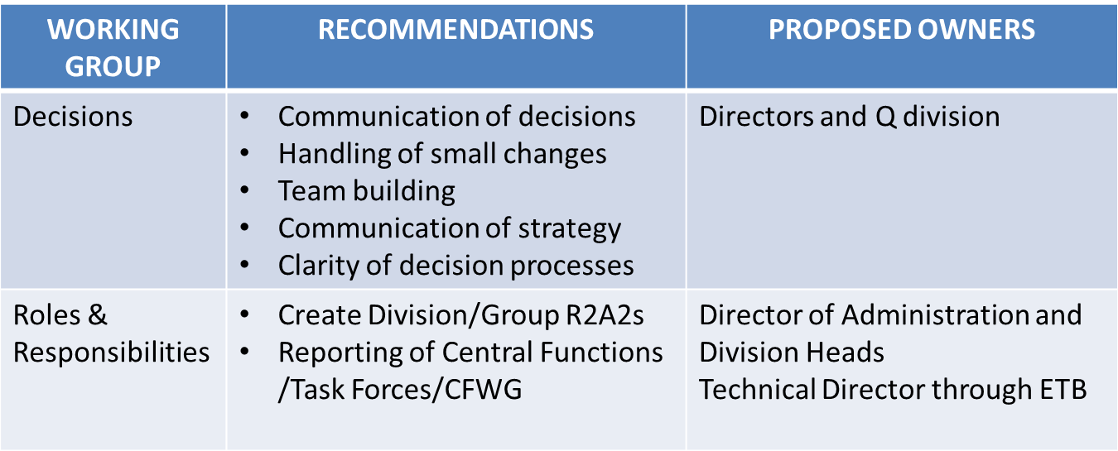
Outcome on ETB 2015-09-11

Slide 5
Progress after the ETB meeting
The decision group has not continued after the ETB meeting
Some relfections
Web-page with structured content established for CCB and ETB established but not for EMT.
Other important decision should be treated in the same way and not to only use the intranet (examples: processes, rules)

Slide 6
Decisions 1st Alignment workshop
Members:
Lennart Stenman, Peter Rådahl, Magnus Eneroth, Mats Lindroos, Eric Pitcher, Shane Kennedy
2015-06-26
www.europeanspallationsource.se

Slide 7
Communicating Decisions
Issue:
Decisions are not clearly communicated nor broadly disseminated to the affected organizations.
Recommendation:
Each decision making body maintains a web site accessible by all ESS staff where the following items are posted:
Agenda
Meeting minutes
Decision log

Slide 8
Delegating Decisions
Issue:
Many design decisions have relatively small cost impacts and yet are brought to Programme CCB because they impact across projects.
Case in point: “chamfers in stubs” action approved at the 2015-01-29 CCB meeting with a cost impact to CF of 50k€.
Smaller cost items such as this can be promptly and effectively dealt with at a lower working level if authority were delegated.
Recommendation:
Delegate authority to lower levels for approving cost impacts between projects. This can be done by allocating contingency downward, i.e., do not hold all contingency at the highest level.
Implement a log to be visual and finally stamped on the appropriate level.

Slide 9
Parochial Decisions
Issue:
Positions on issues are based on parochial interests rather than what is “best for ESS.”
Recommendation:
The recognition of what is best for ESS will require a good deal of listening and understanding of the counterparts’ needs from both sides.
All parties must trust and respect one another.

Slide 10
Prioritizing Decisions
Issue:
No clear priority between cost, schedule and scope in making decisions.
Recommendation:
Establish and clearly communicate which is most important:
Schedule
Cost
Scope
Recognize that cost and schedule are linked

Slide 11
Clarify decision making
Issue:
Not clear how decisions are made in different meetings and what mandate the meeting has.
Recommendation:
Establish and clearly communicate mandates and how decisions are made at the different meetings.
Chairman
Unanimous
Majority

Slide 12
Next steps
Communicating decisions
Identify decision bodies (EMT, ETB, CCB)
Access meeting logs from an ESS central web page
Coordinate with “meetings” group
Propose Q div to take the action to carry it forward
Delegating decisions
Division heads acknowledge a mandate to delegate cost authority to WPMs
Coordinate with “Roles & Responsibilities” group

