Slide 1
Summary of outcome and achievements; Scope & Requirements Workgroup
Peter Sångberg
Systems Engineer, NSS
www.europeanspallationsource.se
30 August 2016

Slide 2
Recommendation 1 (3)
Recommendation
Reassess the PBS using primary function as guiding principle
Aims to address:
“Silo”-thinking: reduced by using function instead of entity (discipline) in the breakdown structure.
Achievements:
Discussions underway between ICS and NSS w.r.t the Instruments breakdown structure.
An initiative is about to commence to reassess the ESS FBS – changes and additions will be made into the so far implemented structure. Initiative is led by EIS/PIM
No consensus that function-based breakdown will address “silo”-thinking during the development.

Slide 3
Recommendation 2 (3)
Recommendation:
Each project to develop and document Scope & Requirements…
Aims to address/acknowledge:
That each project is different
That each project has different methodologies and different ways to document
Agreement of:
“What” needs to be documented for any given system
Transparency by having a cross-reference document/table linking “what “ to “where”
How to manage interfaces by using a more flexible approach than the set context and format of the formal ICD – introduced; Interface Management Package (IMP).
Achievements:
Simplified and flexible chess templates have been created for
Requirements (Stakeholder and Technical)
Interface descriptions. IMPs and templates for these needs to be further discussed.
System architecture and allocation of requirements
System documentation table etc.
Chosen methodologies and documentation also need to comply with the ESS design process which has been conveyed to SSM in the PSAR.

Slide 4
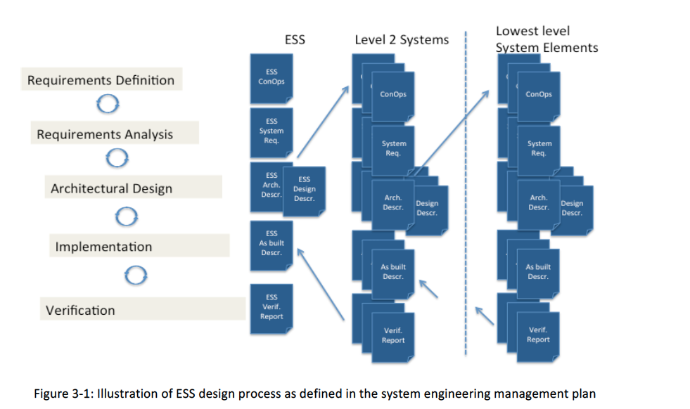
Recommendation 2 (3), cont.
Why matching is required?
The PSAR states in paragraph 3.2:
“Radiation safety analyses and methodologies are an integral part of ESS’s design methodology.
Radiation safety management is a sub-set of risk management activities performed at ESS. The ESS design process starts by identifying the stakeholder needs and the operational context for the facility. From these, requirements for the facility are derived and required functions are defined. The facility is decomposed into system elements, based on use cases and functional analysis, and requirements are allocated to each system element. This process is then repeated for each system element in an iterative and recursive fashion ….”
The authorities will very likely hold us to these statements.

Slide 5
Recommendation 3
Recommendation:
Conduct “integration reviews” at all levels to make sure there is no “orphan scope” and interfaces are agreed
Aims to address:
As stated above: Orphan Scope and track that interfaces are agreed and adhered to
Catch issues during detail design and construction early
Achievements:
Findings was presented in March for R. Garoby and J. Haines
Integration reviews are ESS internal
An outline exists for e.g. how to conduct IRs, set-up and when in time (ESS level)
The term Integration Reviews could be misleading as it actually requires a full time entity to be tasked with the day-to-day hands on effort to ensure aim.
The reviews are the culmination and checkpoints of these continuous and hands-on efforts
The need for the entity and Integrations reviews is urgent!

Slide 6
Conclusions
Reassessment of PBS (now FBS)
ongoing and to be expanded soon
More discussion likely required to settle different perspectives
Limited work done for handling differences in practice.
Need to ensure development methodology and accompanying documentation complies with ESS design process.
The flexibility allowed by this recommendation calls for additional scrutiny and review effort in releasing documents.
IMPs need to be further elaborated.
In light of what’s been conveyed to SSM we should, at the very least revisit this recommendation.
Implementation of an entity to work with integration with follow-on Integration Reviews is urgent.

Slide 7
We are different
Acknowledge that each project is different
Use different methods
Have different ways to document
With a need to communicate effectively
Internally
Externally
IKC
Authorities
With an appropriate level of quality

Slide 8
How to manage differences
System owner is responsible for documentation and for integration of sub-systems
ESS system
System
Doc
How to
Project level systems
Includes cross reference table for agreed outcomes
System
Doc
How to
 | Is found in
Outcome A | “Doc A”
Outcome B | “Doc B”
Outcome C | “Doc C”
Outcome D | “Doc A”
Can be applied as default for sub systems
Lower level systems
Can be applied to IKC or ICS sub systems
System
Doc
System
Doc
How to

Slide 9
Common Goal - Outcomes that would define scope and requirements for a given system
This is the high level “what” needs to be documented for any given system. Systems should be broken down based on their “primary function”
Stakeholder (allocated) requirements and external interfaces.
Technical (derived) requirements.
Traceability of technical requirements to stakeholder requirements.
System elements and their interfaces.
Allocation of technical requirements to system elements.
Detailed design descriptions.
Integration, verification and validation plans.
Operation and maintenance and disposal plans.

Slide 10
How to manage interfaces specifically
For each ESS system interface define a “interface management package” that contains or refers to:
Interface requirements
Interface descriptions
Templates/formats/relations, as needed
Descriptions of “how to”
The content of the package can be developed in Word, Excel, DOORS, etc., but baselined in CHESS

Slide 11
Rationale behind Integration Reviews:
Preferred and ideal way to ensure outcome:
System Design
Detailed Design
Construction
Integration work required, but easily managed.
However our reality is:
Where:
Integration requires a hands-on and practical approach on a day-to-day basis
And given ESS current status and schedule:
There is an urgent need for Integration Reviews led by an independent and responsible entity
System Design
Detailed Design
Construction

Slide 12
Integration Reviews - ESS requires multidimensional Integration:
System Design
= Dedicated hands-on & practical
Integration effort required
ACC
TGT
Holistic & Integrated Detailed Design
Construction
CF
C101
Skanska
ICS
NSS
Piling
Concrete work
Walls & roofs
Rooms/zones
Outfitting Conventional
(substations, pumps,
motors)
Outfitting facility specific
(Accelerator, Target, ICS,
NSS components)
Pipe/vent/cable routing
Etc.
System Documentation
is prepared according to the SEMP
Multiple Juncture points.
Gradually increased maturity of system designs.
The different projects are in different stages of maturity.
Project do not generally share delivery times
Prepared Design Solutions
3D Models (EPL) (Clash detection!)
Accelerator
Target
Neutron Instruments
CF Building items: doors, walls etc.
Main services: piping, cable trays, ventilation and cooling systems etc.
Installation sequence planning (when, order, required equipment (cranes, personnel, tools, forklifts etc.))
Notes:
Integration work and reviews is not a straightforward effort as the sub-projects are in different stages and thus have reached different level of maturity
Introduces yet another dimension of complexity

Slide 13
Integration Reviews
Integration reviews should be conducted to align and harmonize the ESS Project
Integration reviews on/between lower levels are managed within each sub-project (ACC, TGT, NSS, ICS, & CF) .
The critical driver of the IRs is the alignment and consistency between design solutions (3D models, controls implementation, various analysis and the functional & physical aspects) provided for construction, from an ESS wide perspective (i.e. holistic) and the system documentation that is the basis for them.
Required resources and schedule impact due to Installation Sequence planning is dependent on Integration reviews as per this document.
Integration Reviews should be based on actual maturity of the development of ESS – It is a practical and hands-on effort and NO POWERPOINT or other DOCUMENTATION ENGINEERING exercise.
Integration Reviews are the culmination of a continuous hands-on work in-between these events

Slide 14
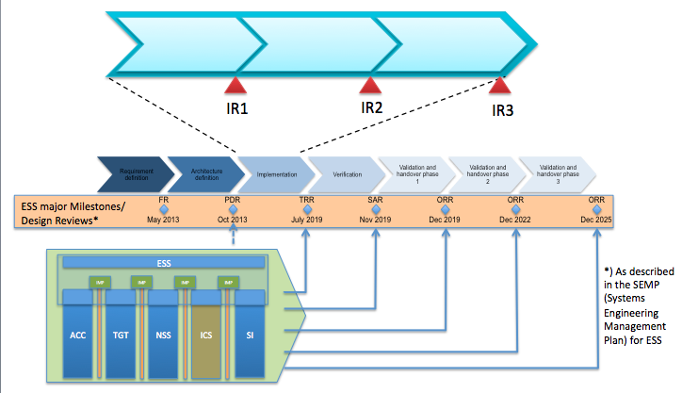
Integration Reviews – How they fit into the “bigger picture”

