Slide 1
Outcome and achievements resulting from the 1st Alignment workshop (June 25-26, 2015, Lund) - Management feedback [part 2] –
continued
Agneta Nestenborg
www.europeanspallationsource.se
16-08-30

Slide 2
Decisions
Roles and Responsibilities
Members:
Dave McGinnis, Rikard Linander, Magnus Täcklind Dan-Magnus Sköld, Peter Jacobsson
Members:
Lennart Stenman, Peter Rådahl, Magnus Eneroth, Mats Lindroos, Eric Pitcher, Shane Kennedy
www.europeanspallationsource.se
16-08-30

Slide 3
Different aspects of decision making
Communicating Decisions
Clarify decision making
Delegating Decisions
Parochial Decisions
Prioritizing Decisions
Clarify roles and responsibilities – mandate to make decisions?
Identify what fora are decision making?
Structure and possibility to communicate – more or less complex
Leadership and strategy

Slide 4
Delegating Decisions
Clarify roles and responsibilities – mandate to make decisions?
Authorisation & Delegation plan
Project and line organisation
Reflected in systems architecture (e.g. Agresso)
Functional descriptions
Areas of responsibility
Where can a decision be made

Slide 5
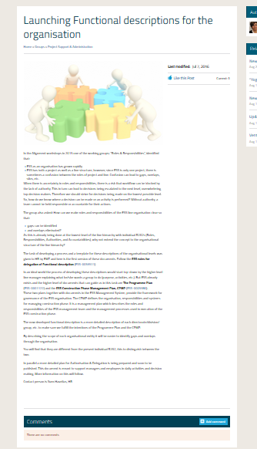
Roles & Responsibilities
Functional descriptions launched in the summer
Build on The Programme Plan (ESS-0001122) and the ESS Construction Phase Management Plan, CPMP (ESS-0005380).
ESS Management System
Key is to discuss and compare to identify gaps and overlaps.
Members

Slide 6
Identify which fora are decision making
A&F C
SAC
ESS Council
IKRC
TAC
DG
CFAC
EMT-T
EMT
EMT-A
ESHAC
Decision
ETB
CCB
Annual R
Prep.
TCM
SMT
AMT
MMT
Advice
PIM
Etc.
SAG

Slide 7
Status Update
Individual meetings have been conducted with ESS Directors and the final summary meeting with all Directors present has been the foundation for the actions below:
MEETING CHARTERS
EMT ESS-0005290, ETB ESS-0005291, CCB ESS-0005292 defined and documented charters
Needs approval from Forum Chairman
ESS PROCESS UPDATE
Process will be adjusted
Process incorporates meeting Charters
PROCESS OWNERSHIP
Process ownership assignment template developed ESS-0030290
Director General will be the process owner ESS-0065174

Slide 8
Communicating Decisions
Main ‘decision’ bodies internally are:
EMT – has taken note of recommendations, but not yet implemented a formal feedback approach; decisions are considered decision of the DG, communicated as needed
ETB – Formal structure and feedback system is in place; minutes are accessible to staff
CCB – Formal structure and feedback system is in place and decisions are accessible to staff
Both ETB & CCB are clearly described on the external website
Next Steps:
Direct information from EMT (and Governance) TBD
More ‘push’ of decision and contextualization (channels TBD)

Slide 9
Decisions contd.
For Parochial Decisions and Prioritizing Decisions key points are
Leadership and strategy
Think OneESS
Core Values
Excellence
Openness
Collaboration
Sustainability
Leadership criteria
Managers’ meetings and trainings
Creating a network where managers get to know each other and meet
Members

Slide 10
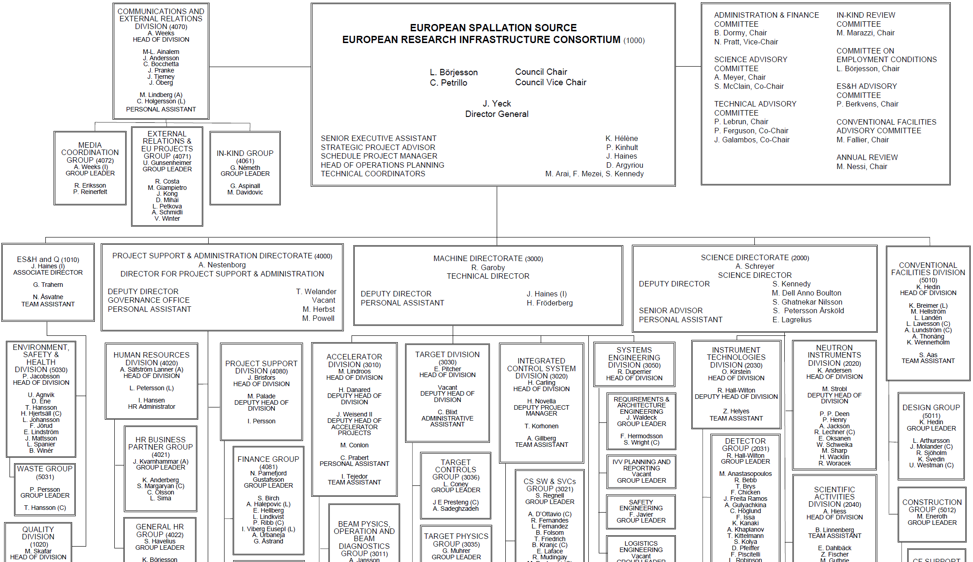
Organisation
~ 100
Collaborating Institutions
42 In-kind Partners
60 Collaboration, MoU and Grant Partners
48
Nationalities
378
Employees

