Slide 1
Overview of systems involved in the Target-NSS Interface
Eric Pitcher and Shane Kennedy
(Project Leaders for Target & NSS systems respectively)
www.europeanspallationsource.se
Interface Advisory Meeting - 4 October 2016

Slide 2
Division of Responsibilities
CF
  Base mat (floor), including bunker shelf
  Cylindrical 80-cm-thick concrete structure surrounding monolith
Target
  Moderators
  Neutron beam extraction system*
  Neutron beam windows at 5.5 m radius
  Light shutters at 5.5 to 6 m radius*
  Monolith
  Maintenance and servicing of all of the above components
NSS
  Neutron Bunker
  In-monolith optics
  Instrument beamlines, including external shutters
Others
  ICS; for control and monitoring systems for Accelerator, Target and NSS
  ES&H; for safety and licensing requirements and standards
* Including optical alignment system, but excluding neutron optics

Slide 3
Project Responsibilities
CF
NSS
Neutron optics inside
inserts and light shutters
Bunker roof support columns
TD
CF

Slide 4
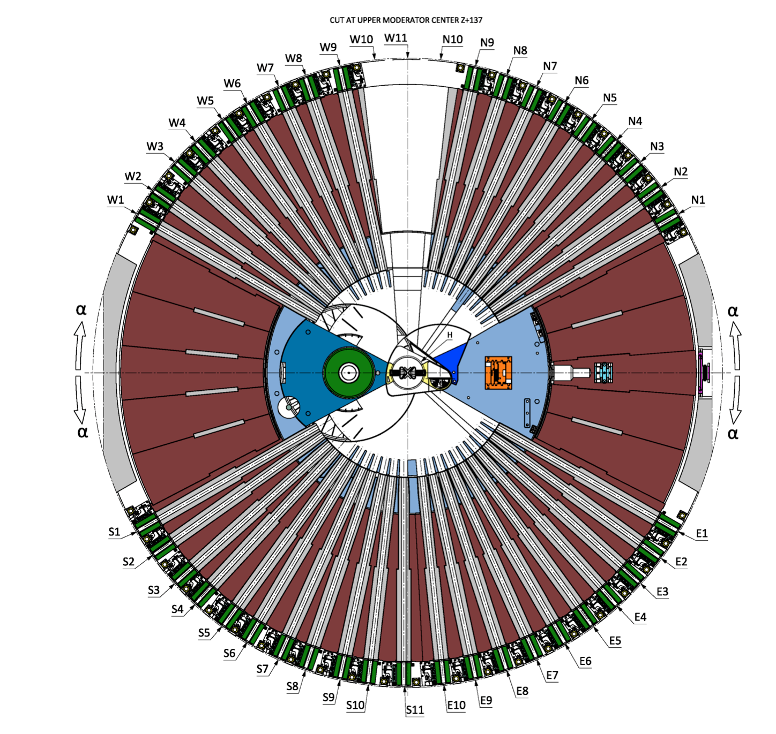
Target’s interfacing systems
Neutron beam inserts
(gray)
Neutron beam windows
(not visible)
6 m
5.5 m
2 m
Moderator
Light shutters
(green)

Slide 5


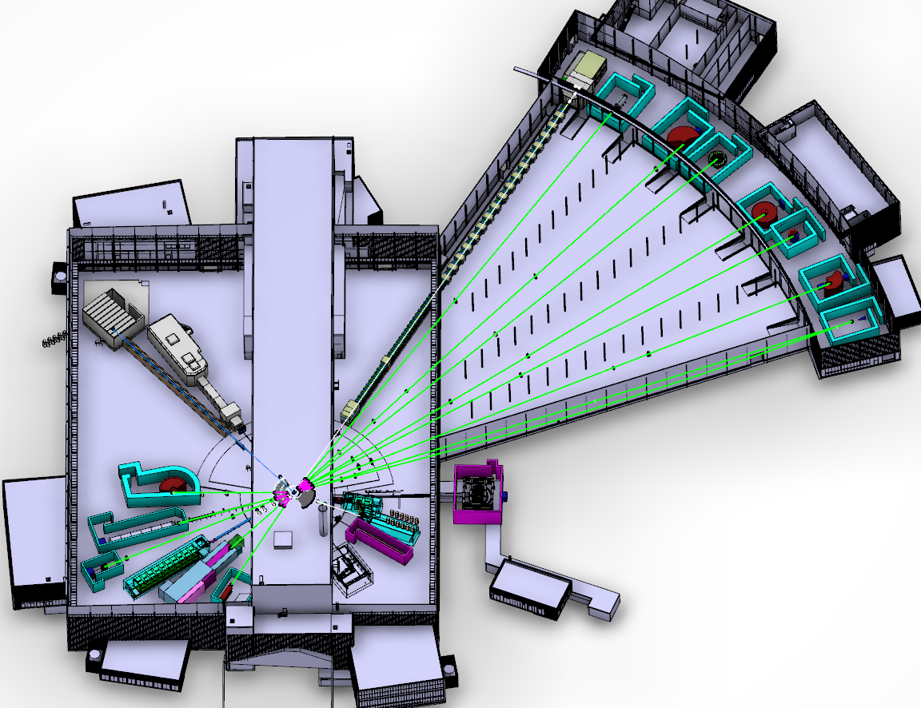









NSS Interfaces for Neutron Instruments
ESS Lead Partners for instrument construction
NMX
BEER
C-SPEC
BIFROST
MIRACLES
MAGIC
DREAM
ODIN
T-REX
HEIMDAL
VOR
LoKI
VESPA
FREIA
HR-NSE
SKADI
ESTIA
50 m
100 m
150 m
ESS In-Kind Partners also collaborate on sample environment, data systems etc.
ESS Instrument Layout (June 2016)

Slide 6
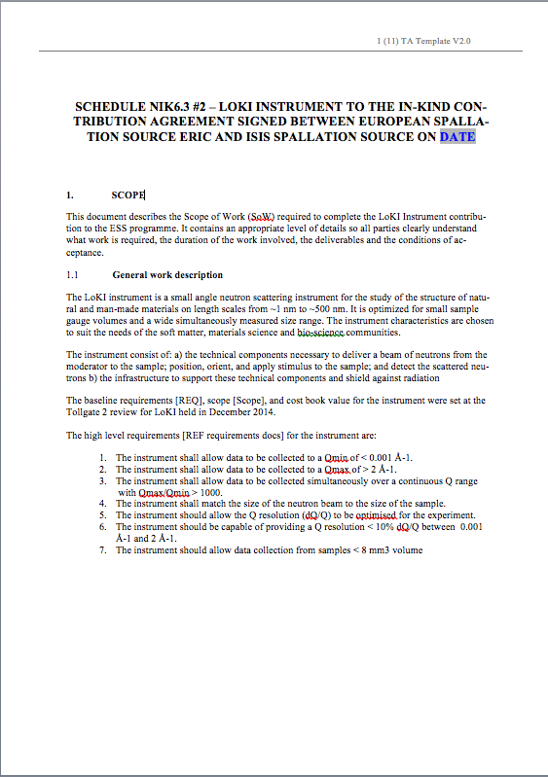
Interface Management
Internal Interfaces (between ESS projects)
  Identified and addressed through meetings, email and usual forms of interaction
  using Interface Control Documents (ICDs)
  Formally agreed by all parties prior to completion of Preliminary Design
External Interfaces for Instruments (between ESS & In-Kind Partners)
  Identified and addressed through formal meetings (STAPs, IKON, ICB, ..), workshops, ad-hoc topical meetings, bilateral meetings and as above
  With formal (signed) Agreements (In-Kind Collaboration Agreements with Technical Annexes & Memoranda of Understanding )
  Major milestones (toll gates) formally agreed by all parties prior to completion of Preliminary Design

Slide 7
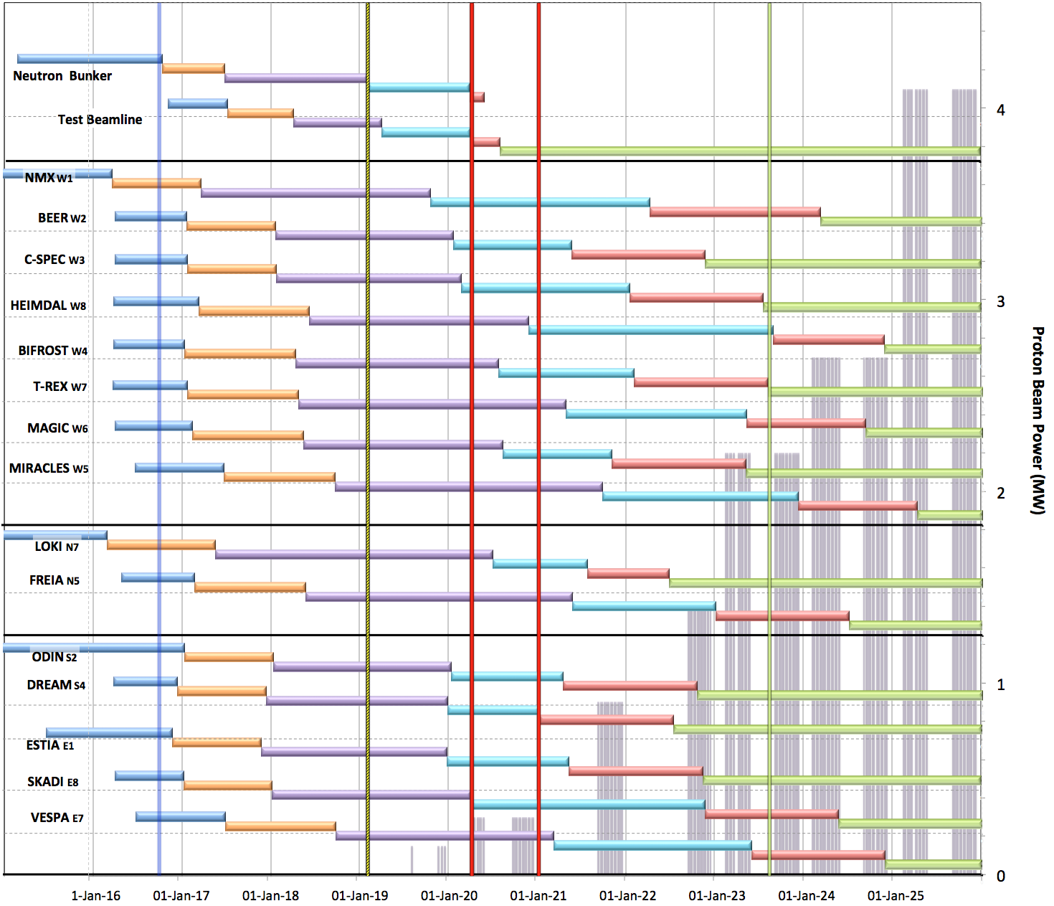

Neutron Beam Instrument Draft Schedule
V1.7, 2nd October 2016
Currently under review
Current date
Full Access D03
Beam on Target / 1st spectrum
Start Hot Commission
User instruments
Start User Program
Commissioning of test beam – to demonstrate performance and inform instrument projects
Notes;
The order of completion 1- 8 chosen for science and deliverability
Shift 9-16 to focus on 1-8 for early science success
Hot Commissioning start;
  E ≥ 200 MeV
  P ≥ 200 kW
  January 2021
West sector
DRAFT
North sector
East and South sectors
Preliminary Design
Detailed Design
Manufacturing & Procurement
Installation & Integration
Hot Commissioning
Operation
2016 2017 2018 2019 2020 2021 2022 2023 2024 2025
Notes:
NSS key milestone is to start user program with 8 instruments in August 2023.
To achieve that we plan to start hot commissioning of first instrument in Jan 2021.
We are currently evaluating which instruments should be among the first 8.
The bunker will be in place, and demonstration of beam on target (BOT) will take place before 2021.
<mouse click> Currently BOT is planned for June 2019, but ESS revising schedule dates for Target and NSS access to the worksite.
Access dates are likely to move into 2019 and BOT is likely to move to early 2020.

Slide 8
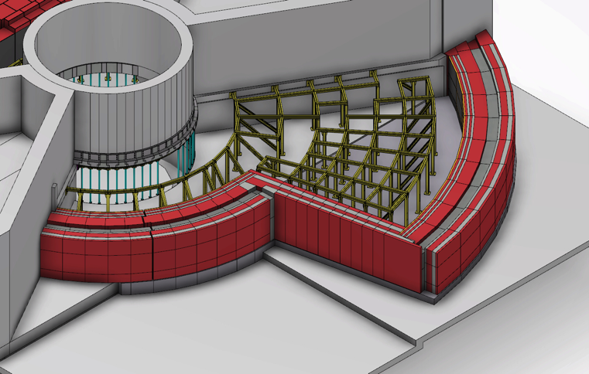
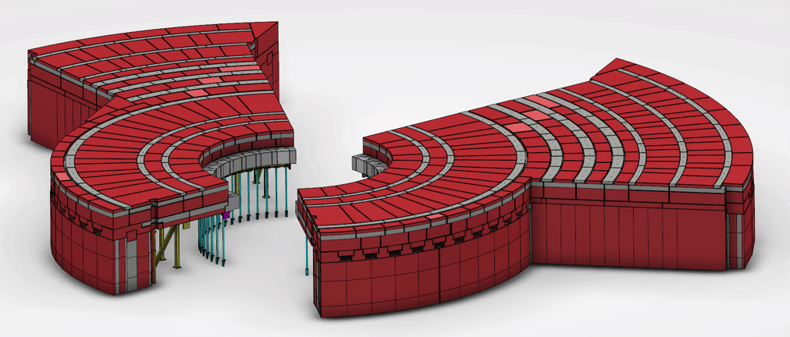
The neutron guide Bunker: milestones
Bunker Project start (Manager: Sara G-N) - June 2015
Initial costing (14.6 M€) - Aug 2015
Neutronic calculations 1st report - April 2016
Full time project manager (Zvonko Lazic) - June 2016
Bunker concept design review - 4-5 Oct 2016
Preliminary Design Review - 15-16 Dec 2016
Critical Design Review - April 2017
Start Manufacturing & Procurement - June 2017
Notes:
Procurement through CF-Skanska most probably
CF and NSS are already collaborating on the Bunker
NSS IK goal 65% can’t be reached, probably between 50% and 60%

