Slide 1
IAC 20161004 Bunker Project
Zvonko Lazic
(Project leader)
Benjamin Davidge
(Mechanical Design Engineer)
www.europeanspallationsource.se

Slide 2
Requirements
The Bunker requirement document ESS-0060210
The current design satisfies identified requirements with a note that:
Requirement for the H4 event is not clearly defined
Work on this is ongoing
The current effort is focused on mitigating identified loading conditions at interfaces with CF that might occur (in the H4 event)
Driving requirement is the radiological protection
Interfaces are identified (discussion under further topic)

Slide 3
Requirements
Q/A

Slide 4
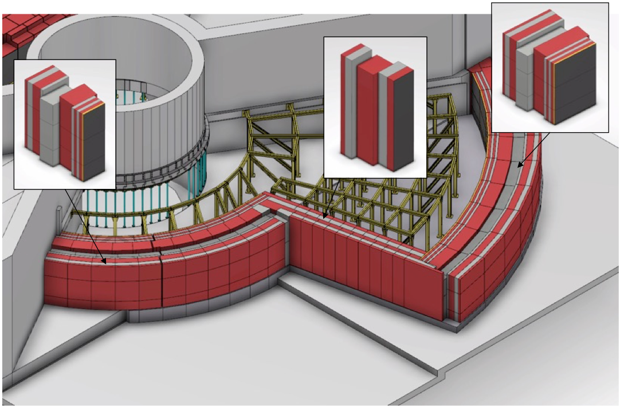
Preliminary engineering 1 Wall configuration

Slide 5
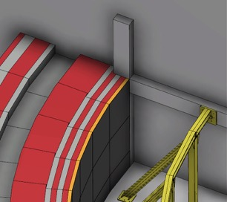
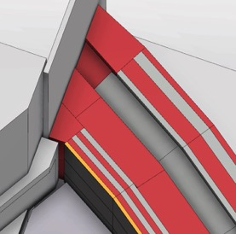
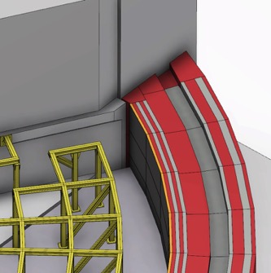
Preliminary engineering 2 Wall configuration
R15m Wall
R28m Wall

Slide 6
Preliminary engineering 3 Support Frame
Individual frame elements must be considered in context of the whole frame structure.
Modification will involve additional design effort and recertification having sizeable cost implications.

Slide 7
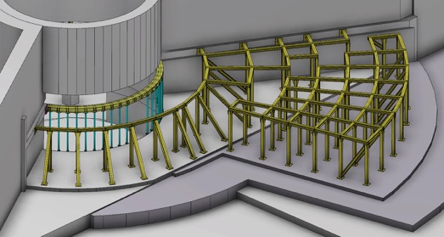
Preliminary engineering 4 Support Frame
R6m Frame
Outer Frame E&S
Outer Frame
Inner Frame
D01
D02
D03
The roof support frame consists of 3 separate frame structures per side.

Slide 8
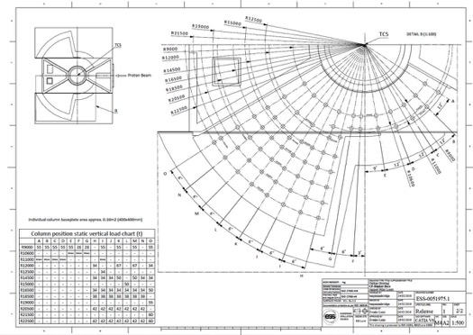
Preliminary engineering 5 Support Frame
Positions for columns and brace beams have been set.
CF is currently undertaking concrete reienforcement design to suit.
Positions are provided in drawing ESS-0051975.

Slide 9
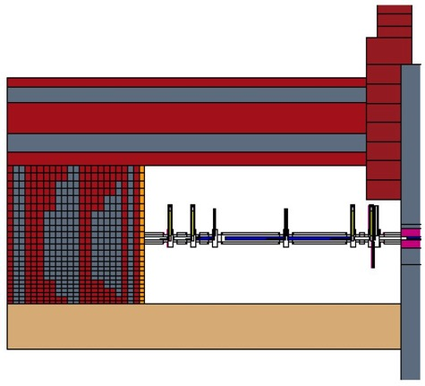
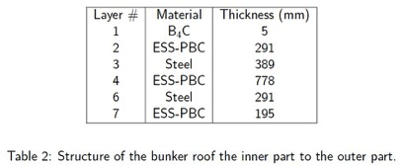
Preliminary engineering 6 Roof
Baseline roof geometry and dimensions defined in document ‘ESS-0052649 Neutronic Design of the Bunker’.
Key requirements considered during concept development:
Eliminate all streaming paths with chicane geometry on blocks (minimum 7:1 chicane to gap ratio)
Conformance to seismic requirements which may include linking blocks together and anchoring down to CF floor via frame
Dilatation joint to be propigated up through blocks in XY plane
PSS interlock detail on blocks
Accessibility optimized for short access time to
instruments beneath
Above roof dimensions and image taken from pg.14 of ESS-0052649

Slide 10
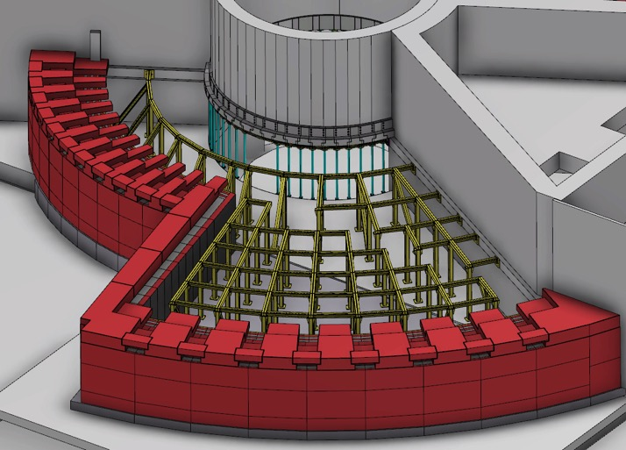
Preliminary engineering 7 Roof
Utilities blocks placed on top of wall sections to provide duct cavity.
Blocks will likely be bolted in place.
All unused utilities ducts will be filled with temporary shielding blocks.

Slide 11
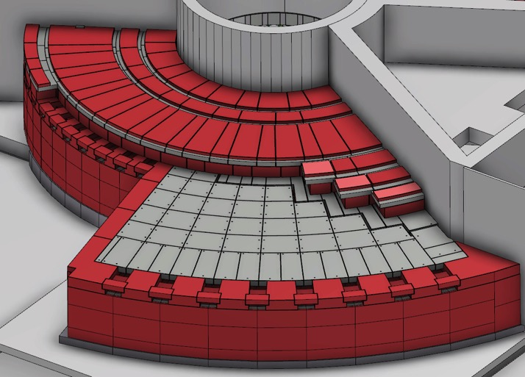
Preliminary engineering 8 Roof
Proposal for last 3 roof layers (75cm ESS-PBC + 30cm steel + 20cm ESS-PBC) to be single composite blocks.
Perimeter blocks to be pinned in place to corresponding side of dilatation joint.
Continued vertical dilatation joint propagation.
Blocks anchored to D02 side

Slide 12
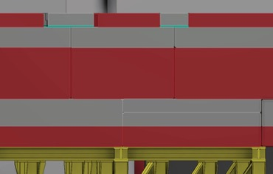
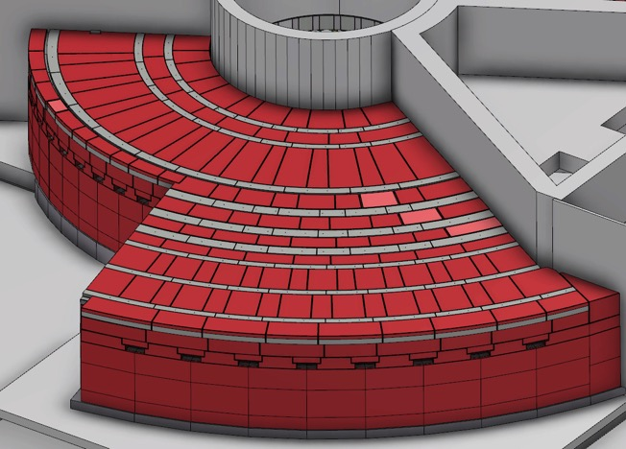
Preliminary engineering 9 Roof
Cross-streaming blocks
Cross-streaming blocks
Borrated PE and Steel radial blocks for small cross-streaming gap mitagation.
Individual blocks between 1-2t each.
Potential location of interlocking within these blocks.

Slide 13
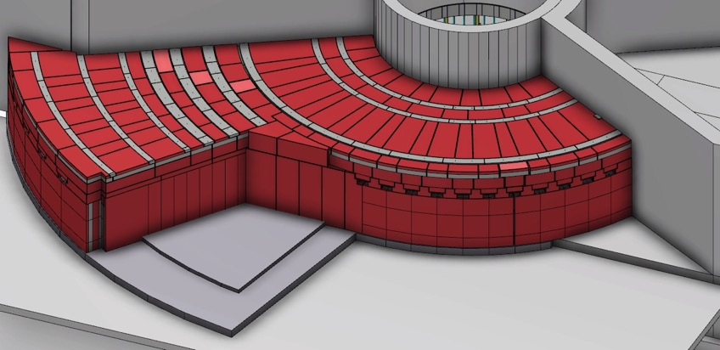
Preliminary engineering 10 Roof
Cost analysis underway for building a reduced South Sector.
Only first 3 – 4 beamport wall blocks initially installed.
Temporary shielding implemented in remaining beamport positions.
Design work to be completed allowing extension to a full South Sector when required.

Slide 14
Preliminary engineering
Q/A

Slide 15
Bunker Interfaces 1 CF
Wall horizontal chicane detail
Roof vertical chicane detail. Shelf also used for roof edge support
Wall horizontal chicane detail
Inner surface of bunker floor at -1250mm below TCS
(regular concrete poured at same time as CF floor)
Wall support floor level -1500mm below TCS
D03 instrument hall floor (West) -2000mm below TCS
D03 instrument hall floor (North) -2500mm below TCS
Monolith D02 building and instrument hall D03 section (North and West instrument sectors)

Slide 16
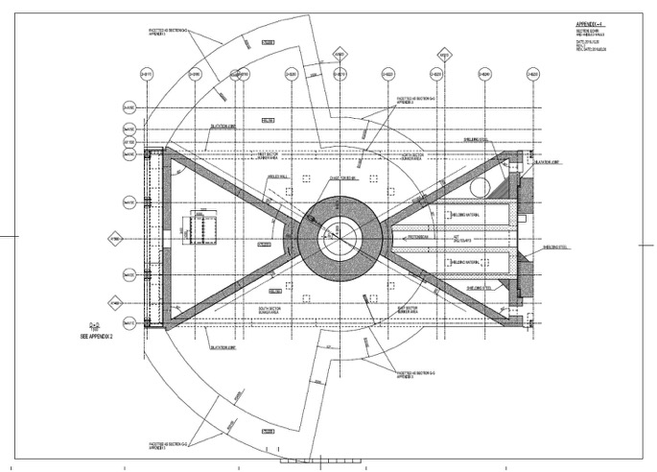
Bunker Interfaces 2 CF
Baseline geometry and dimensions of bunker base floor area were approved mid-April 2016
Above drawing view taken from pg. 4 of appendix ESS-0051605

Slide 17
Bunker Interfaces 3 CF
Positions for columns and brace beams have been set.
CF is currently undertaking concrete reienforcement design to suit.
Positions are provided in drawing ESS-0051975.

Slide 18
Bunker Interfaces 4 CF
R15m Wall
R28m Wall

Slide 19
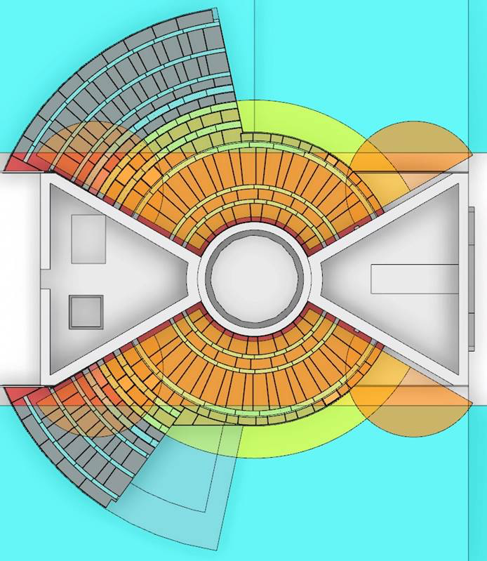
Bunker Interfaces 5 CF - crane
The yellow colored surface is planned ‘monolith crane’ [20t] coverage
The cyan colored surface is the experimental halls crane [30t] coverage
The transfer/buffer zone is indicated by overlap of the two
The monolith crane is not fully defined yet
Once the monolith crane is defined, we will decide on need of extended platform to facilitate the transfer/buffer zone
If the platform is deemed necessary, it is likely to be at the same level as the top of the bunker roof

Slide 20
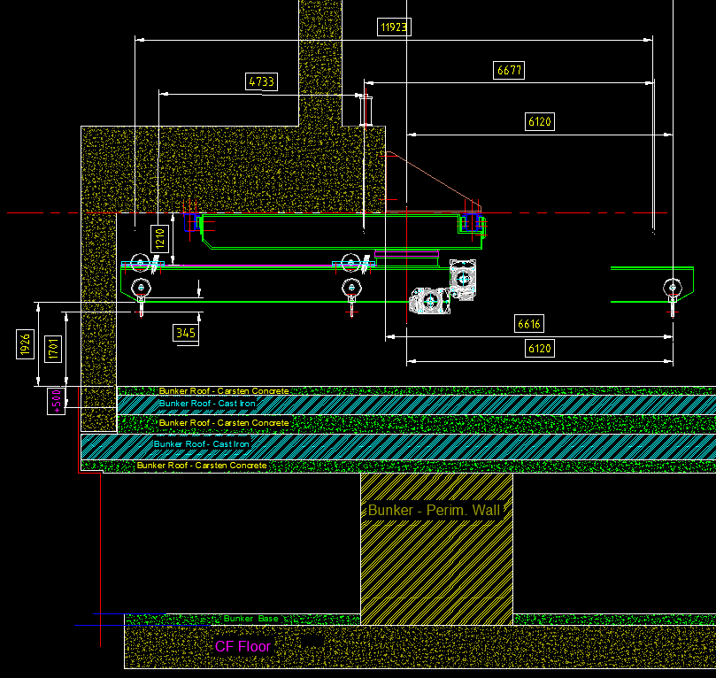
Bunker Interfaces 6 CF - crane
The latest proposal for the monolith crane is shown here and on the following slide
The hook height is unacceptably low
To solve this problem, the bunker (roof) is being redesigned by reducing it’s thickness and lowering it at the same time, gaining total of 500mm
The bunker roof redesign is being performed tentatively, pending full analysis of this change impacting its shielding properties

Slide 21
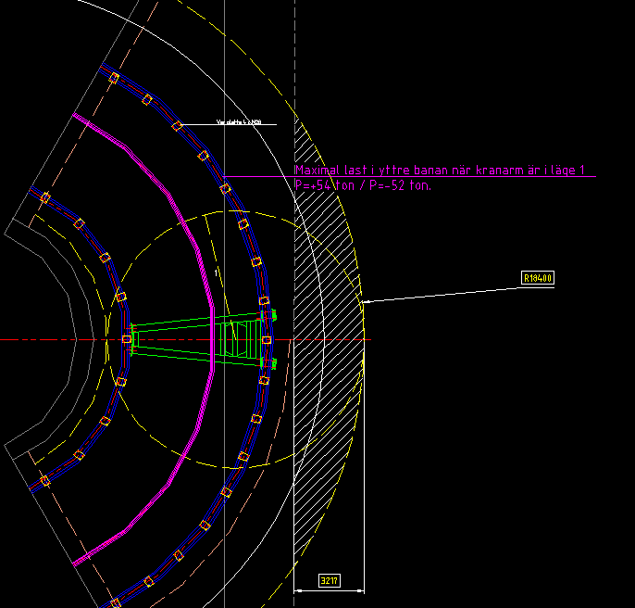
Bunker Interfaces 7 CF - crane
Overlapping zone between the 20t monolith crane and the 30t experimental hall crane is shown here
This design is latest we have as proposed
This design is not deemed final
We are still waiting for positive contact either from the CF-cranes tasked person, or the crane manufacturer themselves

Slide 22
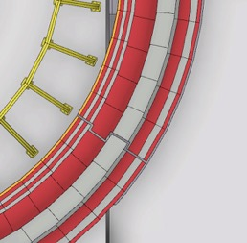
Bunker Interfaces 8 Instruments
Slip surface on target building (D02) base slab for wall segments N6 and N7
Current proposal for dilatation joint propogation through wall (Only North shown – mirror on East Sector)
Second concept currently being investigated in parallel, pending outcome of siesmic study.
N7
N5
N6
~95mm
N4
Dilatation joint gap
Slip surface on instrument hall base slab for wall segments N4 and N5
TCS
10900mm
130mm

Slide 23
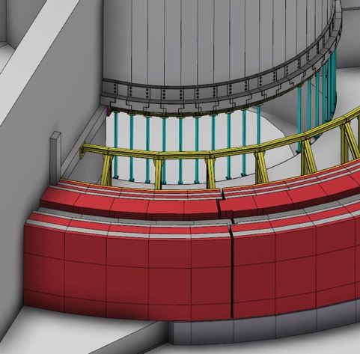
Bunker Interfaces 9 Instruments
Default wall mid-section block set in place

Slide 24
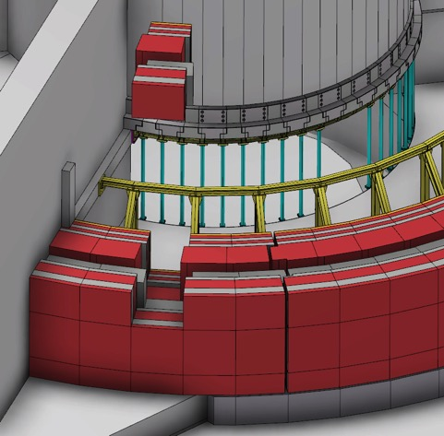
Bunker Interfaces 10 Instruments
Default wall upper-section block set removed

Slide 25
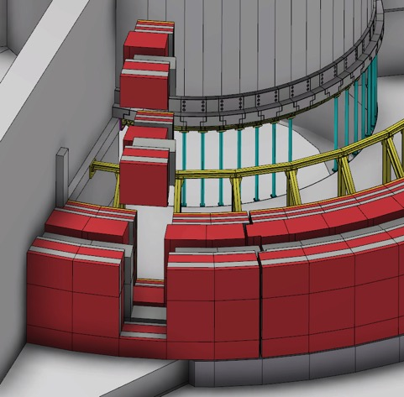
Bunker Interfaces 11 Instruments
Default wall mid-section block set removed

Slide 26
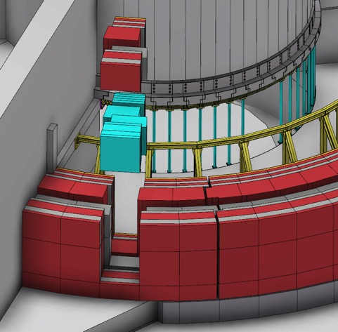
Bunker Interfaces 12 Instruments
Default wall mid-section block set replaced by customized instrument feedthru block set

Slide 27
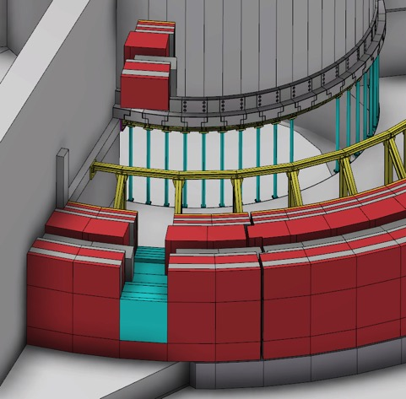
Bunker Interfaces 13 Instruments
Customized instrument feedthru block set installed

Slide 28
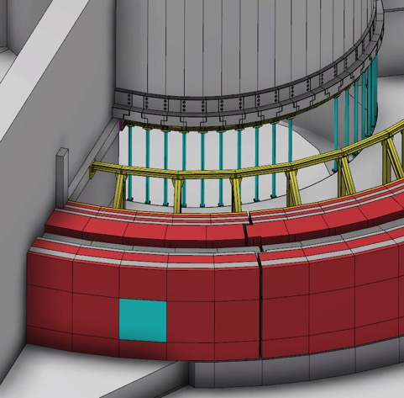
Bunker Interfaces 14 Instruments
Default wall upper-section block set reinstalled

Slide 29
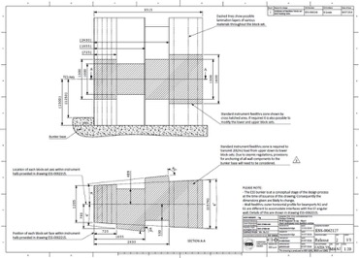
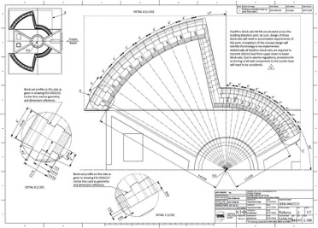
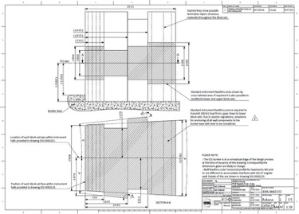
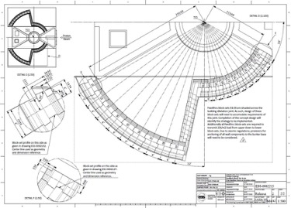
Bunker Interfaces 15 Instruments
Outline drawings of geometry, dimensions and positions for mid-section block sets.
ESS-0062215 (Assm.), ESS-0062127 (Short) and ESS-0062152 (Long).

Slide 30
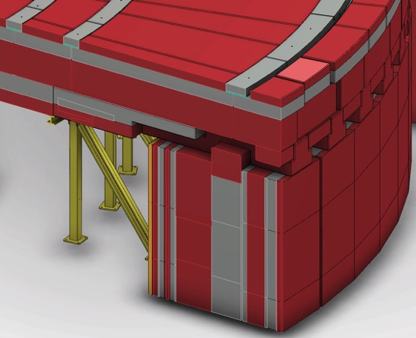
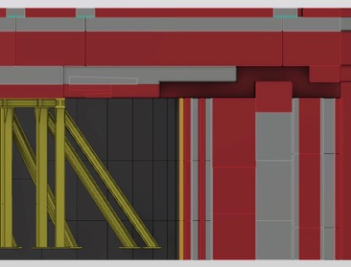
Bunker Interfaces 16 Instruments
Images show proposed geometry of utilities cavity. Investigation underway into maximum foreseeable cavity area required.
(shown 70cm x 35cm high)

Slide 31
Bunker Interfaces 17
Q/A

Slide 32
Reference documents
Documents (PDF’s, available in CHESS):
Neutronic Design of the Bunker – ESS-0052649
Baseline Geometry of Monolith and A2T Supporting Structure – ESS-0042957
Monolith and A2T Appendix (supporting drawings for above) – ESS-0051605
CF-Bunker Base Support Pillar Loads – ESS-0051975
Feedthru Block Set Assm – ESS-0062215
Wall Segment Assm - Short – ESS-0062127
Wall Segment Assm - Large – ESS-0062152
CAD Models (available in Catia V6 and 3D Live Examine in CHESS):
Bunker Top Assembly - ESS-0047079
Bunker & Monolith Assembly – ESS-0053442
EPL (Entire Plant Layout) – ESS-0016885

